Slide 1
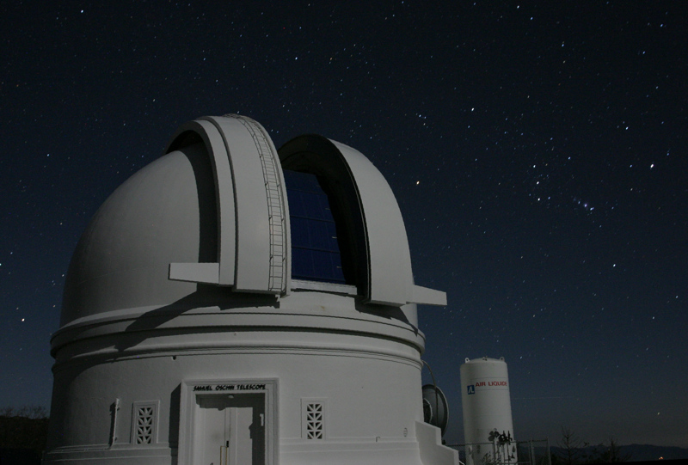

ZTF Real-Bogus Vetting
Umaa Rebbapragada
Jet Propulsion Laboratory
California Institute of Technology
Umaa.D.Rebbapragada@jpl.nasa.gov
With Brian Bue (JPL), Frank Masci (IPAC/Caltech), Ashish Mahabal (Caltech)
Courtesy: PTF
Research described in this presentation was carried out at the Jet Propulsion Laboratory under a Research and Technology Development Grant, under contract with the National Aeronautics and Space Administration. Copyright 2016 California Institute of Technology. All Rights Reserved. US Government Support Acknowledged.

Slide 2
Talk Outline
How to Build Real-Bogus
Real-Bogus at iPTF
Lessons Learned
Roadmap to ZTF Real-Bogus

Slide 3
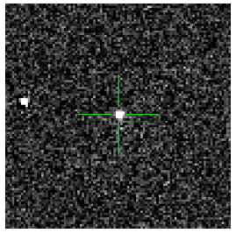
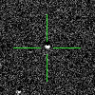
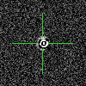
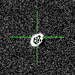
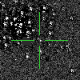
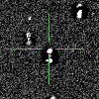
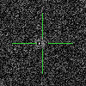
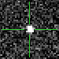
Building Real-Bogus in One Slide
1. Generate training data
3. Build classifier & evaluate performance
ROC curves (FPR v FNR) in cross validation,
score distributions on independent test sets
Real
Bogus
2. Define features
Image Level
background statistics
Bogus score cum. dist.
Real score cum. dist.
4. Threshold selection
Source
Level
brightness
eccentricity
of point source
99%
Filtered
fit of point spread function
counts of negative pixels in an n x n window

Slide 4
Real-Bogus at iPTF
Required two detections
Trained in R-band, applied to R- and g-band
Reals exacted from spectroscopically confirmed transients and variable stars + plus light curve observations
Bogus examples are random queries of database
Trained once, ran forever.
Classifications stored in database (for NERSC pipeline, not IPAC Transients db)
 | # Features | # Real | # Bogus
Point Source (NERSC) | 41 | ~ 18,000 | ~ 18,000
Point Source (IPAC) | 79 | 5,000 | 5,000
Streaks (IPAC) | 12 | 1681 240 reals, 1441 synthetic | ~ 20,000

Slide 5
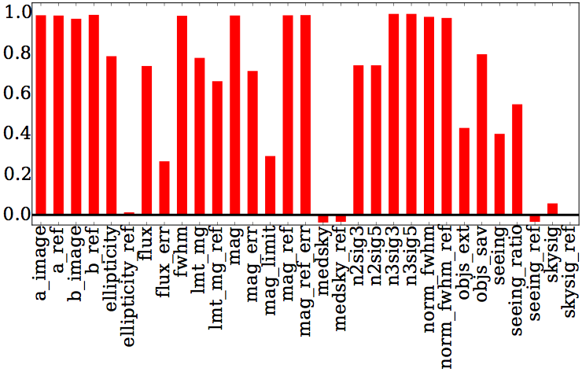
Lessons Learned
Performance greatly improved by:
  expanding number of examples
  reducing training contamination
Pipeline upgrades, survey changes affect data characteristics
Storage of training set, RB versioning
Inability to explain missed detections frustrates science team
Training set in R-band seemed to work for g-band
correlation between PTF and iPTF features. iPTF featured major reference image upgrade.

Slide 6
ZTF RB Open Issues
FPR, FNR requirements or guidelines given new data rates + ZOGY + filters
Training data generation
  use of Zooinverse for training data generation
Single RB for g, R, and I?

Slide 7
Longer-term Considerations
Upgrades communicated; reprocessing of training set
Data drift monitoring
Regular data cleaning with help from science teams
  training data generation interfaces could be repurposed
Feedback from distributed marshalls to update training data at frequent cadence
Move to deep learning; requires postage stamps supplied to RB in real-time
Explanation of missed detections

