Slide 1
Large Lightcurve Queries in ZTF
Kevin Burdge
Caltech

Slide 2
The scientific significance of large lightcurve queries
In stellar astronomy, useful for identifying rare variable/periodic objects (Particularly important in the galactic plane, where reddening diminishes the effectiveness of color searches)
Essential in the effort to search for microlensing events.
Also useful in searching for variable/periodic AGN.
Communities running machine learning on lightcurves to classify objects can immensely benefit from having access to a large training set of lightcurves.

Slide 3
The scientific significance of large lightcurve queries
In stellar astronomy, useful for identifying rare variable/periodic objects (Particularly important in the galactic plane, where reddening diminishes the effectiveness of color searches)
Essential in the effort to search for microlensing events.
Also useful in searching for variable/periodic AGN.
Communities running machine learning on lightcurves to classify objects can immensely benefit from having access to a large training set of lightcurves.

Slide 4
Current infrastructure
IRSA database: Can return around 2 million objects per day. However, queries are limited in size.
Local Caltech database: Takes around a day for 10k objects, however includes crossmatching abilities with several other catalogs
Matchfiles: ~3.3 TB of pytables with merged exposure information for every object in a given field. Can produce around 20 million lightcurves per day when just dumping everything.

Slide 5
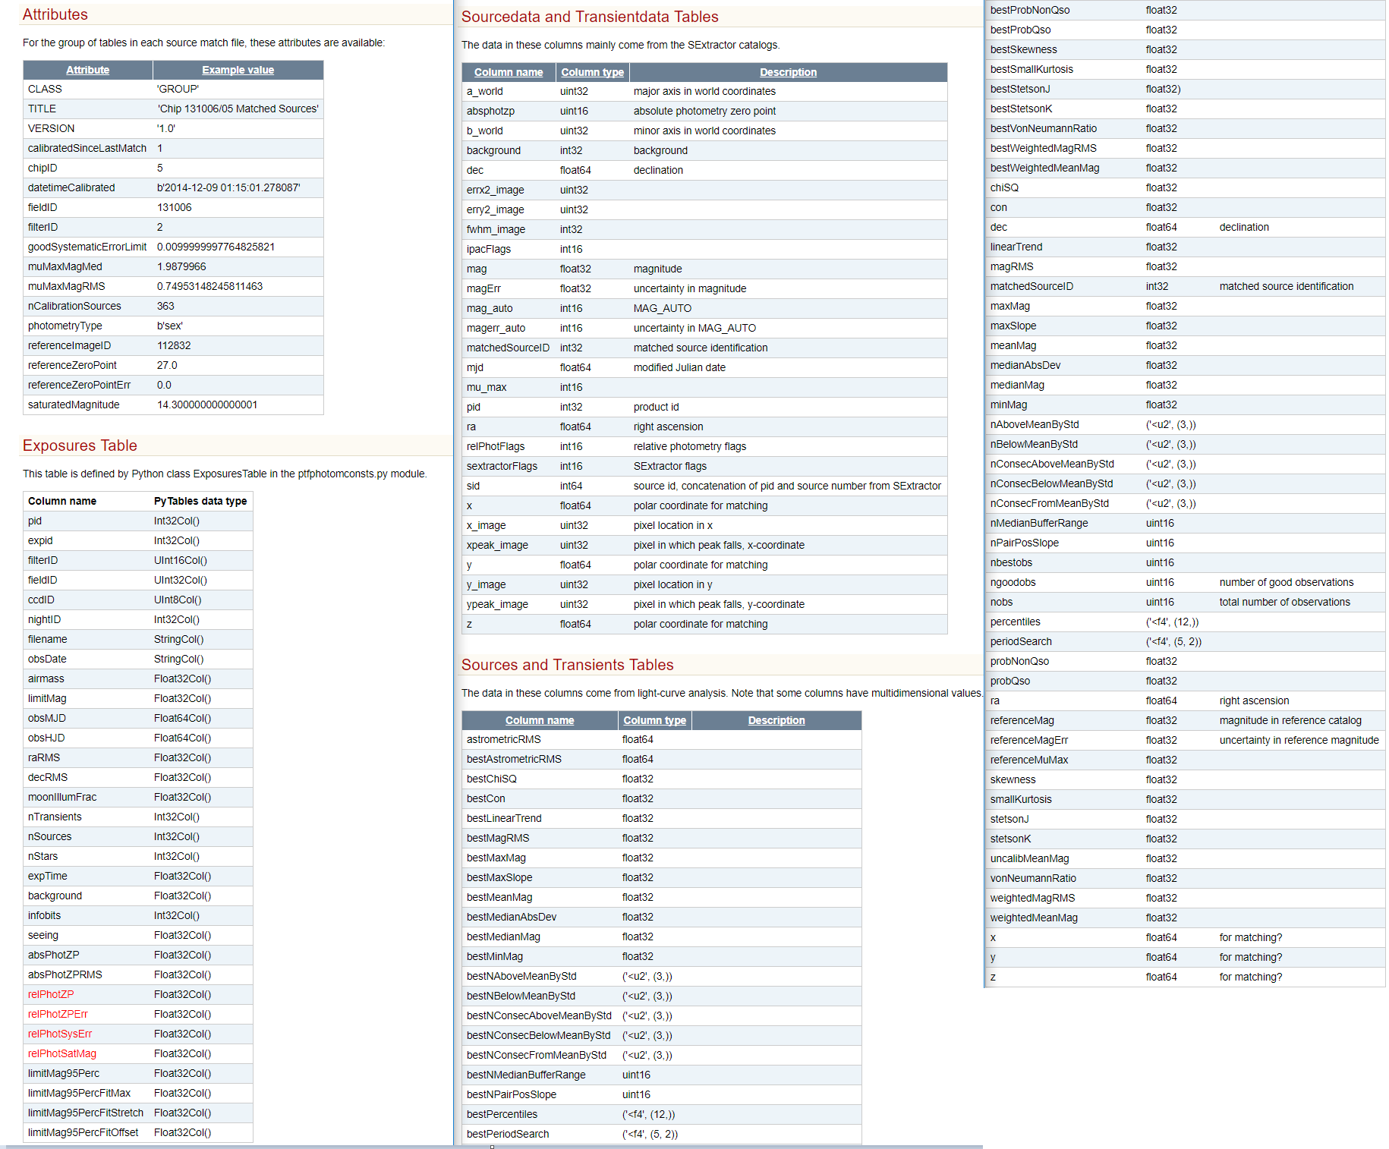

Slide 6
Quick summary
Currently, no infrastructure in development for large lightcurve queries.
There is a plan to create a matchfile product for ZTF, and this could be used as a source for large queries.
As of right now, a script exists which quickly dumps all lightcurves in the matchfiles, but one for a more targeted search has yet to be developed.

