Slide 1
Overview of data flow and data access policy
Matthew J. Graham
Project Scientist

Slide 2
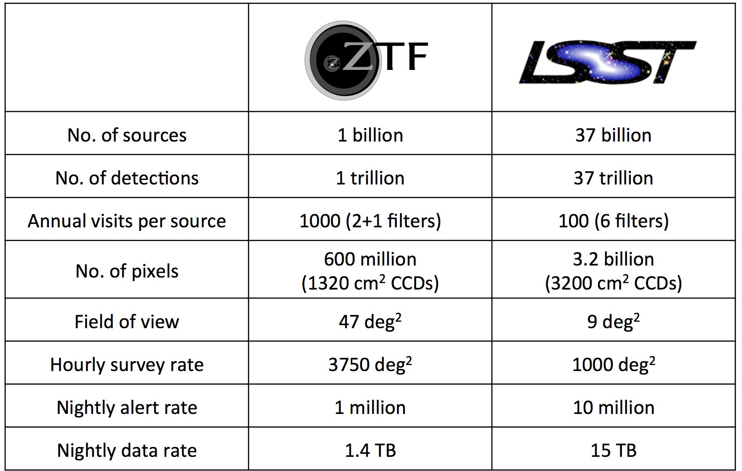
ZTF = 0.1 LSST or x0 PTF?
Notes:
Technical + sociological challenges

Slide 3
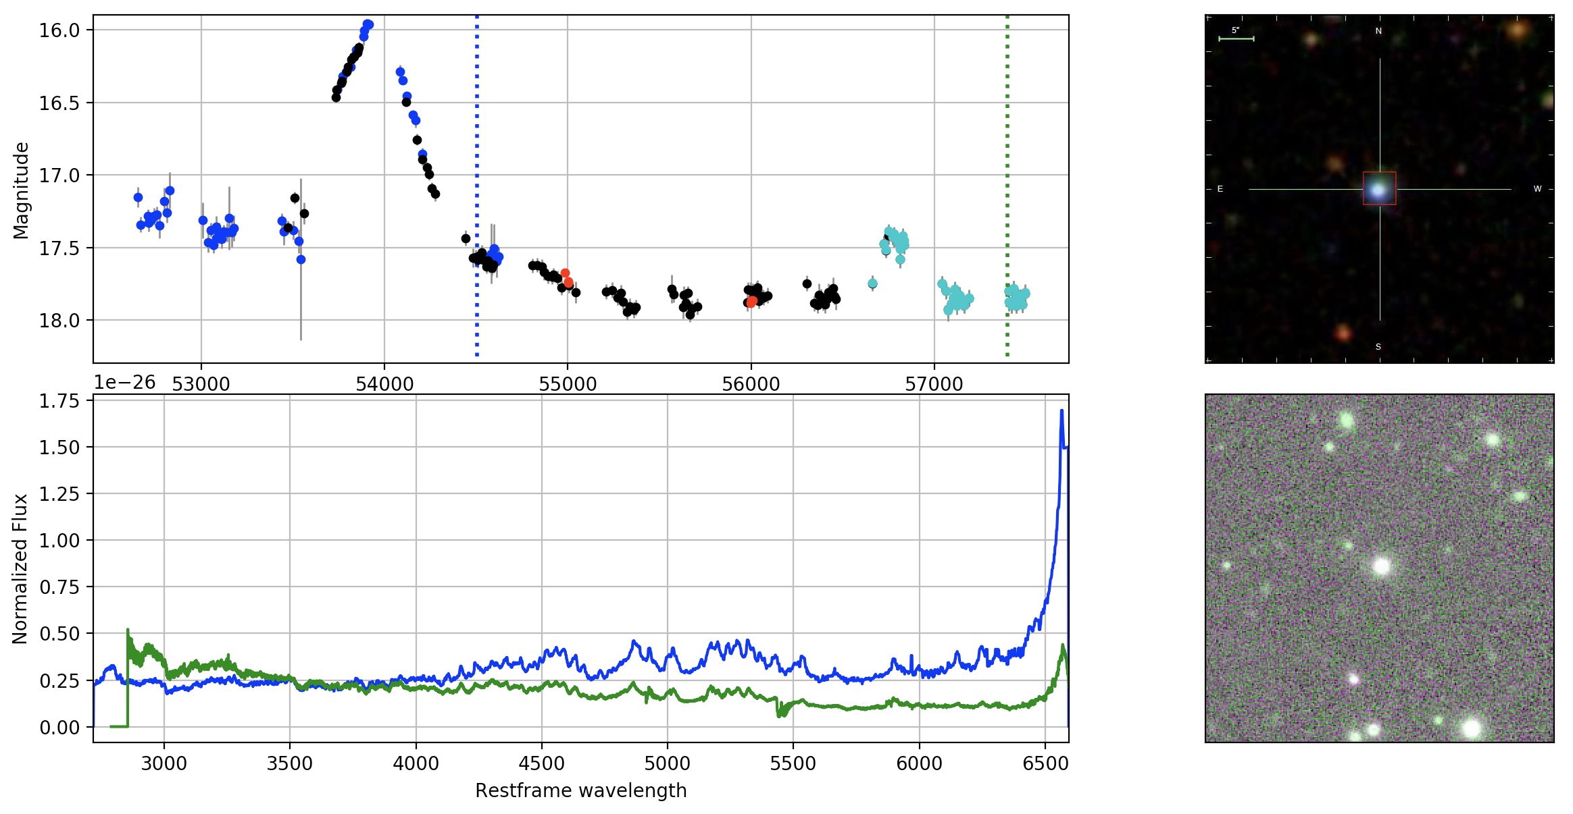
Can I better discover these with ZTF?
Graham et al. 2017
Notes:
Look at data flow more from science perspective (Frank will cover technical aspects)

Slide 4
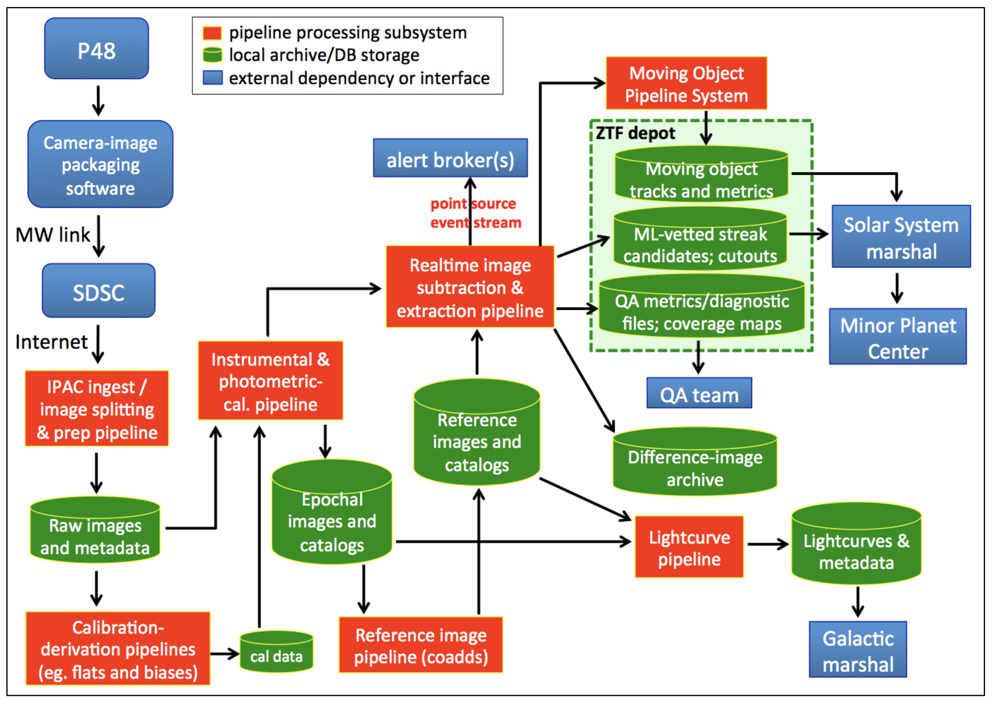
Data system software subsystems
from Frank Masci

Slide 5
Raw data
from Frank Masci
Notes:
A 30s exposure is taken of 47 deg² with 600 million pixels (~1.3 GB image size); Mean slew time of 15s between exposures;
95% maximal transfer time of 10 min to IPAC; Calibration pipeline run pre/post night
Data products: raw images; calibration data – flats, biases, etc.

Slide 6
Single epoch images
from Frank Masci

Slide 7
Difference images
from Frank Masci

Slide 8
Moving objects
from Frank Masci

Slide 9
Alerts
from Frank Masci

Slide 10
Alert system – the bigger picture
Mini
broker
Archive
Broker
Archives
Archive

Slide 11
The alert stream
“Sharded parallel databases provisioned by Kafka streams of Avro in a docker container that is in a datastack cloud.”
Each (Avro) packet contains (at least):
51 x 51 arcsec reference image, observation, and difference image
30 day photometric history
Number of total visits and number of detections
Some associations with external catalogs
Brokers interested in ZTF:
U. Washington
ANTARES (NOAO)
ALeRCE (Chile/Caltech)
U. Edinburgh
...

Slide 12
Data archives
from Frank Masci

Slide 13
Data access
Collaboration/Caltech data available in (near) real-time (shortly after archive ingestion)
MSIP data is only available at public release for general access
MSIP alerts will only contain MSIP data (30 day history)
Collaboration/Caltech events will contain unreleased MSIP data (30 day history)
Solar system data products are exempt
(use all data)
Reference images are exempt (use all
data)

