Slide 1
ZTF related random topics
Eran Ofek
Weizmann Institute of Science
Notes:
Next I would like to cover two topics that as some of you know I am barking about loudly.
And this is how to add and how to subtract.
The main point is that In the past 2 years I realized that I personally don’t know how to add and how to subtract,
And I would like to share with you our results.

Slide 2
Outline
Poisson-noise matched filter (X-ray)
Streak detection
A pipeline for forced-photometry
Image subtraction artifact classification and statistics
Lensed quasars detection and time delay measurement
Other tools (not discussed here)
Notes:
Hello everyone.
During this talk I would like to tell you about several loosely related topics.
This topics are loosly related to ZTF and to each other, and I hope you will find this interesting.
The topics I am going to cover are:
- Poisson-noise matched filter which is important for example for X-ray observations, but also for detecting clusters of galaxies and stellar stream.
- How to detect asteroids and satellite streaks.
I will very briefly tell you about an image subtraction forced-photometry pipeline I am developing.
Related to this, I will tell you about some image subtraction experiments I am did in the past week or so, and the classification and the staistics of subtraction artifacts.
And finally, I will tell you about a method we are developing for the detection of lensed quasars and measuring thir time delay.
I should say that I am also working on many other tools related to image analysis, which I will not cover today.

Slide 3
Poisson-noise matched filter
Notes:
So the first topic is: Detection of sources in the presence of Poisson noise.
In other words we have an image with sources and the number counts are low and therefore Poisson – what is the optimal way to detect sources.

Slide 4
Poisson-noise matched filter
Optimal source detection in the presence of Gaussian noise: matched filter (e.g., using Neymann-Pearson lemma):
What is optimal?
How well do we need to know the template?
Convolution
Image
PSF
Notes:
Before we talk about source detection in the presence of Poisson noise it is constructive to review the
Simpler case of source detection in the presence of Gaussian noise.
As I hope you know, in the case of a Gaussian noise it is possible to show that if you roughly know what you are looking for,
Or in other words you roghly knows the template, or PSF in our case, then the optimal way to find sources is a method called matched filtering.
So in this Gaussian case the optimal statistics is given by convolving the data (image in our case) with the reversal of the template (PSF in our case). This operation is called cross correlation or filtering.
Two points I would like to clarify:
First what do I mean by optimal? By optimal I mean that given a false alaram probability, the completeness is maximized.
or alternatively given a completeness the false alarm probability is minimized.
It is possible to show that in statistics such an optimum exist.
The second issue is how well do we have to know the PSF – well this depands on the application, but the short answer is that for stars or transient detection, the loss of information depends quadratically on errors in the PSF – this means for example,
That if you have 10% error in the PSF width, the loss of information or survey speed will be degraded by the order of 1%.

Slide 5
Poisson-noise matched filter
What should we do when the noise is Poisson (e.g., γ, ν, X-ray, clustering…)?
Literature: sliding cell (Harnden+1984); wavedetect (Freeman+2002)
From (unknown to me) reason the Gaussian-noise matched filter was not used.
Can we derive an optimal statistics?
Notes:
So what should we do when the noise is Poisson? And why do we care about this?
Well Poisson noise appears in many astronomical setups, from fast imaging to high energy imaging and even in detection of galaxy clusters and stellar streams when we have low-number counts of objects in cells.
In the context of X-ray astronomy, the two main methods for detection of sources are the sliding cell method and the wavedetect
Algorithm. They both are filtering techniques, while in the sliding cell method we simply filter the image with a rectangular top-hat
Function, in wavedetect we filter the image with the Maxican-Hat filter.
However, this methods lack a robust justification.
And the question is can we do something better, or in formal langauge can we derive the optimal statistics for source detection?

Slide 6
Poisson-noise matched filter
Yes!
but there are some details…
Details and code in: Ofek+Zackay (2017)
Convolution
Image
Filter
Notes:
And as you can guess the answer is yes – and this is what we get this can be derived using a three lines of algebra.
In this case you can see that the optimal filter is a non-linear function of the flux, background and PSF.

Slide 7
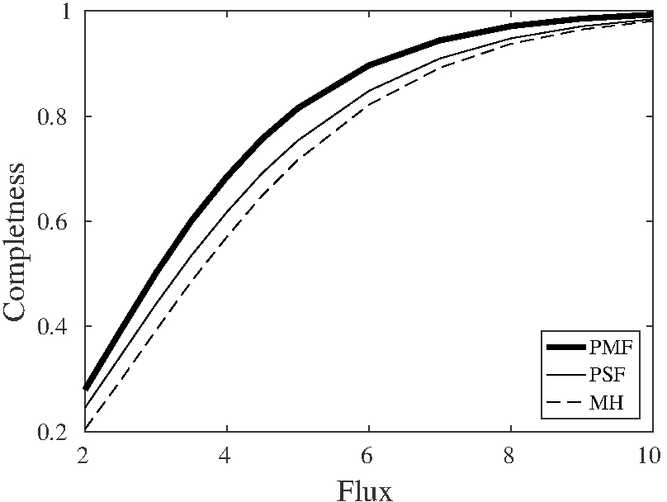
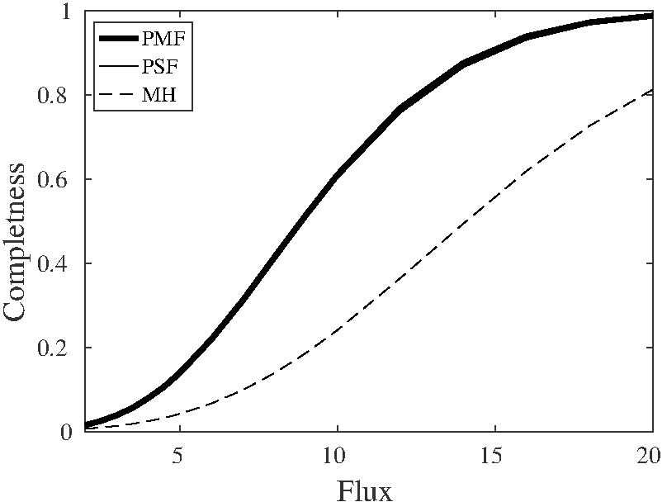
Poisson-noise matched filter
Completeness as function of flux, at fixed false alarm probability (10⁻³).
B=0.005 counts/pix
B=0.1 counts/pix
Notes:
So how much do we gain?
Here are two examples of the completeness curve as a function of flux for a fixed false alarm probability of 10^-3.
There are two plots here for two background levels – low and intermidiate.
The black solid line is our new filter, this is the Gaussian-noise filter and the dashed line is wavedetect.
IN this case, the completeness imprived by about 20%.
However, when the background level is intermidiate, the Poisson and Gaussian matched filter converges,
While they are bout a factor of more than 2.5 better than wavedetect.
I will just say briefly that this can be generalized for flare detections in time and place, so it is very relevant for GRBs and X-ray flare detection.

Slide 8
Poisson-noise matched filter
Can be generalized for: flare detection, energy-dependent PSF
Similarly: equivalent expressions can be derived for EM-CCD

Slide 9
Streak detection
Notes:
Next topic is streak detection – to those of you who don’t know – streak detection refers to detection of linear features,
Such as moving asteroids or satellites in images.

Slide 10
Streak detection
Why do we care about streaks in images:
Asteroids
Satellite streaks
Cosmic ray streaks
Notes:
In ZTF we care about streaks for two reasons:
The first is that due to their fast motion NEO may appears as faint and long streaks in the images,
And we would like to find them.
Second is that some artifacts like CR and satellites appears as streaks and we would like to flag their position
In order to clean our stream of transient candidates.

Slide 11
Streak detection
Methodology:
We have a simple model:
A line (convolved with the PSF)
We can “fit” all possible lines to data (i.e., matched filter).
Complexity: O(N² * N * N)
dimensions
All line lengths
Integrating line
Notes:
So the idea is simple – since we have an exact model to how streak looks like – which simply a line convolved with the SPF,
We can obtain the optimal statistics for streaks detection.
This is simply to match filter our image with all possible lines.
However, this is expensive computationally as we have to go over all positions, and all line lengths and integrate their flux.
The computational complexity is N^3 to N^4.

Slide 12
Streak detection
But, we can do it in N² log(N)
e.k.a., Fast Radon Transform
Similar to FFT or FDMT (Zackay+Ofek 2017)
Requirement: recovers the theoretical streak S/N:
Notes:
Furtuently, many of the summation operations are repeating and we can actulay develop an algorithm that do it once.
The comlexity of such an algorithm is N^2 log N, and in astronomy alone it was invented at least twice.
We call it the fast Radon transform, because is the fast version of the Radon transform that transfer any line in
An 2D image to the intersection and slope coordinate that describes the line.
AN important requirment from our algorithm is that it will recover the S/N of the full streak – and here I give this teoretical
S/N for streaks – you can derive this expression in a few lines of algebra.

Slide 13
Streak detection
Algorithm (Nir+ in prep.)
Details…
Is there a streak?
Notes:
So my student Guy Nir here developed a dynamic version of this algorithm that allow us to detect not only a line in an image, but also a partial line and its length.
And here you can see a simulated image, and the question is – is there a line in this image?
Do you see anything? Anyone?
Well there is a line here with PSF width of 2 pixels and S/N of 1 per PSF.
The reason you don’t see it with your eye is that it is burried in the noiss…

Slide 14
Streak detection
Algorithm (Nir+ in prep.)
Detected with S/N~8 (but looks else-where effect: threshold S/N 4.5->6)
Notes:
And if you applys Guy’s program you will get the Radon Transform, which is shown here,
The X and Y coordinates in the image are interchanged with the slope and intersection coordinates.
And indeed the highest local-maxima in this plot have a S/N of 8 and it corresponds to the line that you don’t see in this image.

Slide 15
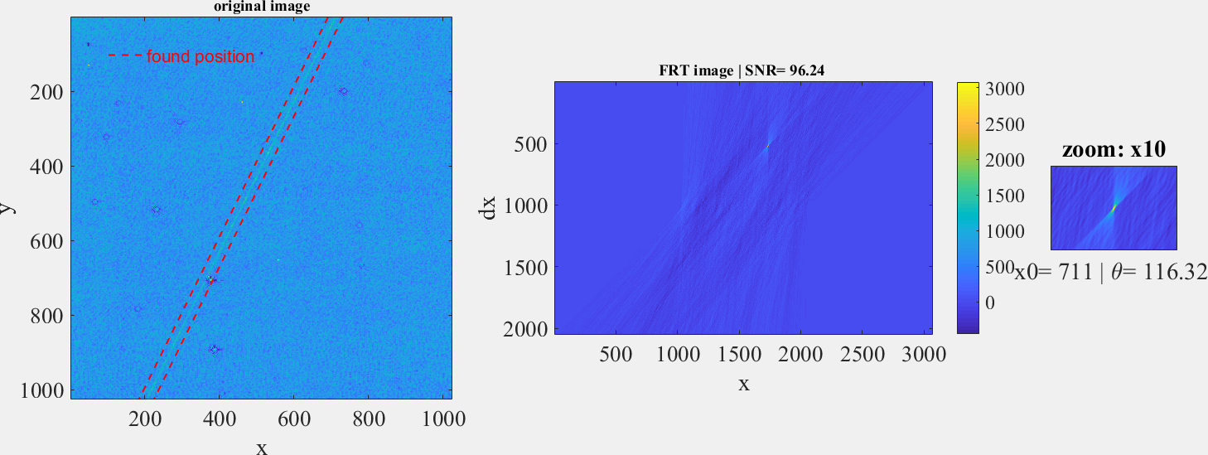
Streak detection
And real data from PTF…
PTF image with a streak: S/N~3 per PSF
Notes:
And here is a test on real PTF data – this is PTF subtraction image, and there is a clear streak
Here – I should say that the streak S/N per PSF is below the detection threshold of 5 we use.
This is about 3 to 4.
And here is the Radon Transform – it is detected here with S/N of 96.
One important comment about this:
Altough the S/N per PSF here is somewhat below our detection threshold – this event will be found
By our transient detection process – why? Because each PSF size along this line is an independent
Experiment and some will fluctuaute above our detection threshold – so our transient detection algorithm
Will peak up some random peaks along this line.
This is another reason why we want to flag the streaks even if they have low S/N.

Slide 16
Streak detection
Sensitivity improvement over naïve detection:
It is fast
How to distinguish between satellite and asteroid?
Notes:
There are two advantages for this method: first it is considerably more sensitive than naïve detection like we used in PTF or we are planning to use in ZTF.
The leading term in improving the sensitivity in magnitude units is given by this expression.
For example, for a line length of 300 pixels, and a PSF of 2 pixels, this method will improve our sensitivity by about 2 magnitude!
This is a lot, and in terms of number of NEOs this may translate to a big factor.
Second advantage is that it is fast – very fast – the runtime is about 3 second per PTF image.
Finally, we have some ideas on how to use this scheme to distinguish between NEOs and some satellite streaks.

Slide 17
A pipeline for forced photometry
Notes:
Next topic I will briefly discuss is a pipeline for forced photometry on subtraction images.
As you know, this is critical for many sciece cases Galactic and extragalactic.

Slide 18
A pipeline for forced photometry
Why: We need high-quality light curves
e.g., near real time follow-up prioritization; coaddition for rise-time/precursors; papers
How: Pre processing + ZOGY
Basic features: source extraction, astrometry, registration, mask generation, subtraction, cleaning, flux measurement's, calibration
Notes:
I am currently working on a pipeline for image subtraction forced photometry.
My main motivation is that I need a fast tool that can produce high quality light curves
Of transients in near real time after their detection.
Moreover, Inspecting the history of this transients and the light curve rise is important in order to prioritize our follow up resources,
And finally to efficiently generate papers…
Furthermore, when ever we detect a transient in ZTF I would like to run this tool also on PTF images – this will allow me to detect
SN precursosrs on time scale of 10 years prior to the SN explosiom.
The pipeline include optionally all the pre-processing steps and it uses the methodogies I told you about last year - this means that it can run without modifications on images taken with other telescopes and not only PTF or ZTF images.

Slide 19
A pipeline for forced photometry
Status: Being tested – send your favorite targets
Notes:
Currently I am testing the pipeline and adding improvements.
For example, the pipeline extract a lot of meta data that can be used to monitor the quality of the results.
For those of you who are interested using it, the most important thing for me right now is that you will send me
One or two of your favorite/challenging PTF targets on which I can test it.
A beta version is already available for those who want to help with the development, and my plan is to make it available
To the community by mid September.

Slide 20
The statistics of subtraction artifacts
Notes:
So given this pipeline I briefly discussed I was able to do something that many of you asked me before, which is to estimate
the number of candidates I encounter in image subtraction, so now I am switching topic again and I will discuss the statistics and classification of subtraction artifacts.

Slide 21
The statistics of subtraction artifacts
Why? Maximize science return -> We need a clean stream of transients (x15 the PTF problem)
Separate between astrophysical transients and instrumental/method transients
w/o compromising the completeness
Notes:
The motivation here is clear – to maximize the return for our large investment in ZTF we need the cleanest possible stream of transients.
Our goal here is to separate between astrophysical transients and transients which are instrumental or due to the method we are using.
And we would like to do all this w/o compromising the detection completeness.
The last point is crucial as a very easy method for reducing the number of transients is simpley to set a higher threshold.
This can be done either by changing the detection threshold or the real/bogus threshold.

Slide 22
The statistics of subtraction artifacts
Demographics:
Transients
Singlets (asteroids, satellites, flare stars)
Multiplets (SN, AGN, variability)
Instrumental (CR, ghosts, bad flat,…)
Statistical (source noise, astrometric noise, error propagation, division by 0) [treated by ZOGY]
Notes:
So first let me start with some definitions and specifically with the demographics of subtraction artifatcs.
These definitions are trivial but there are essential for any clear discussion of this subject.
First there are real astrophysical transients and these can be divided into two classes:
First are the singlets – transients that appears
In the same position In single images, like asteroids and some flare stars.
Second are Multiplets – which are transients that appears in the same position in multiple images, SN for example.
Next there are instrumental transients which may include CR, ghosts, flat fielding, bad pixels etc.
And finally there are statistical transients – for example, there are may be some artifacts due to the method we use for image subtraction, or incorrect error propagation, source noise, astrometric noise etc.
One of the advantages of ZOGY is that it treats the error propagation and numerical stability issues.

Slide 23
The statistics of subtraction artifacts
How to treat them?
Three options:
Model-based approach
ML
Humans
If we have reasonable model, and the number of nuisance parameters is small then model-based approach is the safest approach.
If failed: at least you will know which attributes do you need for deep learning.
Notes:
A question that we should ask is how to distinguish between astrophysical transients and other classes of transients.
There are three kind of solutions.
Machine learning, humans and model-based approach.
In PTF we used all three.
My point of view is that machine learning and specifically deep learning is extremely powerful technique.
However, I think it is clear that if we have evenan aproximate, model, and the number of niuscence parameters is small than
Model-based approach is the best, simply because it is well defined and it can be in many cases constricuted
Optimally.
My personal lesson is that we should always start with a model-based approach and only if we fail we should go
For ML – the reason is that the failure itself can tell us a lot about which attributes we should use for ML.

Slide 24
The statistics of subtraction artifacts
A test on 50 1024² PTF g-band images
Full subtraction pipeline: ZOGY+preprocessing
Model based approach artifacts detection (CR, ghosts)
Not necessarily representative
but helpful for prioritization
Notes:
So now after this introduction, let me describe an experiment I did.
So I used my image subtraction pipeline on large number of PTF images, and I inspected by eye
The results of 50 images each 1k by 1k. The pipeline is based on my own source extraction, registration, PSF estimation,
Flux matching and subtraction code, and it has additional components for model-based artifacts detection.
This example is based on analysis of a single field so it is not neceserrly representetive, but I think it is still very useful,
At least for me, in order to prioritize my efforts.

Slide 25
The statistics of subtraction artifacts
# #/deg²
Asteroids (w/motion) : 18 4.4 of interest
Tran./Asteroids : 16 4 of interest
Satellites : 7 1.7
CR : ~100
unflagged CR : 1 0.2 -
CR streaks: : 3 0.7
Ghosts : 32 7.9 (can be improved)
Faint holes: : 12 3 -
Gal residuals : 2 0.5
Star residuals : 6 +9+37 12.8 (>20,000 e)
Notes:
And here is the statistics of what I find.
There are 4 columns here:
The property, the number of events I detected, there surface density per deg^2, and the status of the filtering.
So I am using a 5sigma detection threshold, and at this threshold if the noise is purely Gaussian
And there are no transients of any kind – we expect about 1.2 events per deg^2 – this is for both negative and positove transients meaning transients below or above 5 sigma - just due to statistical fluctuations Above 5 sigma. This is assuming 2.5” seeing.
In the field I tested I found about 1.7 confirmed asteroids per deg^2 – this include only asteroids for which I could verify
Their motion in pair of images taken at the same night – not always such a apir exist.
Next, I found about 4 transients per deg^2 most of which are multiplets, and usually very faint.
About 1.7 events per deg^2 due to satellite streaks, but these are fully mitgated by our radon transform algotithm.
There are of the order of 100 CR and bad pixels per deg^2, but almost all are mitogated by our CR detection algorithm.
The number of unflagged CR is very low about 0.2 per deg^2, with large uncertanty.
Most of CR in PTF images are delta function like.
However some looks like streak. We still didn’t apply our fast radon transform for these, but I am optimistic it will
Work – the rate of these CR streaks is about 0.7 per deg^2.
Ghosts are very common about 8 per deg^2 even at high Galactic latitude. This will be much worse in low Galactic latitude.
We have a simple algorithm to find those, but I think we can improve this for even less trivial cases.
There are some what I call image holes which are due to bad flat fielding – there rate in PTF is very large,
And here I count only those my algorithm didn’t flag.
However, These are always negative + I am sure it can be fixed with better flat fielding.
Finally, likely the most problematic artifacts are residuals on top or near bright stars or galaxies.
In total I saw about 13 per deg^2. However, if we remove the two worst images contains most of them,
9 and 37 respectively. And the one with 37 has really bad flat fielding issues.
If you remove these two images the rate drops to 1.5 per deg^2.
expect to f
So the first entry is the expectation

Slide 26
Lensed quasars and time delay
with B. Zackay and A. Goobar
Notes:
So the last topic I would like to discuss is again very different topic – how can we detected unresolved lensed quasars and measure their time delays using ZTF and LSST like surveys.
Also involved in this work are Barak Zcaky and Ariel Goobar.

Slide 27
Lensed quasars and time delay
Detection of lensed quasars (separation<FWHM)
Requires(?) high S/N + accurate knowledge of PSF
Another possibility (no assumption* on PSF): astrometric shifts due to variability
However: looking for variability-induced astrometric shifts is not good enough
Notes:
SO the question is can we detected lensed quasars which separayion is much below the seeing FWHM?
If you will think about this a bit you will reach the conclusion that it is maybe possible if you have high S/N and you know the exact PSF.
Howeber, I would like to argue that there is another possibility that doesn’t require almost any assumption on the PSF.
This is astromretric shift of the center of light due to the time delayed variability.

Slide 28
Lensed quasars and time delay
New hope: time delay will generate a complicated correlation between flux and astrometry…
In a lensed quasar: Given position(t) and total flux(t) we can recover the source flux(t), the time delay and flux ratio.
Using FT can be done for multiple images.
Notes:
I would like to convince you that gibe the position of the lensed quasar center of light as a function of time, and the total flux as
A function of time, we can recover the flux of the source as a function of time, the time delay and the flux ratio between the images.
Next we didn’t try it yet, we think this can be done also for lensed quasars with more than 2 images.
And finally we derived the optimal staitistics for lensed qauasr detection and time delay measurments in the presence of red power-spectrum light curve.

Slide 29
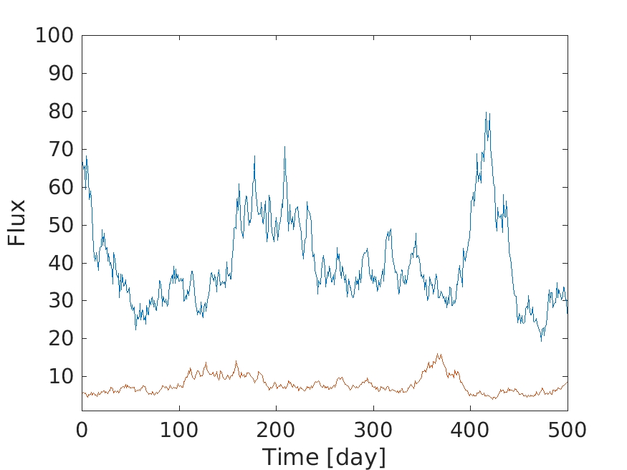
Lensed quasars and time delay
Example: red power spectrum (0.1 mag std)
Ratio 1/5
Err 30 mmag
Err 30 mas
Sep: 1”
Notes:
Here is a simple simulated graphical example:
We have a quasar LC – this LC was generated to have a red power spectrum mimicing those of quasars + some photometric maeasurment noise with 0.03 mag error.
Next we have another image of the same quasar with flux ratio of 1/5 and some time delay of 50 days.
The observer measure the total flux of the system – here the red plus blue curves.

Slide 30
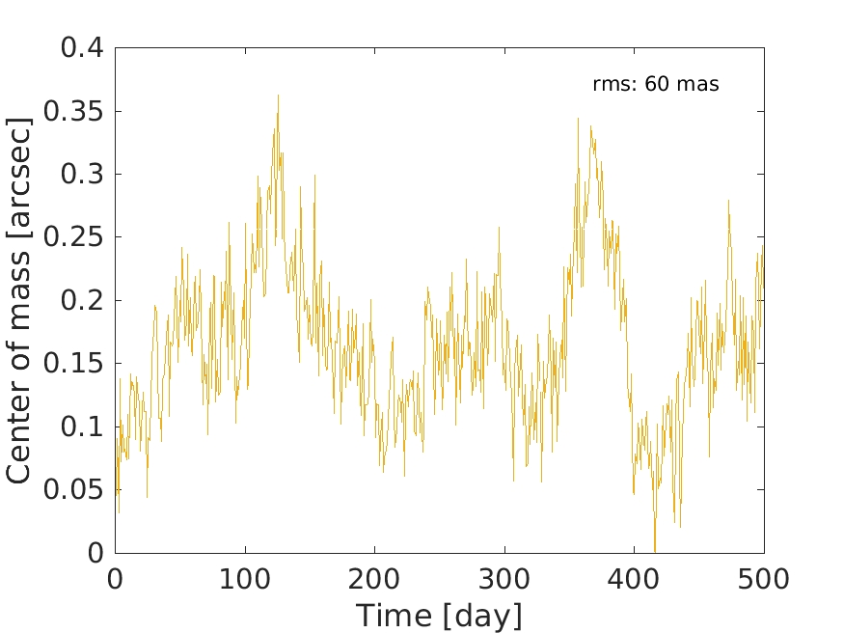
Lensed quasars and time delay
The astrometric signal will be hard to separate from scintillation noise
However:
correlated!
Notes:
In addition we can measure the center of light position shown here.
In this case, the rms of the astrometric signal is 60 mas – this is only factor of two larger than the scintilation noise
And therefore it will be very hard to tell if this astrometric shifts are physical or not.
However, if this is a lensed quasars than the astrometric signature is correlated, in somewhat complicated way,
With the photometric signal, and given we have many observations this allow us to detect even very smaller astrometric signatures that are smaller than The statistical noise.

Slide 31
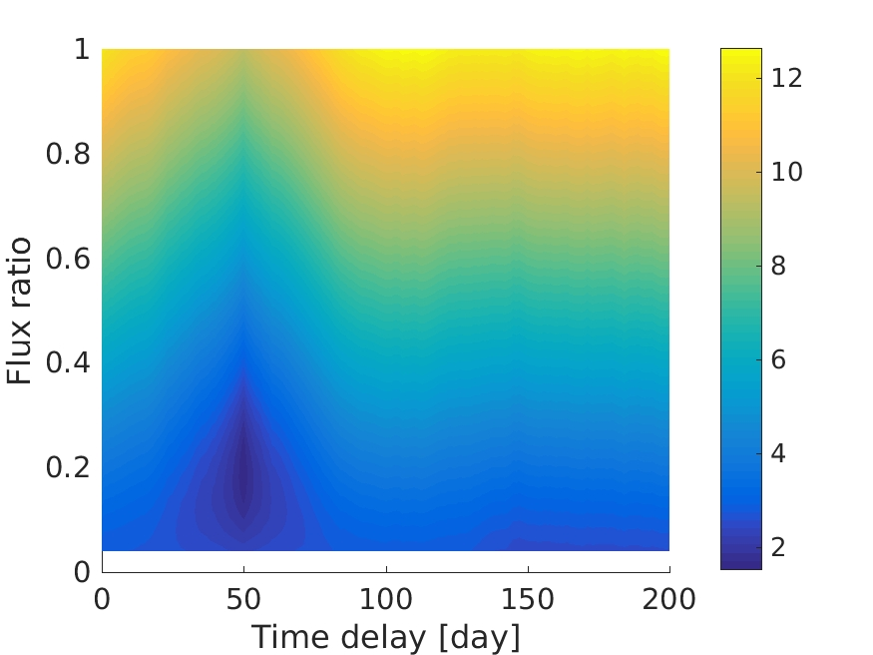
Lensed quasars and time delay
Recovery of time delay using ~200 observations over 5 years
Notes:
For this specific simulation, I applied a preliminary version of our method and I can easily recover the simulated time delay and flux ratio.

Slide 32
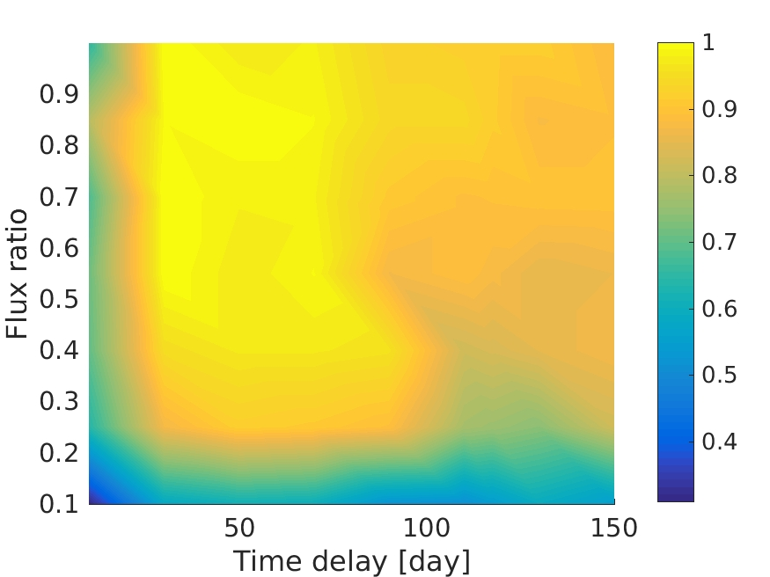
Lensed quasars and time delay
Success rate for time delay recovery
Notes:
Here you can see a more elaborate simulation that shows the success rate in measuring the time delay as a function
Of thr time delay and flux ratio. This simulation, includes realistic cadence and 5 years of observations, with 200 observations, and you can see that we can recover the time delay over a wide range of the phase space.

Slide 33
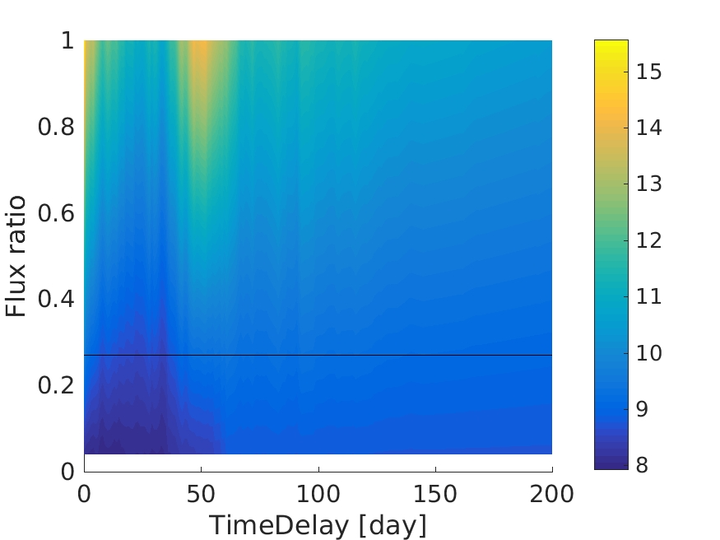
Lensed quasars and time delay
FBQS 1633+3134
Expected time delay ~20 days
Notes:
Finally, just before I came - I applied this to the lensed quasar with the largerst number of observations in PTF – this is FBQS 1633+3134 with image separation of only 0.4”.
Unfortueently the quasar hardly vary, and we had only 200 oservcations, but there is some hint for a time delay of 30-40 days.
In this case we know the time delay sgould be of the porder of 20-30 days.

Slide 34
Lensed quasars and time delay
Status: We derived the optimal statistics for lensed quasar detection and time delay measurement in the presence of red power-spectrum light curve.
Notes:
Finally, just before I came - I applied this to the lensed quasar with the largerst number of observations in PTF – this is FBQS 1633+3134 with image separation of only 0.4”.
Unfortueently the quasar hardly vary, and we had only 200 oservcations, but there is some hint for a time delay of 30-40 days.
In this case we know the time delay sgould be of the porder of 20-30 days.

Slide 35
End
Notes:
Thank you for your time

