Slide 1
2017 ZTF Team Meeting
S. R. Kulkarni
Caltech Optical Observatories

Slide 2
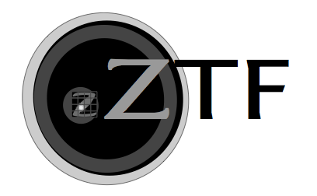
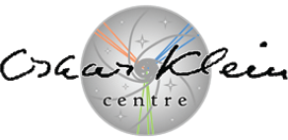
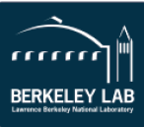
Current ZTF Commissioning Schedule
8/5/17 Trim Plate Polishing Complete
8/14/17 SEDM Upgrade Ship
8/19/17 Trim Plate Acceptance Test Send for Anti-reflection Coating
8/30/17 Science Camera Ship
9/6/17 ZTF First Light (Start of Engineering Commissioning)
9/20/17 Filter Exchanger Ship
10/1/17 Trim Plate Final Install 10/2/17 Start of Science Validation
10/14/17 Flat Field Illuminator Ship
1/3/18 Start of Science Survey

Slide 3
Topics (at this meeting)
Science validation: discussion & plans (a full session)
Tool Developments by Team (various talks)
Marshal
Survey efficiency
Asteroid Science
Tools & facilities within the IPAC Data System (Helou)
Forced Photometry
Sentinel Alert
Coadd
User provided tools

Slide 4
Major & Moderate concerns
SEDM is a critical item to the success for some key projects
Throughput is alarmingly low in the blue
Under investigation
Time table to be still established
Trim plate is essential to achieving desire depth of 20.5 mag
A delayed arrival will squeeze science validation period
Cost Increases
Delay in start of Project
Operational Costs are now assessed to be higher (ZTF is not equal to x12)
State-of-the-art in 2017 is higher than when we set out (2013)

Slide 5
Looking forward
ZTF will produce x12 data relative to PTF & iPTF!
Our effective usage of PTF & iPTF was below 10% (my estimate)
Thus we have tremendous opportunity to do selective science with high impact
SEDM has given us a great advantage and will continue to do so
Relative to other groups we are highly organized and this is a distinct advantage
Important to preserve this advantage (challenges?)

Slide 6
Opportunities for young people (local examples)
Gina Duggan ... Developed & tested algorithm for determining piston and tilt terms for CCD using star-light data
Tiara Hung ... Developing TDE filter (and verifying with observations from P200 and Keck)
Yutaro Tachibana … Implementing PS1-based star/galaxy separation (working with Adam Miller)
Pavan Bilgi … Working with Roger Smith has reduced read time by 0.6 s (with a novel readout mechanism)
Marshal Development … Hung, Feindt, Cannella (led by Kasliwal)

Slide 7
Students & Postdocs: Opportunities to enrich your training
Great opportunity not merely using ZTF but getting involved in hardware and telescopes
e.g. improve P60 pointing, understand SEDM flexure and thereby decrease systematics of SEDM)
Flat field & calibration (status?)
Optimizing the 16 CCDs
Cross-training between groups with strong collaborative programs
GROWTH provides a great framework
Intra-partnership collaborations give students & postdocs opportunity to intense observing experience
Other projects (resulting from this meeting)

