Slide 1

Solar System Overview
Dennis Bodewits (UMD)
Quan-Zhi Ye (Caltech/IPAC), Rex Chang (NCU),
Gerbs Bauer (UMD), Bryce Bolin (UW), Yu-Chi Cheng (NCU),
Ben DeMario (Caltech) , George Helou (Caltech/IPAC), Wing Ip (NCU),
Lynne Jones (UW), Mario Jurić (UW), Michael Kelley (UMD), Emily Kramer (JPL),
Zhong-Yi Lin (NCU), Frank Masci (Caltech/IPAC), Joachim Moeyens (UW),
Chow-Choong Ngeow (NCU), Tom Prince (Caltech)

Slide 2
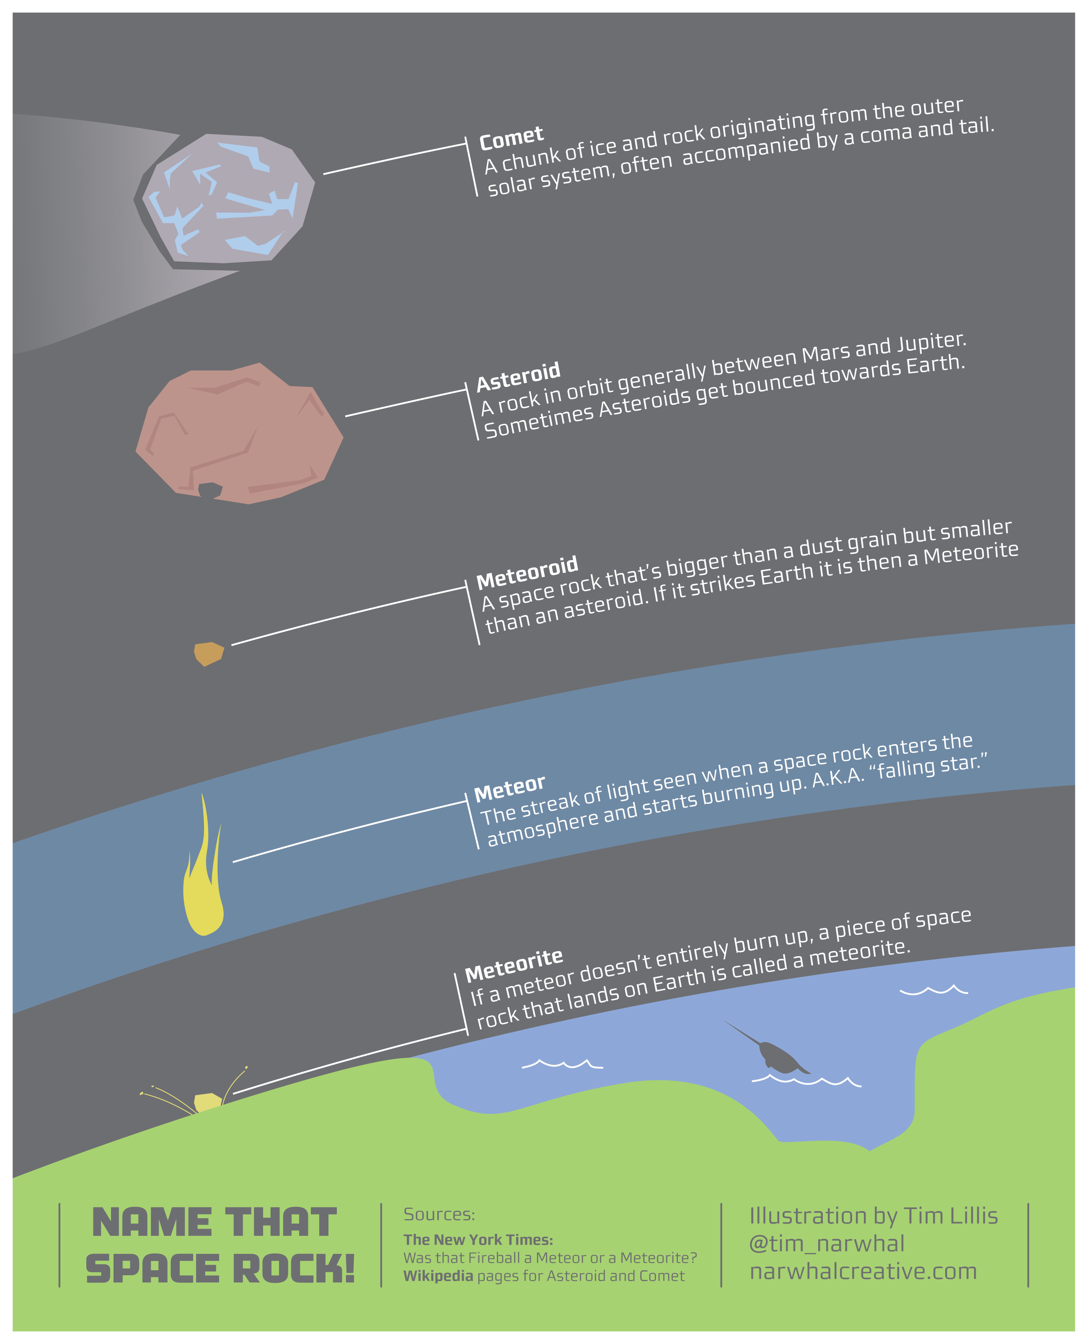
ZTF Solar System Science
Discover, characterize, and monitor small bodies in the solar system
Enable rapid response on transient events
Comets
Main Belt Asteroids
Near Earth Asteroids
Centaurs
Interstellar objects

Slide 3
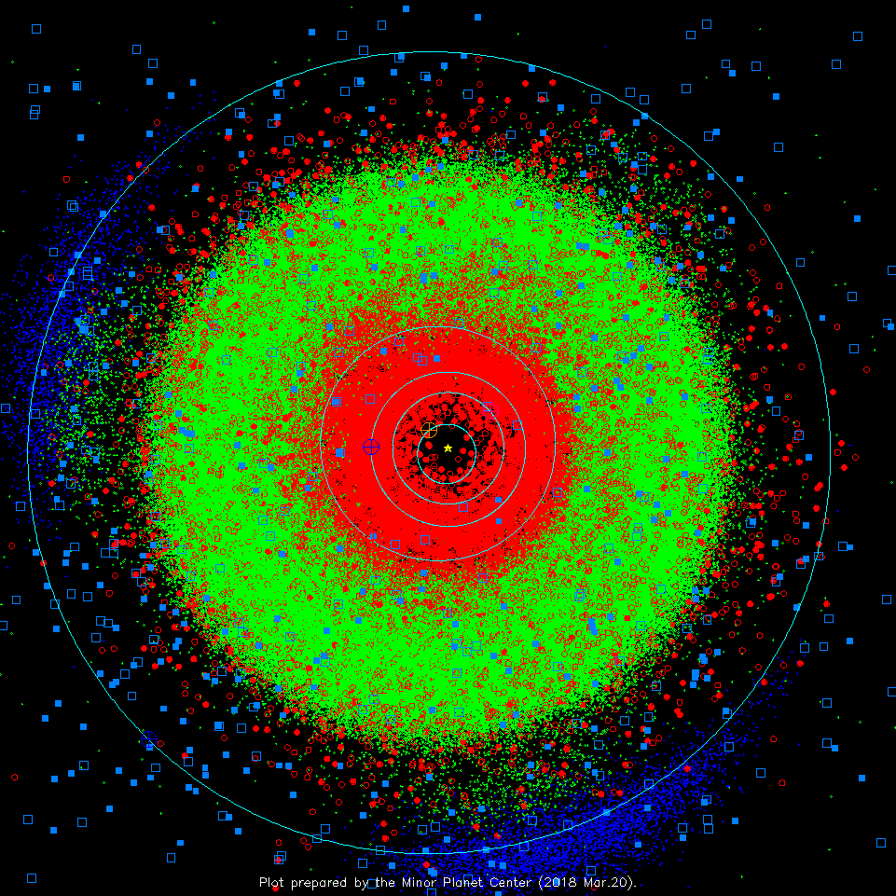
ZTF Solar System Science
Discover, characterize, and monitor small bodies in the solar system
Enable rapid response on transient events
Comets
Main Belt Asteroids
Near Earth Asteroids
Centaurs
Interstellar Objects
Earth
Notes:
Point sources ~13. point LSST.

Slide 4
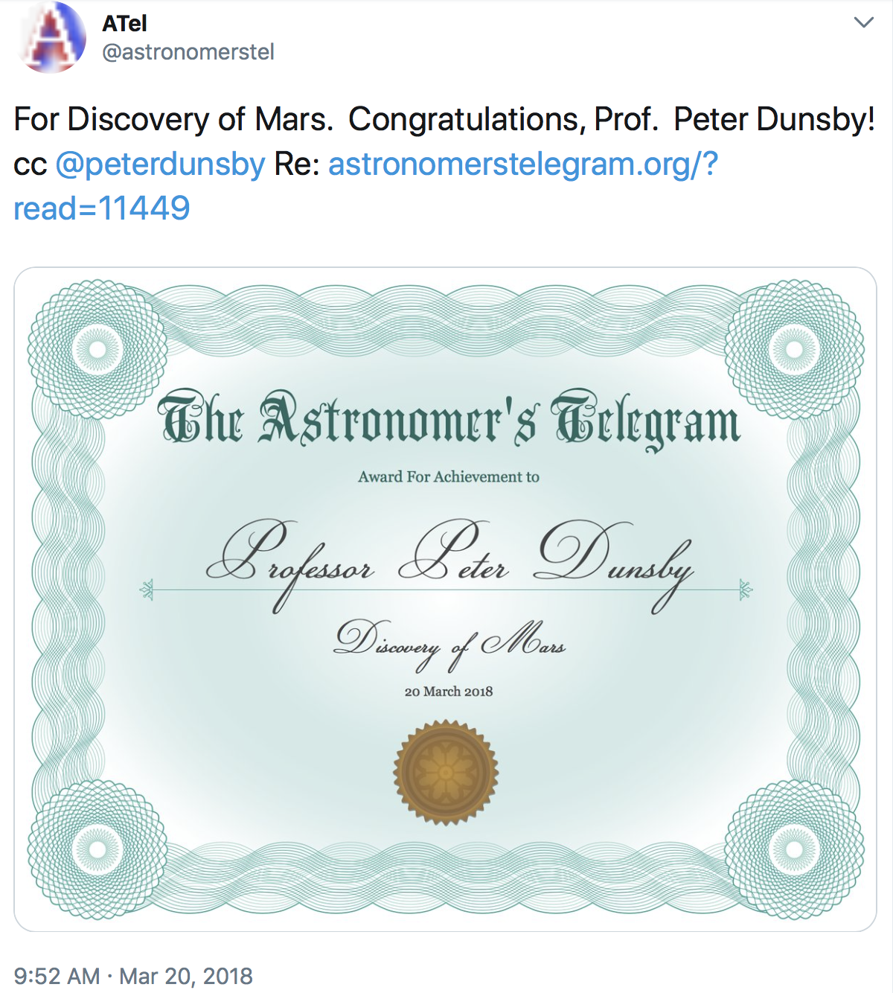
ZTF and the solar system
Notes:
Why we focus on small bodies: brightness of solar system targets.

Slide 5
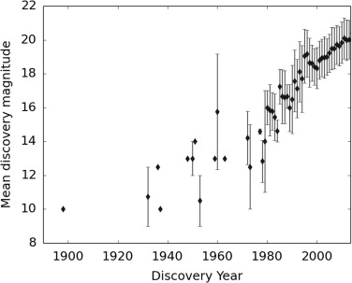
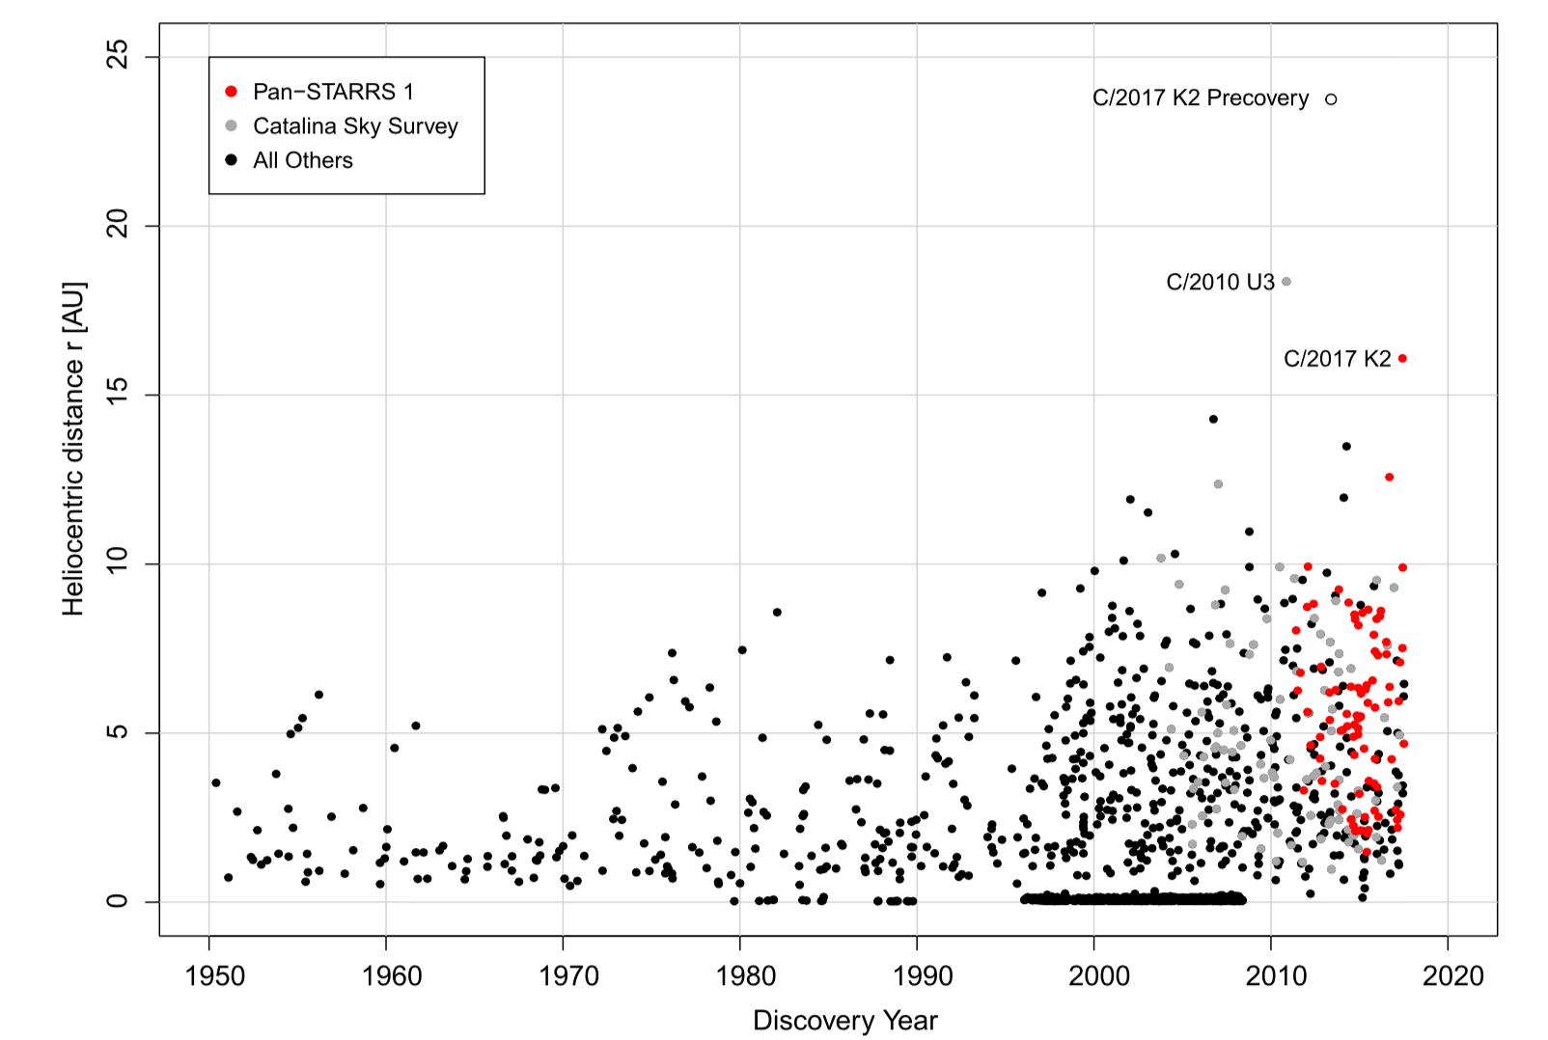
Small body discoveries and all sky surveys
Near Earth Asteroids : Completeness
Comets: Further Away
Galache et al. 2015
Meech et al. 2017

Slide 6
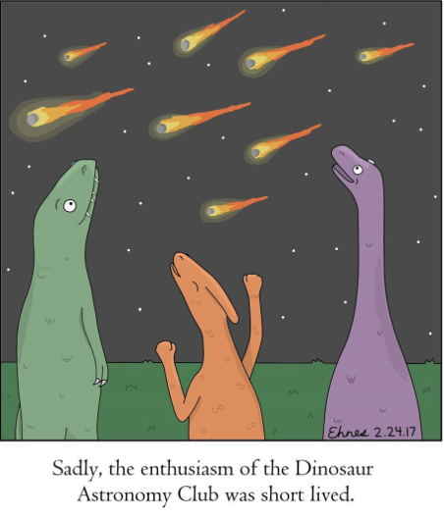
Discovery of Near Earth Asteroids

Slide 7
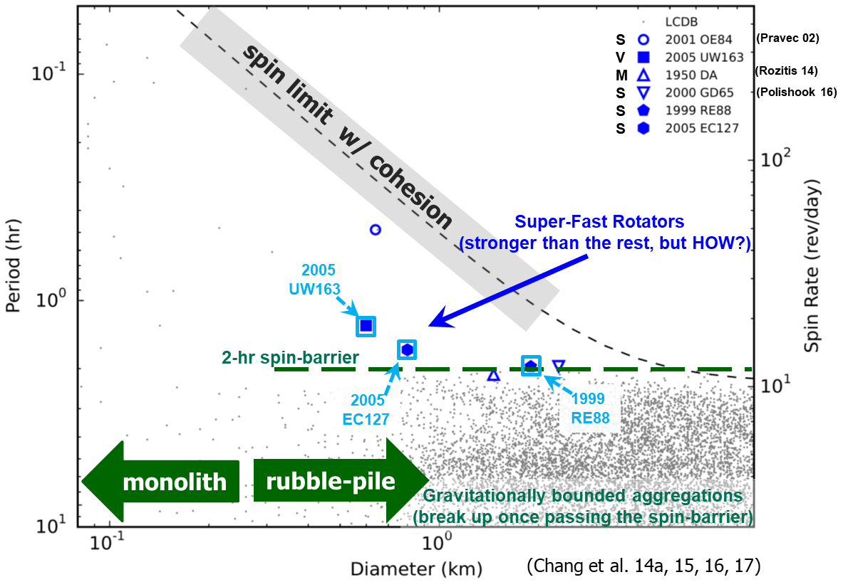
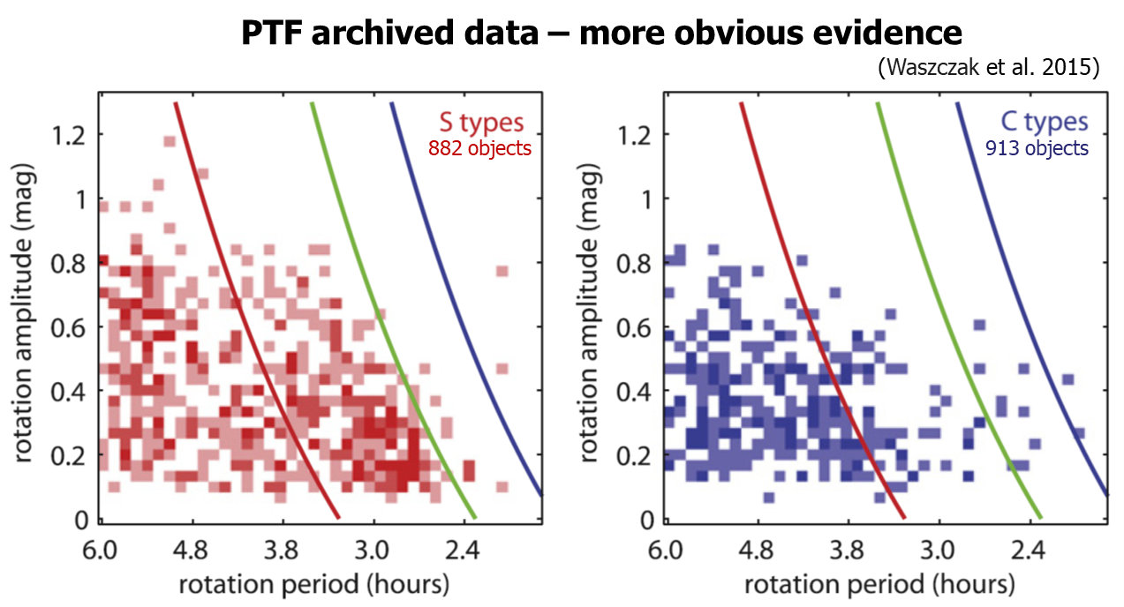
Characterization of Asteroids
Spin rate reveals asteroid strength, interior structure, and evolution

Slide 8
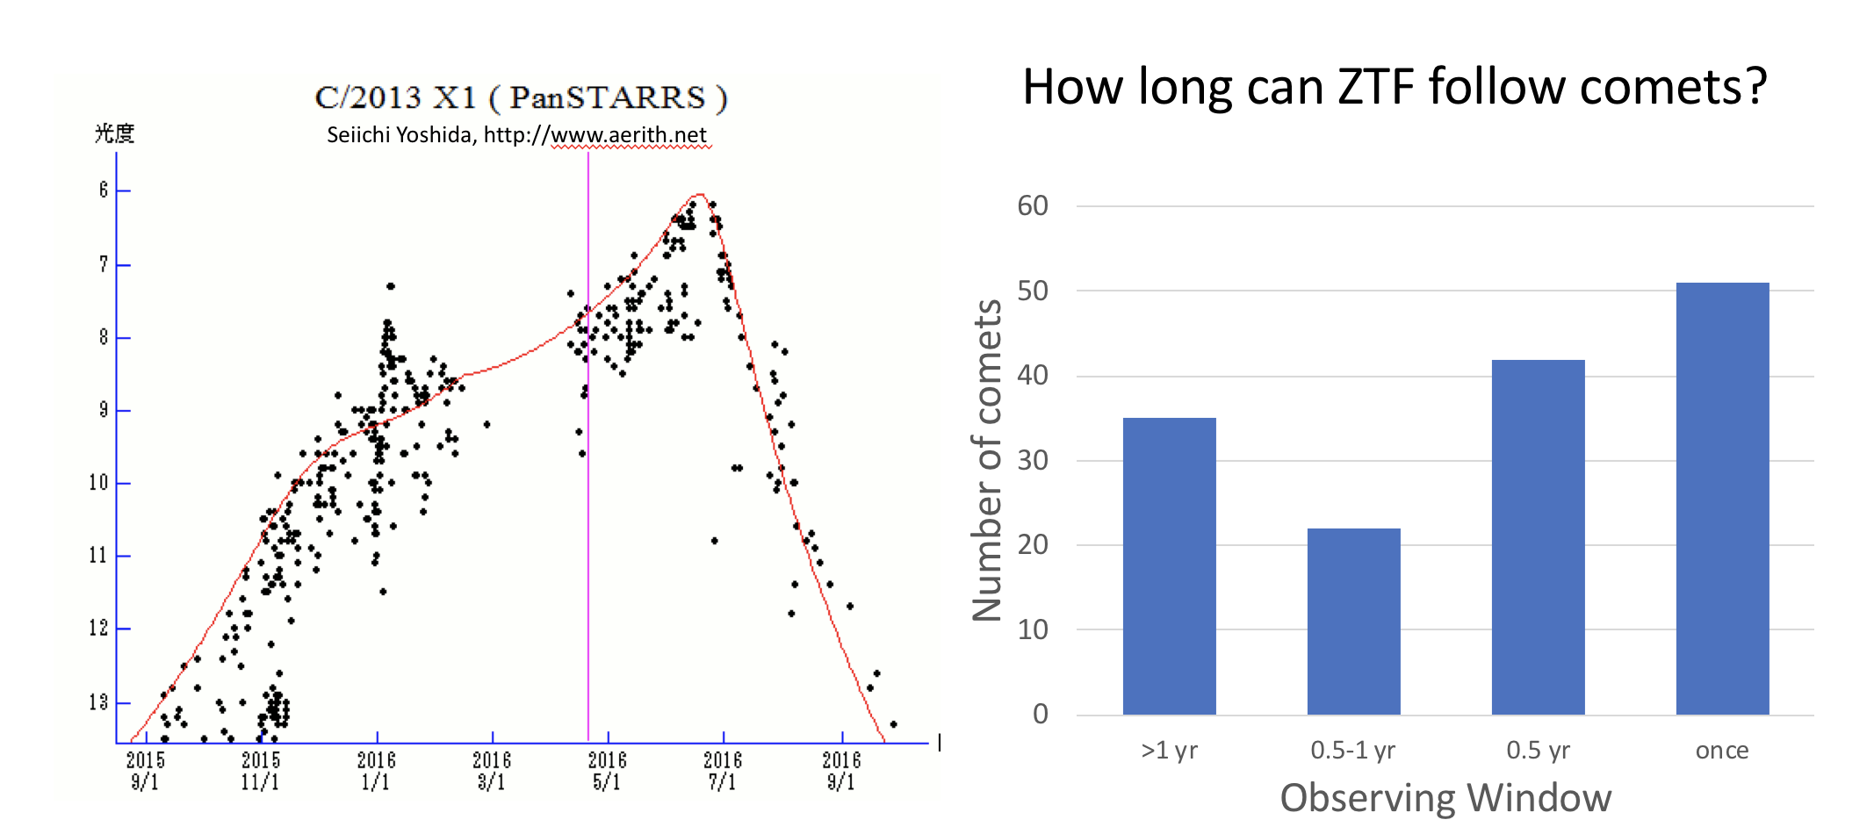
Comet Evolution and Outbursts
Comet Lovejoy (Phil Hart)
Goal: Provide reliable comet light curves and rapid outburst alerts for follow-up observations
Notes:
Go

Slide 9
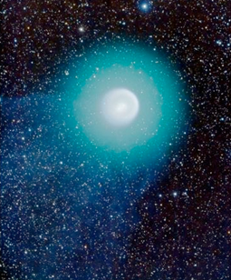
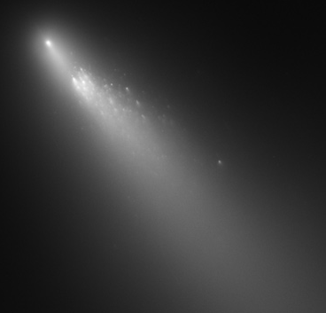
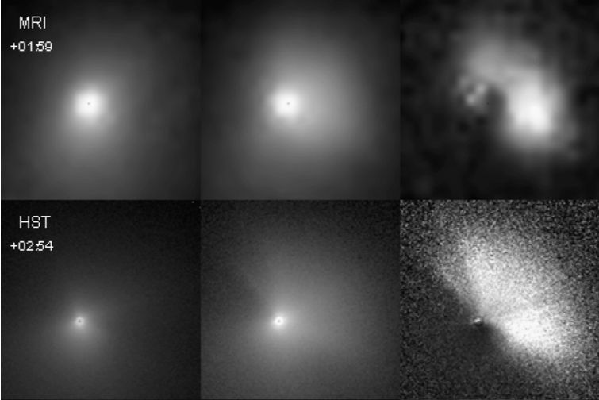
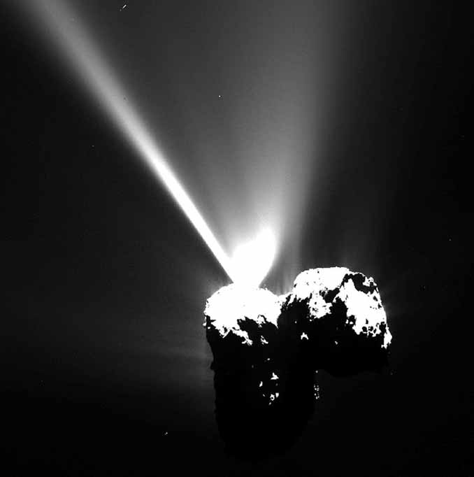
17P/Holmes. NASA / ESA / A. Dyer
73P - NASA, ESA, H. Weaver (APL/JHU),
M. Mutchler and Z. Levay (STScI)
9P/Tempel 1 – Feldman et al. 2007
67P – Vincent et al. 2016
Large
>5 mag
Sustained for weeks or longer
Gas and dust increase
Sometimes fragments
Medium
2-5 mag
Most common
Rise few days
May include short-lived fragments
Requires early warning (< days) for follow up
Small
1-2 mag
Less often discovered, but likely more common
Greatest discovery potential!
Mini
<<1 mag
Occur daily
Very short lived (10s of minutes)
Mostly discovered from spacecraft
Continuous sampling

Slide 10
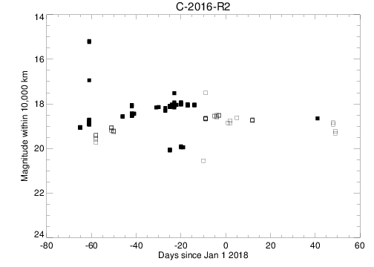
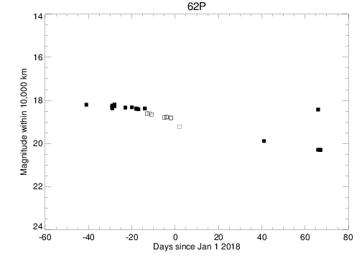
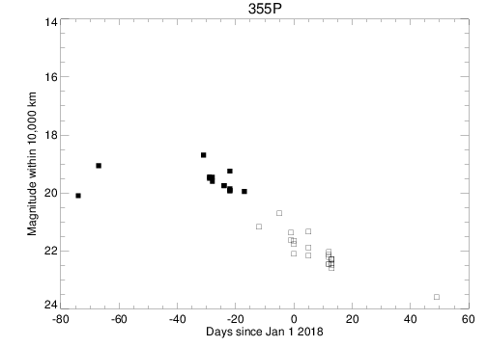
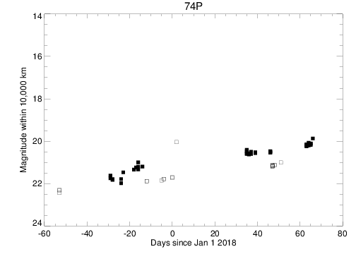
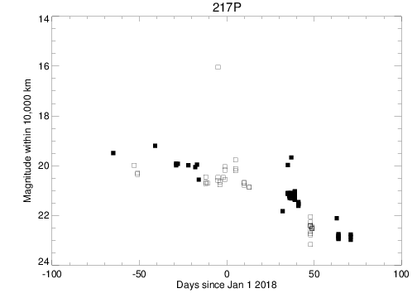
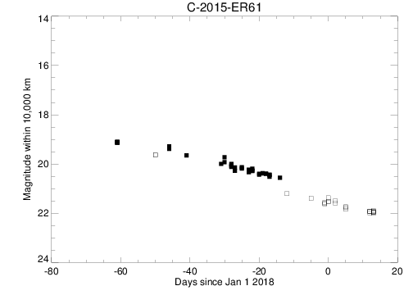
Comet Light curves

Slide 11
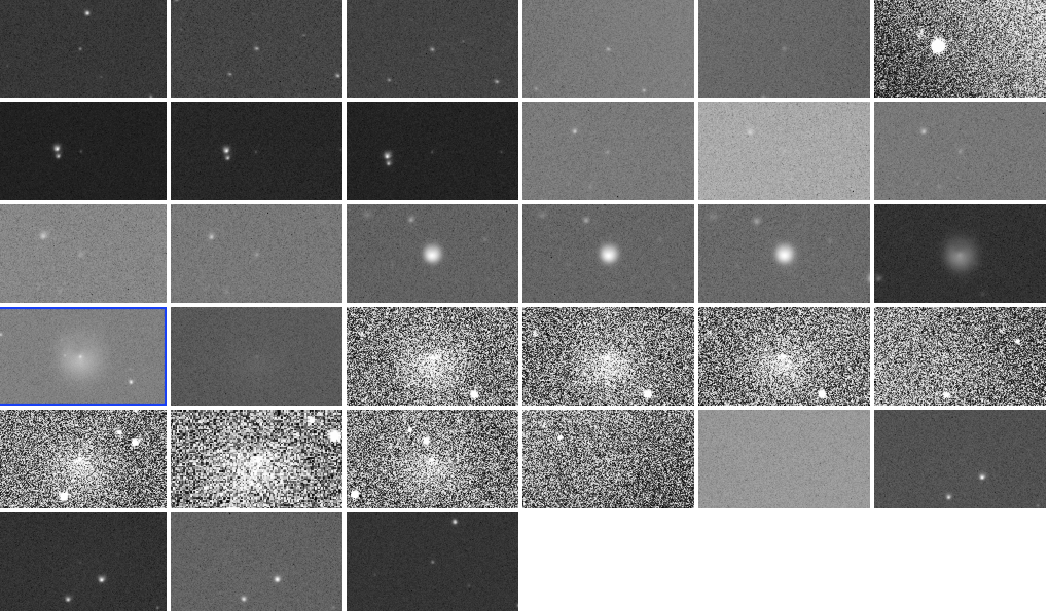
Centaurs: Echeclus Photometry
Periodic outbursts – intense and short-lived
December 2017 intensity similar to December 2006 outburst.
Weeks before activity onset observed in Aug. 2016, CO₂ production ~2 X 10²⁶ molecules/sec
ZFT g filter, color corrected
ZTF thumbnails
Bare Nucleus spherical model
Q_{dust}~50 kg/s (assuming v_{ej} ~3 m/s, grain density ~0.6 g/cm³,
~10μm radius grains)
Bauer et al., ZTF Sci. Meeting, 2018

Slide 12
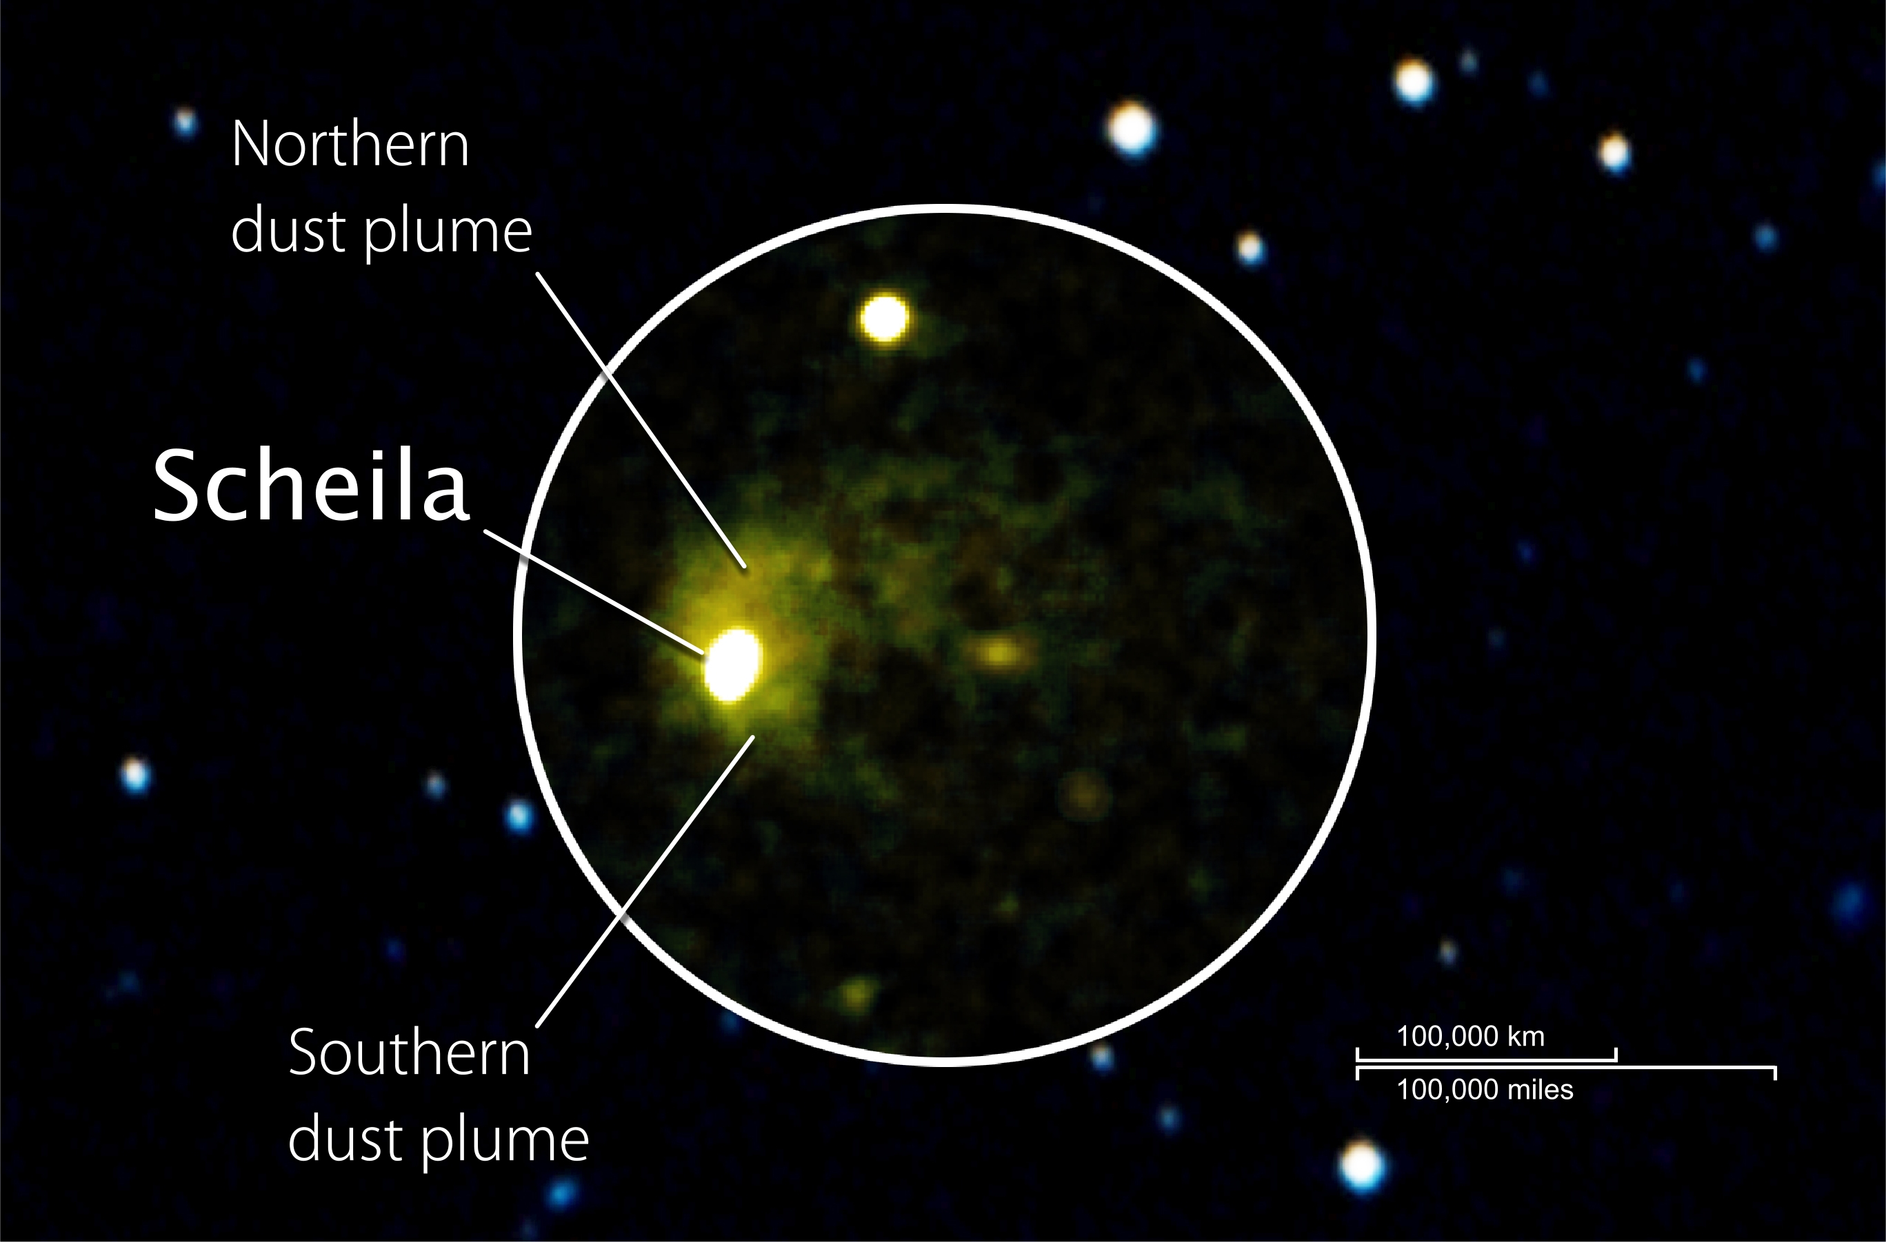
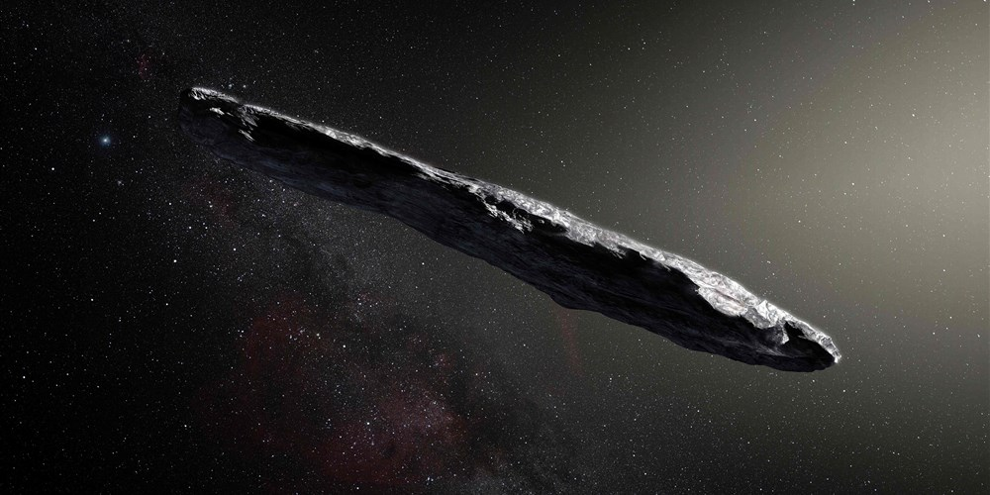
Other solar system transient events
Main belt comets and impacts
Interstellar asteroid Oumoumoua
Bodewits et al. 2011
Meech et al. 2017

Slide 13
Challenges and Follow-up
Operations:
  Completeness ZMODE?
  Need cut outs of reference image subtracted images
  Photometry of moving extended objects?
  Different diagnostics required?
  Discovery of comets?
Follow up:
  Near Earth Asteroid characterization
  Mass and composition outburst ejecta
  SEDM, Lulin, Swift, Las Cumbres Observatory, IRTF, APO, DCT, …
  Where and how to report events to get community follow-up?
  Hard to automate observations of moving extended objects that all have very broad range of properties

Slide 14
Solar System Working Group
Biweekly telecons, Monday 4:30PM PT
ztfsolarsystem.slack.com
ZTF web > ScienceWorkingGroups > SolarSystemWorkingGroup
Coordinators:
  Dennis Bodewits, dennis@astro.umd.edu
  Rex Chang, rex@gm.astro.ncu.edu.tw
  Quan-Zhi Ye, qye@caltech.edu

