Slide 1

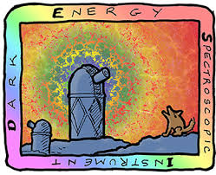
Computing a catalog of ZTF transients hosts observed with DESI
Maayane Soumagnac
Peter Nugent
and many others
Notes:
Hi, I am Maayane, currently a post doc at LBL with Peter Nugent. Today I will tell you about a project we have very recently started, but which is also quite time sensitive.
In short, DESI science validation is going to happen mid-januaruy to mid-june, and our goal is to use this opportunity to try to observe as many interesting hosts of ZTF transients as possible.

Slide 2
Layout
DESI overview & timeline
Current list of ZTF hosts targets
Discussion
Notes:
I will first tell you about DESI, the instrument and the plans for the coming months.
Then I will tell you about our current list of targets, and then the idea is to open a converstaion here on other potential targets which could be added to the Science Validation program.

Slide 3
DESI scientific goals
“Precision measurement of dark energy, while making important contributions to the physics of inflation and neutrinos”
  1. Determine as well as possible whether the accelerating expansion is consistent with a cosmological constant.
  2. Measure as well as possible any time evolution of the dark energy.
  3. Search for a possible failure of general relativity through comparison of the effect of dark energy on cosmic expansion with the effect of dark energy on the growth of cosmological structures like galaxies or galaxy clusters.
2 tools
BAO
A ruler in the sky and enables us to measure the expansion of the Universe
Redshift Space Distorsion
Allows to measure the pull of gravity and check General Relativity
Notes:
The DESI Science Goals is to do “precision measurement of dark energy, while making important contributions to the physics of inflation and neutrinos”
And this has been translated into three subgoals
In order to do this, they will use two tools. Baryon acoustic oscillation, which they will even do with quasars. And Redshift space distorsion (the fact that the spatial distribution of galaxies appears squashed and distorted when their positions are plotted as a function of their redshift rather than as a function of their distance. The effect is due to the peculiar velocities of the galaxies causing a Doppler shift in addition to the redshift caused by the cosmological expansion.)
Q: CD-0 and P5 recommendations are recommendations of DoE?
Q: how do the subgoals help inflation and neutrinos? Neutrino mass Smears ly alpha forest
Read on: RSD

Slide 4
DESI targets and numbers
DESI will observe 14 000 deg² of the night sky
Will take spectra and study the distribution of ~ 35M galaxies and QSOs in 5 years
Each DESI spectrum is a galaxy/QSO redshift
Notes:
In order to do this, DESI will observe 14,000 deg² of the night sky
Will study the distribution of ~ 35M distant galaxies (correlations between them)

Slide 5
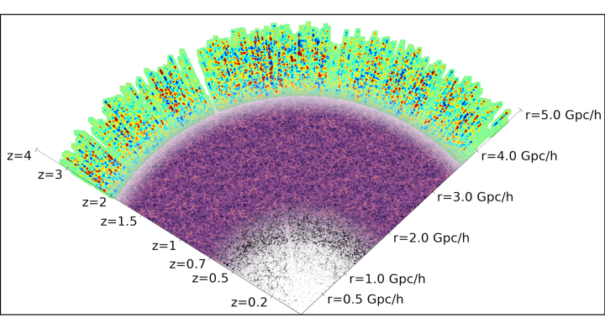
DESI will be the largest spectroscopic survey for dark energy
DESI will explore a x30 larger map over a x10 larger volume than SDSS
2.4 million Quasi Stellar Objects (QSO)
/h
17 million Emission Line Galaxies (ELG)
4 million Luminous Red Galaxies (LRG)
10 million brightest galaxies
Notes:
This is a map of the DESI targets. DESI will be the largest spectroscopic survey for DE. It will explore a volume 10 times larger than SDSS. And this comes with a lot of opportunity for us.
Q:
Q: r en quells units?
Omega lamda becomes larger than omega M
halfU

Slide 6
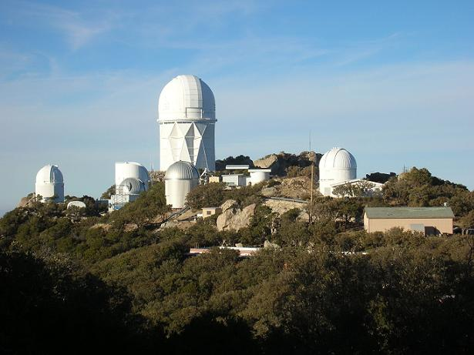
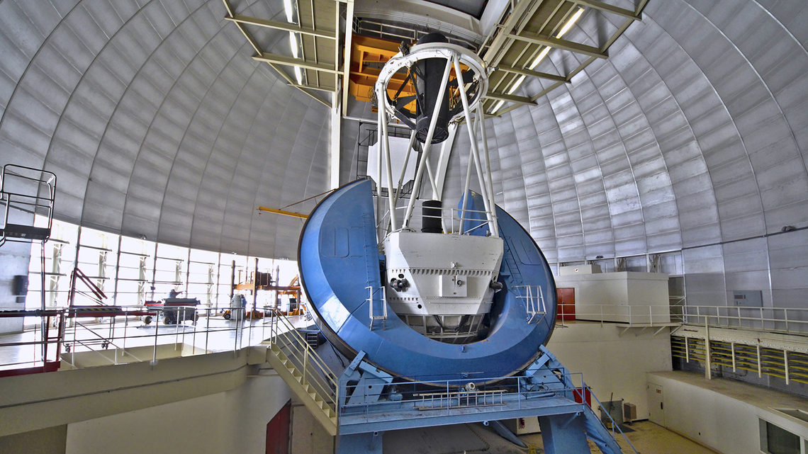
DESI instrument
the Mayall 4-m Telescope at Kitt Peak, Arizona
Notes:
The DESI instrument has been installed at the Mayall 4-m telescope in Kitt peack. The observatory was purchased for 5 years by the Dept of energy and the telescope is full dedicated to DESI. It’s not clear yet what will happen beyon these 5 years.

Slide 7
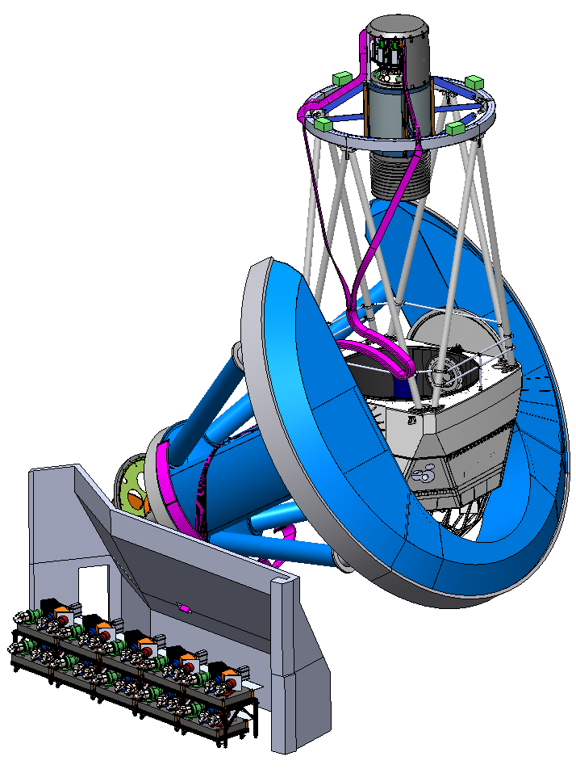
DESI instrument
DESI is a Fiber-fed multi-object spectrograph. It uses robotic control to position a fiber optic strand onto the location of a
known galaxy
5000 robotically positioned
optical fibers on the focal plane
8 sq.deg. FOV
Ten 2-channels spectrographs
Spectra of 35 million galaxies and quasars over 14,000 deg² in 5
years
Resolution: R ~1500(b)/3000(r)
Wavelenths : 3300 -10 000 A
(Split at 5500 A)
Focal Plane Assembly w/5000 fiber positioners
All-new upper ring, spider, cage
6-lens wide-field Corrector on Hexapod
49 meter, 10-cable fiber run
Mayall Telescope
Fiber View Camera
Ten thermally-controlled 2-channels Spectrographs
CREDIT: DESI
Notes:
En fait plutot 360-980 nm
Split 5500 A
2 channels is red and blue

Slide 8
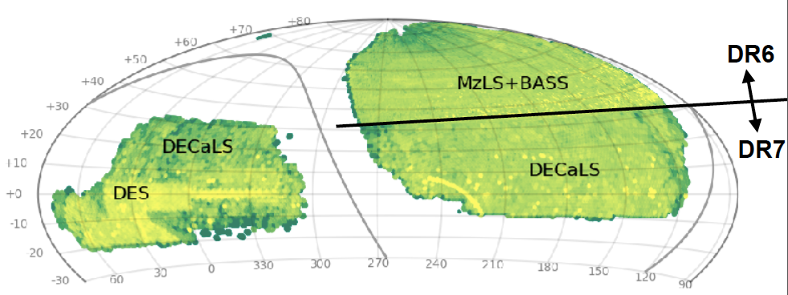
DESI target selection
Target selection required pre-emaging of the 14 000 sq. deg footprint
Three optical surveys
BASS (gr) + MzLS (z):North (5k deg²)
DECaLS (grz) : North + South (9k deg^{2,}
including 5k from DES in the South) ()
One IR all sky survey
All Sky WISE (NASA satellite)
W₁ W₂
()
DR8
CREDIT: DESI
ZTF helped for selecting QSOs!
Notes:
Because you need to go so deep, target selection required pre-imaging. This was performed with 4 different surveys, which are combined in the DR8 data release.
DECAM was used for anything between dec -30 and 30
Everything above was observed witht eh Mzls and BASS surveys.
There was also an all sky infra-red survey performed by WISE fromspace. Good because emission lines gal are not emitting there and
Non detection tells good ELG and detection tells you bright. Variability also helps with the quasars.
ZTF also helped for QSO target selection (because they are variable and LBL provided focal plane design)

Slide 9
DESI Science Verification timeline
2019-10-10 - Commissioning start with focal plane + spectrographs
2019-11-26 - Last spectrograph installed
2019-12-01 - Imaging Surveys DR9 release
2019-12-27 - Initial Survey Validation fields
2020-01-12 - Nominal start of Survey Validation
Science Verification will run from mid-January to mid-June
Notes:
This is the most up-to date timeline.
Commissioning will start very shortly, in octiber,
A the end of November the last spectrograph will be installed
The final imaging data release will be released early december

Slide 10
SV: Current plans for the BGS sample
100 000 BG out of 10 millions will be observed during SV
+ 100 000 as part of a 1% survey 200 000 BG by June
Notes:
What are the plans during science verification.
BGS: 10 million brughtest than 20th mag
During SV: between 1 and 10 %

Slide 11
Current list of ZTF targets hosts
Sne Ia for cosmology (several 100s)
Sne IIp for cosmology (~100)
All RCF targets hosts (~1300)
Notes:
The SV team is quite open to inclide specific hosts in their sample.
I have been in touch with several groups in ZTF to see how galaxy redshifts
We need to be quick.

Slide 12
Current list of ZTF targets hosts
Sne Ia for cosmology (several 100s)
  host galaxy redshifts with at least medium resolution
  The SEDM resolution is not good enough to provide this
  We have several hundreds of classified SNe Ia with good lightcurve, but lack of host redshift
  Most of these have fairly bright host galaxies that could be part of the DESI BGS.
Sne IIp for cosmology (~100)
All RCF targets hosts (~1300)
Notes:
To do SNIa cosmology we need host galaxy redshifts with at least
medium resolution.
- The SEDM resolution is not quite good enough to provide this.
- We have several hundreds of classified SNe Ia with good lightcurve,
but lack of host redshift prevents us from using these.
- Most of these have fairly bright host galaxies that will be part of
the DESI bright galaxy survey, but the earlier we get the redshifts the
earlier we can start with cosmology.

Slide 13
Current list of ZTF targets hosts
Sne Ia for cosmology (several 100s)
Sne IIp for cosmology (~100)
  Distance mesaurement from peculiar velocities
  Factor of 2 worse in terms of distance, but 4 times more common than Ia’s
All RCF targets hosts (~1300)
Notes:
The idea is that IIp are among the best undersood cosmic explosions, we can standardize them to get distance measurment from peculiar velocities.
Factor of 2 worse in terms of distance measurment, but 4 times as many.
(You can do peculiar velocity with Ia and II. Ia’s will domintate to Z=2. Iip to redshift of 0.5)
You can do peculiar velocity with Ia and II. Ia’s will domintate to Z=2. Iip to redshift of 0.5

Slide 14
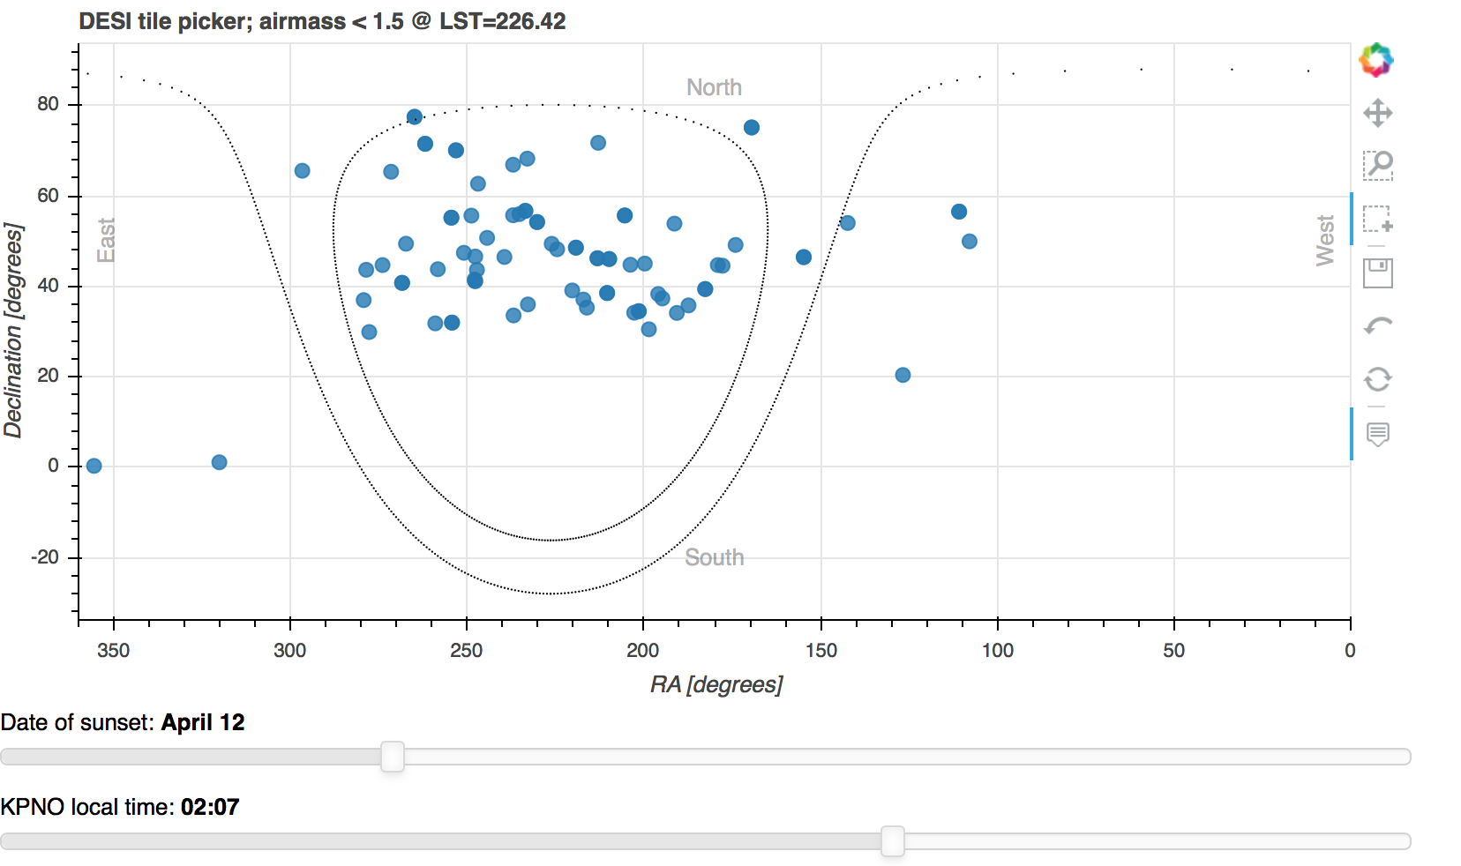
Example: type IIp sample
Notes:
This is a check I have made wih sample of Iip….
This is the kind of plots we will use to convince the UV team.

Slide 15
Current list of ZTF targets hosts
Sne Ia for cosmology (several 100s)
Sne IIp for cosmology (~100)
All RCF targets hosts (~1300)
  All the RCF is public
  Only half have known z
  Community service

Slide 16
Discussion
What other potential targets could be added to the SV run?
What data would be beneficial for the public?
Could DESI analysis tools be used by ZTF?
Notes:
ZTF has data which is public and provate. DESI: goes public every 6 months (Quick reduction 24-48 hours.
). What data is beneficial to take for public good?
There is also private data that will become public: how can this benefit the public?
And then if we think about it as a two-ways colaboration, DESI have tools for analysing the data…
SLSN host are mostly faint.
DESI will do repeat exposures for faint galaxies (so in fact there will be time variation info) but not during SV
For BGS: exposure time is 10 minutes
For ELG fainter: 20 minutes
AGN interested
Galactic sources (but only extra-galactic fields) where there are a lot of Gaia sources.

