Slide 1
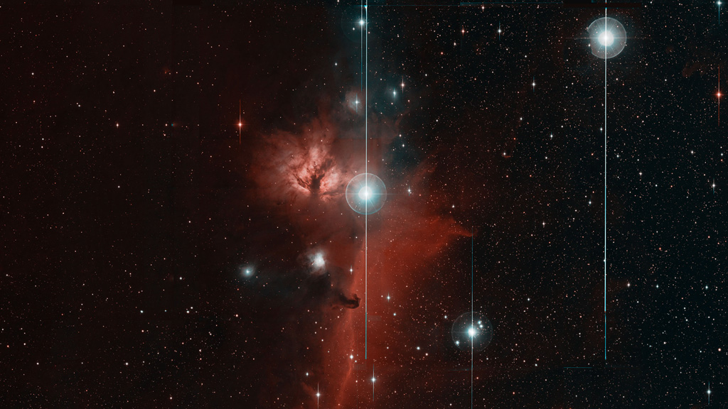
Adam Rubin
Angie Van Sistine
Anders Nyholm
Anna Ho
Anna Franckowiak
Ariel Goobar
Avishay Gal-Yam
Brad Cenko
Claes Fransson
Chow-Choong Ngeow
Christoffer Fremling
Cristina Barbarino
Daniel Gold
Eric Bellm
Emir Karamehmetoglu
Eran Ofek
Frank Masci
Francesco Taddia
Gwendolyn Eadie
Ido Irani
Jacob Jencson
Jakob Nordin
Jakob van Santen
Jesper Sollerman
Kishalay De
Leo Singer
Leonardo Tartaglia
Lin Yan
Maayane Soumagnac
Mansi Kasliwal
Mattia Bulla
Matthew Graham
Melissa Graham
Nadia Blagorodnova
Nora Linn Strotjohann
Ofer Yaron
Pradip Gatkine
Rachel Bruch
Ragnhild Lunnan
Rahul Biswas
Robert Stein
Ryan Lau
Sarafina Nance
Scott Adams
Semeli Papadogiannakis
Shri Kulkarni
Steve Schulze
Suhail Dhawan
Ulrik Feindt
Virginia Cunningham
Yi Yang
Zach Golkhou
Zeljko Ivezic
Working Group:
Physics of Supernovae and
Relativistic Transients

Slide 2
Conclusions
ZTF + extragalactic partnership survey allow to advance in SN science in multiple dimensions:
  Obtaining high quality light curves in g and r for all objects
  Defining samples with minimal selection biases
  Catching the first and last photons of supernovae
  Probing new areas of the transient parameter space
We are aiming in answering questions on the SN progenitors, rates, ensemble properties and SN physics.

Slide 3
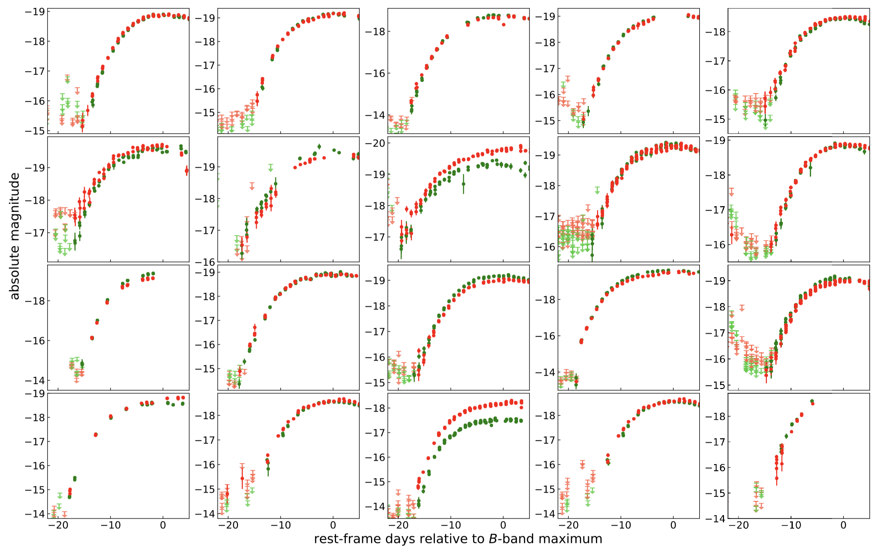
Infant Supernovae: Type Ia SNe
…early observations of SNe Ia to infer the type of progenitor systems
Adam Miller, Mattia Bulla, Yuhan Yao
https://github.com/yaoyuhan/ForcePhotZTF

Slide 4
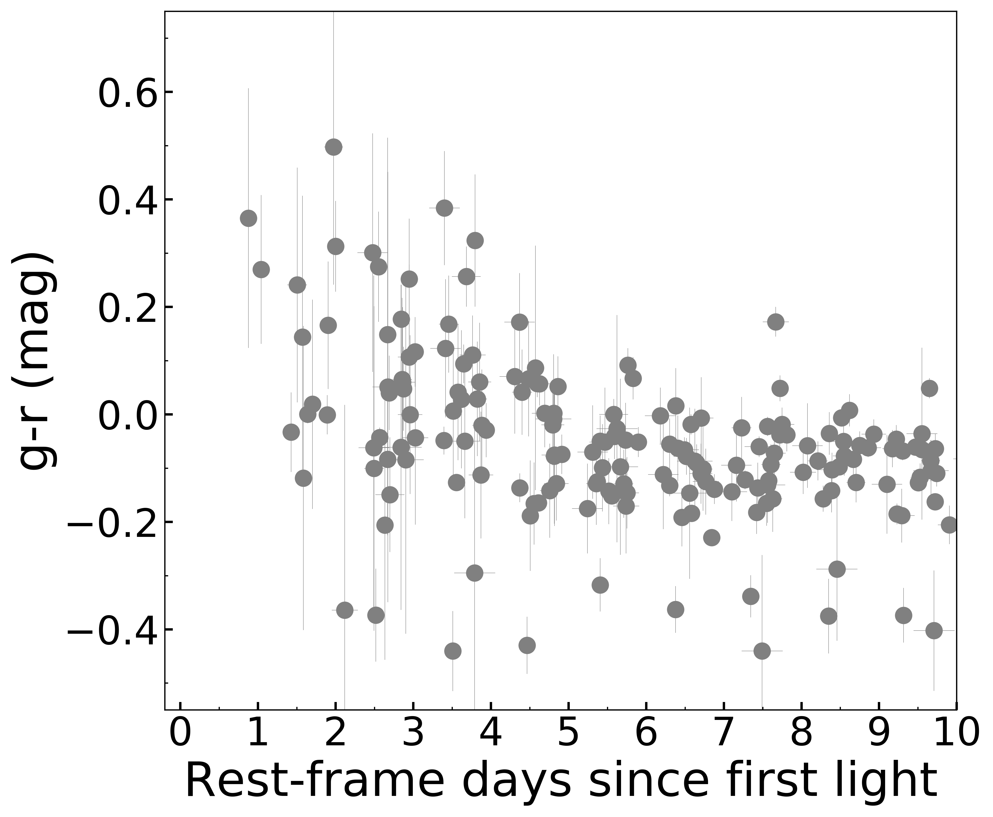
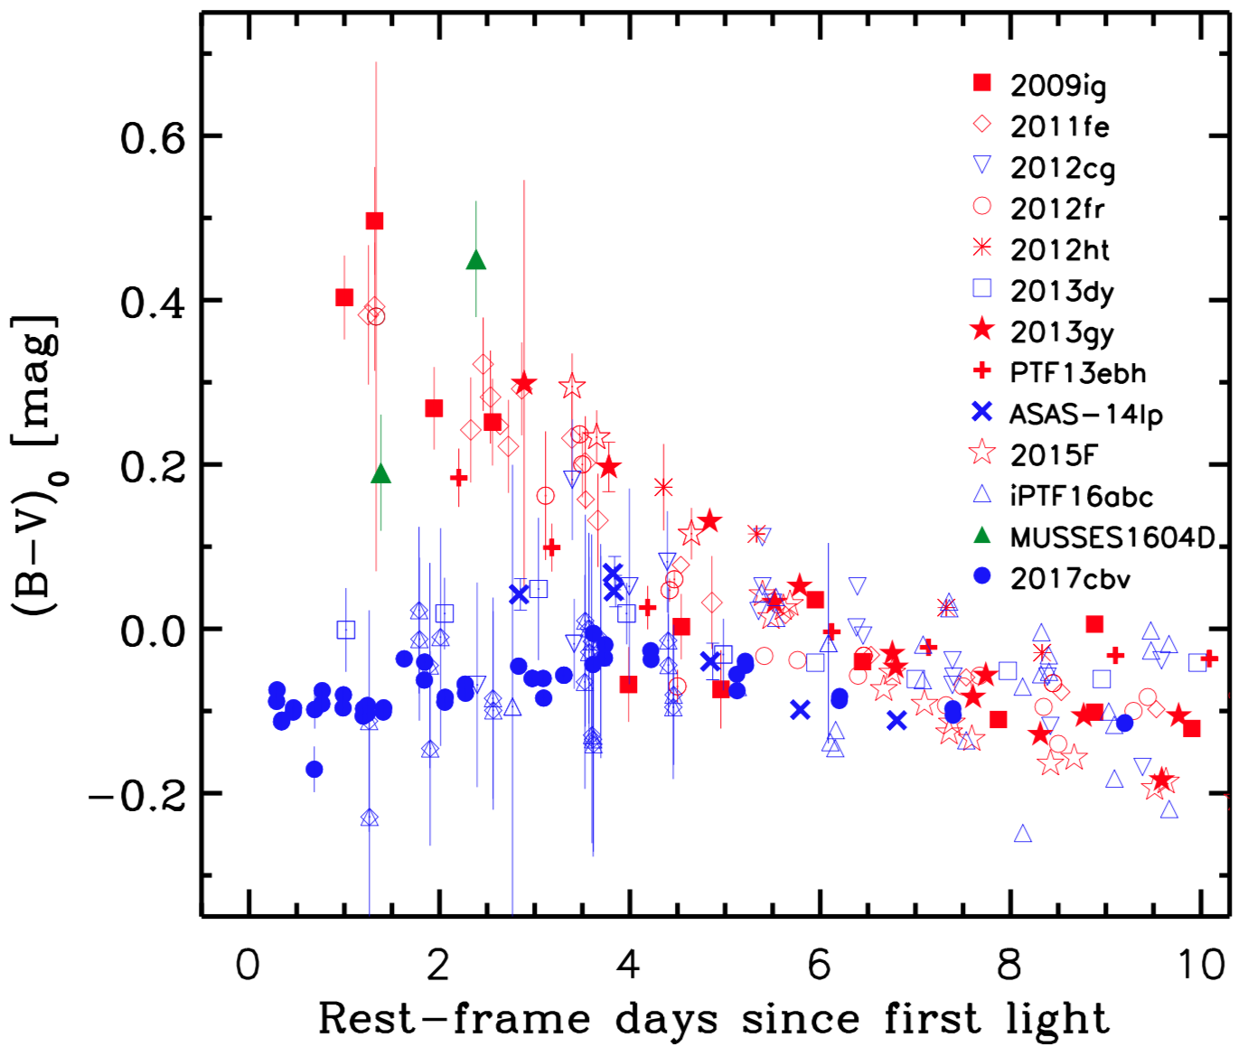
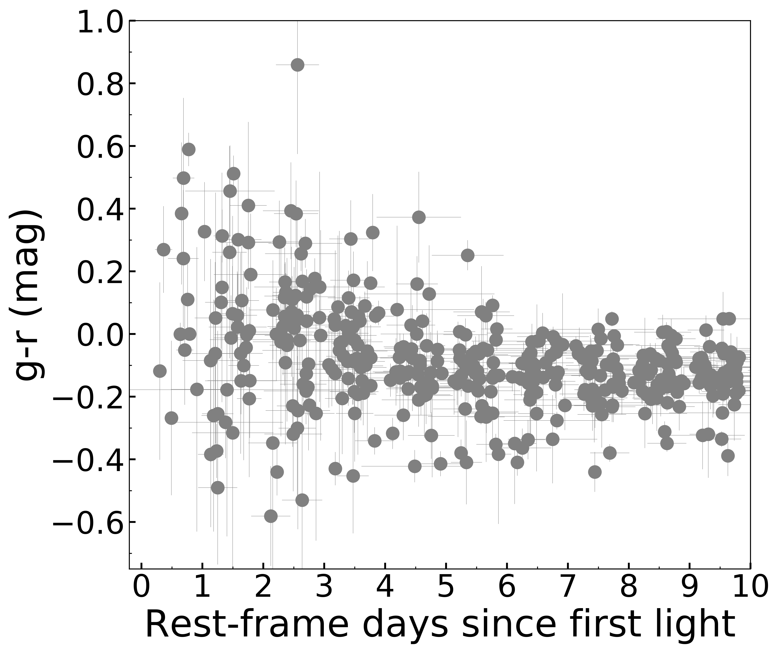
Infant Supernovae: Type Ia SNe
SNe Ia from the literature
Stritzinger et al. 2018
13 discovered within 3 days from first light
With one exception, all nearby (z < 0.02)
Evidence for two distinct populations?
SNe Ia from ZTF - Year 1
Bulla et al. 2019, in prep
26 discovered within 3 days from first light
0.02 < z < 0.14
NO evidence for two distinct populations

Slide 5
Infant Supernovae: Type II SNe
High Quality Infant Type II Light curves
Spectroscopy
Study of flash-ionisation features in infant spectra (<5 days from last non-detection)
Building robust statistics of flash-ionised events
How common is it amongst CCSNe? Is it type dependant?
Light curve structures study :
Early light curve : Clusters of rise types?
Later time structures?
Are there correlations?
New type of study thanks to g and r band: what new information will it bring?
Light-curve modelling with shock-cooling models to constrain the progenitor star (see Maayane's talk)
Are there correlations between flash-ionisation features and light-curve structures (in both early and late light curve)?
Led by Weizmann
Listen to Rachel's song on Wednesday

Slide 6
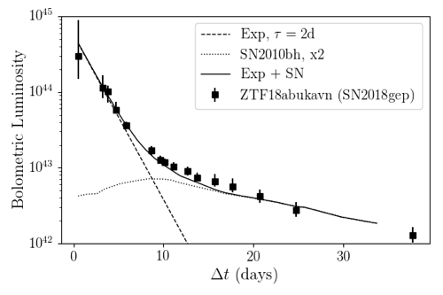
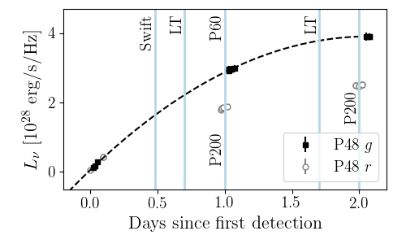
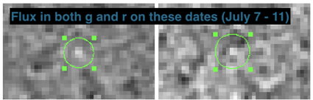
Infant Supernovae: Fast
Caught early
ZTF18abukavn/SN2018gep:
A broad-lined Ic SN without a relativistic outflow
Catching a SN within 30 min after explosion!
Early emission is powered by shock-cooling
After 10 days, Ni takes over
Detection of precursor outburst months before explosion (stay tuned…)
Discovered 20 min after first light, rising 1.3 mag/hr
Rapid phot. and spec. follow-up
Rapid rise (t_{peak} < 0.5 day), blue at peak
(g-r = -0.3), L_{peak} > 3x10⁴⁴ erg/s
Led by Anna Ho

Slide 7
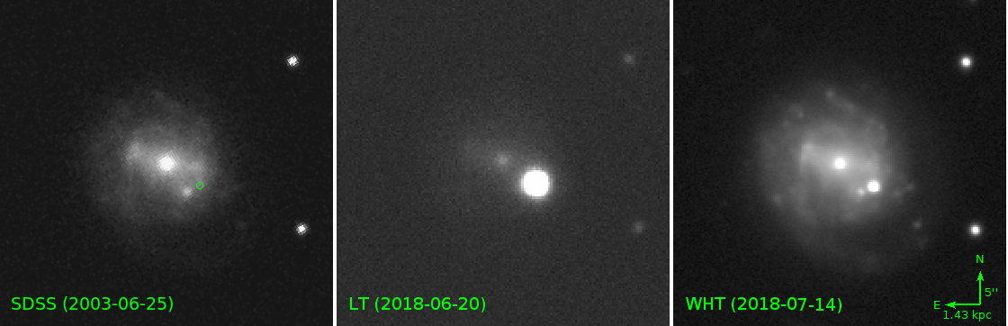
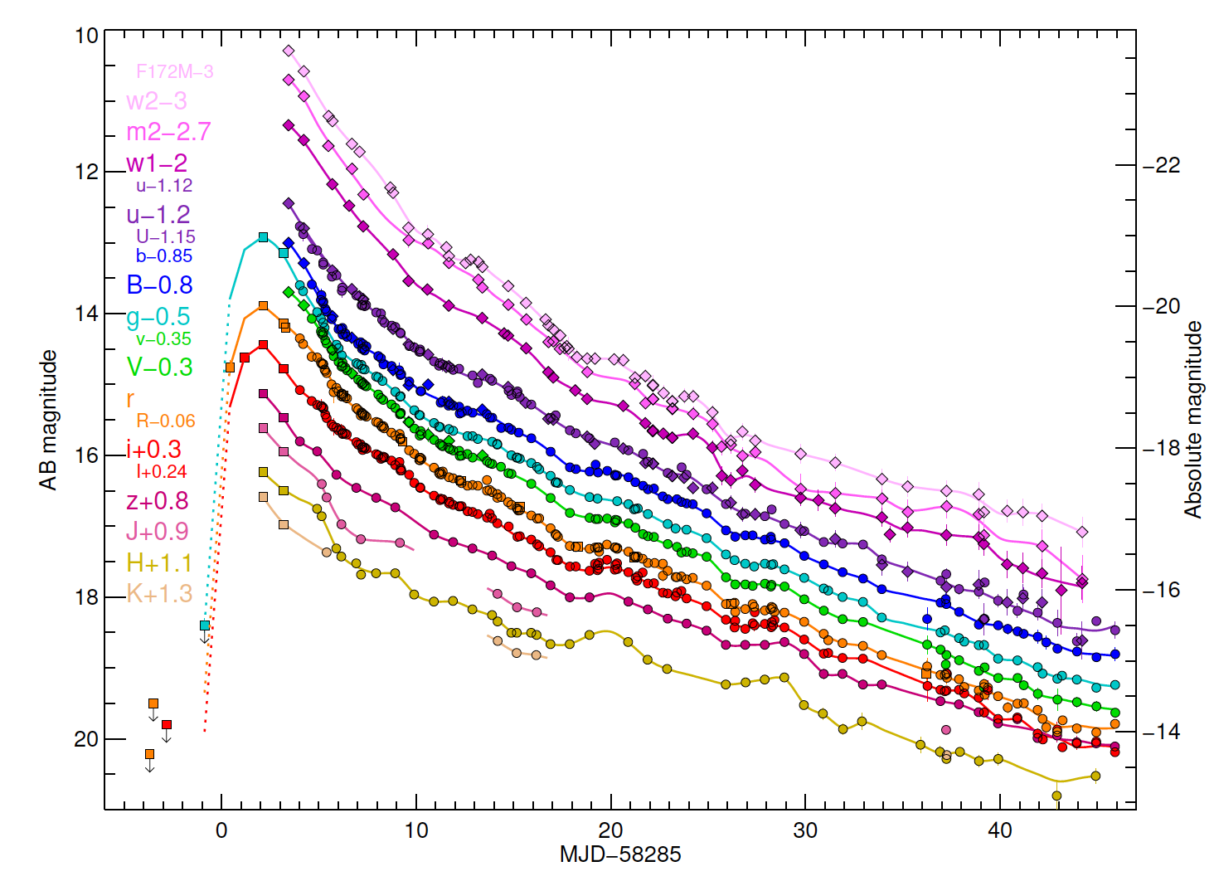
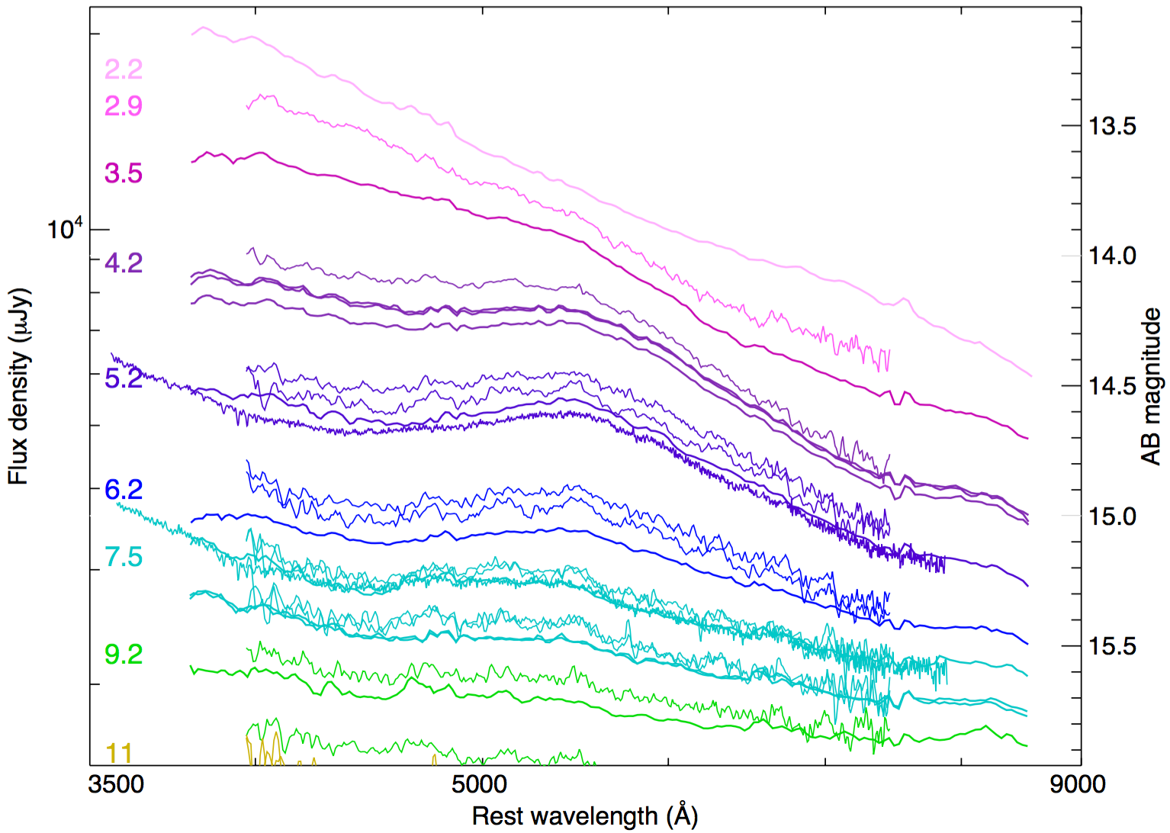
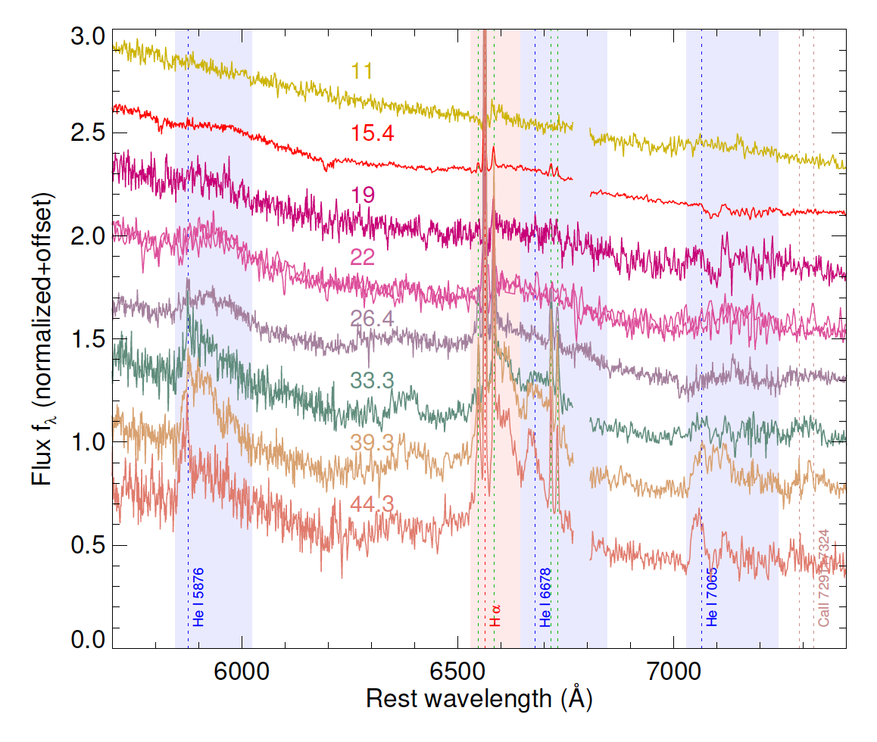
Infant Supernovae: Fast and Furious – Holy Cow!
Caught early
AT2018cow
A mystery object at a distance of 60 Mpc
Dwarf spiral host galaxy
Ultra-high-velocity (~0.3c) features in early spectra
Very fast rise confirmed with ZTF i-band data
Hot, shrinking photosphere
No Nickel bump
Narrow H & He in
late spectra
Perley et al. 2019, MNRAS, 434, 1031; Ho et al. 2019, ApJ, 871, 73

Slide 8
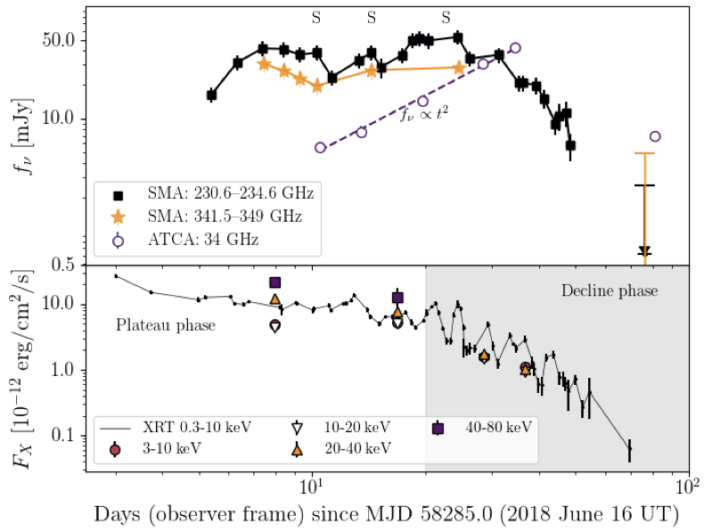
Infant Supernovae: Fast and Furious – Holy Cow!
First detection of transient rising at mm wavelengths
More luminous than any SN
(b/c of high ambient density
+ large energy)
Emergence of central engine
What is the progenitor of AT2018cow?
An extreme SN, disruption of a star by an intermediate mass black-hole or something else?

Slide 9

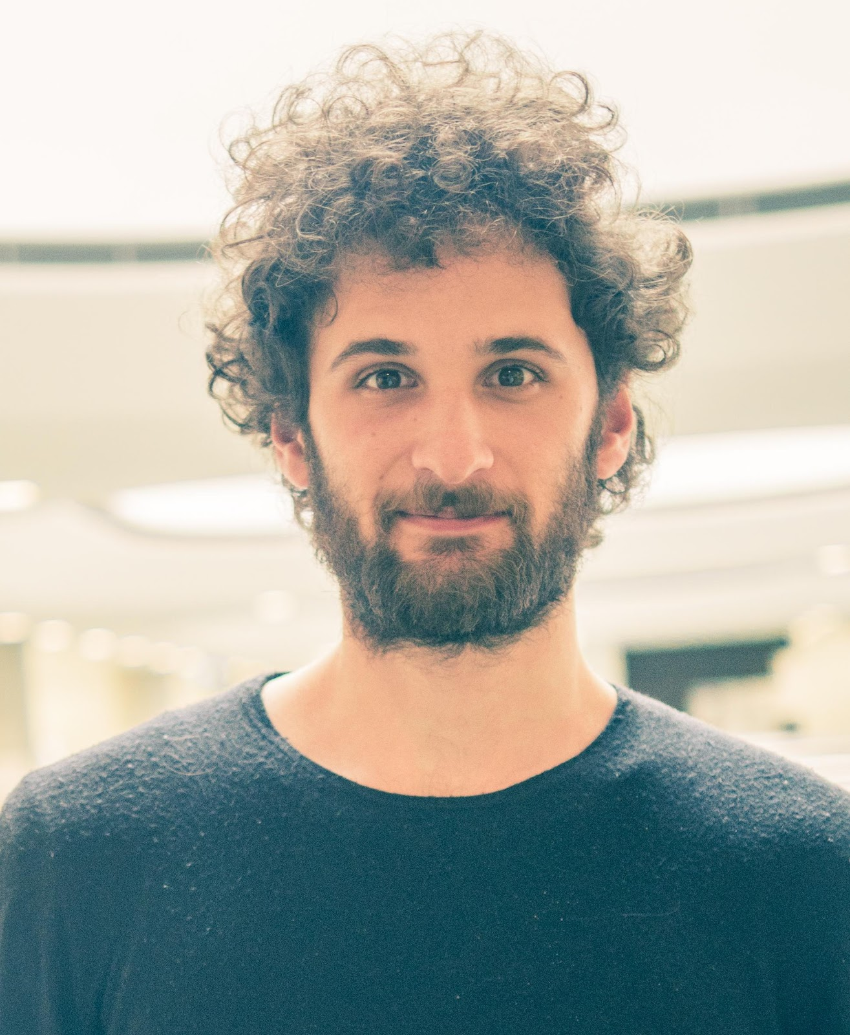
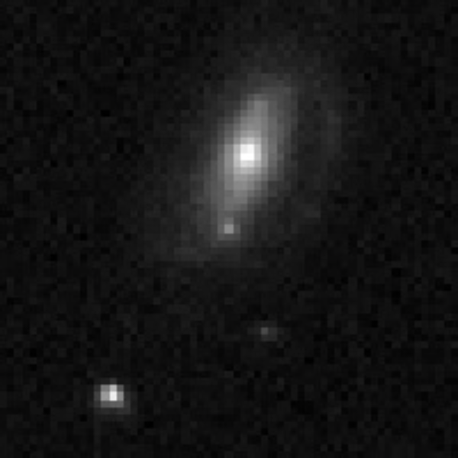
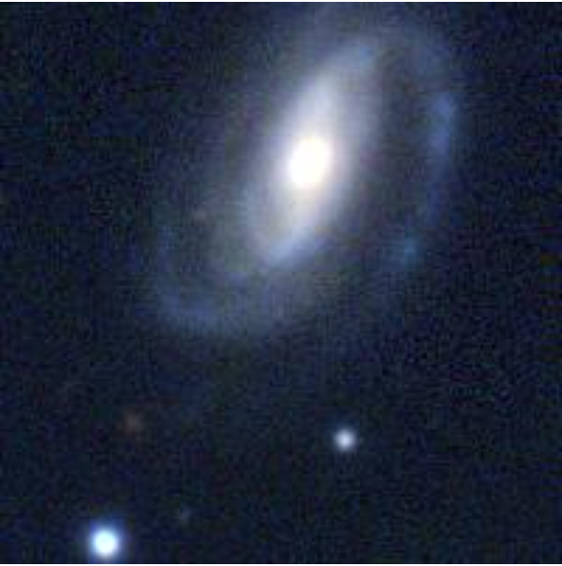
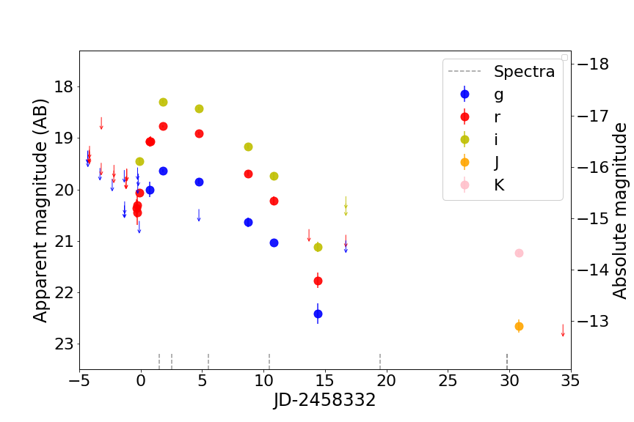
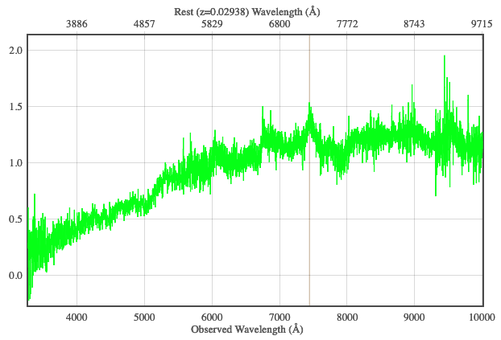
Fast and Red - ZTF18abkmbpy – mind the gap!
Led by Kishalay De and Igor Andreoni
ZTF
PS1
Ca in emission
g – r ~ 0.9 nearly constant, long-lived NIR
Rise time ~ 3 days
Fade time ~ 12 days
M_{r} ~ –16.8 at peak
Led by Kishalay De and Igor Andreoni

Slide 10
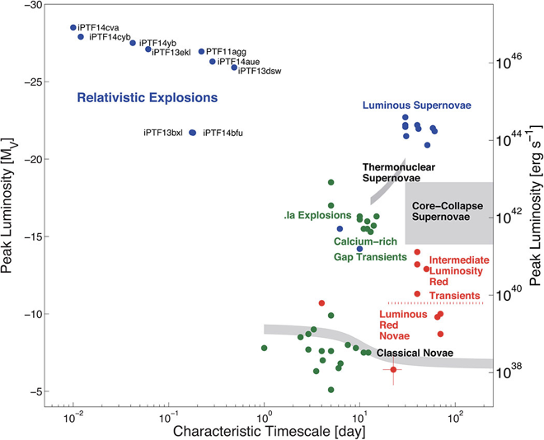
Fast transients
Led by Igor Andreoni and Anna Ho
ZTF
In progress
Probe the minute-timescale transient sky using the Catalina Real Time Survey
Future
Search for gamma-ray and radio counterparts (FRBs?) to ZTF fast transients
DECam
ZTF
Searching for fast transients in DECam data (Andreoni et al. submitted)

Slide 11
Spectro-polarimetry of infant Supernovae led by Yi Yang
Caught early
Peculiar Supernovae
SN Ia-CSM 2018evt
Tracing the pre-explosion mass-loss history of the SN from the geometry of its interaction with CSM
Infant supernovae: before the ejecta sweep away almost all traces of the pre-explosion configuration within a few days...
Infant Type Ia SNe
SN 2019np since day -14.5; Polarization as tool to decipher the 3D Structure of SNe-Ia
Infant Core-Collapse SNe (Waiting for candidates)
Probe the shock breakout and scattering by a CSM environment to measure the geometry of the final-stage mass-loss —‘Flash-Spectropolarimetry’
Notes:
2019np -14.5days; earliest polarimetry of any types of SNe. Low continumm and the non-detection of Oxygen polarization as early as ~3 days after the explosion can mostly rule out the merger models and Helium detonation models.
2018evt very rare types of SNe: Type Ia-CSM, declines very slowly, and still at -18.6 mag in r band after 200 days of the discovery. We put in a separate DDT for multi-epoch spectropolarimetry of SN\,2018evt. We see the continumm drops over time, and the Ha peak almost completely depolarized (except the P-Cygni core). This will help us to understand the origin of Type Ia-CSM Supernovae, and its probably very close relations with Type IIn.

Slide 12
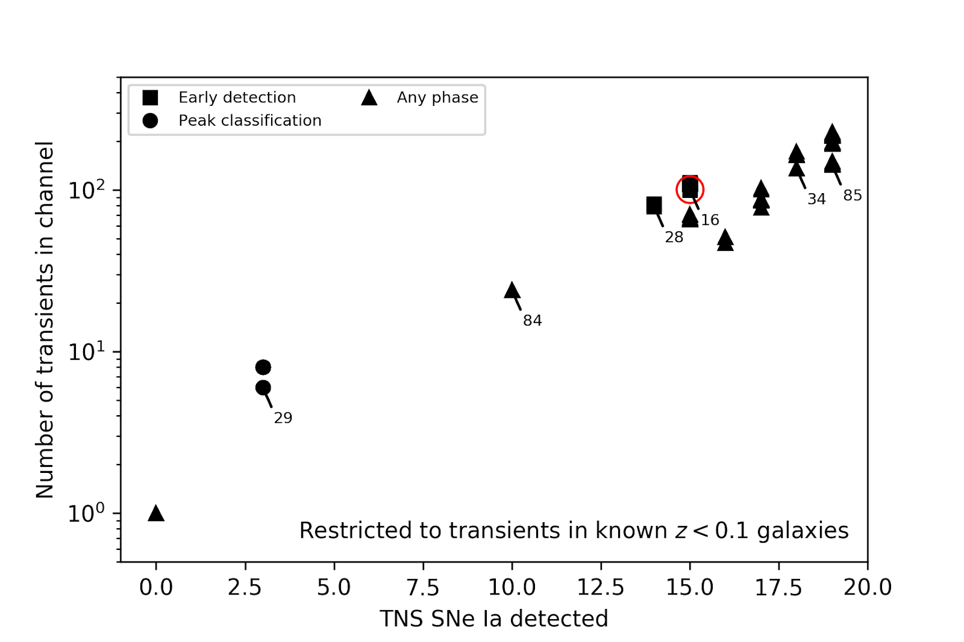
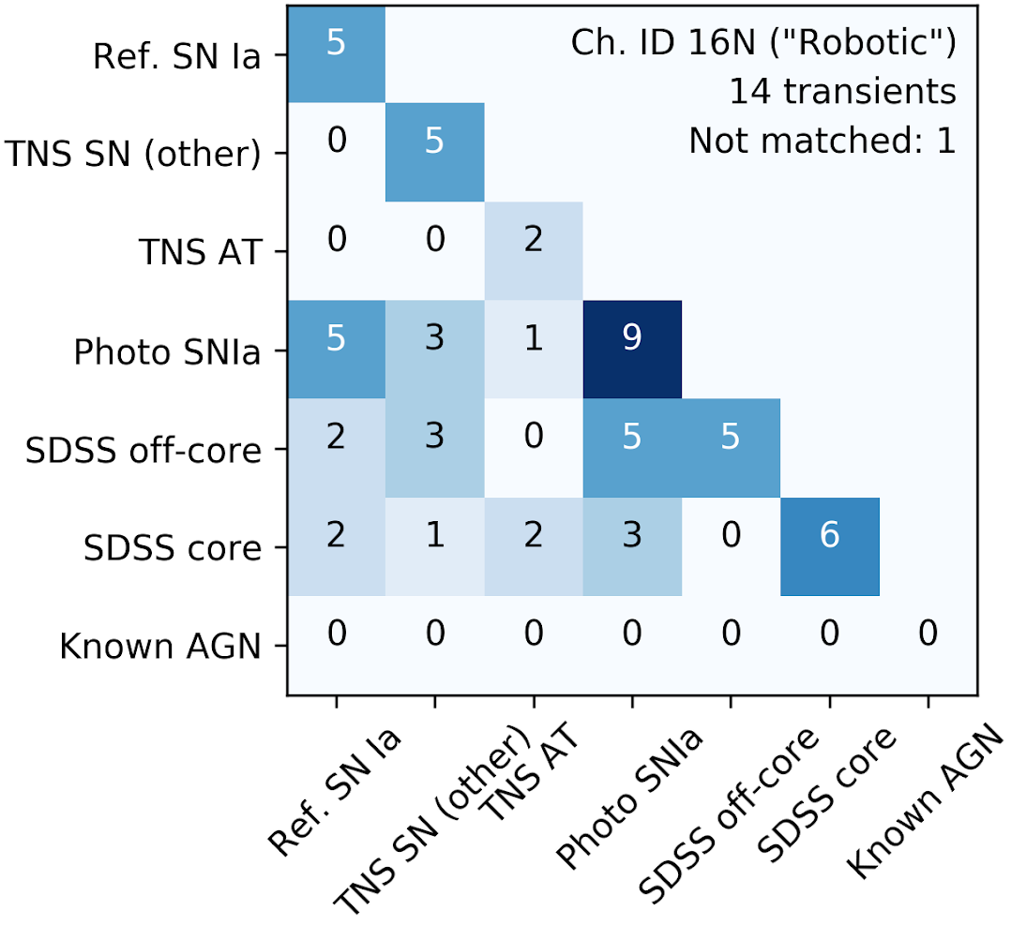

Robotic follow-up of infant SNe
Caught early
Using 2018 alerts to design automatic trigger criteria
We wish to observe transients even earlier.
The ZTF pipeline now delivers candidates within minutes of observations.
Next stage in transient astronomy is automatic follow-up decision and robotic telescope triggers.
LCO, LT and SEDM (soon) have capabilities for executing these.
In short: Two detections, recent non-detection associated with a spectroscopically confirmed nearby galaxy.
Using AMPEL for transient selection
Expected trigger rate ~1/week (in good weather).
Led by Jakob Nordin

Slide 13
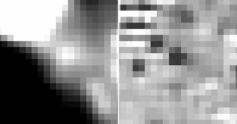
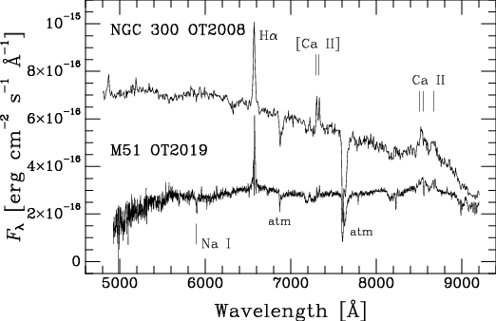
Intermediate Luminosity Transients
Caught early
ZTF19aadyppr/SN2019abn
Exploded in a dusty spiral arm of M51
Spitzer progenitor candidate at 4.5 µm
L~10^{5.5} L⦿, T~275 K
2012 outburst?
Pre-explosion IR brightening?
Multi-band light curves compared to SN2008S, but with significant host reddening: E(B-V) ~ 1 mag
Spectrum compared to NGC 300 OT2008 (small symbols) showing strong Hα, Ca II and [Ca II] emission.
2012 outburst?
Led by Jacob Jencson

Slide 14
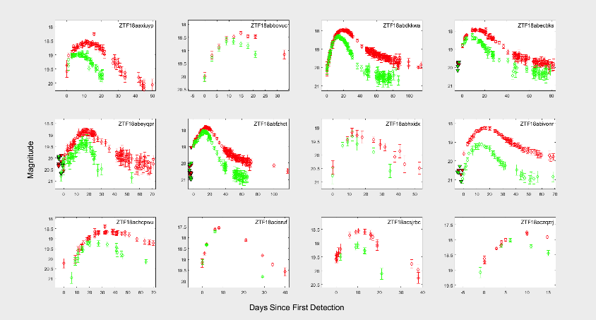
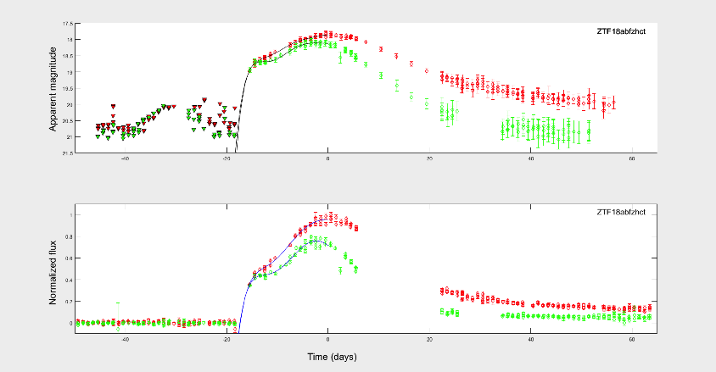
Stripped-Envelope Supernovae: Sample Studies
Characterising the light curve parameters and looking for correlation correlations between them
Led by Patrik Moquist

Slide 15
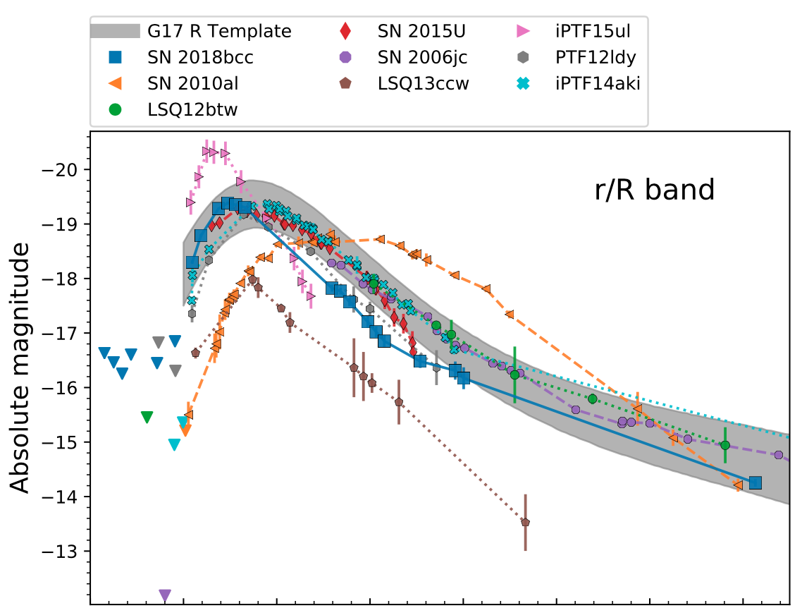
Stripped-Envelope Supernovae: SN2018bcc
Caught early
The first fast-rising Ibn SN from ZTF.
Bolometric LC too bright
and fast.
Not Ni powered, CSM
interaction preferred.
No evidence of SN ejecta in spectra or LC.
LC qualitatively matches PPISN models.
Otherwise an ordinary fast type Ibn SN.
Best example of rising shape and rising color lightcurve (LC) for a fast Type Ibn SN.
Detailed late-time spectra: able to explain the peculiar Helium I line strength ratios of Type Ibn for the first time
Helium line profiles argue for a dense but detached CSM shell.
Led by Emir Karamehmetoglu (draft in the TWIKI Paper store)

Slide 16
Stripped-Envelope Supernovae: ZTF18aalrxas
Caught early
A Type IIb SN from a very extended low-mass progenitor exploding during a period of strong mass loss
Extended envelope models give R~800 R☉
NLTE MC model
Ejecta mass: 1.7 M☉
Nickel Mass: 0.17 M☉
12 M☉ ZAMS mass
Flat H-alpha like SN 1993J
L(H𝛼) translates to ~0.15 M☉
Led by Christoffer Fremling

Slide 17
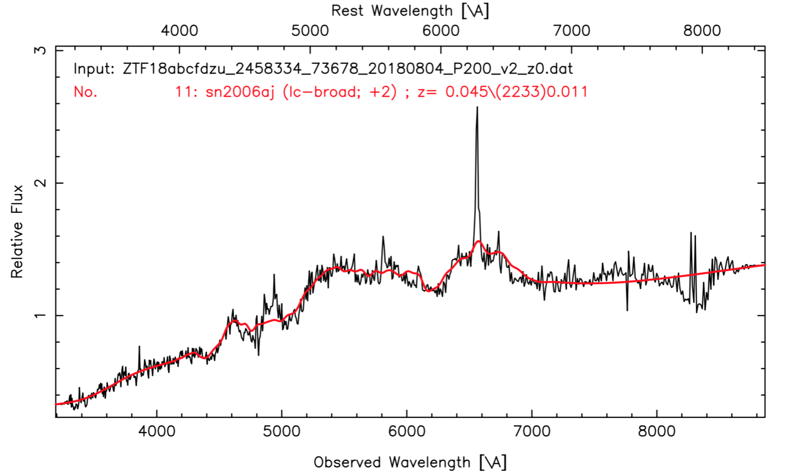
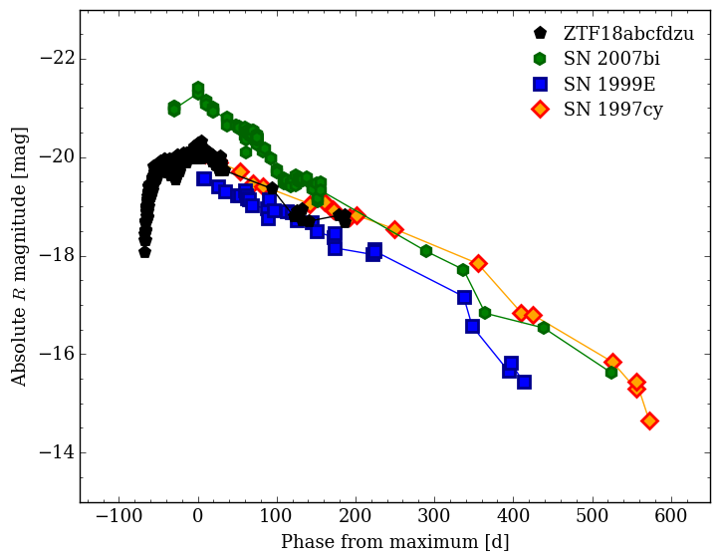
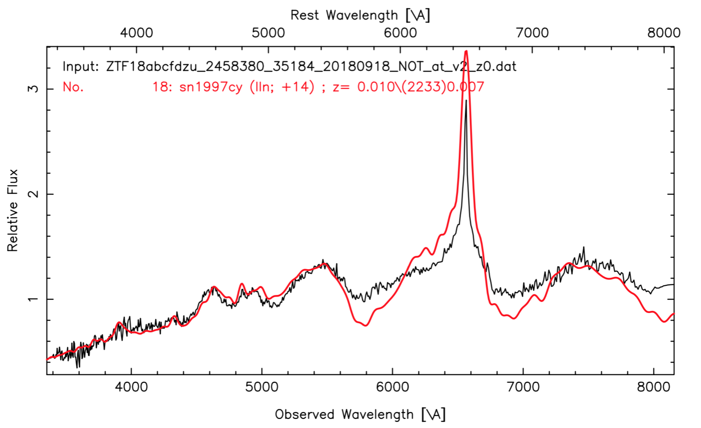
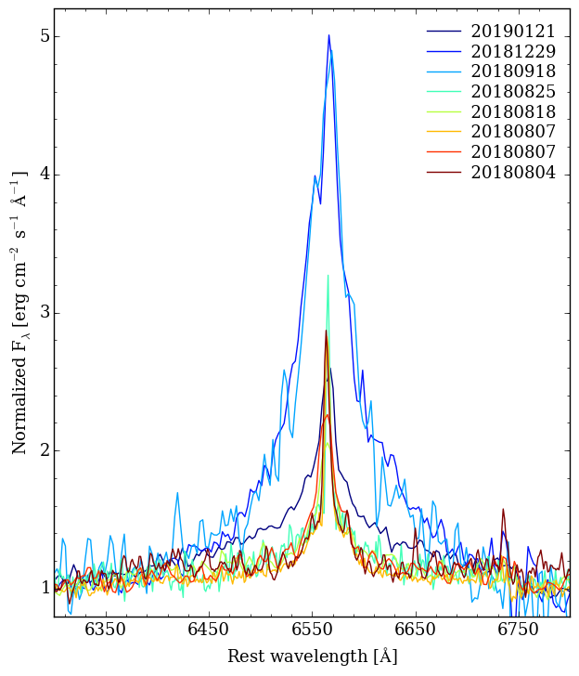
Stripped-Envelope Supernovae: ZTF18abcfdzu
Caught early
The metamorphosis of a board-lined Ic to a IIn supernova.
Significant evolution in the H-alpha profile over ~170 days
Evolution reminiscent of SN2017ens
Rise of ~100 days
Peak luminosity at ~-20 (but is likely to be higher due to reddening)
Led by Leonardo Tartaglia

Slide 18
Superluminous supernovae: Sample Studies
Dedicated filter calculating score based on light curve evolution and host galaxy properties
RCF a nice complement (e.g. found unexpectedly fast SLSN ZTF18aavrmcg)
Papers in prep: first ZTF SLSNe (Lunnan), the very slowly evolving SN2018ibb (Schulze)
ZTF is very efficient - 35 SLSNe found as of March 1, 2019
Currently evaluating results from Year 1 and making plans for systematic/automated search in Year 2 (with a goal of improving rates estimates)
Led by Ragnhild Lunnan

Slide 19
Superluminous supernovae: ZTF18acenqto
Caught early
Evidence for a shell expelled before explosion
ZTF18acenqto/SN2018ibb
Candidate pair-instability supernova
Joint project with ePESSTO under ZTF leadership
Among the slowest evolving SLSNe-I
Rise time of ~100 days
Narrow absorption features (width a few 100 km/s)
Extremely slow spectral evolution
Blue-shifted MgII (-3000 km/s)
Imaging polarimetry: P ~0%
Led by Steve Schulze

Slide 20
Conclusions
ZTF + extragalactic partnership survey allow to advance SN science in multiple dimensions:
  Obtaining high quality light curves in g and r for all objects
  Defining samples with minimal selection biases
  Catching the first and last photons of supernovae
  Probing new areas of the transient parameter space
We are aiming in answering questions on the SN progenitors, rates and ensemble properties.

