Slide 1
SEDM Performance and Upgrades
Don Neill
Michael Feeney
Richard Walters
David Hover

Slide 2
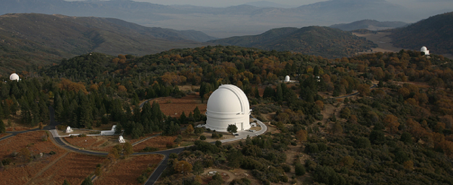
Facility instrument on P60

Slide 3
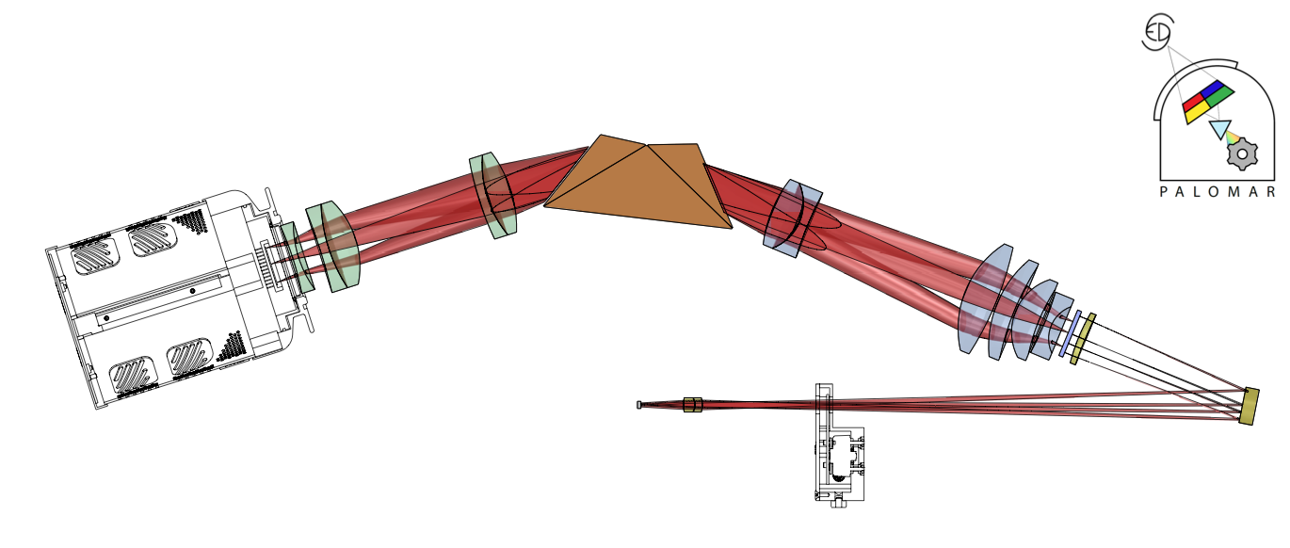
Hyperspectral Imaging Spectrograph

Slide 4
Outline
Current performance
TOO program
SEDM instrument challenges
Future upgrades

Slide 5
Current performance
New MLA
  Throughput similar with new MLA, however:
    Scattered light reduced
    Old MLA throughput may have been artificially boosted by scattered light
    Single image mode now standard, A/B no longer used
Running both pipelines (old and new)
  New Pipeline (see M. Rigault’s talk next)
  Soon only new pipeline
  Soon real-time uploads
More reliable
  Airmass constraint: <= 1.8
Operations status
  See Nadia’s talk on Wed.

Slide 6
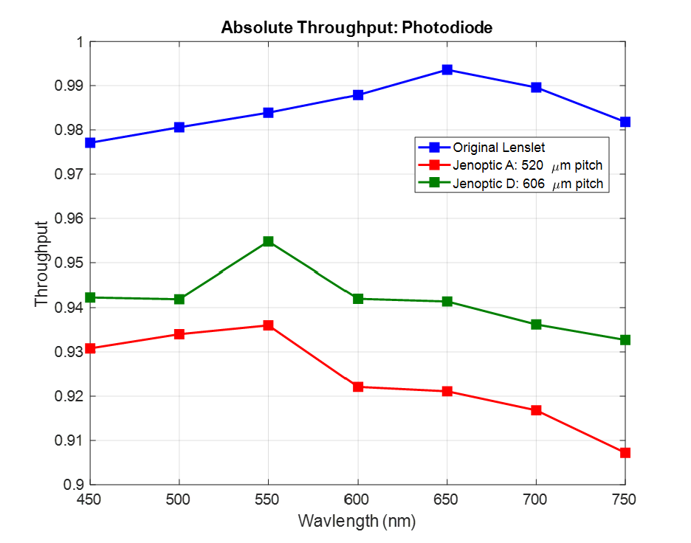
Absolute MLA Throughput
Measured absolute throughput using photodiode. Ratio of measured power with and without the MLA. New MLAs have AR and masking.

Slide 7
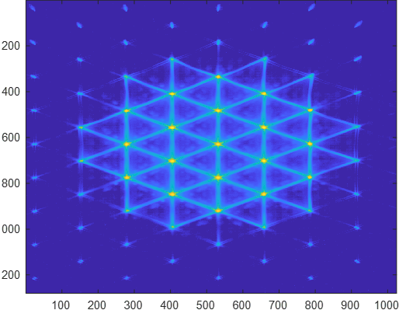
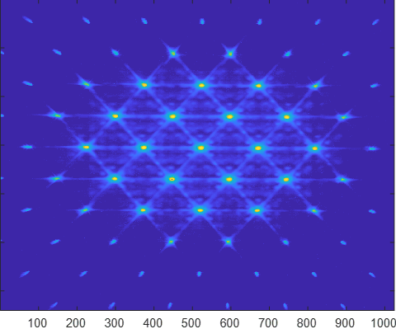
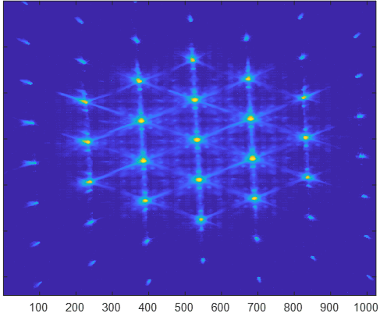
Compare Normalized Image of micro-pupils (log scale)
Original MLA
Jenoptic A (520)
Jenoptic D (606)
New MLAs have have less power in the “wings”.
Masking cuts throughput but controls light better.
Installed Jenoptic A

Slide 8
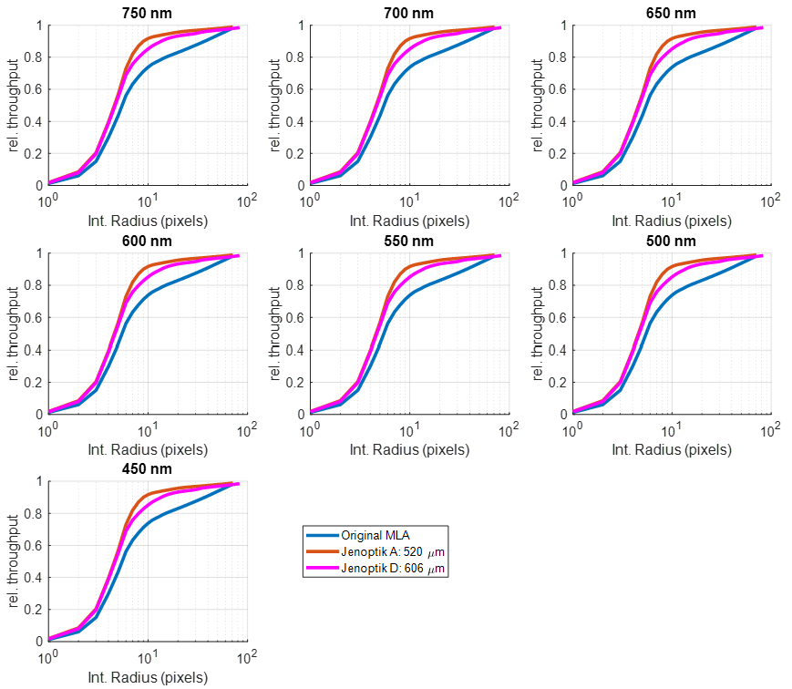
Throughput vs Integration Radius
Green dashes indicate current DRP extraction radius
Integrate detector counts on all centroids, normalized by all detector counts
New MLAs have shallower diffraction tail (greater than 10 pixels)
Currently Jenoptic A installed
X-axis is for test setup. There is a 3 (Test):1 (SEDM) pixel ratio

Slide 9
Gross Efficiency
Before new MLA
20180617 BD+28d4211
After new MLA
20180619 BD+28d4211

Slide 10
Jenoptic A
Installed on
2018 June 19

Slide 11
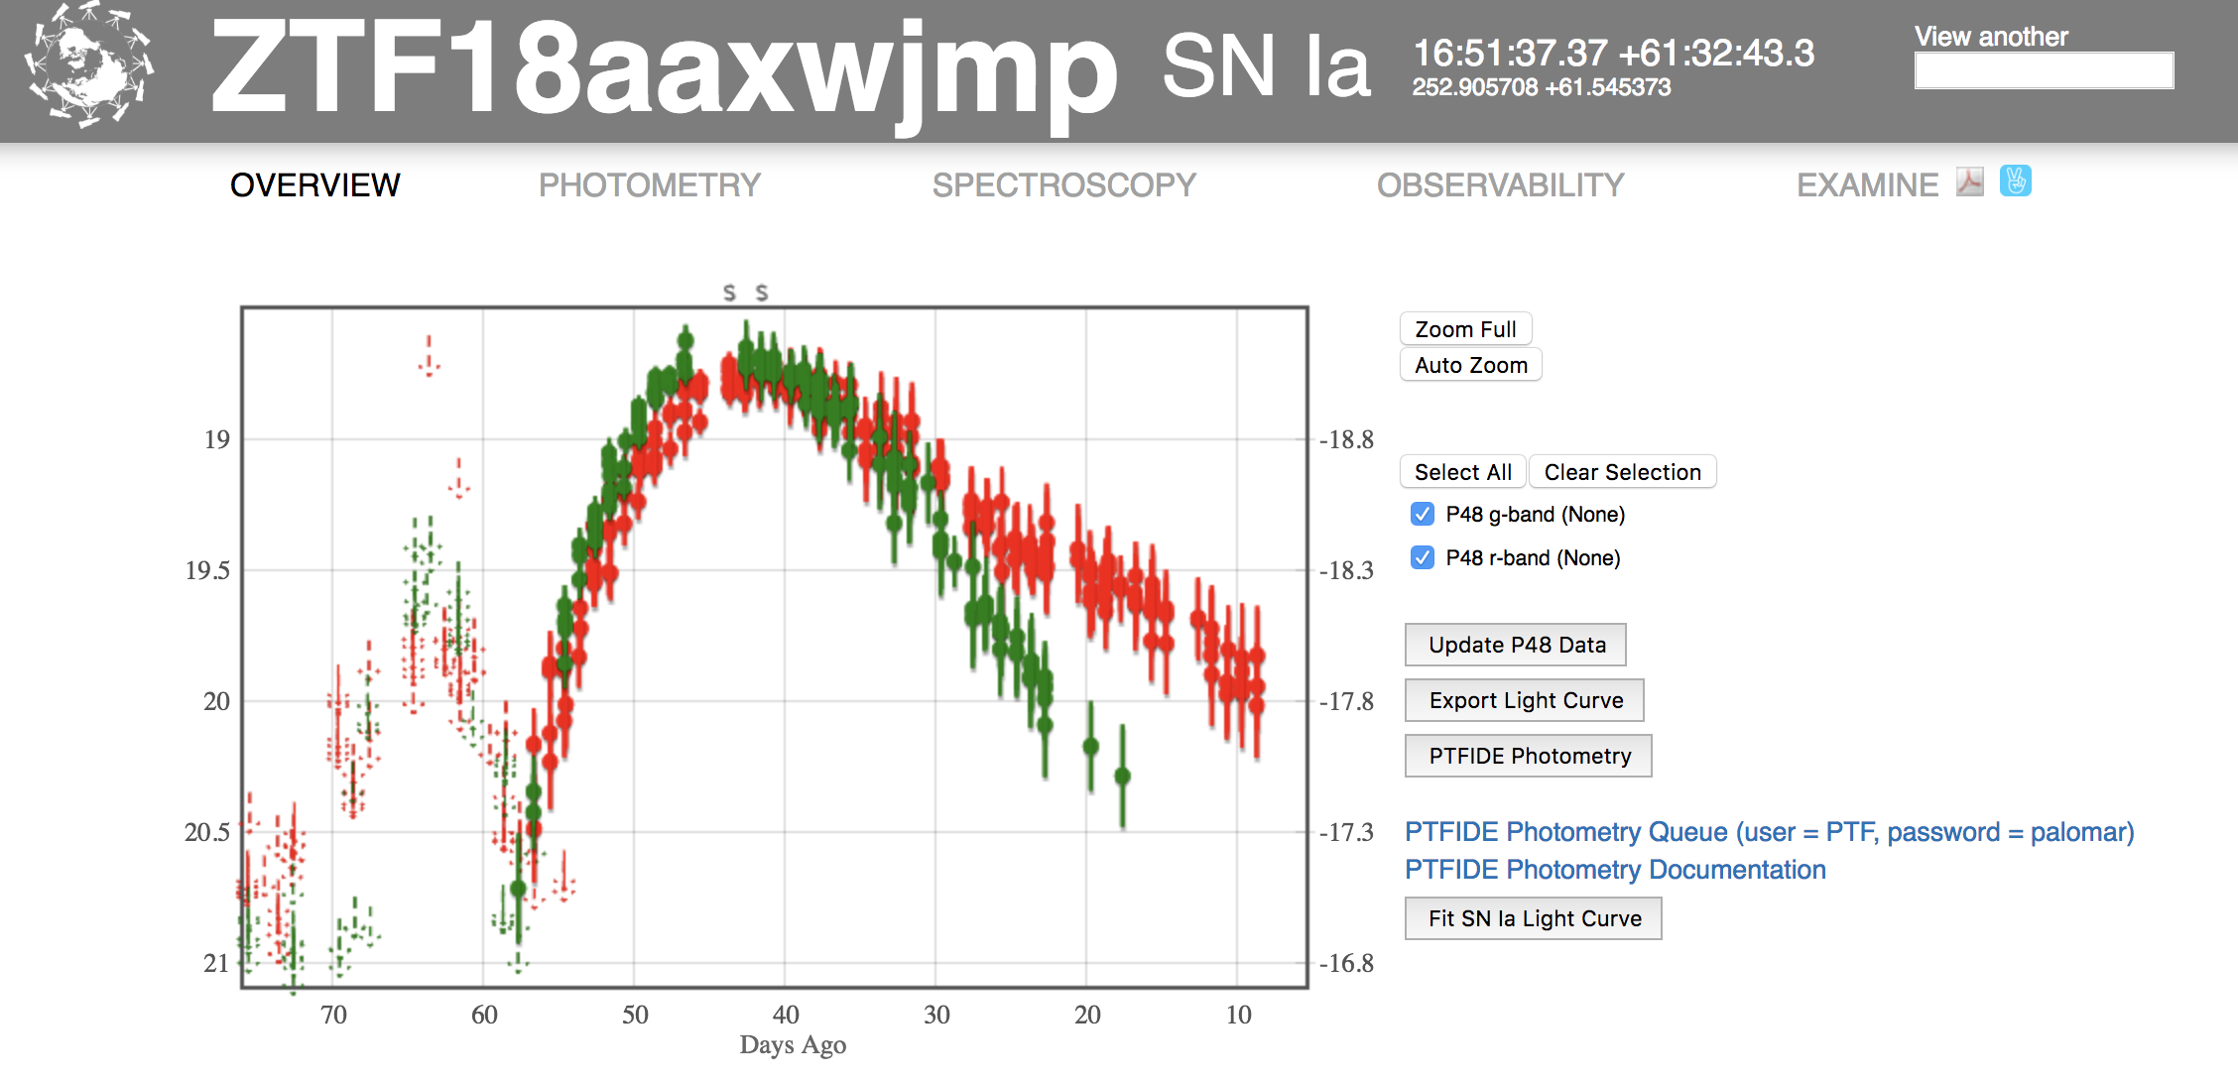
New MLA installed

Slide 12
MLA Upgrade Performance
Old MLA: 2018 June 18
A/B pair 18.7 g mag 2700s
New MLA: 2018 June 20
A/B pair 18.7 g mag 2700s

Slide 13
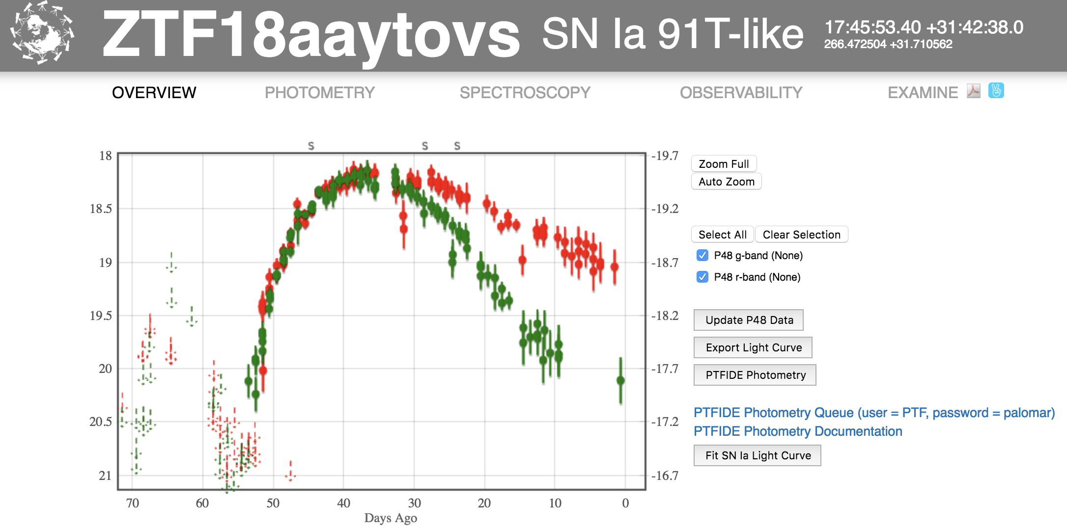
New MLA installed

Slide 14
MLA Upgrade Performance
Old MLA: 2018 June 17
A/B pair 18.5 g mag 2700s
New MLA: 2018 July 03
Single 18.5 g mag 1600s

Slide 15
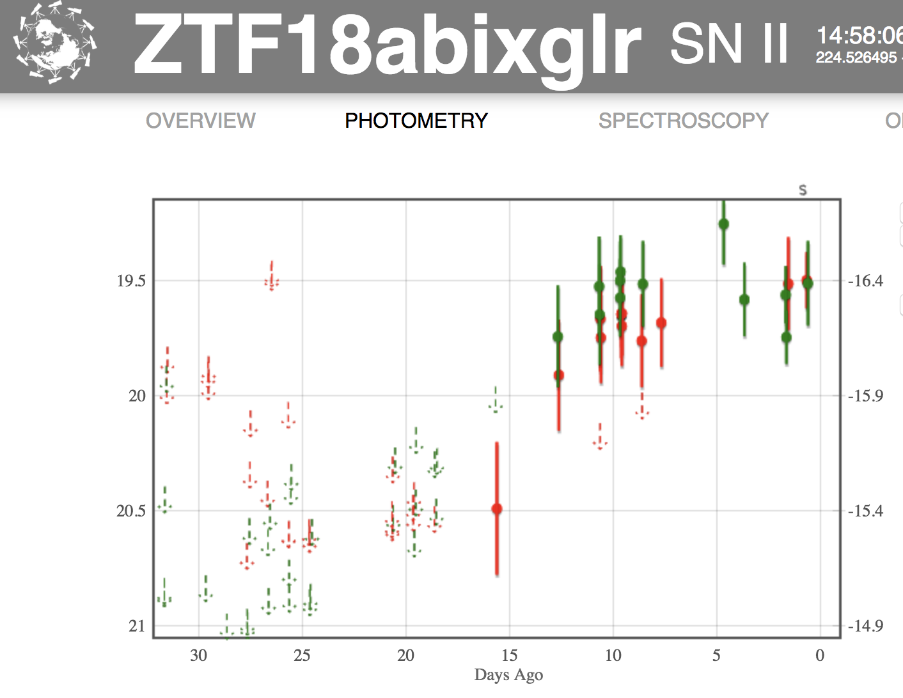
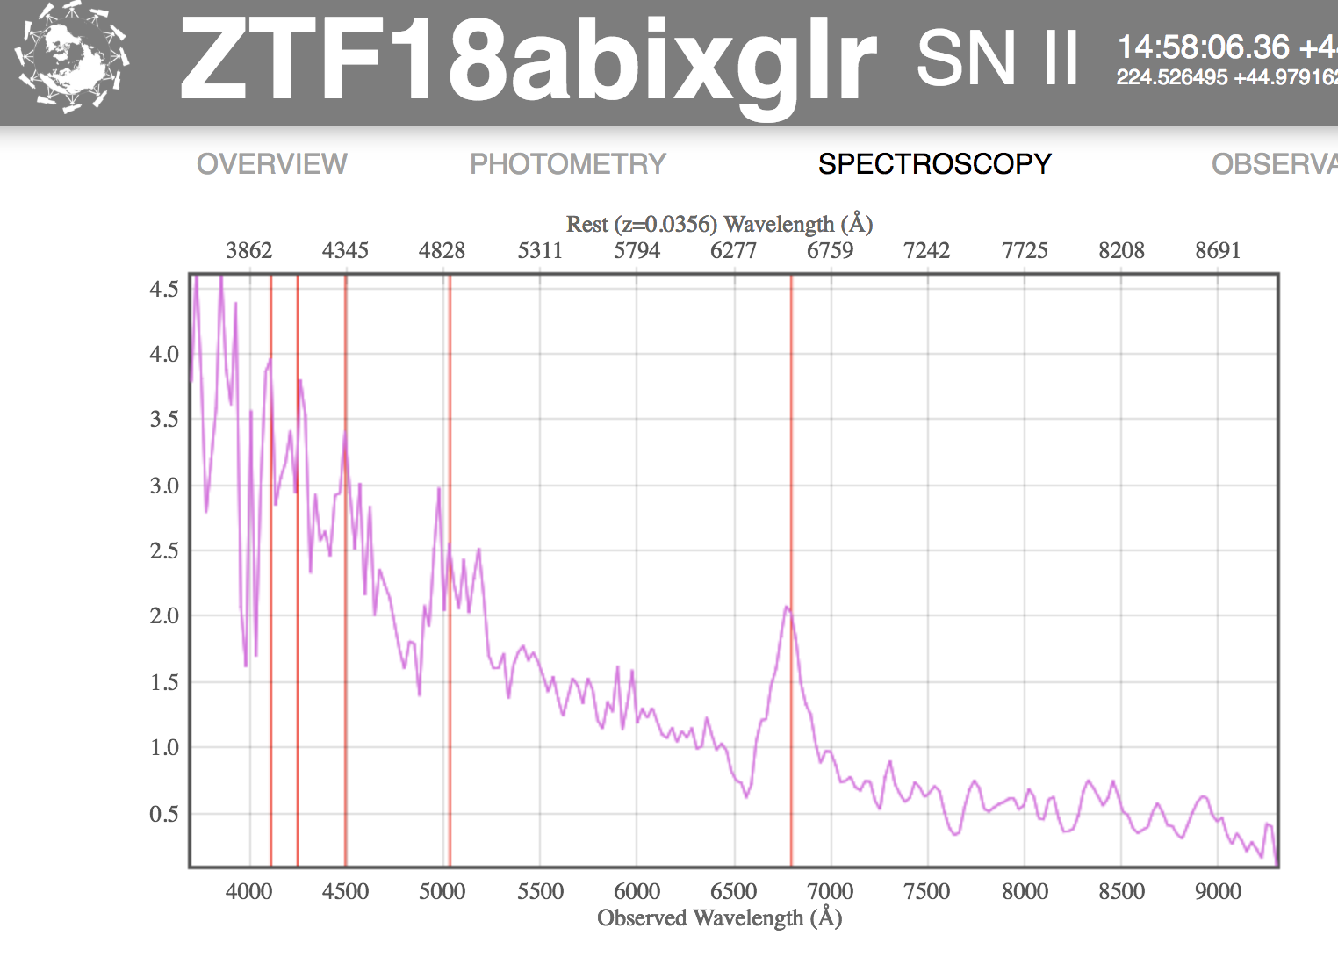
Pushing fainter: ZTF18abixglr at 2430s

Slide 16
MLA Upgrade Performance
Gross throughput marginally improved
Scattered light greatly improved
Allows single, shorter exposures for comparable S/N
Allows fainter objects to be classified

Slide 17
TOO Program
Will interrupt ongoing observation
SWIFT GRB early-time spectra
Uses GRBCam react script
Have observed every possible trigger
  Other triggers were during daylight or outside dec range

Slide 18
Swift805318
GRB180115A
14m 27s after event

Slide 19
Swift808625
GRB180205A
18m 40s after event

Slide 20
Swift843122b
GRB180620A
1h 02m 32s after event
If H𝛂, z = 0.21

Slide 21
SEDM Challenges (I)
Pointing reliability
  Related to astrometry solutions, pointing seems to be OK
    Astrometry failures attributed to clouds
  Eliminated secondary as source of pointing variation (using dial indicators)
    M2 motion < 0.15” slewing from zenith to 35 deg above horizon N/S and to 3.67 Hr E/W
  Added pause before IFU offset
    Helps with science ACQ, but standards still float more than expected
    Maybe due to astrometry solution for standards?

Slide 22
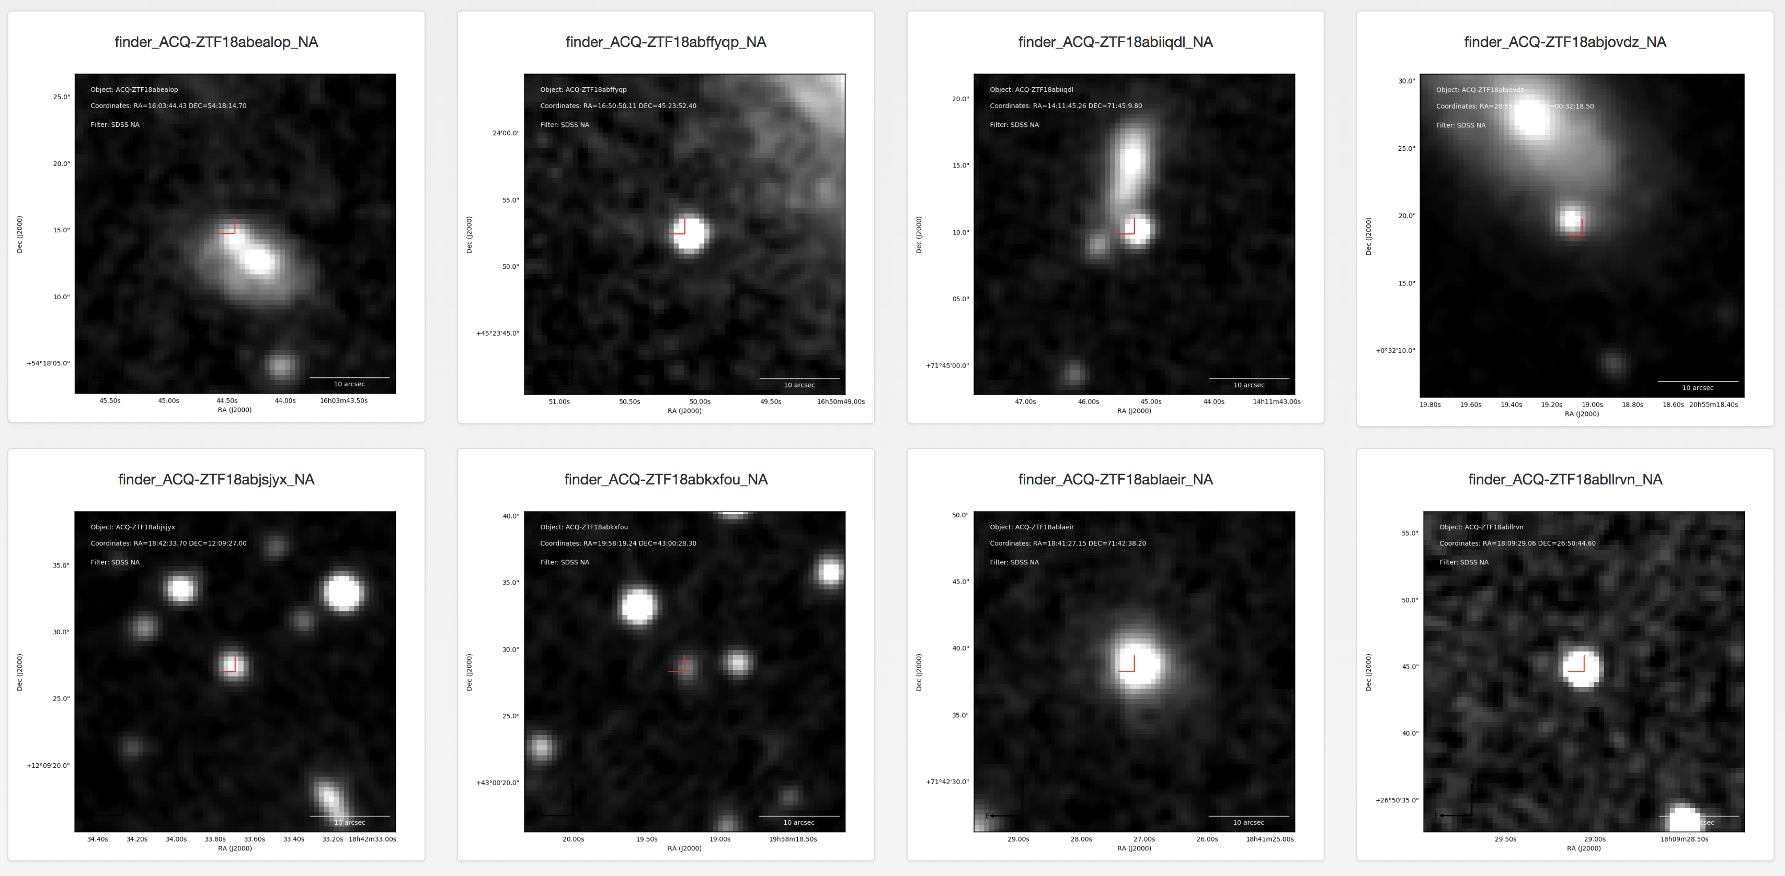
SEDM Acquisition (typical)

Slide 23
SEDM Challenges (II)
Camera reliability
  Failure of cooling units
  Loss of communication due to poor cable handling
  Expensive repairs
  Airmass limit of 1.8 implemented 2018 May 25
  No issues since, but limits sky access
Scattered light
  New MLA
  Enclosure not air-tight, allows condensation

Slide 24
Addressing the Challenges
New enclosure/base
  Better cable handling (removes airmass limit)
  Air-tight enclosure (dry air feed removes condensation)
New Cameras
Review
  Ensure new design will meet specs

Slide 25
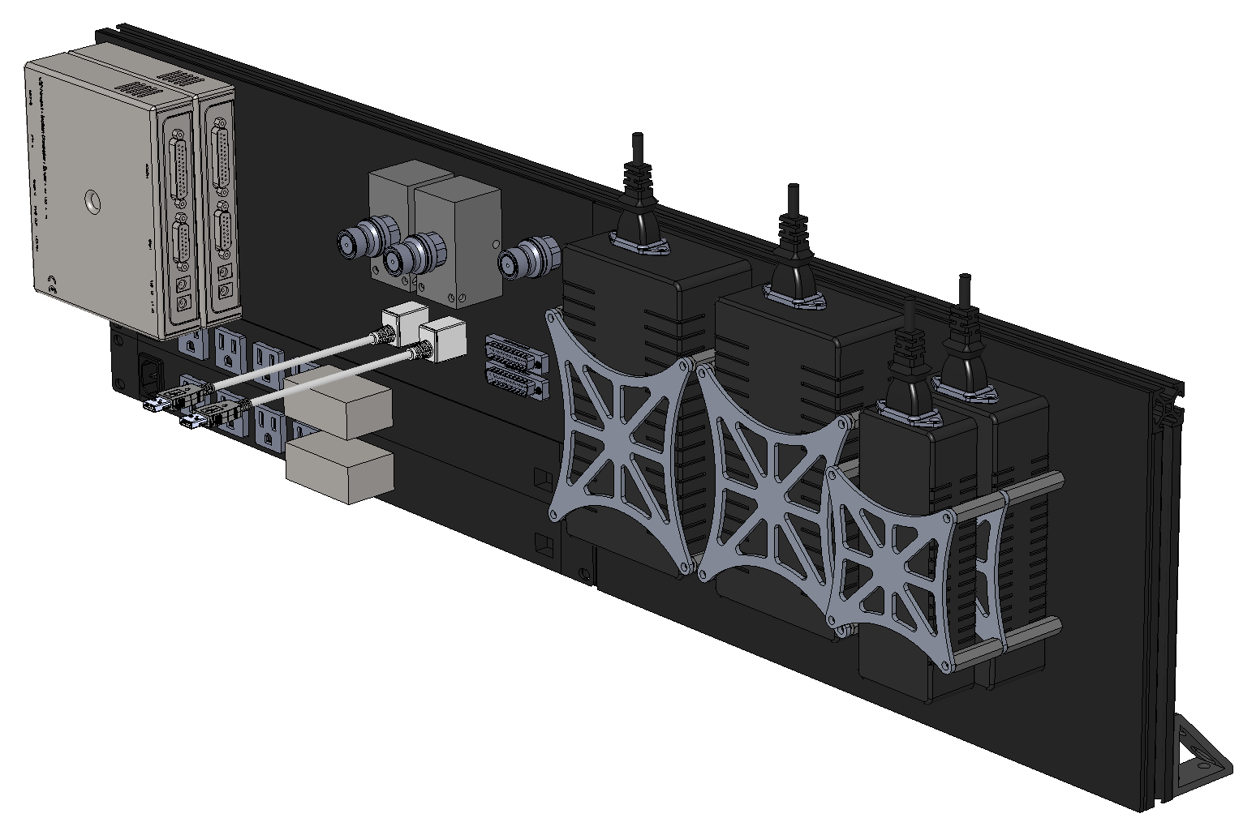
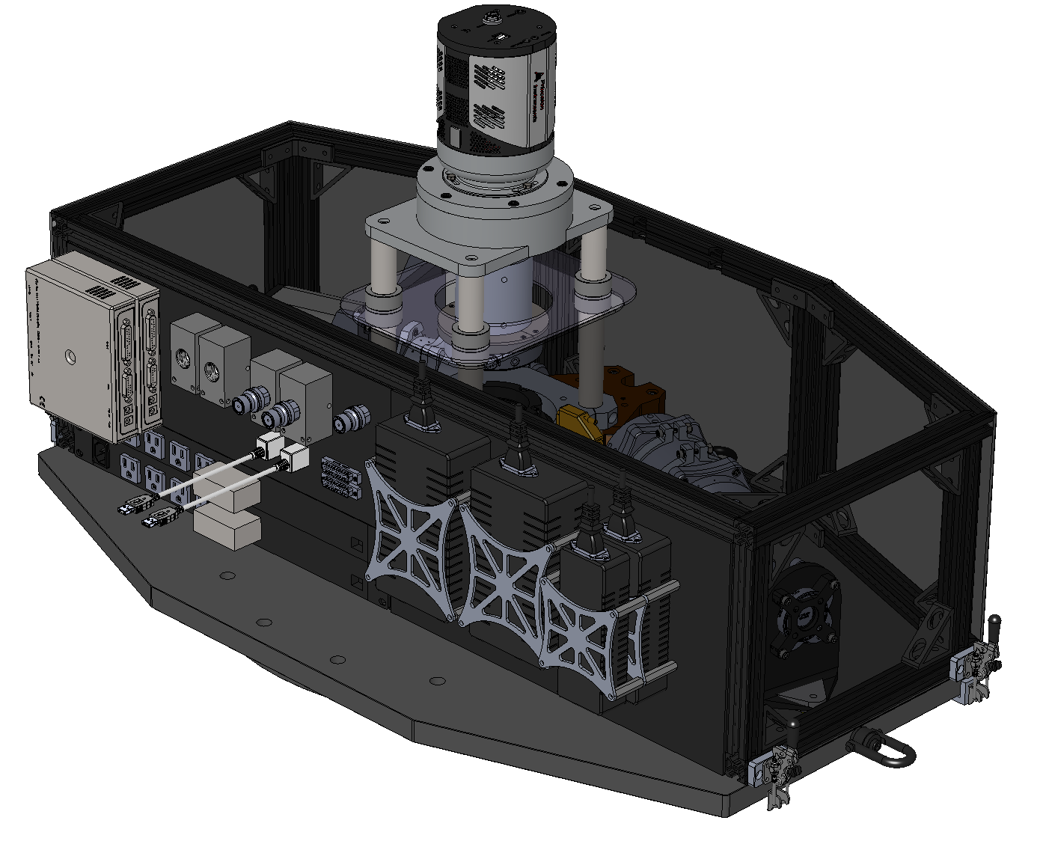
SEDM: Future Plans
QDC Manifold Glycol Plumbing
Dry Air Supply
Removable Enclosure
2X NPS
(Remote Shutoff)
IO Bulkhead Connectors
Why new optical bench?
Current curved profile of the optical bench makes the enclosure framework segmented and complicated (the current enclosure is terrible). Difficult to curve acrylic.
Benefits from a new bench outweigh the cost (<$3000). Doing it correctly vs. bandaid approach
Adapting the existing bench will require setup fee
New bench will give more space for electronics handling
Much lighter (current design has no light-weighing and unnecessarily heavy)
Integrated tapped holes for enclosure and IO panel
Better accessibility to instrument mounting bolts
PSU Management
New Optical Bench
Instrument IO Panel

Slide 26
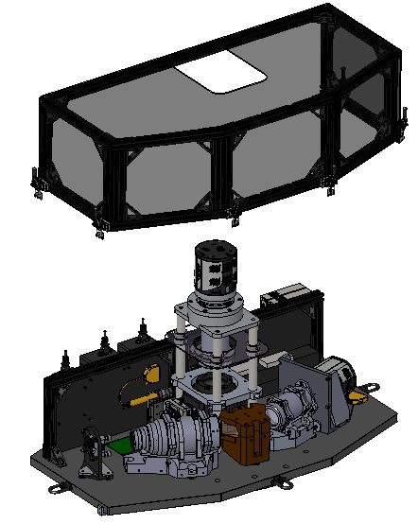
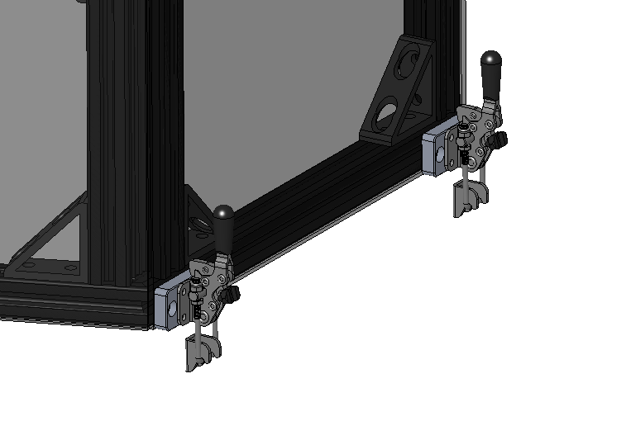
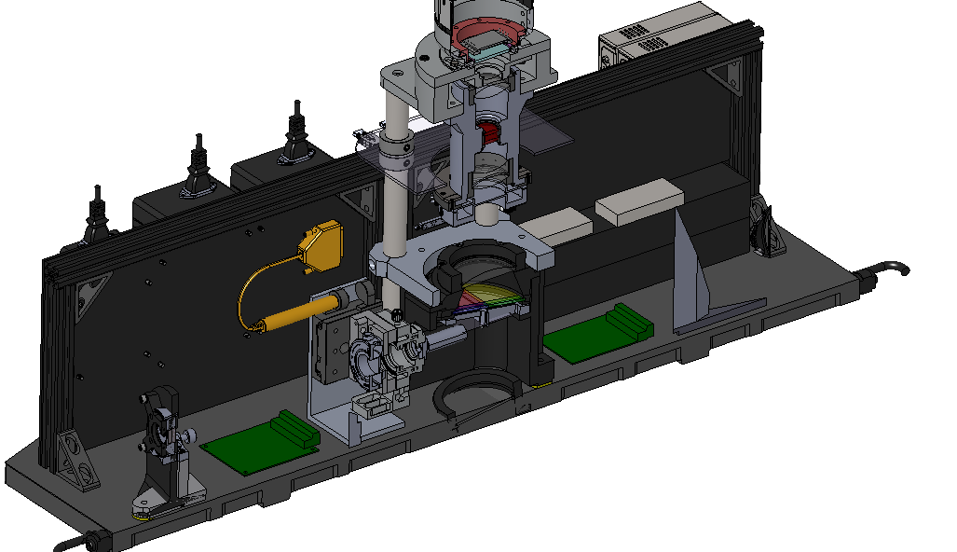
SEDM: Future Plans
User-friendly, quick release, sealing enclosure. Cushioned rails for sealing, black acrylic paneling, toggle clamps for releasing.
All optical components tied to optical bench
Existing mounts can be reused and transplanted onto new bench.

Slide 27
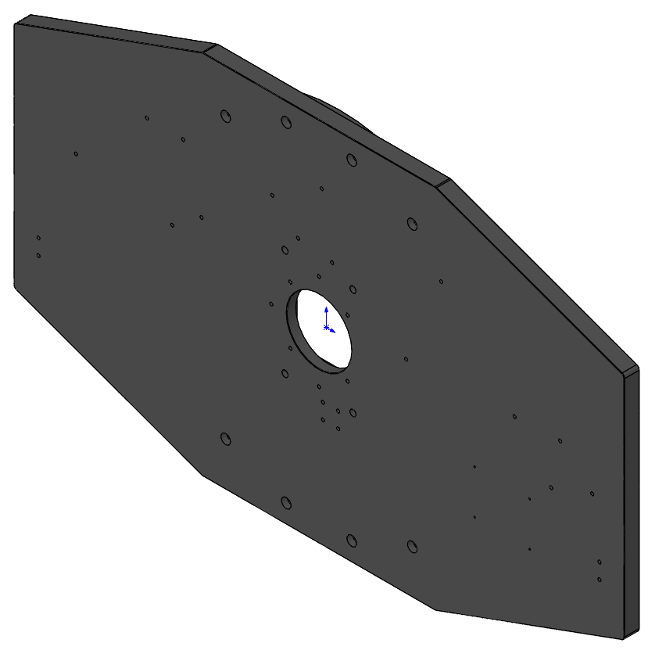
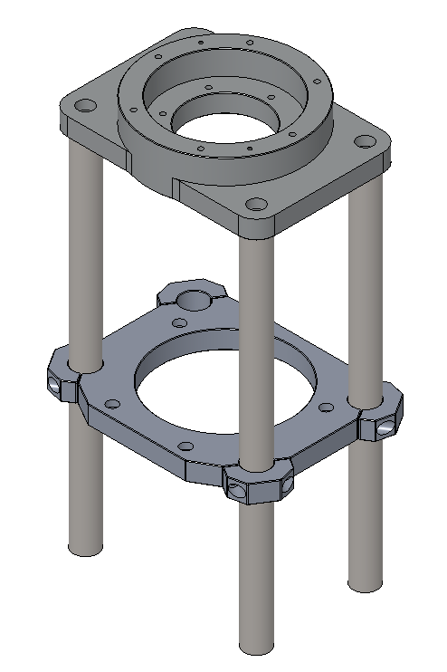
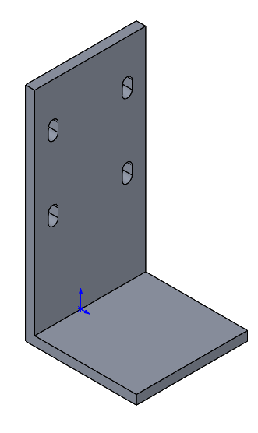
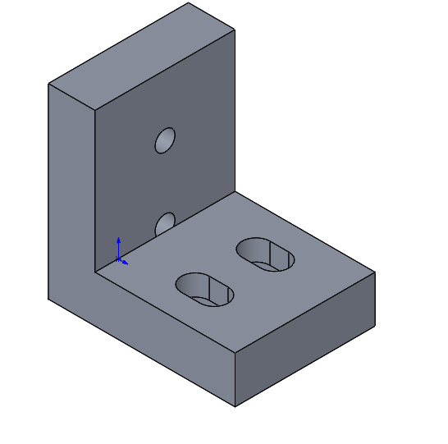
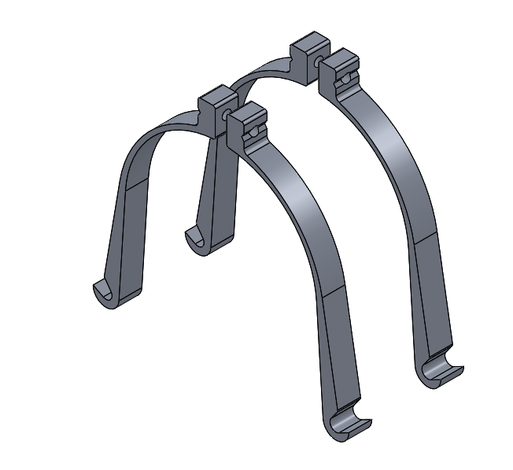
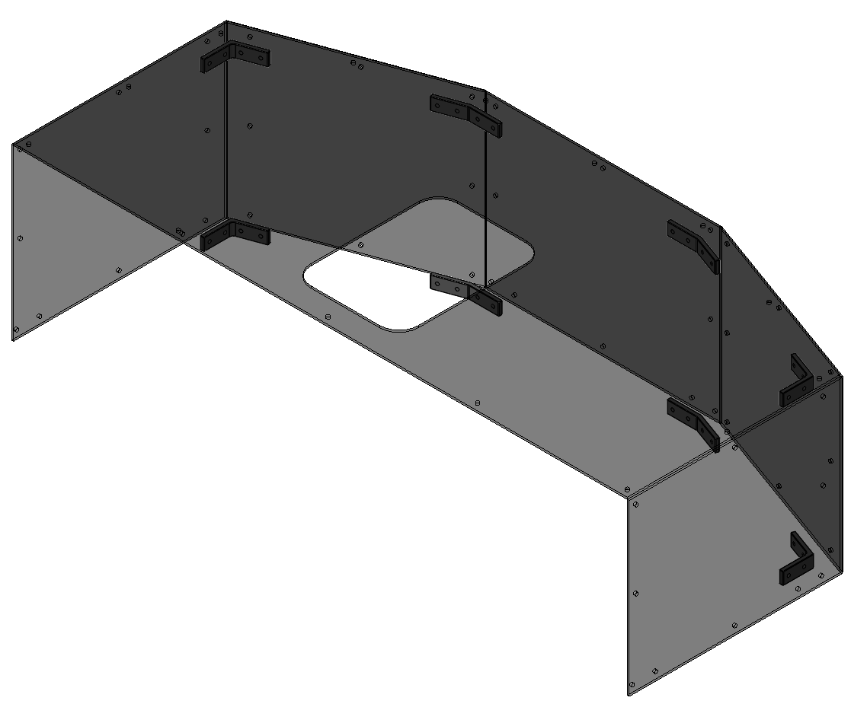
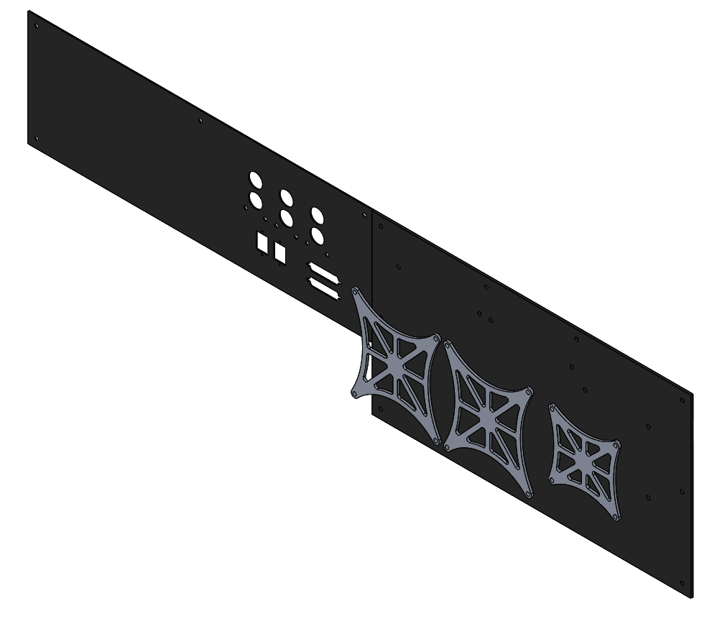
Cost Estimate: Manufactured Parts
Component | Price [$]
Optical Bench | $3000
Rainbow Camera Mount | $2000
Various L Brackets | $500
Lens Barrel Straps | $500
Enclosure Panels + Brackets | $1000
IO Panels and Brackets | $1000
TOTAL | $8000

Slide 28
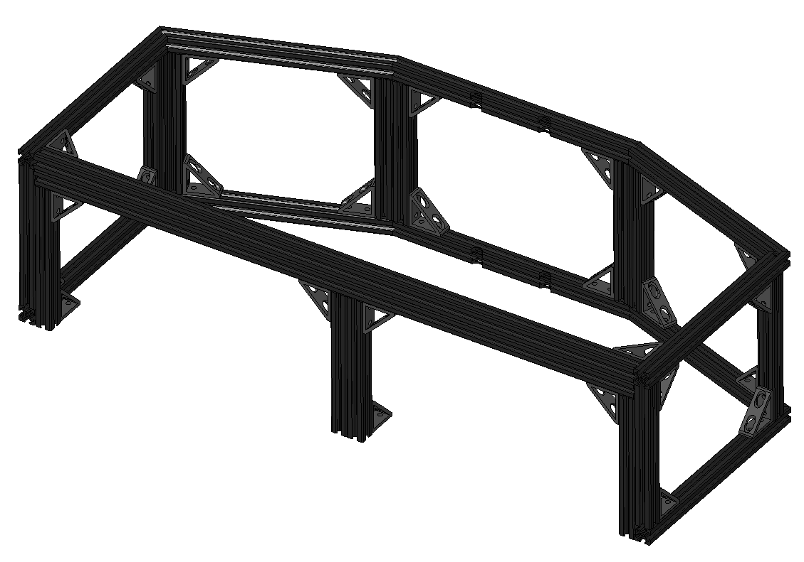
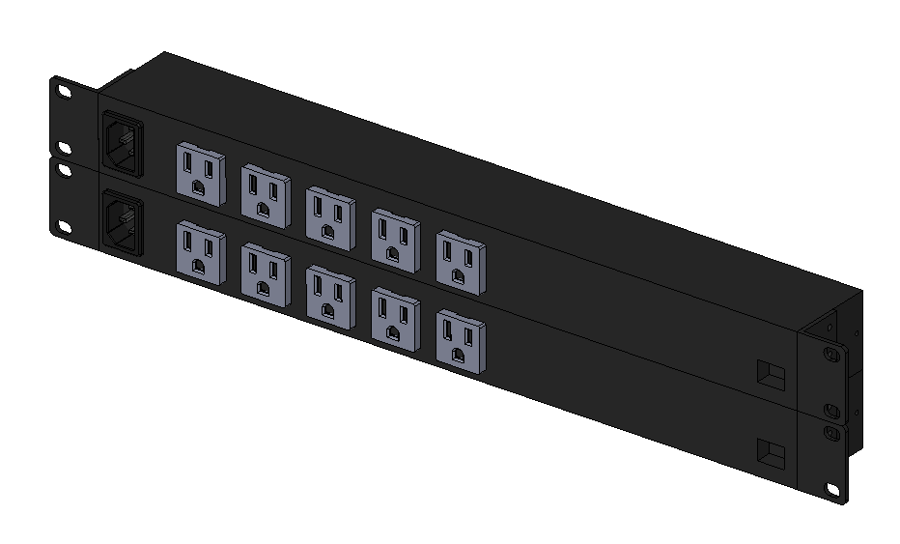
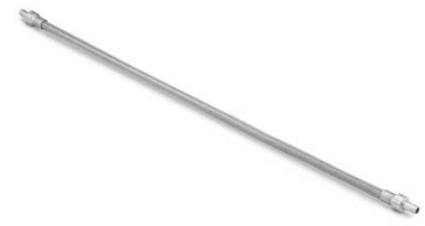
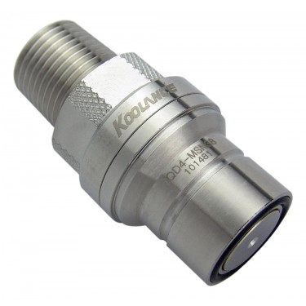
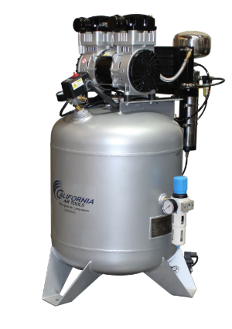
Cost Estimate: COTS Parts
Component | Price [$]
McMaster | $350
8020 Extrusion | $500
NPS’s | $500
Plumbing | $1000
Dry Air Compressor | $1500
Electrical Connectors + Cabling | $500
TOTAL | $4350

Slide 29
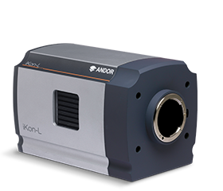
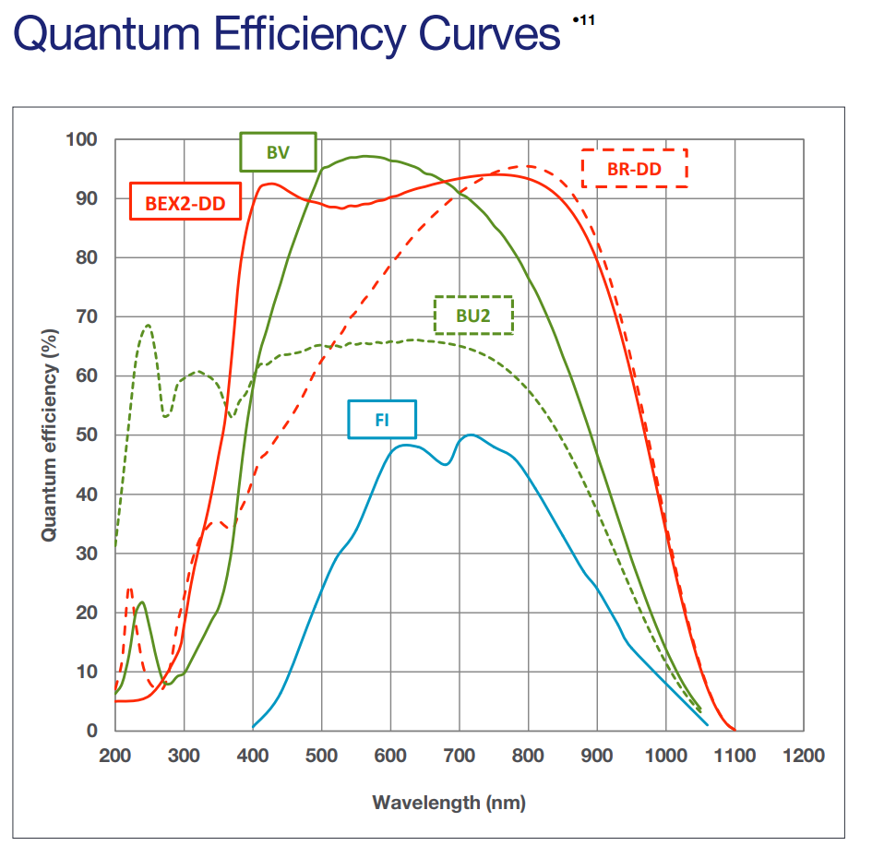
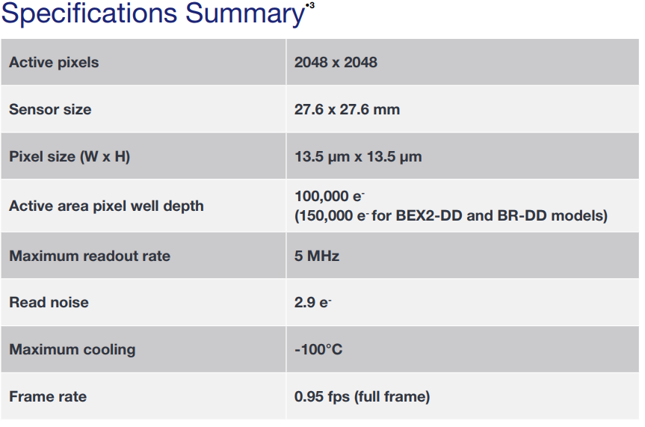
Cost Estimate: Cameras
BEX2-DD: $85,000
BV: $53,500
Pixis: $64,000

Slide 30
Cost Estimate Totals:
$12,3500
$119,3500
$182,3500
Camera decision will impact upgrade design
as well as total cost

Slide 31
SEDM in production
Documentation
  www.astro.caltech.edu/sedm
Current status
  pharos.caltech.edu/login
New pipeline
  github.com/MickaelRigault/pysedm

