Slide 1














Overview of ZTF Performance
Team Meeting, Stockholm – 6th August 2018
Matthew J. Graham
ZTF Project Scientist

Slide 2

Performance goals
Scheduler:
  40% MSIP, 40% partnership, 20% Caltech
  ToOs
Telescope system:
  <40s> between observations
  <10s> slew
  Focus: 2” in r, 2.2” in g
Data system:
  <20 min> between acquisition and distribution for alerts
Public alert stream May/June 2018

Slide 3

Memorable dates
(November 2017 – first light)
March 17, 2018 – start of survey operations (snowed)
April 4, 2018 – first use of filter exchanger
May 24, 2018 – first ToO
June 4, 2018 – start of public alert stream (240 GB to Aug 1)
June 12, 2018 – first NEO ToO

Slide 4
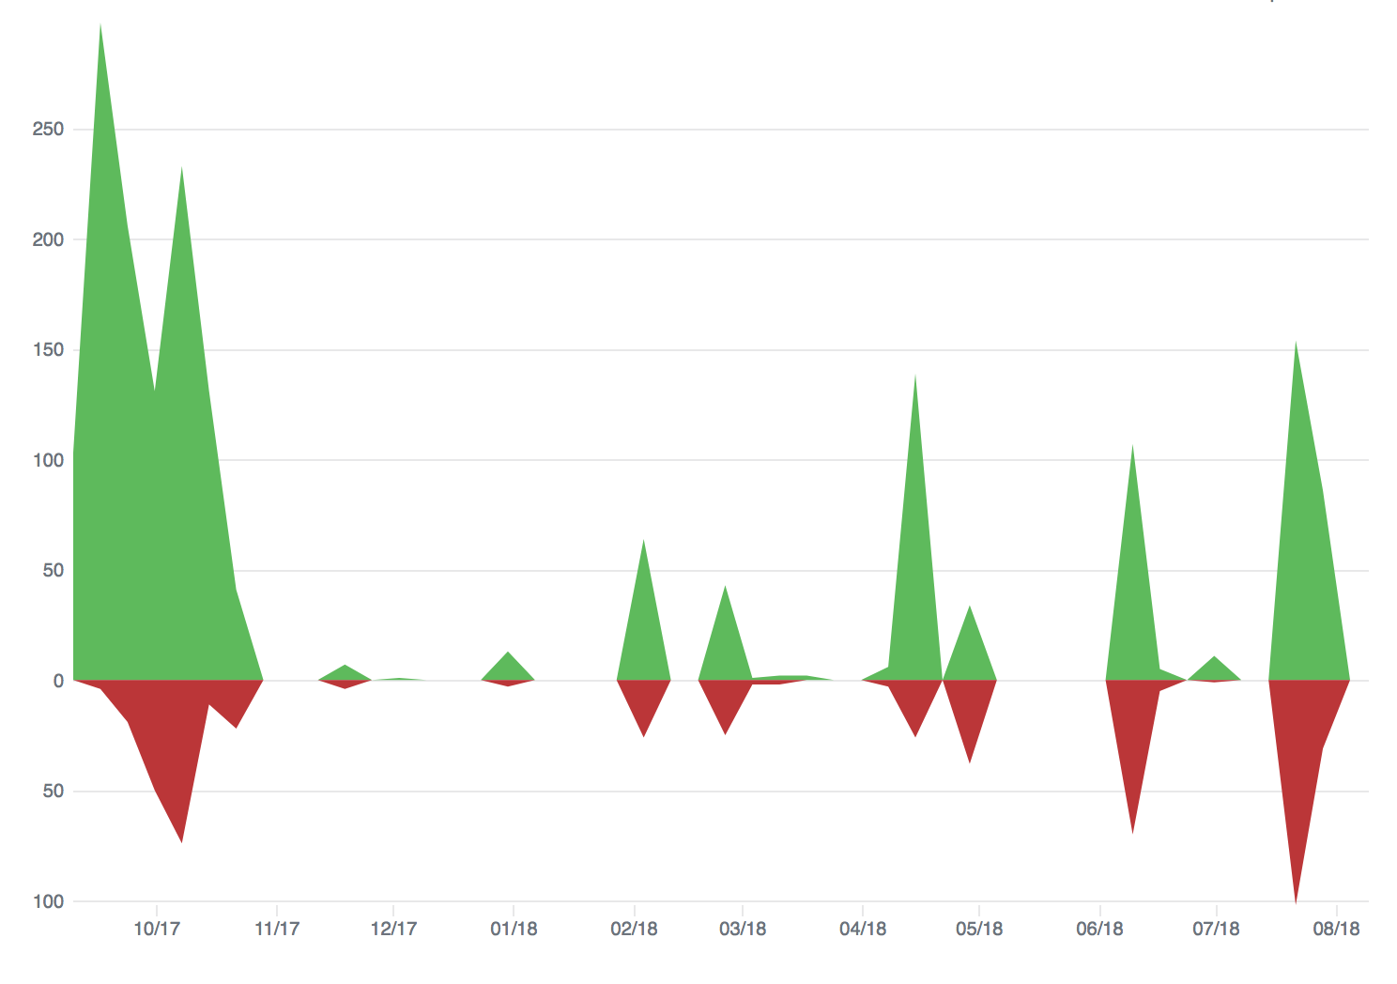
Evolving systems
ROS: 0.82 -> 0.97
TCS: …
ZSDS: 328 commits since Mar 17th
Alert packet: v1.7 -> v3.0
RB: t6_f4_c3 (04/04) -> t12_f5_c3 (08/06)
Marshal: …
Scheduler

Slide 5


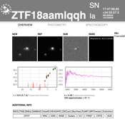


ZTF: The current big picture
…
MARS

Slide 6
Observing performance (137 nights to Aug 1)

Slide 7
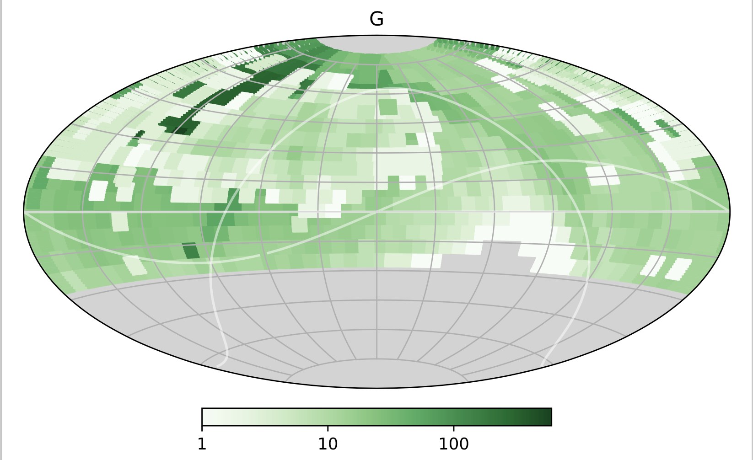
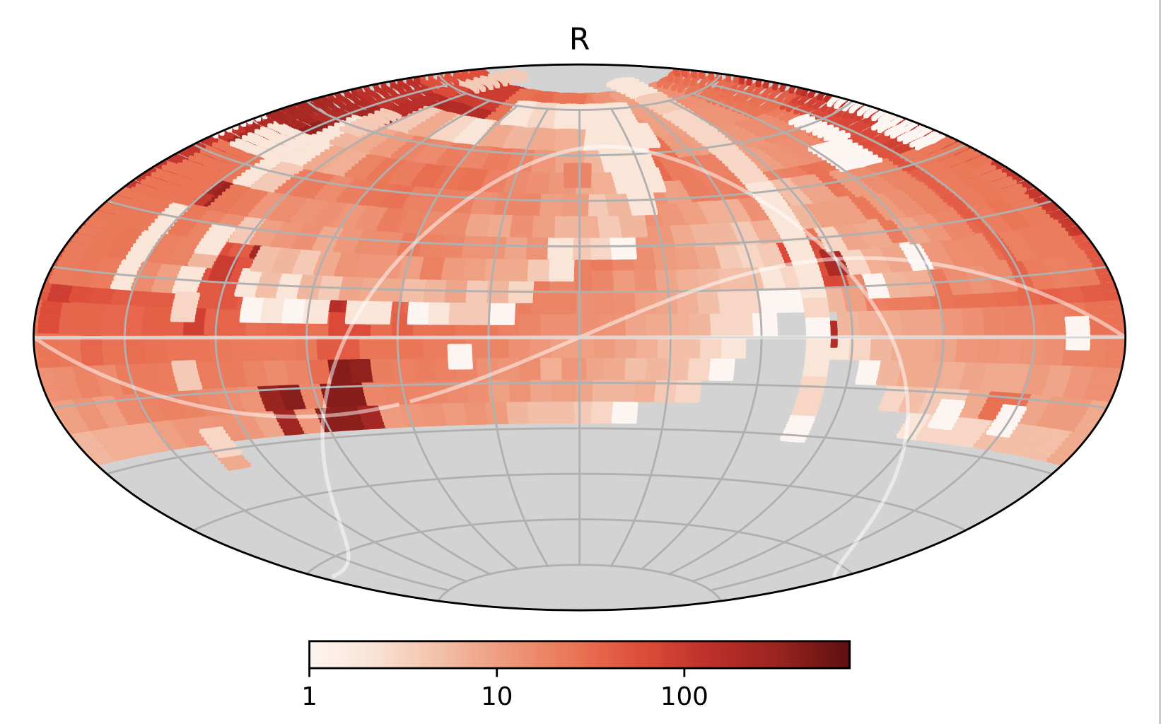
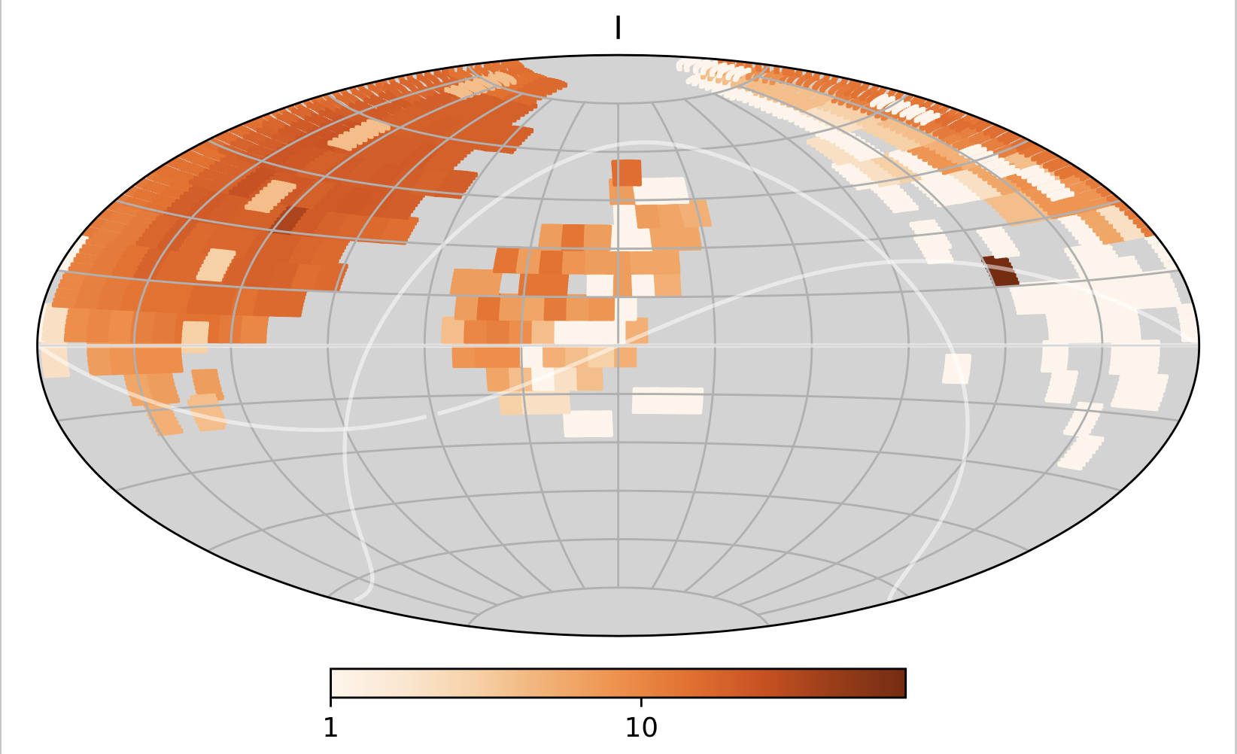
Where have we observed so far?

Slide 8
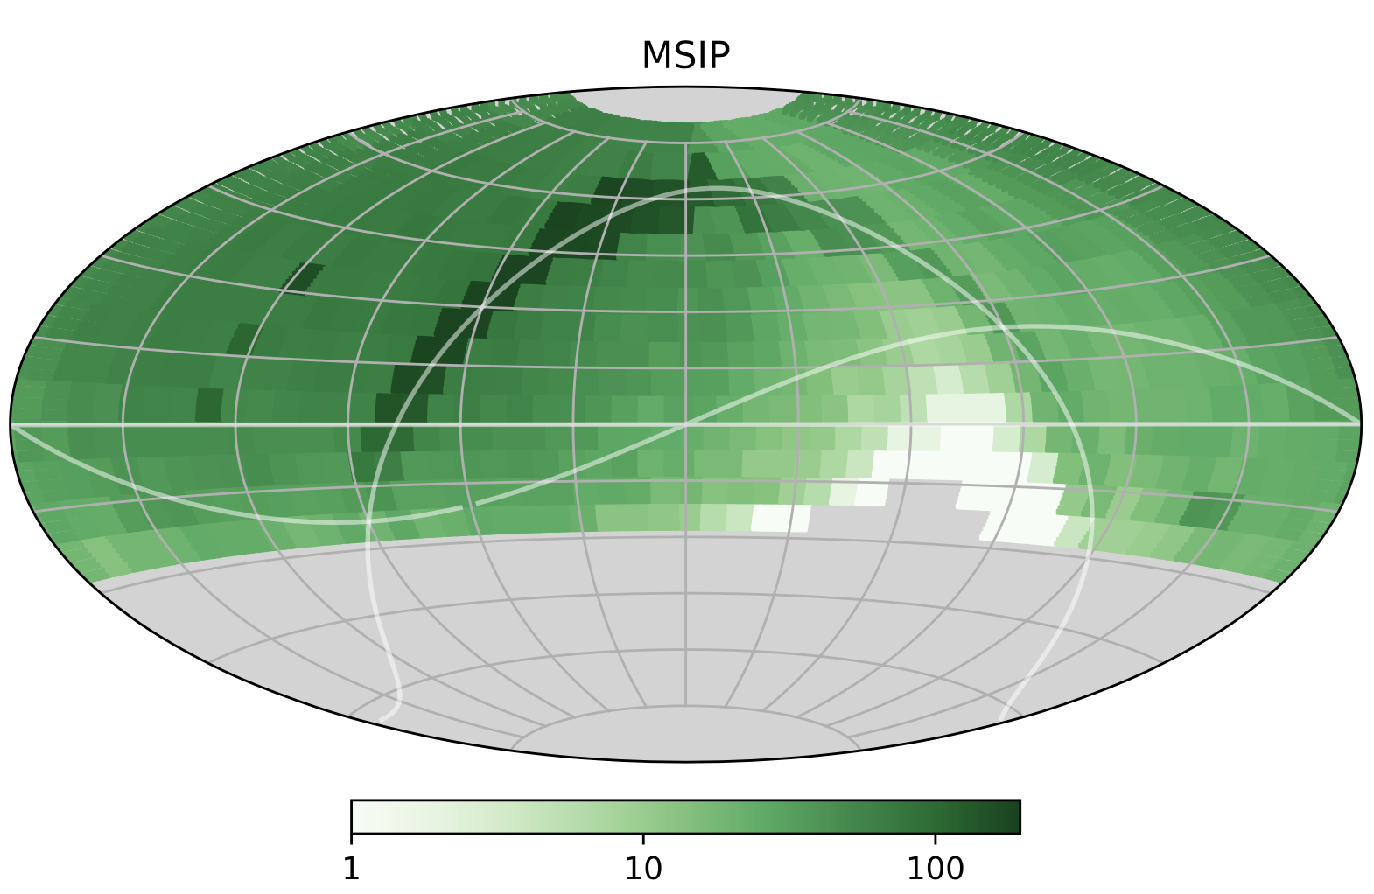
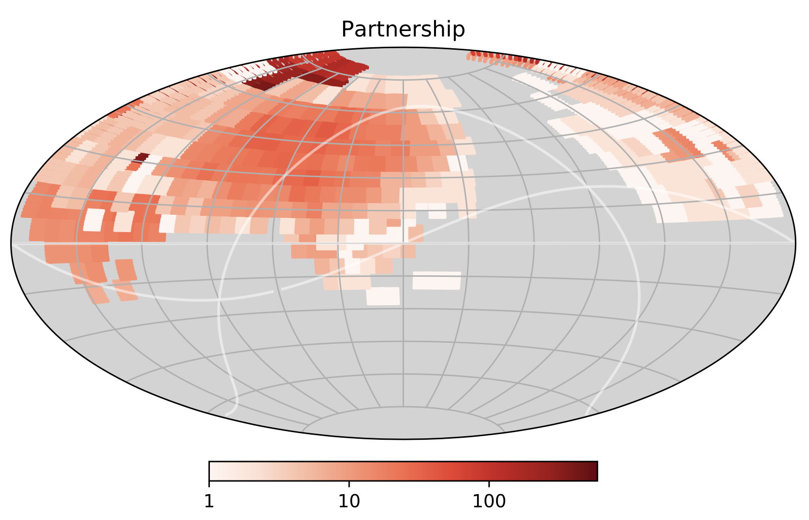
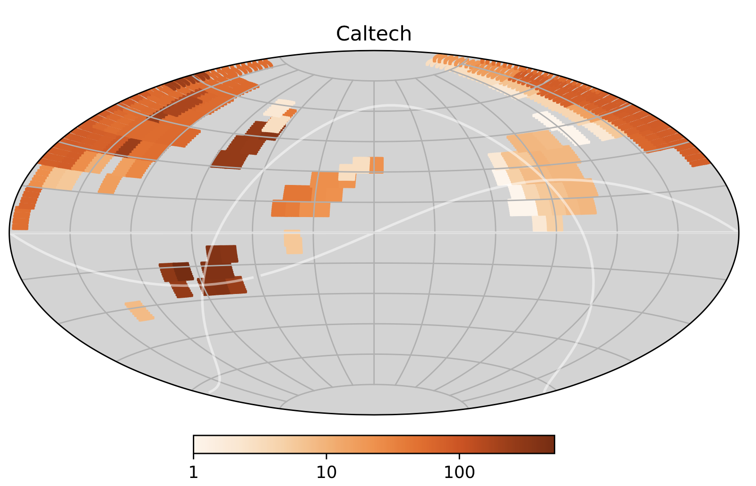
Concerns about overlapping programs

Slide 9
Observing overheads

Slide 10
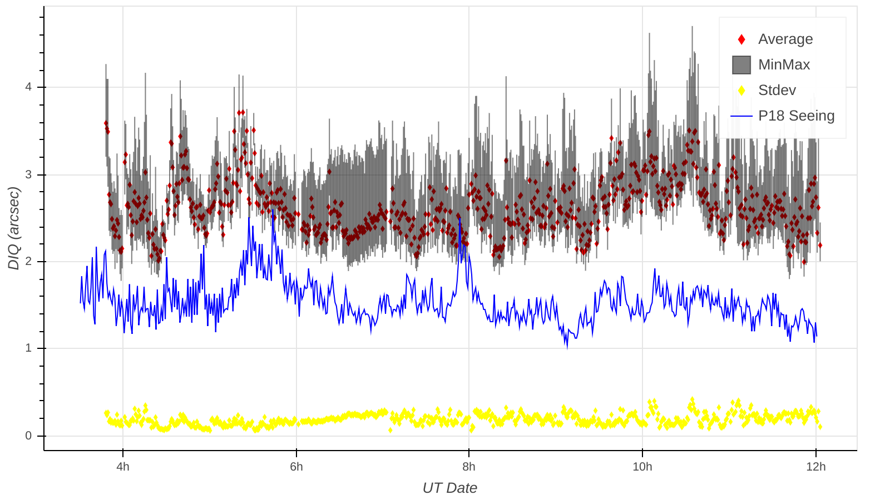
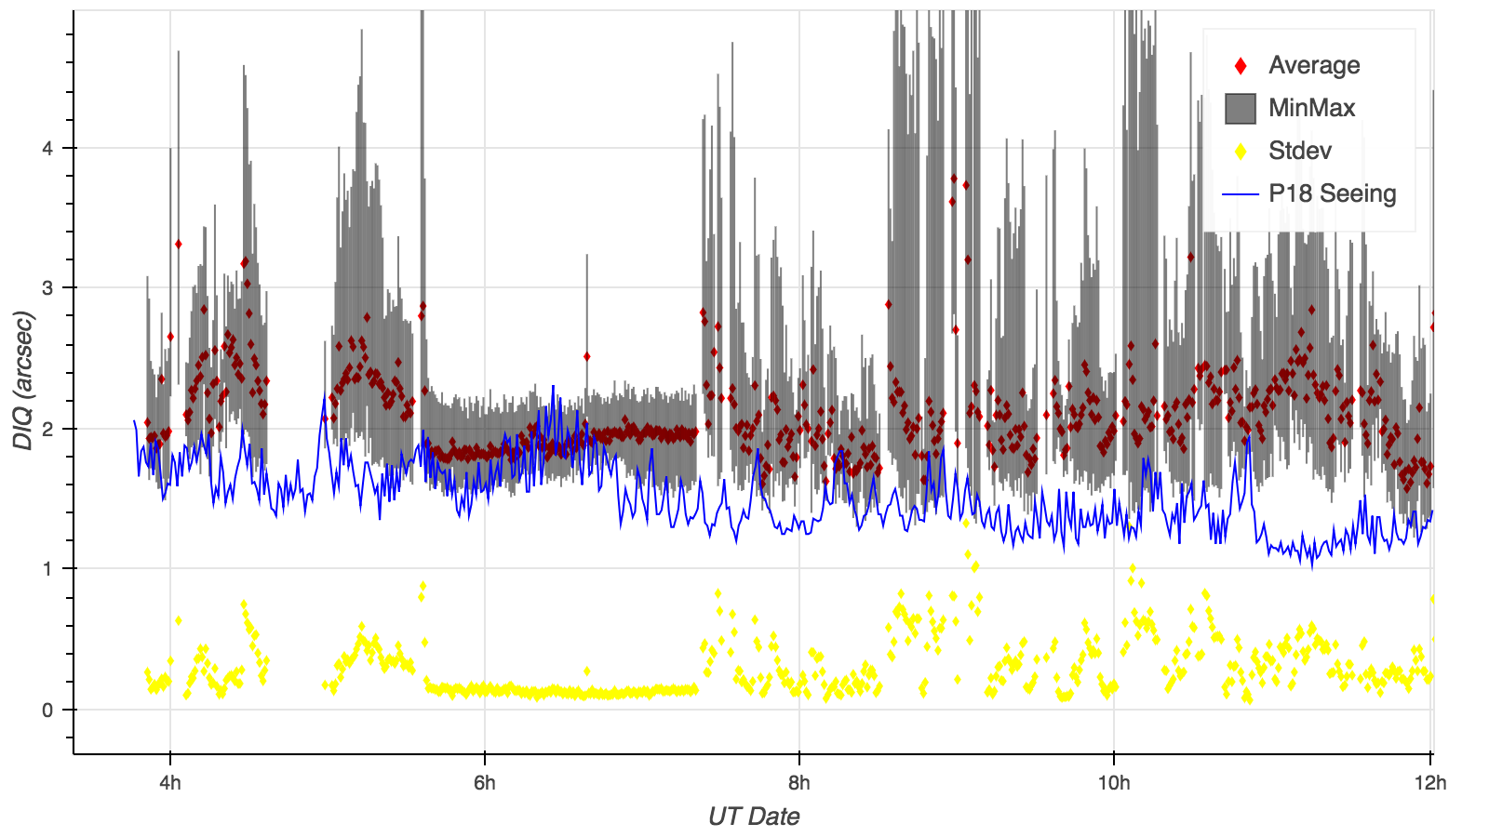
Improving focus
2018 earlier
2018-08-03

Slide 11
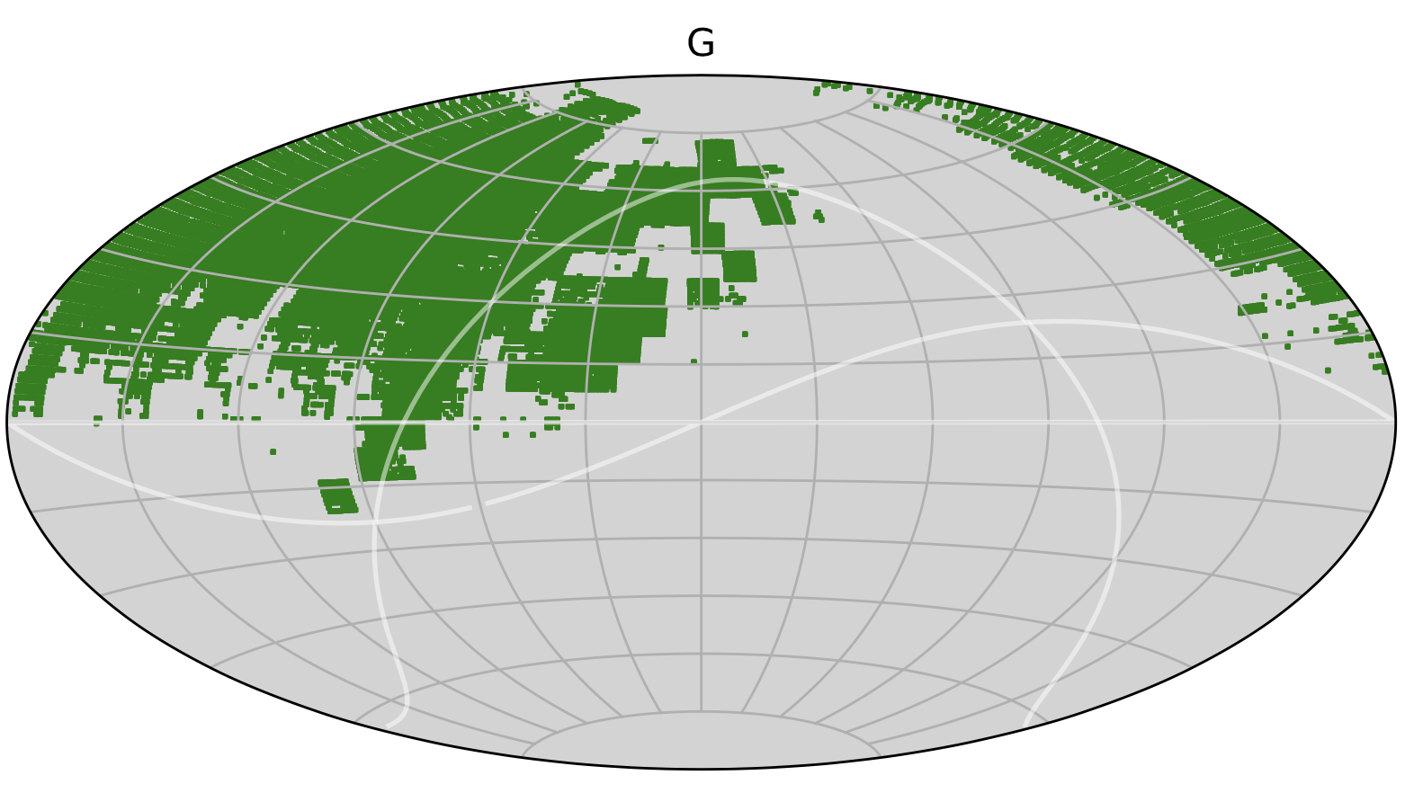
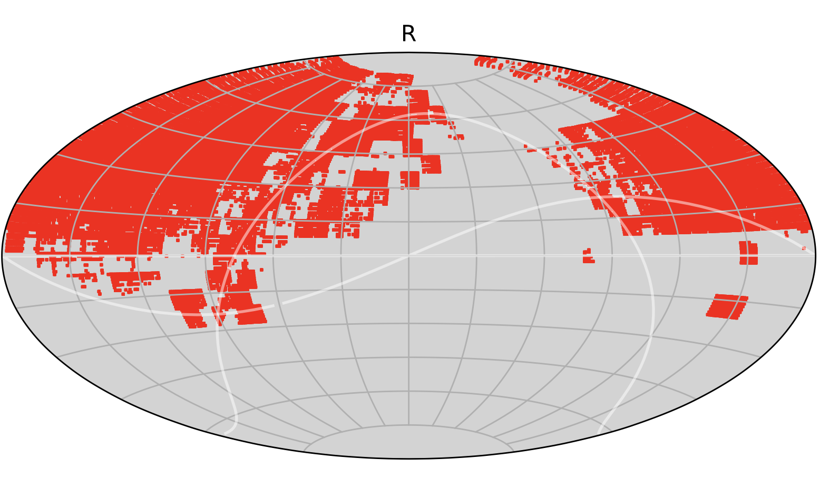
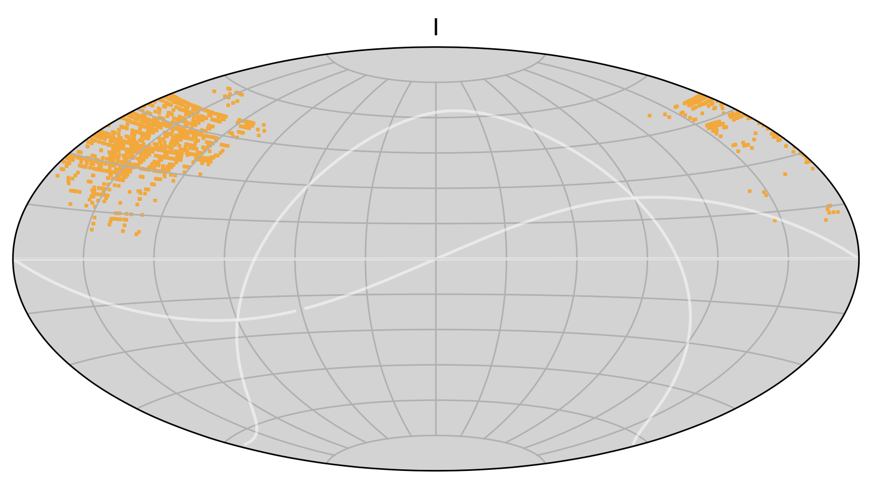
Reference images (to Aug 1)

Slide 12
Alerts : 28,421,000 to Aug 1

Slide 13
Alerts breakdown

Slide 14
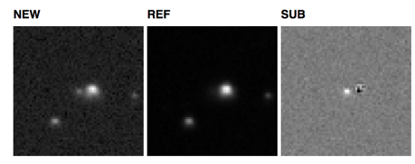
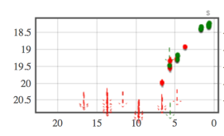
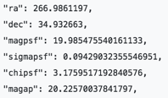
Issues with alerts
Image artifacts
ZTF18abcdefg
Alert names
Parameters
“It would be useful to also report…”
“What did we observe last night?”
“Why can’t I see any alerts?”
“<Survey x> detected this – why didn’t we?”
“What’s wrong with the values of parameter <x>?”
Scatter in photometry

Slide 15
Real bogus
Vers | Date | #Train | # Real | # Bogus | # Feat | FPR | FNR | ACC | FNR at 1% FPR
t1_f1_c1 | 10 Jan | 1620 | 1316 | 304 | 67 | 30.7 | 3.8 | 91.2 | 36.4
t6_f4_c3 | 17 Mar | 5498 | 2749 | 2749 | 61 | 11.3 | 3.8 | 93.6 | 27.0
t7_f4_c3 | 11 April | 7767 | 3361 | 4406 | 61 | 4.8 | 7.6 | 94.0 | 17.1
t8_f5_c3 | 7 May | 14762 | 5076 | 9686 | 59 | 10.1 | 2.7 | 93.6 | 20.1
t9_f5_c3 | 16 May | 15796 | 5589 | 10207 | 59 | 10.8 | 2.3 | 93.4 | 23.8
t10_f5_c3 | 23 June | 17684 | 6488 | 11196 | 59 | 11.6 | 5.5 | 91.4 | 29.3
t11_f5_c3 | 19 July | 18883 | 6876 | 12007 | 59 | 14.0 | 5.7 | 90.1 | 26.0
t12_f5_c3 | 8 Aug | 20923 | 7936 | 12987 | 59 | 14.9 | 7.2 | 89.0 | 33.6
(Umaa and Ashish)

Slide 16
Real bogus
July 25, 2018

Slide 17
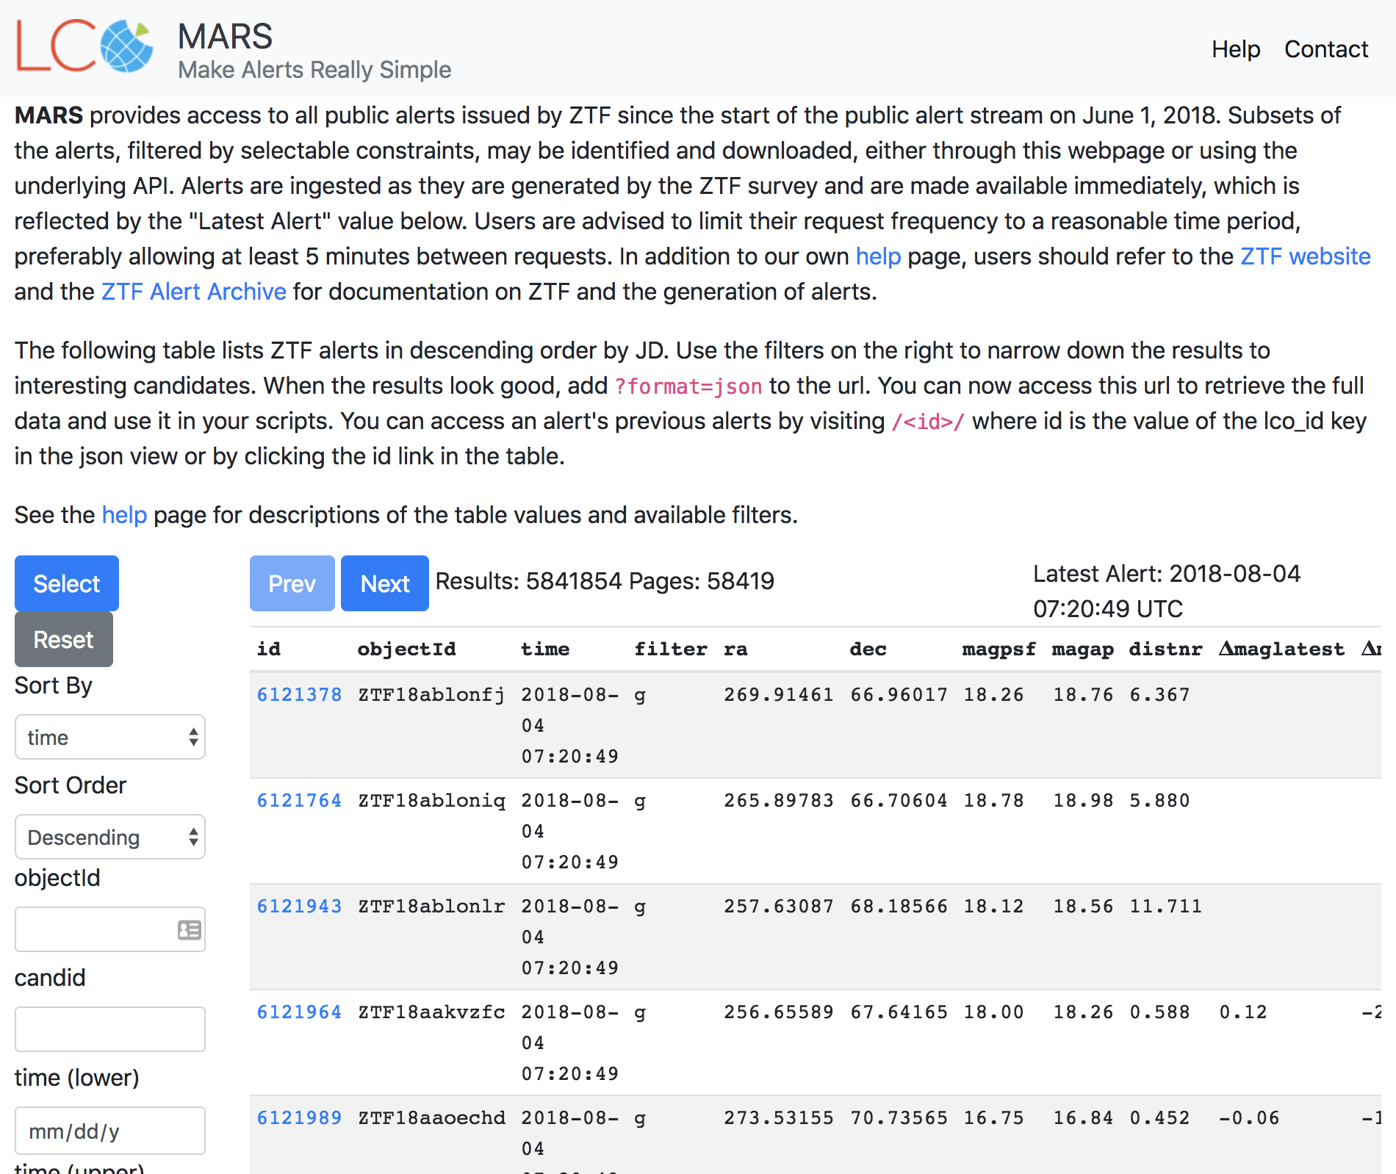
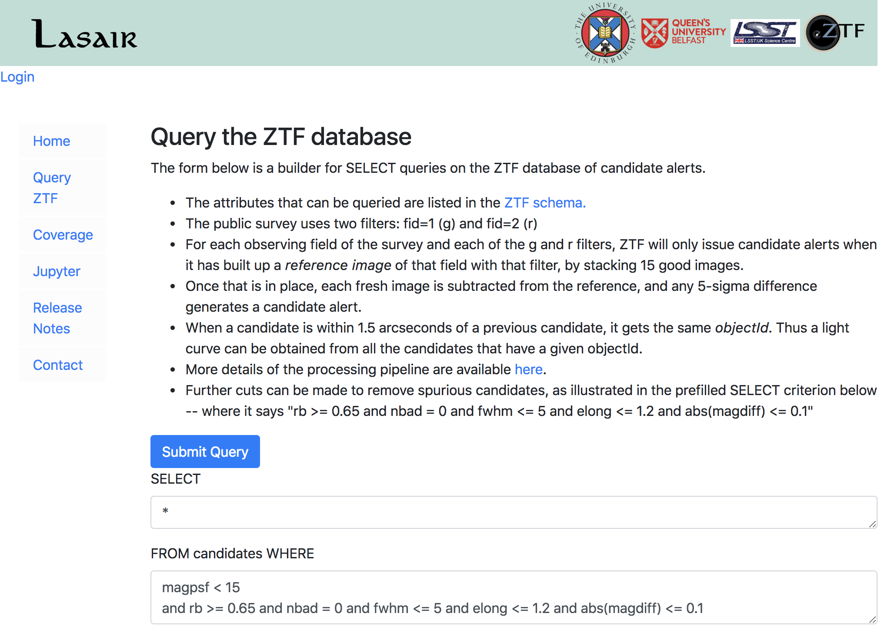
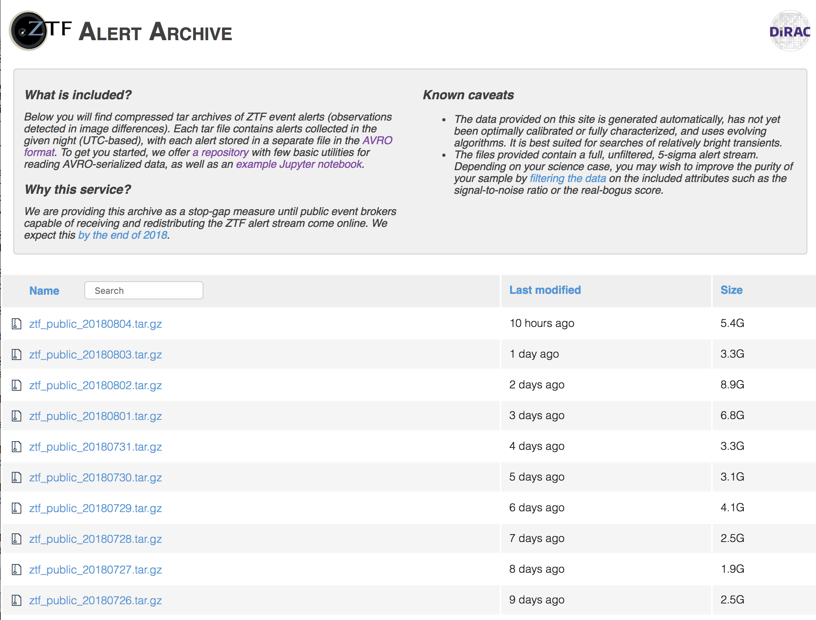
Brokers and followup

Slide 18
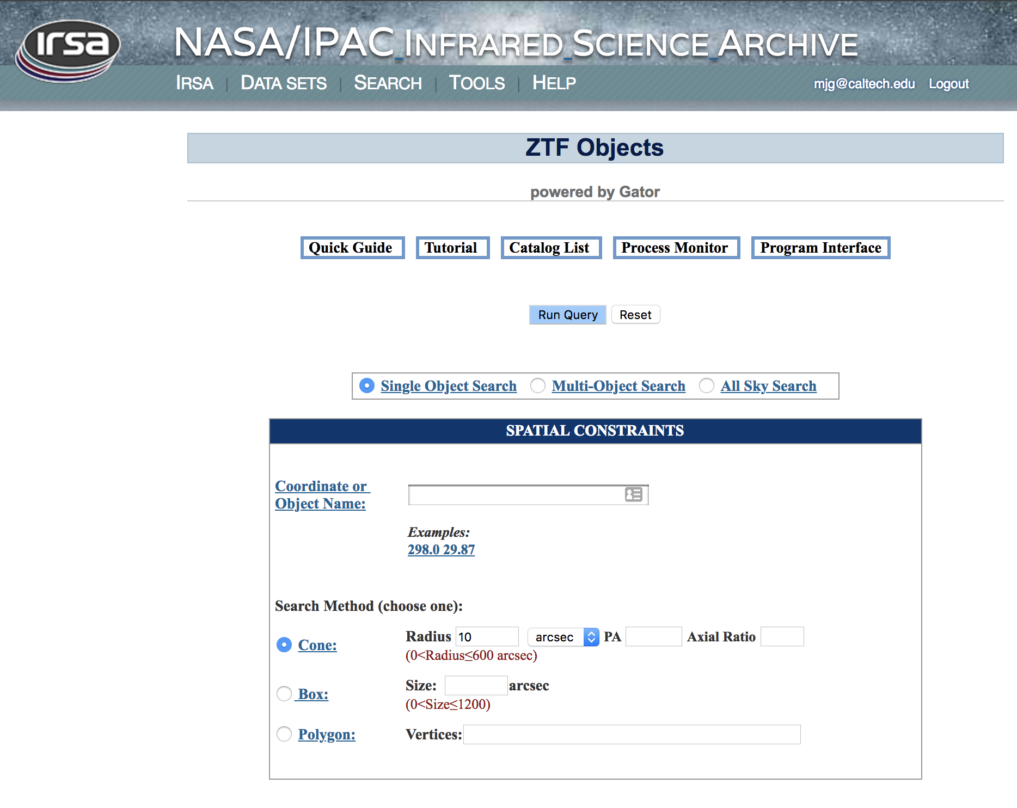
Matchfiles

Slide 19
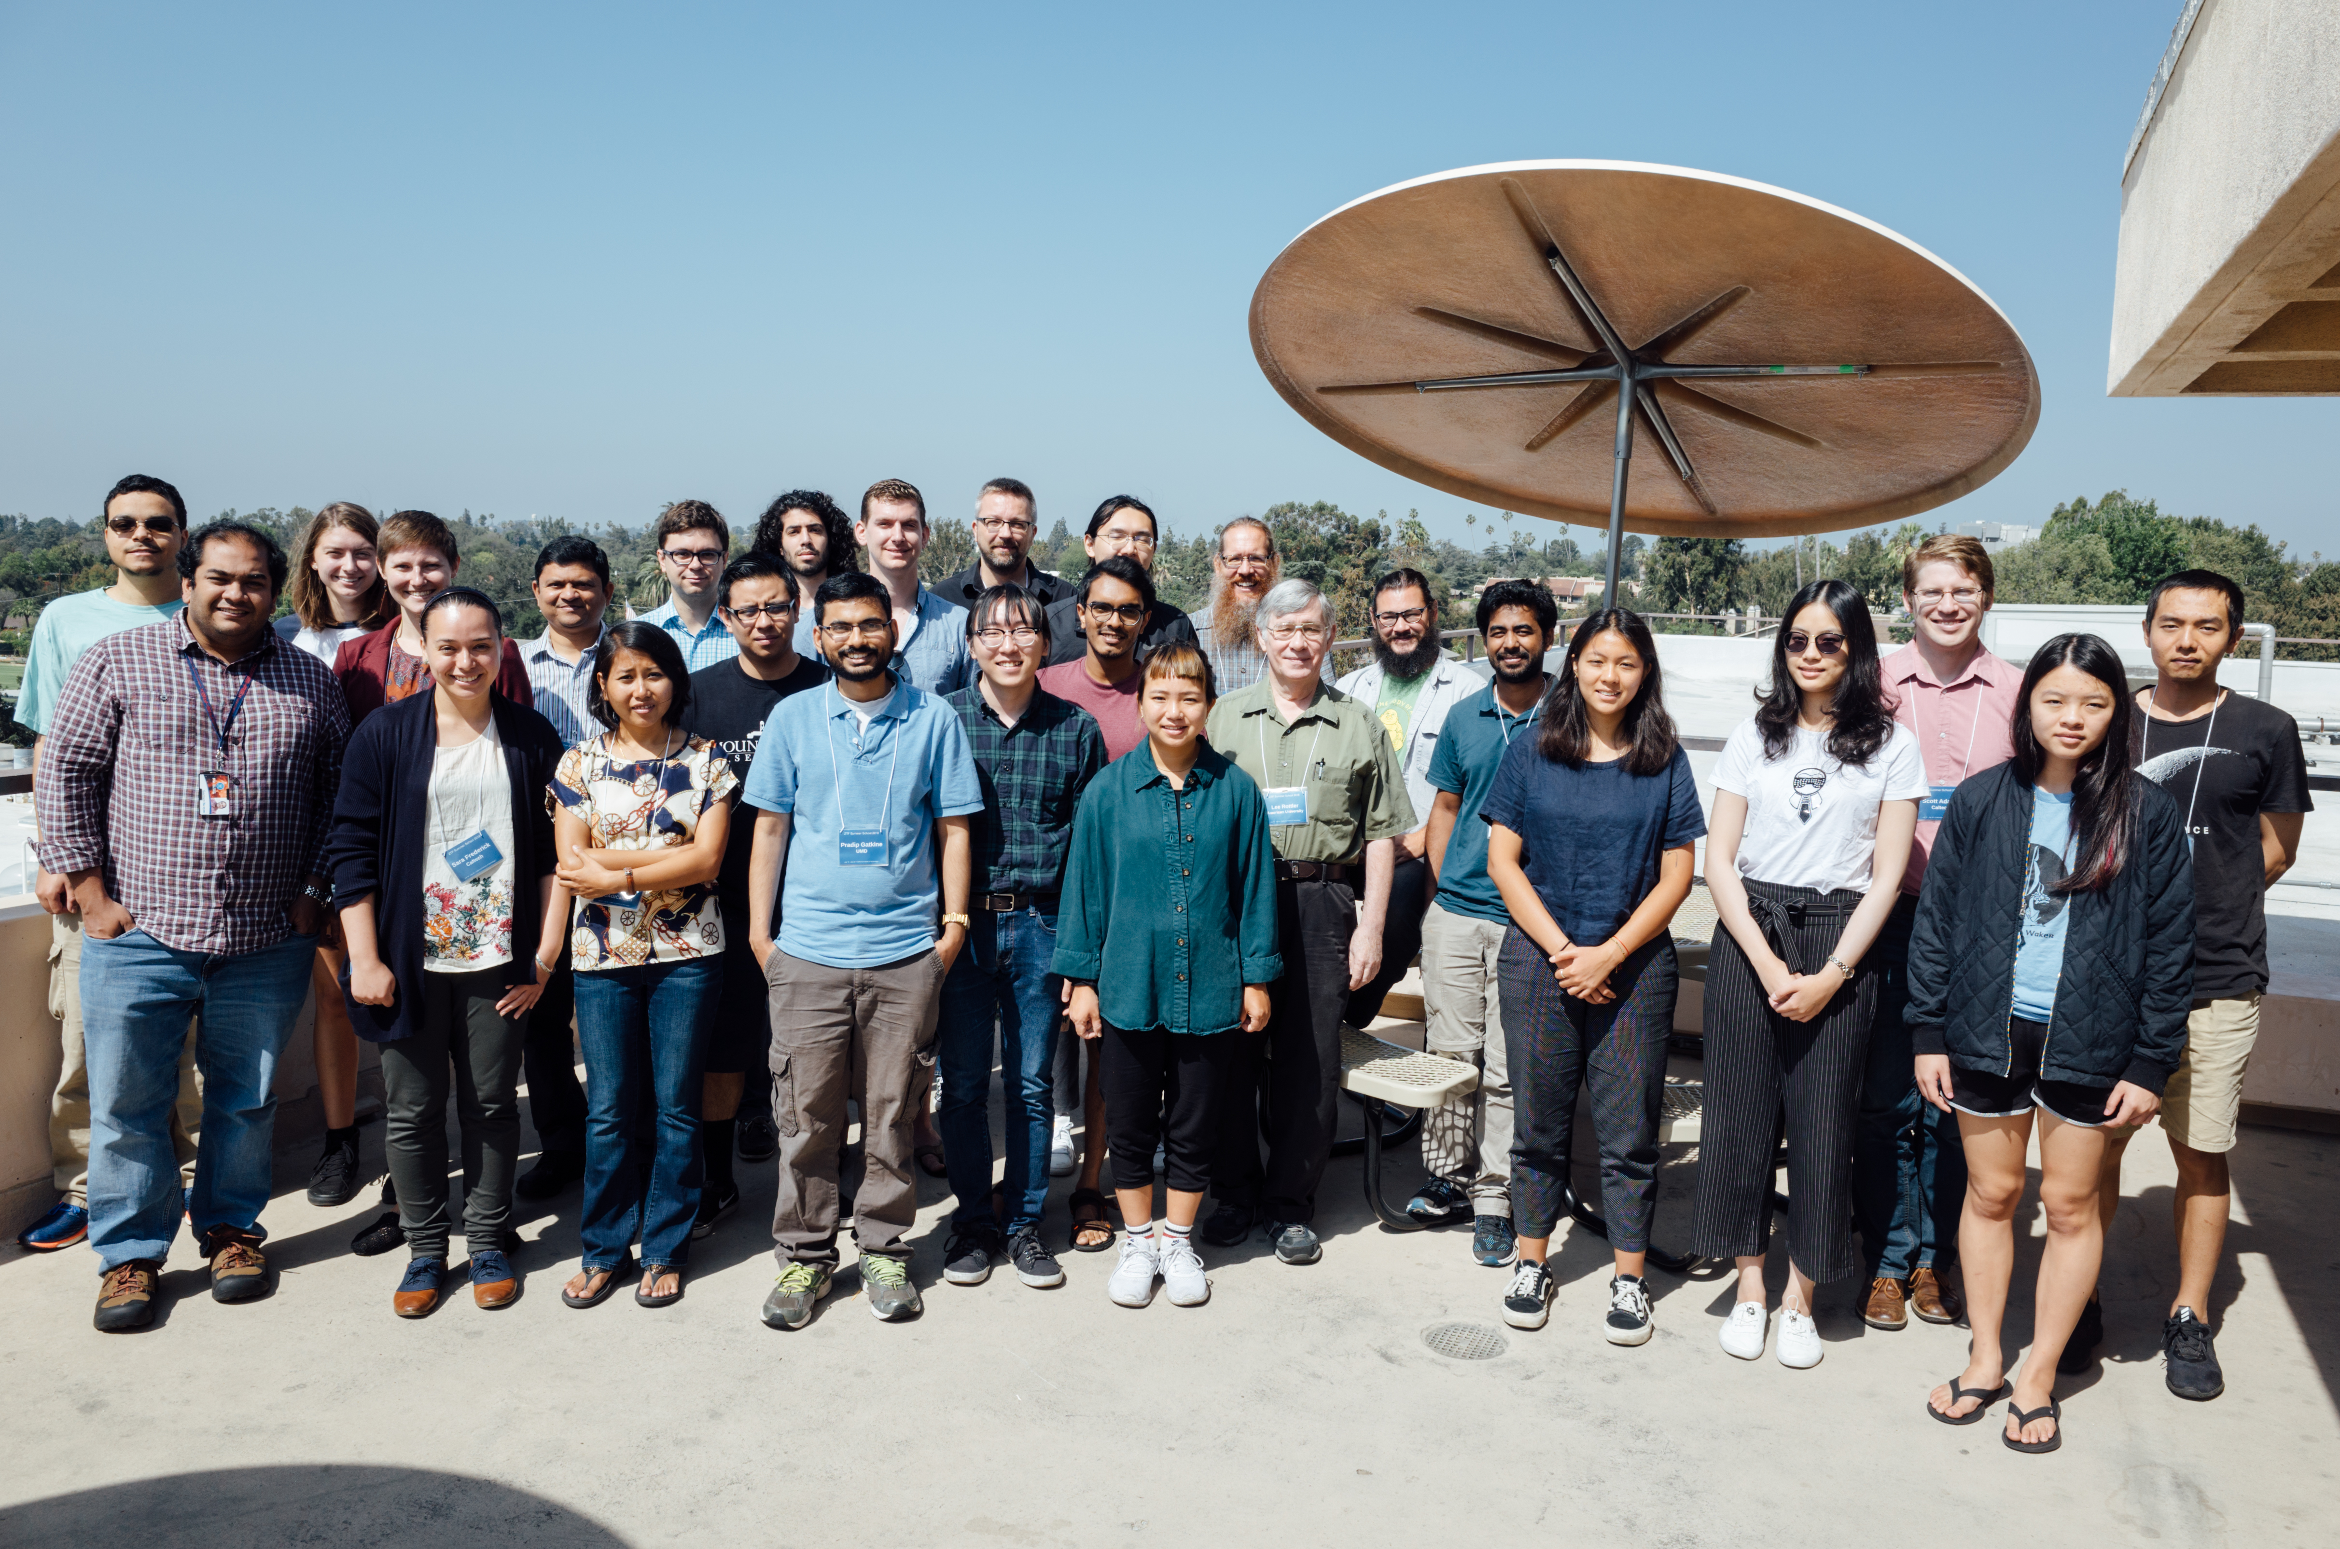
Outreach: ZTF 2018 Summer School

Slide 20
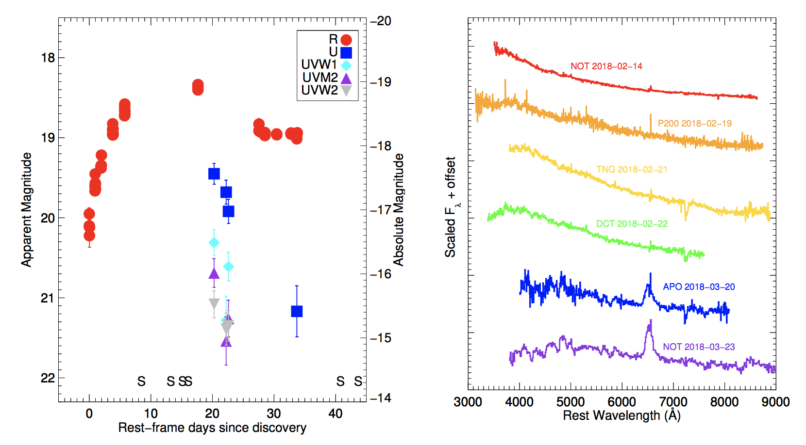
Science highlights - I
Physics of SNe and relativistic explosions, Ia cosmology, etc.
Total: 426 SNe so far
Ia: 294 - 99 already have sufficient coverage in all bands to
give good distance estimates
II: 88
Ib: 12
Ic: 8
Ic-BL: 2
SLSNe: 11
We are now regularly finding supernovae within one day of
explosion (triggering follow-up in real time), and have already
found multiple events with flash features.

Slide 21
Science highlights - II
TDEs and AGN
2 confirmed TDEs:
  NedStark (ZTF commissioning and MSIP)
  JonSnow (MSIP)
20 more candidates awaiting
7 spectroscopically confirmed CLAGN: Sy 1.8/LINER -> Sy 1
Galactic and M31 science
Discovery of an ultra-compact binary with a 7-minute
orbital period
Only one other stellar binary, HM Cancri, has a shorter
period, 5.4 minutes
We predict that we will detect decay of the orbit due to
gravitational waves by September of this year

Slide 22
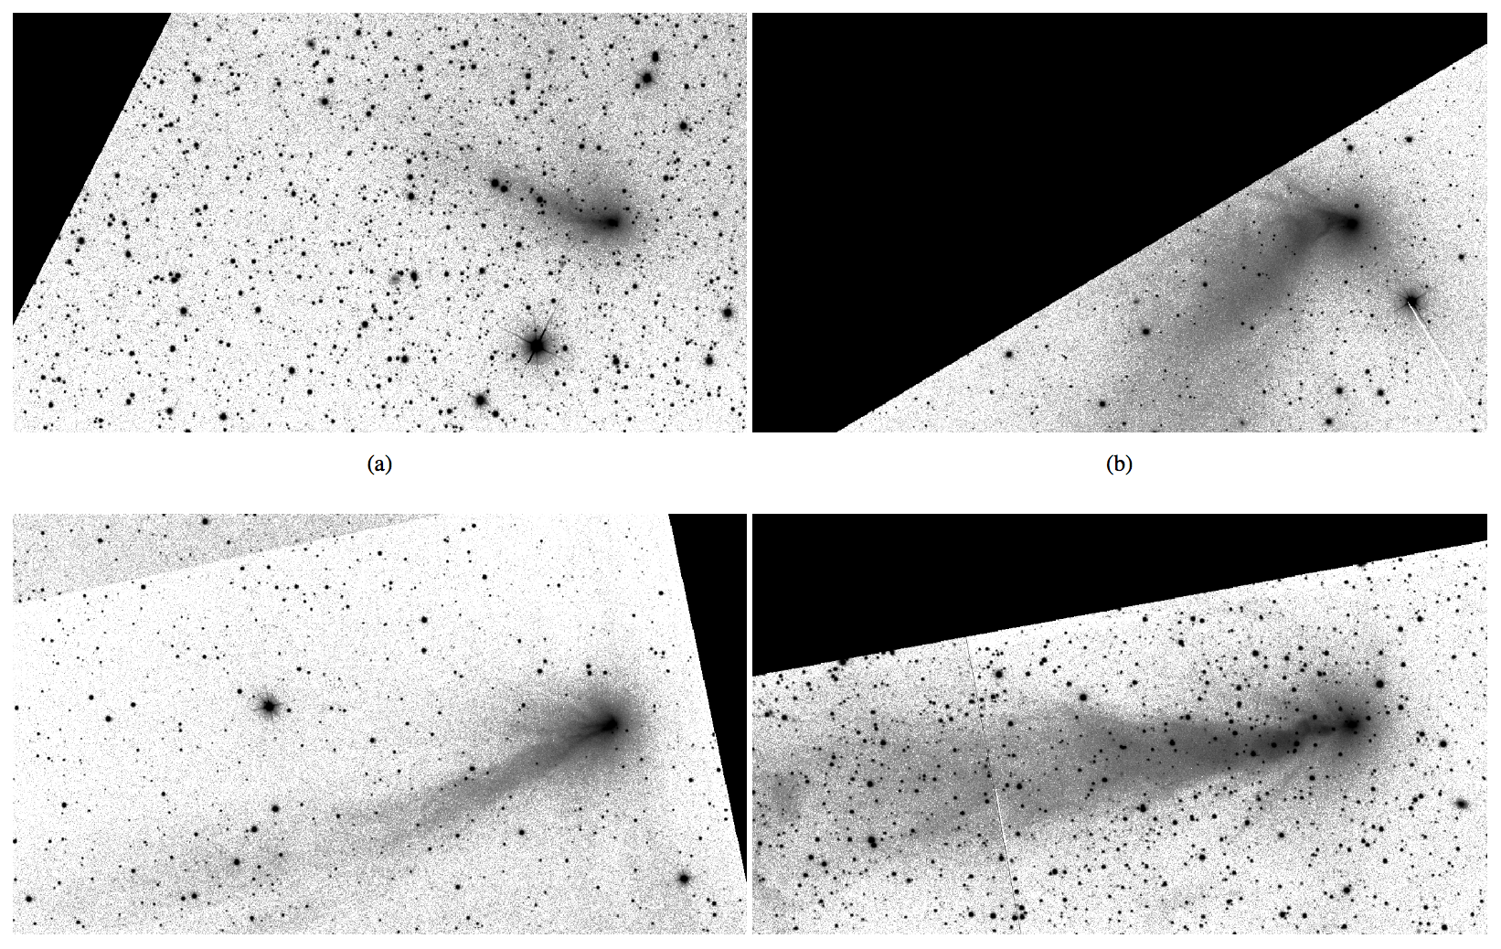
Science highlights - III
Small Solar System Bodies
Discovery of ~500 new asteroids, including 18 Near-Earth
Asteroids (NEAs).
3 ZTF-found NEAs passed within 1 lunar distance

Slide 23

Summary
ZTF is now operational and serving Caltech, the partnership, and the community
There is ongoing work to improve:
  Overall optimization
  Focus and guider system
  Real-bogus score
  Feedback/communication
  Marshal
Bigger challenges:
  Archival data
  ML-based alert classification

