Slide 1
ZTF Image Quality (etc)
Roger Smith
Caltech

Slide 2
Delivered Image Quality
Static shims
Open loop map (boustrophedonic vs. random sampled)
Closed loop correction
Example of good
Example of bad
Ambiguity between tilt and translation
Current work
  Direct measurement of flexure primary, ring girder instrument
  Faster TTF sampling rate

Slide 3
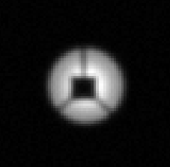
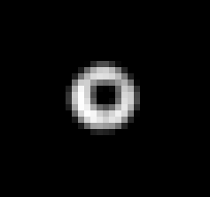
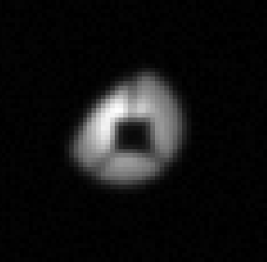
Focus algorithm validation (R. Dekany)
Thanks to Aaron Roodman, LSST, for extra-focal imaging help.
We validated algorithms using artificial data to test immunity to various biases. The wavefront propagation model includes the effects of diffraction and optical aberations.
Inner CCD
Our test case
A ‘step-staircase’ where every CCD was pistoned in 25 micron height increments. We also simulated the effect of not having a trim plate during our May 2017 engineering run.
Conclusions
Calibrated: Vignetting of the pupil due to beam walk off of primary mirror biases sextractor image width determination (critical to our focus algorithms accuracy.)
Confirmed: Presence of spherical aberration during our engineering run did not bias our image width results, except in the presence of primary mirror vignetting.
Confirmed: Effect of moving spider and hub shadow does not bias image width determination.
Corner CCD
(~4 deg off-axis)
~0.4 mm defocus
(no spherical aberration)
~1.8 mm defocus
(w/ 7 λ spherical aberration)

Slide 4
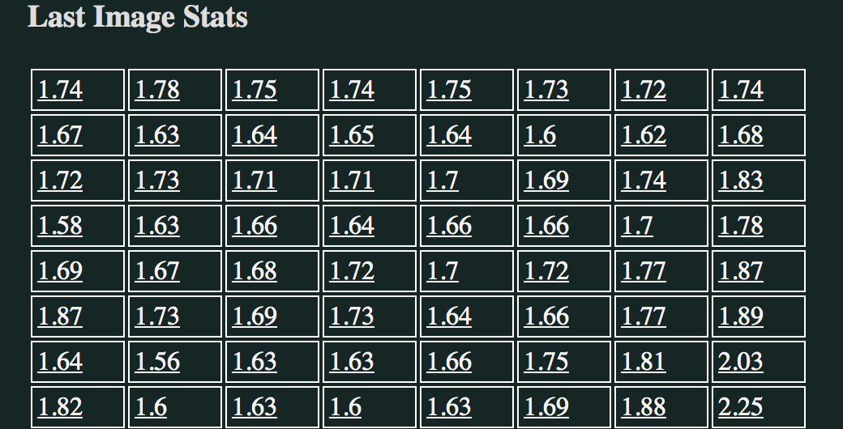
Image quality, can be sub-Nyquist !
Median FWHM per quadrant (arcsec)

Slide 5
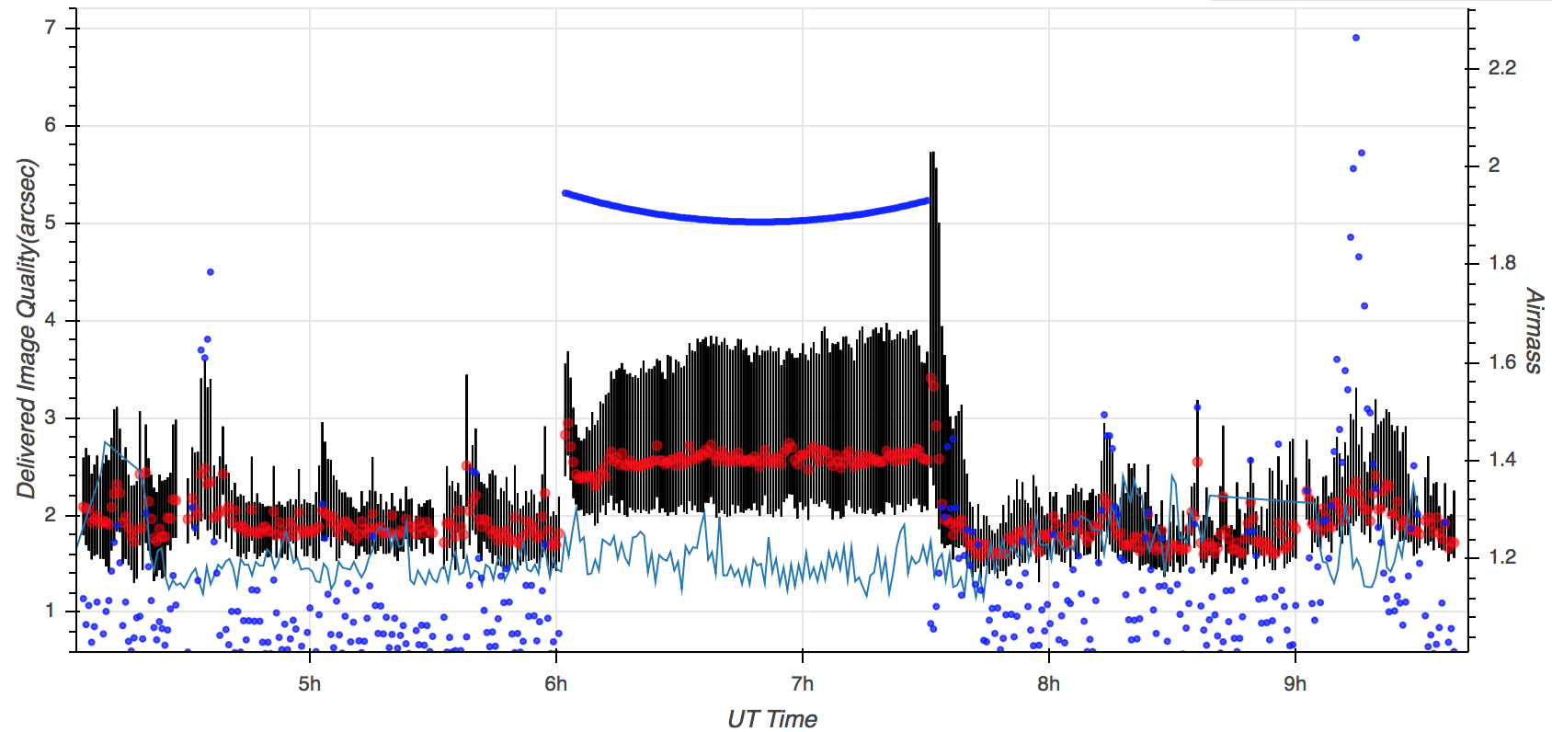
Tilt and focus variability
To be removed by auto-focus…. under development
Same field
Black=min-max →tilt
Red=median
Airmass

Slide 6
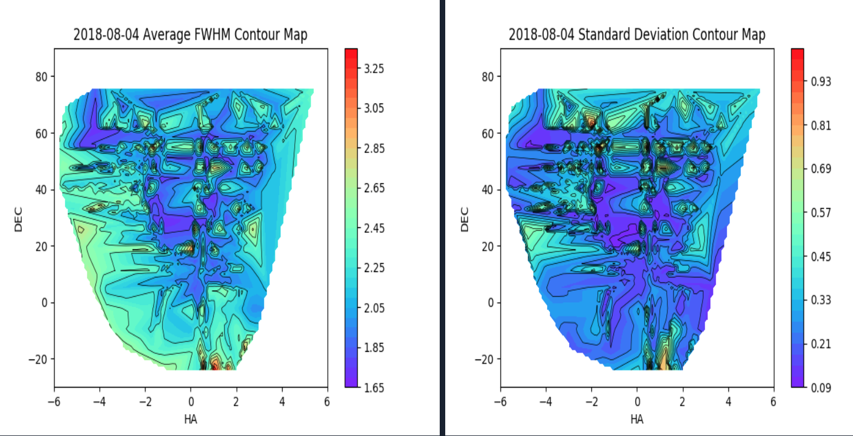
Static map of flexure induced focus and tilt
After larges we must use static map of flexure induced focus and tilt.
Focus CCDs continuously refine map and apply feedback
Need several steps to beat down noise → lag

Slide 7
Why is focus tilt so “noisy” ?
Many improvements in algorithm … now the measurement is stable for constant pointing.
There appears to be something moving when we slew:
  Mirror position in cell has been measured
  More instrumentation to break degeneracy between X-Y motion and tip-tilt
    Position of ring girder
    Instrument with respect to ring girder
Tilt and XY shift are degenerate.
Pointing errors (telescope w.r.t. sky) mask instrument motion w.r.t. telescope.

Slide 8
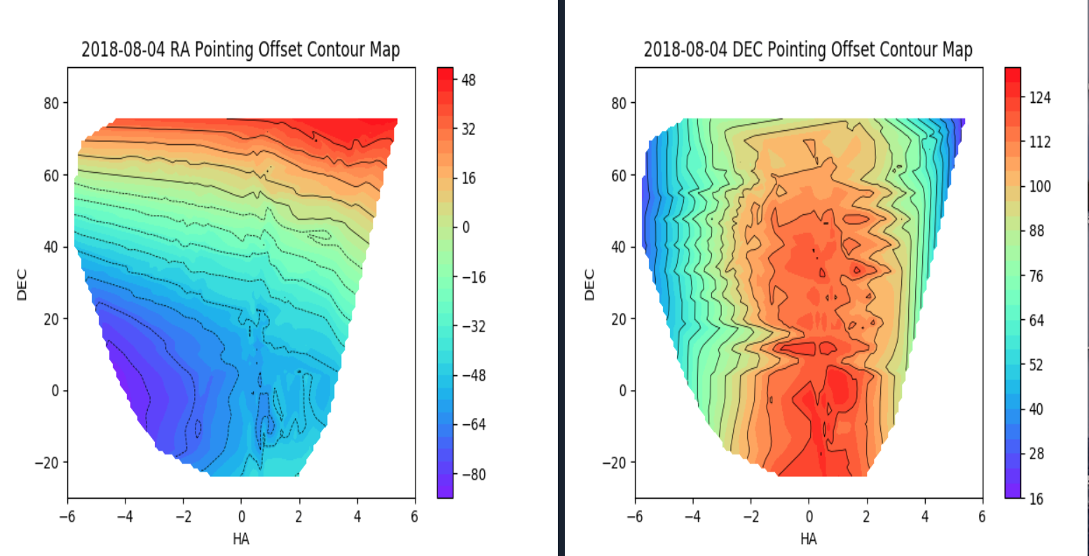
Pointing issues ← masking flexure?
Polar axis mis-alignment (or error in pointing model)
Also there is Dec encoder drift.

Slide 9
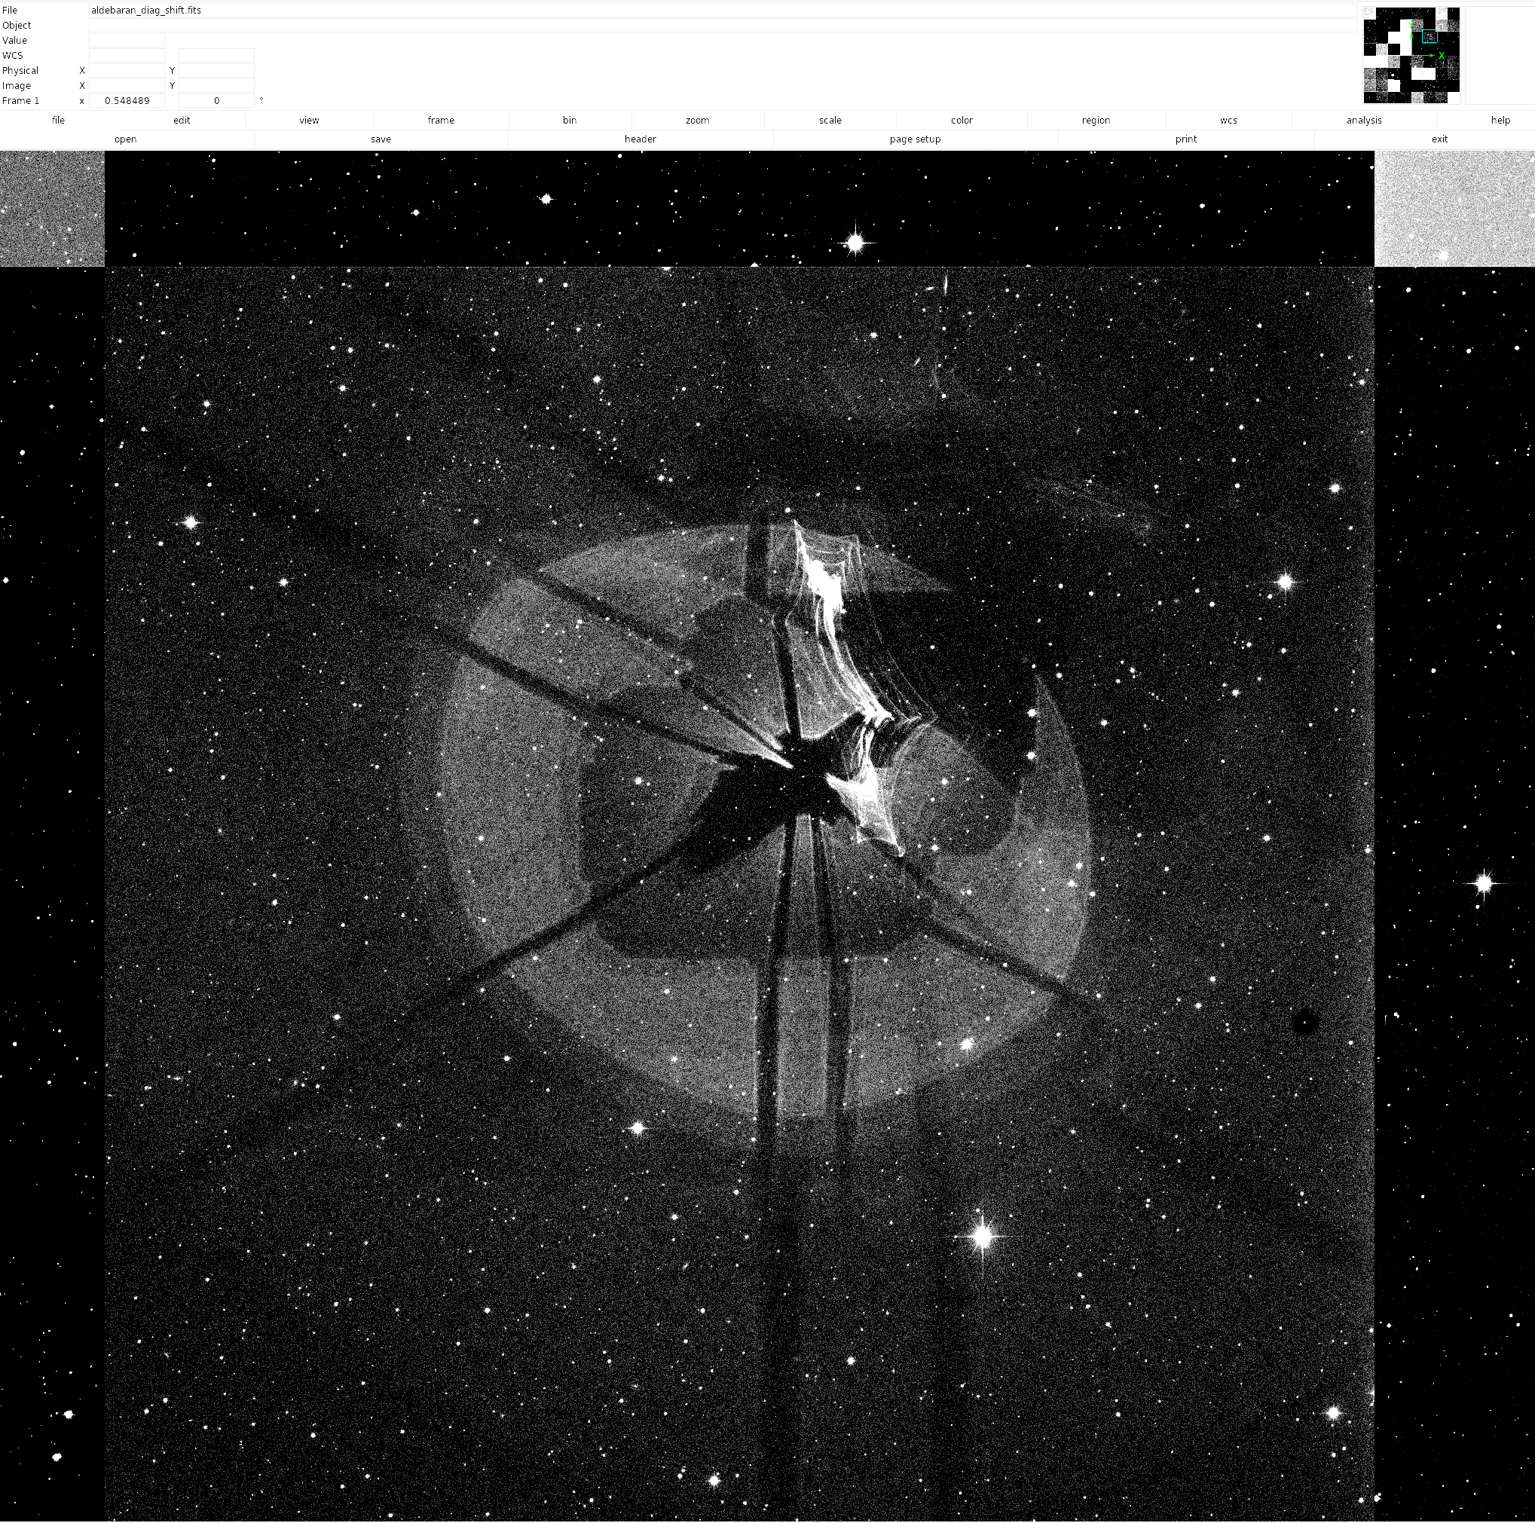
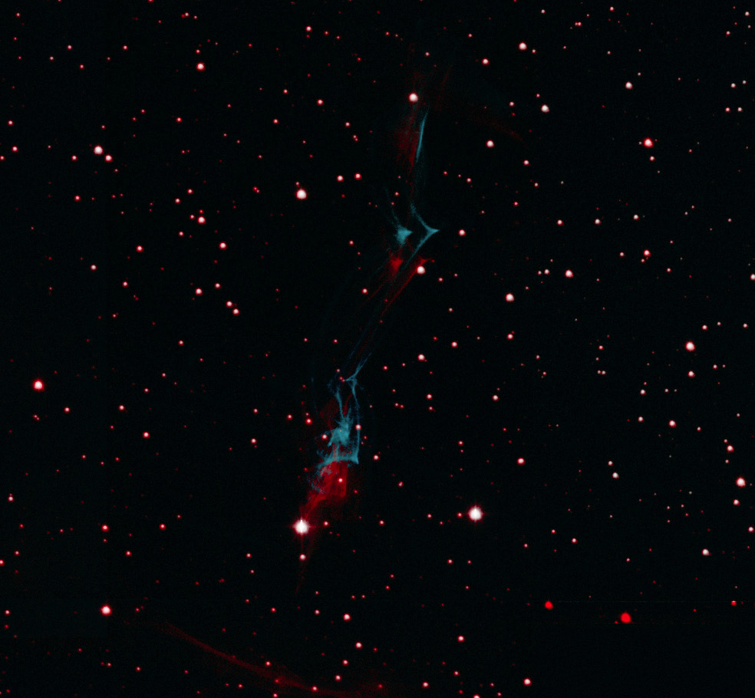
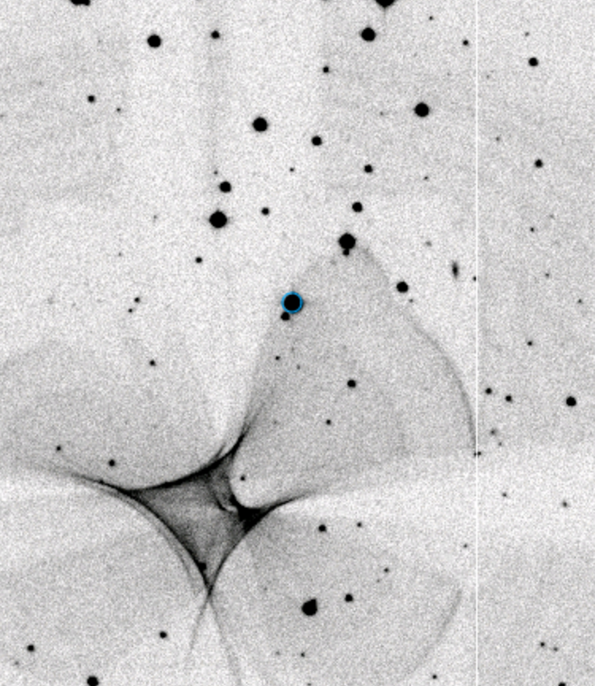
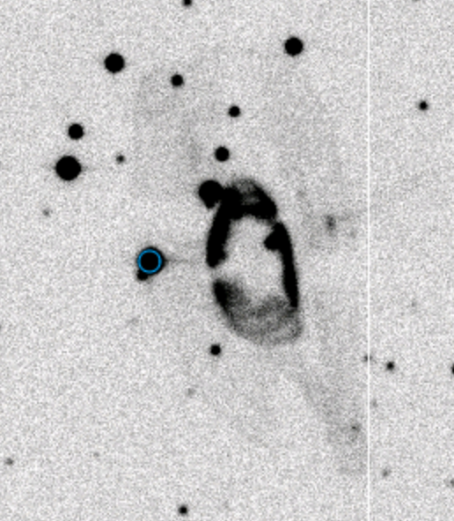
Scattered light
Extensive new baffles
Recent cleaning of corrector; monitor via wings of profiles
Scattering by field flattener frames
Dust
Ghosts

Slide 10
Ghost Mitigation
Trim plate could have been made a meniscus but wasn’t ☹
Trim plate and corrector could have been tilted, but weren’t ☹
Invert corrector doublet, maybe ? – a meniscus !
→ Software is the only remedy without down time.

Slide 11
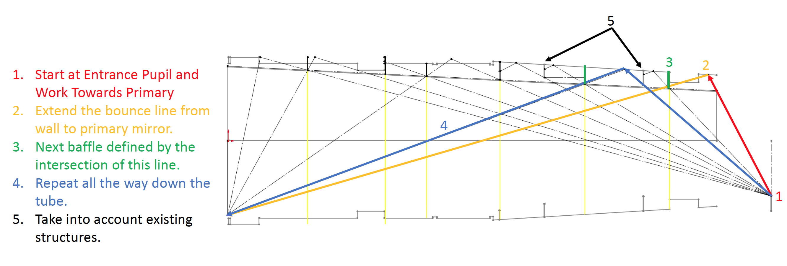
New baffles
Extensive baffles on tube interior.
No single bounce to primary.

Slide 12
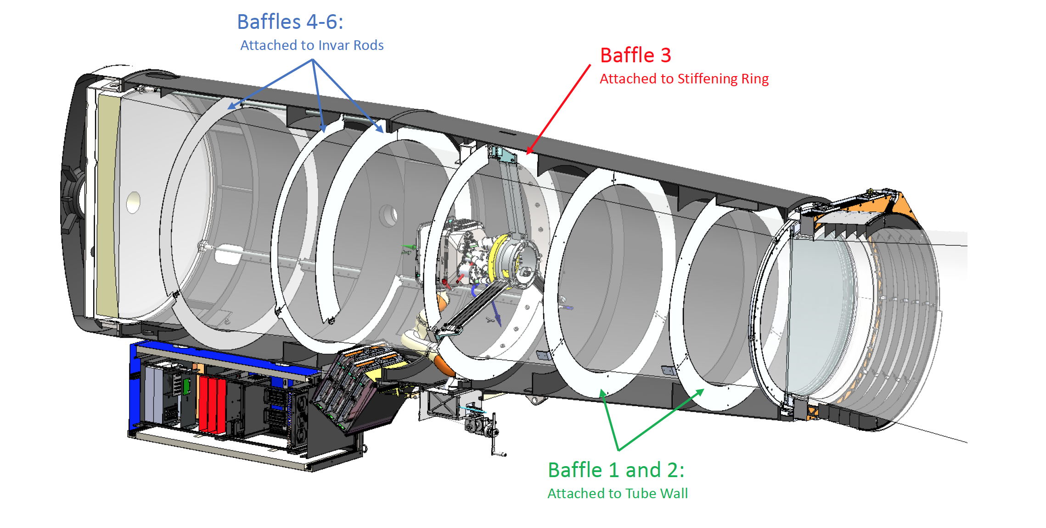
New baffles
Extensive baffles on tube interior.
No single bounce to primary.
Closely spaced to block scattering onto corrector

Slide 13
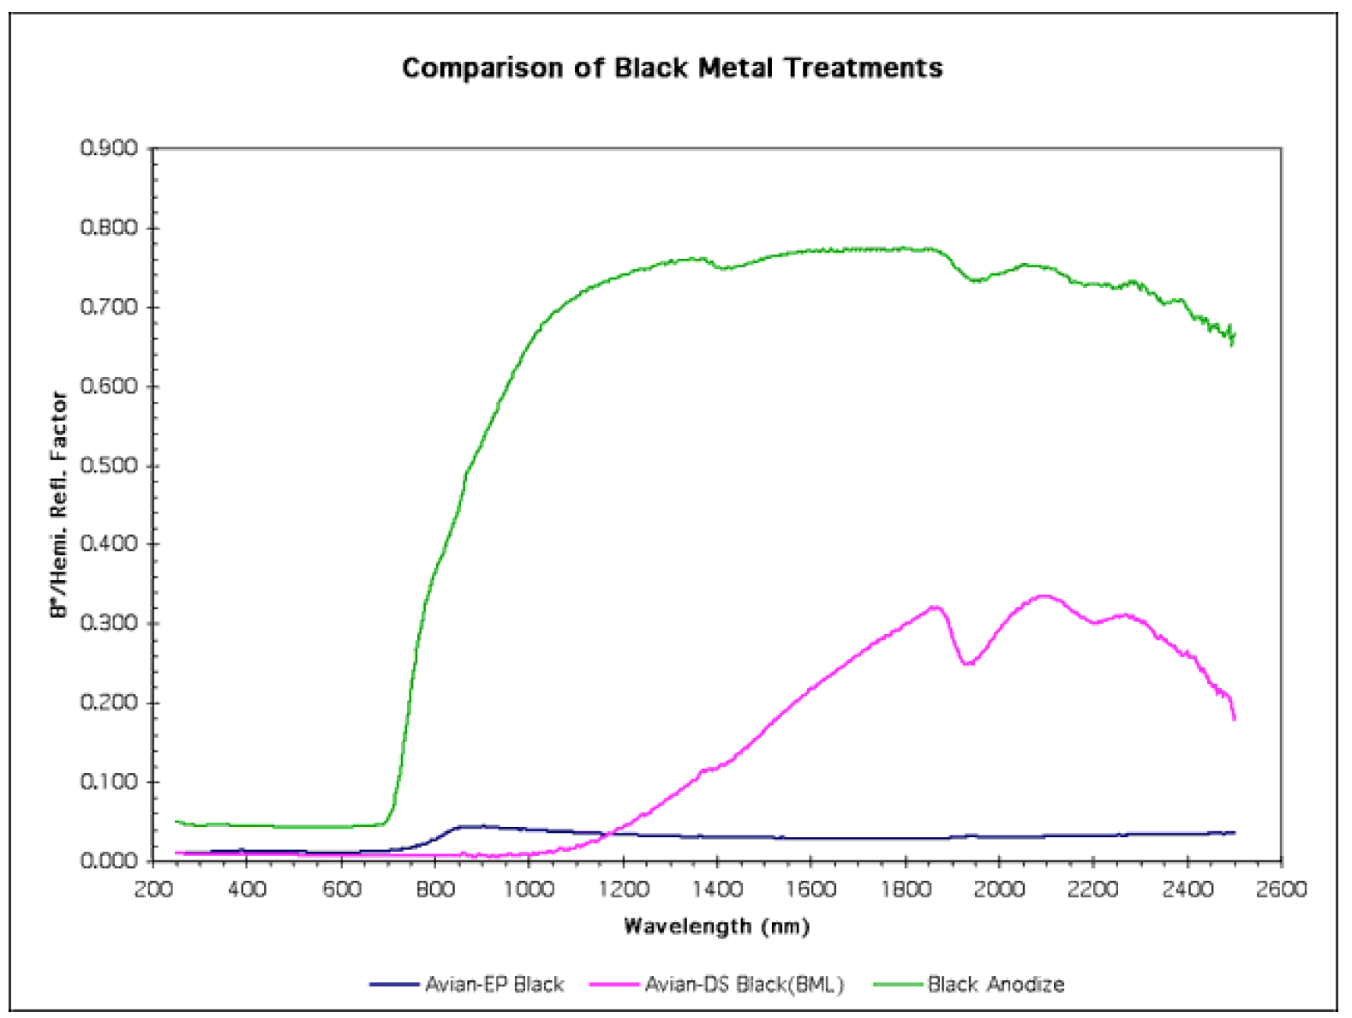
Paint, flocking
Surfaces subject to wear and dust accumulation:
  Avian-D black paint
  <3% reflectivity,
  Much better than average at low incidence
  good wear resistance
Protected surfaces (facing primary)
  “Protostar” Flocking
  <1% reflectivity
  8x better even than Avian D at low incidence
  Robust. Negligible shedding of lint.
Black Annodize
Avian-D

Slide 14
Contamination monitoring
Track cleanliness of corrector:
Fraction of light in wings of bright stars successfully used by Thomas Kupfer to trace cryopumping.
Should work for corrector cleanliness too. Angie Van Sistine is repeating after first cleaning of trim plate.
Dust spot tracking:
useful to understand flat field stability and dewar cleanliness.

Slide 15
Flat fields
Illumination/vignetting pattern
Shutter timing error map
Filter leaks
Illuminator
  How we acquire flats
  Post factor color balance
  Effects of screen non-uniformity
  Requirement on stability of intensity distribution
Star-flats
  dominated by scattering from field flattener frames
  Compare to DES
CCD sensitivity dependence on wavelength
  mid scales
  PRNU
  fringing

Slide 16
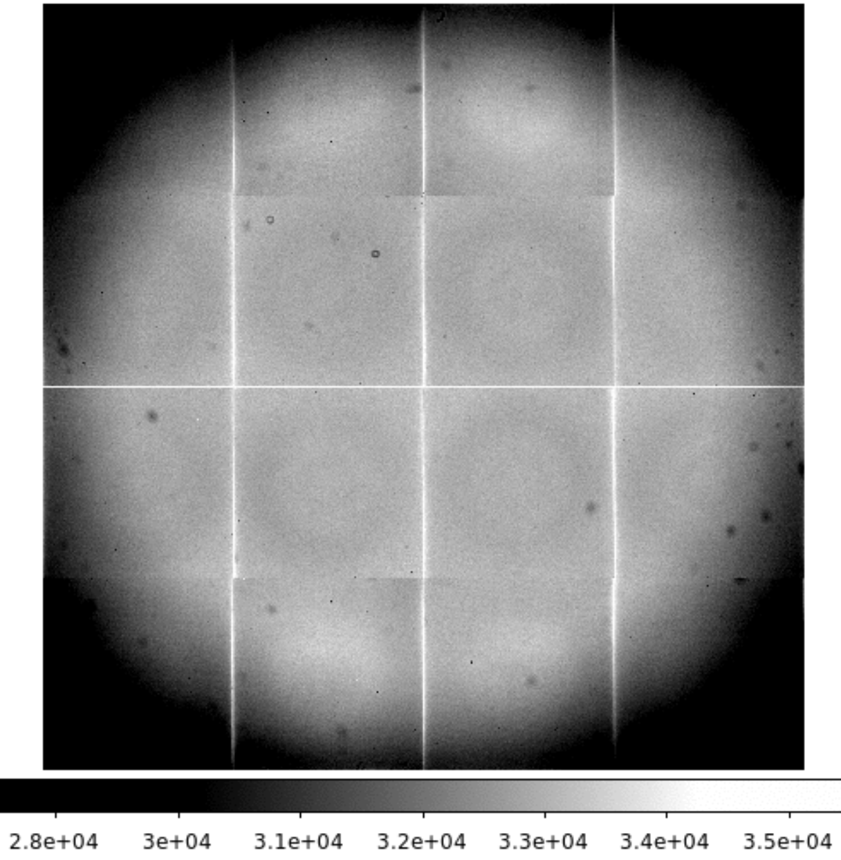
Raw R flat
Quadrant gains adjusted for continuity across boundaries by Nadia Blagorodnova
Dust
on field flattener
How stable?
not real?
Rings due to CCD QE (thickness?)
Scattering off frames holding field flatteners
Vignetting: beam walks of primary

Slide 17
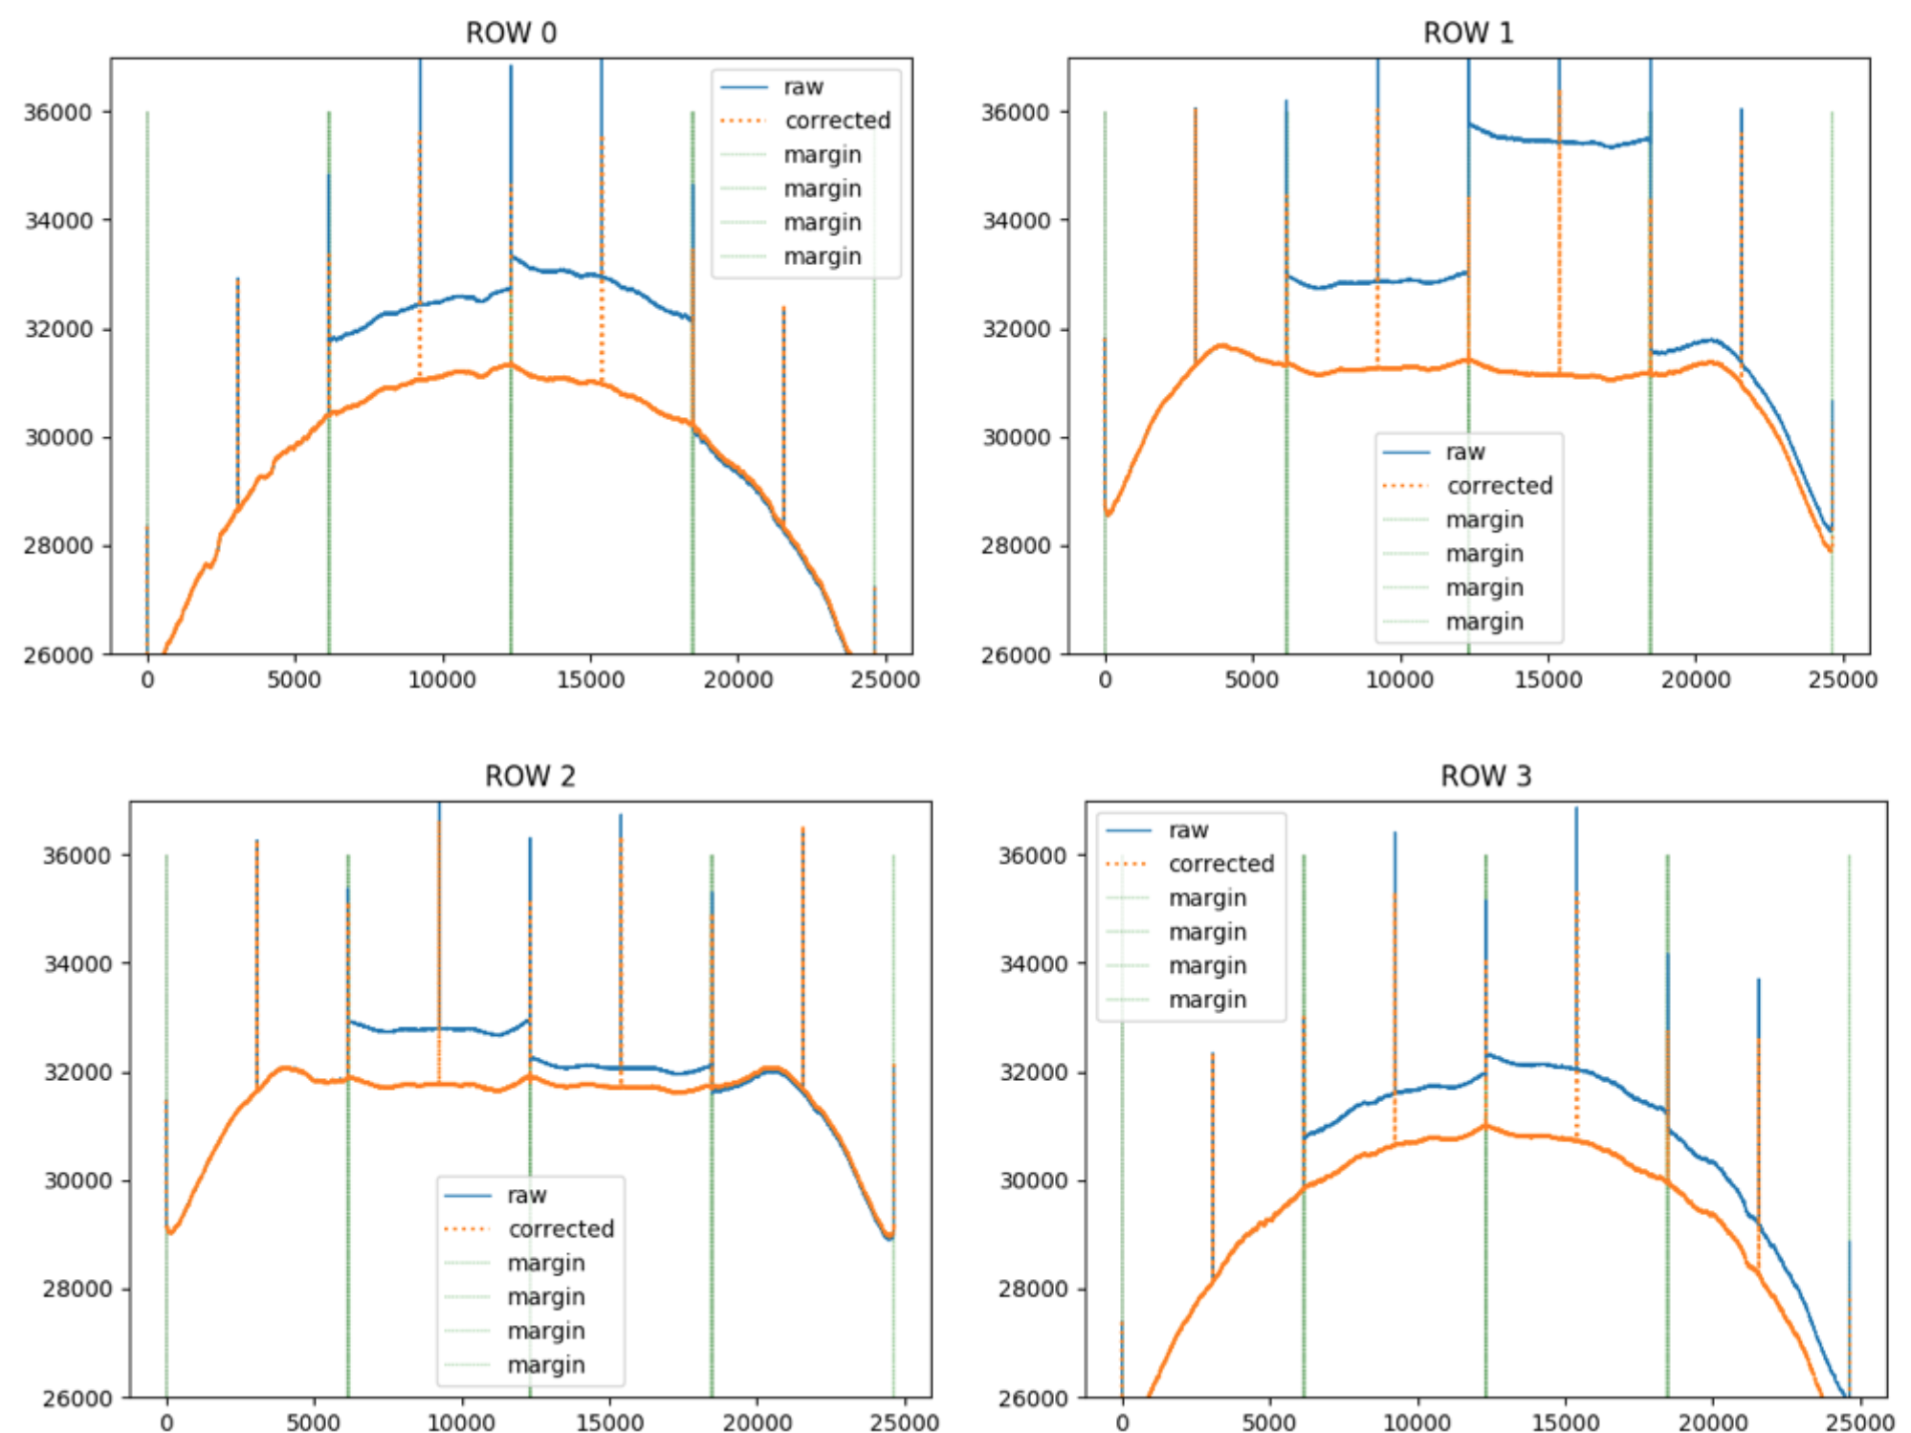
The bright initial line has been fixed … check this!

Slide 18
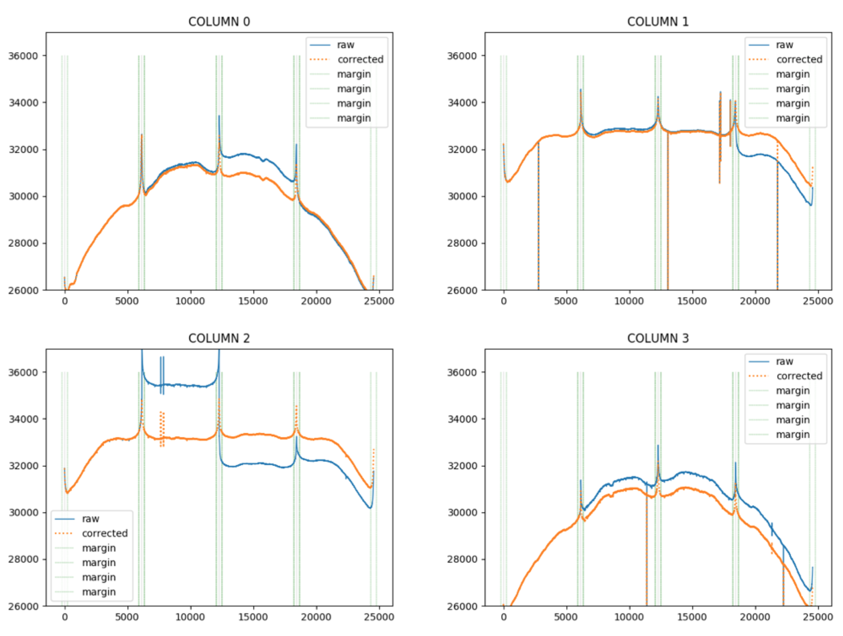
Scattering off frames is an increase in background.
It is not a sensitivity enhancement so must be removed from flats (about 6% correction)

Slide 19
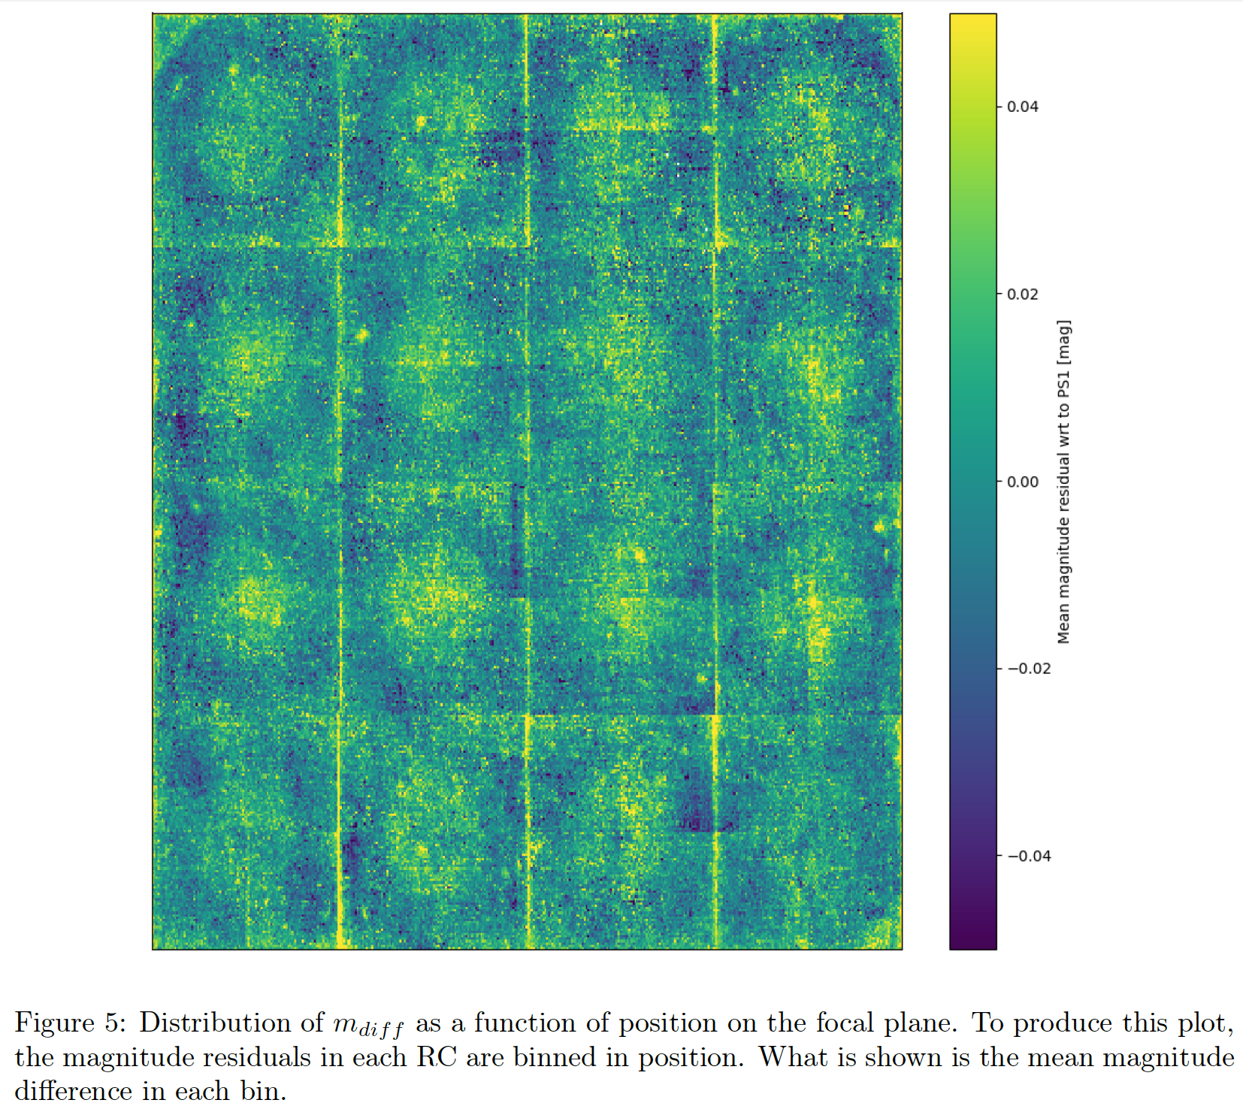
Star Flats
From report by Matteo Giomi
Star flats have been fat fielded and should not show…
CCD QE structure
CCD channel gains
Scattering off field flatteners
Note that large scale illumination structure has been removed quite well by dome flats

Slide 20
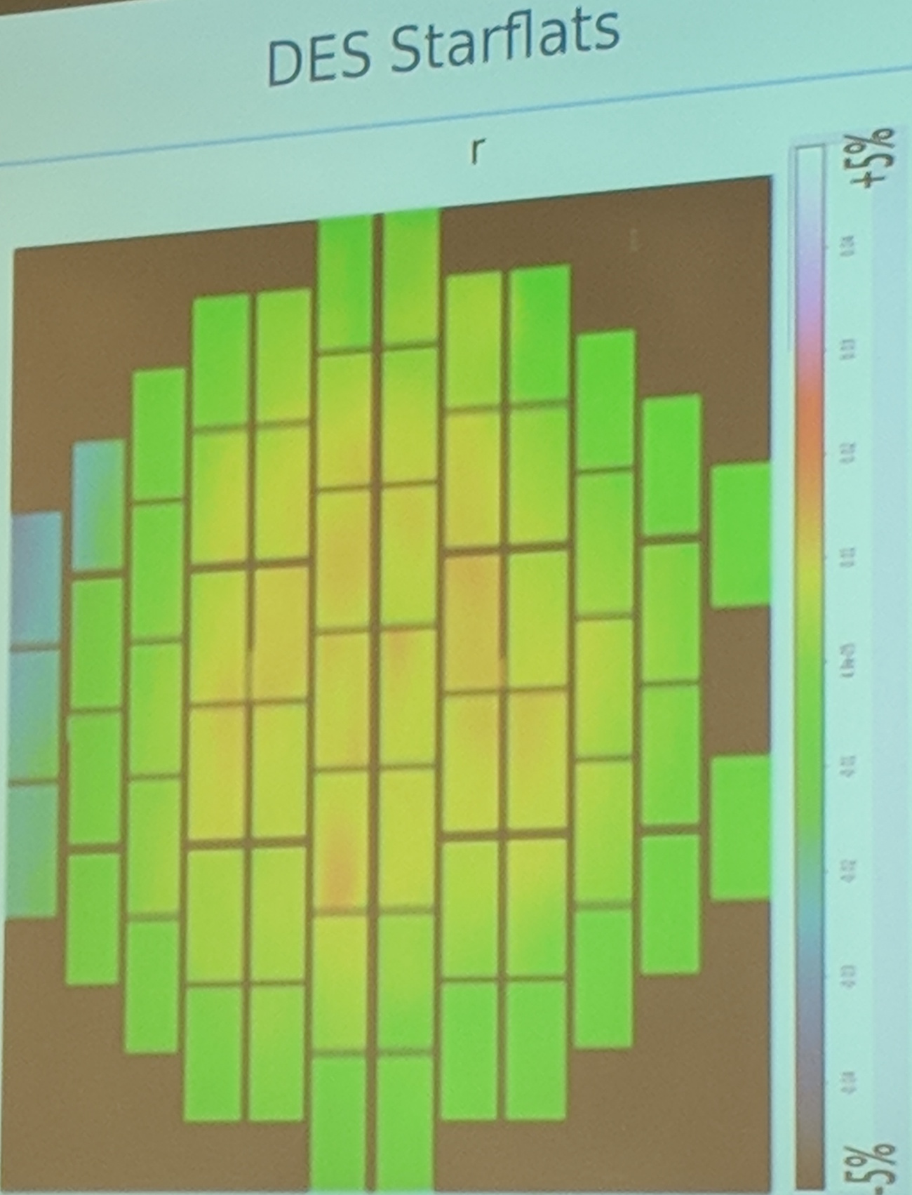
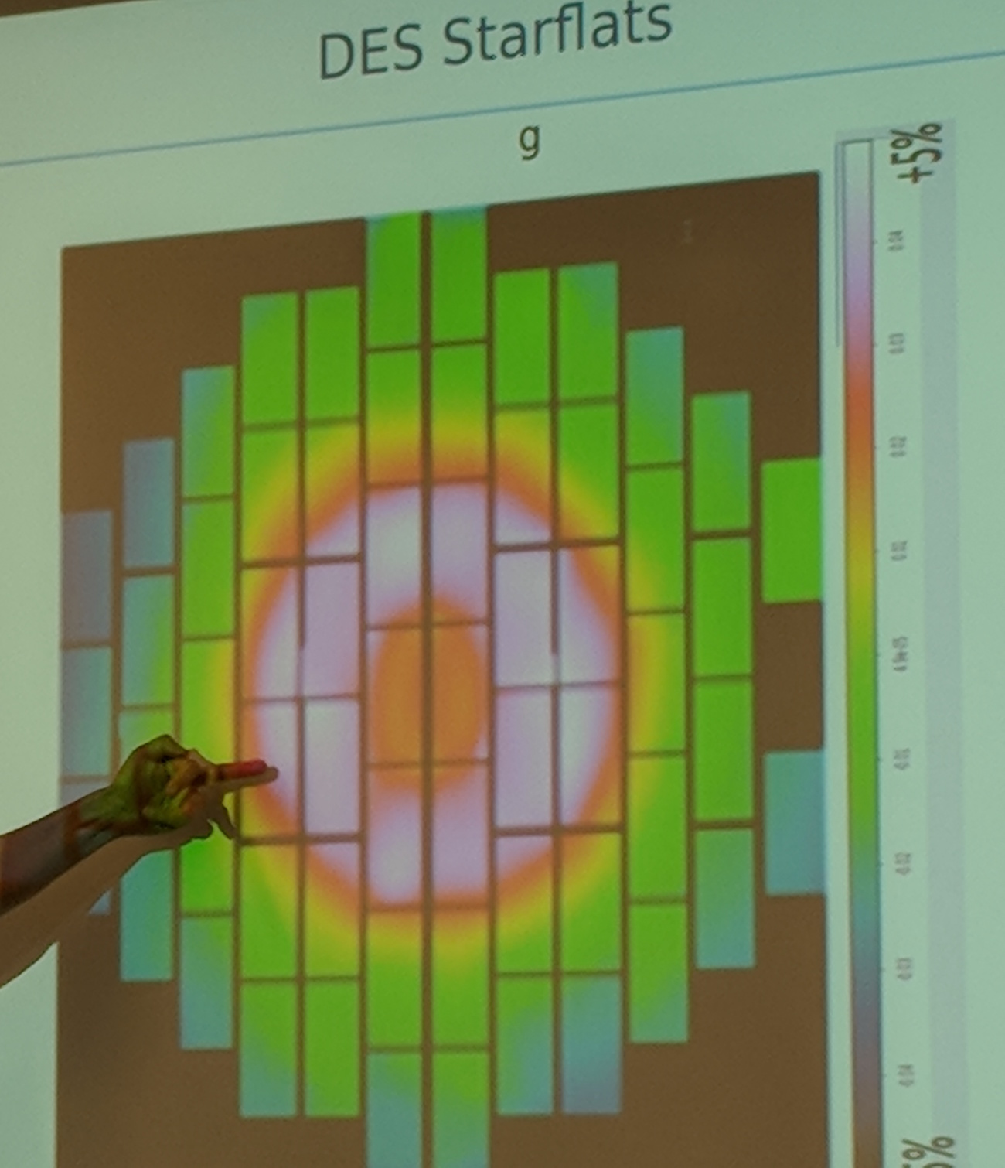
DES star-flats …for comparison
From Robert Lupton

Slide 21
Shutter timing error
Shutter open

Slide 22
Shutter timing error
Shadows of blades cross obstructions at different times for different field points

Slide 23
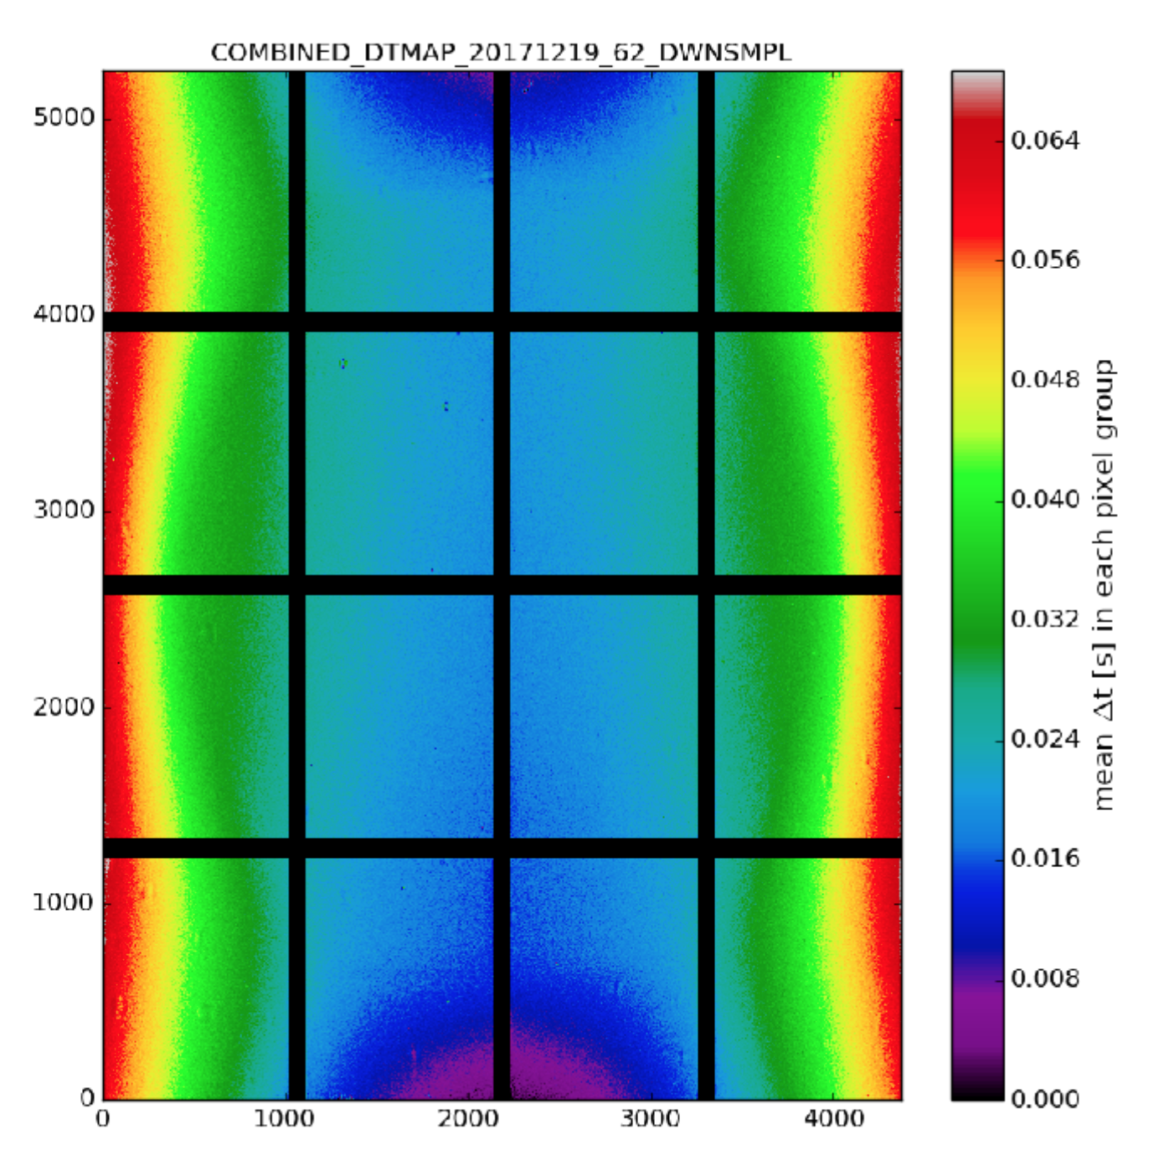
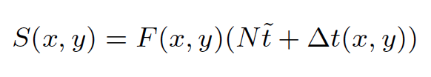

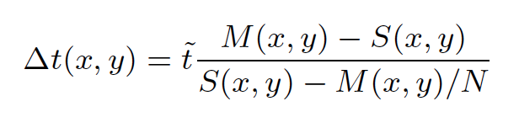
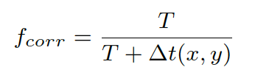
Timing error map
Only 0.2% error
but easily corrected.
Not present in dome flats since LED is pulsed when shutter is fully open.
Dec (pixels)
Single exposure:
Seconds
Multi-exposure:
Effective exposure time error:
HA (pixels)
Multiply signal by:

Slide 24
Flat field illuminator
Telescope docks to screen mounted on tower, not dome.
Makes light seal. Baffled to reduce scattering from corrector.

Slide 25
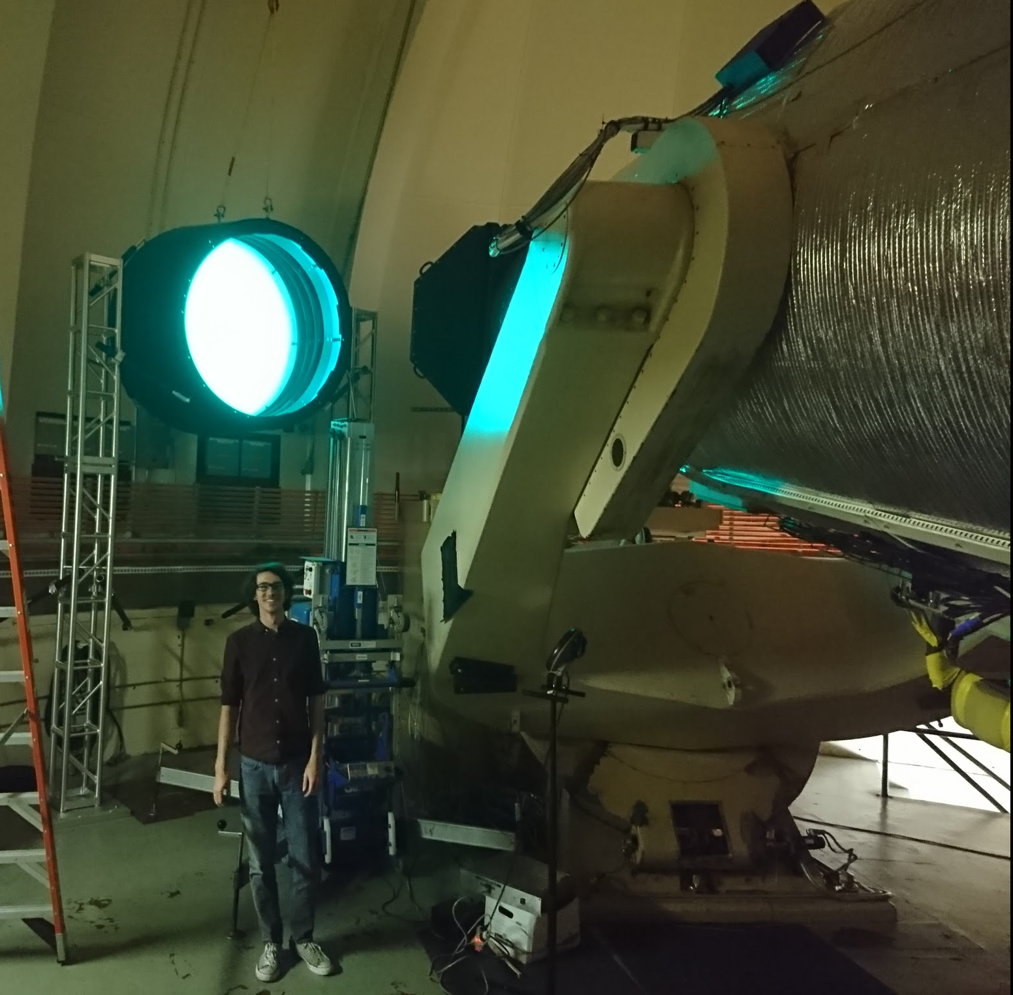
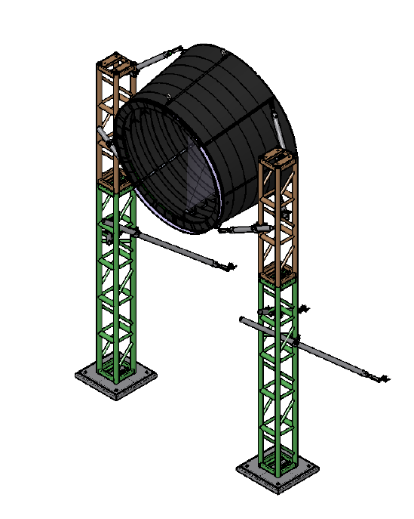

Slide 26
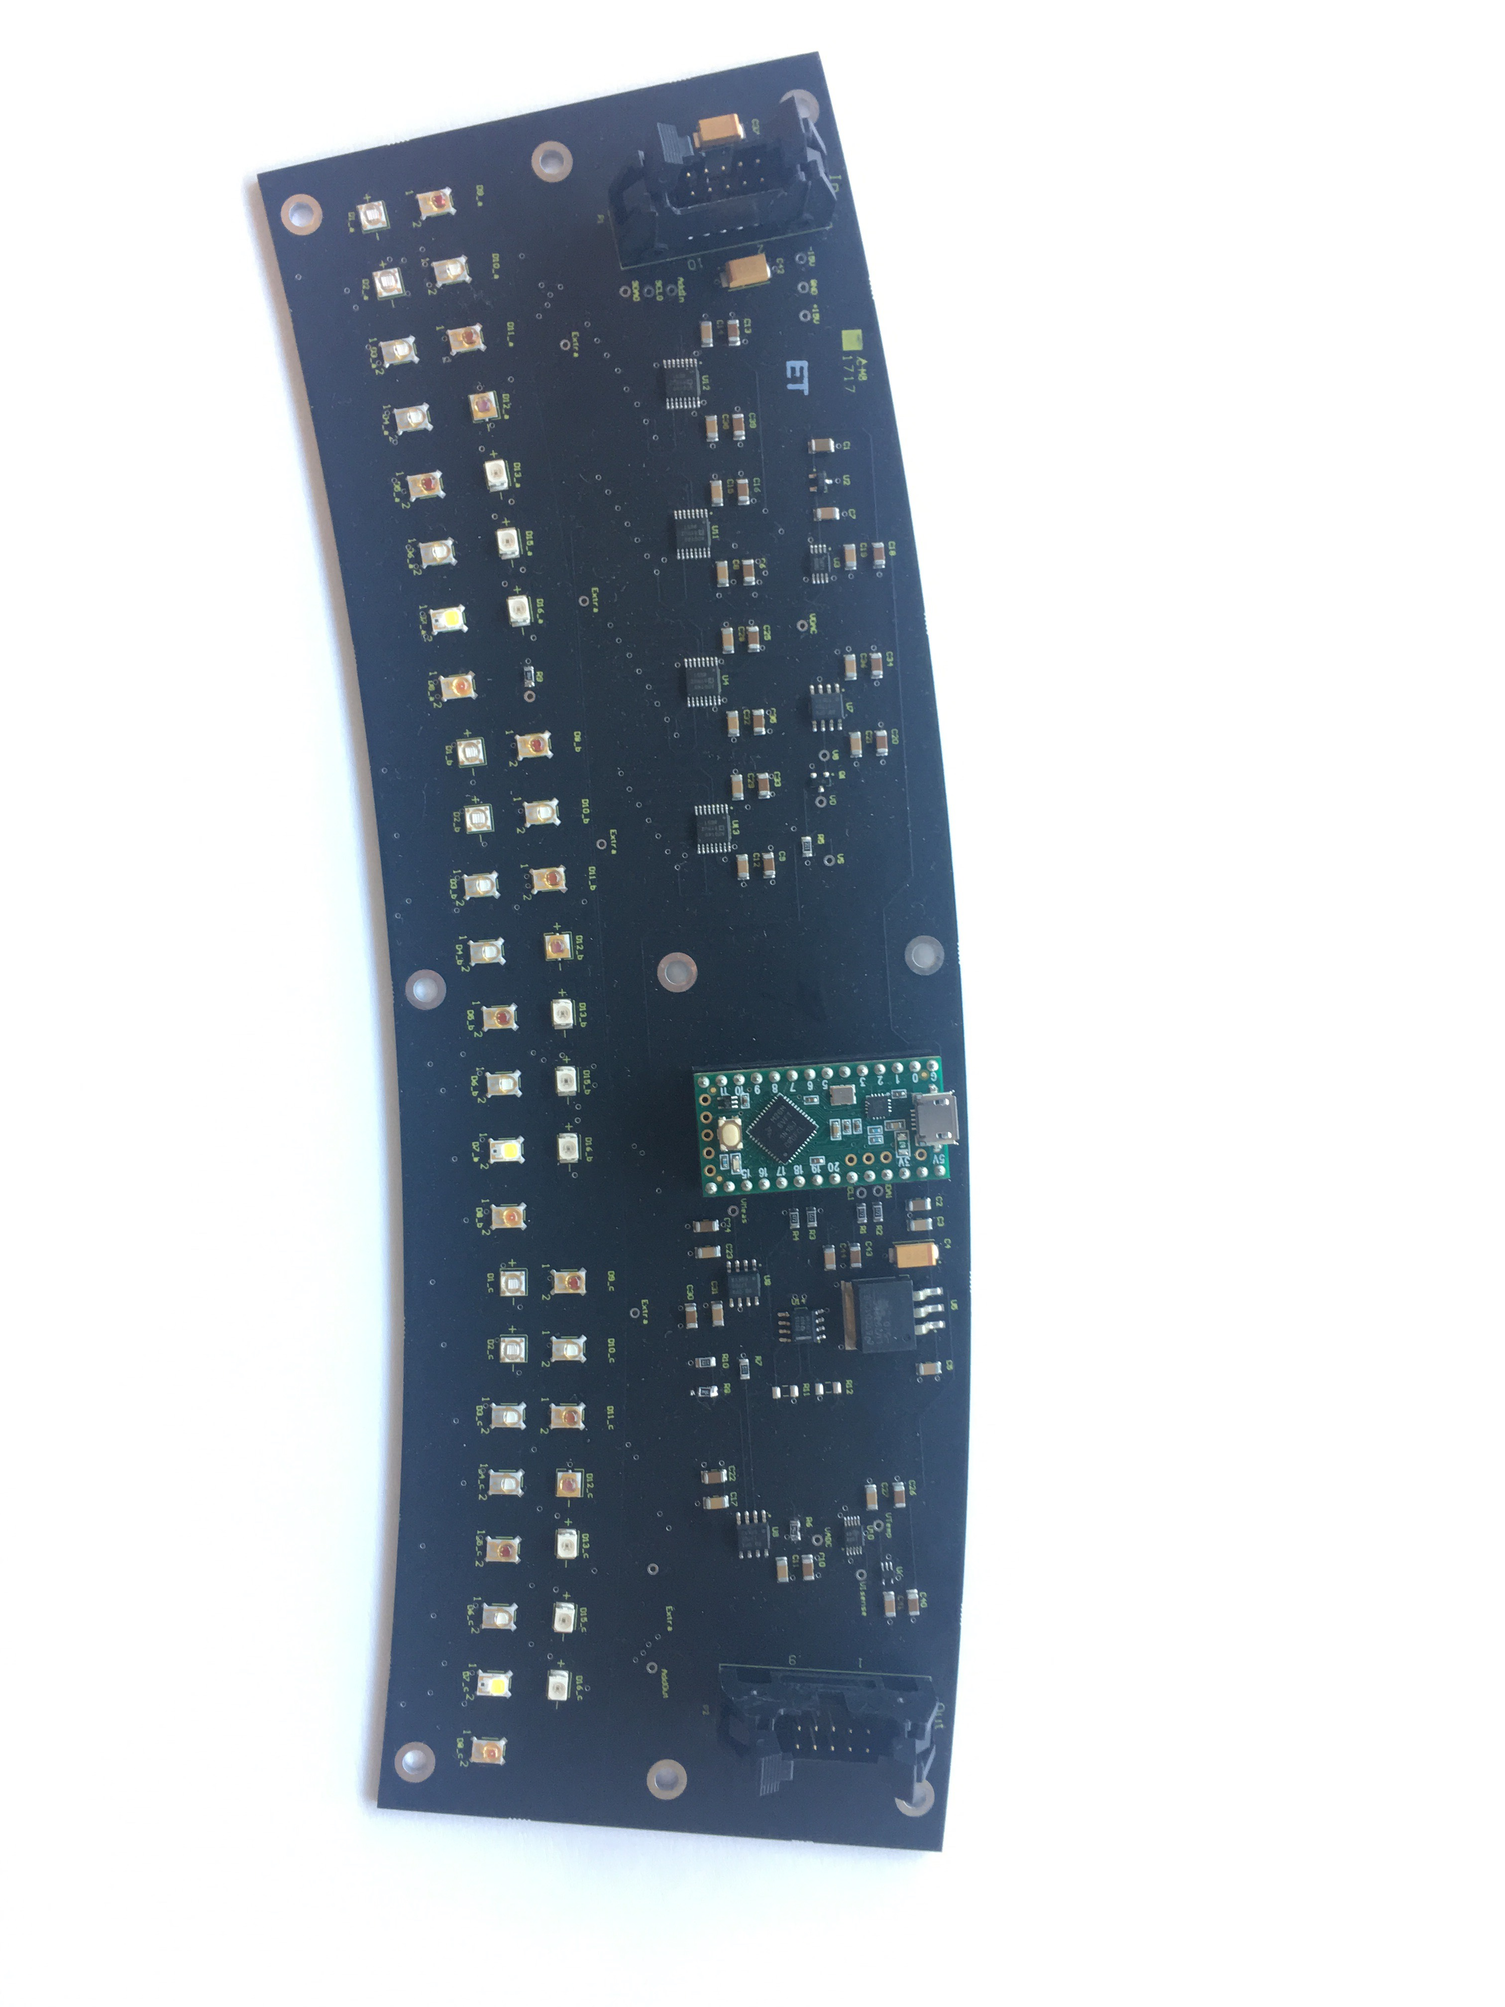
Flat Field Illuminator boards
Ring of 24 LEDs per color: individually addressable on
8 boards in ring; daisy chained; I2C serial bus
15 color options: 3 per filter passband plus some out-of-band.
Independent intensity control, per color, per board.
Read back of board temperature and LED forward voltage to allow correction for efficiency changes with LED junction temperature.
Independent photometer with calibrated photodiode to record long term intensity changes.
Teensy
Controller
Programmable Current Source
LED switches
Voltage & Temp RO
15 wavelengths, 3 LEDs each

Slide 27
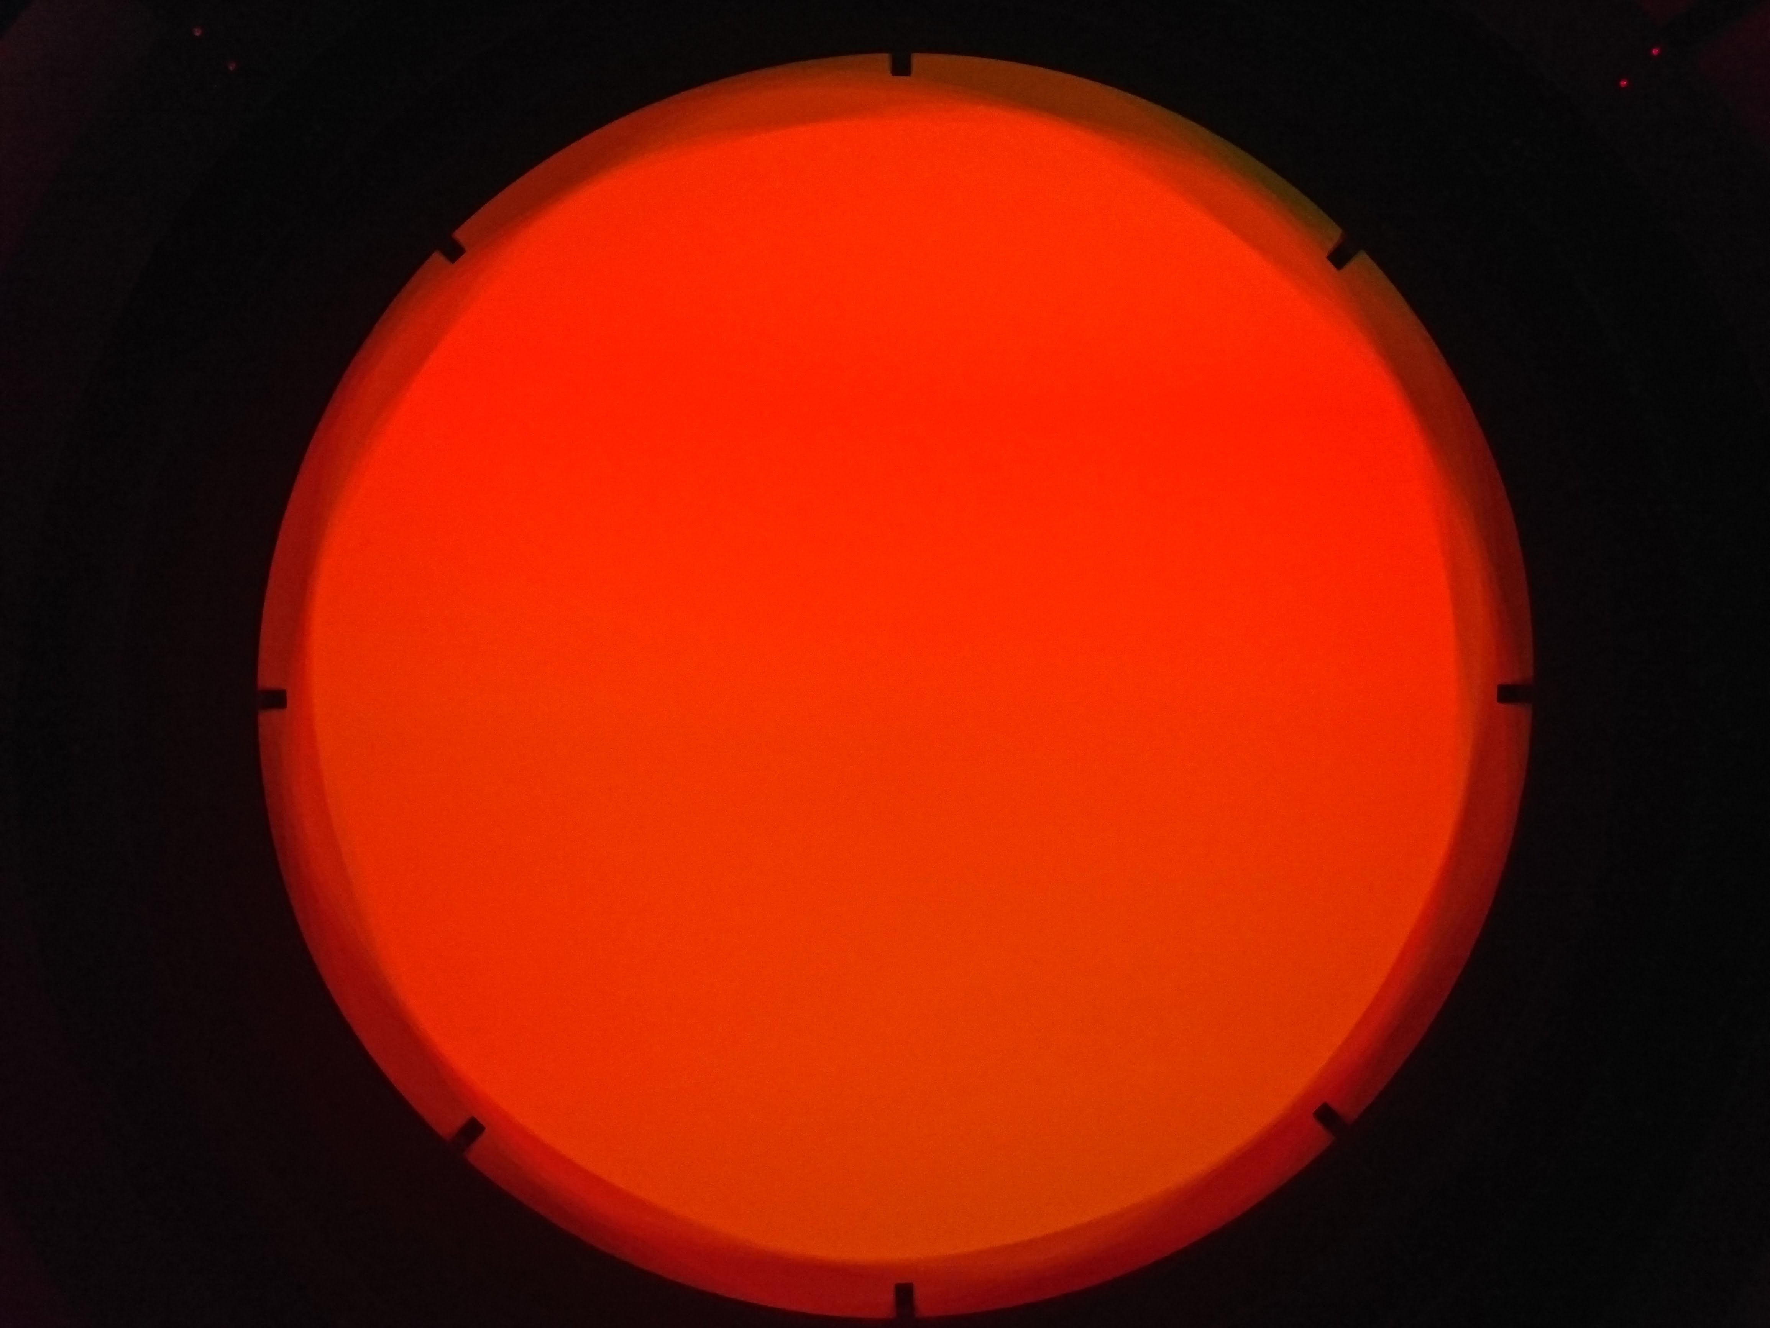
Beam footprint
Lies within shadowing at edges
…check this !

Slide 28
Intensity Uniformity
Uniformity measured with RGB CMOS camera,
calibrate by moving closer to screen
Mask off pattern beyond FoV of telescope
For each color channel, plot:
  Image/mean(Image)-1
RGB analysis is:
  (Image_R + Image_G + Image_B)
  / mean(Image_R + Image_G + Image_B)
  - 1

Slide 29
Line Cuts

Slide 30
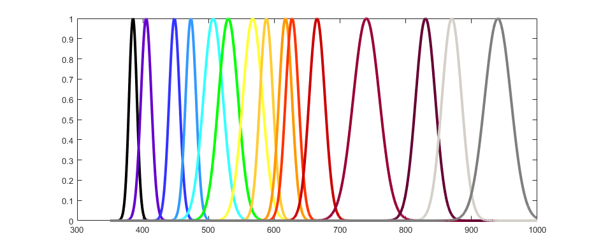
LED Wavelengths
G-Band
R-Band
I-Band
100
80
60
% Intensity
40
20
0
300
400
500
600
700
800
900
1000
Wavelength (nm)

Slide 31
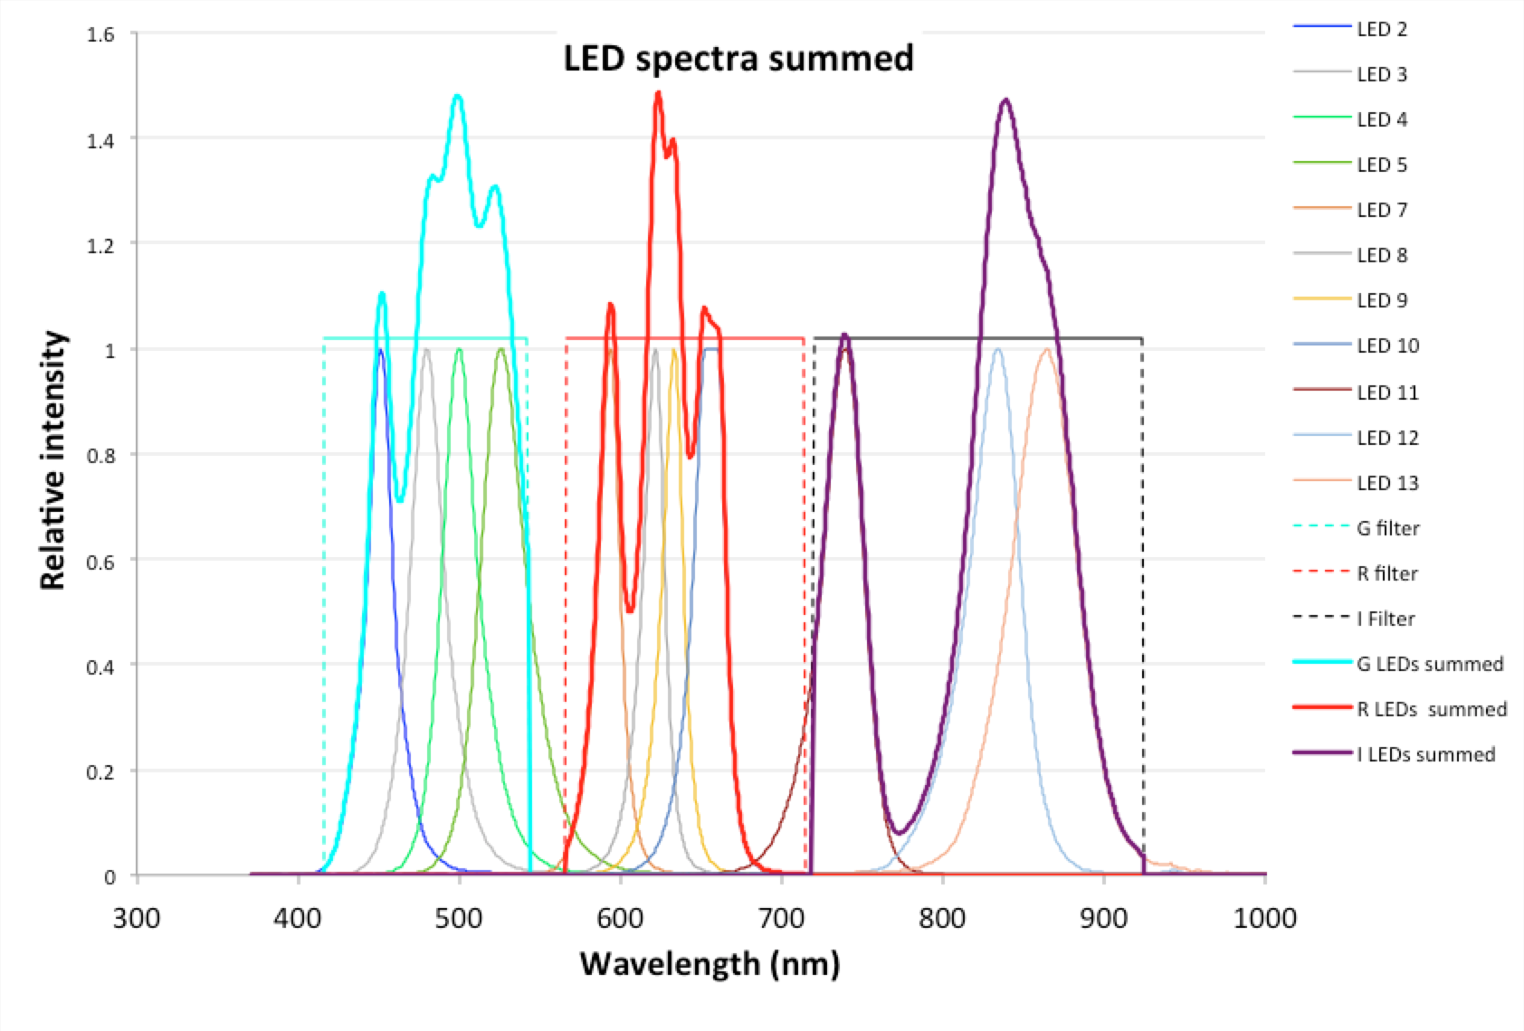
What spectral weighting?
For each filter{
Select Filter
  For each wavelength in passband {
  Open shutter
  Pulse LED
  Close shutter
  Read out }
  Sum flats for passband. }
LED current is set for similar signal in each color.
Currently uniform weighting is used but this is clearly not optimal as shown at left.

Slide 32
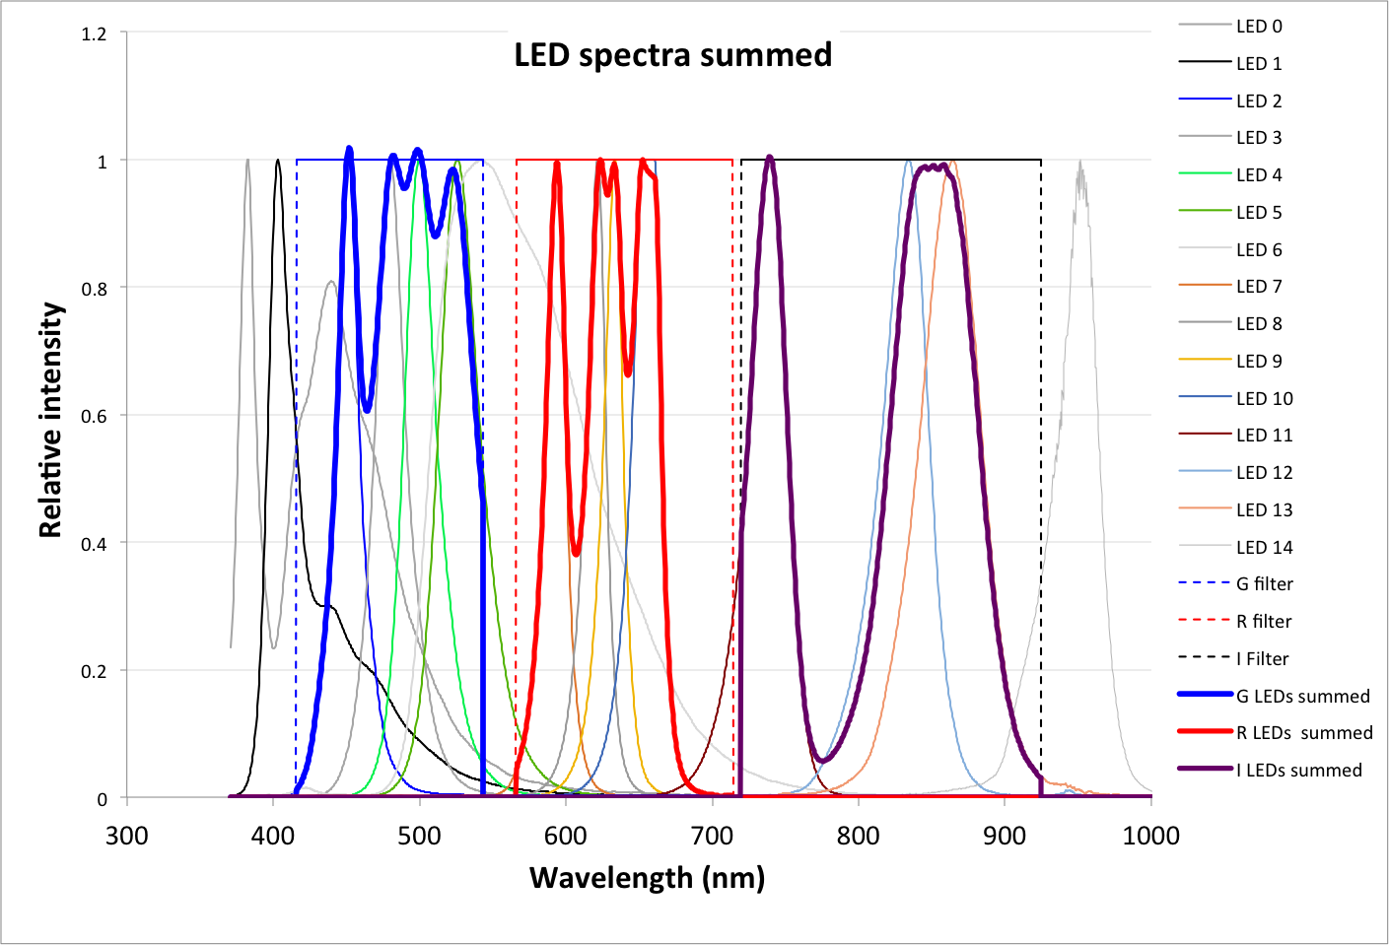
Alternate LED weighting
Example only.
Probably still not color balanced.

Slide 33
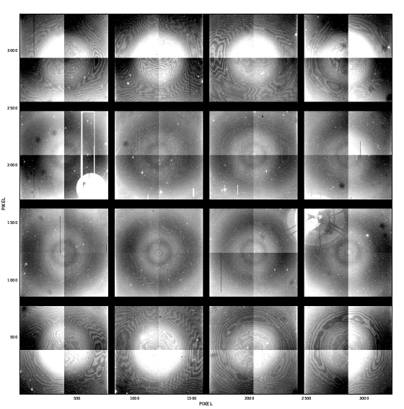
Flat field flip-book – I band example
Need to a set of full-mosiac reference flats
All wavelengths for all filters gives us:
  Flat field variation with wavelength for CCDs
  Out-of-band rejection by filters
  Leaks around edges of filters, and at focus CCDs.
  Bandpass uniformity

Slide 34
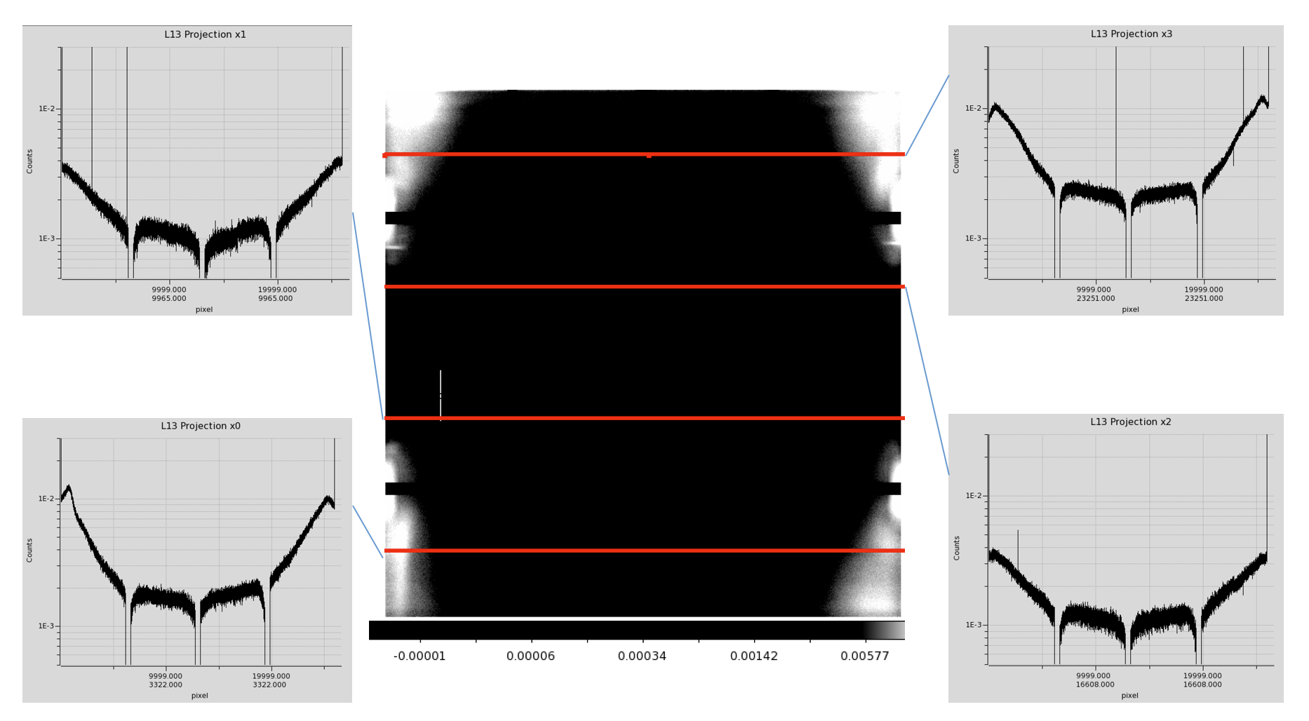
Example out-of-band flat (R filter)
e.g. Before frames redesigned…. Much better now

Slide 35
PRNU – low to mid frequencies suppressed
The following images are from WaSP
Each image has been divided by a box car filtered version of itself (~20x20 pixels) to leave only high patial frequencies.

Slide 36
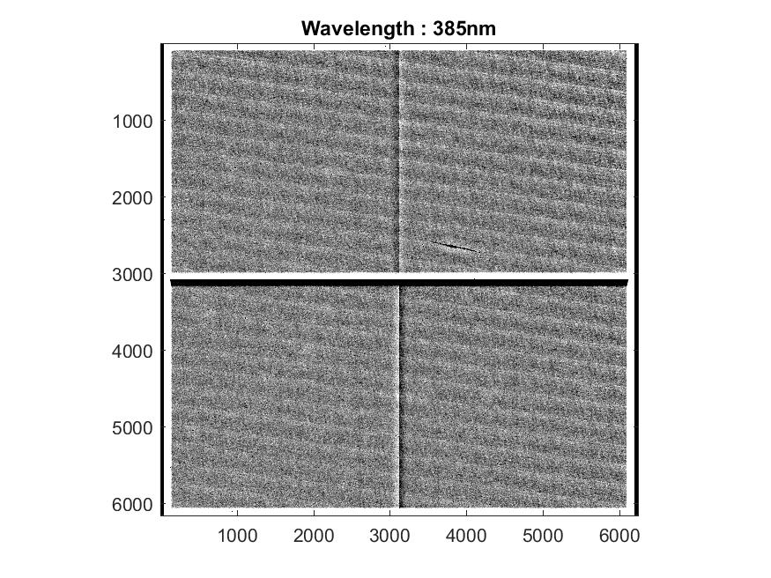
Flats vs wavelength
FLAT
from WaSP
Laser annealing pattern fro Boron implant at backside
AR coating defect or surface contamination

Slide 37
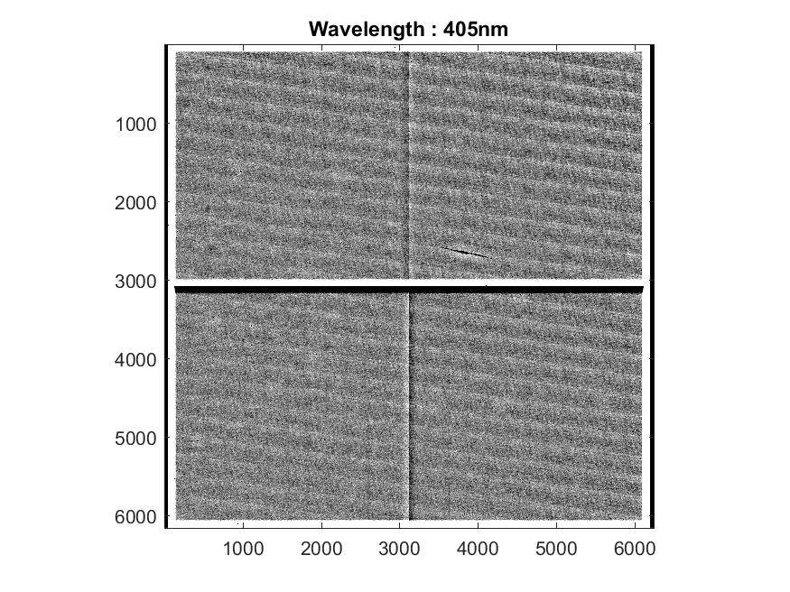
FLAT

Slide 38
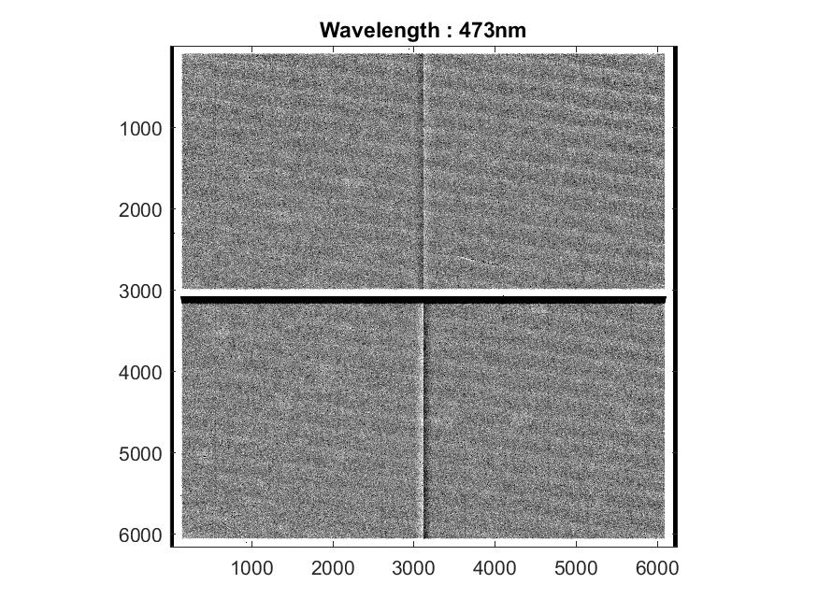
FLAT

Slide 39

FLAT

Slide 40

FLAT

Slide 41

FLAT

Slide 42


Slide 43
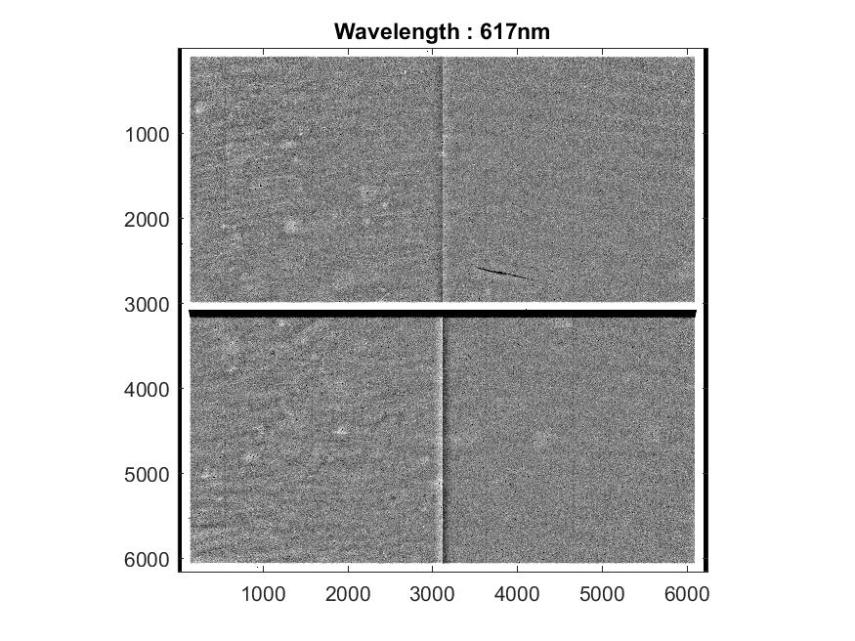

Slide 44


Slide 45

FLAT

Slide 46

FLAT

Slide 47

FLAT

Slide 48

FLAT

Slide 49
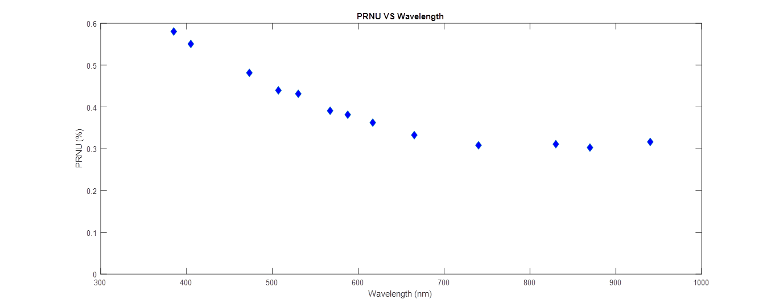
Non-uniformity vs wavelength
Sum of 10 flats → ~2E6 e-/pixel → shot noise ~0.07%
Stddev/mean in large region without dust spots,
after dividing by 200x200 box car to remove mild illumination gradient
Laser annealing pattern,
for Boron implant at back surface
Non-uniformity (%)
Probably pixel area, not sensitivity variation
Wavelength (nm)

