Slide 1
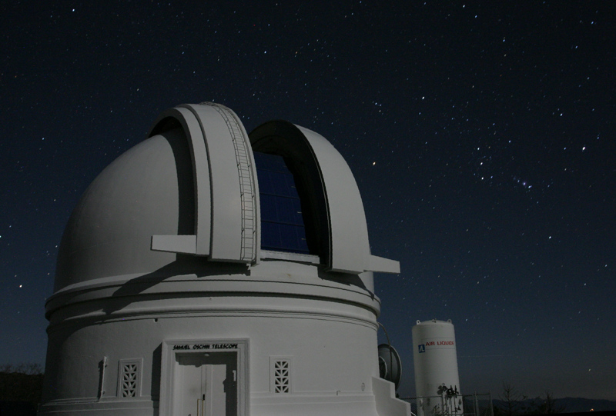

ZTF Real-Bogus Vetting
Umaa Rebbapragada
Jet Propulsion Laboratory
California Institute of Technology
Umaa.D.Rebbapragada@jpl.nasa.gov
with Ashish Mahabal , Charlotte Ward, Sara Frederick, Tiara Hung, Frank Masci, Richard Walters, Nadia Blagorodnova , Dmitry Duev, Brian Bue
Research described in this presentation was carried out at the Jet Propulsion Laboratory under a Research and Technology Development Grant, under contract with the National Aeronautics and Space Administration. Copyright 2018 California Institute of Technology. All Rights Reserved. US Government Support Acknowledged.

Slide 2
Talk Outline
Review of deployed versions
Training Set
Current performance
RB workflow
Next Steps

Slide 3
Deployed Versions
Version Tag: tX_fY_cZ
  X is training set version
  Y is feature version
  Z is classifier software version
Tag | Deployed
t1_f1_c1 | 12 Jan 2018
t6_f4_c3 | 04 April 2018
t7_f4_c3 | 08 May 2018
t8_f5_c3 | 29 May 2018
t12_f5_c3 | 07 Aug 2018

Slide 4
Training Data
Weekly feed from GROWTH (reals and boguses)
Zooniverse downloads on demand
Re-train every two weeks
Current 20923 total
  Real: 7936
  Bogus: 12987
59 features
  Alert meta-data not available to RB in real-time
Alerts are subject to filters that were designed to cut down on certain artifacts
  This filtered subspace generates our training

Slide 5
Magnitude

Slide 6
Positive/Negative Subtraction

Slide 7
Galactic Plane
Notes:
08-07 09:39 train-report INFO Galactic Plane
08-07 09:39 train-report INFO T=1984, F=18939
08-07 09:39 train-report INFO REALS: 7936 T=1463 F=6473
08-07 09:39 train-report INFO BOGUS: 12987 T=521 F=12466

Slide 8
Filters

Slide 9
CCDID

Slide 10
Cross Validation Performance
Vers | Train Date | #Train | # Real | # Bogus | # Feat | FPR | FNR | ACC | FNR at 1% FPR
t1_f1_c1 | 10 Jan | 1620 | 1316 | 304 | 67 | 30.7 | 3.8 | 91.2 | 36.4
t6_f4_c3 | 17 Mar | 5498 | 2749 | 2749 | 61 | 11.3 | 3.8 | 93.6 | 27.0
t7_f4_c3 | 11 April | 7767 | 3361 | 4406 | 61 | 4.8 | 7.6 | 94.0 | 17.1
t8_f5_c3 | 7 May | 14762 | 5076 | 9686 | 59 | 10.1 | 2.7 | 93.6 | 20.1
t12_f5_c3 | 8 Aug | 20923 | 7936 | 12987 | 59 | 14.9 | 7.2 | 89.0 | 33.6

Slide 11
Test Set Performance
Inclusive of 7/5/2018 through 8/4/2018
Num reals: 662, Num bogus: 666

Slide 12
Test Set Performance
Inclusive of 7/5/2018 through 8/4/2018
Num reals: 662, Num bogus: 666
Bogus
Reals

Slide 13
Galactic Plane Analysis
|b| > 10
|b| < 10

Slide 14
GP Analysis cont.
|b| < 10 bogus
|b| < 10 reals

Slide 15
RB Workflow
Zooniverse
å
Zooniverse
Merge Candids
(filter conflicts)
Labeled Data
Split Train/Test
Training Set
Balance Classes
GROWTH
Reals + Boguses
IPAC
Train Random Forest
GROWTH
Marshall
Test Set
Classifier
Analysis

Slide 16
RB Workflow (Future)
Zooniverse
2. Automate cross-matching process
å
Catalog Cross Matches
Override Labels
4. Override labels
Zooniverse
Merge Candids
(filter conflicts and old data, eliminate contaminated)
Labeled Data
Split Train/Test
Training Set
Balance Classes
GROWTH
Reals + Boguses
3. Filter contaminated
Train Random Forest
IPAC
GROWTH
Marshall
ALERTS
(Kowalski)
Test Set
ALERTS
(Kowalski)
Classifier
1. Bring in light curve observations as real
Analysis
5. Discussion expansion of feature space to include alert meta-dataa

Slide 17
Future Work
Automate process of classifier training, performance analysis
Increase Labeling Sources
  Light-curves
  Automate cross-matches to catalogs
  More feedback from marshalls
Eliminate contamination
  Investigating automated methods
Active learning integrated into Zooniverse
  efficient method of training data collection
Deep Learning (2019)

