Slide 1
Weizmann Institute SN II projects
Overview presentation for the ZTF SN-WG
October 2018

Slide 2
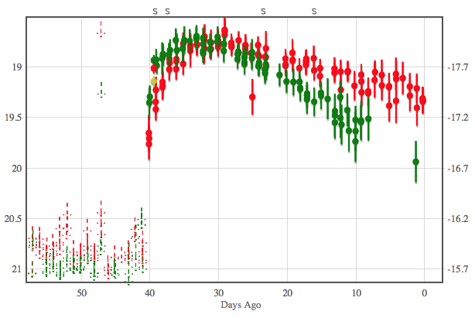
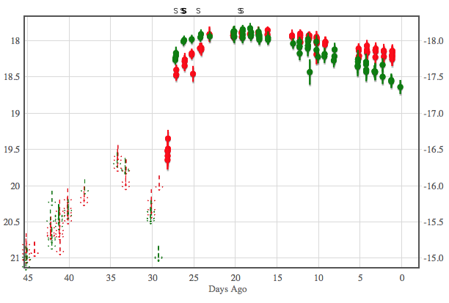
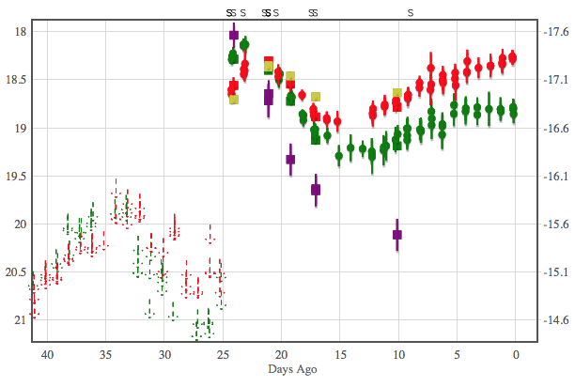
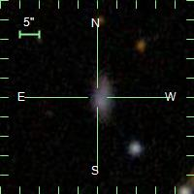
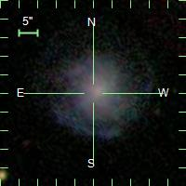
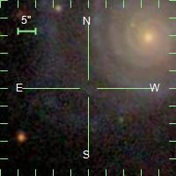
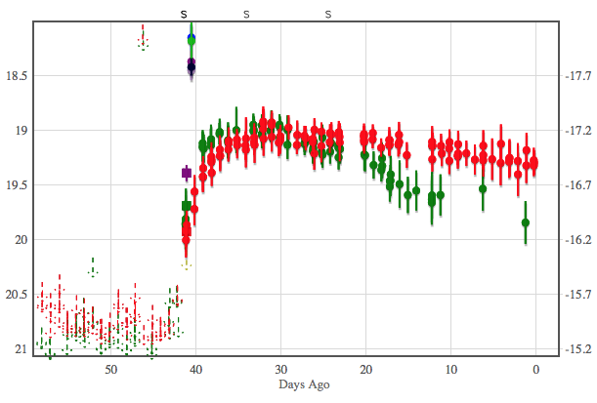
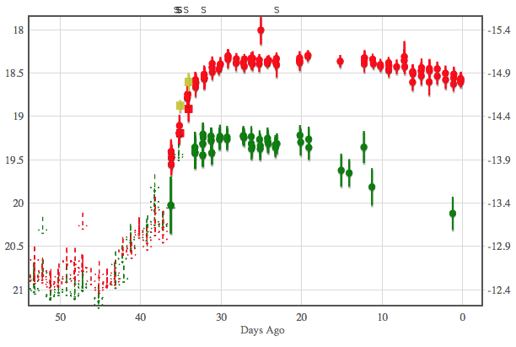
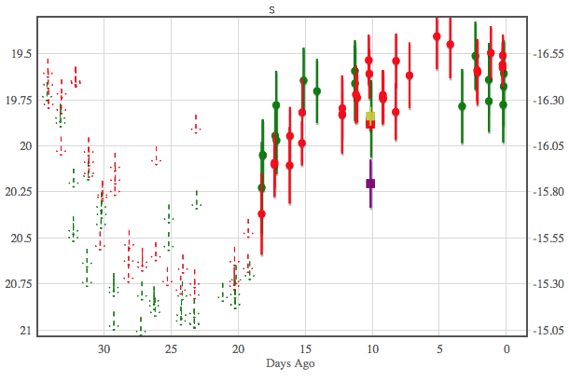
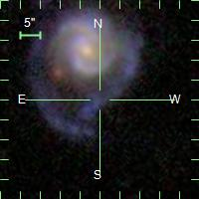
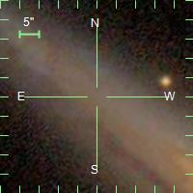
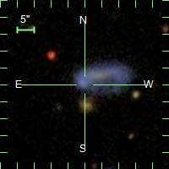
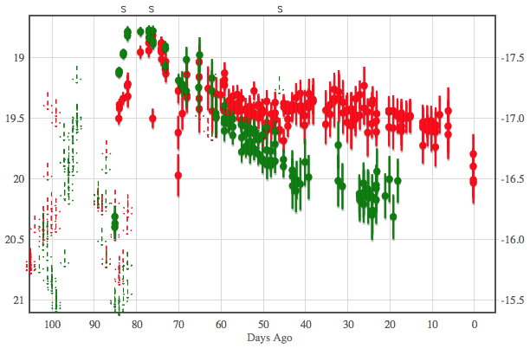
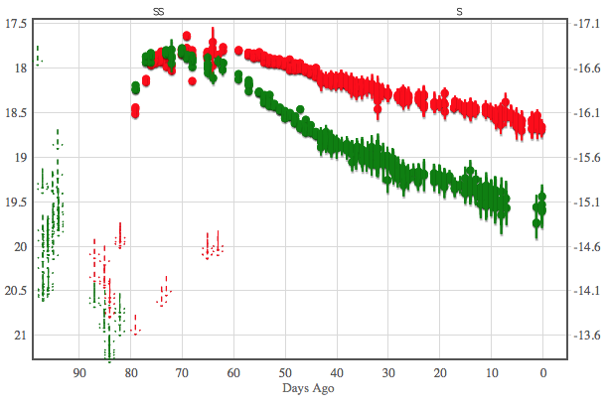
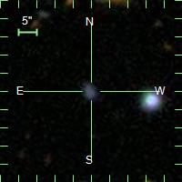
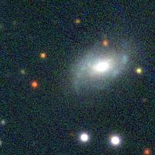
ZTF young SN II sample
ZTF18abcptmt Type II 1-d lim Flash
ZTF18abeajml Type II 1-d lim Flash
ZTF18abffyqp Type II 1-d lim Flash
Z=0.05
Z=0.036
Z=0.03
Rachel Bruch Ph.D project
Selected to have:
Tight constraints on explosions time
Good photometry
A confirmation spectrum
No indication for long-term interaction
ZTF18abckutn Type II(P?) 1-d lim
ZTF18abdbysy Type II(P?) 1-d lim
ZTF18abgqvwv Type II 1-d lim
Z=0.04
Z=0.01
Z=0.038
ZTF18aarpttw Type II 2-d lim
ZTF18aatyqds Type II(P?) 3-d lim
ZTF18abeajml Type II 1-d lim
Z=0.047
Z=0.02
Z=0.04
Look at “SN II” Marshal program to see full sample

Slide 3
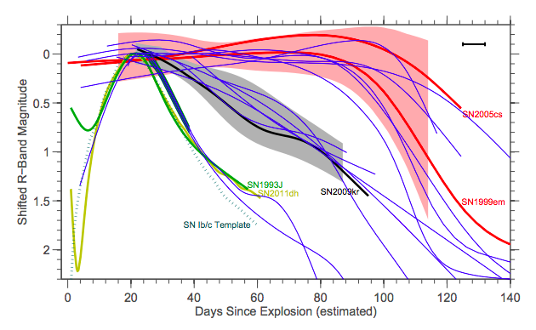
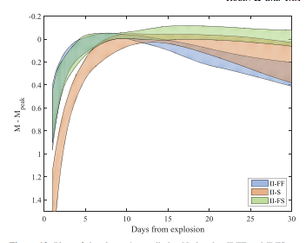
ZTF young SN II sample
Main science questions:
What fraction of SN II show flash features during days 1-2? (improve on Khazov 16)
Use unprecedented ZTF early LCs to study SN II LC morphology, implications
Other analysis and ideas: compare LCs to previous r-band samples (Arcavi, Faran, Rubin): are there robust subclasses?
Use g+r to synthesize V band – compare to work from CSP (Anderson, etc)
How can we explain long-term LC structure? (Ni, shock cooling and how to combine)
Spectral evolution during drop from plateau
Ni tails and correlations with other parameters
Data availability and needs:
Minimal data: ZTF LCs, confirmation spectrum (SEDM ok) – in hand
Flash spectra on days 1-2: resources secured, help always good!
Late time spectra and photometry – proposals + help from collaboration (Caltech, NOT…)

Slide 4
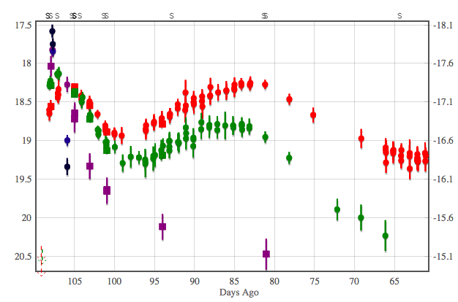
SN 2018dfi (ZTF18abffyqp)
Part of Noam Ganot’s thesis project (analysis of early optical+UV SN LCs; 2 previous papers on PTF+GALEX)
Object has an excellent optical+UV LC during first few days
Main science questions:
Model early UV+visible LC of event
Derive progenitor properties
Late time paper: led by Fremling+OKC
Data availability and needs:
All data in hand
Need to adjust modelling code for new data

Slide 5
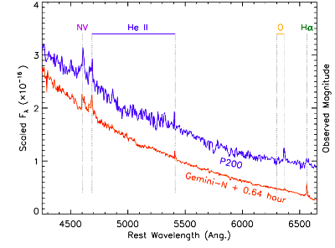
SN 2018dfi (ZTF18abffyqp) - II
Postdoc Yi Yang to look at two flash spectra (Gemini and P200) obtained within <1 hour of each other
Main science questions:
Derive limits on emitting region from light crossing time
Implications for CSM configuration and origin
Data availability and needs:
All data in hand
Analysis ongoing

Slide 6
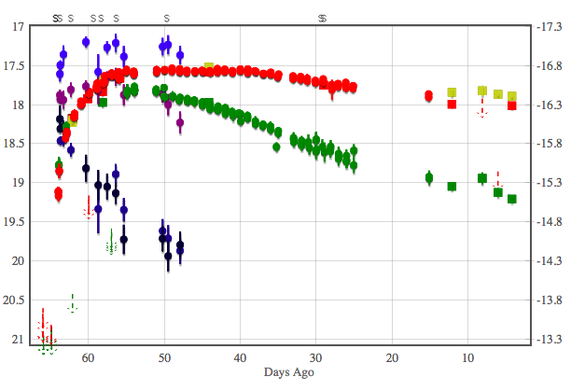
SN 2018fif (ZTF18abokyfk) - II
Postdoc Maayane Soumagnac to look at this Type II SN with apparent slow cooling (long-lived UV emission)
No signs of interaction (spectroscopic)
Main science questions:
Is the cooling really slow? (comparison to other events)
Can we explain with regular shock-cooling models?
Data availability and needs:
All data in hand; need to re-reduce Gemini spectrum
Analysis ongoing

Slide 7
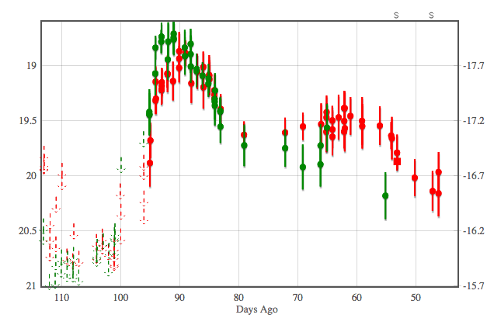
Double-humped non-interacting SNe II
Ofer Yaron trying to understand non-interacting SNe II with double-humped light curves
Main science questions:
What drives this behavior?
ZTF18abcfdzu has a double hump but is possibly interacting – OKC looking into that one
ZTF18abimhfu (SN2018efj)
Data availability and needs:
All data in hand; need careful photometry of ZTF18abgqvwv (SN 2018egh), also, a late-time spectrum (WHT data being analyzed)
Analysis ongoing

