Slide 1
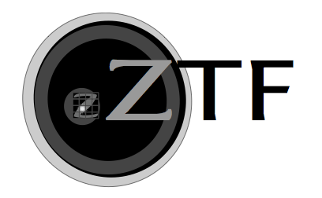
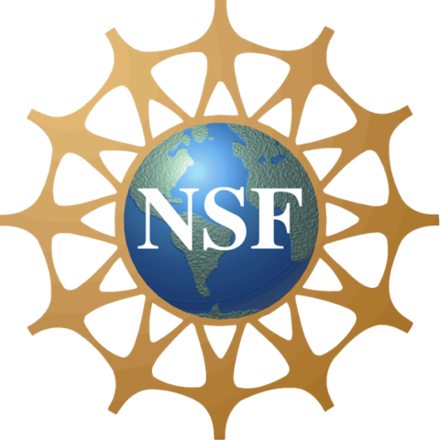
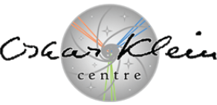
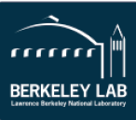
Cometary Science With the Zwicky Transient Facility
Michael S. P. Kelley, Dennis Bodewits,
James “Gerbs” Bauer, Tony L. Farnham,
& Matthew M. Knight
University of Maryland
AOGS 2018 Honolulu, HI

Slide 2
COMETARY OUTBURSTS HAPPEN
But why?

Slide 3
FIND OUTBURSTS
Then study them.

Slide 4
TIME-DOMAIN SURVEY
Like ZTF!

Slide 5
Cometary Science With the Zwicky Transient Facility
Outbursts
Michael S. P. Kelley, Dennis Bodewits,
James “Gerbs” Bauer, Tony L. Farnham,
& Matthew M. Knight
University of Maryland
AOGS 2018 Honolulu, HI

Slide 6
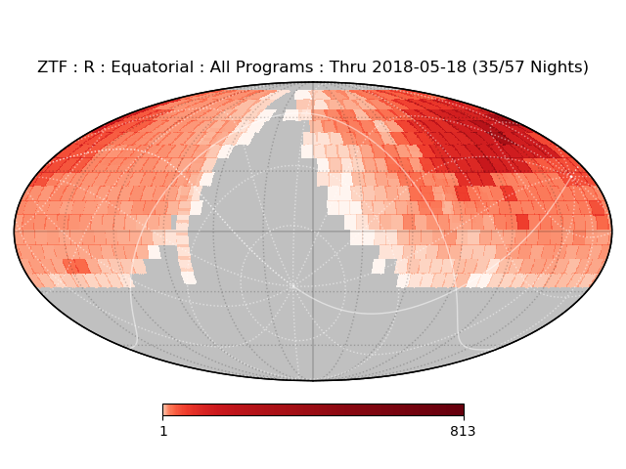
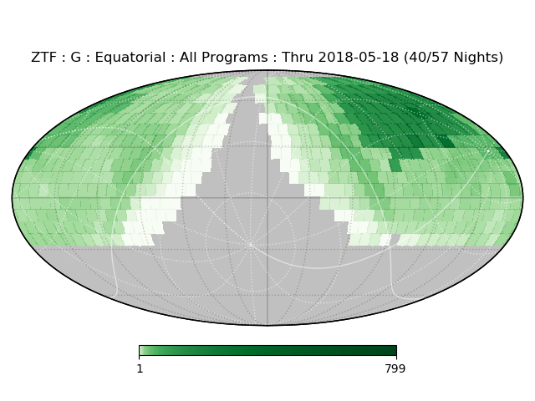
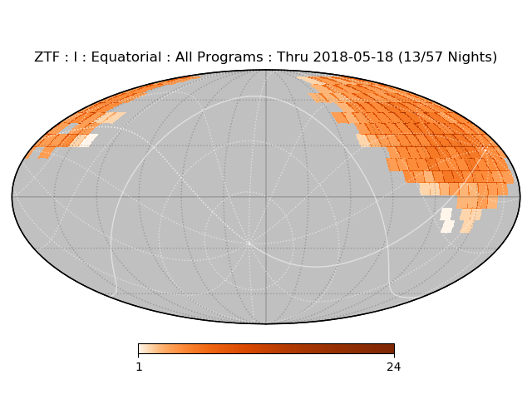
Observing all the comets all the time improves our chances of catching an outburst.

Slide 7
ZTF Observing Programs
40% Public survey
Northern sky, 3-day cadence
Galactic plane, nightly
40% ZTF partnership time
Mainly extragalactic, nightly
Includes Solar System twilight survey
20% Caltech time
→ What do these mean for cometary outbursts?

Slide 8
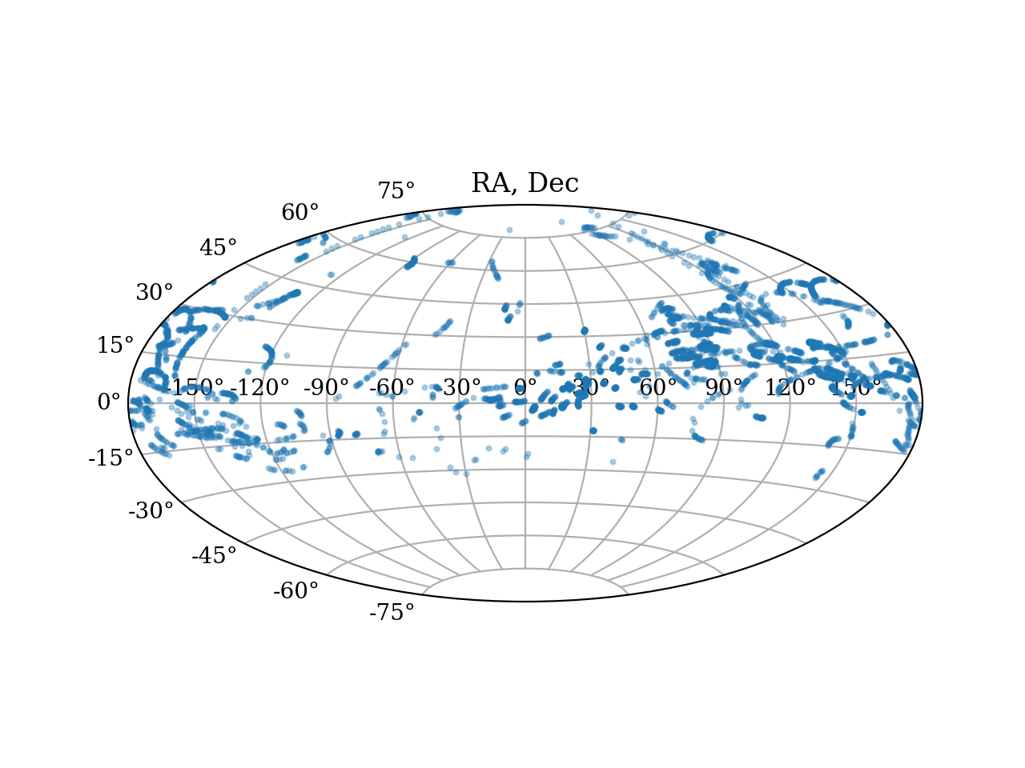
Comet search: Dec 2017 – May 2018
Nominal AB mag 5-sigma limit is r’=20.4
Search for all targets brighter than V=22 mag:
4100 ephemeris positions covered

Slide 9
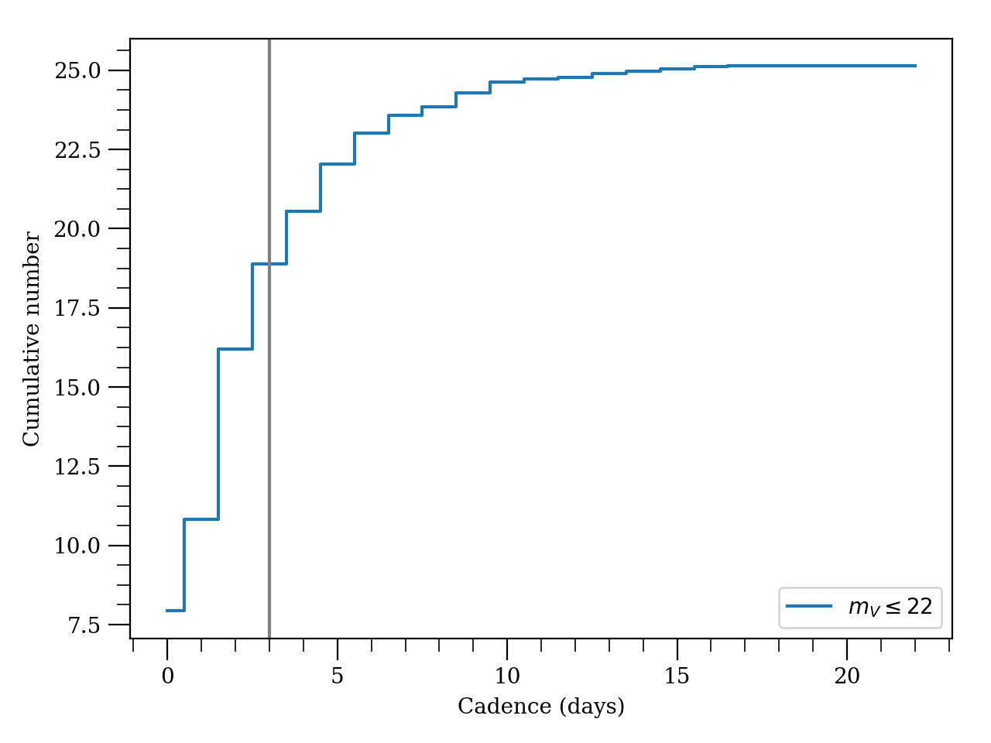
Since survey operations began in mid March:
18 comets observed each night with 3-day cadence or less
(includes weather losses)

Slide 10
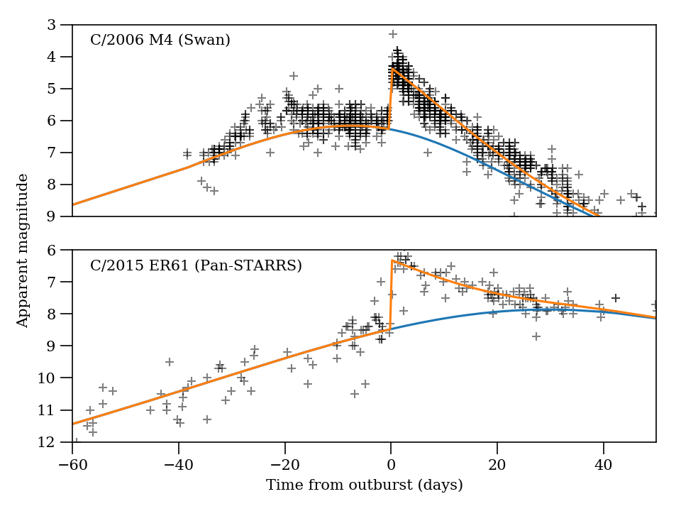
This cadence is good for medium to large outbursts, especially if fragments or prolonged activity are produced.
Δm ~ 2 mag
~9 day exponential decay in total magnitude.
These data are photometry reported to Crni Vhr Observatory. ZTF photometry is better!

Slide 11
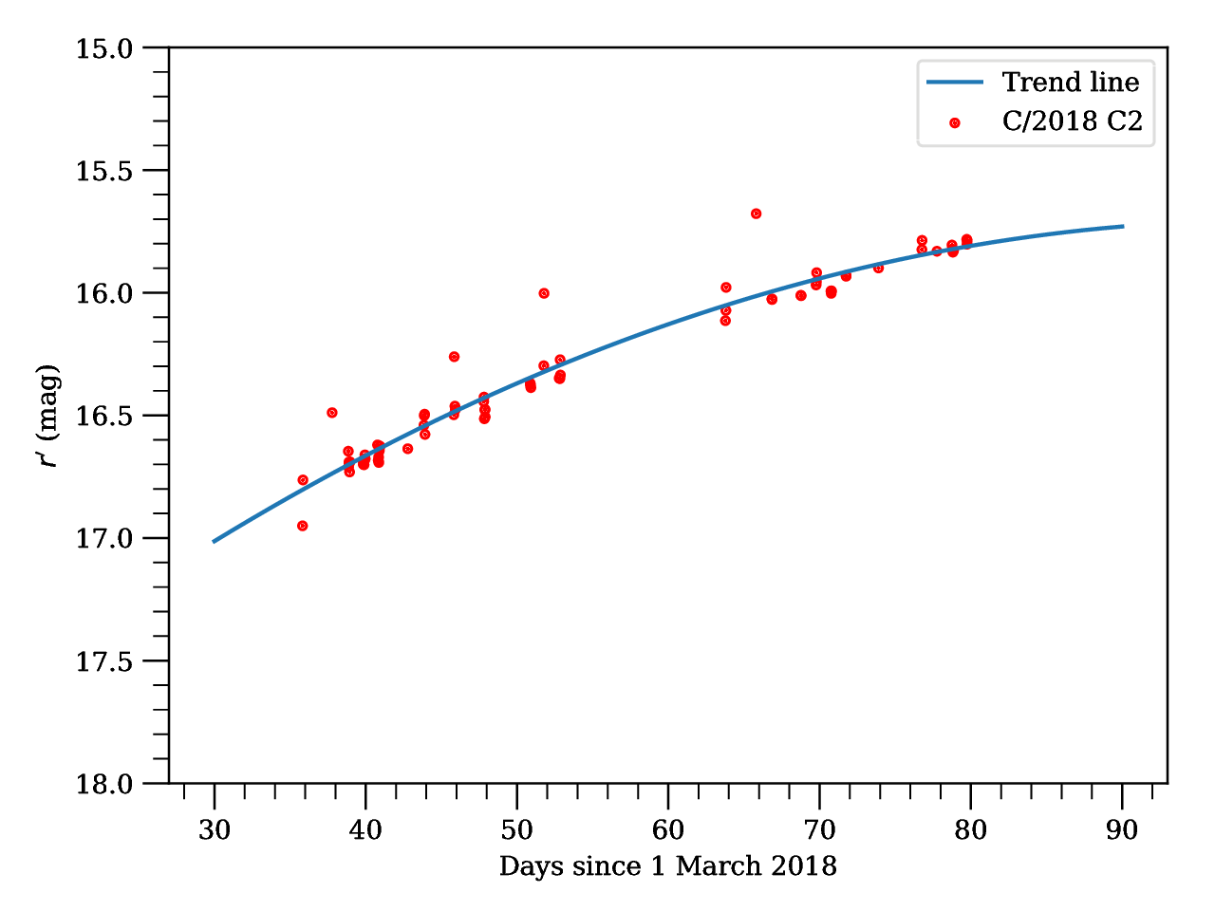
Two approaches to detecting outbursts / variability: photometric, morphological
C/2018 C2 (Lemmon)
1 stdev = 0.08 mag
0.2 mag excursions are background stars that will be subtracted in the future

Slide 12
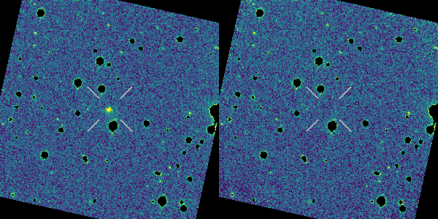
Two approaches to detecting outbursts / variability: photometric, morphological
Nightly stack
Baseline subtracted
C/2017 K2 (PanSTARRS)

Slide 13
To do list
ZTF Alert Stream: find comets and assess completeness. Public alert stream is live as of June 4:
http://www.ztf.caltech.edu/
Aside from outbursts: Gas/dust ratio, dust color, activity vs rh & season.
Automatic PCCP object checking.
Find outbursts of “asteroids.”
Big thanks to Quan-Zhi Ye, Frank Masci, the ZTF SSWG, Caltech, IPAC, and Palomar Observatory.

