Slide 1
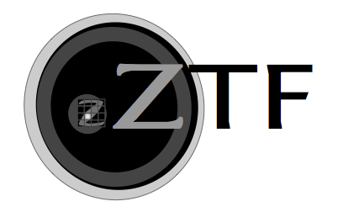













Solar System Science with the Zwicky Transient Facility
Dennis Bodewits (U. Maryland)
Quan-Zhi Ye (Caltech/IPAC), Rex Chang (NCU), Gerbs Bauer (UMD),
Bryce Bolin (UW), Yu-Chi Cheng (NCU), George Helou (Caltech/IPAC),
Wing Ip (NCU), Lynne Jones (UW), Mario Jurić (UW), Michael Kelley (UMD),
Emily Kramer (JPL), Zhong-Yi Lin (NCU), Frank Masci (Caltech/IPAC),
Joachim Moeyens (UW), Chow-Choong Ngeow (NCU), Tom Prince (Caltech)

Slide 2
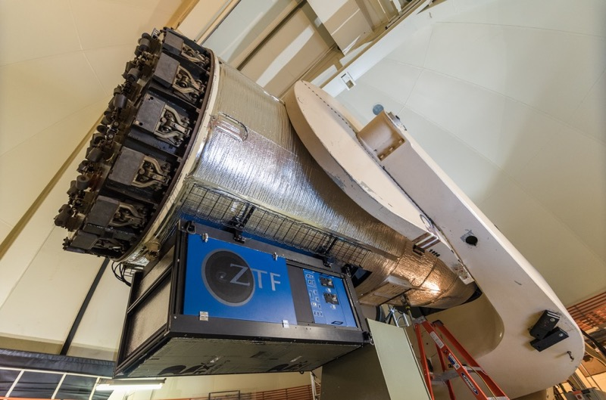
Zwicky Transient Facility
48-inch Samual Oschin-Schmidt telescope at Palomar
Active area: 47 deg²
Exposure time: 30 sec
Median image quality (r): 2.0” FWHM
Median Depth (r): 20.4
Yearly exposures per field: 290
Areal Survey Rate: 3760 deg²/hr
Filters: g, r, i
Caltech optical observatories

Slide 3
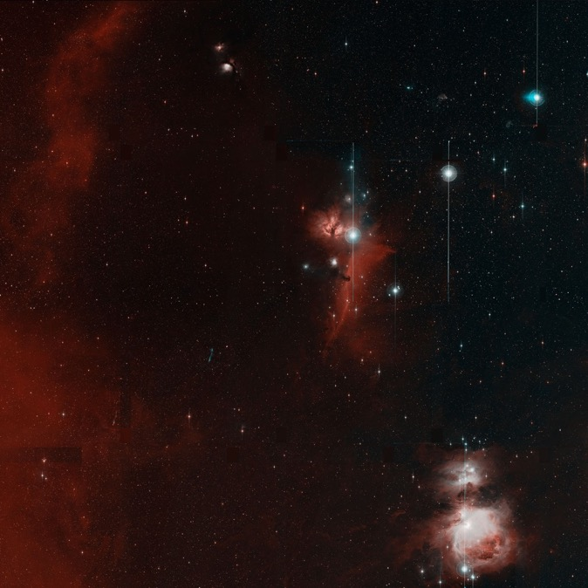
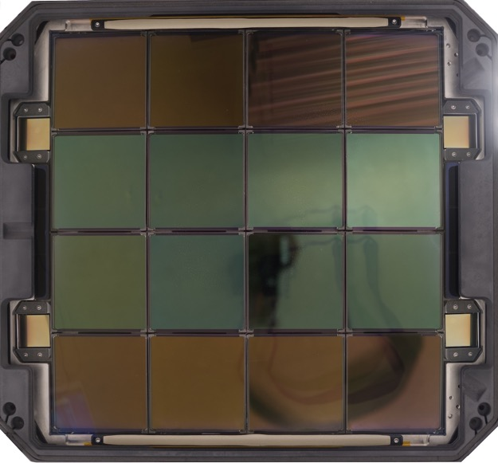
Zwicky Transient Facility
First light: Orion
47 square degrees, 24,000 x 24,000 pixels
235 full moons
Caltech Optical Observatories

Slide 4
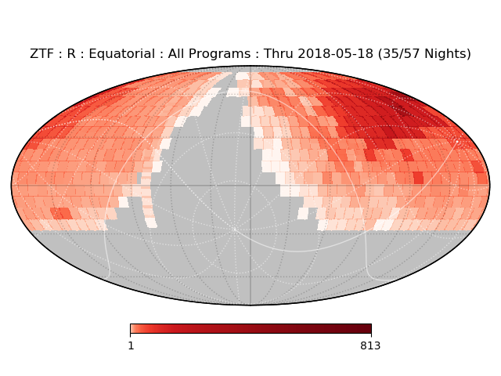
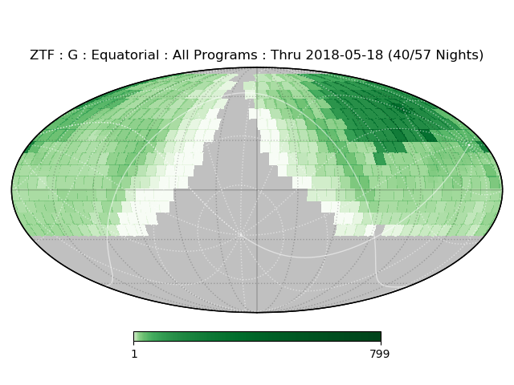
ZTF observes several programs
40% Public survey
  Northern sky, 3-day cadence
  Galactic plane, nightly
40% ZTF partnership time
  Mainly extragalactic, nightly
  Includes twilight survey for near-Sun comets and Earth Trojans
20% Caltech time

Slide 5
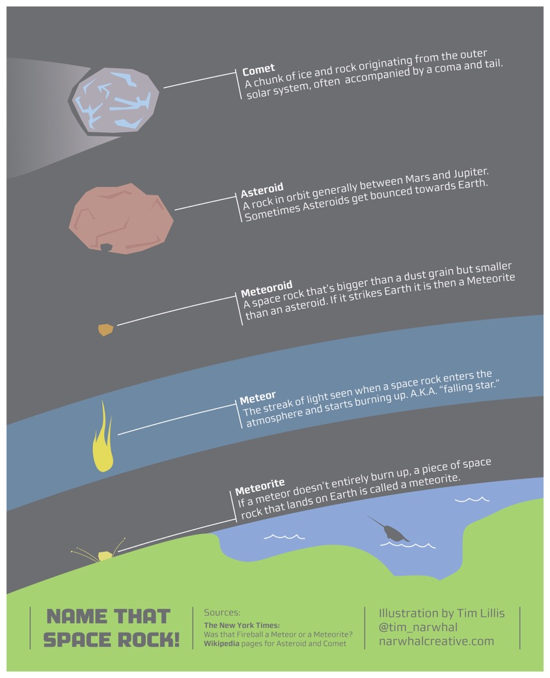
ZTF Solar System Science
Discover, characterize, and monitor small bodies in the solar system
Enable rapid response on transient events
  Comets
  Main Belt Asteroids
  Near Earth Asteroids
  Centaurs
  Interstellar objects
Notes:
Expain why small bodies

Slide 6
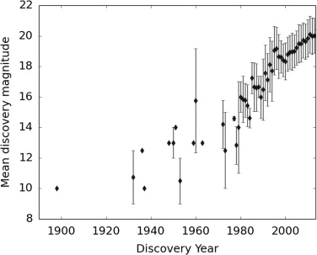
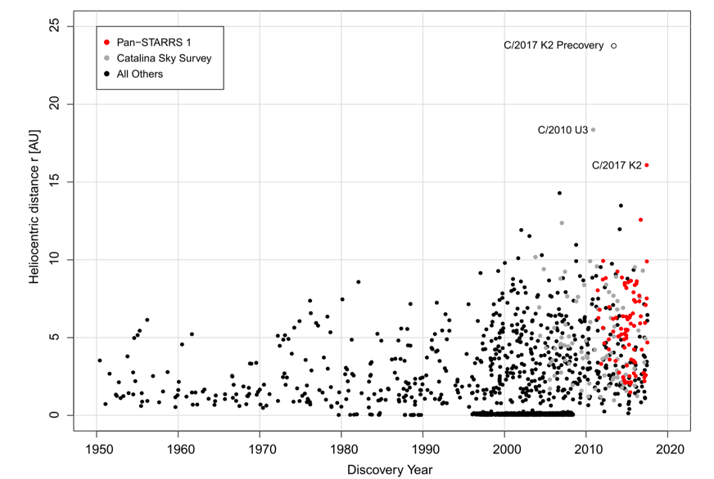
Small body discoveries and all sky surveys
Near Earth Asteroids : Completeness
Comets: Further Away
Galache et al. 2015
Meech et al. 2017
Notes:
ZTF can observe ~25,000 asteroids per night

Slide 7
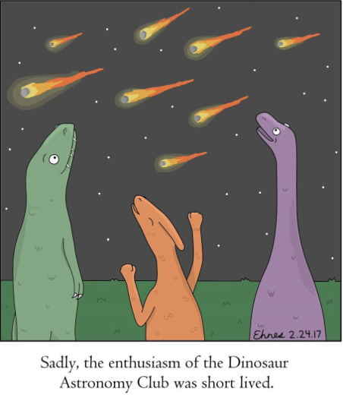
Discovery of Near Earth Asteroids
ZTF is a discovery telescope tightly integrated with a number of follow-up facilities
As of June 2018, ZTF has discovered:
>400 new asteroids
8 near earth asteroids
1 potentially hazardous asteroid (2018 CL)
Automated search for point sources and streaks
Streak detection system being optimized

Slide 8
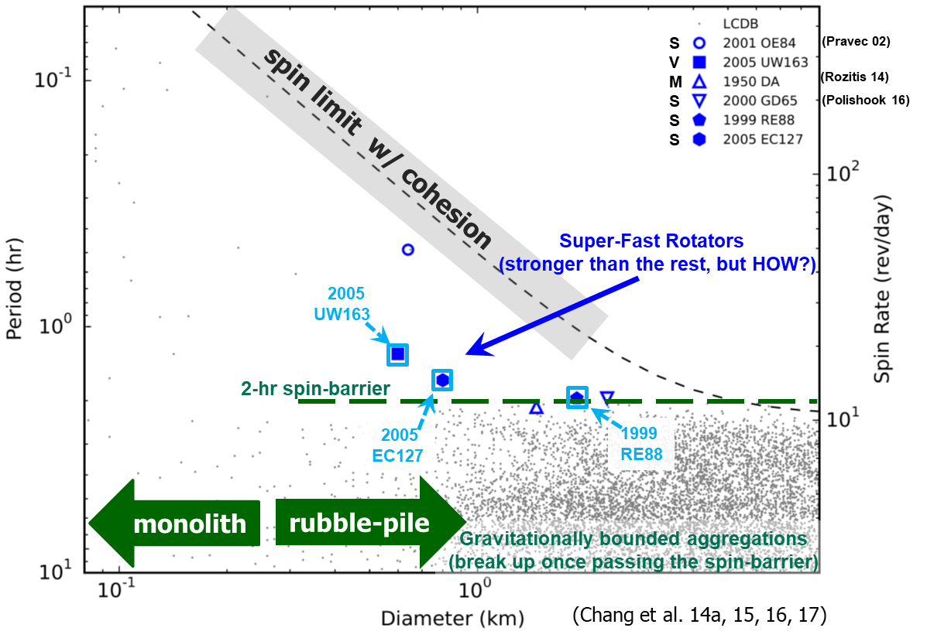
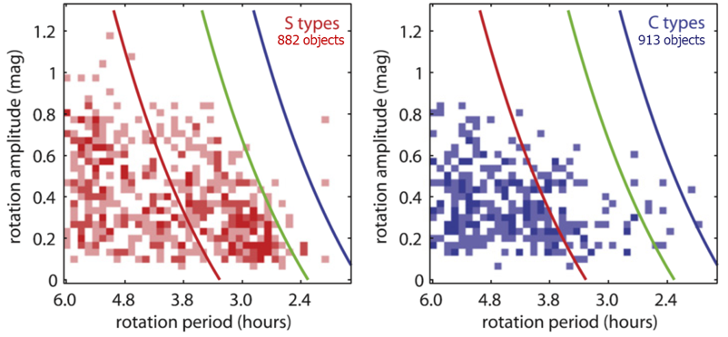
Characterization of Asteroids
Spin rate reveals asteroid strength, interior structure, and evolution
ZTF will measure over 100,000 asteroid light curves per year
As of May 2018 over 600,000 measurements have been reported to MPC
Taxonomic dependence of spin rate and amplitude
ρ
ρ
Waszczak et al. 2015
Notes:
Color lines are density 1/2/3 g/cm3

Slide 9
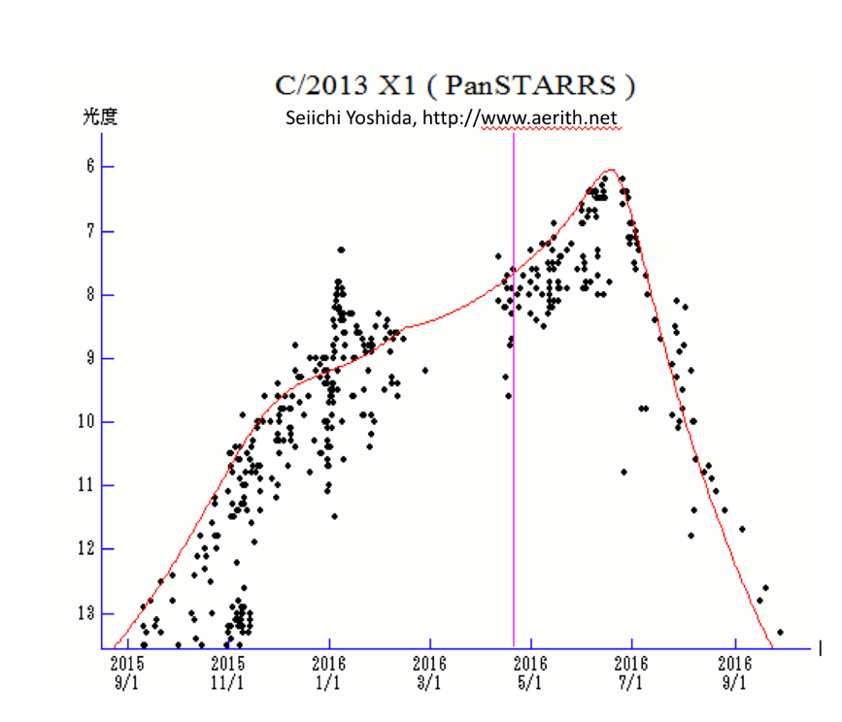
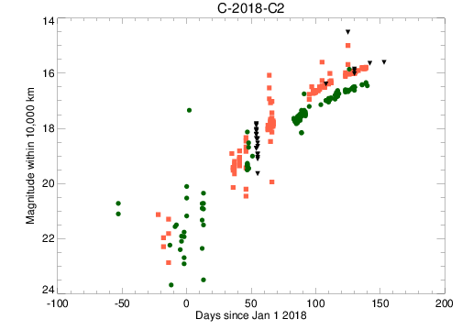
Comet Evolution and Outbursts
Provide reliable comet light curves and rapid outburst alerts for follow-up observations
ZTF data
Notes:
Go

Slide 10
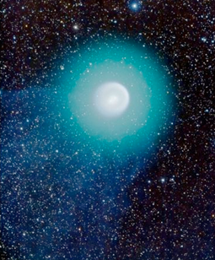
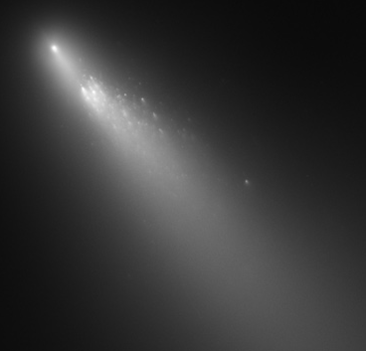
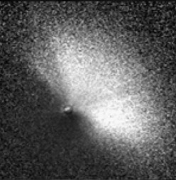
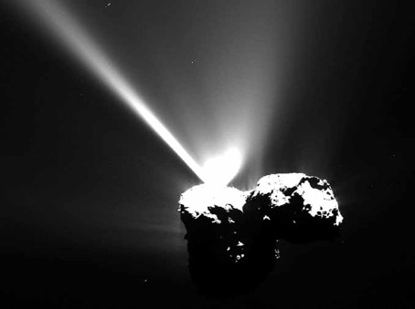
17P/Holmes. NASA / ESA / A. Dyer
73P - NASA, ESA, H. Weaver (APL/JHU),
M. Mutchler and Z. Levay (STScI)
9P/Tempel 1 – Feldman et al. 2007
67P – Vincent et al. 2016
Large
>5 mag
Sustained for weeks or longer
Gas and dust increase
Sometimes fragments
Medium
2-5 mag
Most common
Rise few days
May include short-lived fragments
Requires early warning (< days) for follow up
Small
1-2 mag
Less often discovered, but likely more common
Greatest discovery potential!
Mini
<<1 mag
Occur daily
Very short lived (10s of minutes)
Mostly discovered from spacecraft
Continuous sampling

Slide 11
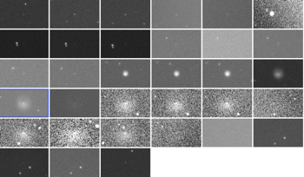
Centaurs
Survey the number, rate, and amplitude of activity within the Centaur population
Echeclus Photometry:
Periodic outbursts – intense and short-lived
December 2017 intensity similar to December 2006 outburst.
Weeks before activity onset observed in Aug. 2016, CO₂ production ~2 X 10²⁶ molecules/sec
ZFT g filter, color corrected
ZTF thumbnails
Bare Nucleus spherical model
Q_{dust}~50 kg/s (assuming v_{ej} ~3 m/s, grain density ~0.6 g/cm³, ~10μm radius grains)
Bauer et al., ZTF Sci. Meeting, 2018

Slide 12
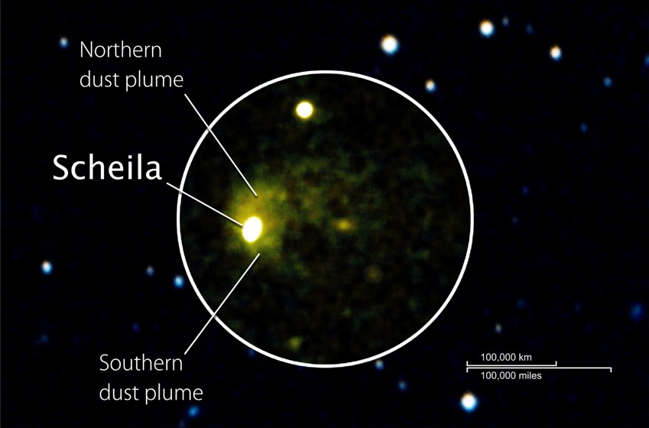
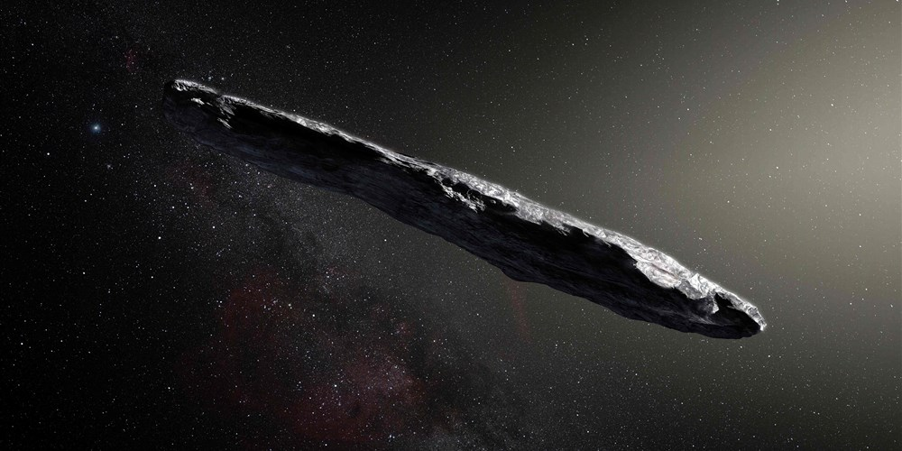
Other solar system transient events
Active Asteroids
Interstellar asteroid `Oumoumoua
Bodewits et al. 2011
Meech et al. 2017

Slide 13
Solar System Science with the
Zwicky Transient Facility
Scans more than 3750 square degrees/hour to a depth of 20.4 mag
Discover, characterize, and monitor small bodies in the solar system
Enable rapid response on transient events

