Slide 1
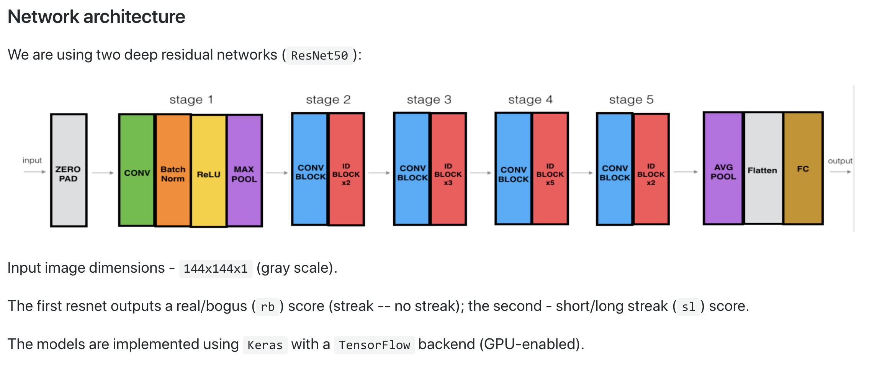
Notes:
In general, in a deep convolutional neural network, several layers are stacked and are trained to the task at hand. The network learns several low/mid/high level features at the end of its layers. In residual learning, instead of trying to learn some features, we try to learn some residual. Residual can be simply understood as subtraction of feature learned from input of that layer. ResNet does this using shortcut connections (directly connecting input of nth layer to some (n+x)th layer. It has proved that training this form of networks is easier than training simple deep convolutional neural networks and also the problem of degrading accuracy is resolved.

Slide 2
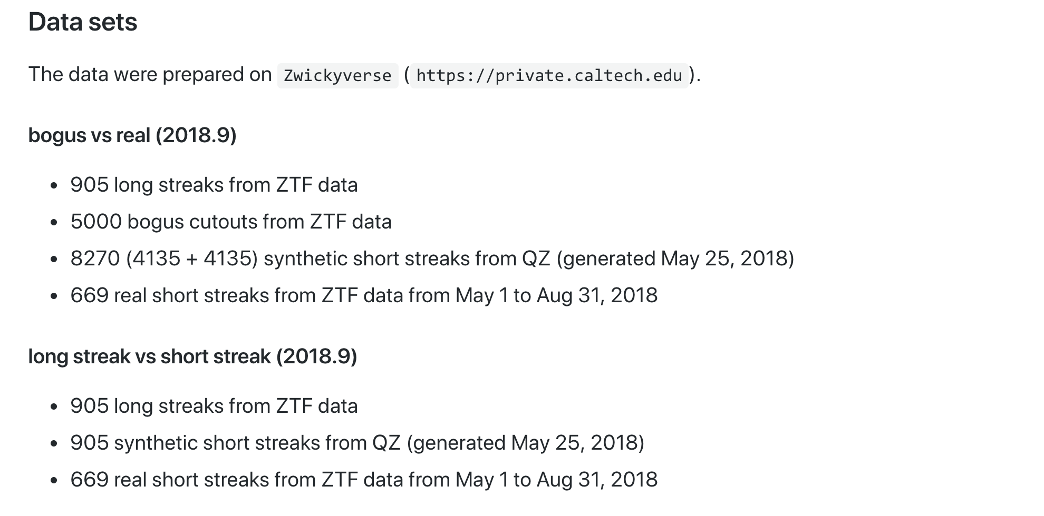

Slide 3
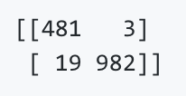
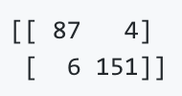
Training and performance
The models were trained on rico's Nvidia Tesla P100 GPU (12G) for 20 epochs with a mini-batch size of 32, which takes ~20 minutes for the rb model. 10% of data are used as a test set, 5% for validation
Confusion matrices / Normalized CM
rb: (0 is bogus, 1 is real) [ResNet50_rb_20e_20181024_154924]
sl: (0 is long, 1 is short) [ResNet50_sl_20e_20181024_163759]
The (mis)classifications are based on an 0.5 score cut: completeness can be increased by lowering the threshold.

Slide 4
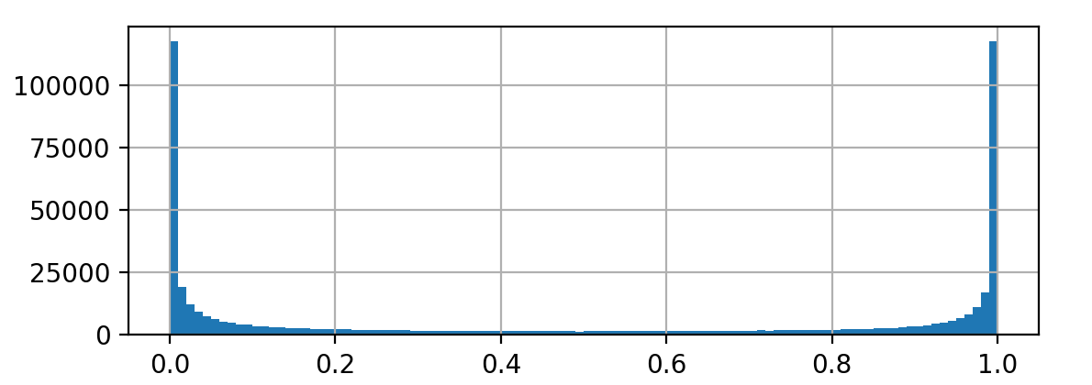
rb classifier [ResNet50_rb_20e_20181024_154924]
Ran the classifier on 5 nights worth of data just before the recent shutdown + one night in August -> ~520k predictions
Examples of 1 particular class of bogus turned out to be under-represented in the training set (multiple badly subtracted stars; especially when there are 2 stars close stars in the center -> blended), thus the peak around 1
Otherwise performance close to what is shown on previous slide
QZ: 5k bogus examples came from one (very good and therefore not very representative) night
Sampled 3k with rb < 0.2, 3k with rb > 0.8, and 3k 0.2 < rb < 0.8, just finished labeling on Zwickyverse/private
QZ to prepare an additional set of synthetic streaks based on misclassification
Will re-train the classifier

Slide 5
Production service
Cutouts/metadata are rsynced between yupana (where QZ keeps them) and private (where I run the classifiers). This should be replaced
Classifiers are run on all data automatically, everything stored to a DB
Frontend to talk to the DB/display results is up and running

