Slide 1
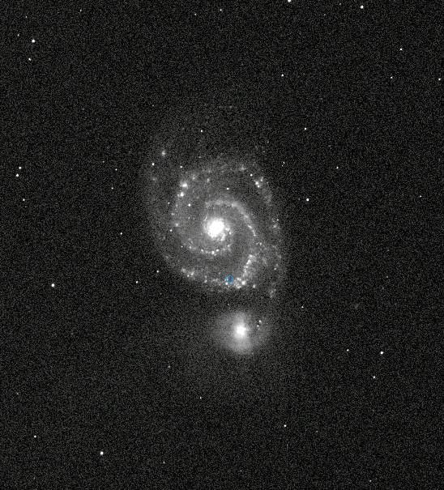
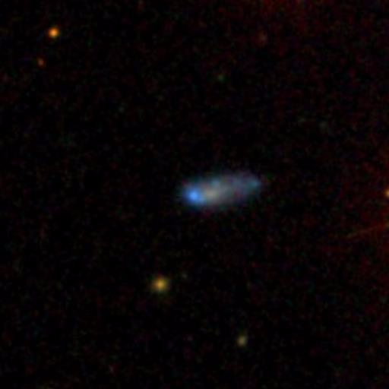
Census of the Local Universe
(CLU) – Hα Galaxy Survey
M51
David Cook
Caltech
PTF/ZTF Meeting
Maryland
May 20th, 2016
Collaborators: Mansi Kasliwal (Caltech), Angie Van Sistine (U of Wisconsin, Milwaukee), PTF
PTF Hα (6563 Å)
Notes:
Pretty pics in background – continuum subtracted…

Slide 2
Scientific Goals
Galaxy Catalog out to 200 Mpc
  Pinpoint an electromagnetic counterpart of a gravitational wave event
  Assisting transient surveys (e.g. ZTF, LSST, VLASS, etc.)
Star formation rate (SFR) density at z=0
  Reduce cosmic variance
SFR(Ha)/SFR(FUV) discrepancy
  Better constraints for low SFR galaxies
Plus many more…
Notes:
Ptf can reduce false positives – forground(asteroids, flares, etc) and background(SN, AGN,etc)

Slide 3
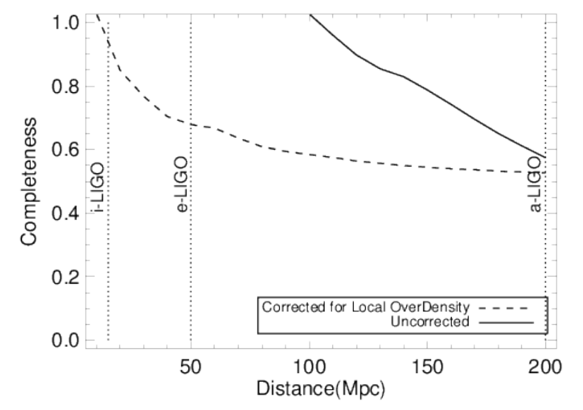
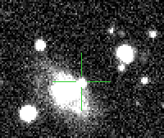
Why Do We Need a Nearby Galaxy Survey?
NED, SDSS, +other studies: N~250,000 galaxies
  B-band light ~50% complete at 200 Mpc
New close-by galaxy
Supernova
Galaxy: D=20 Mpc
PTF optical image
Notes:
Why do we need to make this galaxy catalog
Only 50% B-band light is captured compared to a schecter function

Slide 4
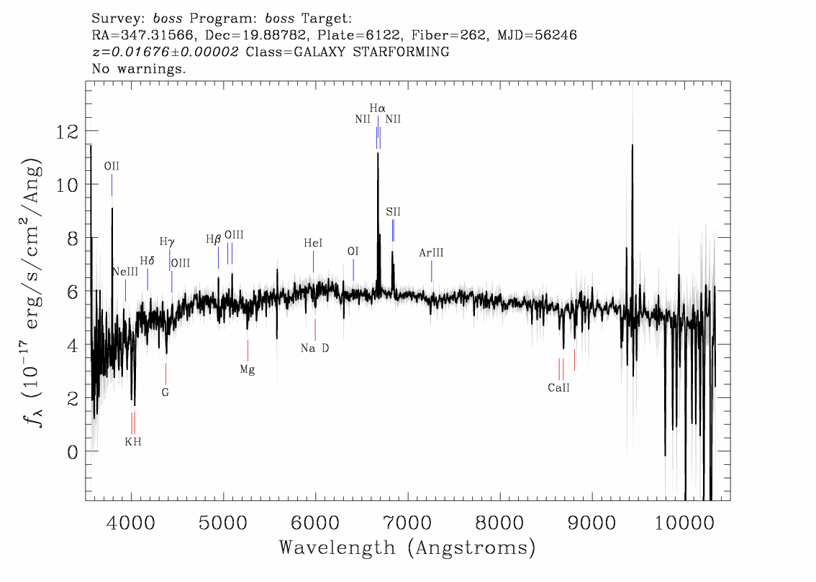
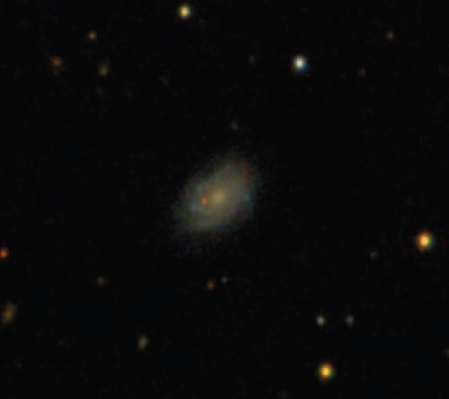
Galaxies
Hα
Narrowband
Filters

Slide 5
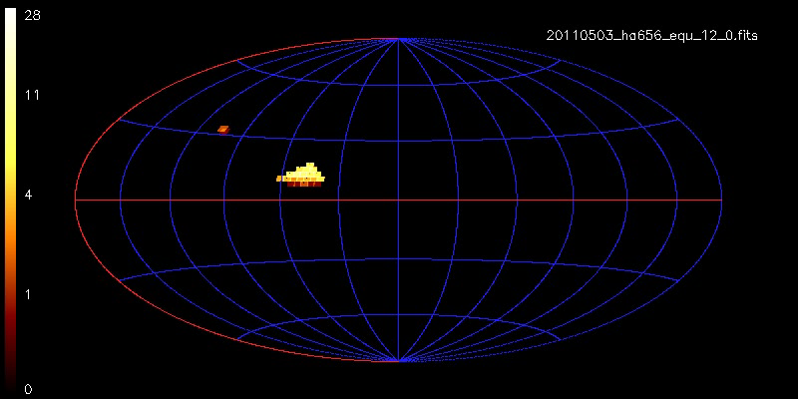
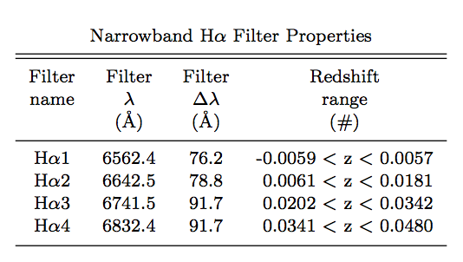
PTF Hα
Cook+16 (in prep)
λ~6563 Å (z ~ 0)
15,000 deg² of the sky
4 narrow-band filters
  Hα at different z
>75% finished in all filters
Observations will be finished by end of 2016
200 Mpc
z=0
Notes:
4 nights every month – near full moon
2 images per filter

Slide 6
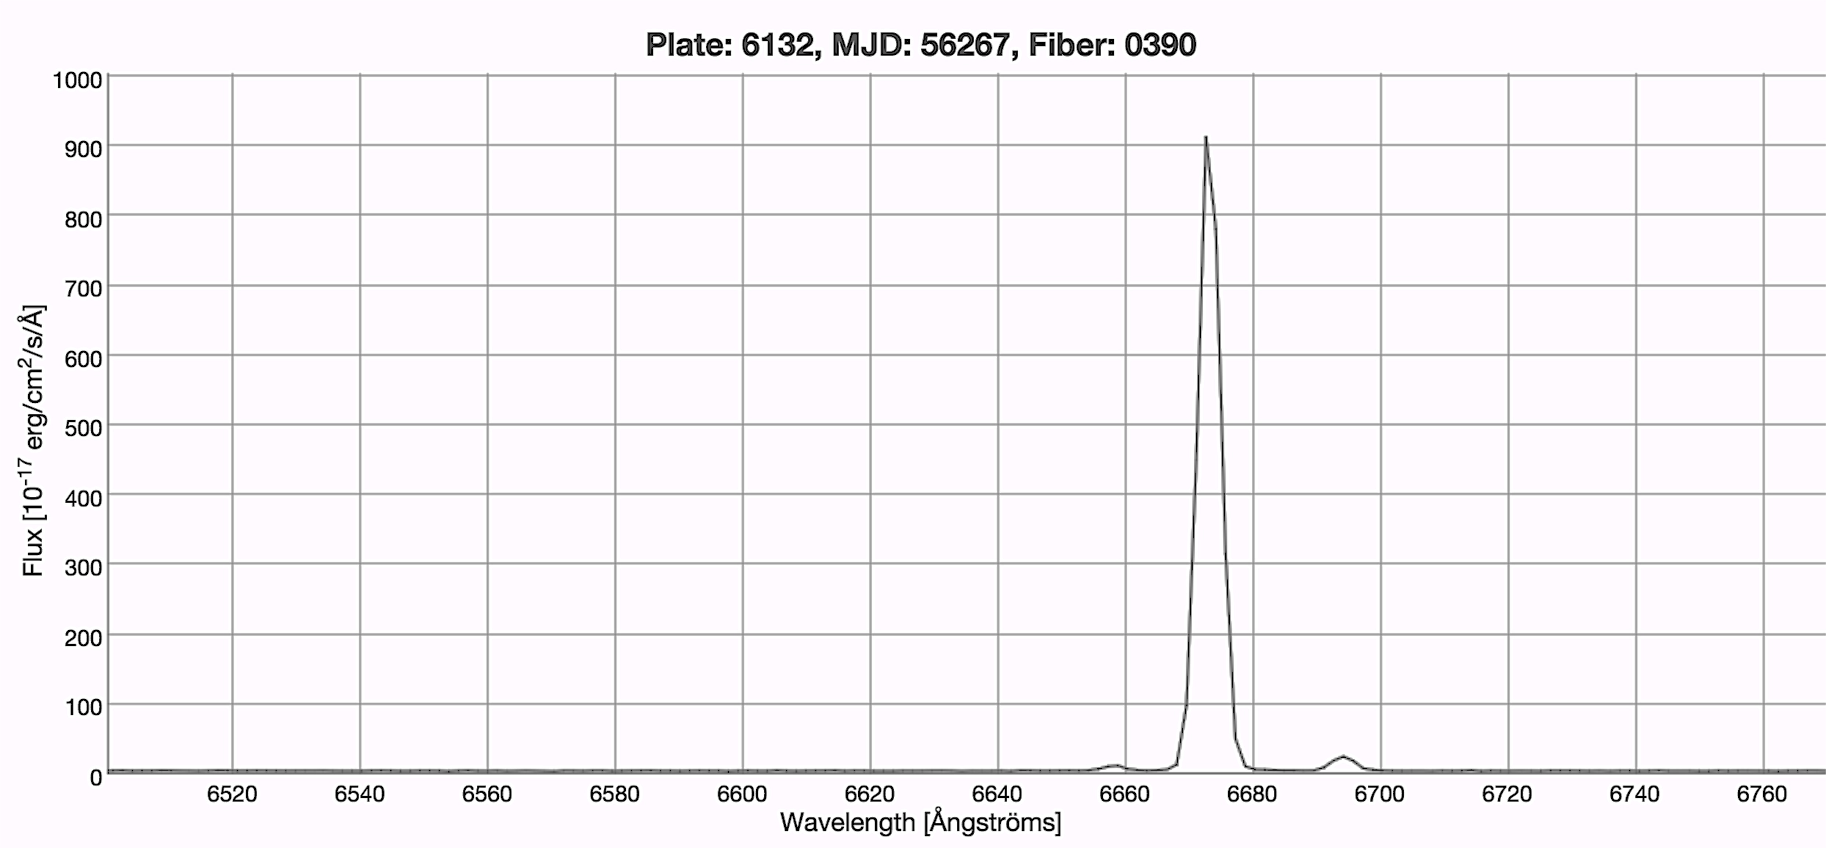
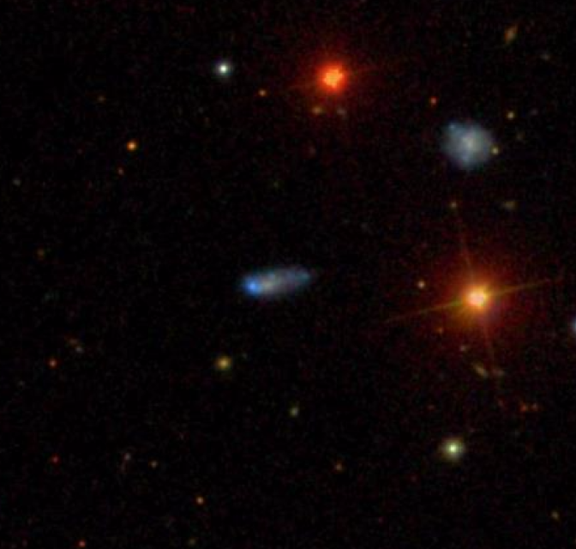
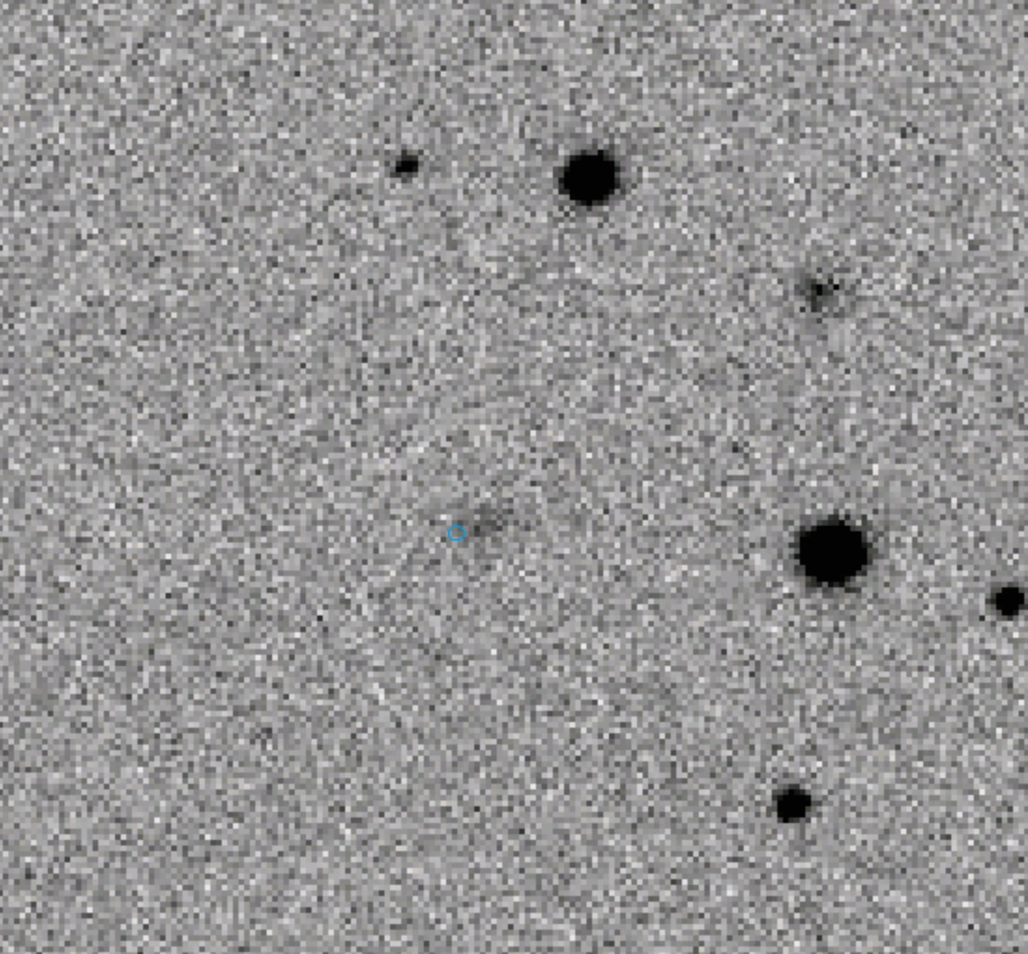
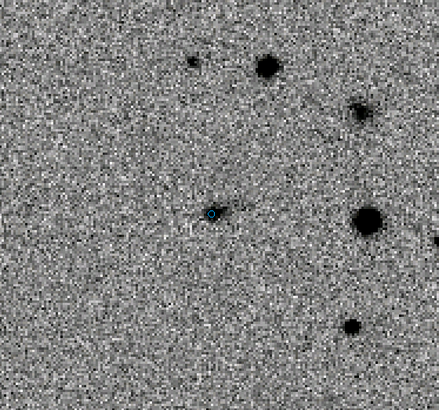
Narrowband Strategy
BOSS - spectra
6563Å
Hα
6720Å
6630 Å
New Galaxy
Hαcolor (On − Off) = 1.5 mag
at z ~ 0.017 (~75 Mpc)
Hα EW = 675 Å
Continuum
SDSS gri
Hα off - 6563Å
Hα on – 6630 Å

Slide 7
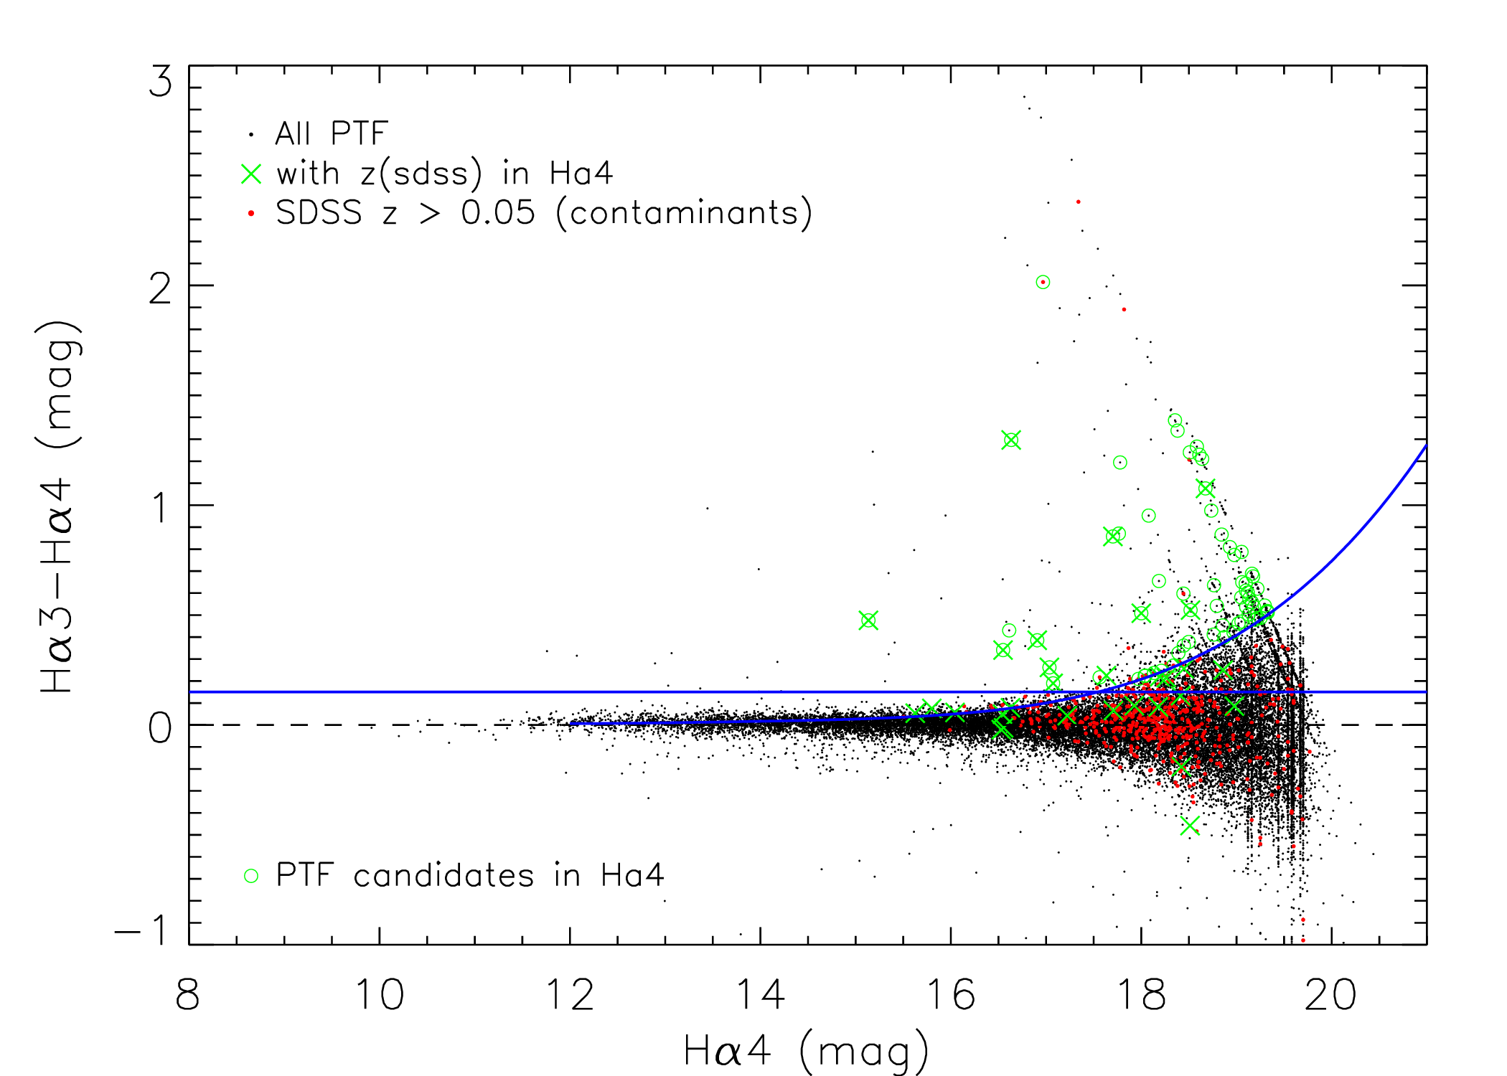
Selection Criteria
Selection Criteria
  (Sobral+09,Lee+12)
  Continuum sources > 3σ
    mag < 15
  Excess Hα color > 2.5σ
  Extended sources
Galaxy candidates
  4 preliminary fields
  With SDSS coverage
  N~500 total
  N=273 new candidates
1 Prelim Field
2.5σ color error
3σ bright stars
Cook+16 (in prep)

Slide 8
Comparison to SDSS galaxies
Galaxy candidates (4 fields with SDSS overlap)
  N=273 new candidates
  ~half are known SDSS galaxies
Completeness (galaxies with redshifts that have Hα in the filter they were found)
  95% at EW ~ 50 Å
  75% at EW ~ 20 Å
  15% are high redshift galaxies (False Positives)
Estimated new galaxies:
  273 * 0.15 (contaminants) * 0.05 (junk via visual inspection) / 4 = 54 per PTF field
  N=109,000 new galaxies for all ~2000 PTF fields
  Lower limit on new galaxies - Half area covered by SDSS → ~150,000 new galaxies?

Slide 9
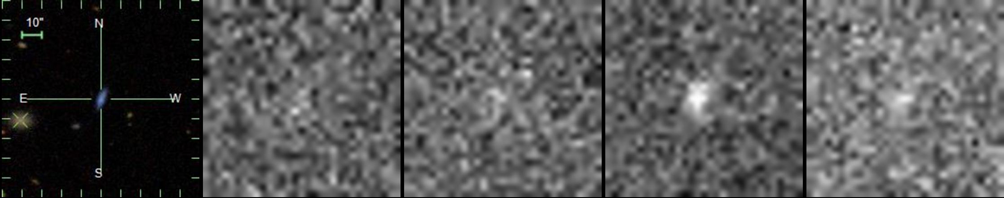
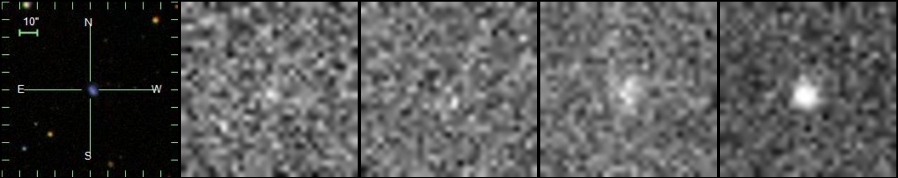
New Candidates
No redshifts!
Hα1
Hα2
Hα3
Hα4
SDSS

Slide 10
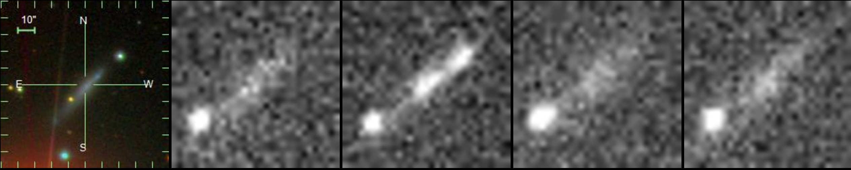
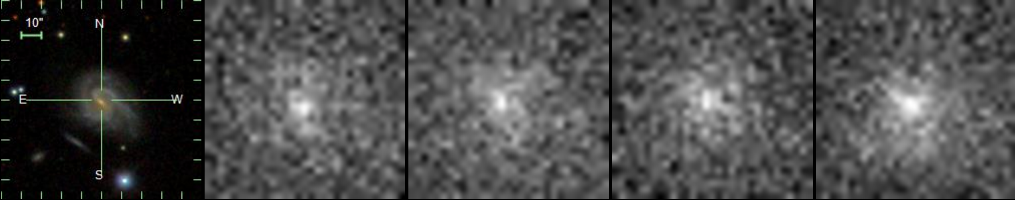
Impressive New Candidates
No redshifts!
Hα1
Hα2
Hα3
Hα4
r=17 mag
SDSS
r=15 mag

Slide 11
Spectroscopic Follow-up
SDSS/BOSS – 20 candidates confirmed
Palomar
  200 inch
    Awarded 3 nights in 2016
      1 night – another 21 candidates confirmed
      2 nights in July
    Proposing for more
  60 inch – 60+ hours in Summer-Fall 2016
WIRO 2.3m
  10 nights in April 2016
  Data still needs to be reduced

Slide 12
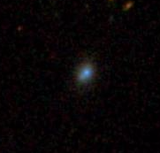
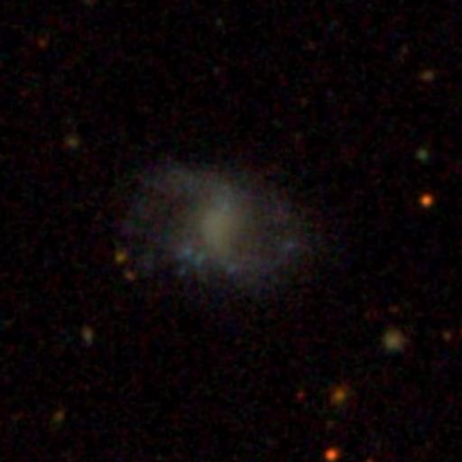
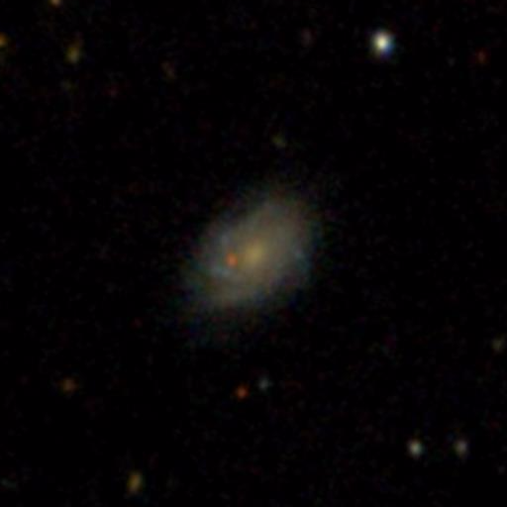
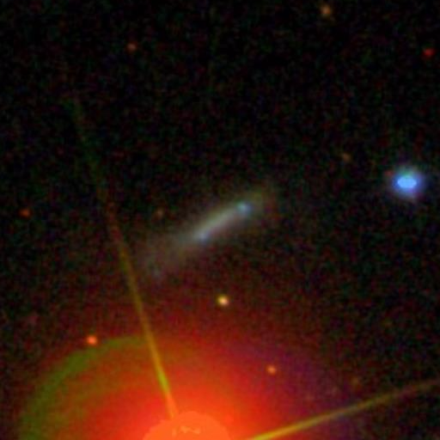
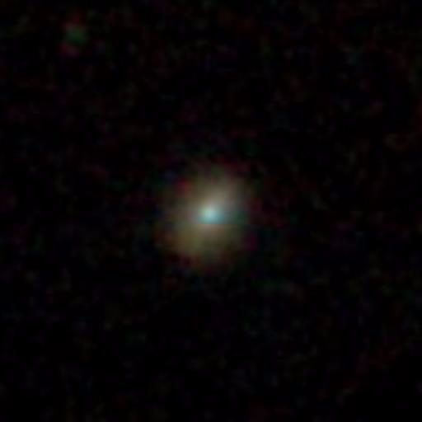
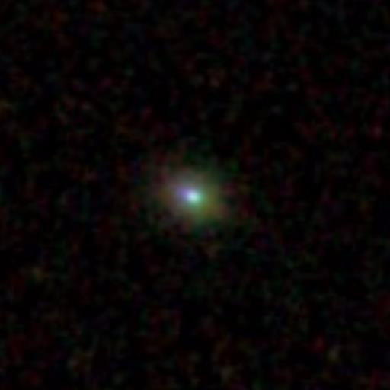
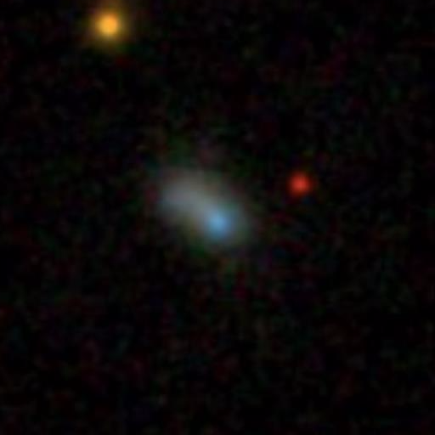
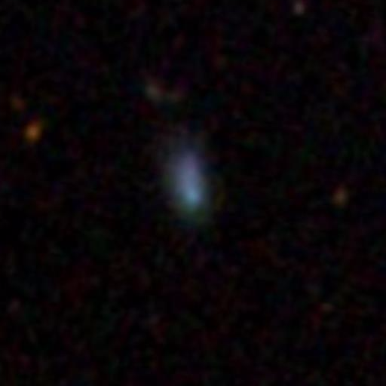
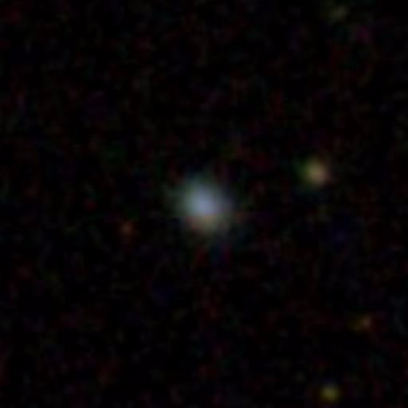
New Local Galaxy Discoveries
All with BOSS/SDSS spectra
  Prelim sensitivity using SDSS overlap:
  EW~tens Å
  Line flux~1e-15 erg/s/cm²
EW~580
EW~10
EW~6
EW~28
EW~675
EW~260
EW~125
EW~290
EW~205
EW~15

Slide 13
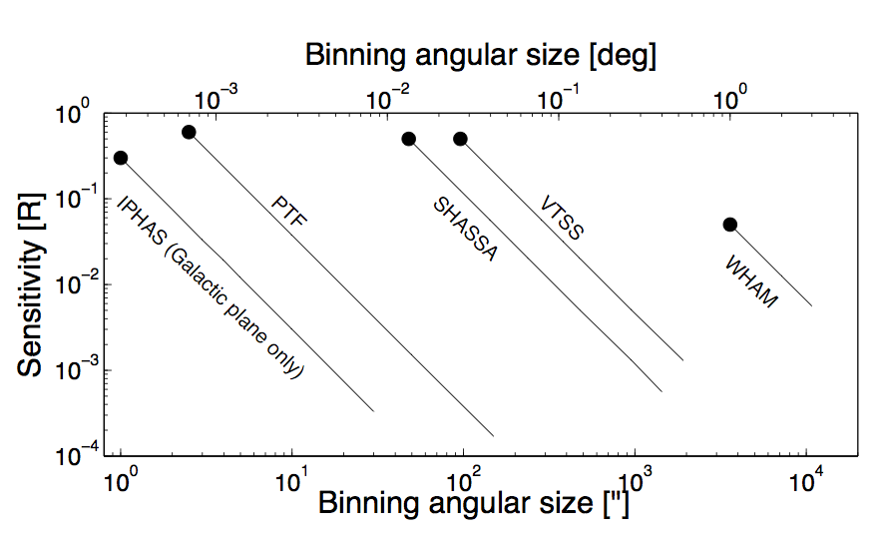
Sensitivity
PTF Hα Sensitivity
  point source
  2e-17 erg s⁻¹cm⁻²
  1e-15 erg s⁻¹cm⁻²
  R~10 Rayleigh
In order of area:
  PTF – 30,000 deg²
  PTF – 15,065 deg²
  SHASSA – 17,000 deg²
  WHAM – 17,000 Deg²
  IPHAS – 1,800 deg²
      Galactic plane
  VTSS – 1,000 deg²
PTF
Rau+2009 – Modified by Cook

Slide 14
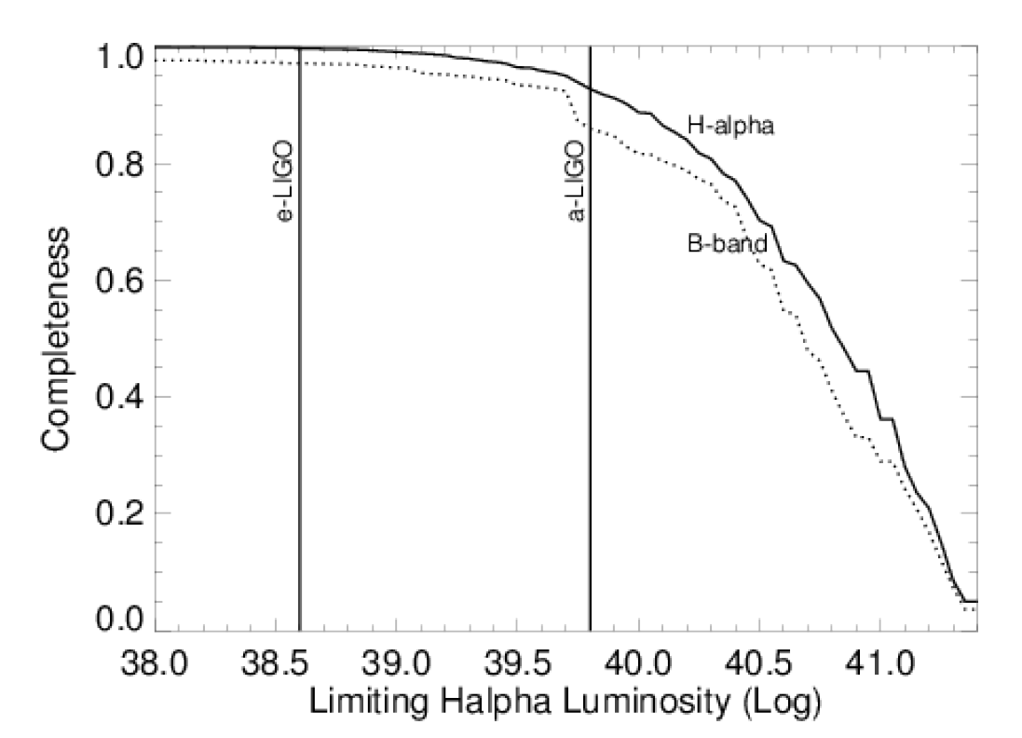
CLU
Completeness
PTF Hα Sensitivity
  EW ~ 20 Å
At 200 Mpc
  Log L(Hα) ~ 39.8 erg/s
  85% complete B-band
  90% in L(Hα)
at 50 Mpc
at 200 Mpc
Courtesy: Mansi M. Kasliwal
A comparison to 11HUGS complete out to 11 Mpc
- Kennicutt+08, Lee+09
Notes:
Sensitivity of the CLU survey. At a distance of 200Mpc (denoted by ”a-LIGO” horizon line), PTF will be able to detect galaxies with Hα luminosity greater than 10^39.8 erg s−1 . Comparing to the 11HUGS Hα survey undertaken by R. Kennicutt and collaborators which is complete to 11 Mpc, we expect this luminosity limit to capture 85% of the B-band light out to 200 Mpc.

Slide 15
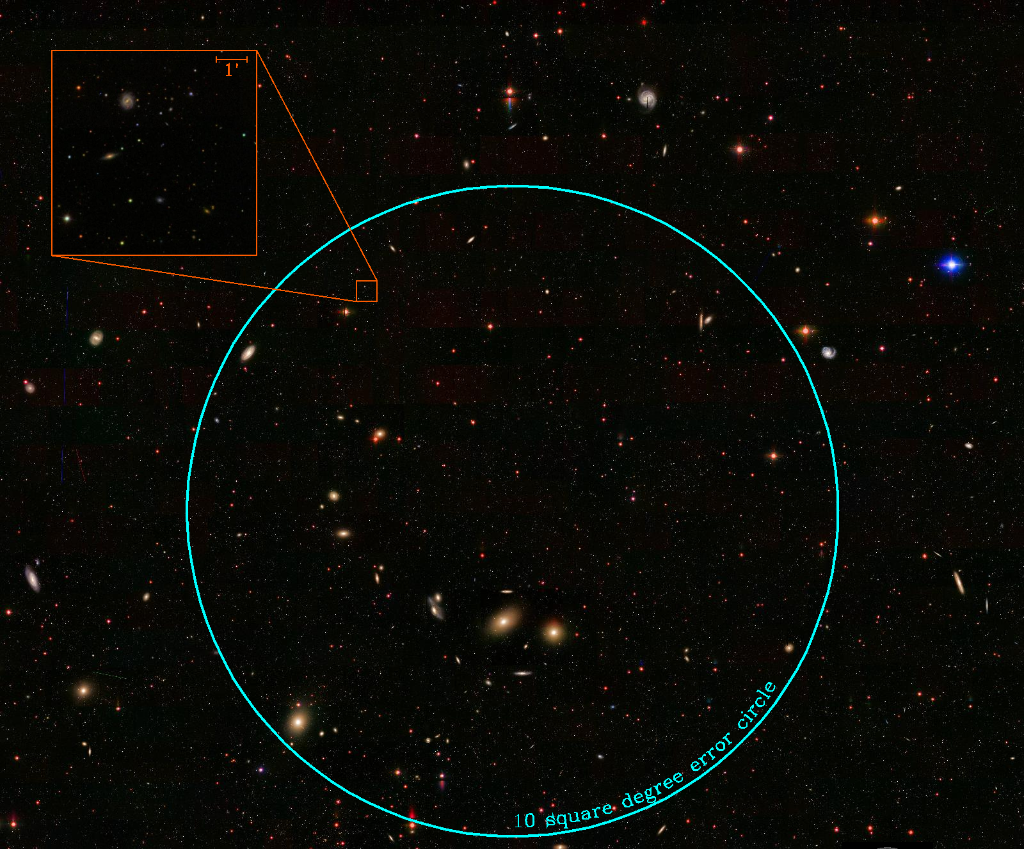
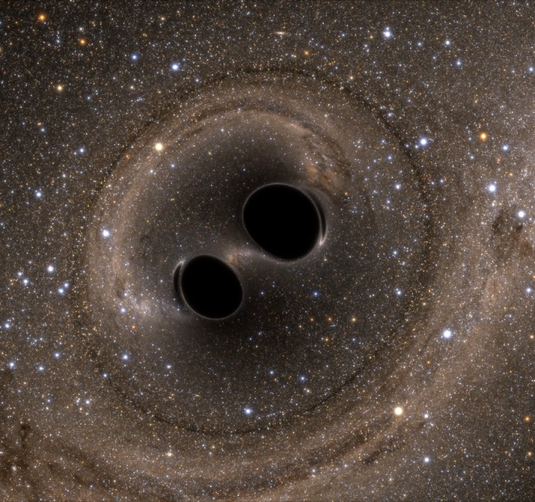
Gravitational Waves
Galaxy Area on Sky is Very Small (<1%)
?
Credit: Simulating eXtreme Spacetimes
Notes:
GRB = LIGO
Fade by 15 mag in 1 day (GRBs)
LIGO – first light = Sept 2015 – no localization
2016 – 100 deg^2
See Brad Cenko talk PTF summer school

Slide 16
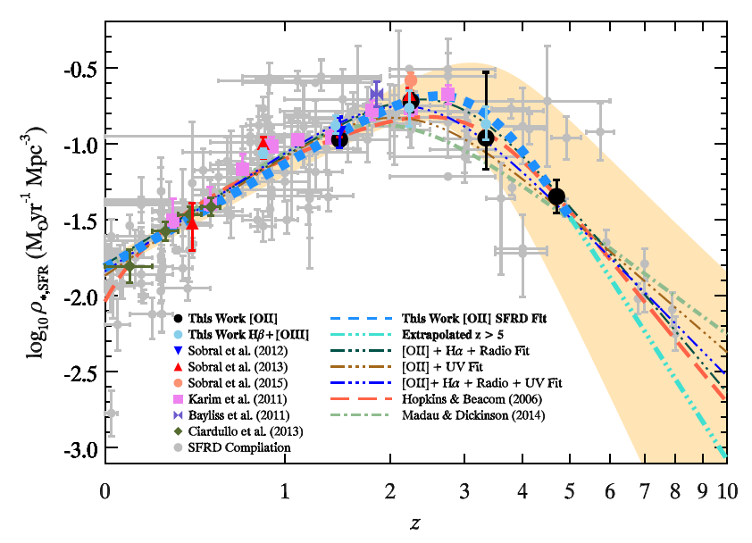
Galaxy Science - SFR Density
  Cosmic SFR density
  ρ = SFR/Mpc³
z=0 Luminosity Function
  Where is the z=0 anchor???
  What is the intrinsic shape???
CLU – 15,000 deg²
  Less cosmic variance
  ρerror can be ~ 100% for small areas (Stroe+2015)
  150,000s of galaxies
?
Khostovan+2015

Slide 17
  Galaxy Science - Ha/FUV
Implications
      Stochastic IMF vs IGIMF
      Different timescales
      SSP models
      L-derived physical properties
At D~50 Mpc
PTF Halpha
  1e-15 erg/s/cm²
  SFR (M/yr) ~ 1e-3
  15,000 deg²
GALEX (5σ)
  All sky Survey
    m_{lim}~20.5 mag → SFR (M/yr)~1e-2
    26,000 deg²
  Medium Imaging
    m_{lim}~23.5 → SFR (M/yr) ~ 6e-4
    1,000 deg²
PTF
Lee+2009

Slide 18
Timeline
Limiting step is calibration (i.e., SDSS)
With SDSS overlap
  End of Summer 2016
All PTF
    Will be calibrated to PanStarrs
    PanStarrs release: this year???
    CLU candidates for all PTF timeline: Early-Mid Next year…

Slide 19
Additional Slides

Slide 20
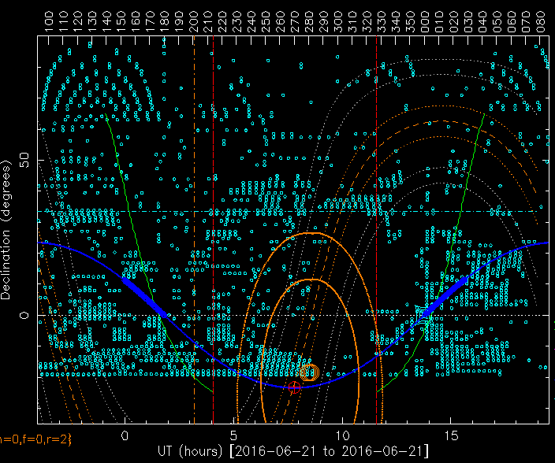
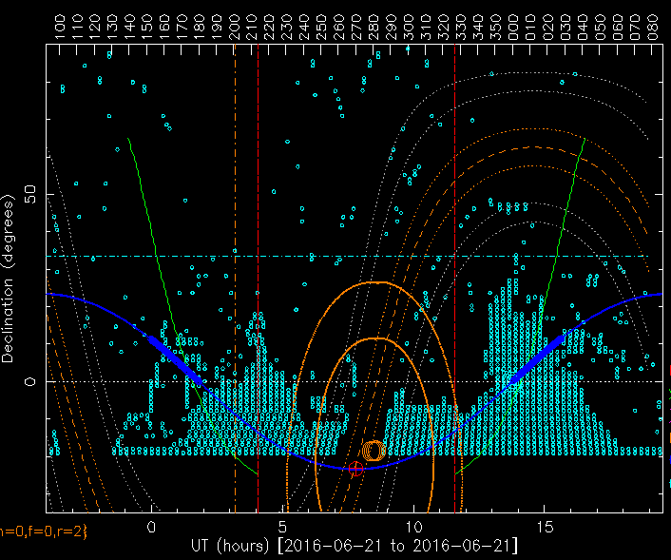
Left-to-Go
Hα1/Hα2
Hα3/Hα4
– 20
~78% done
Observations will be finished by end of 2016
– 20 dec
~75% done

Slide 21
Calibration
Cook+16 (in prep)

Slide 22
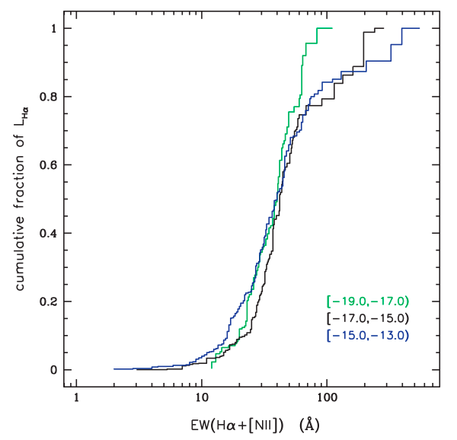
Completeness: Hα Luminosity
CLU completeness
~20 Å EW
>85% complete in L(Hα)
11HUGS - Kennicutt et al., 2008 and Lee et al., 2009

Slide 23
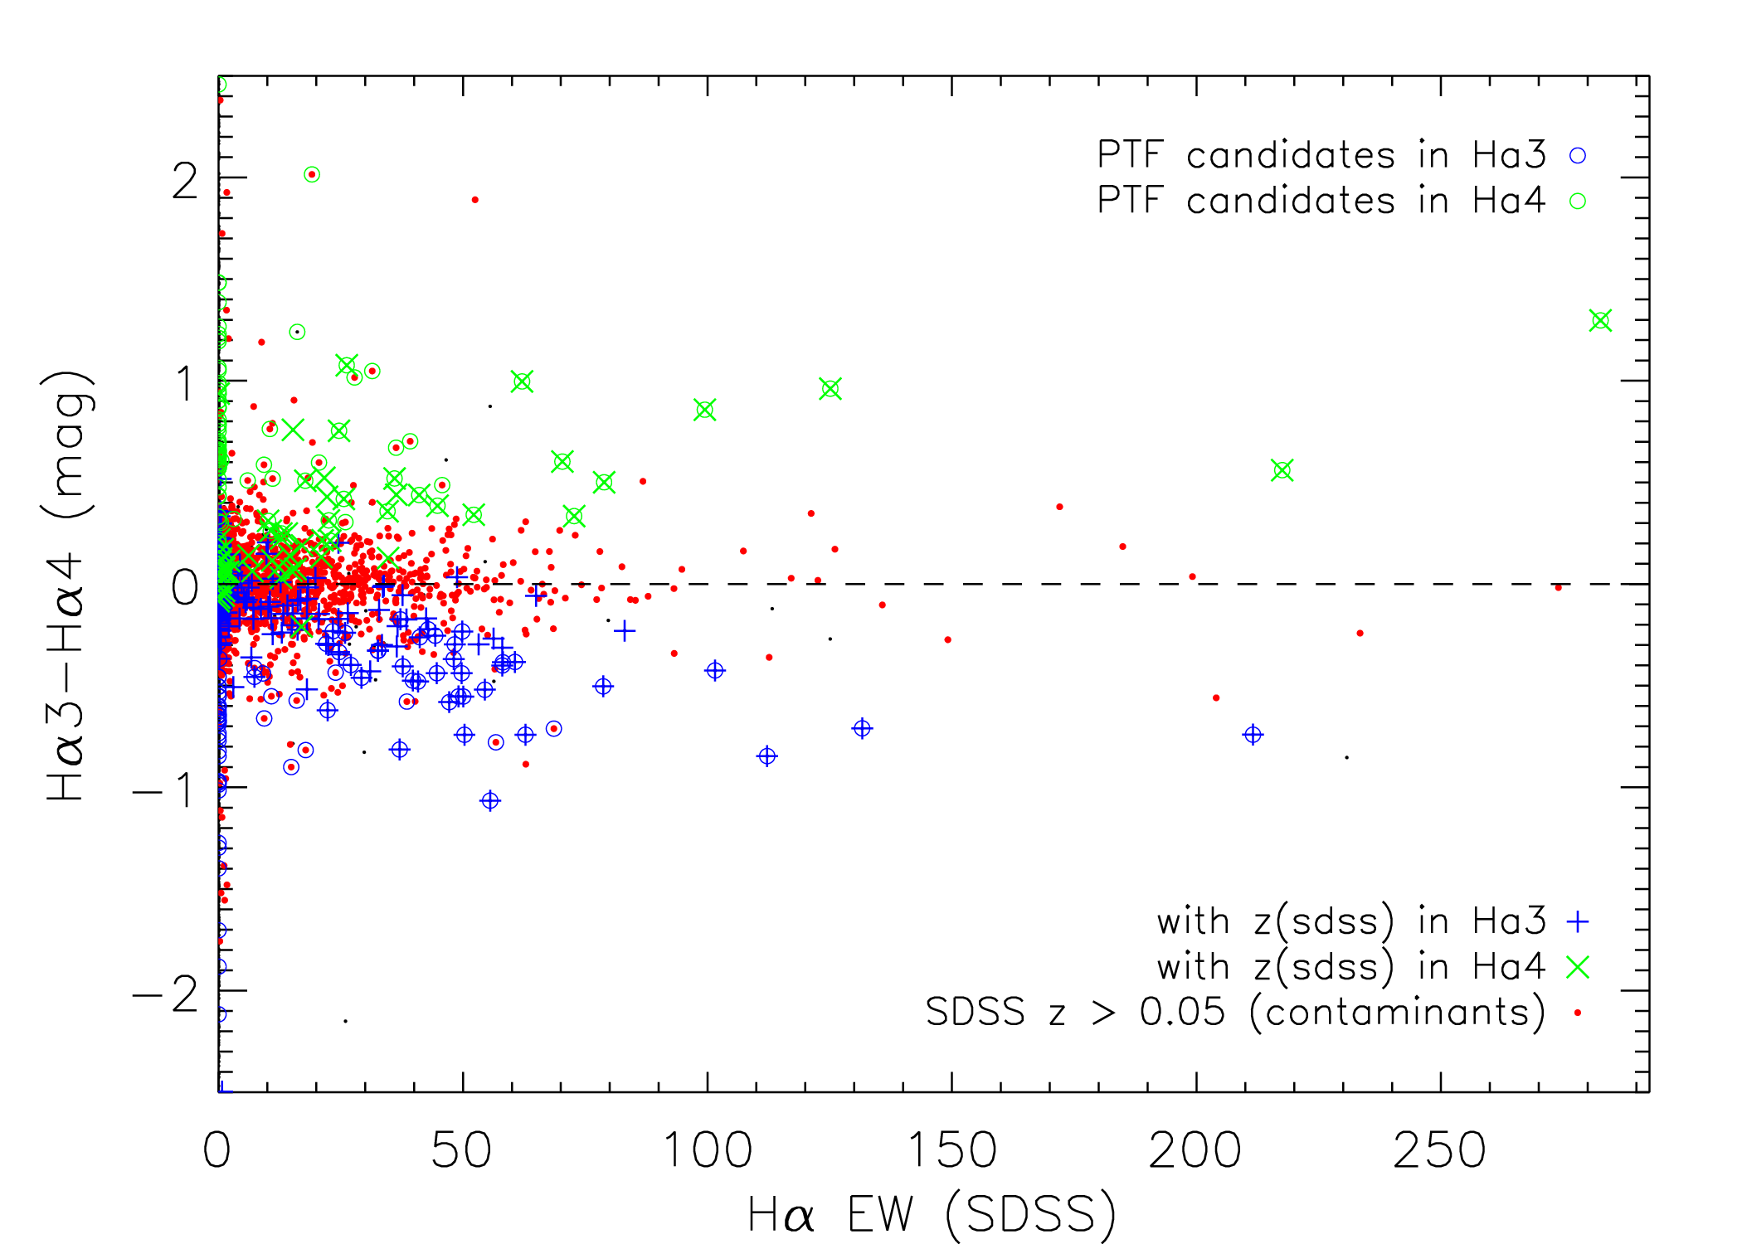
Survey Sensitivity
SDSS Equivalent width
  Limit ~ 20 Å
  SDSS spec mag lim~17.8 mag…
EW limit → Flux density
  1e-15 erg/s/cm²
  ~9 Raleighs
Cook+16 (in prep)

Slide 24
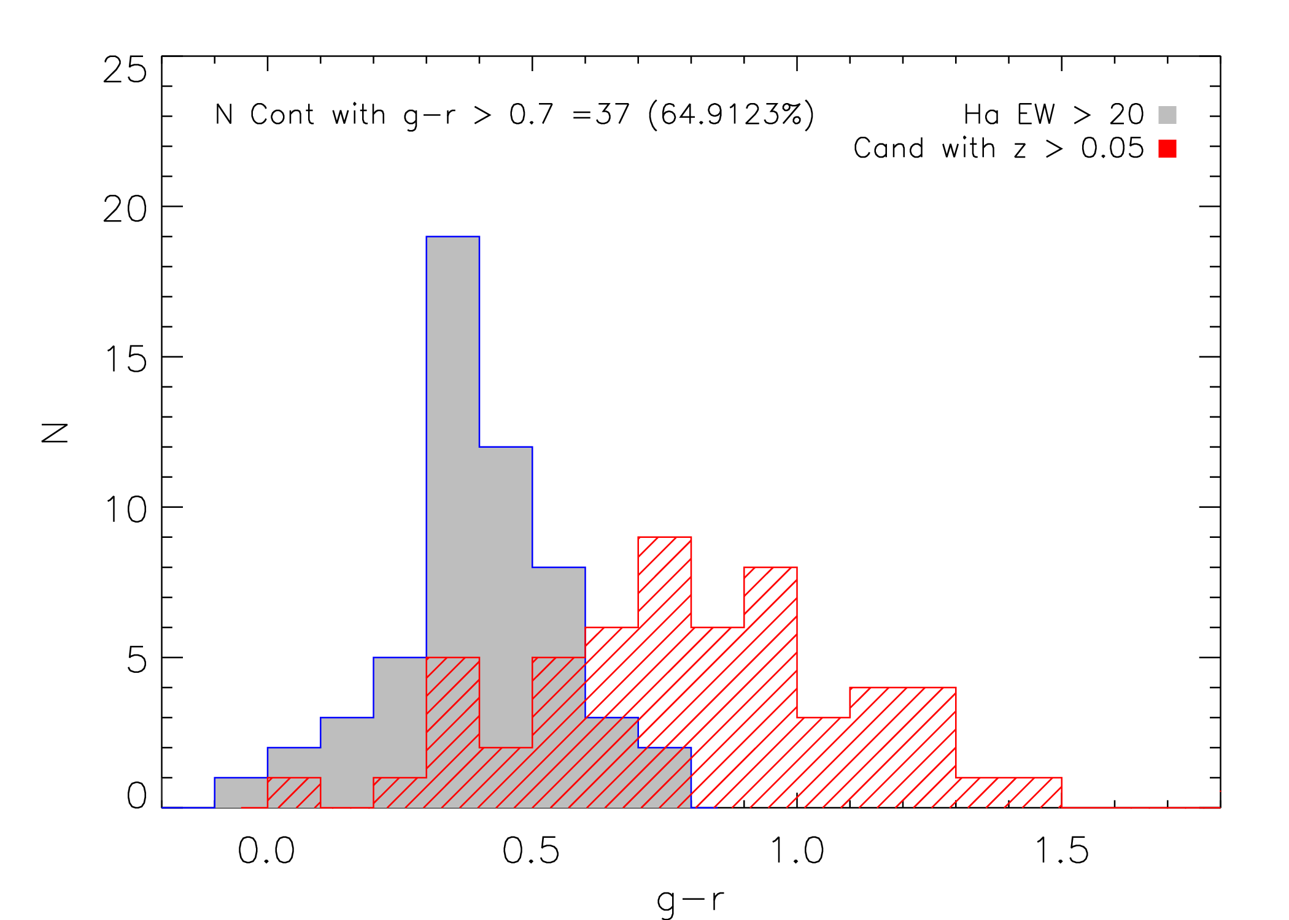
High-z Elliptical Galaxies

Slide 25
Galaxy Catalog
100 Mpc
200 Mpc
What kind of galaxies will we probe?
Halpha emission lines
  Star-forming galaxies
SDSS
Cook+2014c

Slide 26
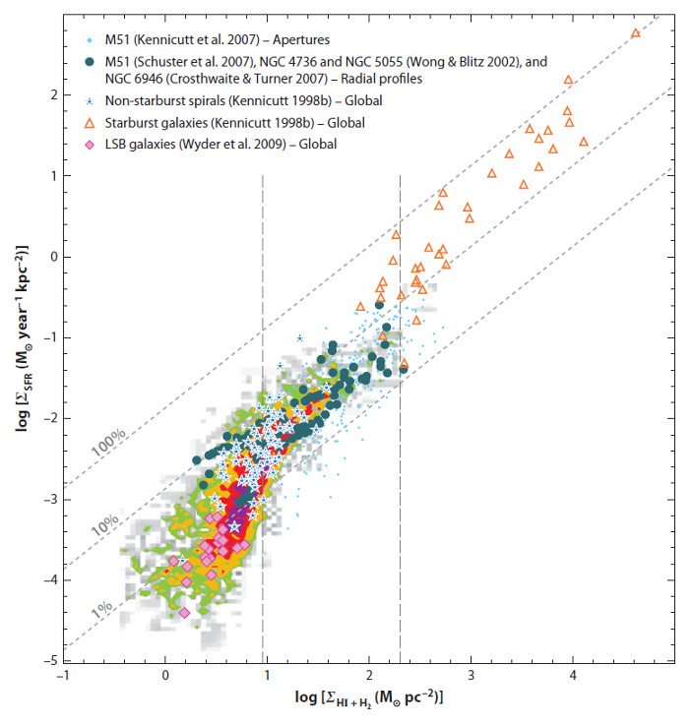
Kennicutt-Schmidt
Law?
PTF Hα
Bigiel+08

