Slide 1
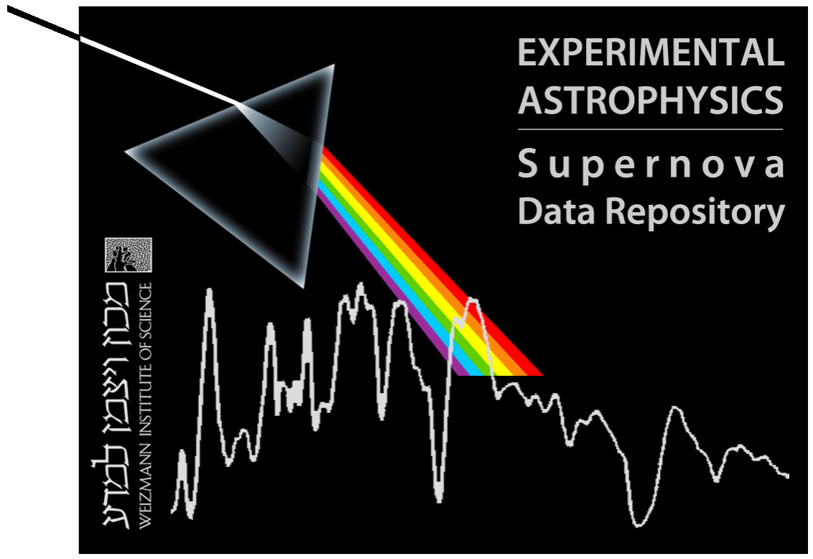
PTF Flash-Spectroscopy Sample
2009-2014
Offer Yaron
Weizmann Institute of Science
Israel
Sponsored by WISeREP
The Universe’s leading SN archive

Slide 2
PTF Flash-Spectroscopy Sample
Within a total of 302 Core-Collapse SNe (2009 – Feb 2014), having a spectrum within 6 days from discovery (=1st detection; typical pre-explosion limits 1-5 days), we find:
39 events showing Blue/Featureless (B/F) early spectrum,
9 events showing F-S signatures ➔All Type II’s (II/IIb/IIP)!
These (9) account for:
  ~3% of all CC-SNe in our sample,
  ~6% of all CC-SNe having a spectrum within 3 d from disc.
  ~8% of all Type II SNe having a spectrum within 3 d from disc.
  (…all these are likely strong undershoots if trying to assess the true frequency of the phenomenon.)
PTF Meeting Stockholm 2014 | Ofer Yaron, Weizmann Institute of Science

Slide 3
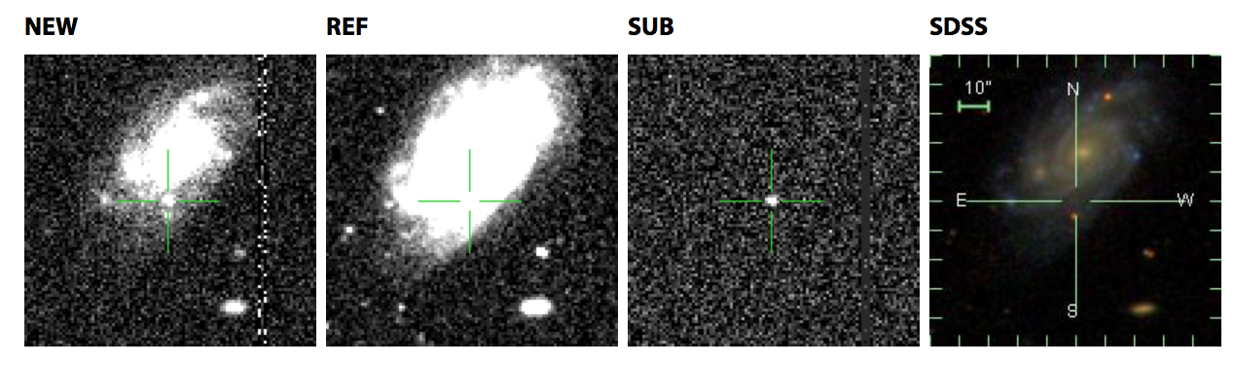
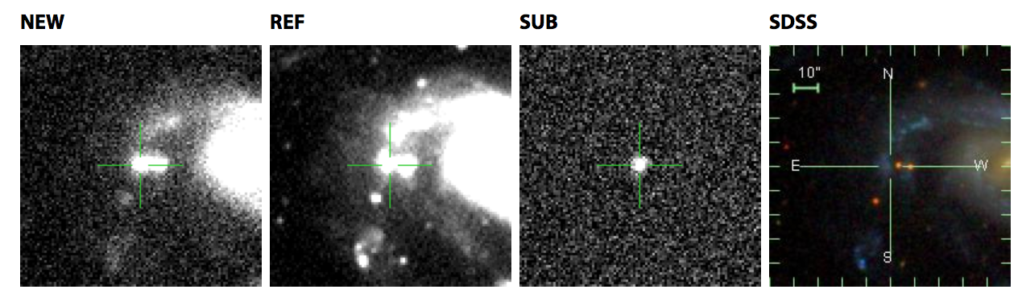
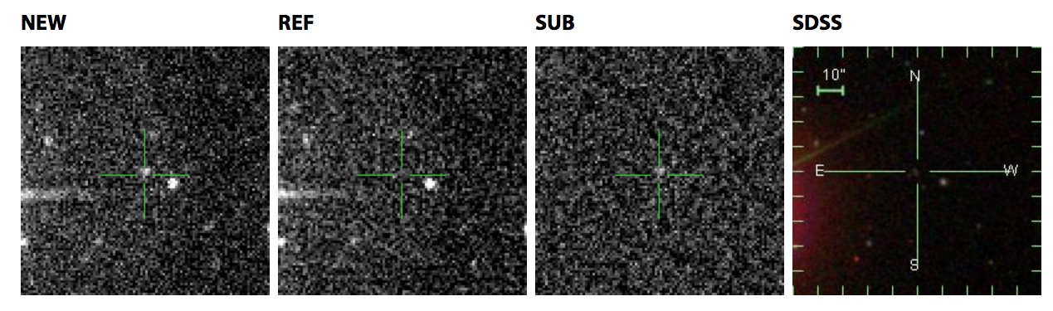
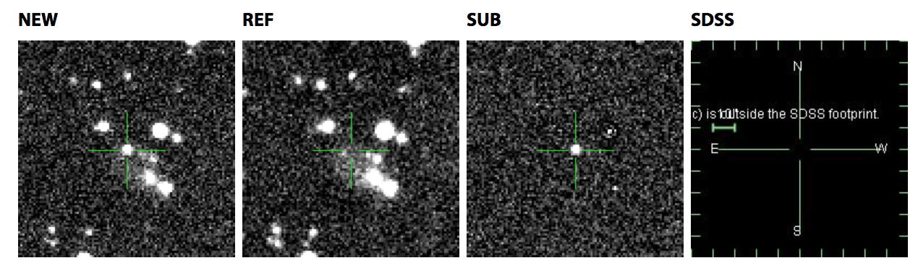
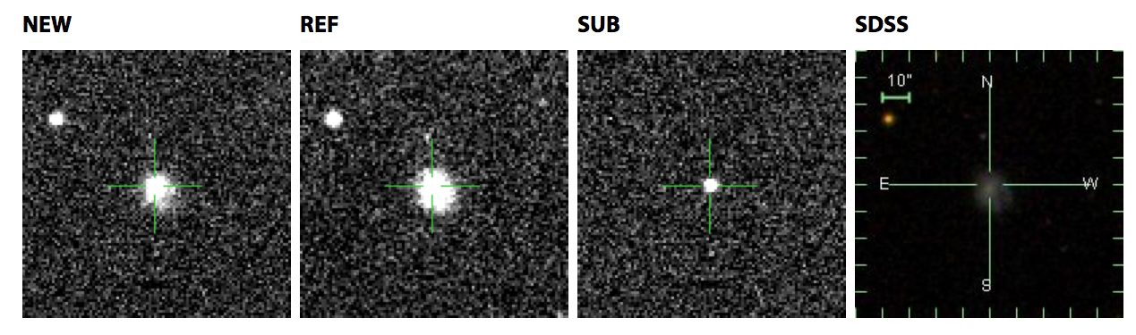
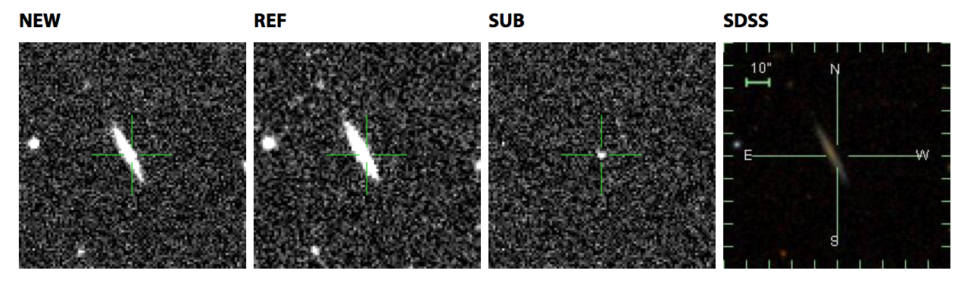
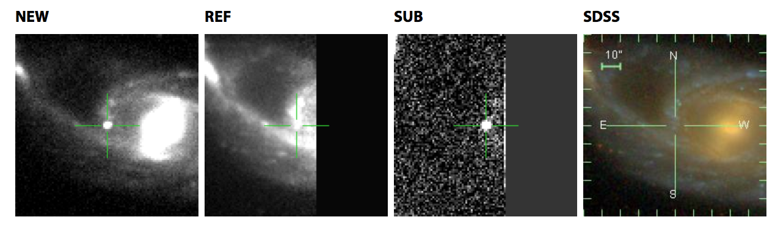
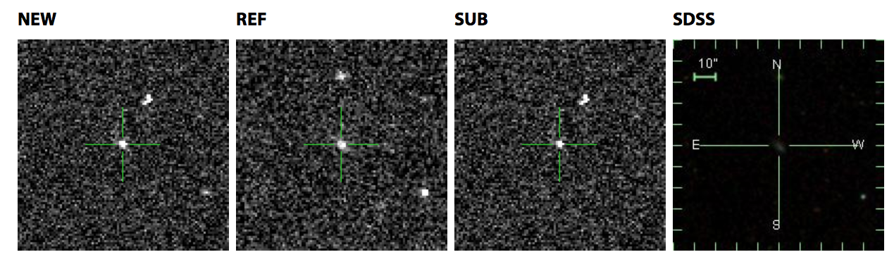
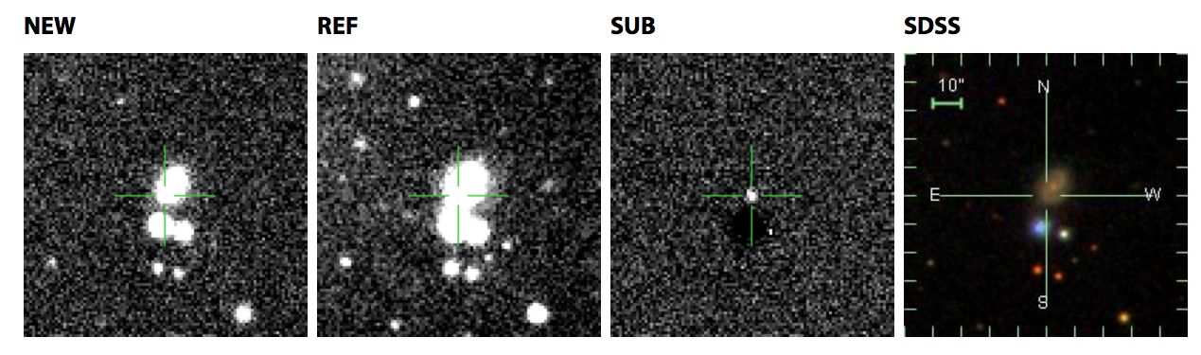
PTF Flash-Spectroscopy Sample
13ast
Type IIb
Z=0.026
13dqy
Type IIP
Z=0.012
09ij
Type II
Z=0.124
10abyy
Type II
Z=0.030
10gva
Type II
Z=0.025
10uls
Type II
Z=0.044
11iqb
Type II
Z=0.013
12gnn
Type II
Z=0.031
12krf
Type II
Z=0.063
14…???
PTF Meeting Stockholm 2014 | Ofer Yaron, Weizmann Institute of Science

Slide 4
Early spectra showing F-S signatures
Hα, Hβ
He II λ4686 (5411)
In cases:
N III blends (~4640)
Highly ionized O…
PTF Meeting Stockholm 2014 | Ofer Yaron, Weizmann Institute of Science

Slide 5
3 SNe originally classified as a IIn
11iqb: Changed to a Type II.
09ij (1 spec), 10uls (2nd spec shows broad P-Cyg): Likely not a IIn; changed to a Type II.
PTF Meeting Stockholm 2014 | Ofer Yaron, Weizmann Institute of Science

Slide 6
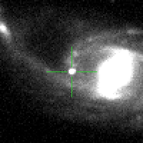
11iqb (Type II) - Similar to 13ast (Type IIb) in both early spectral features & peak mag.
Both are highly luminous, showing WN Wolf-Rayet spectral lines…
NGC 0151, z=0.0125
PTF Meeting Stockholm 2014 | Ofer Yaron, Weizmann Institute of Science

Slide 7
First spectrum epoch distributions
PTF Meeting Stockholm 2014 | Ofer Yaron, Weizmann Institute of Science

Slide 8
… and wrt the pre-explosion limits (B/F+F-S, cut off at 10 days)
PTF Meeting Stockholm 2014 | Ofer Yaron, Weizmann Institute of Science

Slide 9
SN type distributions
ALL CC-SNe - 302
B/F - 39 (13%)
Flash - 9 (3%)
No B/F | F-S
For Stripped
CC-SNe
PTF Meeting Stockholm 2014 | Ofer Yaron, Weizmann Institute of Science

Slide 10
A recent flash-spec event – 14bag ?
PTF Meeting Stockholm 2014 | Ofer Yaron, Weizmann Institute of Science

Slide 11
Flash-Spec Sample Key Points / Discussion
F-S events, indicating the existence of a nearby CSM are common among Type II CC-SNe (>>10% ?).
➔ Indeed, potentially an efficient channel to identify the progenitor star (and link progenitors to explosions).
Stripped (Type I) CC-SNe do not show neither F-S signatures nor B/F early spectra.
Examining the evolution of very early (prompt) spectral sequences provides a good handle for trying to identify the general distribution of CSM properties & extents.
Caution in IIn classification. Avoid when on basis of a single early spectrum.
PTF Meeting Stockholm 2014 | Ofer Yaron, Weizmann Institute of Science

Slide 13
WISeREP
http://wiserep.weizmann.ac.il
Weizmann Interactive Supernova (data) REPository
PTF Meeting Stockholm 2014 | Ofer Yaron, Weizmann Institute of Science

Slide 14
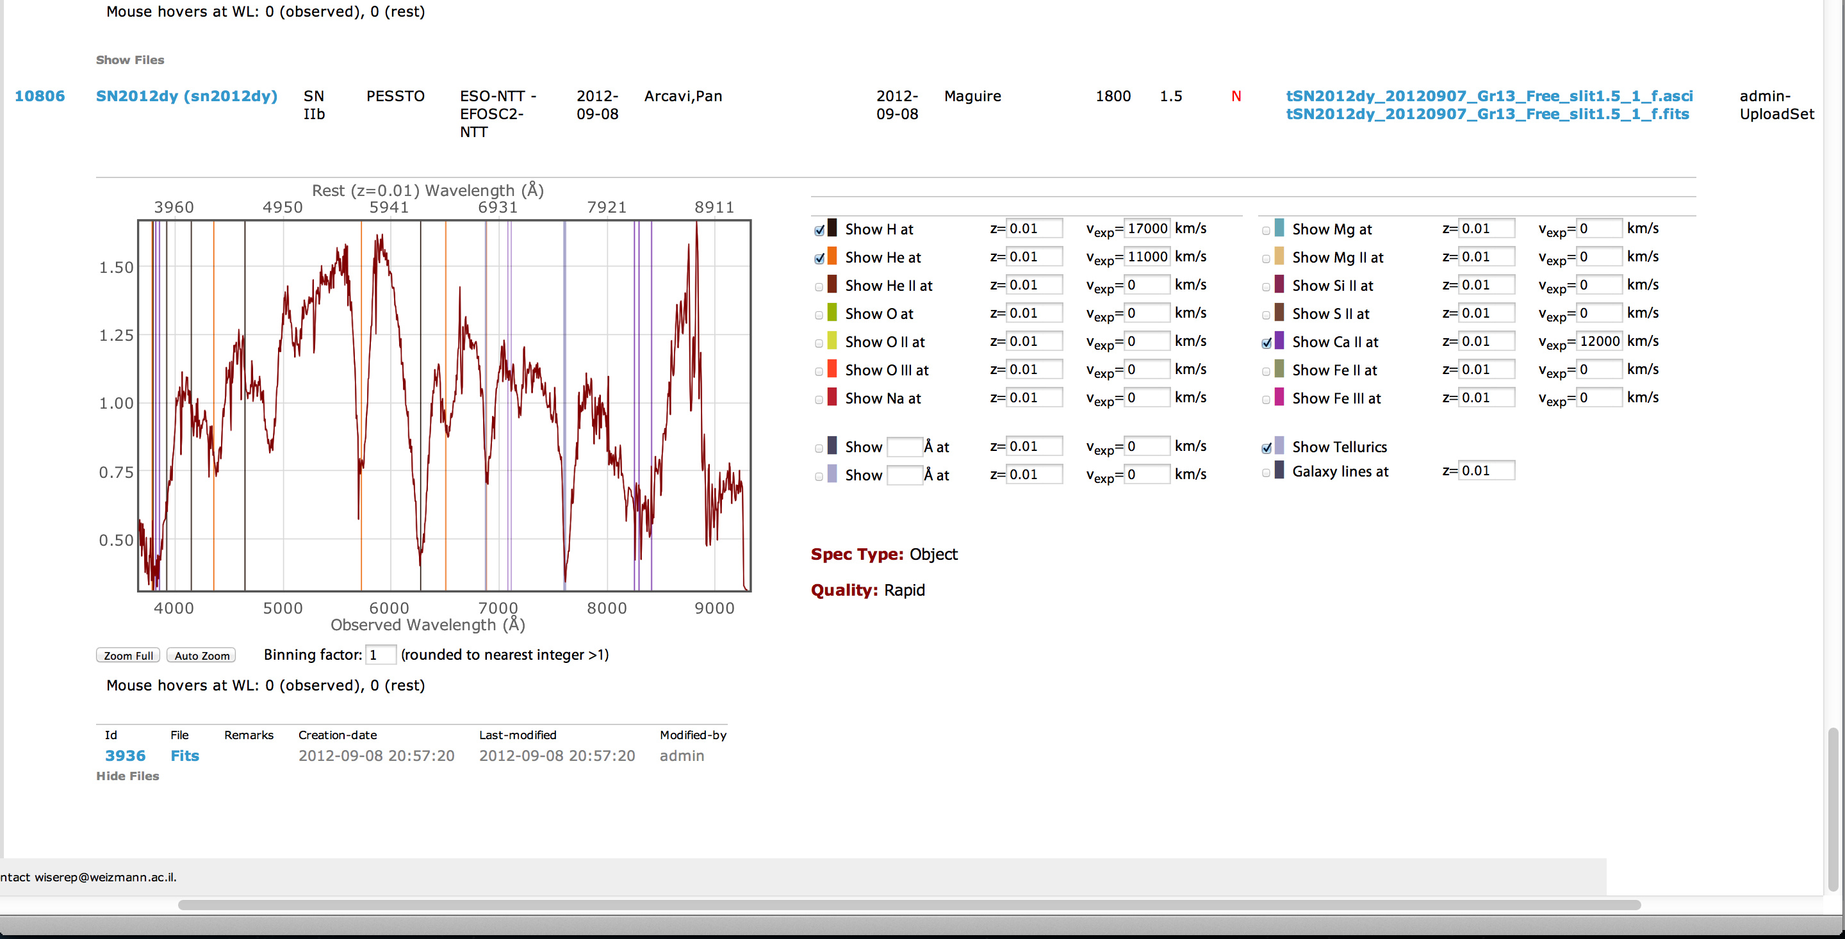
WISeREP
http://wiserep.weizmann.ac.il
Archive of SN spectra, hosting data from many programs & surveys.
>15,000 spectra, ~9,000 on public domain.
Interactive plots -> basic analysis: line identifications, redshifts, expansion velocities…
Various cross-ref. utils: ATels, IAU-SNe…
PTF Meeting Stockholm 2014 | Ofer Yaron, Weizmann Institute of Science

Slide 15
WISeREP
http://wiserep.weizmann.ac.il
Archive of SN spectra, hosting data from many programs & surveys.
>15,000 spectra, ~9,000 on public domain.
Interactive plots -> basic analysis: line identifications, redshifts, expansion velocities…
Various cross-ref. utils: ATels, IAU-SNe…
Over-plotting flash spectroscopy features; 1st Keck Spectrum of iPTF 13dqy
PTF Meeting Stockholm 2014 | Ofer Yaron, Weizmann Institute of Science

Slide 16
WISeREP
http://wiserep.weizmann.ac.il
All SN spectra by program (2014-05-28)
program | spectra
PTF | 3654
CfA-Ia | 2602
PESSTO | 1452
SUSPECT | 1243
BSNIP | 1129
iPTF | 920
Other | 668
CfA-Stripped | 632
TS3 | 524
SNLS | 463
UCB-SNDB | 311
NTT-NOT | 218
CCCP | 178
HST-Ia | 115
SNfactory | 69
CSP | 62
HIRES | 60
ESO-NTT | 13
…
Total | 14343
Histogram displays programs having >50 spectra
PTF Meeting Stockholm 2014 | Ofer Yaron, Weizmann Institute of Science

Slide 17
WISeREP
http://wiserep.weizmann.ac.il
All PUBLIC SN spectra by program (2014-05-28)
program | spectra
CfA-Ia | 2602
SUSPECT | 1243
BSNIP | 1129
Other | 660
PESSTO | 567
CfA-Stripped | 559
SNLS | 463
UCB-SNDB | 311
NTT-NOT | 218
PTF | 212
iPTF | 139
CCCP | 103
SNfactory | 69
CSP | 62
HIRES | 60
HST-Ia | 40
…
Total | 8471
Histogram displays programs having >50 spectra
PTF Meeting Stockholm 2014 | Ofer Yaron, Weizmann Institute of Science

Slide 19
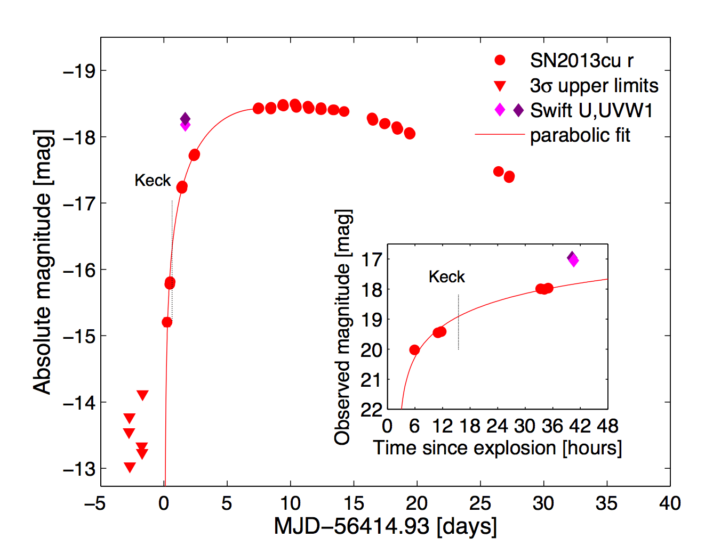
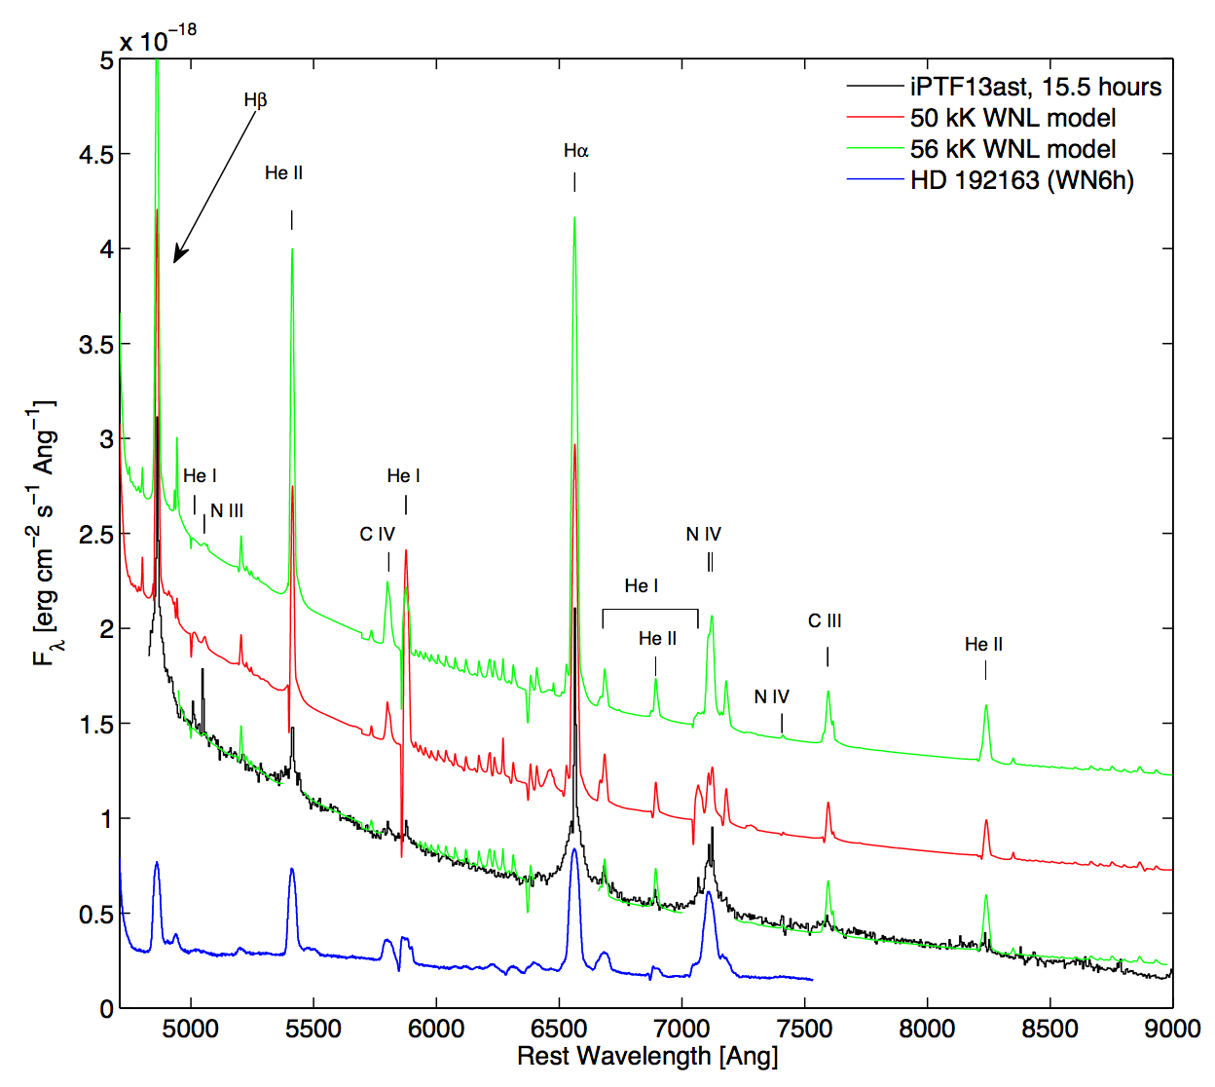
PTF/iPTF Highlights
13ast type IIb
Rapid spectroscopic follow-up – “flash spectroscopy” - to directly detect Wolf-Rayet wind features from an exploding WNh star with low H mass fraction.
Keck spectrum obtained 4 hrs after photometric confirmation, ~15 hrs after explosion.
Gal-Yam et al. 2014

Slide 20
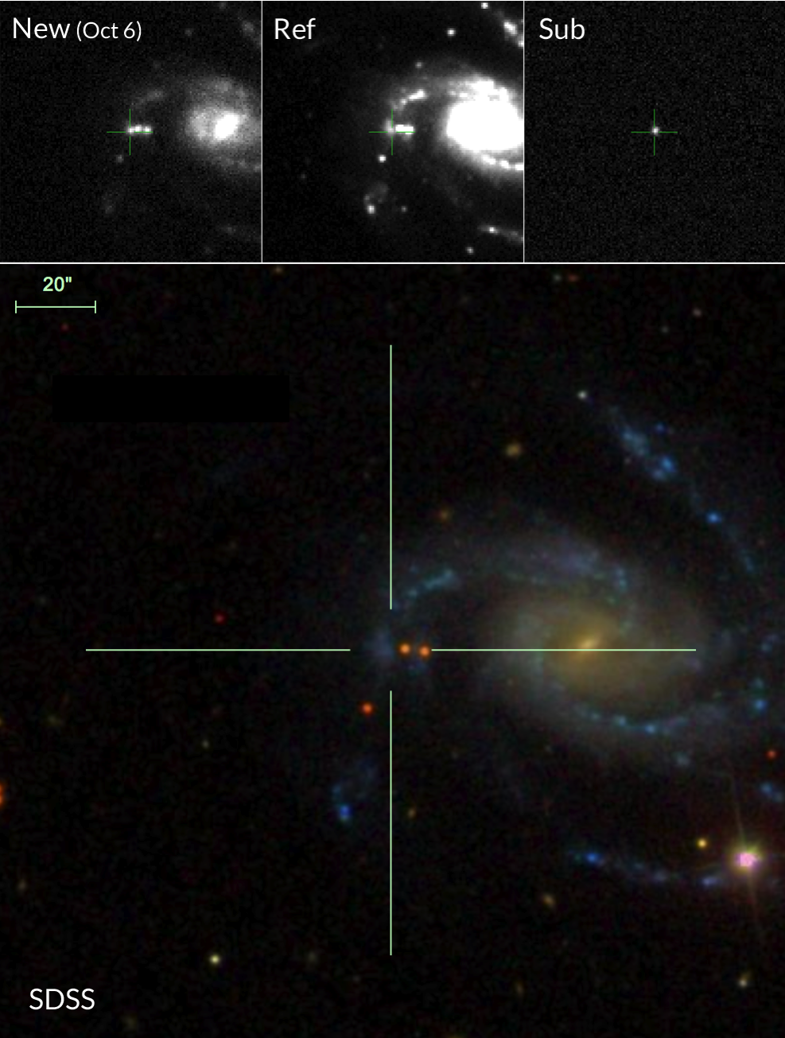
PTF/iPTF Highlights
13dqy type IIP
NGC 7610 50 Mpc
Another extraordinary Flash-Spectroscopy event.
Detection within ~3 hrs from explosion. A sequence of Keck spectra obtained between 6 and 10 hrs after explosion, to show emission lines of highly ionized species; He II, O IV / V / VI.
Yaron et al., in prep

Slide 21
PTF/iPTF Highlights
13dqy type IIP
NGC 7610 50 Mpc
Flash-spectroscopy shows evidence for a nearby cutoff shell of CSM, likely a result of an episode of enhanced mass-loss shortly before the explosion.
Early Spectra
Yaron et al., in prep
Later Spectra (“normal” IIP)

