Slide 1
IRMS Rotator Module Support Structure Conceptual Design
B. Weber
October 3, 2011

Slide 2
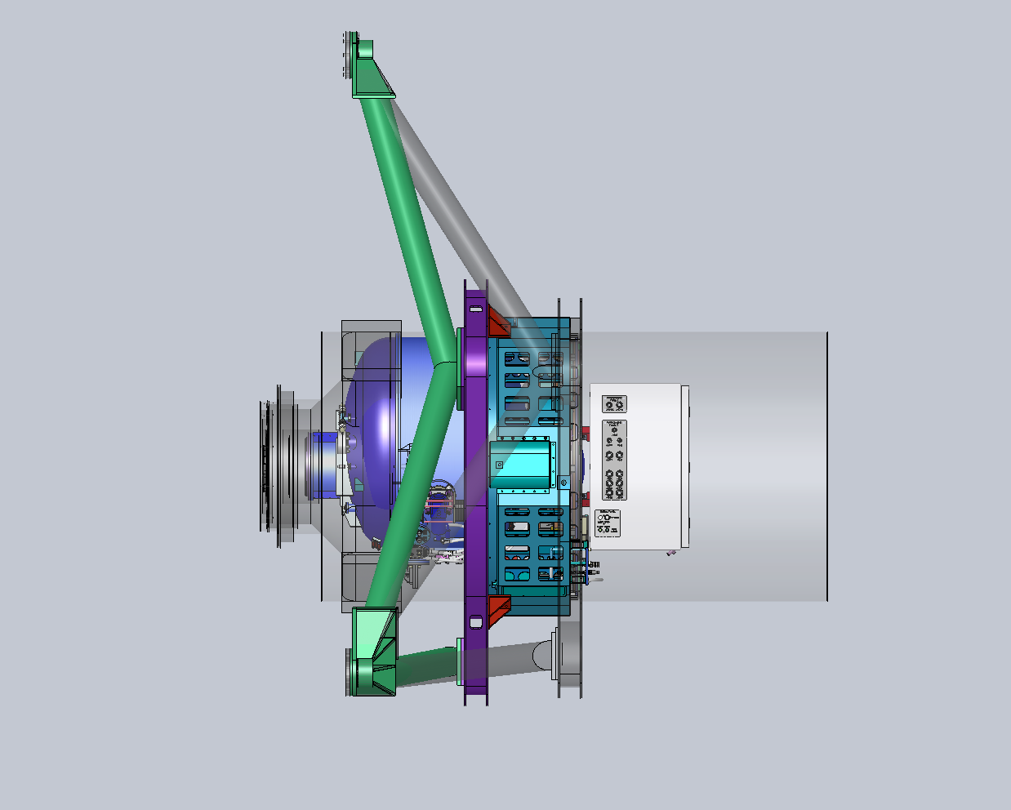
Support Structure Based on IRIS Design Concept
IRMS support
weldment
(green)
IRIS supports
(transparent)
Mount brackets (red)
bridge between the interface ring and the locations where Keck Observatory defining points are normally attached to the module (4X)
IRMS rotator
module interface
Ring weldment
(purple)

Slide 3
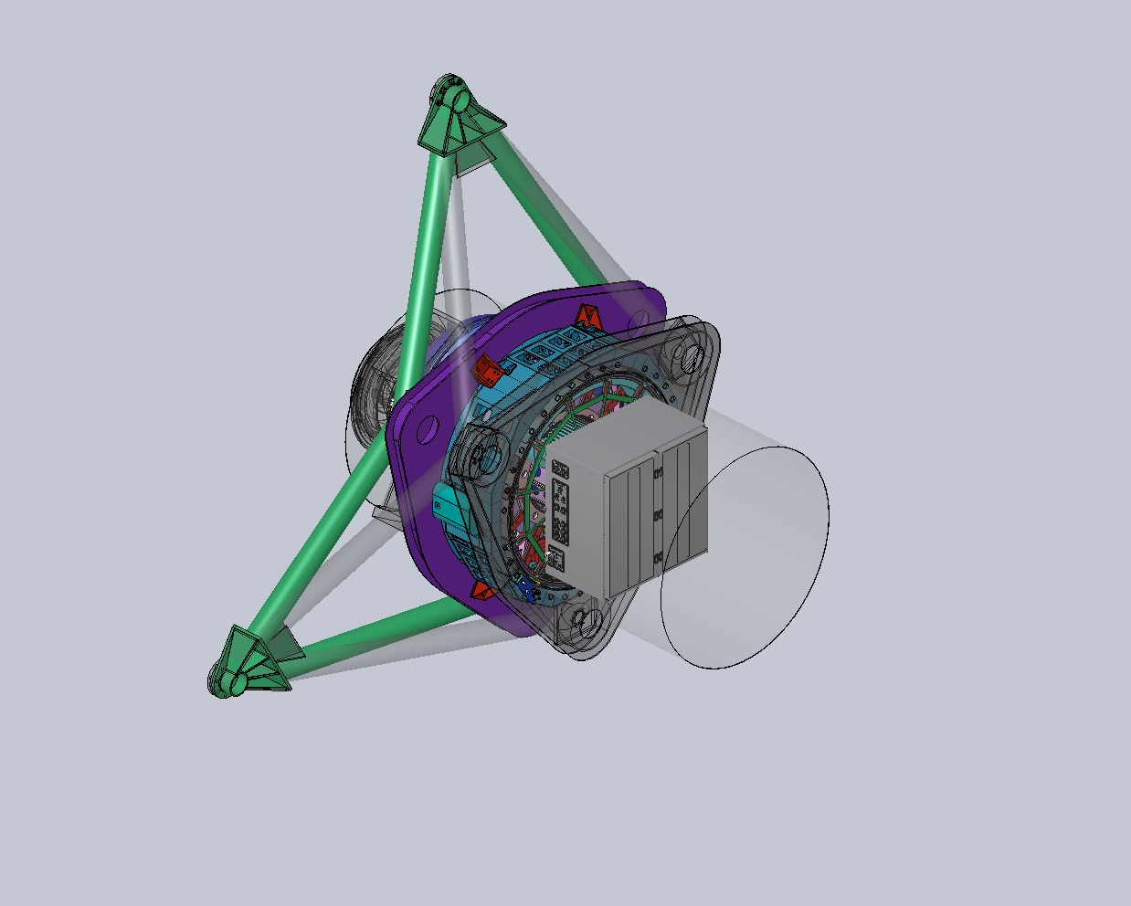
Support Structure Based on IRIS Design Concept

Slide 4
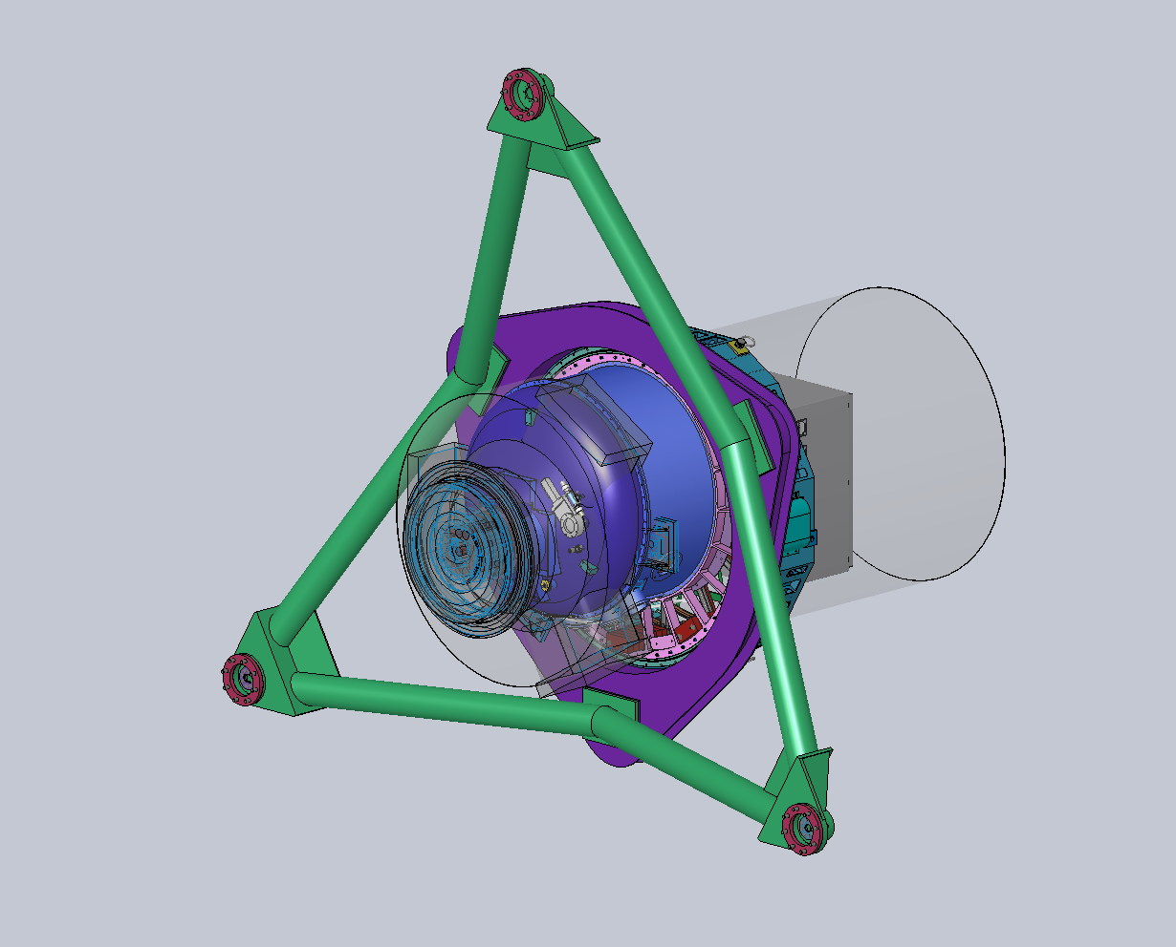
IRMS Support Structure W/Out IRIS Overlay
IRIS to NFIRAOS
Interface Overlay
(transparent)
Available instrument space envelope (transparent)

Slide 5
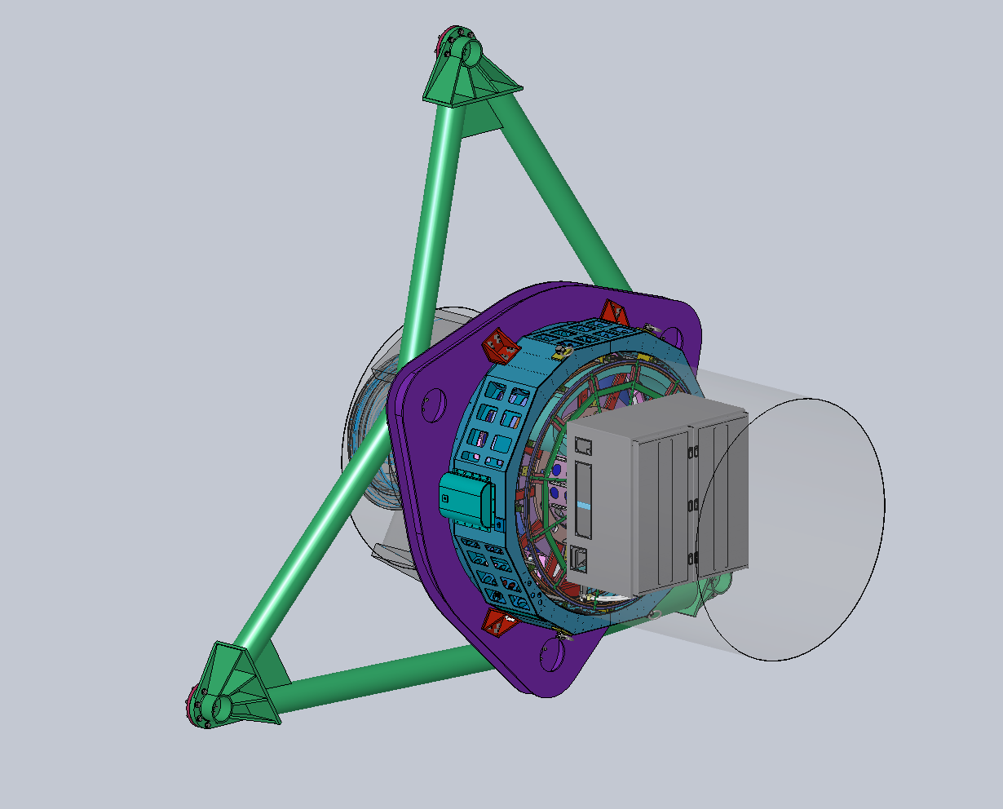
IRMS Support Structure W/Out IRIS Overlay

Slide 6
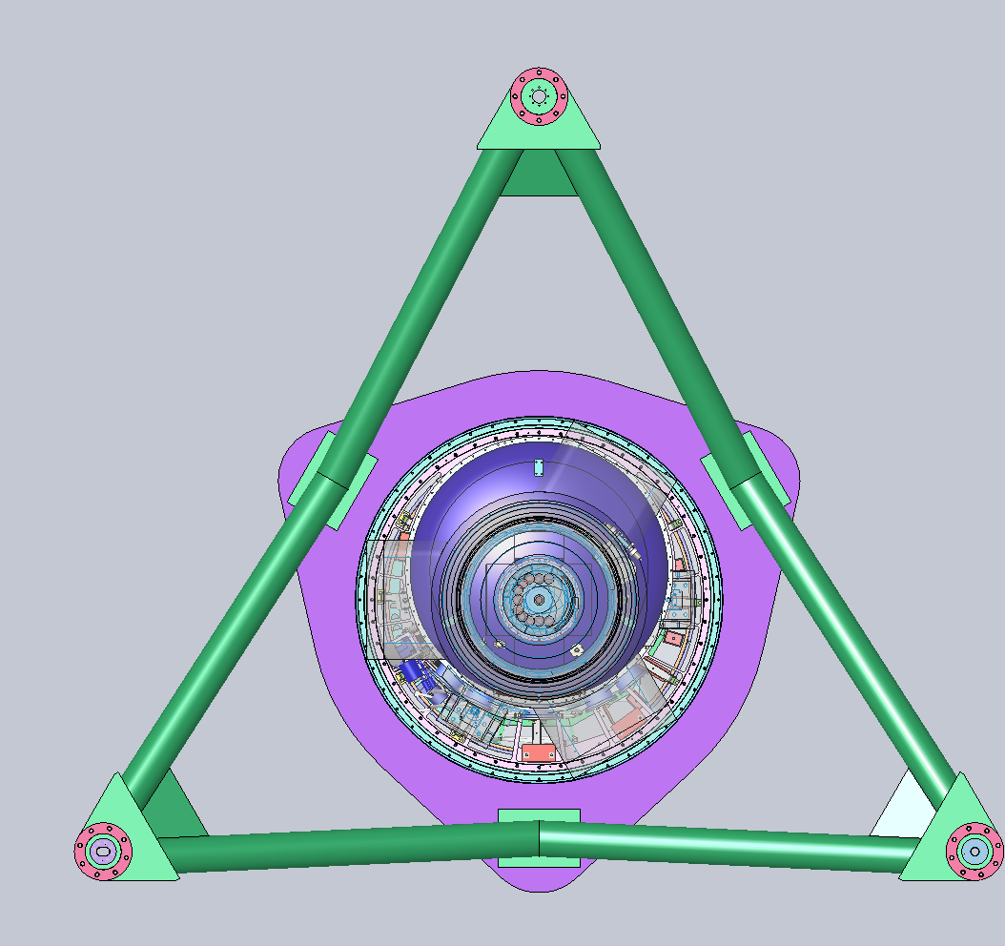
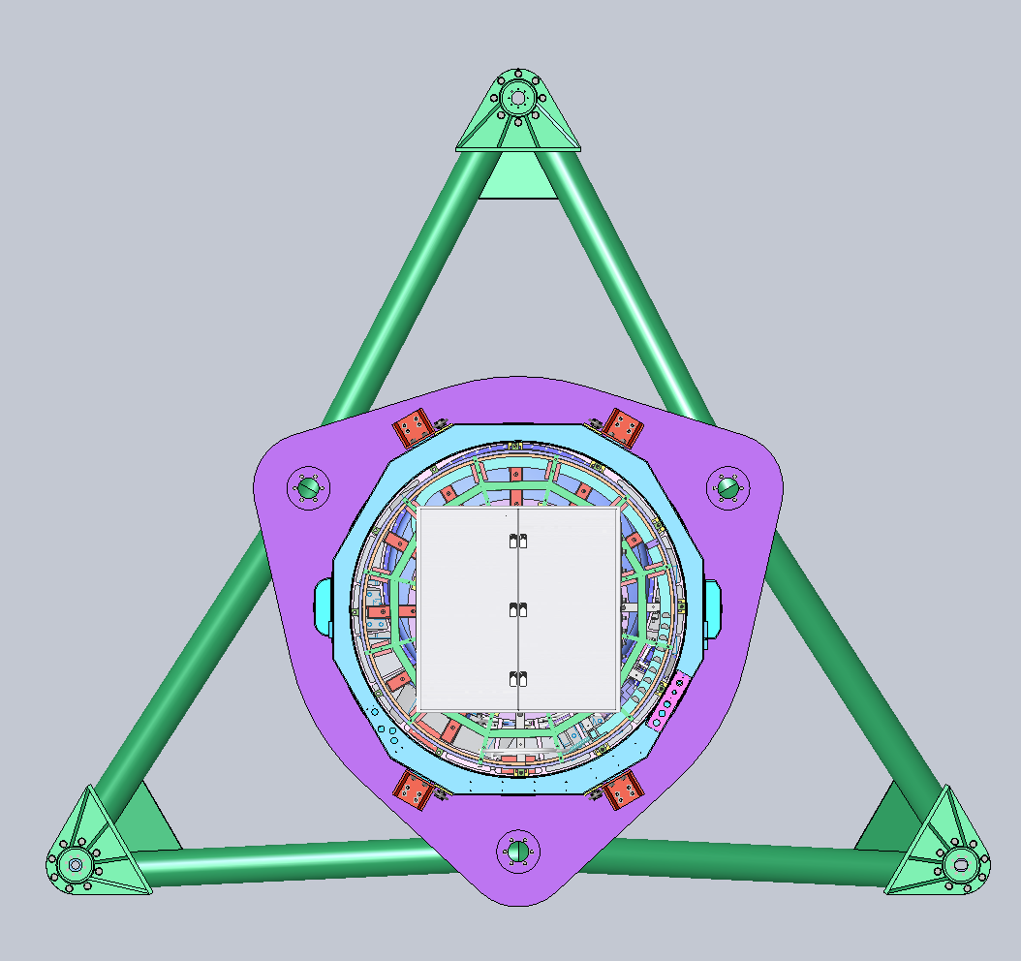
IRMS Support Structure Front & Back Views

Slide 7
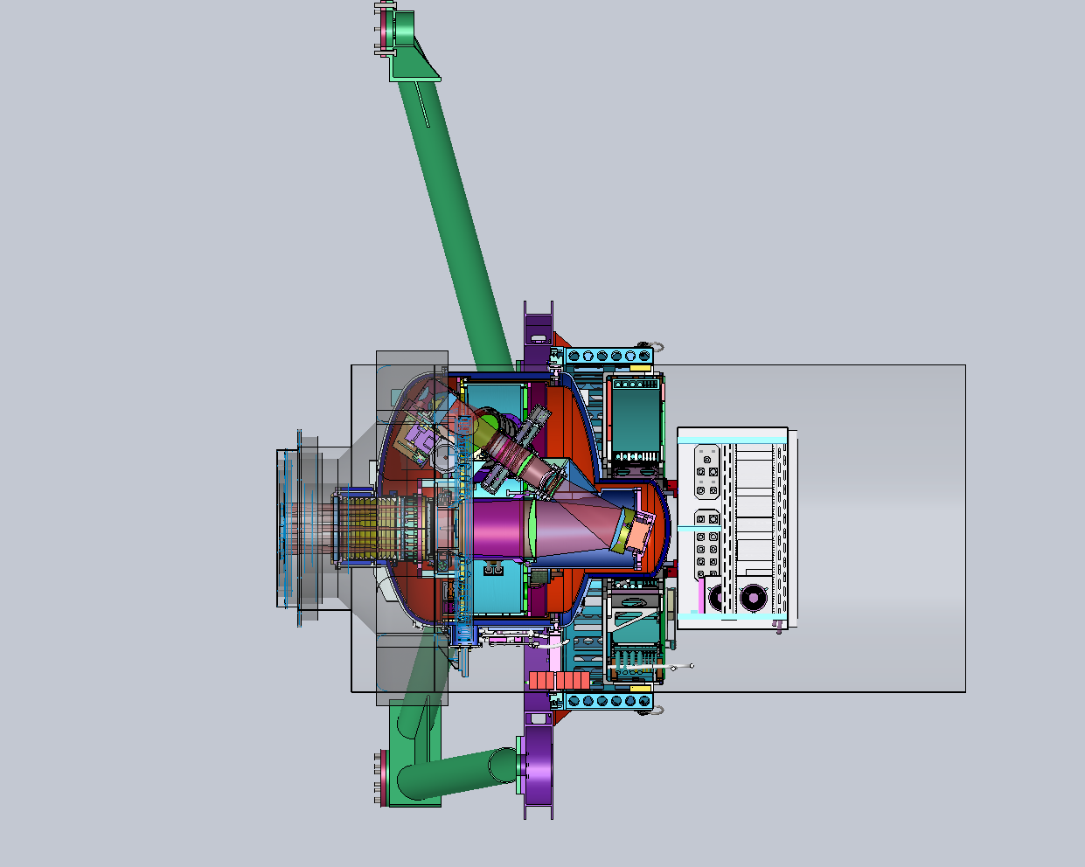
IRMS Support Structure Side Section View

Slide 8
Conceptual Design Analysis Overview
IRMS Weight Estimate: 13,000 lbs. (5,909 kg.)
Instrument: 5,500 lbs. (2,500 kg.)
Rotator Module: 2,500 lbs. (1,136 kg.)
Support Structure: 5,000 lbs. (2,273 kg.)
Support Structure FEA Results Summary (FEA report at: http://www.oir.caltech.edu/twiki_oir/bin/view/TMT/IRMS/ObservatoryInterfaces)
Static vertical load Safety Factor = 5.6 (yield strength)
1g lateral load minimum Safety Factor = 3.6 (yield strength)
1st Natural frequency of support structure (only) = 53.3 Hz
The static vertical load translated through the hexapod legs creates a maximum lateral radial load in the NFIRAOS structure = ~10,600 lbs. (4,818 kg.) tension.

