Slide 1
IRIS Interface Features Overlaid on IRMS
B. Weber
September 13, 2011

Slide 2
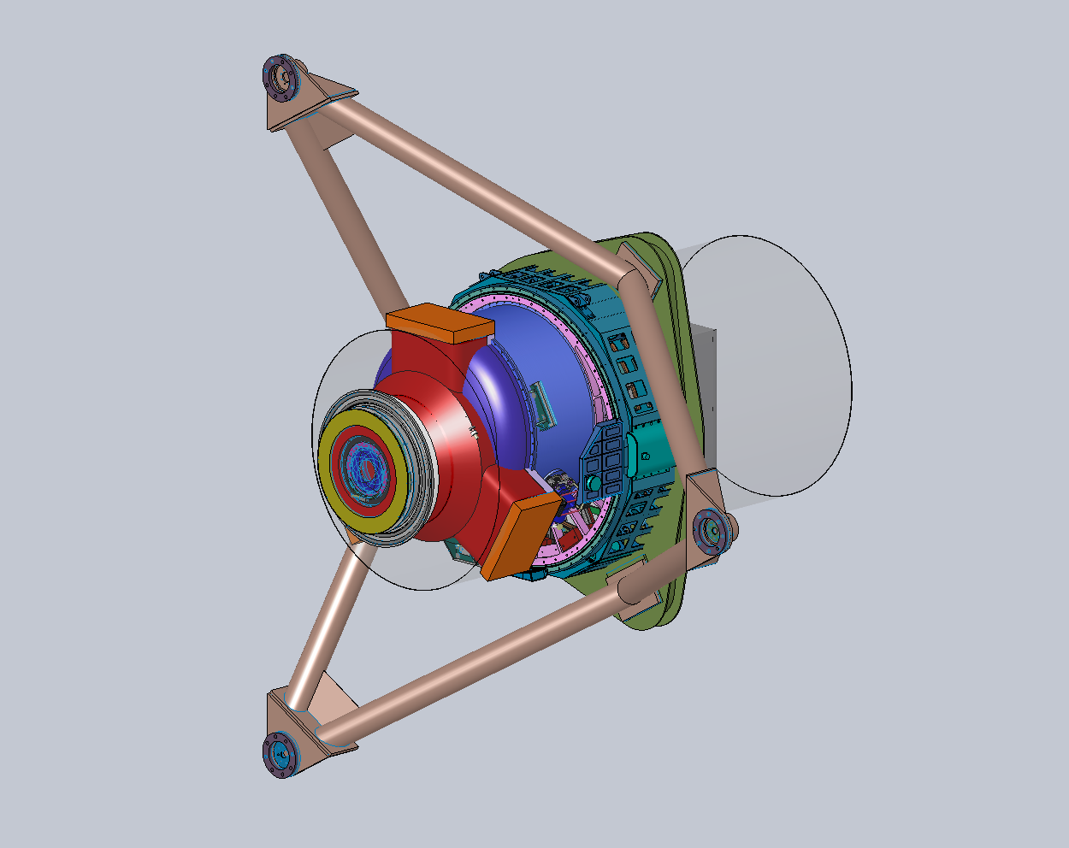

Slide 3
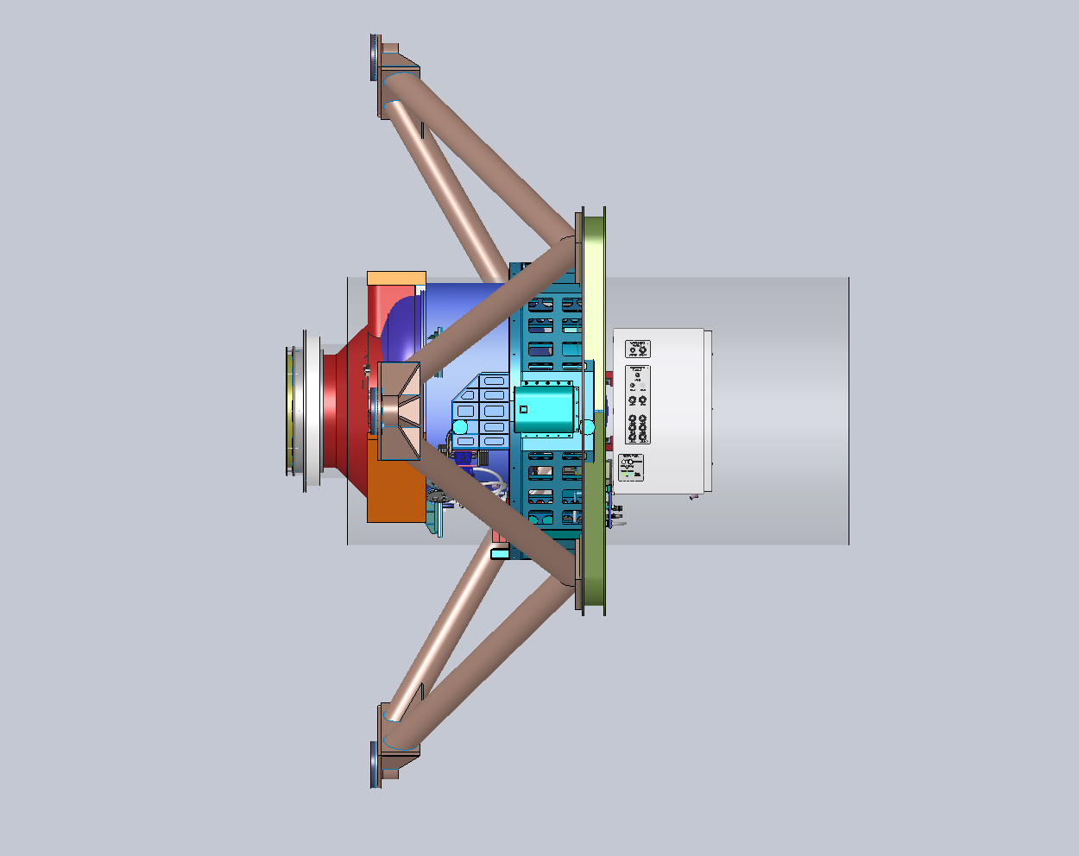

Slide 4
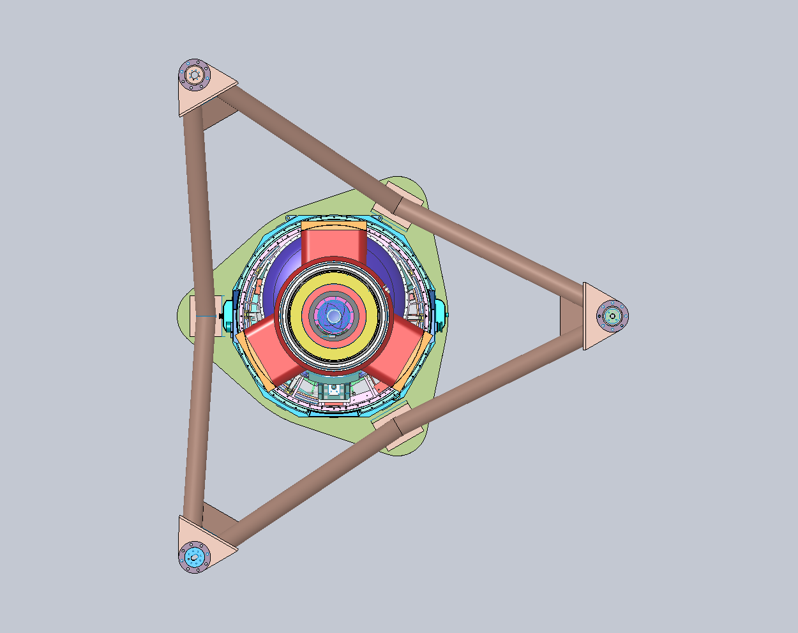

Slide 5
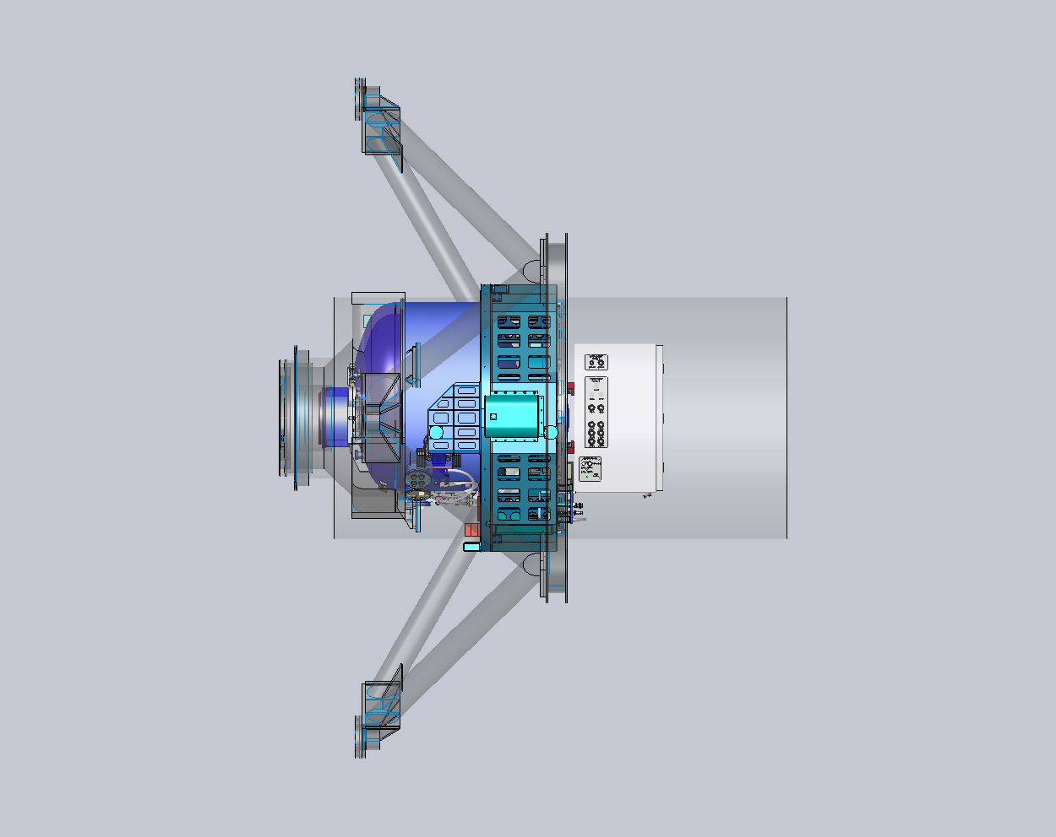

Slide 6
