Slide 1
PFI Mechanical Structure Handoff Review – updates and real-time notes added
Olivia Dawson, PFI Structure Lead
Eric Ek, Design Engineer
Jason Kempenaar, Thermal Analyst
December 17, 2012

Slide 2
Agenda
Review Objectives
Status of Work Sharing Agreement Items
Subsystem Description/Deliverables List
Requirements
Interfaces
Block diagram
Design
Thermal Design/Analysis
Mass + CG Estimates
Trades Status
Issues + Concerns
Risks
Plans Forward - include remaining tasks for JPL + for ASIAA
Backup Material

Slide 3
Review Objectives
This review is for the purpose of handing off all design materials for the Prime Focus Instrument (PFI) Mechanical Structure from JPL to ASIAA.
The review objectives are to present the current design, clarify design intent, update mass/CG status, and identify issues to be resolved and who is responsible for resolution.
As a handoff review we are NOT expecting:
Formal review board and Pass/Fail criteria.
Formal RFAs.
As a handoff review we ARE expecting:
Participation from the responsible organizations.
ASIAA to continue design process to PDR.

Slide 4
Status of Work Sharing Agreement items
CAD Model – post on Caltech Twiki
Preliminary analyses (modal, thermal, optical analysis)
No modal or optical analyses performed within Structure development task
Simplified structural analyses performed for concept development only
Thermal information posted + presented in Thermal section
Rotating and fixed structure interface drawings – JPL dwg # 10354752 issued 12/10/12, posted on Twiki, and presented in Interfaces section
Rotating and fixed structure L3 and L4 requirements – posted and presented in Requirements section
PFI MICDs and EICDs
MICDs posted and discussed in Interfaces section
EICDs were not explicitly developed separately from MICDs

Slide 5
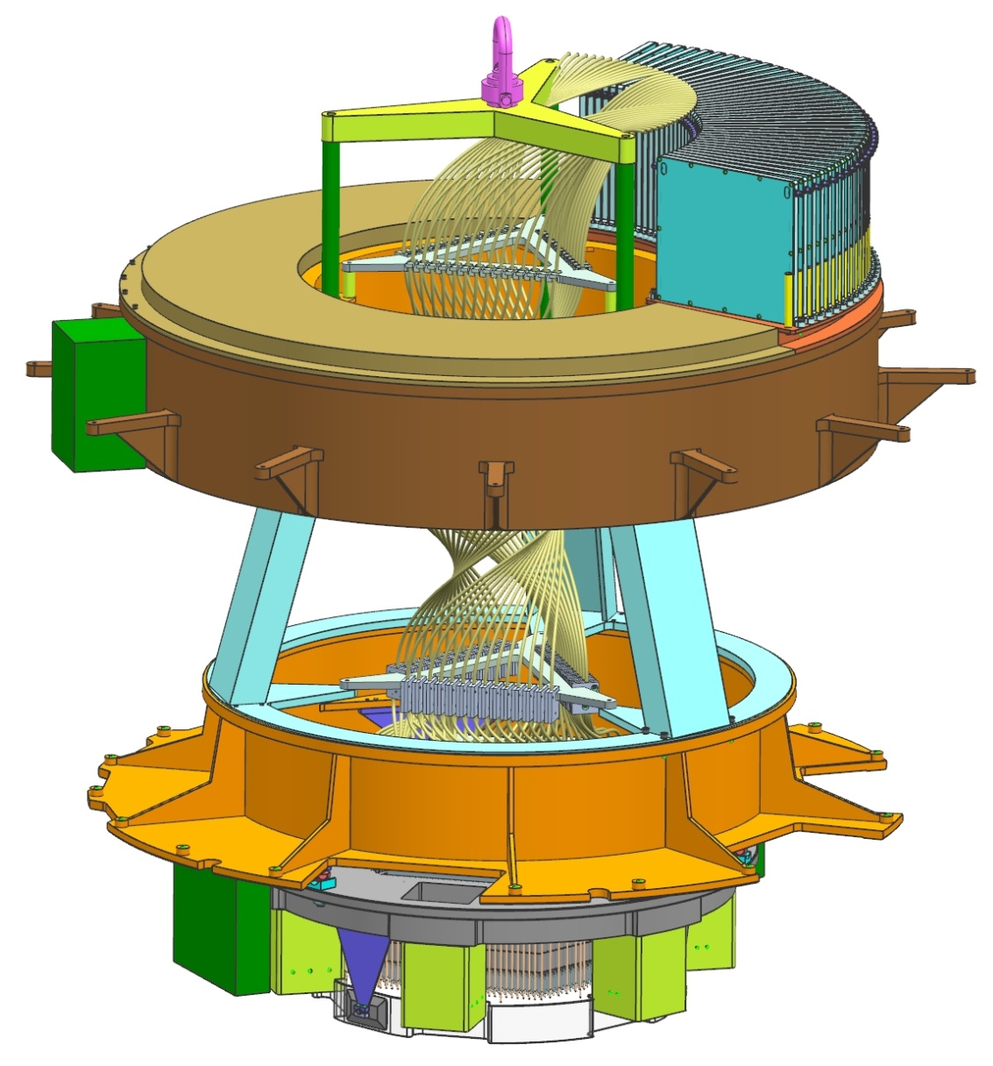
Mechanical Structure Subsystem Description
Upper PFI Mechanical Structure
Elements:
Fixed interface frame
Cable wrapper cover(s)
Lift rods/spider/ring
Interfaces:
POpt2 fixed mounting plane
Cable wrapper parts
Fiber strain relief box (SRB)
Fiber Cable C segment tube plate 3
Lower PFI Mechanical Structure
Elements:
Rotating interface frame
Lower/Upper link
Positioner bench mounts (depending on interface location)
Interfaces:
POpt2 Instrument Rotator
Positioner Bench Assembly (PBA)
Electronics boxes
Fiber Cable C segment tube plate 2

Slide 6
Mechanical Structure Requirements
Req ID | Title | Requirement Text | Predecessor | Verification Approach
L4-MS-001 | POpt2 Interface | The PFI mechanical structure shall interface with the POpt2 as specified in JPL drawing 10354752. | L3-PFI-001 | Inspection, Demonstration (fit check)
L4-MS-026 | Cable C Interface | The PFI mechanical structure shall interface with the Fiber Strain Relief Box(es) and with Cable C Segment Tube Plates 2 & 3 as specified in TBD ICD. | L3-PFI-009 | Inspection
L4-MS-027 | A&G Camera Electronics Box Interface | The PFI mechanical structure shall interface with the A & G Camera Electronics Box as specified in TBD ICD. | L3-PFI-005 | Inspection
L4-MS-028 | Fiducial Illumunator Electronics Box Interface | The PFI mechanical structure shall interface with the Fiducial Illumunator Electronics Box as specified in TBD ICD. | L3-PFI-008 | Inspection
L4-MS-029 | Optical Bench Interface | The PFI mechanical structure shall interface with the Optical Bench as specified in JPL drawing 10354754. | L3-PFI-009 | Inspection
L4-MS-030 | Fiber Positioner Electronics Box Interface | The PFI mechanical structure shall interface with the Fiber Positioner Electronics Box as specified in TBD ICD. | L3-PFI-009 | Inspection

Slide 7
Mechanical Structure Requirements cont’d
Req ID | Title | Requirement Text | Predecessor | Verification Approach
L4-MS-031 | Ethernet Hub Interface | The PFI mechanical structure shall interface with the Ethernet Hub as specified in TBD ICD. | L3-PFI-005 L3-PFI-008 L3-PFI-009 | Inspection
L4-MS-002 | Transportation | The PFI mechanical structure shall meet the Facility interface requirements as specified in TBD ICD for safe transport to and within the Subaru facility. | L3-PFI-002 | Analysis, Demonstration
L4-MS-003 | Lift Points | All lift points on the PFI mechanical structure shall be certified. | L3-PFI-003 | Analysis, Test
L4-MS-005 | Science Mode Elevation and Rotation Ranges | The PFI mechanical structure shall meet all the requirements during science observations with telescope elevations between 30 deg and 85 deg and rotator angles between +/- 60 deg. | L3-PFI-012 | Design, Analysis, Test
L4-MS-006 | Calibration Mode Elevation and Rotation Ranges | The PFI mechanical structure shall meet all the requirements described during calibrations with telescope elevations between 8 deg and 90 deg and rotator angles between +/- 60 deg. | L3-PFI-013 | Design, Analysis, Test
L4-MS-007 | Engineering and Maintenance Mode Elevation and Rotation Ranges | PFI shall operate for the purpose of engineering operations and maintenance with telescope elevations between 8 deg and 90 deg and rotator angles between +/- 278 deg. | L3-PFI-014 | Design, Analysis, Test

Slide 8
Mechanical Structure Requirements cont’d
Req ID | Title | Requirement Text | Predecessor | Verification Approach
L4-MS-008 | Operational Environments | The PFI mechanical structure shall meet operational requirements in the environmental conditions of the telescope area in the Subaru dome enclosure at the Mauna Kea summit as listed in the table in L3-PFI-016. | L3-PFI-016 | Design, Analysis, Test
L3-PFI-016 | Operational Environments | PFI shall meet operational requirements in the environmental conditions of the telescope area in the Subaru dome enclosure as listed below.
 |  | Altitude: 4,200 m
 |  | Ambient air pressure: 610 hPa
 |  | Ambient air temperature: -5 to + 5 C
 |  | Relative humidity: 0 to 80%
 |  | Wind speed: 0 to 10 m/sec
 |  | Vibration: [TBD] g, [TBD] Hz, in [TBD] axes
 |  | Cleanliness: Dust, sand and insects occasionally blown by the wind.

Slide 9
Mechanical Structure Requirements cont’d
Req ID | Title | Requirement Text | Predecessor | Verification Approach
L4-MS-025 | Non-Operational Environments | The PFI mechanical structure shall meet operational requirements after exposure to the non-operational environmental conditions listed in L3-PFI-054. | L3-PFI-054 | Design, Analysis, Demonstration
L3-PFI-054 | Non-Operational Environments | PFI shall withstand the non-operational environmental conditions of the telescope area in the Subaru dome enclosure as listed below.
 |  | Altitude: 4,200 m
 |  | Ambient air pressure: 610 hPa
 |  | Ambient air temperature: -10 to +20 C
 |  | Relative humidity: 0 to 100% with condensation
 |  | Wind speed: 0 to 10 m/sec
 |  | Vibration: [TBD] g, [TBD] Hz, in [TBD] axes
 |  | Shock: [TBD] g in all axes [TBD]
 |  | Cleanliness: [TBD]

Slide 10
Mechanical Structure Requirements cont’d
Req ID | Title | Requirement Text | Predecessor | Verification Approach
L4-MS-009 | Storage Environments | The PFI mechanical structure shall meet all requirements after exposure to storage environments listed in L3-PFI-017. | L3-PFI-017 | Design, Analysis, Demonstration
L3-PFI-017 | Storage Environments | PFI shall be capable of withstanding the environmental conditions listed in the table below during transportation.
 |  | Altitude: 4,200 m
 |  | Ambient air pressure: 610 hPa
 |  | Ambient air temperature: -2 to + 15 C
 |  | Relative humidity: 0 to 100% with condensation
 |  | Wind speed: 0 to 10 m/sec
 |  | Vibration: [TBD] g, [TBD] Hz, in [TBD] axes
 |  | Shock: [TBD] g in all axes [TBD]
 |  | Cleanliness: [TBD]

Slide 11
Mechanical Structure Requirements cont’d
Req ID | Title | Requirement Text | Predecessor | Verification Approach
L4-MS-010 | Earthquake Survival | The PFI mechanical structure shall be designed to withstand an earthquake with a level of vibration of 0.4 g [TBC], 0.5 to 100 Hz [TBC], in any axis. | L3-PFI-018 | Analysis
L4-MS-011 | Rotating Mass | The PFI mechanical structure mass supported on the rotator interface shall not exceed TBD kg. | L3-PFI-019 | Inspection
L4-MS-012 | Fixed Mass | The PFI mechanical structure mass supported on the fixed interface shall not exceed TBD kg. | L3-PFI-020 | Inspection
L4-MS-013 | Center of Gravity | The center of mass (CM) of the PFI mechanical structure supported on the rotating interface shall be placed at TBD location with TBD accuracy. | L3-PFI-021 | Analysis, Demonstration?
L4-MS-014 | Optical bench Alignment Stability | The displacement of the optical bench interface plane relative to the rotator interface shall be no larger than 3 arcsec [TBC] in tilt and 10 um [TBC] in translation when telescope elevation angle changes from 90 to 0 degrees at any rotator angle between -60 and + 60 degrees. | L3-PFI-043 | Analysis, Test
 | MS Driving Requirements

Slide 12
Mechanical Structure Requirements cont’d
Req ID | Title | Requirement Text | Predecessor | Verification Approach
L4-MS-015 | PFI to POpt2 Alignment Accuracy | PFI mechanical structure shall contribute no more than 200 um [TBC] in radial translation, 100 um [TBC] in focus, and 15 arcsec [TBC] in tilt to the misalignment of the PFI image plane relative to the rotator interface as defined by the ICD referenced in L4-MS-001. | L3-PFI-042 | Design, Analysis
L4-MS-016 | Installation | The PFI mechanical structure shall allow PFI removal from POpt2 as a single assembly. | L3-PFI-030 | Design, Demonstration
L4-MS-017 | Metric Fasteners | The PFI mechanical structure shall use metric fasteners for all screws, bolts, nuts, and tapped fixtures. The only exception will be internal components of commercially purchased mechanisms, or fixtures to attach these (e.g. pre-tapped holes). | L3-PFI-048 | Design, Inspection
L4-MS-018 | SI Units | The PFI mechanical structure shall use metric dimensions on all drawings and documentation. | L3-PFI-049 | Inspection
L4-MS-019 | Safety | The PFI mechanical structure design and construction shall be in accordance safety standards at the Subaru observatory. | L3-PFI-050 | Design, Analysis
L4-MS-020 | PFI power dissipation into the dome | The mechanical structure shall accommodate TBD thermal control hardware to limit the PFI power dissipation into the telescope dome air. | L3-PFI-023 | Design

Slide 13
Mechanical Structure Requirements cont’d
Req ID | Title | Requirement Text | Predecessor | Verification Approach
L4-MS-021 | PFI structure focus stability due to temperature effects | The PFI Structure shall compensate for the axial displacements of POpt2, Optical Bench, Rail, and Positioner to match the displacement of the PFI microlens plane. The compensation shall limit the relative displacements of the PFI image plane and the WFC image plane to within 0 to 12 um +/-20% (displacement in the +Z direction in the PFI Coordinate System) TBC over the operational environments, excluding the positioner power dissipation effect. The WFC image plane Z-displacements with respect to the PFI/Instrument Rotator interface are defined in TBD Project Document. | L3-PFI-053 | Design, Analysis
L4-MS-22 | Cable C handling during integration | The PFI mechanical structure shall include provision to support and protect the un-mated ends of cable C during PFI installation and removal from POpt2 that allow one person to safely stow, unstow and integrate cable C to the cable B interface. | L3-PFI-30 | Design, Demonstration
L4-MS-23 | Fiber Positioner Removal | The PFI mechanical structure shall allow installation and removal of a single fiber positioner module and associated Cable C elements from the PFI without disturbing the other cable C fibers. | L3-PFI-052 | Design

Slide 14
Stiffness Requirement
PFS PO provided Mitsubishi Doc #TM_N54491 to JPL, specifying maximum radial and axial stiffness values for the PFI “Positioner Frame” (Rotating Interface Frame), as well as a suggested method for stiffness analysis, in order to maintain acceptable stress levels in the Rotator/Lens Frame when PFI is installed.
JPL has not analytically determined the Frame stiffness, but the structure likely meets the specifications for the following reasons:
Radial: The PFI Rotating I/F Frame structure is open across the interior, rather than closed like the HSC I/F frame shown in the analysis images, and thus can be shown by inspection to be softer than the required maximum stiffness.
Axial: The PFI Frame is adequately similar to the HSC I/F Frame as to have comparable stiffness.
This stiffness specification has never been turned into an official requirement on the PFI structure.
JPL has some questions:
Is there a minimum stiffness required?
Can a requirement be written differently so as to become independent of the analysis done by Mitsubishi, which we don’t entirely understand? (Why is their axial displacement constrained only in 4 places, instead of around bolt hole pattern? Why is force applied at outer flange?)

Slide 15
Status of Requirements and Work to Go
Status:
TBDs in 11 requirements
TBCs in 4 requirements
Missing stiffness requirement (tilt/decenter/focus)
Some wording still to be negotiated (e.g. MS-L4-009, MS-L4-015, MS-L4-021)
Verification approaches may indicate tests that have not yet been planned/discussed with I&T
Work to Go to PDR:
Continue negotiations to complete and ensure clarity in all L4s (JPL-Caltech SE/PO/LNA/ASIAA)
Define L2 absolute stiffness requirement with respect to PFI/POpt2 Rotator I/F (PO)
Eliminate, where possible, requirements derived from HSC (PO/JPL SE)
Develop MS L4 requirement verification plan (JPL-Caltech SE / ASIAA)
Perform all preliminary analyses to determine performance with respect to requirements (ASIAA)
Use mass CBEs presented here to sub-allocate mass requirement (JPL SE / PO)
Develop verification plan for L4-MS-23 (JPL I&T / LNA / ASIAA)

Slide 16
Interfaces to PFI Mechanical Structure - Summary
Component: POpt2 Interfaces to: Upper (non-rotating) and Lower (rotating) PFI Structure Responsible organization: PFS Project Office Status: Envelope ICD proposed Dec 10, 2012
Component: Cable Wrapper Interfaces to: Upper (non-rotating) and Lower (rotating) PFI Structure, electrical + thermal subsystems Responsible organization: ASIAA Status: design in negotiation
Component: Fiber Optic Cable C Interfaces to: Upper (non-rotating) and Lower (rotating) PFI Structure Responsible organization: LNA Status: design in negotiation
Component: Positioner Bench Assembly Interfaces to: Lower (rotating) PFI Structure Responsible organization: JPL Status: design proposed herein; no MICD started
Component: A&G Power Distribution Box Interfaces to: Lower (rotating) PFI Structure, electrical + thermal subsystems Responsible organization: ASIAA Status: not yet started
Component: Fiducial Illuminator + Power Distribution Box Interfaces to: Lower (rotating) PFI Structure, electrical + thermal subsystems Responsible organization: ASIAA Status: not yet started
Component: Ethernet Hub Interfaces to: Lower (rotating) PFI Structure, electrical + thermal subsystems Responsible organization: JPL Status: not yet started
Component: Positioner Power Regulator / Capacitor Box Interfaces to: Lower (rotating) PFI Structure, electrical + thermal subsystems Responsible organization: JPL Status: not yet started

Slide 17
Interfaces to PFI Mechanical Structure – Summary cont’d
Component: Thermal Subsystem
Interfaces to: Lower (rotating) PFI Structure Responsible organization: ASIAA Status: not yet started

Slide 18
Interface (1) – PFI-to-POpt2
Description: Envelope within POpt2 instrument allocated for use by PFI.
Status: Preliminary drawing issued Dec 10, 2012.
Included in current drawing:
Dimensioned envelope
PFI coordinate system
Current understanding of “Fixed” and “Rotator” mounting hole patterns (designed/built by Mitsubishi)
Nominal location of best-fit plane to front flats of PFI fiber microlenses (“PFI Microlens Plane”)
Nominal location of image plane created by WFC (“PFI Image Plane”)
Direction of telescope cabling
Direction of PFI science fiber output Cable C
Work to go to PDR:
Scrutinize current dimensions + model for accuracy. Expand existing envelope to accommodate current, acceptable violations. (ASIAA/PO/Subaru)
Determine whether 1364mm diameter at top should be diameter ~1030mm.
Confirm Note 2 with Mitsubishi.
Update Note 4 to 278 deg, per Requirement L3-PFI-014.
Determine tolerance qualified by Note 5.
Confirm dimensions qualified by Note 6.

Slide 19
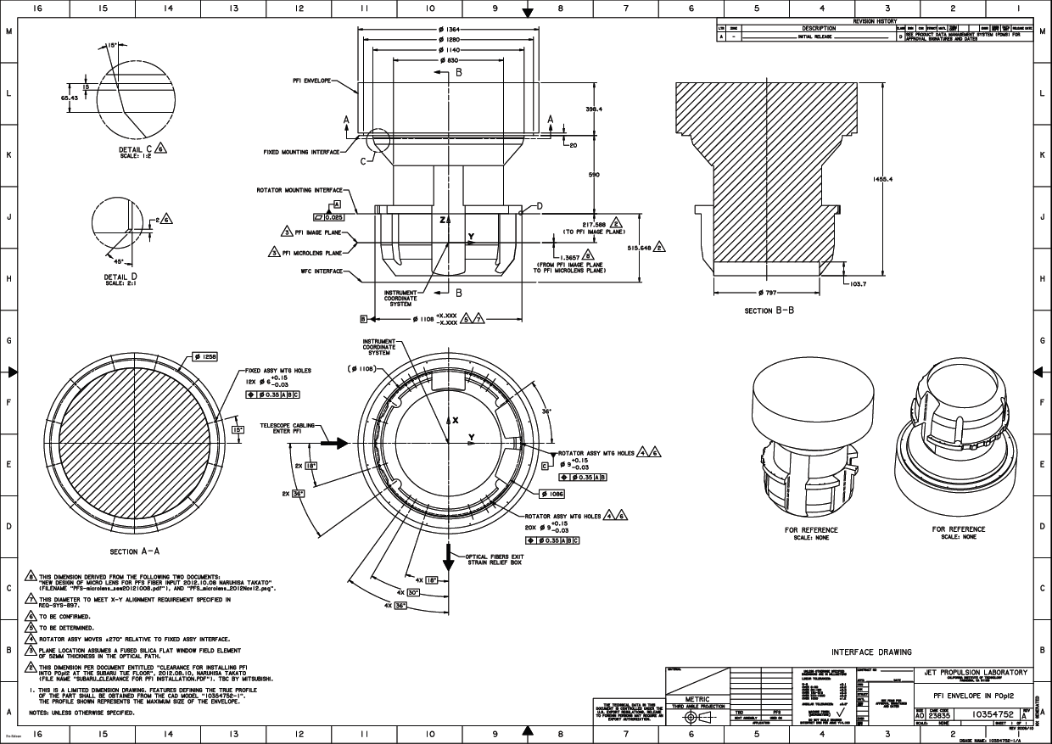
Interface (1) – PFI-to-POpt2 ICD Drawing

Slide 20
Interface (2) – Cable Wrapper (CW)
Description: Commercial cable-wrapping and bearing components mount inside PFI Upper Structure. Rotating portion of cable wrapper chain interfaces with drive arm on PFI Lower Structure. Upper structure also provides interfaces for electrical and thermal subsystem elements (cabling and glycol lines).
Status:
JPL/ASIAA agree on mechanical envelope (proposed 11/21/12 – see Backup for image). JPL proposes an Upper Structure design in this package to accommodate the CW chain + bearing parts.
JPL suggests that locating the thermal/electrical bulkhead on top of the CW assembly may be easier than having it on the side, as in the current design.
There is confusion about exactly what cabling elements are passing through the CW as described in ASIAA’s document “MeetingonPFI20121001.pdf”. UPDATE: Email from M. Kimura on 12/17/12 lists the following elements:
Coolant line: 3/4” hose (1 pair)
Power line: AWG #16 for Cobras (2 pair) + ASIAA (1 pair)
AC 2-line system, NO GROUND line
LAN (communication): 2 pairs of optical fiber (AG) and 1 GB Ethernet (common line)
Signal line: I think no direct communication of telescope system
Discussion of emergency stop signal line: It is not yet determined how the e-stop interlock will be designed, or whether the signal for it needs to pass through the rotating side of the cable wrapper.

Slide 21
Interface (2) – Cable Wrapper (CW) cont’d
MICD info provided by ASIAA:
How to handle and support the fiber cables?
Need a leak sensor for coolant.
Need an emergency stop or a monitor system for a detection of an angler shift between instrument rotator and cable wrapper.
Rotation angle for mechanics : CW & CCW direction _______deg
Rotation angle for observation: CW & CCW direction _______deg
Operation for telescope elevation angle: _______deg
Rotation torque: CW & CCW direction _______ +- _____ kgf m
Work to go to PDR:
ASIAA assumes responsibility on 12/17/12 for the I/F between CW parts and Upper Structure and for Upper Structure design. (ASIAA)
No MICD for these parts may necessarily be required after transfer to ASIAA
Establish contents of CW (including limit switch) (ASIAA/ JPL-Caltech SE)

Slide 22
Interface (3) – Fiber Optic Cable C
Description: 3 mechanical interfaces along the fiber optic cable assembly.
Interface to the Lower PFI Structure: Segment Tube Plate (STP) 2.
Interfaces to the Upper PFI Structure: Segment Tube Plate 3 and the fiber Strain Relief Box (SRB), an array of 42 individual boxes (containing some length of slack in the science fiber bundles) mounted as a single unit on top of the cable wrapper assembly.
Status:
SRB envelope proposed by JPL on 12/5/2012 accepted by LNA.
Interfaces with STPs unchanged since Sept 2012. Location planes are acceptable. Hole patterns and exact geometry of interfacing hardware have not been defined.
STP1 interface with Positioner Bench is tentative and dependent upon Bench analysis results.
MICD info provided by LNA:
Other requirements: SRB needs to be black anodized to avoid reflections

Slide 23
Interface (3) – Fiber Optic Cable C cont’d
Work to go to PDR:
Within current envelope, negotiate SRB design and interface that is acceptable to both LNA and ASIAA. JPL has design suggestions for incorporating the SRB into a cover plate for Cable Wrapper on Upper Structure (see Design section). (ASIAA/ LNA/ Caltech I&T / JPL SE)
LNA Cable C is modeled with 240 deg twist and twist between PBA and STP1. Correct to 278 deg, remove twist, and determine whether lower twist is needed. (LNA/ASIAA)
Stowing Cable C on MS is undefined. (LNA/ASIAA/PO/JPL-Caltech I&T + SE)
Look closely at whether envelope for SRB box slices will clear STP1. Make mockup? (ASIAA/LNA/JPL-Caltech SE & I&T)
Establish mounting hole patterns for attaching STPs to Lower and Upper Structures (LNA/ASIAA).
Work with JPL to finalize decision on whether to mount STP 1 to Positioner Bench or to Lower Structure. (JPL/ASIAA)

Slide 24
Interface (4) – Positioner Bench Assembly
Description: Lower PFI Structure supports the PBA on kinematic mounts to accommodate CTE differences. This interface can be established at the Structure end or the PBA end of these mounts. (See Design section for details.)
Status:
Design presented herein by JPL is preliminary. No analysis has been performed.
Kinematic flexure design cannot be finalized until the effective CTE of POpt2 structure is known.
In the baseline presented, this I/F is at the PBA (and thus is an ASIAA deliverable).
Could, however, become a JPL deliverable if the I/F were made at the Rotating I/F Frame.
No MICD has been started (JPL deliverable). – check JPL dwg
Work to go to PDR:
Determine whose deliverable the flexure mounts will be (ASIAA vs. JPL). (ASIAA/JPL)
Establish exactly where interface will be. (ASIAA/JPL)
Determine whether a requirement is necessary for any adjustability in this interface. (PO/JPL SE/ASIAA)
Deliver MICD. (JPL)

Slide 25
Interfaces (5), (6), (7), (8) – Electronics Boxes
Description: Electronics boxes mounted to Lower PFI Structure:
A&G Power Distribution Box (ASIAA)
Fiducial Illuminator + Power Distribution Box (ASIAA)
Ethernet Hub (ASIAA)
Positioner Power Regulator / Capacitor Boxes (12) (JPL)
All boxes are expected to require glycol cooling lines to limit dissipation of heat into the air.
Status:
Update on Dec 13, 2012 indicates that there will be 12 JPL boxes for Positioner electronics (only one box shown in Design section images)
Box envelopes/interfaces/MICDs have not been developed.
Envelope locations on the Lower Structure have not been identified.
Power values are still preliminary.
Thermal system for cooling electronics has not been designed.
Work to go to PDR:
Develop ICDs for all electronics boxes as mass, volume and power values mature. (ASIAA/ JPL)
Ensure that all electronics box designs include features necessary for limiting power dissipation to the air to the required maximum (see Thermal section). (JPL/ASIAA)

Slide 26
Interface (9) – Thermal subsystem
Description:
Accommodation for glycol cooling lines:
Into bulkhead on Upper Assembly
Through CW
To/from all electronics boxes
To/from Positioner Bench
Accommodation for dust cover/thermal enclosure on Lower Assembly
Status:
Conceptual design initiated at JPL (see Thermal section).
Concept is currently too preliminary to design the mechanical accommodations listed above in any detail.
No MICD has been started (ASIAA deliverable).
Work to go to PDR:
Mature the power dissipation values (as described in Thermal section). (JPL/ASIAA)
Develop an instrument-level thermal system of glycol cooling. (ASIAA)
Design mechanical accommodations described above as necessary, after Thermal design has more maturity. (ASIAA)
Deliver MICD. (ASIAA)

Slide 27
Mechanical Structure Block Diagram
Subaru facility
Spectrographs
Glycol
Power
Comm.
SRB
Fixed Upper Structure
Cable Wrapper
Rotating Lower Structure
Ethernet hub
A&G Power + control
Fiducial Illuminator Power + control
POS
power
boxes
Rotator E-Stop
Optical fibers
Fiducial Illuminator
Positioner
System
A&G Cameras

Slide 28
Design – introductory general notes
The design has been developed with the requirements in mind, as well as fabrication/material costs and ease of manufacturing.
No stress- or modal analysis has been performed.
ASIAA updated CW design and envelope on 11/21/12 – JPL and LNA agree to this change but JPL/ASIAA are still waiting for LNA’s resulting updates, so the Cable C representation in the images is not completely up-to-date. Update: LNA CAD Model from 12/18/12 is now shown in the images.
Baseline design presented herein does not reflect the update to JPL Positioner electronics made on 12/13/12. Concept presented at the end of this section is very preliminary.
Due to the lack of maturity of any of the electronics box design/interfaces, all electronics boxes shown in the images are notional representations.
No thermal hardware has been modeled, which will likely include: glycol lines / manifold and associated support brackets, heat exchangers, and thermal enclosures on both sides of Positioner Bench.

Slide 29
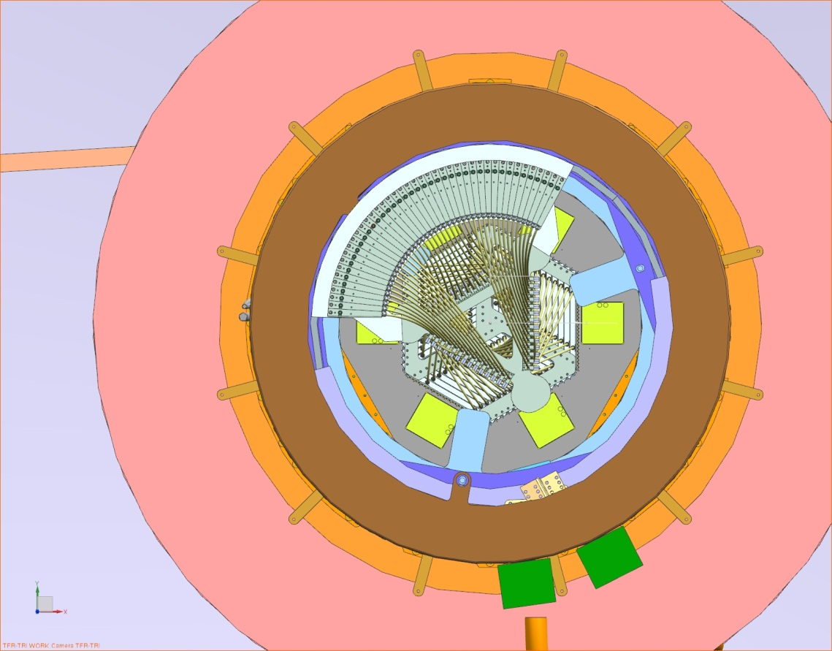
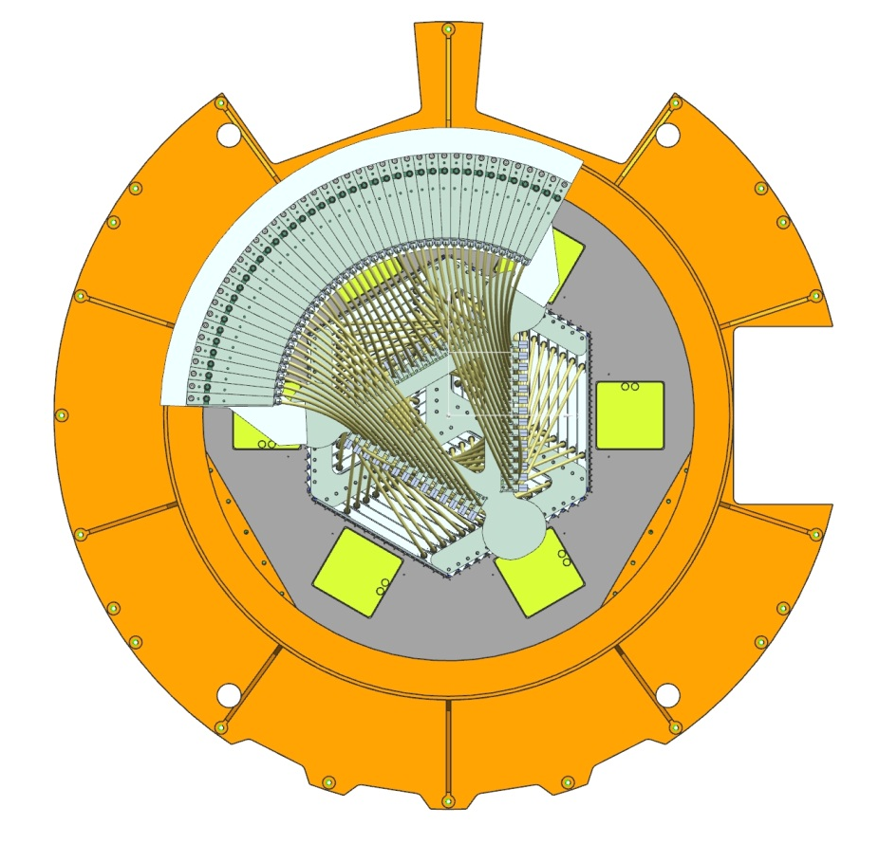
PFI Mechanical Structure on Subaru
Y
Fiber Cable C exits along spider vane
X
POpt2
PFI with instrument coordinates
Telescope cables enter from spider vane
SRB and Cable C were recently proposed by JPL to rotate into position above; accepted by LNA and ASIAA.
Cabling enters via one spider vane, and fibers exit via another.

Slide 30
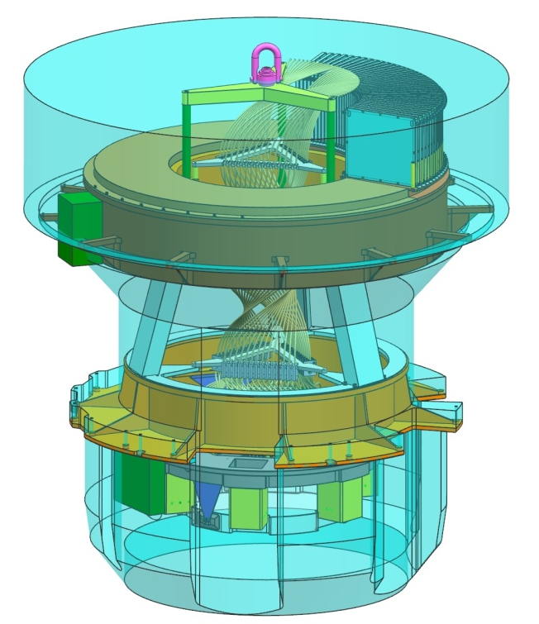
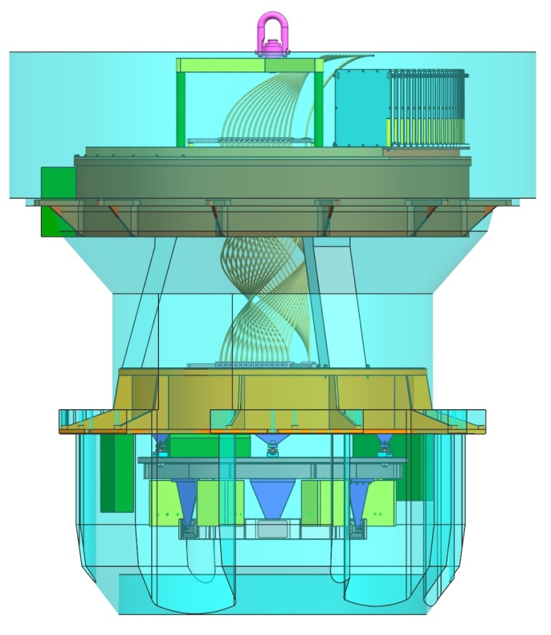
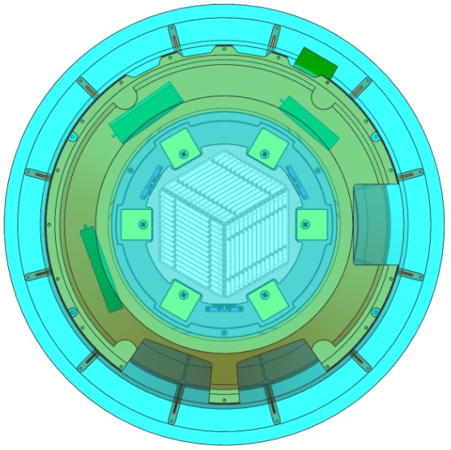
PFI Mechanical Structure inside Allowable Envelope
1
2
3
Lift Ring exceeds envelope, but it is removed for operation. JPL has not received definition of whether or not this is allowable. – Acceptable per ASIAA/PO
Bulkhead plate/box exceeds the diameter dimension put in place to allow adequate access to Rotator I/F holes; however, it does not interfere with POpt2 structure.
Gussets exceed envelope but do not interfere with POpt2 structure.

Slide 31
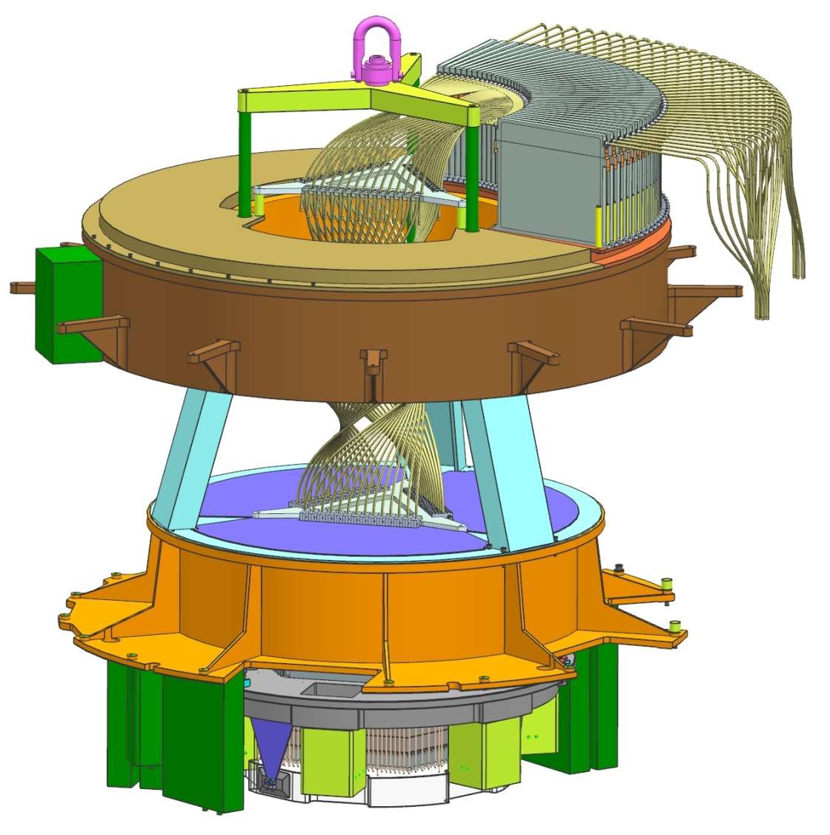
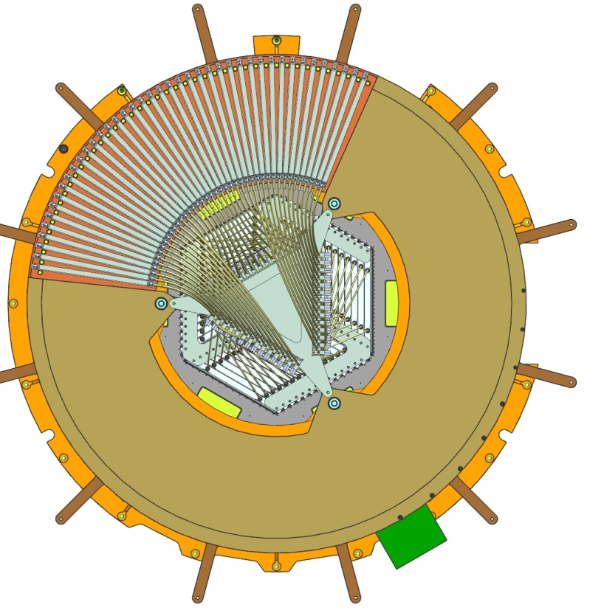
Detailed Design Description – PFI Mechanical Structure (shown with PBA)
PFI lift ring
3 lifting rods run through Upper Structure and tighten into Lower Structure for transport. Rods are removed when PFI is installed and Lower Structure is bolted into Rotator I/F. CG and lift ring axis must coincide.
POpt2
Fixed I/F
POpt2
Rotator I/F
All Rotator I/F holes accessible from top (specialty long wrench required)
Locations
for 4 guide pins
PBA
Top View

Slide 32
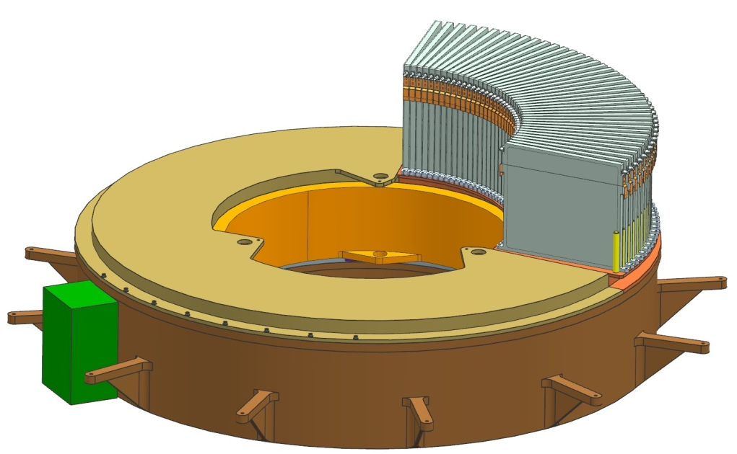
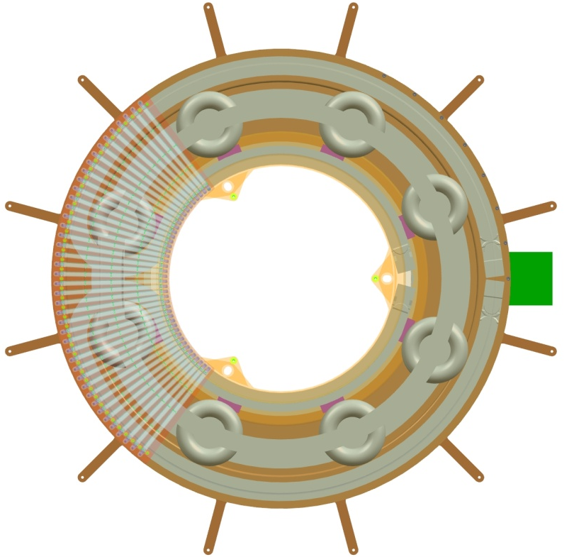
Detailed Design Description – Upper PFI Structure
SRB
Bulkhead connector plate/box
cover
SRB holder plate / cover
Segment Tube Plate 3 mounts to 3 tabs
CW components
Covers removed
Upper Structure mounts to POpt2 on fixed interface described by JPL dwg #10354752.
Cable wrapper (CW) parts mount inside Al structure; 2 Al covers close out the top.
Fiber Strain Relief Box (SRB) – part of LNA’s Cable C – mounts directly to cover; this flat-plate cover could either be an ASIAA or LNA deliverable.
Bulkhead connector bracket provides interface for electrical + thermal cabling elements; can be mounted on side, as shown, or on top of Upper Assembly.

Slide 33
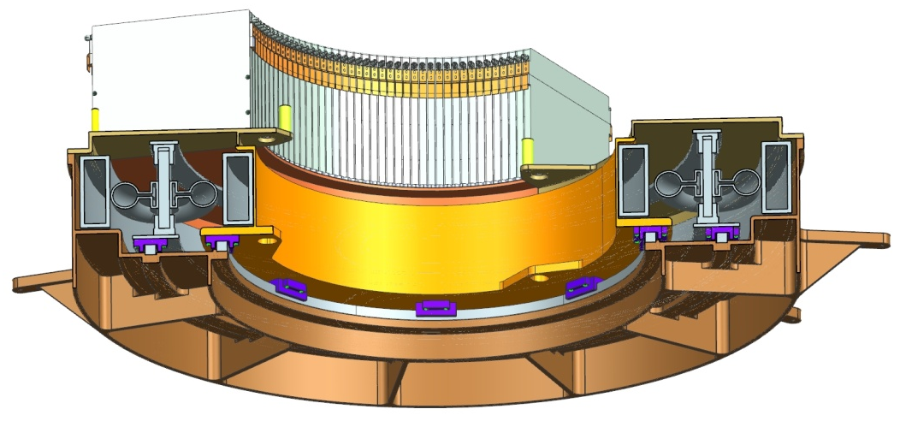
Detailed Design Description – Upper PFI Structure cont’d
Cable wrapper elements (commercial chain + guide parts) mount onto Fixed Interface Plate
Covers attach to outer diameter surface of Fixed I/F Plate only; isolated from rotating chain support by a gap
CW chain parts
Rotating chain support
Fixed I/F Plate
Circular bearing guides
Bearings

Slide 34
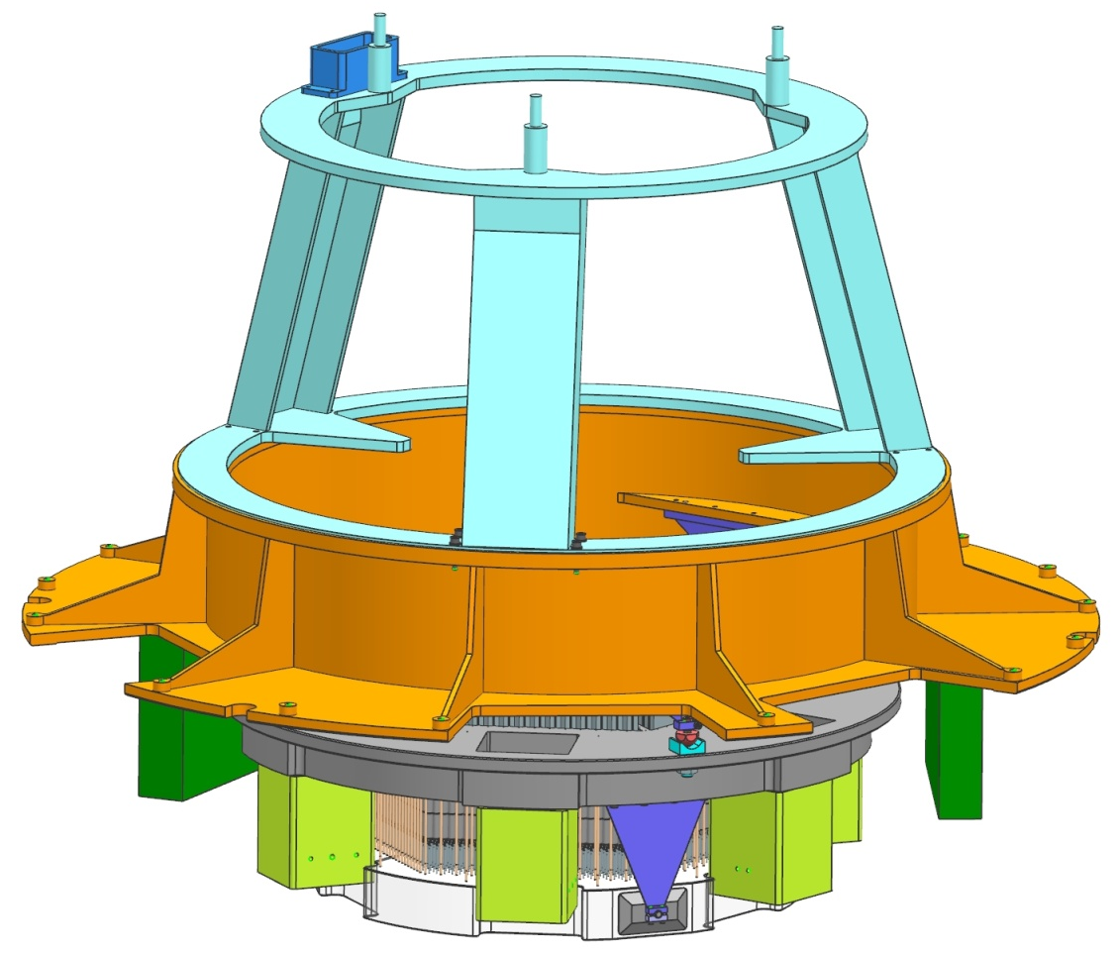
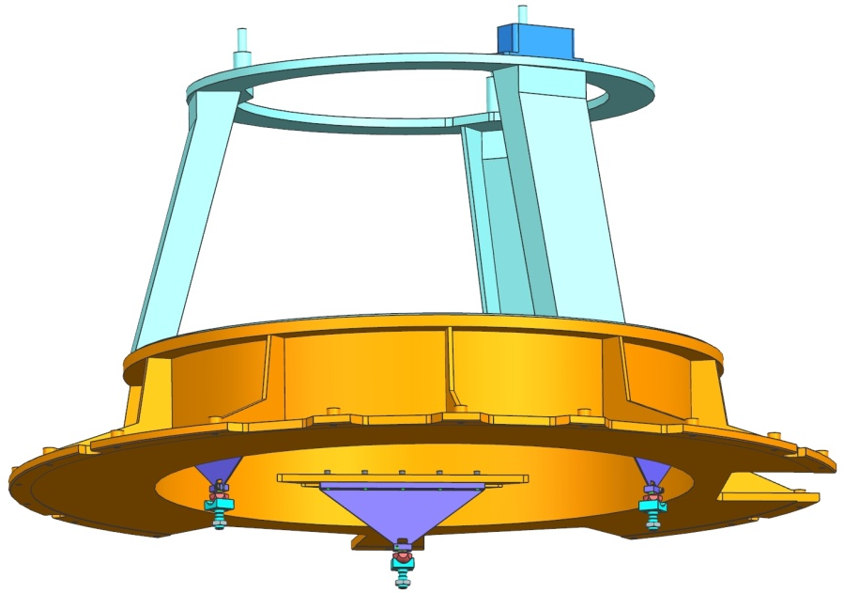
Detailed Design Description – Lower PFI Structure
Upper/Lower PFI link structure
Rotating I/F Frame
E-box
E-box
Structure assy only
Shown with PBA
PBA interface
Lower Structure mounts to POpt2 at rotating interface plane shown in POpt2 MICD drawing.
Rotating I/F Frame bolts to POpt2 using captive screws. A custom attachment can be designed to press onto screw heads to guide in the end of long wrench.
Lower Structure interfaces with JPL Positioner Bench.
Link structure drives rotating portion of CW.
All electronics boxes (shown as notional representations) mount directly to bottom side of Rotator I/F Frame.
Material of Rotating I/F Frame and Link Structure: aluminum

Slide 35
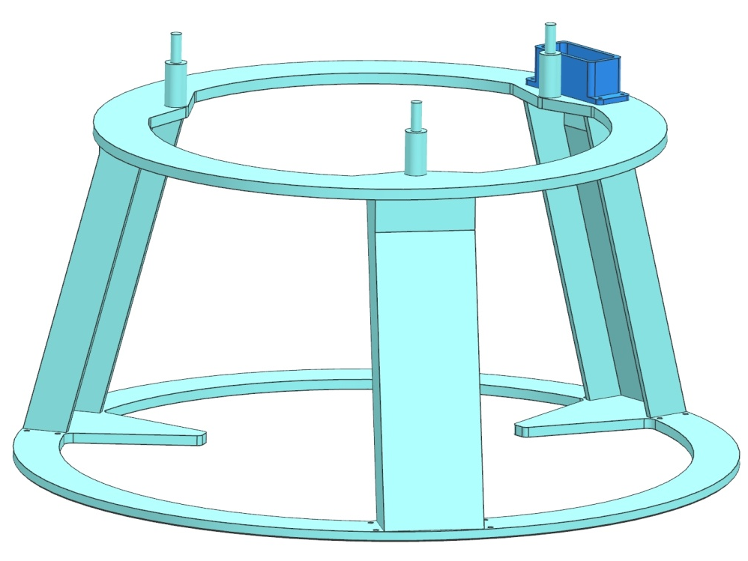
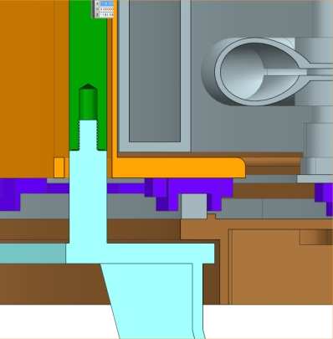
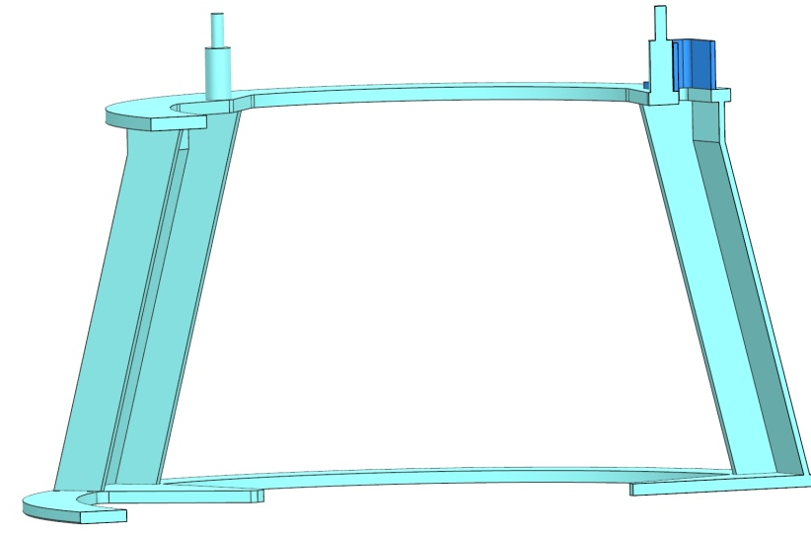
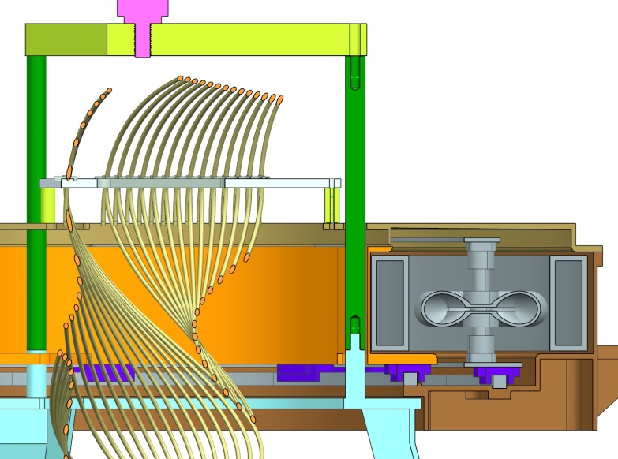
Detailed Design Description – Link between Lower and Upper Structures
CW drive link
Link structure is welded or braised.
Lift rods thread onto posts on Link Structure (not necessarily integral as shown).
Cables from CW travel through drive link, down the adjacent structure leg to Lower Assembly.
I/F holes with Segment Tube Plate 2 not yet determined.
Threaded posts for lift rod attachment
STP I/F plane (hole locations TBD)
Fasteners attach lift spider to rods
Lift rods screw onto threaded posts
Cabling travels down leg to Lower Assy
Fasteners can attach through Link structure into Upper Structure for transport

Slide 36
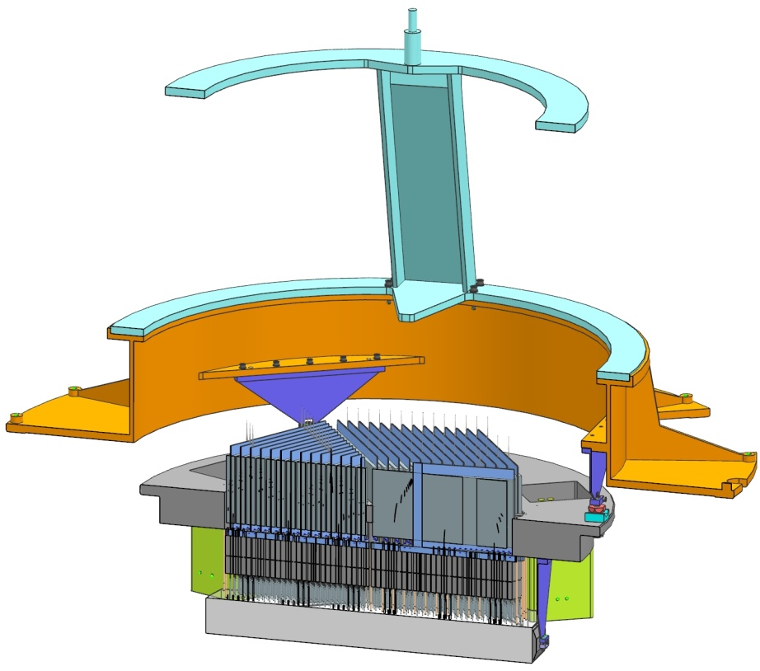
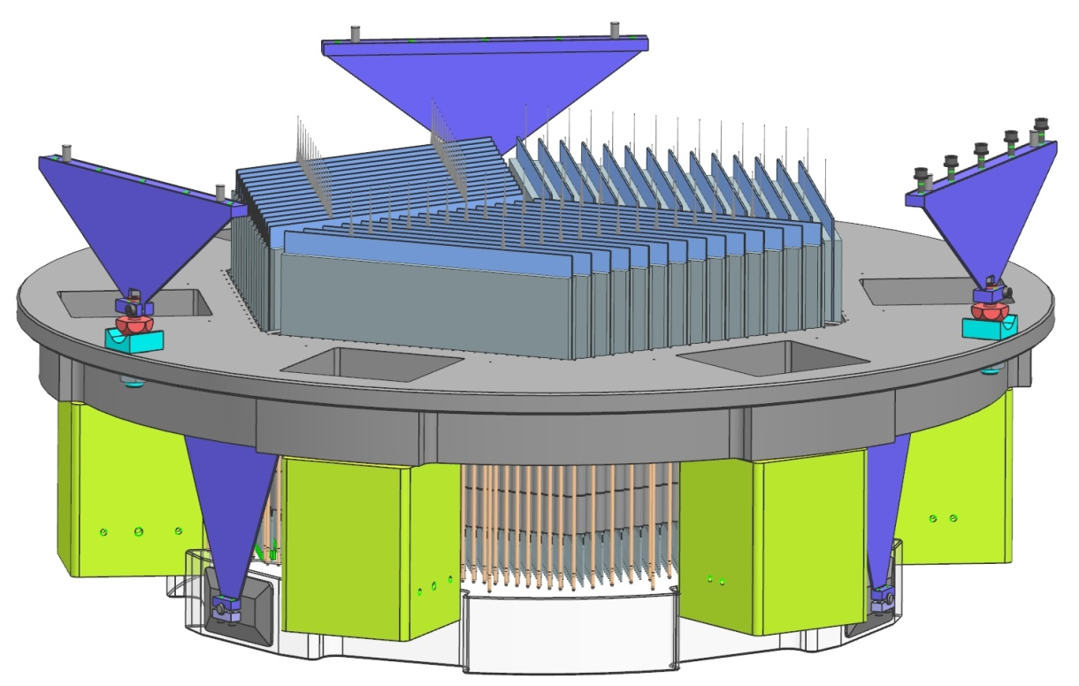
Detailed Design Description – Lower Structure I/F with PBA
pins
Blade flexures
Rotating I/F Frame
Positioner Bench
(Invar)
3 blade flexures:
Support Positioner Bench kinematically to accommodate CTE differences.
Are pinned (match-drilled if different materials) and bolted into flats machined into Rotating I/F Frame.
Are part of the ASIAA-delivered PFI Structure in the baseline presented.
Could, however, become a JPL deliverable if the I/F were made at the Rotating Frame flat surface.
Blade flexures are designed to athermalize the PFI Image Plane with respect to POpt2 (currently, the effective CTE of the POpt2 structure is not known). Current design does not specify material or length of flexures in Z-direction.

Slide 37
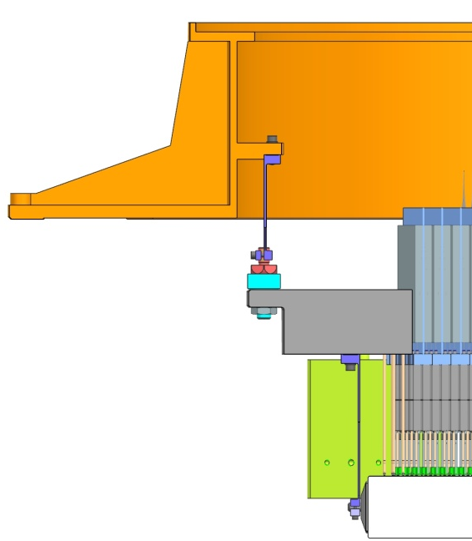
Detailed Design Description – PBA I/F cont’d
Spherical nut
V-groove channel
Positioner Bench
Spherical nut interfaces with V-groove channel. Thru-bolt (fine-threaded) preloads the joint.
Materials have not been finalized. Bolt, nut and V-groove channel to be hardened stainless steel.
Joint has not been analyzed.

Slide 38
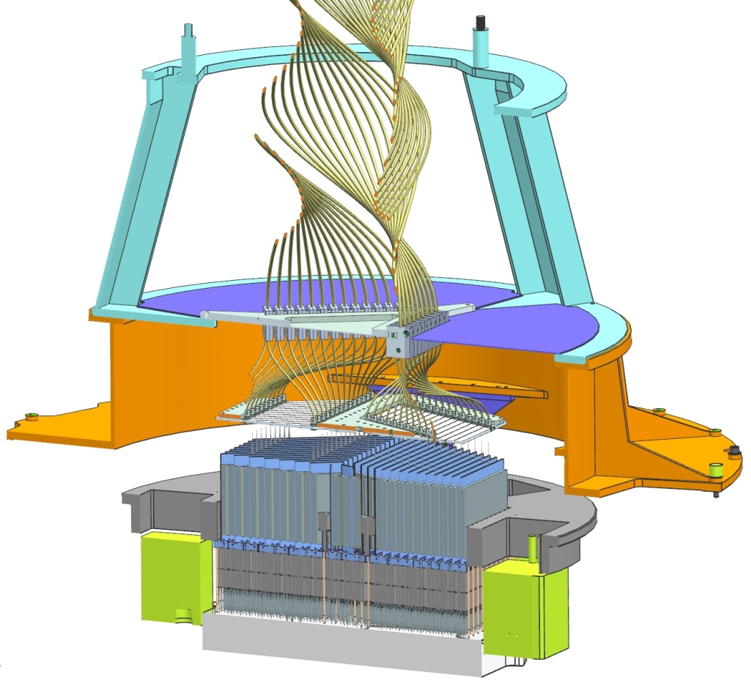
Design Description – Thermal Enclosures on Lower Structure
Update: enclosure concept added to model (and I/F Frame modified accordingly)
Dust cover / thermal enclosure on front side of PBA could be a thin-walled cylindrical metal part with a narrow lip around the bottom surface a small distance from the front surface of the Field Element to catch it if its mounting bonds break.
Dust cover / thermal enclosure on back side of PBA may be thin metal close-out plates or a film taped over Positioners. Not well defined (see Thermal section).

Slide 39
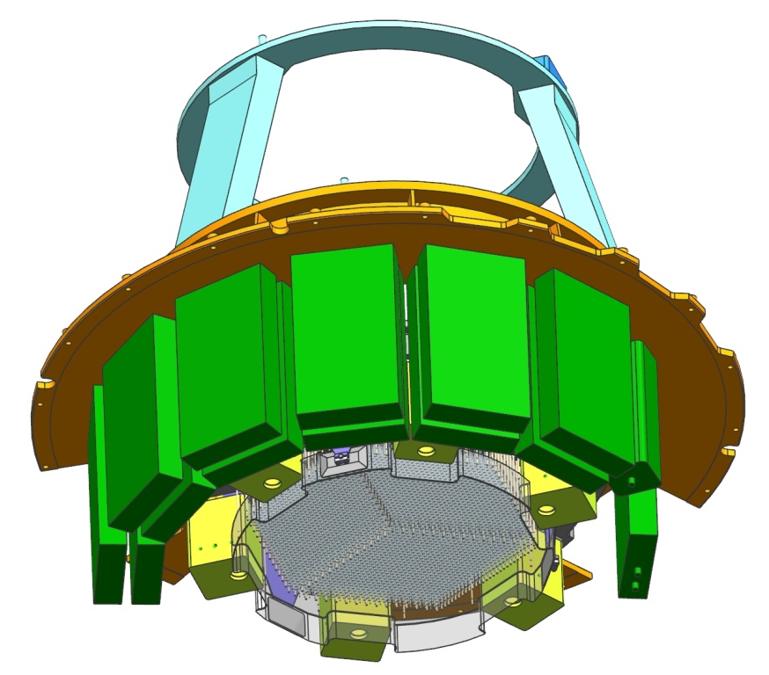
Design Suggestion – Updated JPL Positioner Power Regulator boxes
Electronics boxes all attached (thermally and structurally) to glycol-cooled cylindrical structure extending from underside of Rotating I/F Frame.
Array configuration to be re-designed as necessary to meet any CG requirements.
Box envelopes are defined by commercial product size; interfaces are all still undefined.

Slide 40
Design Summary: Work to Go to PDR
LNA needs to deliver updated CAD model of Cable C: (JPL/ LNA/ ASIAA)
Fibers exiting instrument need to be clocked per agreement
Need new SRB design, within agreed envelope (design presented here is suggested by JPL)
Why aren’t the fibers inside the instrument shown in their neutral position within total rotation range?
Why are the fibers between the PBA and the STP1 shown twisted, instead of straight?
Finalize I/F location of Cable C Segment Tube Plate 1 (currently at PB) – may need to move to PFI Structure as design matures. (JPL/LNA/ASIAA)
PBA interface with PFI Structure: (JPL/ASIAA)
Determine whether I/F lies at machined flat on Rotator I/F Frame or at Positioner Bench (at spherical nut? at flat surface?).
Receive effective CTE of POpt2 assembly from Mitsubishi.
Optimize flexure supports for length, thickness, material through analysis.
Perform all structural analysis to establish PDR-level designs that meet requirements. (ASIAA)
Update electronics envelopes/interfaces as box designs mature (including defining acceptable envelope for the new increase in number of JPL Positioner electronics boxes). (JPL/ASIAA)
Thermal hardware not yet designed. (ASIAA)
Components not yet in CAD model: coolant lines, cables, fasteners, brackets. (ASIAA)

Slide 41
Thermal Design Description
Requirement that PFI shall dissipate no more than 10 W to the dome air [L3-PFI-023] drives instrument thermal design
As much heat as possible must be removed by glycol cooling loops. With glycol cooling, the temperature of components can easily be maintained within safe limits, but careful design is still needed to meet the 10 W requirement.
Any components (A&G cameras and electronics boxes) for which glycol cooling can easily be implemented should be glycol-cooled to allow a simpler design for components which cannot be easily glycol-cooled (positioners).
Cameras and Electronics Boxes
Cameras and Electronics boxes must be cooled by a heat exchanger on at least one side.
Preliminary thermal models show that if a thin layer of thermal insulation is used and chassis thickness is adequate, then the heat loss from cameras and electronic boxes into the air will be acceptable.
Instrument dust cover / thermal enclosure
PFI configuration will include a dust cover to protect fibers/positioners from debris, which may also serve as a thermal enclosure to trap heated air convecting off positioner bench assembly
If enclosure is small, or glycol cooling to extract heat from it is required, then 6061 Aluminum <3mm thick would likely be an adequate material/thickness choice.
If the enclosure is large enough, and heat extraction from it is not required, then a thin static-dissipative film such as amerstat would suffice for material.

Slide 42
Thermal Design Description cont’d
Positioners/Rail-Mounted Electronics
Positioners and rail-mounted electronics are passively cooled, with most heat lost to air via convection
The dissipation of the positioners and rail-mounted electronics is small, and implementing direct glycol cooling would be difficult.
If necessary, the dust cover can be cooled to intercept some heat lost to air.

Slide 43
Thermal Analysis - Heat loss to air via convection
Preliminary estimates for heat loss to the air via convection were made using 2 separate finite element models (FEM):
One for the positioner/rail mounted electronics
One for cameras and electronics boxes
General assumption: Heat transfer to POpt2 structure has been neglected in this analysis (justified by active cooling of PFI components and relatively long conduction paths).
A brief summary of the model setup and assumptions for each model, with results, follows.

Slide 44
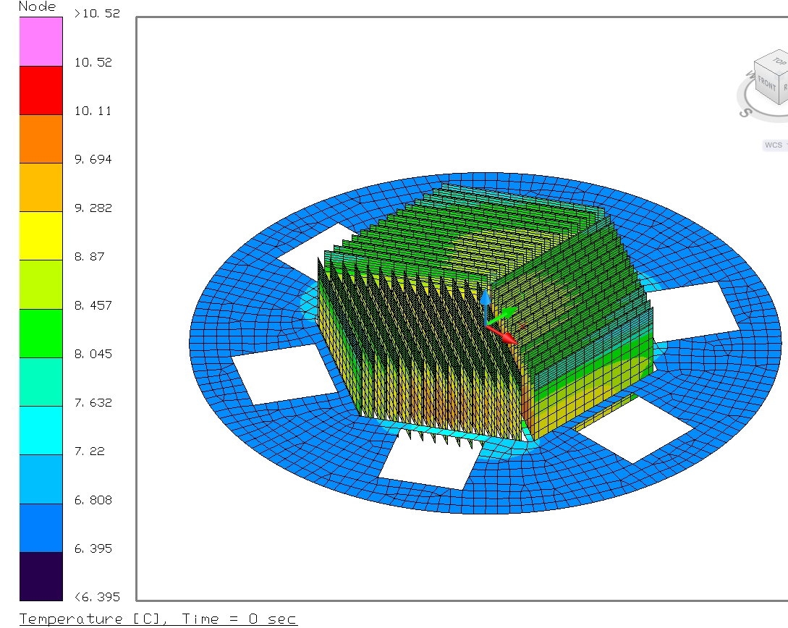
Thermal Analysis - Positioner/Rail-Mounted Electronics Heat Loss Model
Model Setup + Assumptions:
Assumed that only the exposed, upper (+Z-direction) portion of rail fins is effective for radiation/convection; lower portion is blocked by rail-mounted electronics
Ambient air & radiative sink temperature are both 5C
Radiation from both sides of Positioner Bench Assembly (PBA) and effective portion of fins
Convection from top (+Z) side of PBA and effective portion of fins
Average Dissipation of Positioners/Rail Mounted Electronics = 6.8W
(will be updated before PDR)
Fins and PBA painted black
PBA and Rails material: Invar
Convection given by empirical relationships (flat plate for PBA, finned surface for rail)
Glycol cooling loop plumbed in series
Result:
Heat loss to air from positioners/rails: ~6W

Slide 45
Thermal Analysis - Cameras and Electronics Heat Loss Model
Model Setup + Assumptions:
Model only represents camera and electronics box chassis
Heat is only lost via convection to air and conduction to heat exchangers
Air Temperature = 3C and Glycol Inlet Temperature = 1C
(based on Subaru data)
Glycol Flow rate = 0.1 kg/s
Dissipations shown in table (heat only applied to 2 sides of box):
Convection given by empirical relationships
Chassis material: aluminum
HX mounted to one side of each box only
Insulation used in some cases to further reduce heat loss to air
Numerous cases were run to estimate the heat loss to the air and design sensitivities.
Examined: different insulation materials, insulation thicknesses, and chassis thicknesses
 | Q [W]
A&G Camera (each) | 46.4
A&G Cam Power Box | 52
Fiber Illuminator | 40
Positioner Power Reg. & Cap Box | 509
Ethernet I/F Box | 2

Slide 46
Thermal Analysis Results - Camera and Electronics Boxes Heat Loss Model
 | Heat Loss to Air [W]
Case | Cameras (Total) | Ethernet I/F | Fiber Illuminator | Camera Power Box | Power Regulator/ Cap Box | Total
2.54 mm Thick Chassis, no insulation | 8.3 | -0.4 | 0.4 | 3.7 | 11.3 | 23.2
20 mm Thick Chassis, no insulation ( approximates isothermal chassis that HX on more sides would provide) | 0.1 | -0.5 | 0.0 | 0.1 | 1.6 | 1.3
2.54 mm Thick Chassis, 6mm Polyisocyanurate insulation | 4.6 | -0.3 | 0.2 | 2.3 | 5.7 | 12.4
2.54 mm Thick Chassis, 13mm Polyisocyanurate insulation | 3.1 | -0.3 | 0.2 | 1.6 | 3.7 | 8.2
2.54 mm Thick Chassis, 25 mm Polyisocyanurate insulation | 2.0 | -0.3 | 0.1 | 1.1 | 2.3 | 5.2
2.54 mm Thick Chassis, 6mm Spaceloft Subsea (Aspen Aerogels) | 3.3 | -0.3 | 0.2 | 1.7 | 3.9 | 8.7
2.54 mm Thick Chassis, 13mm Spaceloft Subsea (Aspen Aerogels) | 2.0 | -0.3 | 0.1 | 1.0 | 2.3 | 5.1
2.54 mm Thick Chassis, 25mm Spaceloft Subsea (Aspen Aerogels) | 1.0 | -0.2 | 0.1 | 0.6 | 1.3 | 2.8
2.54 mm Thick Chassis, 6mm Spaceloft Subsea (Aspen Aerogels)- Power Reg/Cap Box only 100W | 3.3 | -0.3 | 0.2 | 1.7 | 0.6 | 5.4
Sensitivities: The primary factors affecting the heat loss are box dissipation, chassis wall thickness, number of sides with HX, insulation vs. no insulation, series vs. parallel plumbing and the order in which boxes are plumbed.
Conclusion: Heat loss varied from 23.2 W to 1.3 W.
Recommendation: Choose chassis thickness to be as isothermal with HX as possible and use a thin layer of insulation. With this approach, the heat loss to air from the cameras and electronics can easily approach < 4W.

Slide 47
Thermal Conclusions and Recommendations
The recommended architecture is to use a combination of glycol cooling and insulation on A&G cameras and all electronics boxes, and passive cooling for the positioners/rail-mounted electronics
The positioners and rail-mounted electronics will dissipate ~6W to air. Direct glycol cooling here is not possible, so a glycol-cooled enclosure would be necessary and should be avoided if possible.
Analysis shows that limiting camera/electronics heat loss to air to < 4W is attainable with glycol cooling. For these components direct glycol cooling can reasonably be implemented with flat HX plates.
Based on the analysis, it is recommended that the 10W allocation for heat loss to air be sub-allocated as follows:
Positioners and Rail-Mounted Electronics may dissipate no more than 6W total to dome air.
A&G Cameras and all other electronics may dissipate no more than 4W total to dome air.
It is recommended that sub-allocation of this 4W to the electronics and cameras be calculated by weighting the dissipation of each item against the total (i.e. if an electronics box dissipates 25% of the total dissipation, it should be allocated 25% of the 4W). The table below gives the calculated sub-allocation values, using this weighting scheme and the dissipation estimates used in the thermal model:
 | Q [W]
A&G Camera (each) | 0.2
A&G Cam Power Box | 0.2
Fiber Illuminator | 0.2
Positioner Power Reg. & Cap Box (total) | 2.3
Ethernet I/F Box | 0.1

Slide 48
Mass + CG Estimates
Upper Assembly:
Mass: 89.4 kg
Excludes: fibers, coolant lines, cables, fasteners
Lower Assembly Structure
Mass: 36.4kg
Includes: PFI Interface Frame, PFI Lower-Upper Link, PFI Drive Arm, PFI Positioner Bench Flexures and Flexure Hardware
CG: 141.5mm above mounting plane for PFI Interface Frame
Lower Assembly
Mass: 243.7 kg
As shown in images, excludes: fibers, fiber brackets, coolant lines, cables, fasteners, thermal shrouds, heat exchangers
Includes: positioners, fiducial fibers, A&G cameras, maximum estimated mass for all electronics, including positioner electronics
CG: 80.5mm below mounting plane for PFI Interface Frame

Slide 49
Trades
Closed trade: Field Element mounted to PBA rather than to PFI Structure
Open trades:
PBA interface location (at Positioner Bench vs. at Rotator I/F Frame)
Segment tube plate interface location (on PB vs. on Lower Structure – either Rotator I/F Frame or on Link Structure)

Slide 50
Issues and Concerns
No significant technical concerns at this point.
There is a lot of work to go, particularly regarding ICDs and analysis, to get to PDR in February.

Slide 51
Risks
No Project-level risks pertain directly to the Structure; however, Risk 4-1 may affect overall configuration (Thermal Subsystem and supporting hardware).
LIKELIHOOD | 5
 | 4
 | 3
 | 2
 | 1
 |  | 1
 | 3, 4 |  | 2
Rank & Trend |  | Risk ID | Approach | Risk Title
1 | ð | 2-1 | P | Actuator Procurement Cost from New Scale
2 | ò | 5-1 | P | Positioner Tilt/Focus Requirements
3 | ð | 4-1 | P | Positioner/Electronics Power Budget
4 | ð | 3-2 | P | EMI issues with fiber positioners/drive electronics
Criticality |  |  | LxC Trend | Approach
 |  |  | ò Decreasing (Improving) ñ Increasing (Worsening) ð Unchanged £ New since last Month | M - Mitigate W - Watch A - Accept R - Research P – Pending
 | High
 | Med
 | Low
1 | 2 | 3 | 4 | 5
CONSEQUENCES

Slide 52
Plans Forward to Project PDR
JPL Mechanical Systems Engineering needs to continue to stay in contact with LNA and ASIAA regarding interfaces and design updates.
Requirements and interfaces must continue to mature.
JPL will need to be in contact with ASIAA thermal engineer. (Has this person been identified?)
Alignment of POpt2-to-PFI requirement (L3-PFI-043) will be owned by the owner of the Positioner Bench Assy mounts.

Slide 53
Backup Material

Slide 54
Structure Focus Alignment Errors

Slide 55
Structure X-Y Alignment Errors

Slide 56
Structure Tilt Alignment Errors

Slide 57
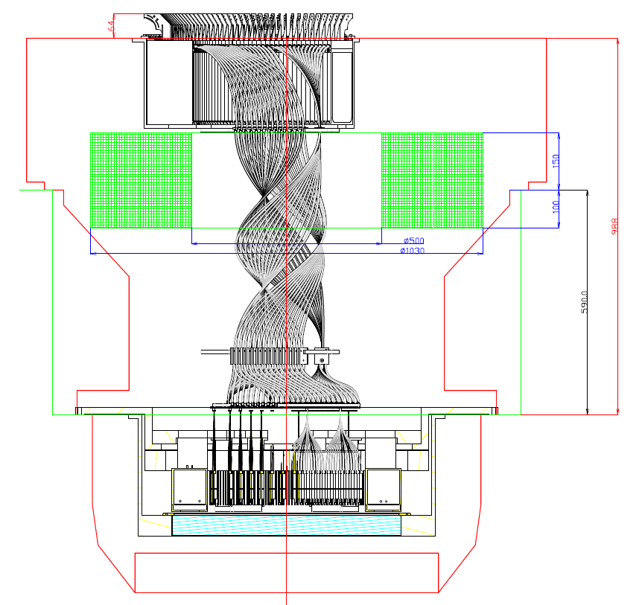
CW Envelope Proposed by ASIAA 11/21/12
SRB to mount on top of cable wrapper
If Segment Tube Plate 3 is in optimal position along Z, then distance between it and top of envelope is fixed; current height of SRBs exceeds it
PFI envelope in POpt2
This envelope is misleadingly large; usable OD has shrunk to ~1030mm (due to request from Subaru telescope)
Latest cable wrapper envelope in green

Slide 58
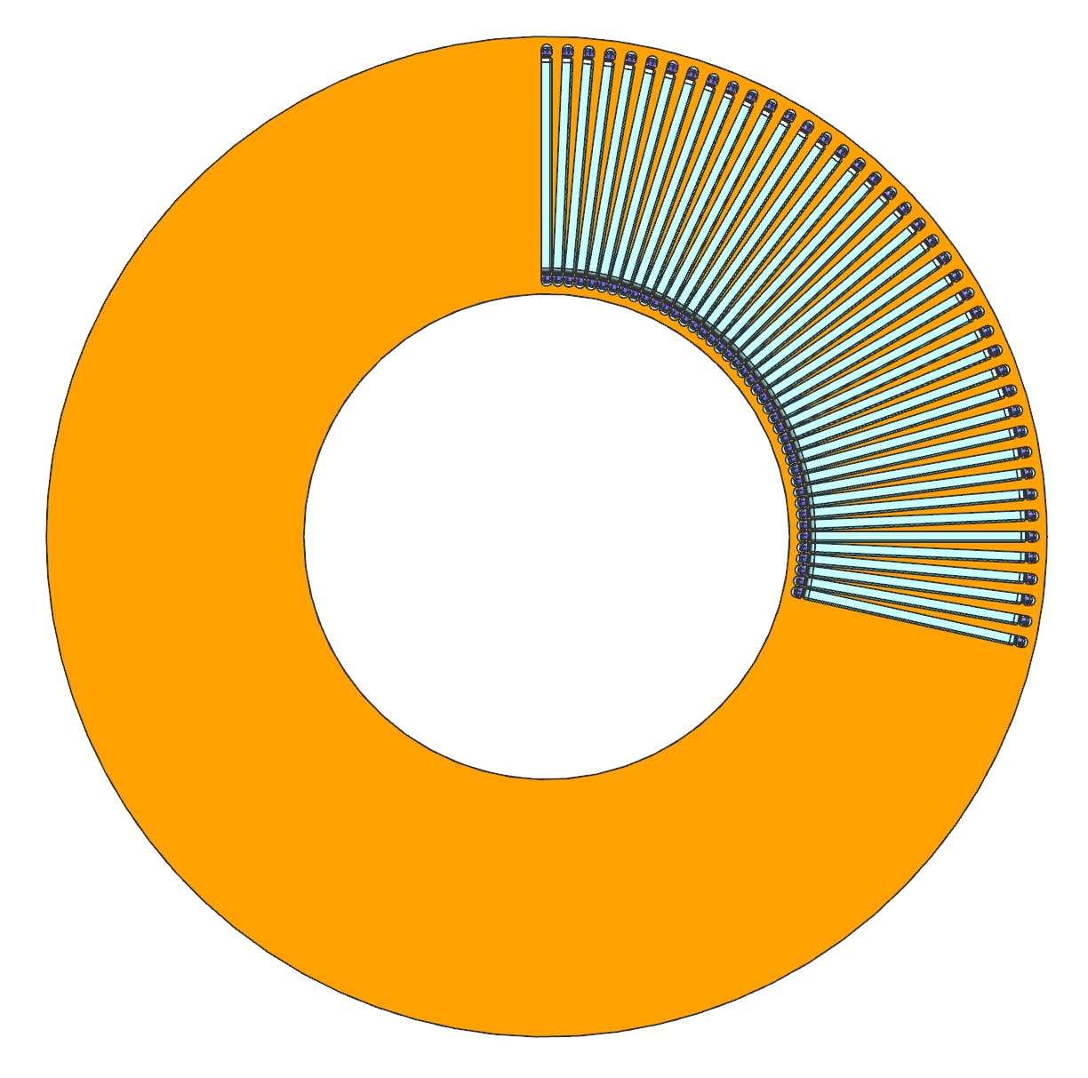
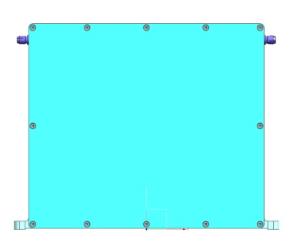
SRB Envelope Proposed by JPL 12/5/12
Maximum size available:
259mm max
102.5deg
201mm max
500mm
1030mm

Slide 59
Materials List
Assy name | Part name | Material | Delivering Org
Upper Structure Assembly
 | Fixed I/F Frame | Al | ASIAA
 | Cable Wrapper cover | Al | ASIAA
 | LNA Base Plate / CW cover | Al | LNA or ASIAA
 | SRB box slices | plastic? | LNA
 | SRB stabilizing posts |  | LNA or ASIAA
 | Segmented Tube Plate 3 | Al | LNA
 | Lift rods | steel | ASIAA
 | Lift rod spider | steel | ASIAA
 | Lift ring | steel | ASIAA
 | Lift rod threaded posts | steel | ASIAA
Lower Structure Assembly
 | Lower-Upper Link | Al | ASIAA
 | Rotating I/F Frame | Al | ASIAA
 | Segmented Tube Plate 2 | Al | LNA
 | Positioner Bench | Invar | JPL
 | Positioner Rails | Invar | JPL
 | Field Element | Fused Silica | PO
 | Field Element Mount | Invar | JPL
 | PBA mount assy
 | flexured mounts |  | JPL
 | spherical nut |  | JPL
 | V-groove channel |  | JPL

Slide 60
PFI Mechanical Structure in POpt2

Slide 61
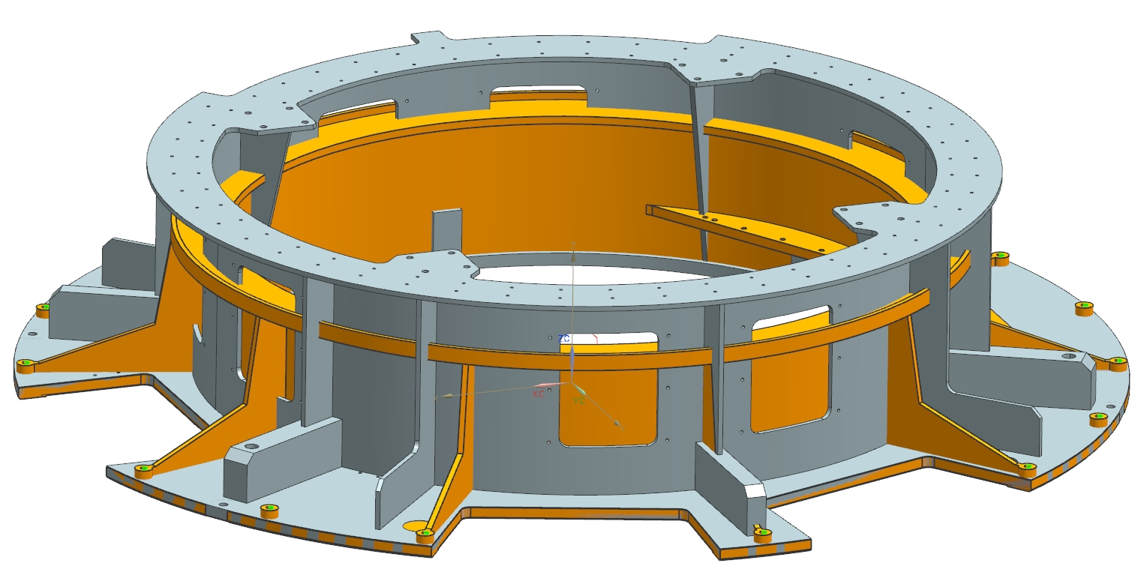
PFI I/F Frame (orange) Superimposed on HSC Frame (gray)

Slide 62
Backup Thermal Analysis Results – Positioners/Rail-Mounted Electronics Heat Loss Model
Neglecting blockage from cabling, fibers, and other hardware not modeled, estimates for heat loss to air from positioners/rails are as low as 4.3W
However, this overestimates the radiation
Approximating the blockage by reducing the effective emissivity of the surfaces yields a heat loss to the air of 5W
Since this is a rough approximation, applying ~20% margin is appropriate, giving a best estimate of ~6W

