Slide 1
CHANGES TO “PFI_ASSY” MODEL
ERIC EK
3/15/2013

Slide 2
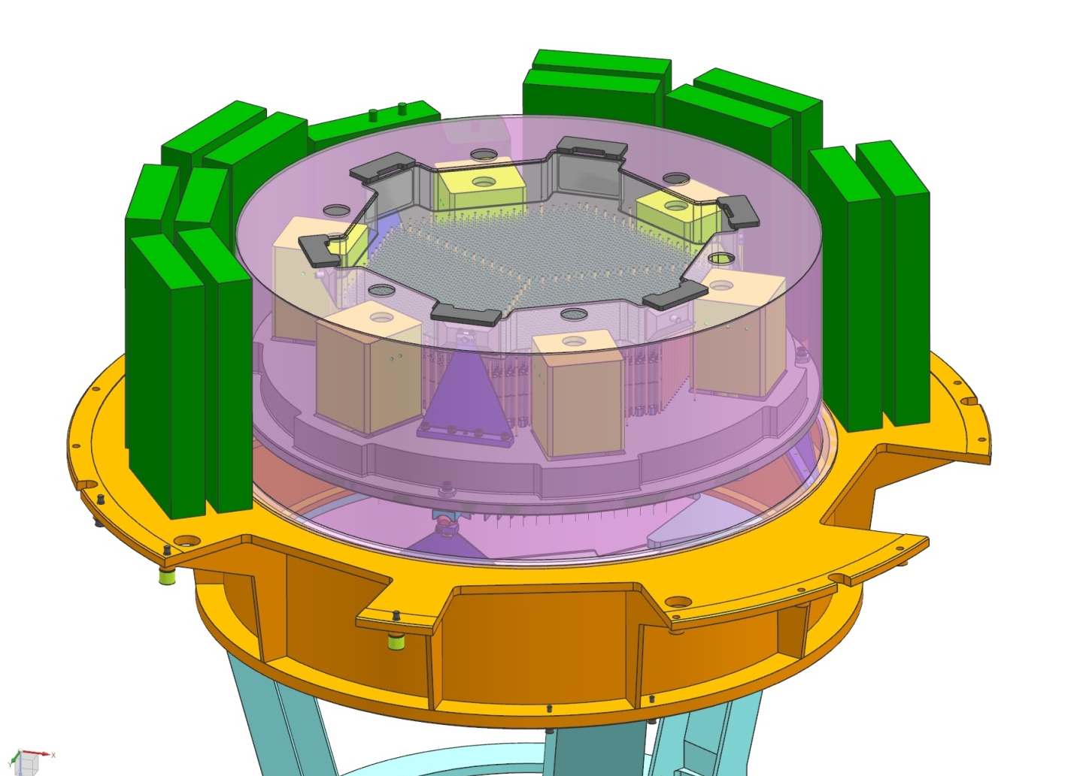
Following Parts Were Changed or Repositioned
Positions of Electronics Boxes
PFI_FIELD_ELEMENT
ek_THERMAL_
COVER_ASSY

Slide 3
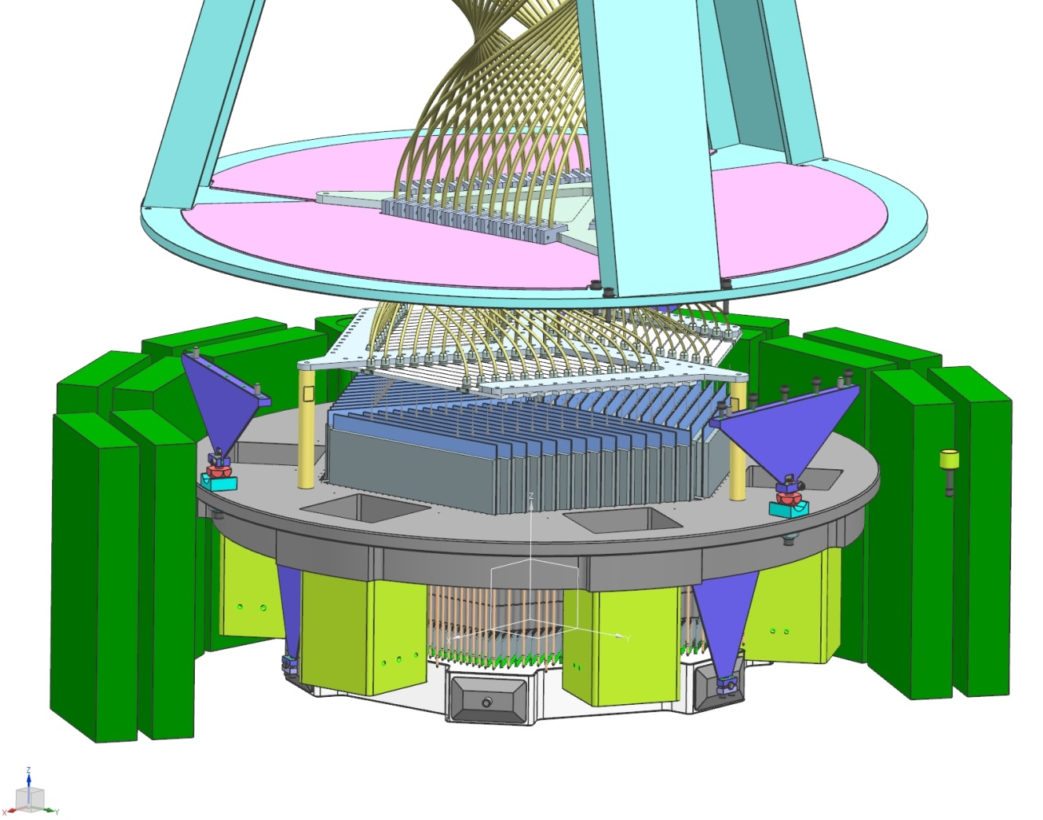
Following Parts Were Changed or Added
Added Three
ek_COBRA_
HOLDER_PLATE
POSTS
Modified LNA_COBRA_
HOLDERS_PLATE

Slide 4
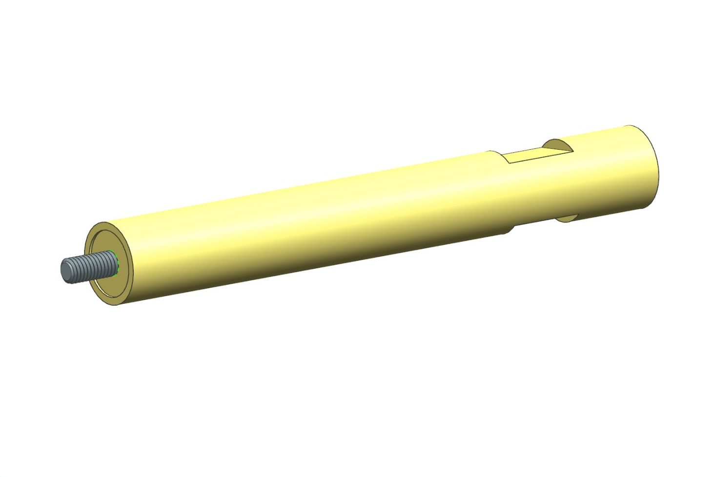
ek_COBRA_HOLDER_PLATE_POST
Threaded Stud

