Slide 1
ATD Assembly

Slide 2
ATD Assembly #1

Slide 3
Dewar Assembly #1
Status:
Dewar has been completely assembled and vacuum tested.
No vacuum leaks were detected on the outer shell of dewar assembly #1.
Best pressure rise test was 0.1mT/hr
Lowest vacuum pressure recorded
Boil off rate averaged 5scfh.
The tank was able to hold vacuum at ambient temperature, but now has a vacuum leak.

Slide 4
Dewar Assembly #2 Short Stack
Status:
Ln2 tank cleaned in ultra sonic cleaner after removing fill tube and burst disk.
Assembled SST fill tube assembly.
Leak checked fill tube at weld.
Epoxied the bellows to the bellows flange.
Leak checked fill tube assembly mounted to dewar shell.
Leak checked Ln2 tank. Helium leak found at the burst disk.
Leak check both burst disks. Leak detected on 1 burst disk.
Tested pipe plug at Ln2 temperatures using different sealants.
Attached working burst disk to tank.
Leak checked dewar and Ln2 tank. No leak detected at room temperatures.

Slide 5
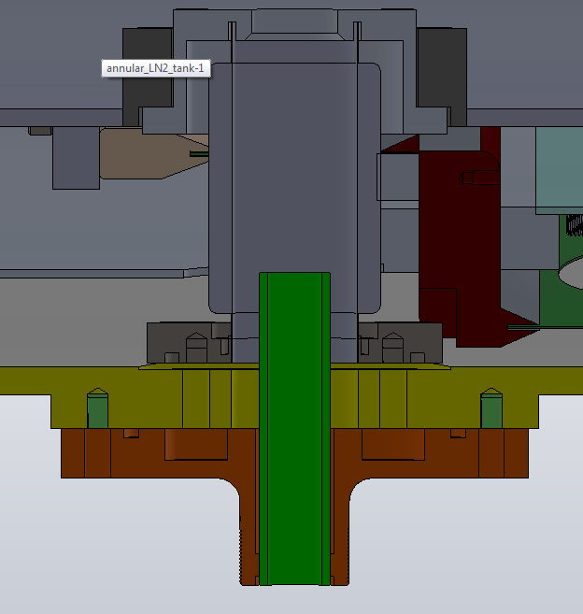
Dewar Assembly
Fill Tube Assembly
LN2 Tank
Bellows Flange
SST Bellows
Bellows Enclosure Flange
Dewar Shell
G-10 Fill Tube

Slide 6
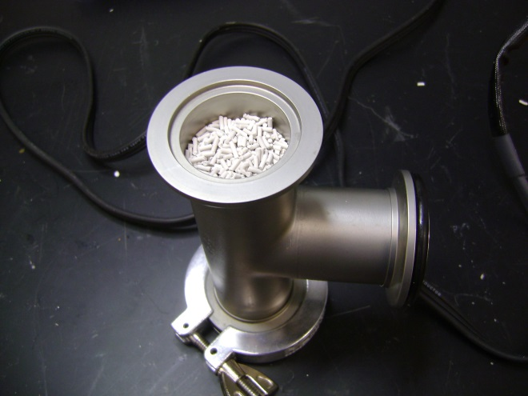
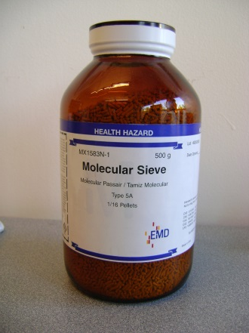
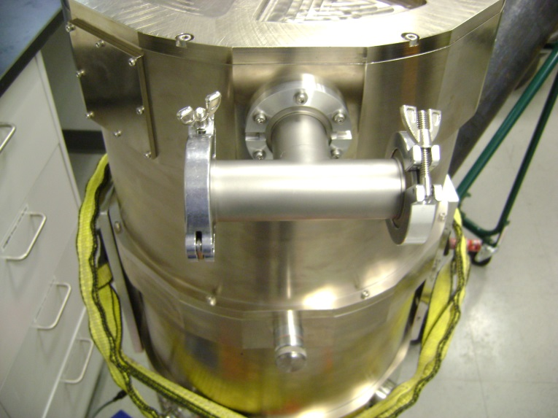
Dewar Assembly
Zeolite Assembly

Slide 7
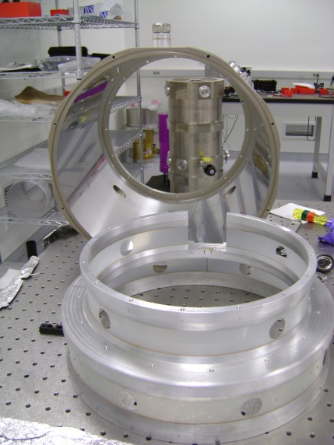
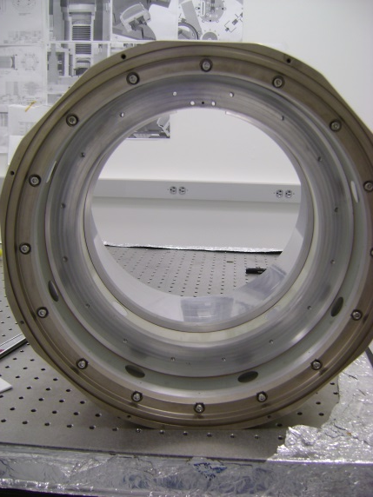
Dewar Assembly
Dewar Assembly Procedure
Mount the inner structure to the dewar shell using (16) 5mm screws.
Short Stack Assembly only:
Clean O-ring groove on dewar shell.
Install O-ring in groove.
Fasten end cap to dewar shell.

Slide 8
Dewar Assembly
C-clip
Viton 211 Oring
Spacer
Bellows Compression Screw Assembly

Slide 9
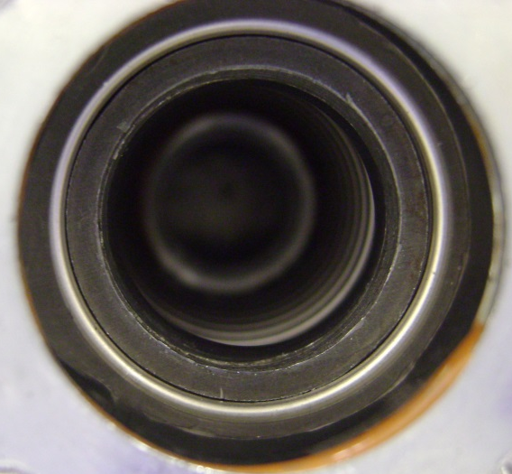
Dewar Assembly
Install a Viton -211 O-ring in the bellows enclosure flange. The O-ring should fit in the second groove of the bellows.
Install spacer on top of the O-ring.
Compress the SST fill tube assembly .125” with the ¾”-16 x 3” socket set screw.
Spacer
O-ring
Bellows

Slide 10
Dewar Assembly
5mm socket head cap screws that mount the tank to the inner structure
Clean O-ring groove and O-ring.
Apply vacuum grease on O-ring and install onto bellows.
Insert (15) 5mm socket head set screws and disc bellevilles onto tank.
211 Viton O-ring

Slide 11
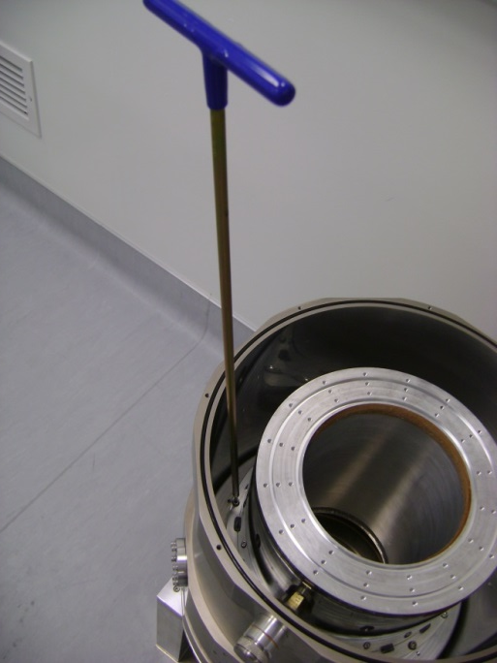
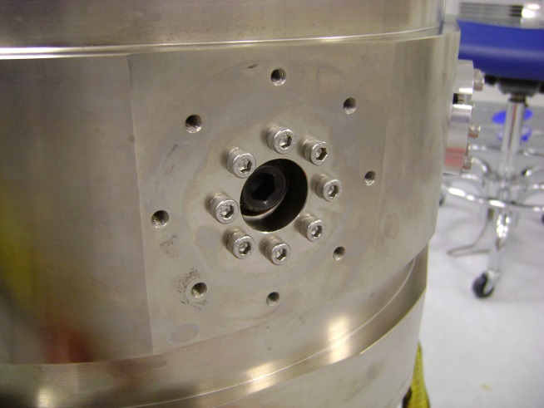
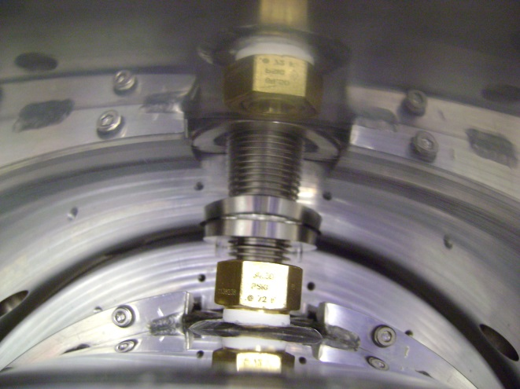
Dewar Assembly
Lower the Ln2 tank onto the inner structure.
Fasten the tank to the inner structure.
Release the ¾”-16 x 3” socket set screw. Note: The O-ring and spacer will remain inside the bellows.
Align the bellows to the 8 screw holes on the dewar shell.
Fasten the bellows to the dewar shell.

Slide 12
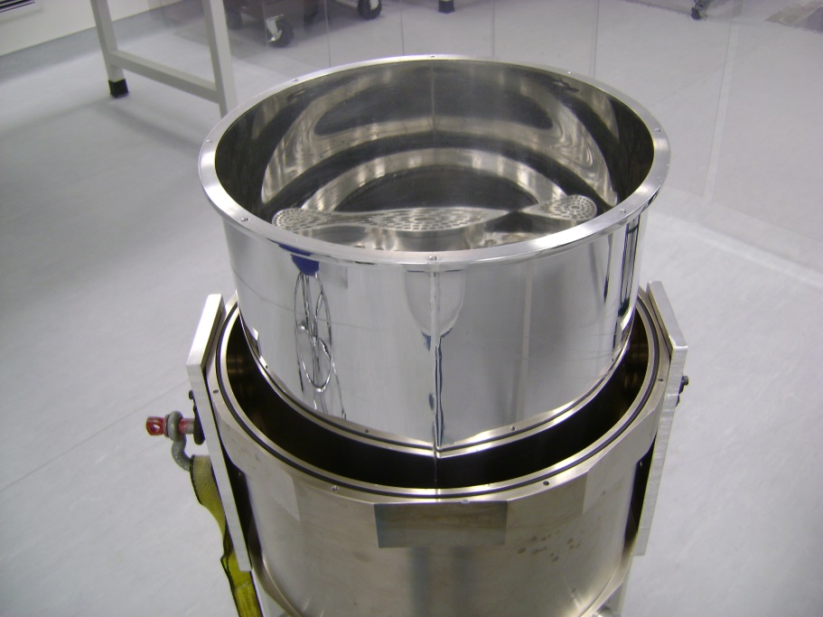
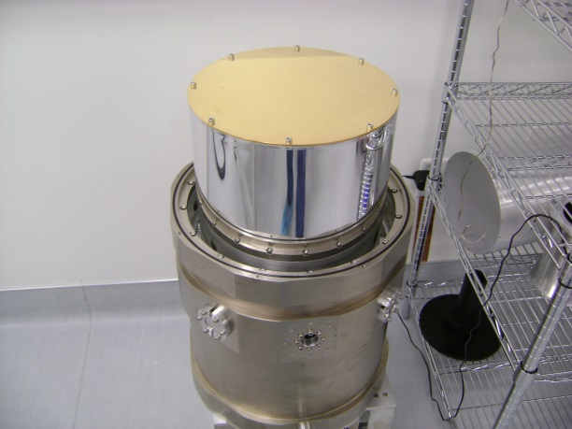
Dewar Assembly
Clean O-ring groove.
Clean Viton -281 O-ring and apply vacuum grease to the O-ring, and install O-ring.
Install and fasten the front radiation shield to the inner structure with the 5mm captive screws.
Install the blank cap radiation shield and fasten with 5mm socket head cap screws.
Install and fasten end cap to dewar shell.
Install fill tube flange.

Slide 13
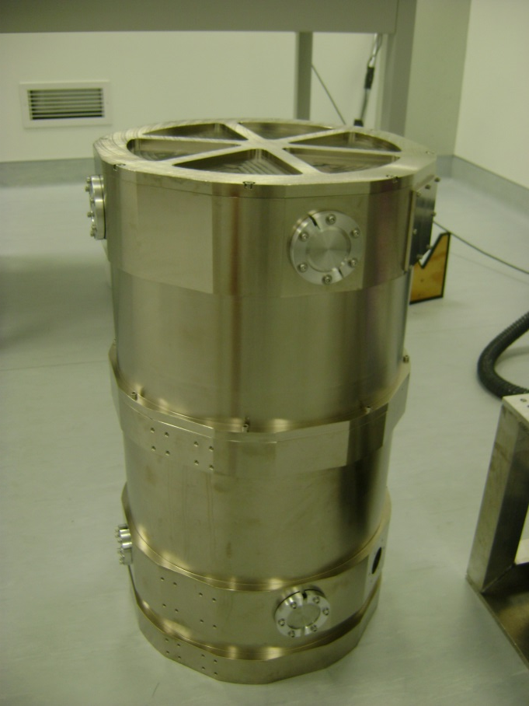
Dewar Assembly
Install KF-40 and KF25 Bulkhead clamp assemblies where required.
Install blank connector plate with O-ring where required.
Install KF-40 vacuum valve.
Install KF-40 chamber containing the zeolite
Short Stack Assembly complete.
Continue on to next page to complete the Long Stack Assembly.
Blank Connector Plate
KF40 Bulkhead Clamp Assembly
Short Stack Assembly

Slide 14
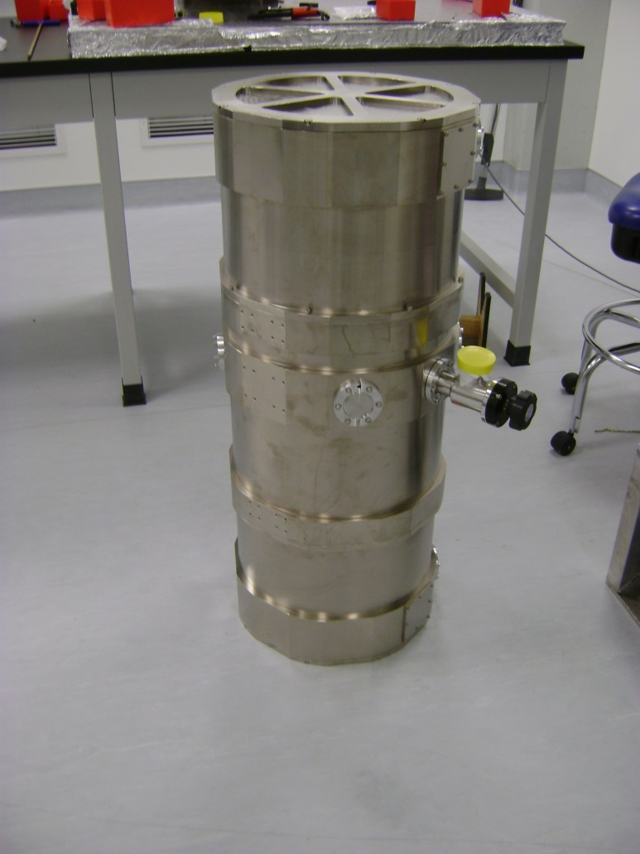
Dewar Assembly
Long Stack Assembly
Rotate the dewar 180° to complete the long stack assembly.
Clean the O-ring groove on the dewar shell.
Install O-ring in groove.
Install and secure the rear radiation shield to the inner structure with 5mm captive screws.
Install and secure blank cap radiation shield with 5mm socket head cap screws.
Install and secure dewar extension to the dewar shell.
Clean the O-ring groove on the extension dewar shell.
Install O-ring in groove.
Install KF-40 and KF25 Bulkhead clamp assemblies where required.
Install blank connector plate with O-ring where required.
Long Stack Assembly Complete.
Long Stack Assembly

