Slide 1
ZTF cryostat readiness review
Shawn Callahan
12/14/2014

Slide 2
readiness
read·i·ness
ˈredēnəs/
noun
1.
willingness to do something.
"Spain had indicated a readiness to accept his terms“
2.
the state of being fully prepared for something.
"your muscles tense in readiness for action"
synonyms: | willingness, enthusiasm, eagerness, keenness; More
synonyms: | preparedness, preparation More

Slide 3
Exploded cross-section

Slide 4
Cryostat section view

Slide 5
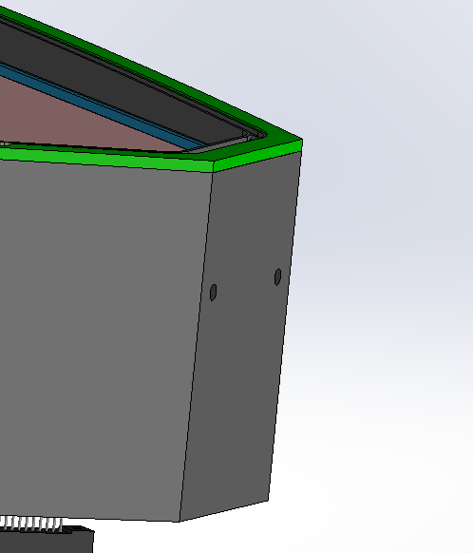
Cryostat walls
Material: 304 Stainless Steel
Minimum wall thickness: 7mm
Thickness at corners: 12mm to allow tapped holes for cover latches

Slide 6
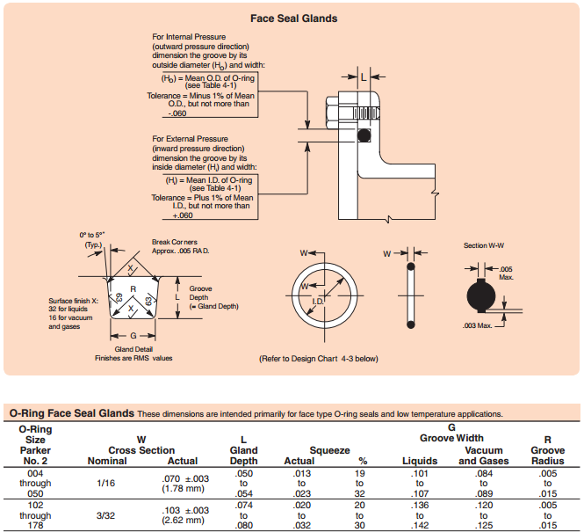
O-ring specification
Use Parker 3/32” [2.63mm] for both the window and VIB interface

Slide 7
Parker O-ring recommendations

Slide 8
Window temperature regulator (shown in green) Relief gland 3mm deep

Slide 9
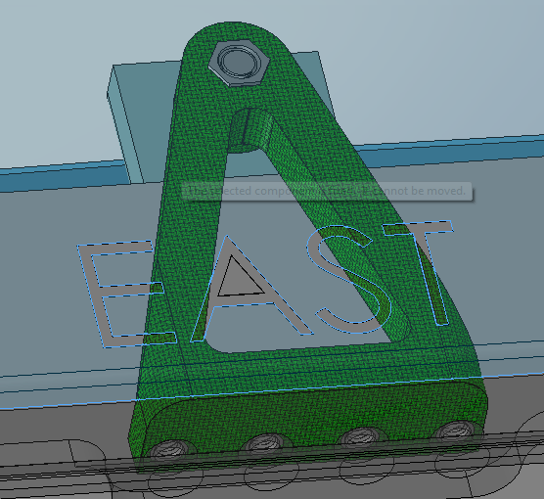
Bipod flanges M4 S.H.C.S.

Slide 10
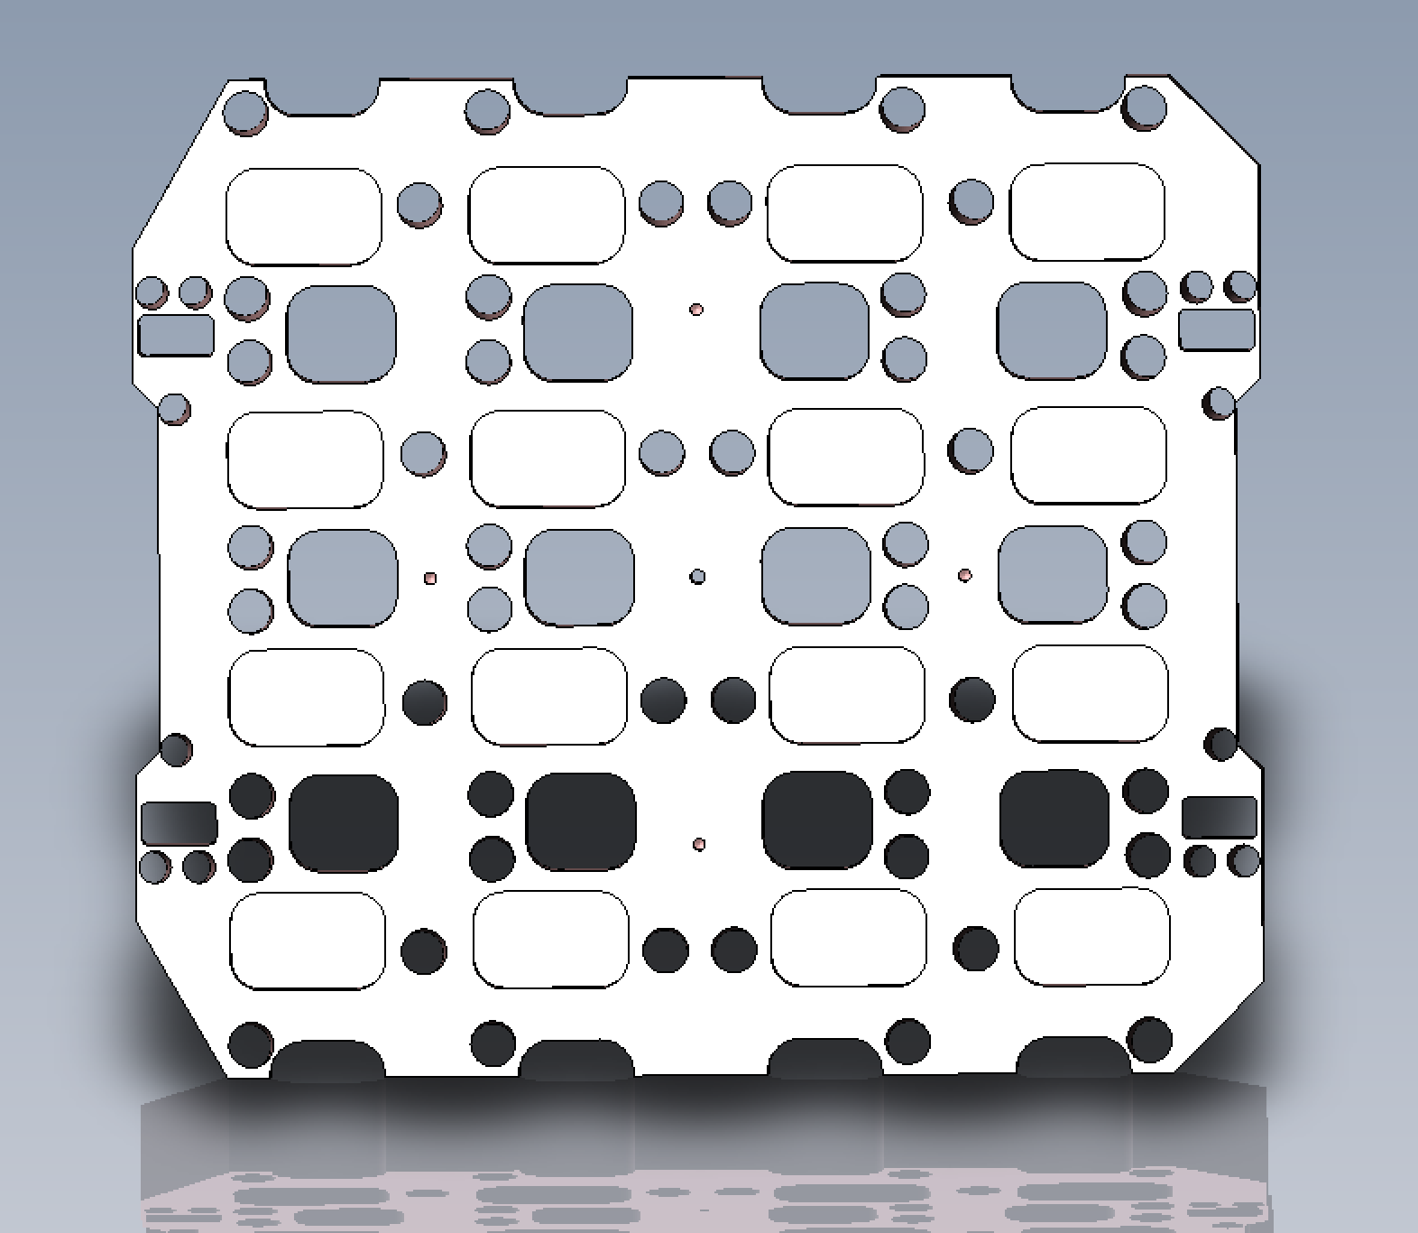
Each pocket to also contain threaded holes for temperature sensors
Steve: select bimetallic thermostat ! Will it fit?
TO-220 power resistors Rating ~10W each

Slide 11
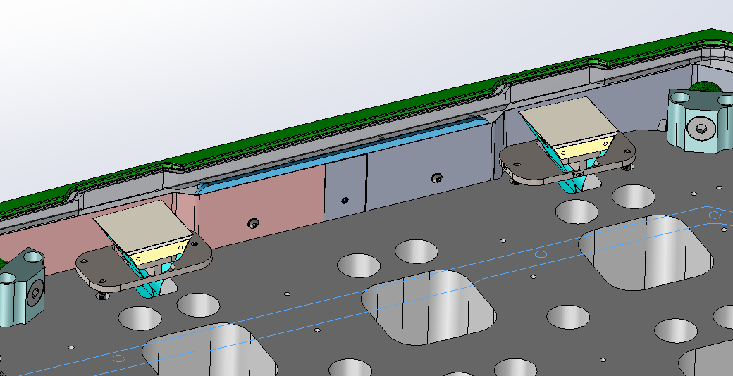
Cut-out in cryostat walls for guide cameras

Slide 12
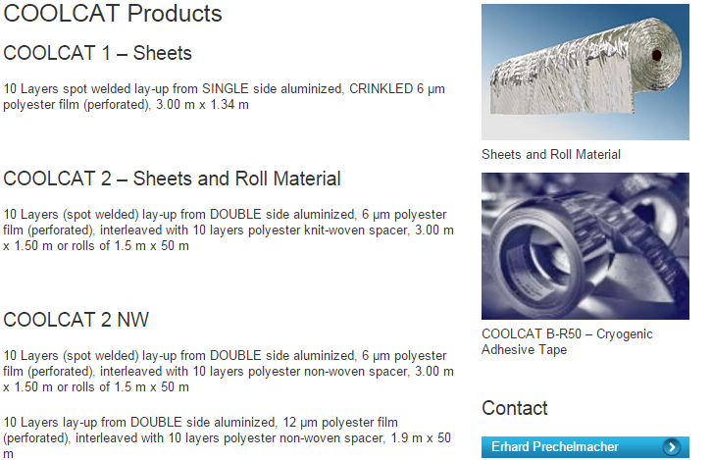
Inside recess for radiation shield mounting lattice (shown in blue) MLI is available as a “user option”

Slide 13
Spring loaded cover latch assembly is removable

Slide 14
Scatter light
Option A:“stair step” grooves on outside of walls (not shown).
Option B: Protostar flocked light trap material.
Combination of both methods.

Slide 15
FEA Model to determine component stress See: cryostat pressure model 121214

Slide 16
Check stress in cryostat due to atmospheric pressure

Slide 17
Window Heater Stress G-10 3mm thick

Slide 18
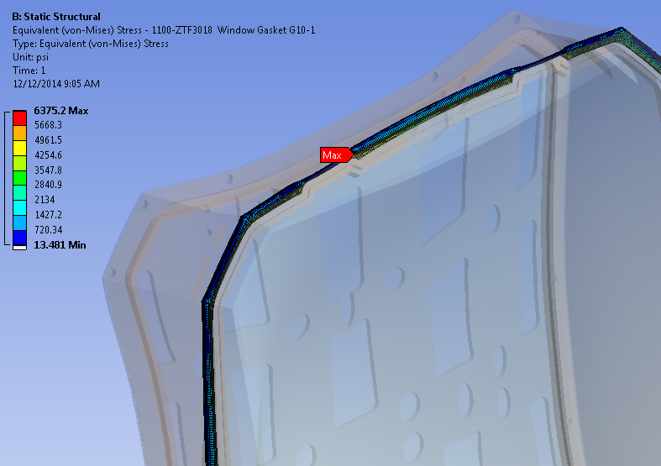
Von-Mises stress in heater Maximum 6400 psi Strength Min. 38,000. (FOS ~6)

Slide 19
G-10: Tensile strength 38,000 psi Compressive strength: 65,000 psi

Slide 20
Cryostat Wall Stress 7mm minimum wall thickness 304 Stainless Steel

Slide 21
Von Mises stress in Cryostat walls <9600 psi Strength 304 Stainless Steel: 47,900psi (FOS =5)

Slide 22
304 Stainless Steel

Slide 23
Window Stress

Slide 24
11/7/2014 Analysis of Window stress
Increase window size by 6mm to accommodate 3mm spacing between CCD’s.
Change gasket to G10 so that a heating circuit can be embedded.

Slide 25
Apply 1 atmosphere 14.7 psi to top surface inside O-ring (pressure inside surface)
Frictional contacts between window and gasket and gasket and cryostat enclosure. COF=0.2 to solve quickly and allow surfaces to open and close.
Elastic supports added to window solve.

Slide 26
Boundary conditions

Slide 27
Maximum Principal stress in window. 9.7MPa

Slide 28
Determine factor of safety vs. probability of success
Use MathCad model: Design Strength-Fused Silica.

Slide 29
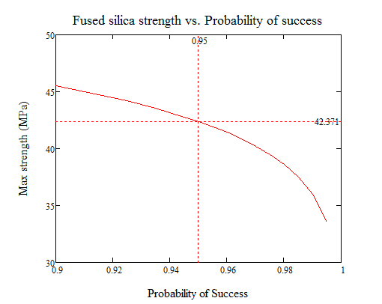
Strength of Fused Silica Window vs. Probability of success. (95% probability of success shown by markers)

Slide 30
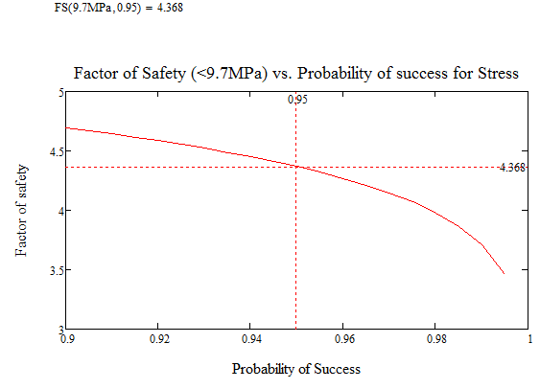
Factor of safety at 9.9MPa vs probability of success. Markers show 95% probability of success has a FOS=4.4

Slide 31
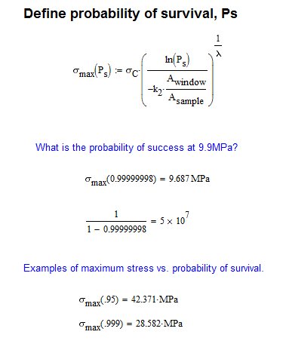
Another way to look at this is to calcuate the probability of success at 9.9MPa.
The probability of survival can be calculated at 9.7MPa using the above MathCad model: 1 part in 5 x 10E7.

