Slide 1
ZTF Mechanical Review
1/9/2015
Shawn Callahan

Slide 2
1100-ZTF3001 Cryostat Enclosure

Slide 3
1100-ZTF3001 Cryostat Enclosure
Next Intent, Inc.: $14,473.69
Carousel USA: No Bid
Meridian Mechatronics: No Bid
Ricardo Paniagua: No Bid

Slide 4
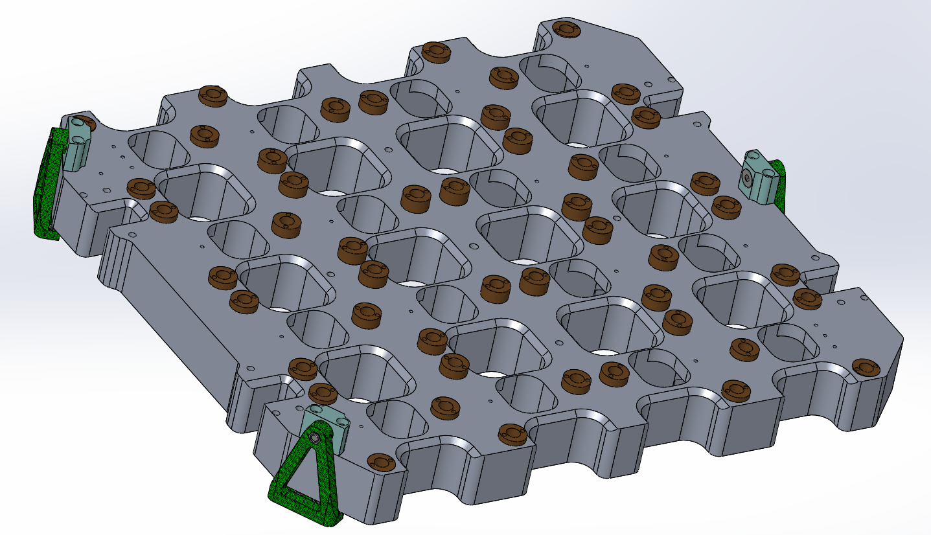
1000-ZTF3200 Cold Plate Assembly

Slide 6
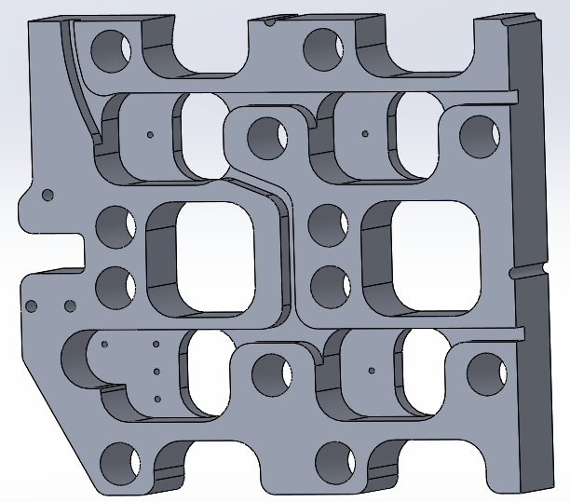
1100-ZTF3201 Cold plate ¼ model

Slide 7
CCD fasteners to cold plate

Slide 8
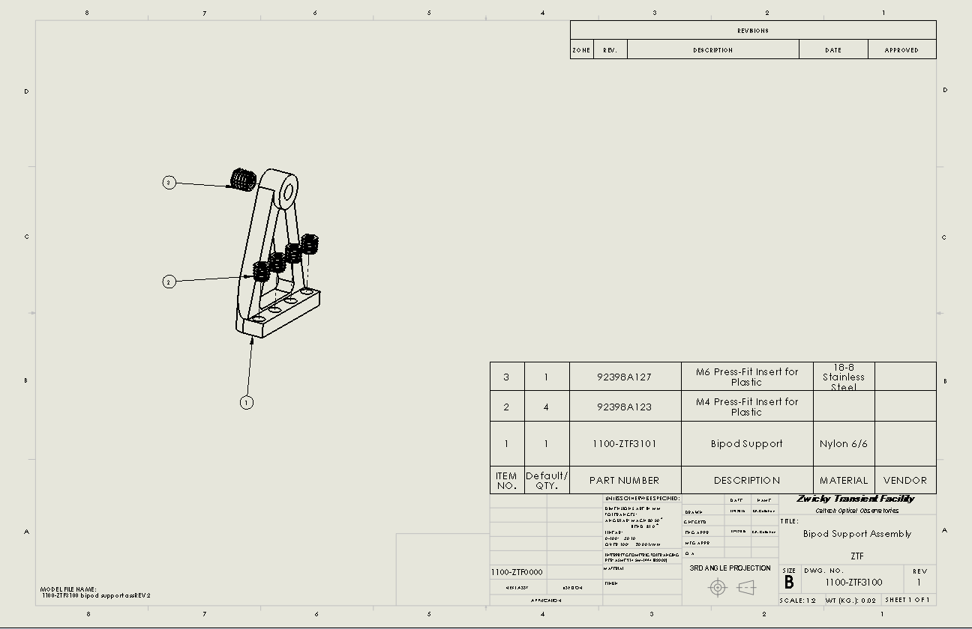
1100-ZTF3100 Bipod Assembly

Slide 9
1100-ZTF3102 Bipod mounting block.
SolidConcepts: $42/each
Material: Nytek 1200CF
Thermal Conductivity:0.299 W/mK (at 153K)
Thermal Conductivity of G10: 0.288 (Matweb.com)
See: http://utwired.engr.utexas.edu/lff/symposium/proceedingsarchive/pubs/Manuscripts/2011/2011-32-Yuan.pdf

Slide 11
End

Slide 12
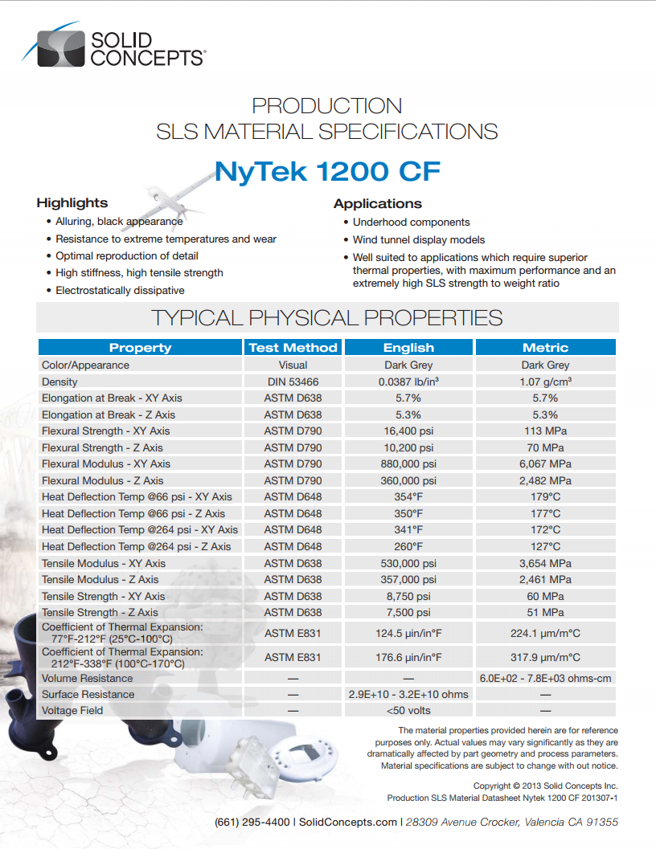
Thermal Conductivity: Nylon 12=
G-10 Fiberglass Epoxy Laminate=0.288 W/m-K

Slide 13
Cryostat Back plate
Carousel USA: $8310. 17-24 days ARO
Next Intent: $15,617.25 70 days ARO

Slide 14
Carousel USA (Monrovia Water Jet)

