Slide 1
ZTF Gasket and window stress under 1 atm pressure
Callahan
10/23/2014

Slide 2
Model names
CAD model 1100=ZTF0000
FEA model: Window with gasket

Slide 3
Boundary Conditions 1 ATM

Slide 4
Window stress Max Principal Design Strength of Fused Silca 8.9MPa (FOS=4)

Slide 5
Gasket stress Von Mises ~13 MPa Strength of NytekCF = 52MPa [7500 psi]

Slide 6
Gasket compression 5 microns

Slide 7
11/7/2014
Increase window size by 6mm to accommodate 3mm spacing between CCD’s.
Change gasket to G10 so that a heating circuit can be embedded.

Slide 8
Apply 1 atmosphere 14.7 psi to top surface inside O-ring (pressure inside surface)
Frictional contacts between window and gasket and gasket and cryostat enclosure. COF=0.2 to solve quickly and allow surfaces to open and close.
Elastic supports added to window solve.

Slide 9
Boundary conditions

Slide 10
Maximum Principal stress in window. 9.7MPa

Slide 11
Determine factor of safety vs. probability of success
Use MathCad model: Design Strength-Fused Silica.

Slide 12
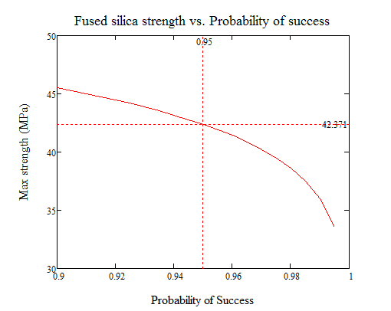
Strength of Fused Silica Window vs. Probability of success. (95% probability of success shown by markers)

Slide 13
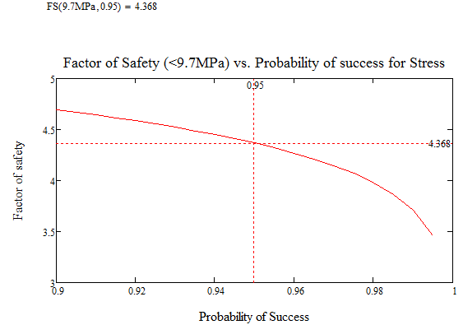
Factor of safety at 9.9MPa vs probability of success. Markers show 95% probability of success has a FOS=4.4

Slide 14
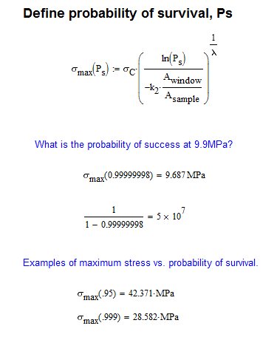
Another way to look at this is to calcuate the probability of success at 9.9MPa.
The probability of survival can be calculated at 9.7MPa using the above MathCad model: 1 part in 5 x 10E7.

Slide 15
Cryostat assembly Gravity loads

Slide 16
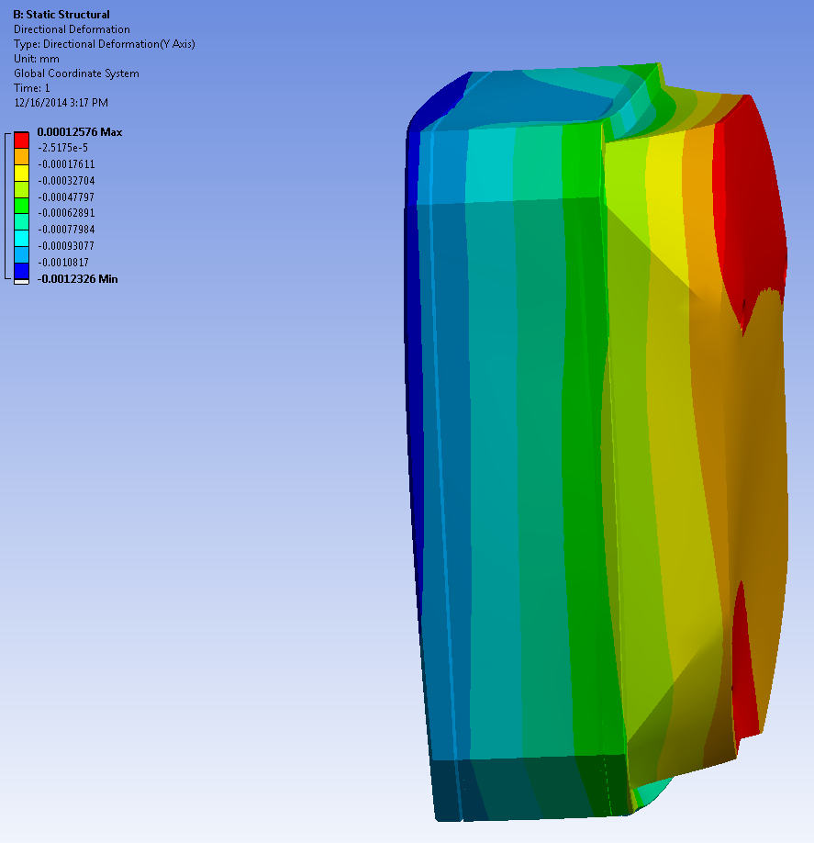
1 g vertical loads max deflection 1.2 microns
Requirement: 580 micron profile of window w.r.t. optical axis.
Loadcase: 1g vertical
Supported: at 3x hexapod locations
20 Kg

Slide 17
Von Mises stress 1 atmosphere pressure
Wt: 27 Kg

Slide 18
Von Mises stress Max <3000 psi Yield strength 304 stainless = 31200 psi (Matweb.com)

Slide 19
Z-deformation 113 microns

