Slide 1
ZTF Observatory Schedule Review February 22, 2017
Goals:
Review the proposed ZTF-P48 changeover schedule;
Confirm proposed timing meets the expected project plan goals;
Confirm timing of activities that require campus & summit coordination;
Adjust phasing and duration of activities;
Identify items that pose a potential risk to the proposed schedule;
.

Slide 2
Milestones
End of iPTF science operations : February 28, 2017
ZTF changeover begins at P48: March 1, 2017
Camera Alignment Testing (early): May 2 – 11, 2017
Camera Alignment Testing (baseline): May 23 – June 6, 2017
Trim plate est. at Palomar (soonest): July 17, 2017
ZTF 1st Light: August 1, 2017
ZTF Science Verification Tests begins: September 13, 2017

Slide 3
Commissioning Schedule drivers
Before ZTF camera alignment tests:
Telescope structural changes;
Access hatch enlargement & Cable ports;
Mounting for Filter Exchanger, Instr. Support, E-Rack,
TCS testing;
Cable/hose mgt and air treatment system;
Telescope interior cleaning & painting;
Optics: primary mirror recoating & doublet corrector refurbishment;
After ZTF camera alignment test to 1st Light:
ZTF camera CCD alignment and thermal mgt modifications; (Est 10 weeks)
Trim plate delivery; (earliest estimates @ July 17)

Slide 4
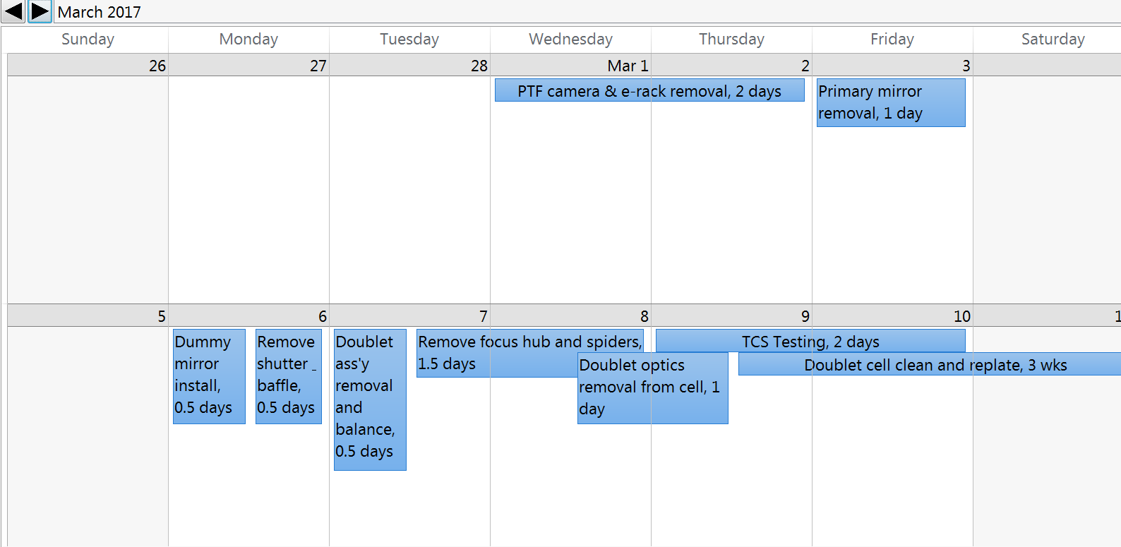
Week 1 - 2

Slide 5
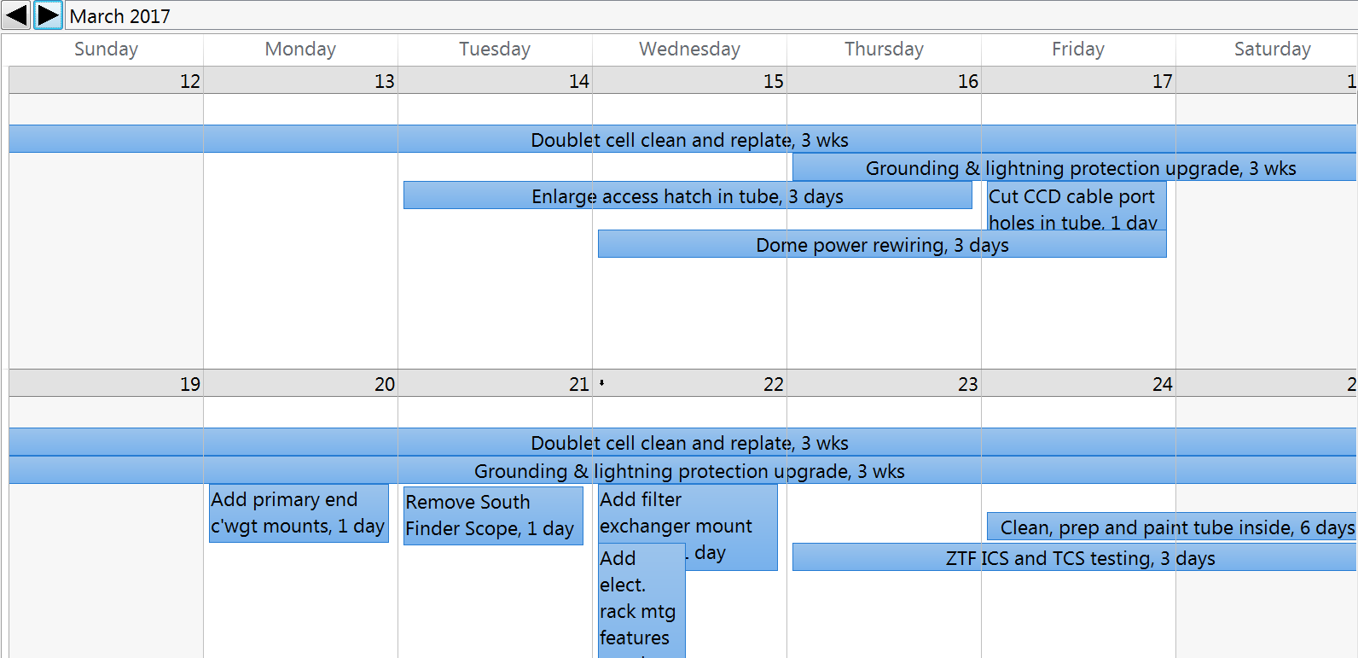
Week 3 - 4

Slide 6
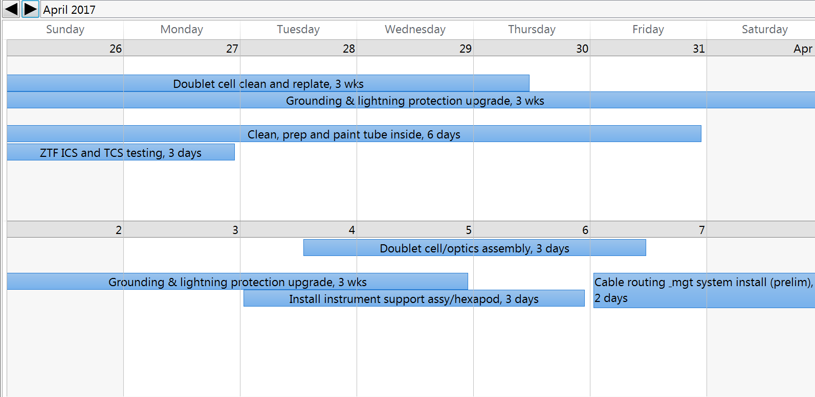
Week 5 – 6

Slide 7
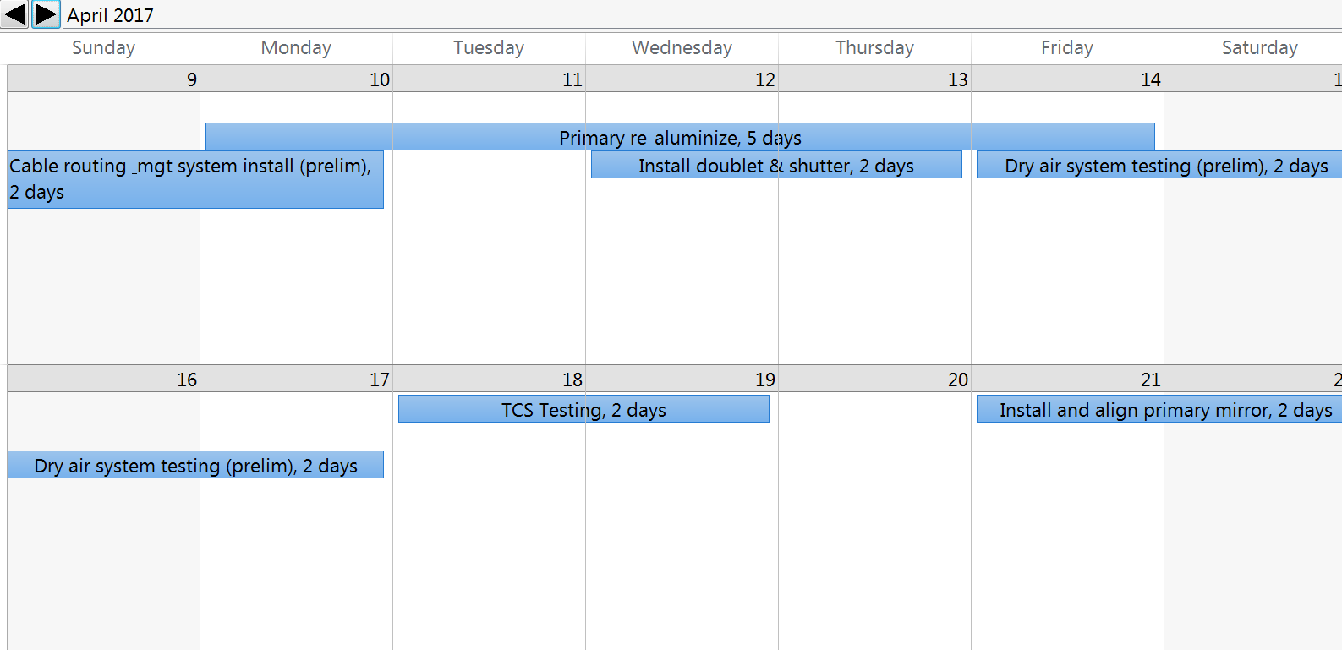
Week 7 – 8

Slide 8
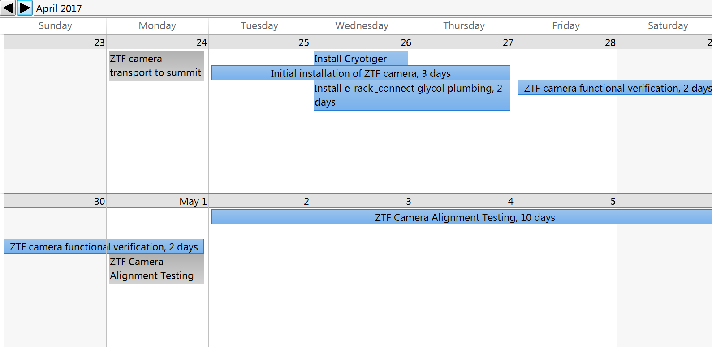
Week 9 – 10

Slide 9
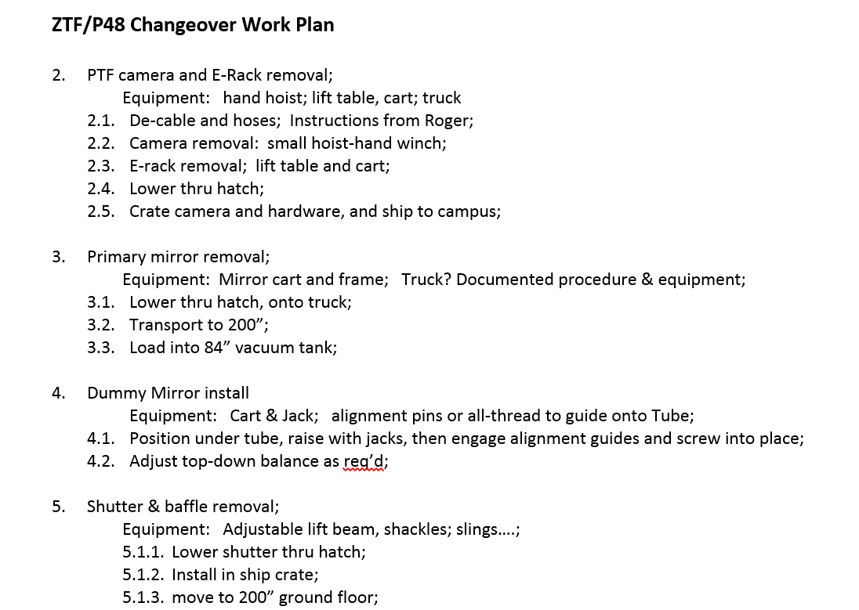
Detailed Work Plan
Each line item on schedule will be detailed with respect to:
Procedure;
Material;
Equipment;
This will be transferred into a daily work schedule with personnel assignments;
Progress will be reported weekly during the changeover work;
Forecast to be given at least 2 weeks in advance for milestones where campus involvement will be required.

Slide 10
Schedule Risks
Planned & Unplanned, Non-ZTF related Observatory events
The same Palomar staff that will be working the ZTF changeover, are responsible for maintaining & fixing all other observatory systems, and supporting other project/customers;
Other work may pull resources away from ZTF work at various times throughout the commissioning period.
Risk Mitigation
Maintain a reasonable contingency in the schedule;

Slide 11
Schedule Risks
Air treatment system
Compressor/dryer installed and operating;
Pressure & temperature regulation system needs development;
Risk Mitigation
Pressure/temperature regulation can be developed without interfering with other commissioning work and is not needed until end of commissioning
Hose & cable routing/mgt
Needs development;
Risk Mitigation
Campus engineering assigned to support;
Final routing system not needed until end of commissioning;

Slide 12
Schedule Risks
TSC development completed so far
New Delta Tau based TCS hardware and interface cabling assembled;
Individual sub-system functions have been bench tested;
User interface software: Console, GXN interfaces implemented.
TCS work to be completed
Demonstration of connection/feedback of all "housekeeping" interfaces.
Demonstration of Delta Tau basic functionality with all observatory interfaces;
Motion control performance tuning of all drives;
Risk Mitigation
Define several TCS testing periods interspersed in schedule;
4 events; 12 days;
Alignment test can proceed using Vertex controls with manual target acquisition;
Acquire consulting support for performance tuning phase; (Delta Tau or others)

