Slide 1
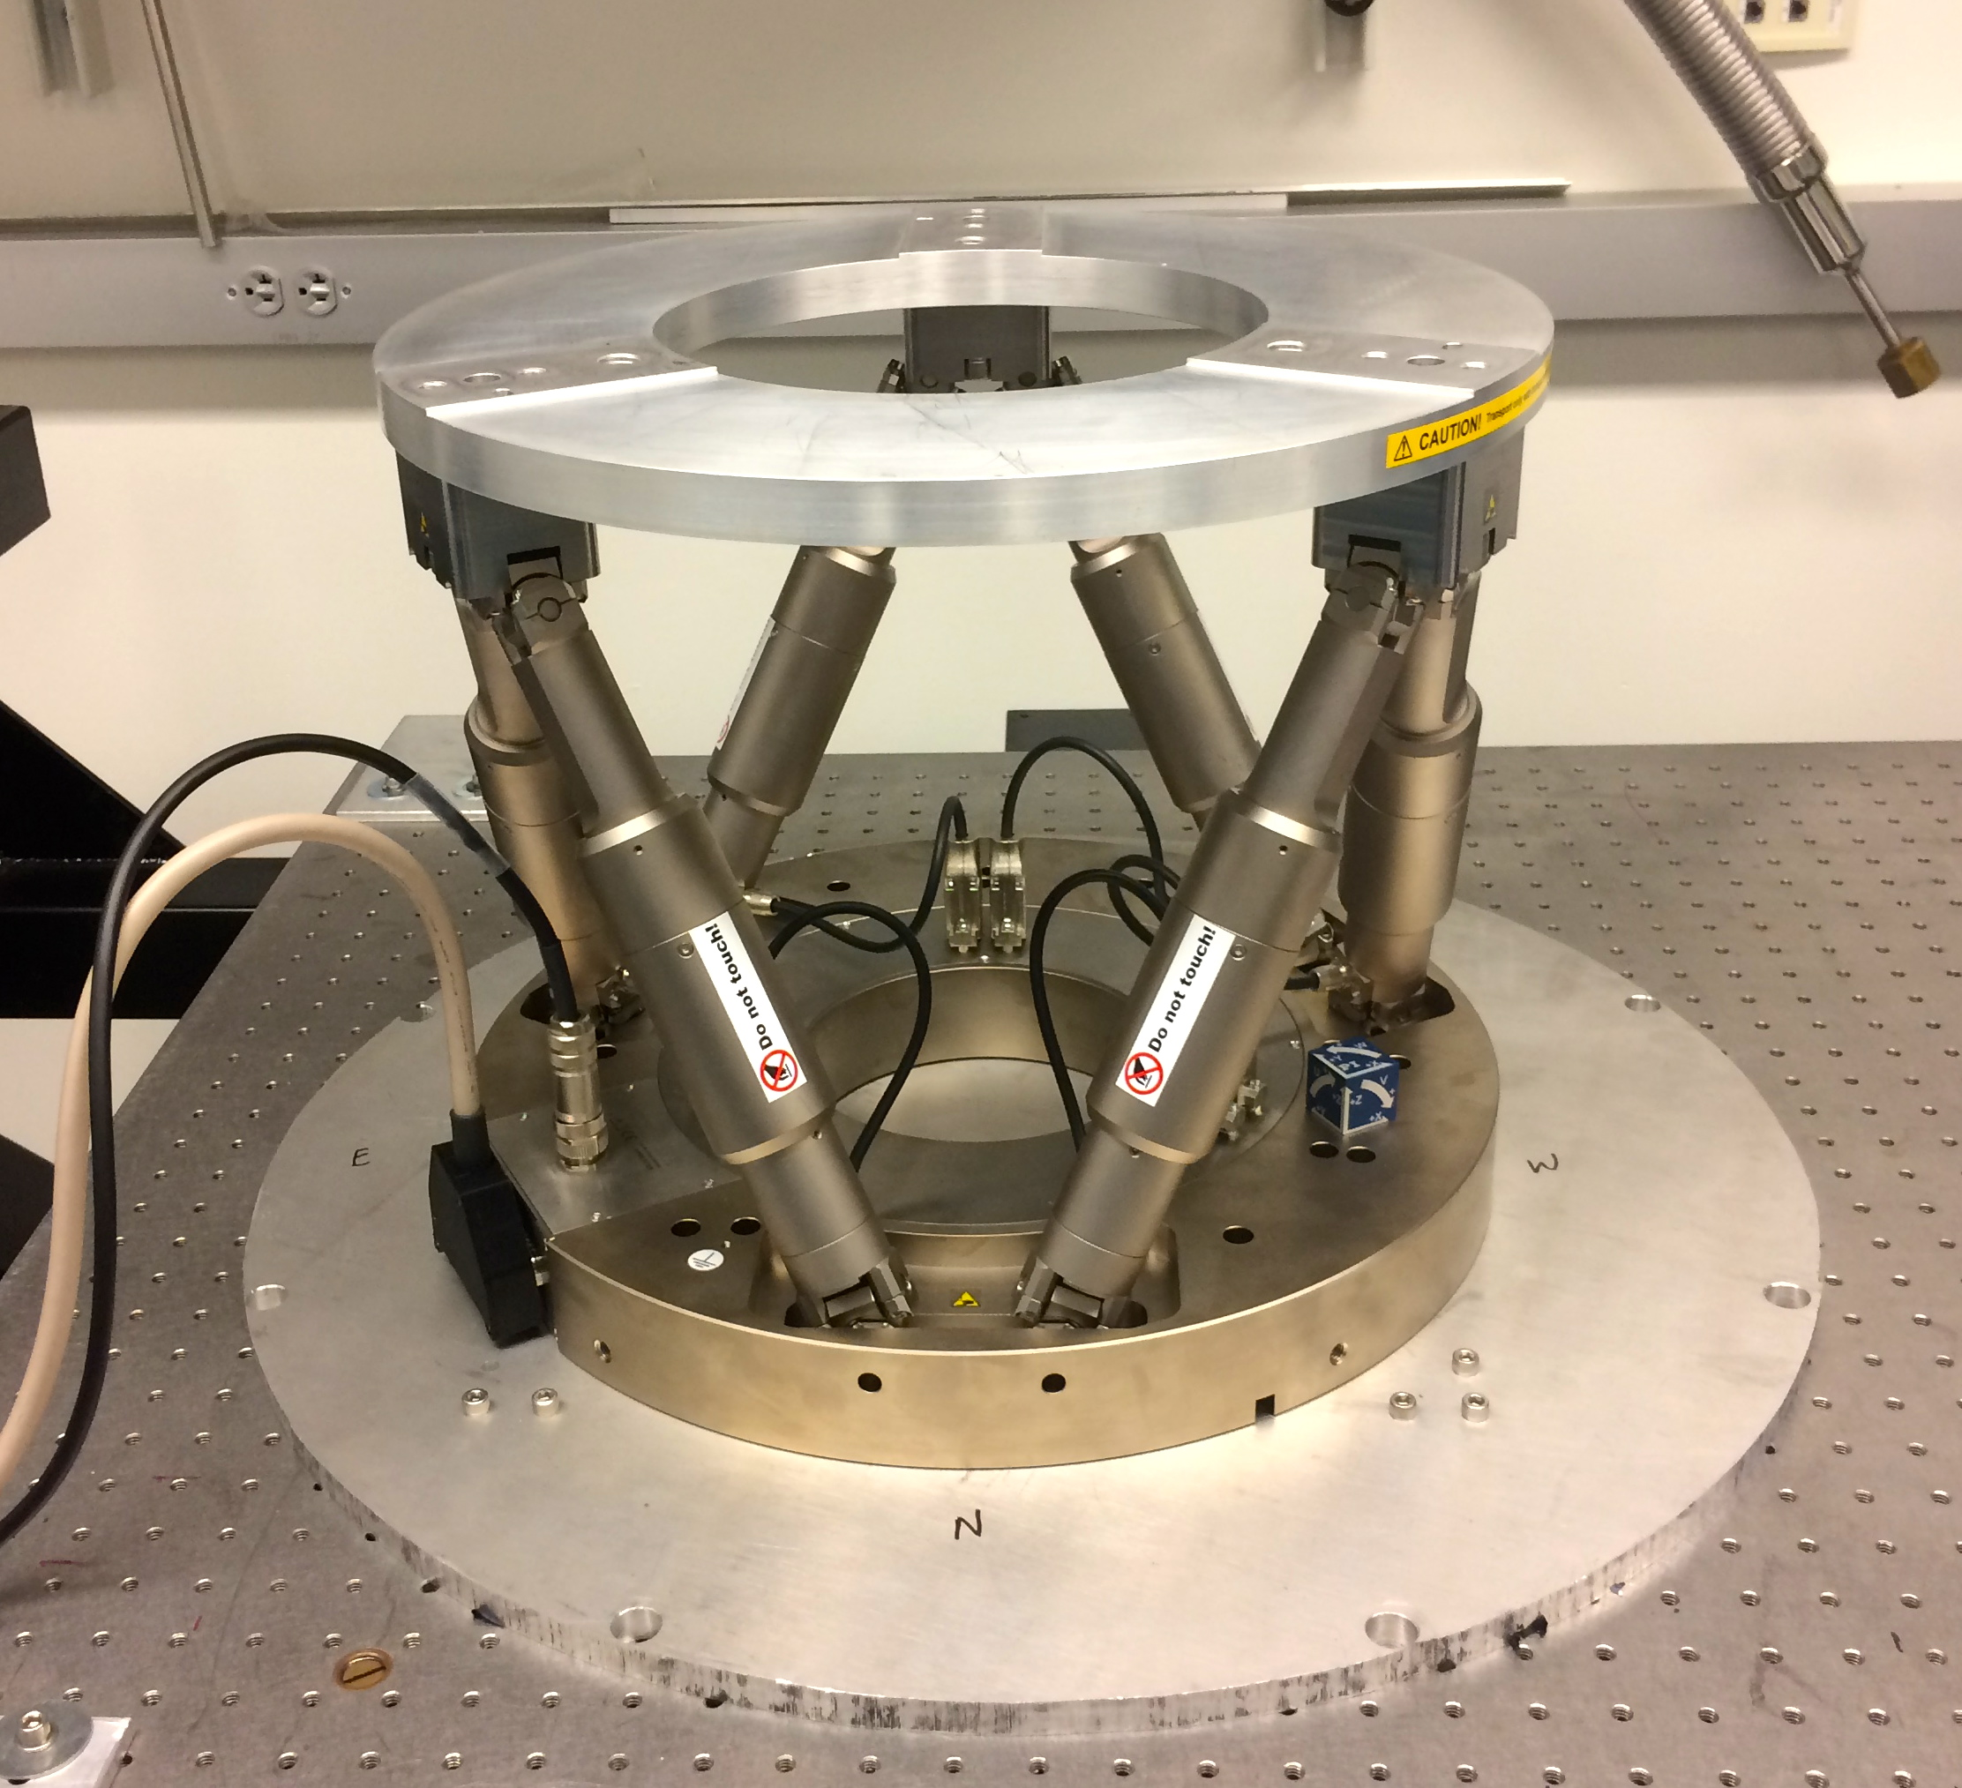

Slide 2
Hexapod axes and max. ranges
X, translation: ±10 mm
Y, translation: ±10 mm
Z, translation: ±10 mm
U, rotation about X: ±5˚
V, rotation about Y: ±5˚
W, rotation about Z: ±10˚
Theoretical max. velocity (translation): 0.5 mm/s, typical, 0.3.
Theoretical max. velocity (rotation): 6 mrad/s, typical, 3.

Slide 3
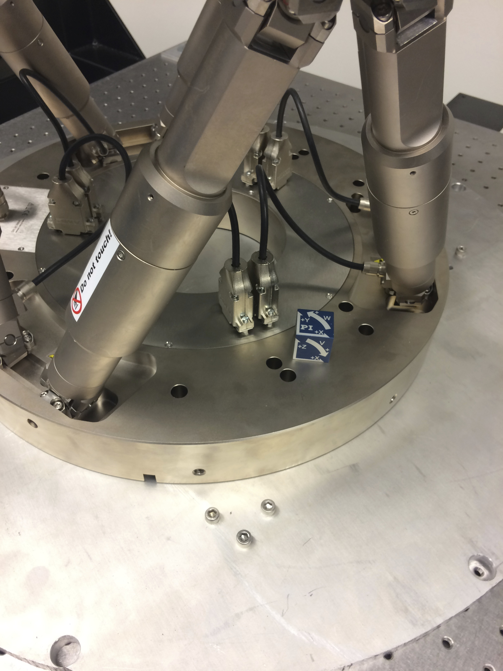

Slide 4
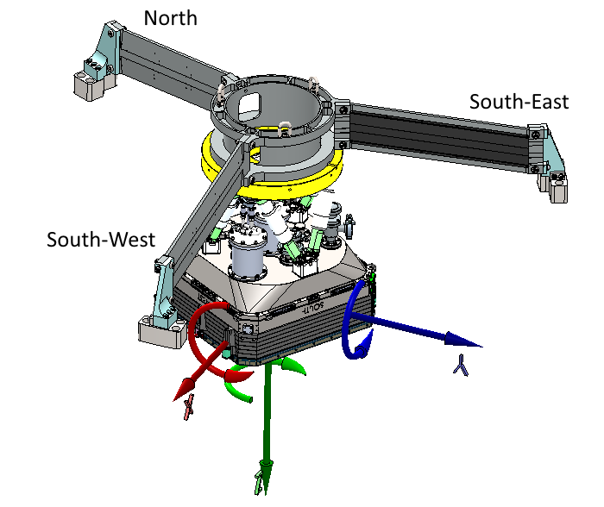
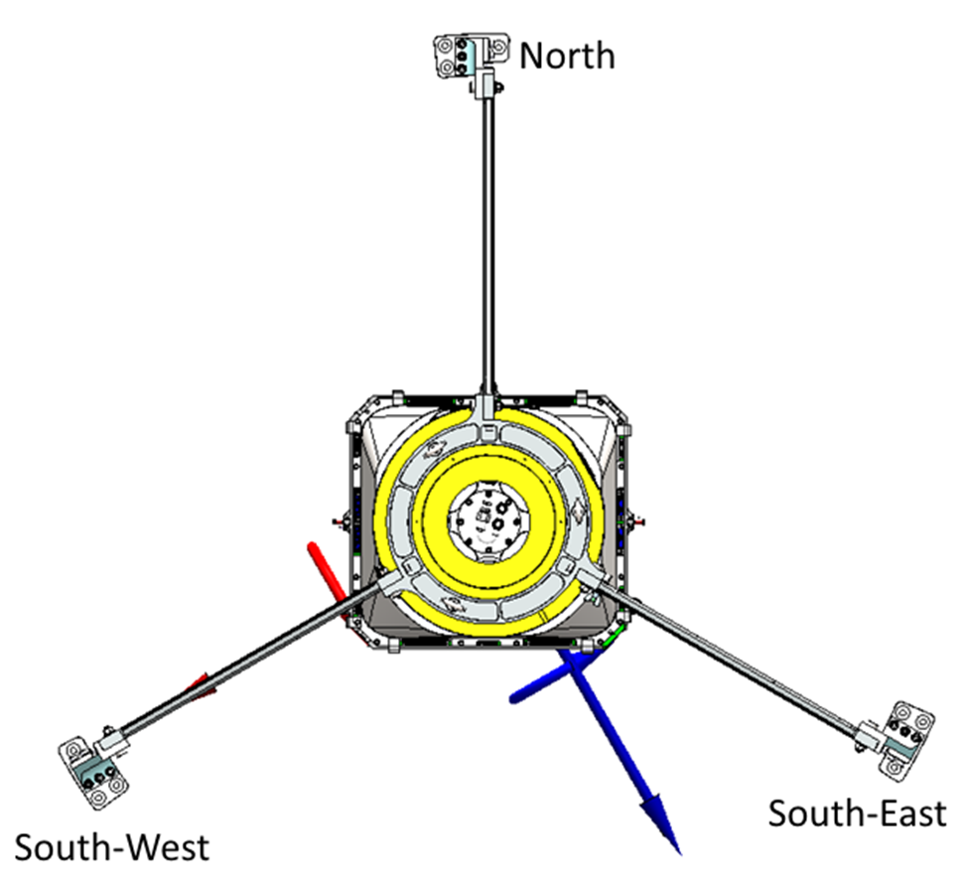
PI Hexapod H-850K043 Coordinate System: Relative to ZTF

Slide 5
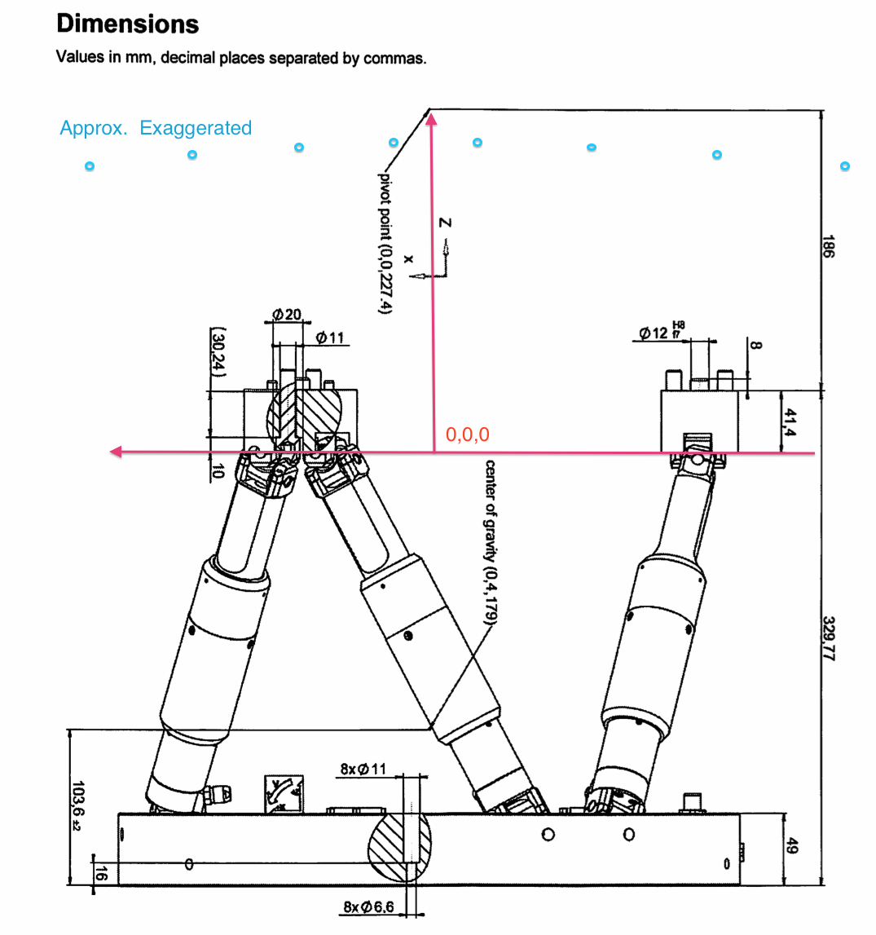

Slide 6
Some speed measurements I
x,y,z translations:
Single axis moves: ~290 microns/sec
Multiple axis moves: ~150 microns/sec
u,v rotations:
Single axis moves: ~0.075 deg/sec
Multiple axis moves: ~0.025 deg/sec
w is faster: ~0.19 deg/sec

Slide 7
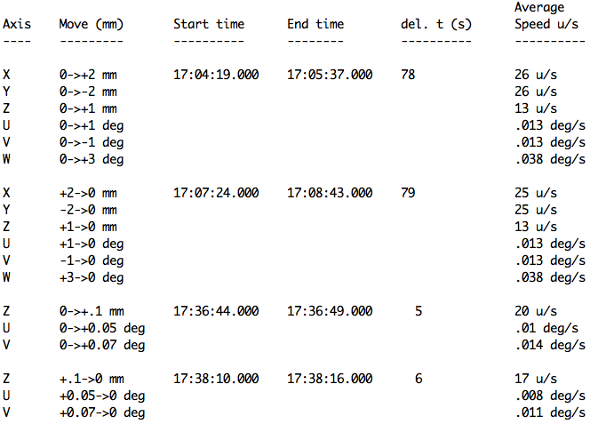
Some speed measurements II

Slide 8
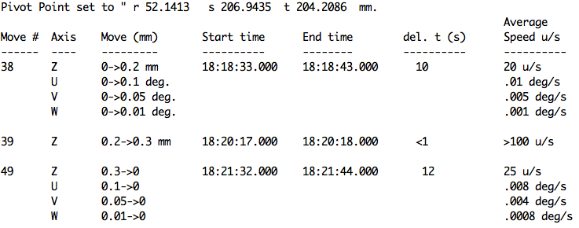
Some speed measurements III

Slide 9
Software control
Command line interface (“piask”, “pisend”).
Interface test menu.
Motion daemon menu.
Python interface. (CIN in progress.)

Slide 10
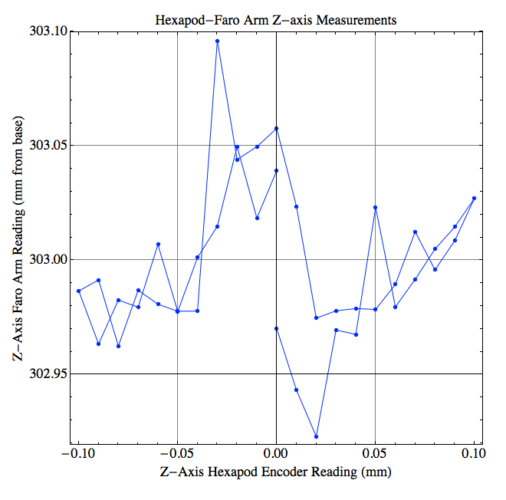
First hysteresis test results

