Slide 1
Pixel Timing and Noise Performance
Stephen Kaye

Slide 2
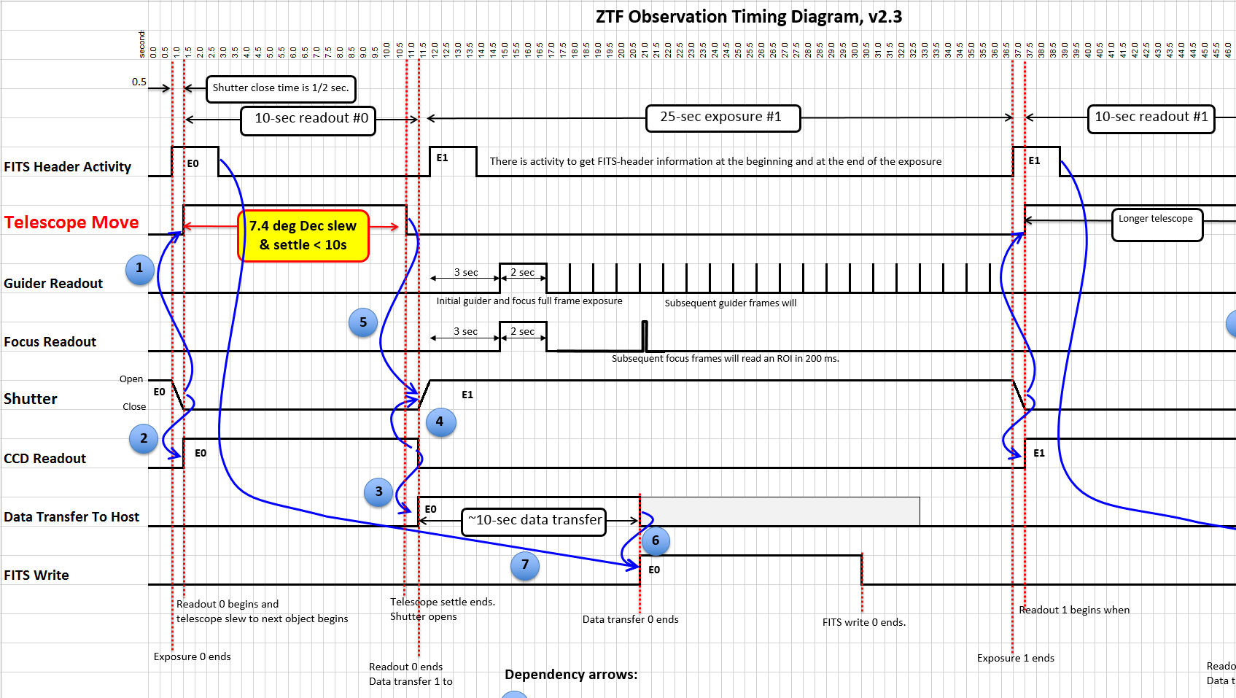
CCD and Readout Specifications
CCD format size 6160 x 6144 active pixels in quadrant format
  Overscan adds pixels and readout time
Readout time for CCD
  Target 10 seconds due to telescope slew time
  Faster readout is desirable
Required pixel time is around 1 µsecond

Slide 3
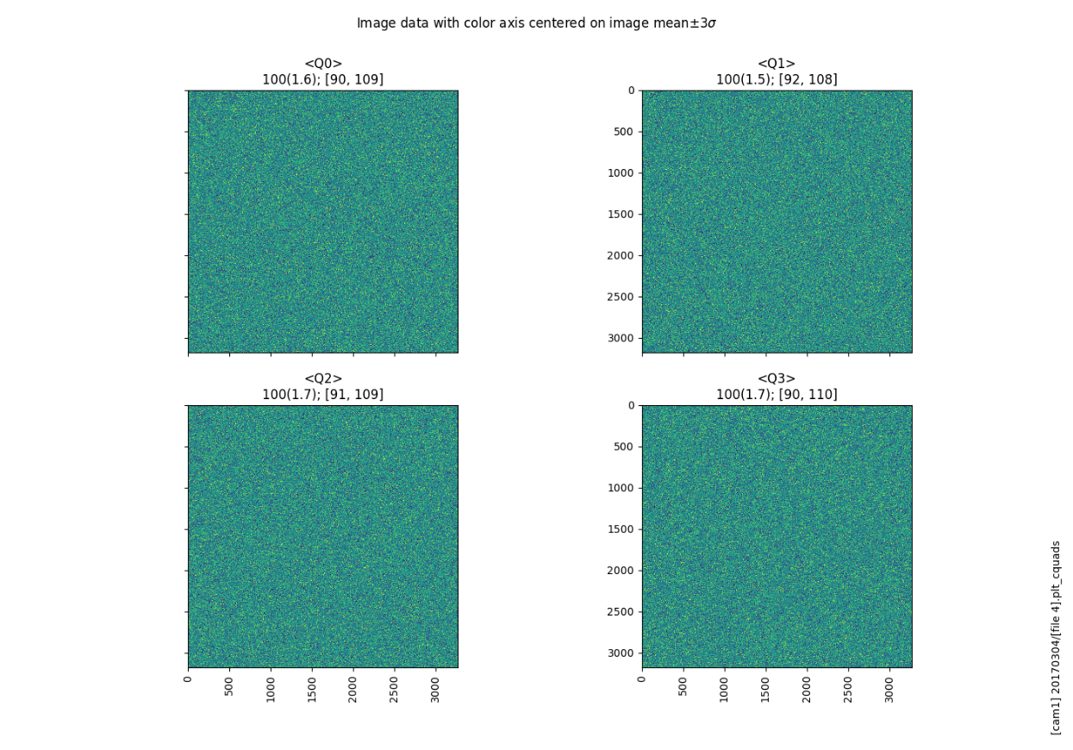
Present Readout Time and Noise
Each quadrant is 3272 x 3180
Calculated readout time is 13.42 seconds
Measured 13.44 seconds from CESL outputs
  GET_FRAME
  READ_FRAME_INTO_MEMORY
Noise performance with 10 sample window
  Around 1.6-1.7 ADU
  Poor common mode rejection noise ~3.5 ADU
  Conversion is ~6 e⁻ per ADU

Slide 4
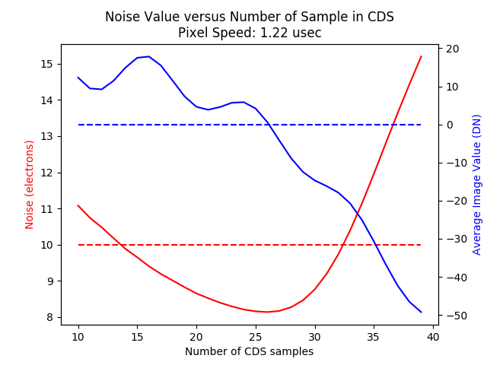
Improving Noise with Increasing Number of Samples
Increasing the number of samples in the reset and charge signals reduces noise
There is a maximum benefit until the sampling window impinges on the settling of the signal.
Absolute detector number in the image changes

Slide 5
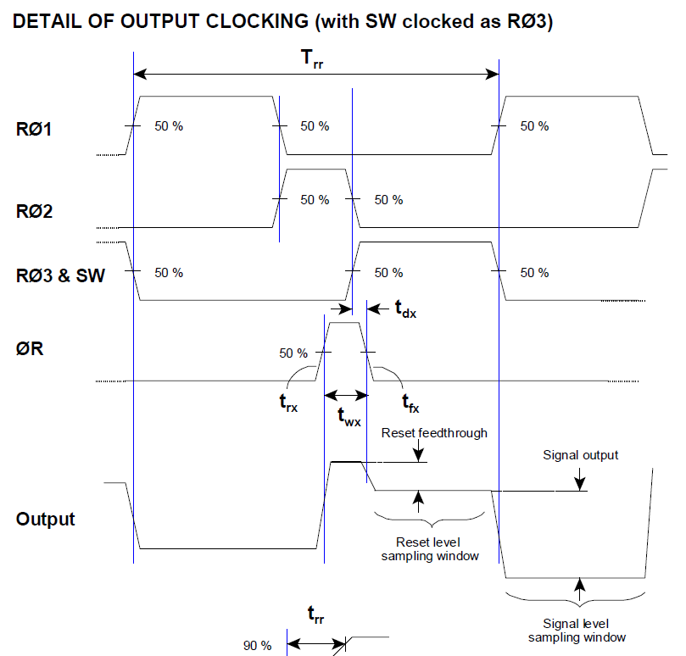
Reducing Readout Time (Serial Clocks)
Reducing pixel time will bring clock edges and settling closer to the sampling levels.
Reset level and Signal level need to be maximized to ~400 ns each for sampling.
Reset pulse tests will determine how narrow pulse can be.
  Present reset pulse (t_{wx}) is 200 ns in width

Slide 6
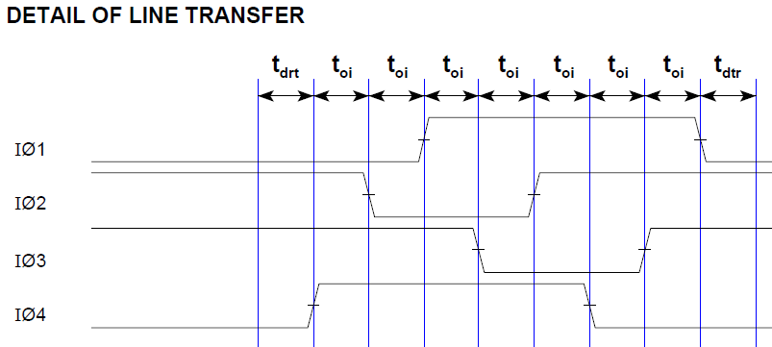
Reducing Readout Time (Parallel Clocking)
Parallel Clocking needs to be minimized
Presently, the parallel shift takes 225 us and is done 3180 times in a readout = 0.72 seconds
We can move to a method of simultaneous parallel and serial clocking

Slide 7
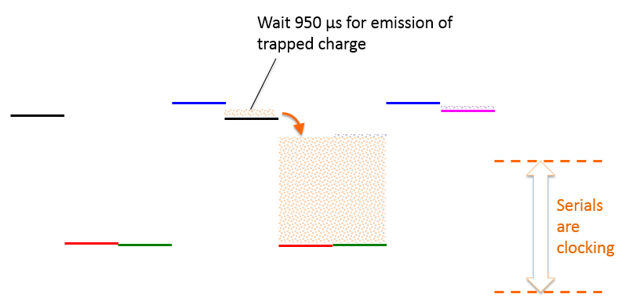
Simultaneous Parallel and Serial
Simultaneous clocking allows us to relax the parallel shifting time by an order of magnitude
Slower parallel clocking will allow time for detrapping of charge
A third clock level added to the parallels will allow an “in-between” to allow charge to detrap and move into collection phase

