Slide 1
P48 Telescope Drive Upgrade
Preliminary Design Review
October 21, 2015

Slide 2
Outline of Review
Overview of telescope history
  Original drive design configuration and performance;
  Current (Vertex) design configuration and performance;
Requirements review;
  ZTF Telescope requirements document;
  Comparison of original & Vertex design performance, and ZTF requirements;
  Other requirements: Interface, Safety, Reliability;
System performance requirements flow down to hardware requirements;
  Design process used to derive and allocate hardware performance specs;
    Calcs, motor perf curves, form factor, ….etc.
    Estimation of performance with defined hardware;
    Comparison of estimated performance to requirements;
Gear Load Calculations;
  Loading of critical components, normal operation;
  Wear & durability analysis, lubrication;
Safety features for abnormal operation;
  Software & control; Mechanical devices;
Risk management;
  Testing & analysis;
Project management;
  Cost & Schedule

Slide 3
Overview of telescope history
  Telescope operations history
    Original use and duty cycle:
      Commissioned ~ 1948
      Survey with photographic plates;
      POSS: <10 exposures / night
    Vertex drive upgrade; motivation and operational modes.
      Early 2001 installation;
      Near Earth Asteroid Tracking; Moving to remote mode of operation;
    Quest survey;
    PTF era operations and duty cycle;
      Robotic observations with ~300 exposures / night
    ZTF duty cycle;
      35 sec exposure & repoint => ~1000 exposures / night
  Telescope design history
  Original drive design; each drive included at least 3 motors: slew, set, and guide
    RA Drive original drawing: 102008.pdf; 101762-1.pdf; 101762-2.pdf
    Dec Drive original drawing: 101822-1.pdf 101822-2.pdf
  Current (Vertex-RSI) design configuration (circa 2001); Single servo motor drive
    Drawings: Vertex Dec drive assembly.PDF ; Vertex RA drive assembly

Slide 4
System Requirements
ZTF Telescope requirements document:
  Dec Slew performance target
Parameter | Requirement | Expected | Rationale
Total slew time | 10s for 7.3 deg | ” “ “ | Slew plus settle hidden within 10s CCD readout time.
Acceleration | 0.41 deg/s/s | 0.5 deg/s/s
Acceleration ramp up/down | 0.5 s |  | See timing budget.
Slew speed | 1.5 deg/s | 3.0 deg/s
Settling to track | 1 s | TBD | See timing budget.

Slide 5
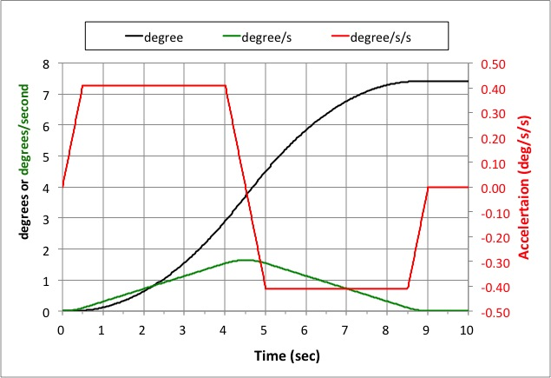
System Requirements
ZTF Telescope requirements document:
  Dec Slew timing budget

Slide 6
System Requirements
ZTF Telescope requirements document:
  RA Slew performance target
Parameter | Requirement | Goal | Rationale
Total slew time | 15s for 7.25 deg | ” “ “ | Slew plus settle is ideally hidden within 10s CCD readout but this can be relaxed since RA slews are less common.
Acceleration | 0.27 deg/s/s | 0.5 deg/s/s
Deceleration | 0.2 deg/s/s | 0.5 deg/s/s
Torque ramp up/down | 1 s |  | See timing budget.
Slew speed | 1.18 deg/s | 3.0 deg/s
Settling to track | <3s | TBD

Slide 7
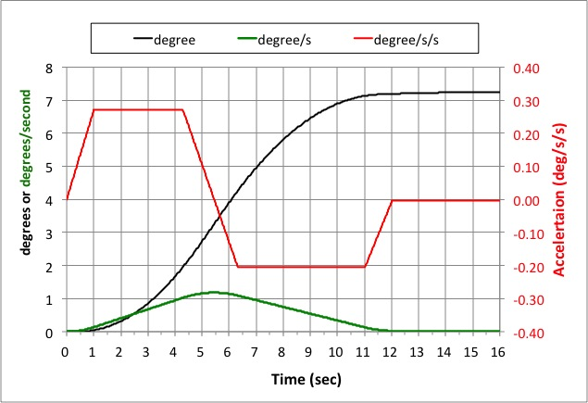
System Requirements
ZTF Telescope requirements document:
  RA Slew timing budget

Slide 8
System Requirements
  Comparison of performance history
 | Parameter | Original Design | Vertex Design (current) | ZTF Reqmt | ZTF Goal
DEC | Acceleration deg/s/s |  | 0.3 (measured) | 0.41 | 0.5
 | Slew speed deg/s | 1.43 | 1.25 | 1.5 | 3.0
RA | Acceleration deg/s/s |  | 0.4 (measured) | 0.27 | 0.5
 | Slew speed deg/s | 1.60 | 1.67 | 1.18 | 3.0

Slide 9
System Requirements
Other requirements:
  Interface:
    The goal is to implement a higher performance drive system with the minimal modifications to existing telescope hardware and supporting infrastructure.
  Safety:
    The upgraded system shall not increase the risk of damage to the telescope and infrastructure, or constitute an increased risk to personnel.
  Reliability:
    The upgraded system shall consider telescope operational reliability as a priority, and shall not increase the risk of telescope downtime.

Slide 10
Hardware requirements
Design process used to derive and allocate hardware performance specs
Primary considerations, based on science requirements & telescope properties:
  maximum axis speed
  acceleration (torque requirements)
  dynamic range: adequate slew speed + tracking accuracy
  behavior of telescope (preloaded drive gear with lash; structural resonances)
  safety factors (see Gear Loading & Safety Features for Abnormal Situations, below)
Other considerations:
  cost
  the state of the art
    obsolescence of old motors (buy on eBay)
    higher feedback resolution of new motors
    performance & safety features of new amplifiers
Development spreadsheet allows trading off various parameters:
  max axis speed vs tracking accuracy (max motor speed)
  acceleration & preload vs drive train torques
  safety torque limiting vs working torque requirements
The smallest motor in the current frame size gives plenty of speed & torque for any reasonable scenario; the limitation appears to be telescope dynamics.

Slide 11
Hardware requirements
Calculations: HA (planetary ratio = 25:1, was 50:1; acceleration = 0.5°/sec²)
HA maximum slew speed = 3.56°/sec
  8000 rpm (motor) / 25 (planetary reducer) / 540 (worm) * 6 ((°/sec) / rpm)
RA tracking speed = 9.38 rpm
  15 arcsec/sec * 60 (sec/min) / 1.296e6 (arcsec/rev) * 25 * 540
HA maximum axis torque = 9073 lb-in (accelerating west)
  preload torque = 3670 lb-in (183 lb cable tension x 20" cable drum radius)
  friction torque = 2000 lb-in (based on measurement; approximate)
  acceleration torque = 3403 lb-in (390000 lb-in-sec² x 0.00873 rad/sec²)
    max HA moment of inertia (MoI) calculated for current mass distribution with Dec @ 0°, adjusted by 32500 lb-in-sec² for added ZTF equipment
HA minimum axis torque = -1733 lb-in (accelerating east)
  3670 lb-in (preload) - 2000 lb-in (friction) - 3403 lb-in (acceleration)
  worm gear moves to other side of tooth lash
  to avoid motion through lash, increase preload and/or decrease acceleration
HA maximum motor torque = 1.49 lb-in
  9073 lb-in / 540 (worm ratio) / 25 (planetary reducer ratio) / 0.48 (worm efficiency) / 0.94 (planetary efficiency)

Slide 12
Hardware requirements
Calculations: Dec (planetary ratio = 4:1, was 10:1; acceleration = 0.5°/sec²)
Dec maximum slew speed = 3.33°/sec
  8000 rpm (motor) / 4 (planetary reducer) / 6.67 (spur reducer) / 540 (worm) * 6 ((°/sec) / rpm)
Dec maximum axis torque = 10716 lb-in
  preload torque = 5985 lb-in (157 lb cable tension x 38" cable drum radius)
  friction torque = 2000 lb-in (based on HA measurement)
  acceleration torque = 2731 lb-in (313000 lb-in-sec² x 0.00873 rad/sec²)
    Dec MoI calculated for current mass distribution, adjusted by 32500 lb-in-sec² for added ZTF equipment
Dec maximum motor torque = 1.65 lb-in
  10716 lb-in / 540 (worm ratio) / 26.7 (planetary & spur gear reducer ratio) / 0.48 (worm efficiency) / 0.94 (reducer efficiency)

Slide 13
Hardware requirements
Tracking accuracy
Speed matters: rms errors of a given size have a smaller effect at higher base speed
New motor tracking speed of 9.38 rpm is half of old motor (18.75 rpm). This is a tradeoff to achieve higher slew speed.
New motor technology gives better velocity control to offset slower tracking speed:
  BiSS sine encoder feedback: 2²⁷ bits resolution, vs ~2¹⁶ bits for resolver feedback
  AKD amplifier has fast cycle times: 0.67 μsec current loop; 62.5 μsec velocity loop
  EtherCAT interface provides better noise immunity and control resolution than ±10V analog input

Slide 14
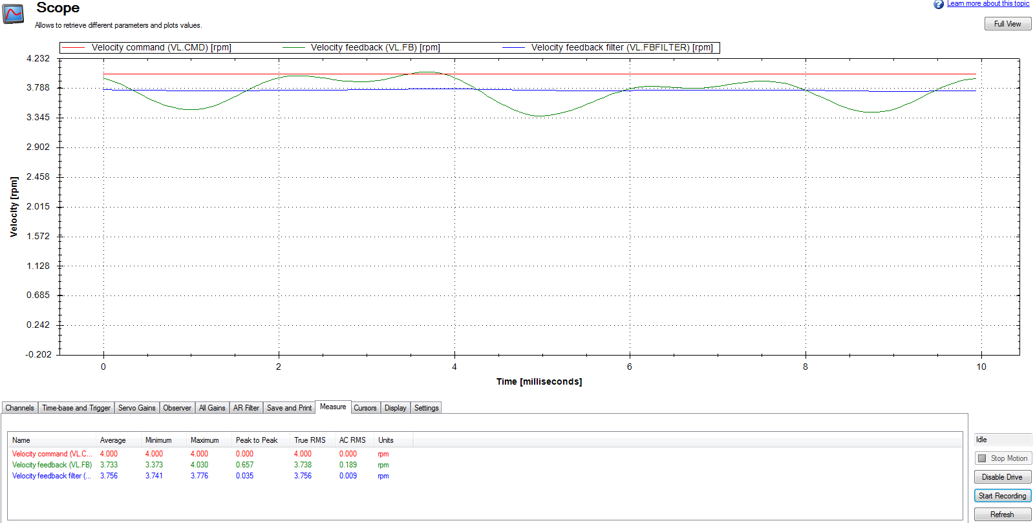
Hardware requirements
Tracking accuracy
BiSS feedback, 4 rpm tracking

Slide 15
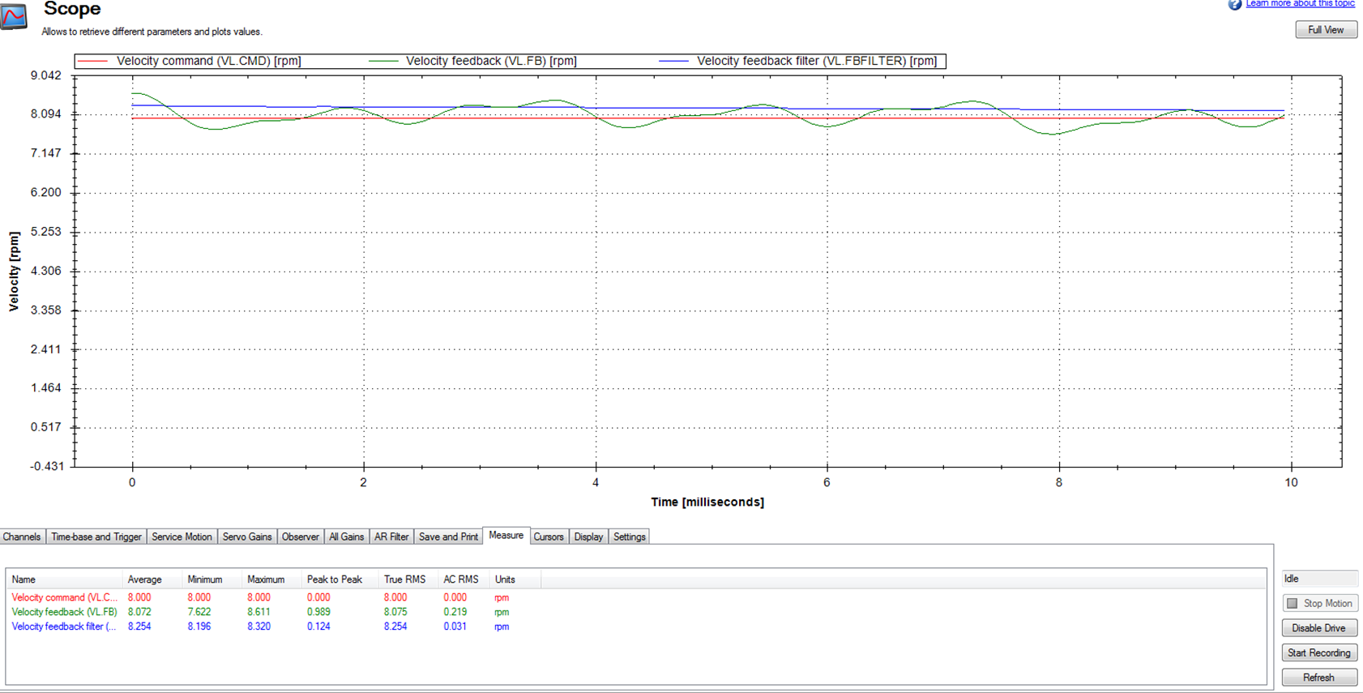
Hardware requirements
Tracking accuracy
BiSS feedback, 8 rpm tracking

Slide 16
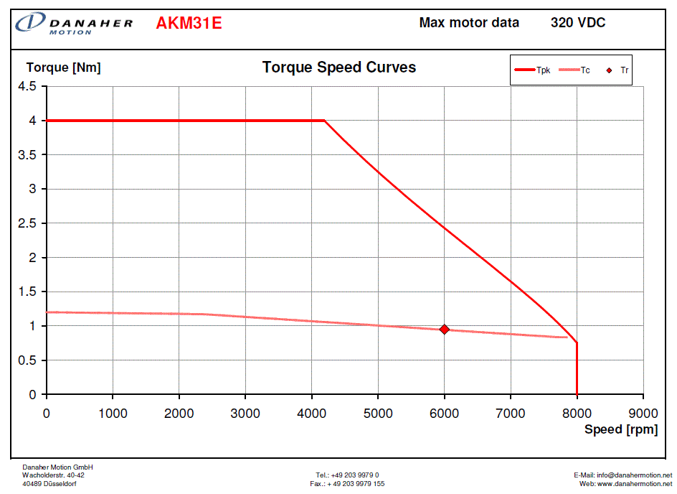
Hardware requirements
Motor Performance curve
Existing Kollmorgen B-102A motors are rated 6 lb-in continuous @ 7500 rpm.
New Kollmorgen AKM31E motors are rated 7 lb-in (0.8 Nm) continuous @ 8000 rpm.
Projected motor torque on both HA and Dec axes is < 2 lb-in (0.23 Nm, per above calculations: minimal heating, maximal control).

Slide 17
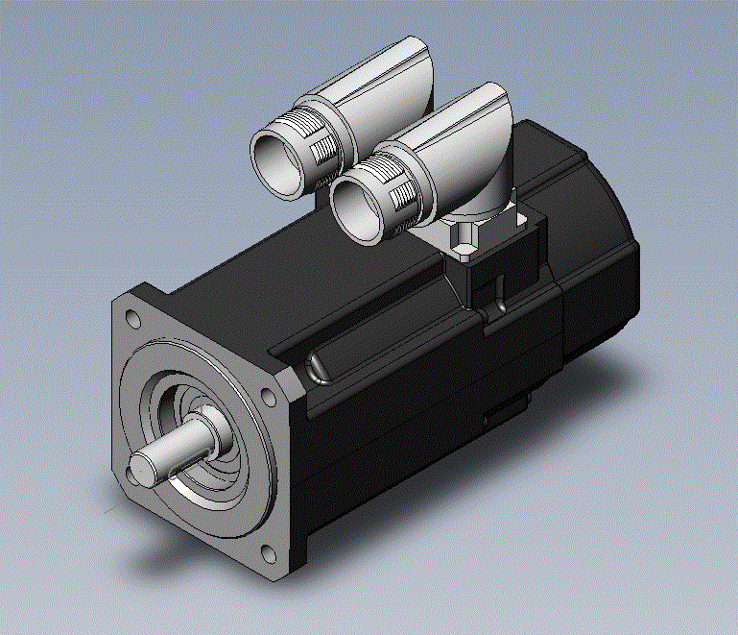
Hardware requirements
Planetary reducers
Currently planning on Apex Dynamics AB060 series.
Selection based on:
  output torque capacity (4:1 = 442.5 lb-in; 25:1 = 531 lb-in)
  input speed (nominal = 5000 rpm; maximum = 10000 rpm)
  noise level (≤ 58 dB(A))
  service life (20000 hr)
  size is compatible with existing drive train
Motor form factor
New motors have same 70mm frame size as existing motors
Both old and new motors have brakes attached
HA:
  existing motor + reducer = 8.7" + 4" = 12.7" long
  new motor + reducer = 5.6" + 4.5" = 10.1" long
Dec:
  existing motor + reducer = 8.7" + 2.6" = 11.3" long
  new motor + reducer = 5.6" + 3" = 8.6" long

Slide 18
Hardware requirements
Comparison of estimated performance to requirements
As shown in above calculations, worst-case motor load is much less than rated torque; even at 1°/sec² acceleration, motor loads are just 2.05 lb-in for HA and 2.07 lb-in for Dec.
Maximum axis speeds of 3.56°/sec for HA and 3.33°/sec for Dec meet or exceed requirements.

Slide 19
Gear Loading
  Critical components:
  There are certain components of the drive system and telescope which are considered very high value and their replacement if damaged,
    maybe problematic for continuation of the operations, or
    cause a very long interruption of operations.
      Dec and RA Worm Gear; 101768.pdf ; 101769.pdf
      DEC & RA Worm; 101780.pdf
      Dec Spur Gear Reducer; 101822-1.pdf 101822-2.pdf
  Loading of critical components;
    Normal operation;
    Unintended behavior: collision; uncontrolled motor; moving beyond limits;
    Strength, Wear & Durability analysis;
    Lubrication;
  Safety features;
    Software & control;
    Mechanical devices;

Slide 20
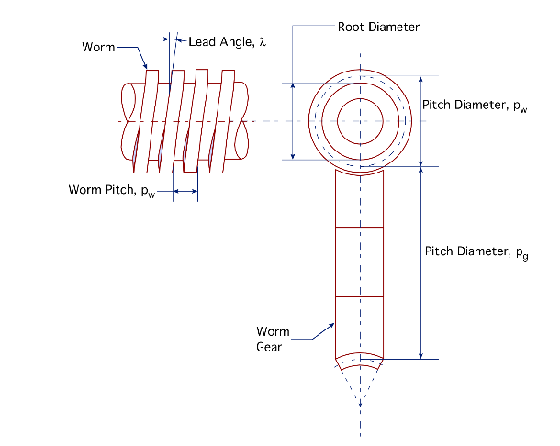
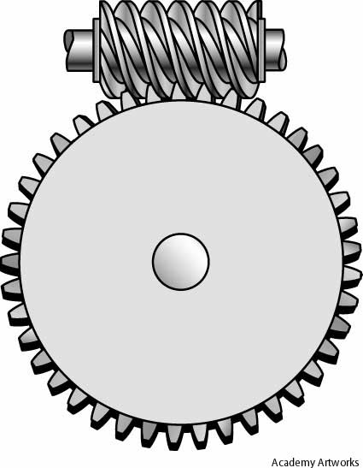
Gear Load Calculations

Slide 21
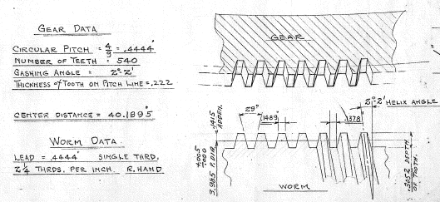
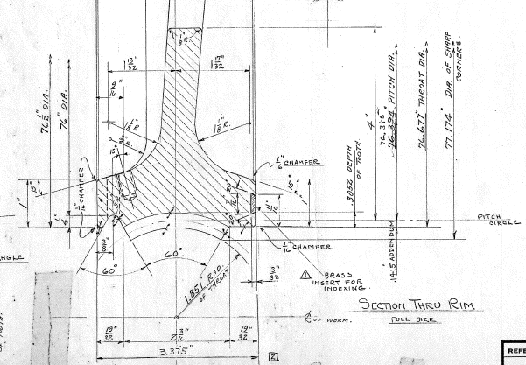
Gear load calculations
Dec Worm Gear Parameters
Dg = pitch dia (Gear): 76.385”
Pc = Circular Pitch (Gear): 0.4444”
Pa = Axial pitch (Worm): 0.4444”
Pd= Diametral pitch Tg/Dg: 0.1415
Tg = No. of teeth (Gear): 540
Pressure angle: 14.5°
λ= Lead Angle: 2°2’ = 2.033°
b= Tooth Face width @ Pc 2.045”
M= Module = Pc/π: 0.1415
Face width = 2.187- 2[(0.1415(sin30)]= 2.045”
From Dec Worm Gear drawing 101768

Slide 22
Gear load calculations
There are two primary modes of failure for gears in contact:
1) Tooth breakage by bending stress;
  The bending stress is calculated by assuming the gear tooth is a cantilevered beam, with a cross section of face width by tooth thickness.
2) Tooth failure by contact stress at the gear tooth surface;
  The contact stress, or pitting stress, between two contacting gears is a function of the Hertzian contact equation.
For both cases we are interested in the tooth load, which is produced by the operating torque.
There are various methods used for calculating these values, the most common being from AGMA 6022-C93, and British Standards 721.
The most basic, and conservative approach was applied for an initial assessment.
Due to the relative slow operating speeds, and large mass of components/structure, thermal factors have not been considered.

Slide 23
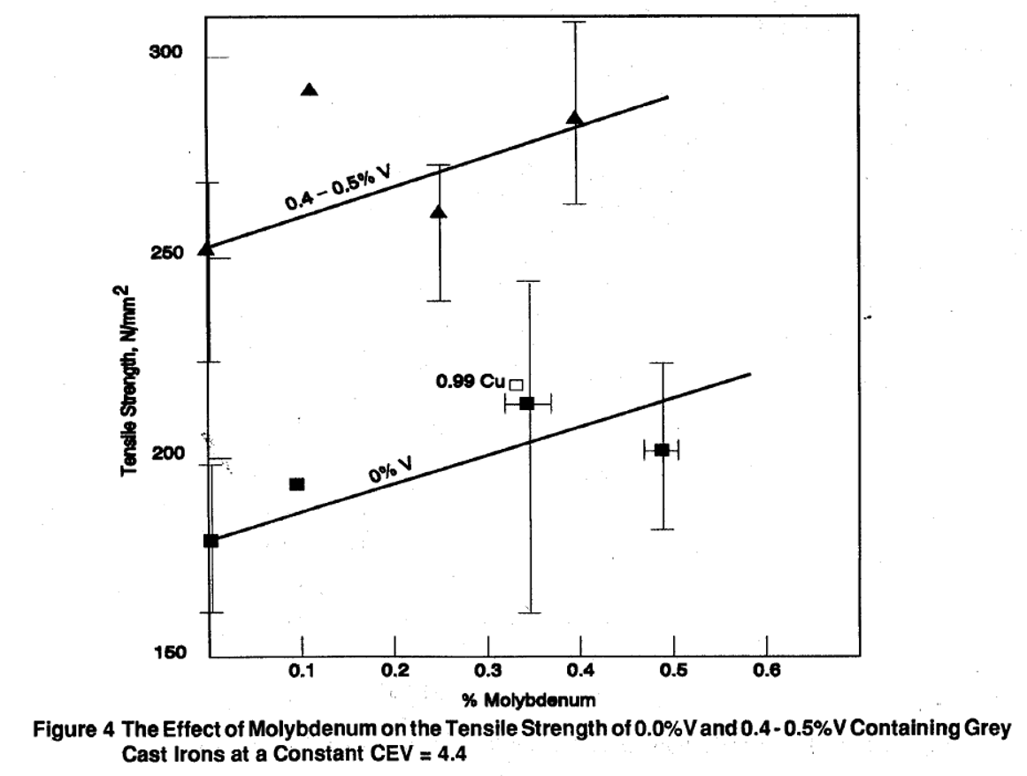
Gear load calculations
Allowable tooth load – Material Properties
Material properties for standard cast iron have been assumed for lack of more detailed information on specifics of actual properties. 0.5% Moly Cast Iron
References found which provide some indication of enhanced properties of 0.5% Moly cast iron, but content of other alloying elements need to be known to be more definitive.
Reference:
http://demos.netarsoft.com/vanitec/wp-content/uploads/2011/09/The-Effects-of-V-Mo-Ni-and-Cu-on-the-Strength-and-Thermal-Fatigue-Resistance-of-Grey-Irons-Suitable-for-High-Duty-Applications.pdf

Slide 24
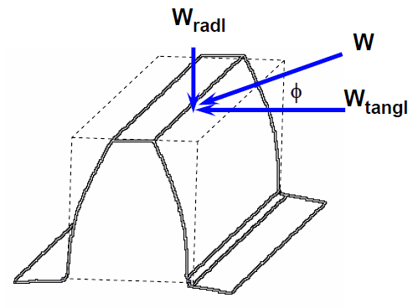
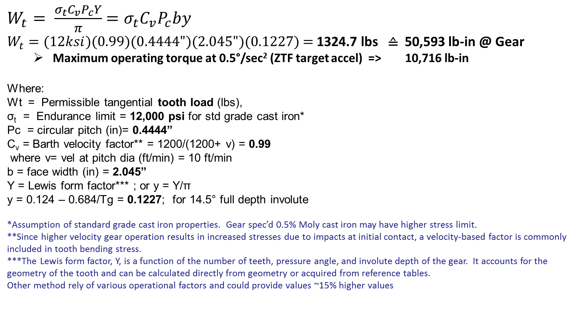
Gear load calculations
Allowable tooth load – Bending Stress
The most common method of estimating the allowable tooth load due to bending stresses in a gear tooth is the Lewis Equation. From the basic equation for bending stress: $σ=Mc/I$ , Lewis derived:
$W_{t}= \frac{σ_{t}C_{v}P_{c}Y}{π}$ $=σ_{t}C_{v}P_{c}by$
$W_{t}=(12ksi)(0.99)(0.4444")(2.045")(0.1227)$ = 1324.7 lbs ≙ 50,593 lb-in @ Gear
  Maximum operating torque at 0.5°/sec² (ZTF target accel) => 10,716 lb-in
Where:
Wt = Permissible tangential tooth load (lbs),
σ_{t} = Endurance limit = 12,000 psi for std grade cast iron*
Pc = circular pitch (in)= 0.4444”
C_{v} = Barth velocity factor** = 1200/(1200+ v) = 0.99
where v= vel at pitch dia (ft/min) = 10 ft/min
b = face width (in) = 2.045”
Y = Lewis form factor*** ; or y = Y/π
y = 0.124 – 0.684/Tg = 0.1227; for 14.5° full depth involute
*Assumption of standard grade cast iron properties. Gear spec’d 0.5% Moly cast iron may have higher stress limit.
**Since higher velocity gear operation results in increased stresses due to impacts at initial contact, a velocity-based factor is commonly included in tooth bending stress.
***The Lewis form factor, Y, is a function of the number of teeth, pressure angle, and involute depth of the gear. It accounts for the geometry of the tooth and can be calculated directly from geometry or acquired from reference tables.
Other method rely of various operational factors and could provide values ~15% higher values

Slide 25
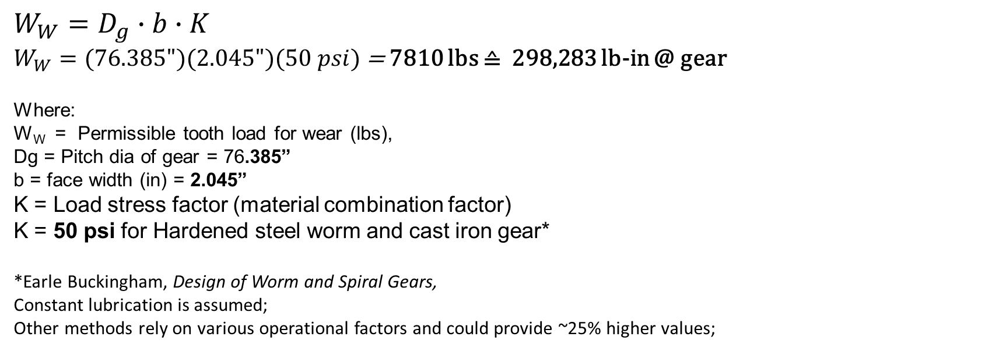
Gear load calculations
Allowable tooth load: Contact stress - Wear
Even though a gear tooth may not break due to bending stresses during its life, it could develop pits on the tooth face due to high contact stresses fatiguing the surface by compression.
Limiting load for wear is given by:
$$W_{W}=D_{g}∙b∙K$$
$W_{W}=(76.385")(2.045")(50 psi)$ = 7810 lbs ≙ 298,283 lb-in @ gear
Where:
W_{W} = Permissible tooth load for wear (lbs),
Dg = Pitch dia of gear = 76.385”
b = face width (in) = 2.045”
K = Load stress factor (material combination factor)
K = 50 psi for Hardened steel worm and cast iron gear*
*Earle Buckingham, Design of Worm and Spiral Gears,
Constant lubrication is assumed;
Other methods rely on various operational factors and could provide ~25% higher values;

Slide 26
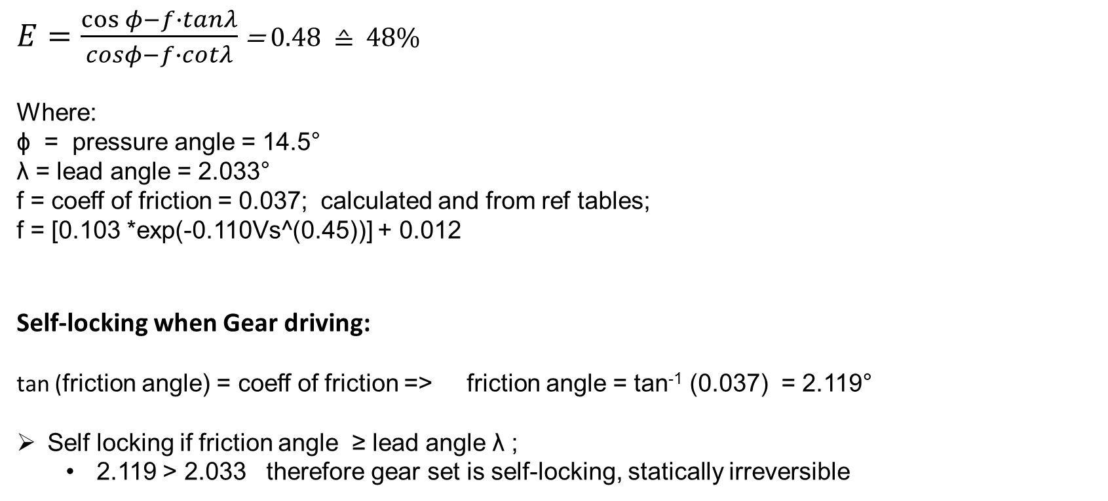
Gear load calculations
Efficiency and friction
Efficiency and friction of worm/gear with worm driving is given by:
$E=\frac{\cos{φ−f∙tanλ}}{cosφ−f∙cotλ}$ = 0.48 ≙ 48%
Where:
ϕ = pressure angle = 14.5°
λ = lead angle = 2.033°
f = coeff of friction = 0.037; calculated and from ref tables;
f = [0.103 *exp(-0.110Vs^(0.45))] + 0.012
Self-locking when Gear driving:
tan (friction angle) = coeff of friction => friction angle = tan⁻¹ (0.037) = 2.119°
Self locking if friction angle ≥ lead angle λ ;
  2.119 > 2.033 therefore gear set is self-locking, statically irreversible

Slide 27
Lubrication
With a worm drive system, sliding motion is the only transfer of power; High sliding friction
  As the worm slides across the tooth of the wheel, it slowly rubs off the lubricant film, until there is no lubricant film left, and as a result, the worm rubs at the metal of the wheel in a boundary lubrication regime.
  When the worm surface leaves the wheel surface, it picks up more lubricant, and starts the process over again on the next revolution.
  The only way to prevent the worm from touching the wheel is to have a film thickness large enough to not have the entire tooth surface lube wiped off before that part of the worm is out of the load zone.
Current Lube system: Jet spray lubrication system from spray bar on RA & Dec worm;
  RA: Oil flow is continuous when telescope powered on, and monitored for pressure;
  DEC: Oil flow only when Dec speed above threshold; No pressure monitoring;
Proposed improvement to lube system:
  Implement continuous flow with pressure monitoring on Dec, same as RA.
    Dec duty cycle under ZTF will be higher than RA

Slide 28
Safety features for abnormal situations
Telescope collides with object on floor
Axis stops -> worm gear stops -> torque build up through drive train
Motor torque can far exceed normal operational levels if not limited by amplifier
Torque multiplication through reducers could give 100,000’s lb-in torque at worm
Install mechanical torque limiters with trip level ≈ 2x-3x peak working torque between planetary reducer and downstream drive train
  original drives had slip clutches built into slew motor flywheels to limit torque
  HA: 90 lb-in (working torque is 1.49 lb-in (motor) * 25 (reducer) = 37 lb-in)
    HA worm/worm gear torque would be 23328 lb-in
  Dec: 22 lb-in (working torque is 1.65 lb-in (motor) * 4 (reducer) = 6.6 lb-in)
    Dec worm/worm gear torque would be 36495 lb-in
  protects both worm & worm gear, and planetary reducer at motor
  torque limiter should have electrical trip signal so amplifier can stop motor

Slide 29
Safety features for abnormal situations
Brake hold-off power is lost unexpectedly
Motors require brakes to hold telescope during power-down or fault
Brakes require power to be disengaged
Loss of 24V brake power supply is one possible failure scenario
Motor brake setting suddenly during slew could generate high stress in worm/worm gear from telescope kinetic energy
  mechanical torque limiter would release torque, but worm may not back-drive to send torque to the limiter

Slide 30
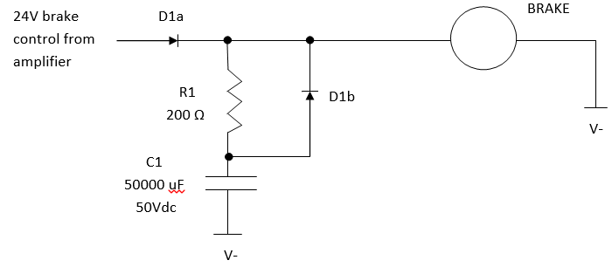
Safety features for abnormal situations
Brake hold-off power is lost unexpectedly
We propose a simple electrical circuit that would reliably keep brake powered for several seconds, long enough for axis to coast to a stop
  D1a prevents added circuitry from feeding back to servo amplifier brake output. R1 limits charging current (24V from amplifier has to drive brake and charge capacitor C1). D1b allows current from capacitor to flow to solenoid when 24V control voltage is removed.

Slide 31
Safety features for abnormal situations
Telescope goes beyond normal limits (including tracking into west limit)
1st defense: software limits for HA and Dec axis travel, plus soft horizon limit
2nd defense: electrical switch limits on HA and Dec axes set directional travel limits at servo amplifiers; 4° and 0.5° ball horizon limits generate disable signals
3rd defense: HA axis has spring-loaded mechanical stops for snubbing (we have not yet found comparable mechanical limits on Dec)
Motor goes berserk
If motor is moving at a rate TCS does not expect, software can set a signal to disable the amplifiers (which have Safe Torque Off or STO inputs)
Electrical and mechanical limits (including torque limiters) described above also apply here

Slide 32
Risk management
Numbers used in calculations require corroboration to provide confidence.
Testing & analysis
Axis frictional torque: we applied gear motor with spring scale on lever arm to measure torque at worm input shaft. HA: 1 lb @ 6” -> 6 lb-in -> 6 lb-in * 540 * 0.48 = 1555 lb-in, round to 2000 lb-in
  effort to rock HA through lash when balancing supports this measurement
  test point on HA & Dec servo amplifiers (V ∝ Imotor, torque by proxy) reads very low during slew
  calculation using bearing loads and standard coefficients of friction gives similar results
  Dec has not been measured; assumed similar to HA
Torque to overcome preload: we set HA max acceleration in TCS to 0.5°/sec². Clunk (suspected to be tooth re-engagement) heard only during east acceleration recovery from west slew overshoot.
  indirect, but supports calculated sum of preload, friction, and acceleration torques
  clunk was not heard during east acceleration from stop, but soft acceleration profile could have masked travel through gear lash
  Dec: no clunk heard with acceleration set at 0.5°/sec²

Slide 33
Risk management
Testing & analysis (continued)
Torque limiter settings: limiters did not trip during tests with accelerations set to 0.5°/sec². We planned to measure limiter settings directly, but this was deferred when failure of Dec lubrication pump was discovered.
Motor torque required to drive axes: existing Kollmorgen motors showed no signs of strain when accelerating HA and Dec axes at 0.5°/sec². New motors have marginally higher torque, though lower reducer ratios will increase motor loads.

Slide 34
Cost & Schedule
Cost
Schedule
P48 DRIVE UPGRADE MAT’L COSTS | UNIT COST | QUANTITY | EXTENDED COST
HA AXIS
Kollmorgen AKM31E-GNC2AA00 motor | $1,234.69 | 1 | $1,234.69
Kollmorgen AKD-P00606-NBEC-0000 drive | $1,104.85 | 1 | $1,104.85
Kollmorgen VP-508CFAN-12-0 power cable | $285.00 | 1 | $285.00
Kollmorgen VF-SB4474N-10-0 feedback cable | $170.05 | 1 | $170.05
Apex Dynamics AB060A-025-S2-P1 reducer | $2,000.00 | 1 | $2,000.00
Misc electrical parts | $1,000.00 | 1 | $1,000.00
Torque limiter | ? | 1 | ?
DEC AXIS
Kollmorgen AKM31E-GNC2AA00 motor | $1,234.69 | 1 | $1,234.69
Kollmorgen AKD-P00606-NBEC-0000 drive | $1,104.85 | 1 | $1,104.85
Kollmorgen CP-507CDAN-20-0 power cable | $886.88 | 1 | $886.88
Kollmorgen CF-SB7374N-20-0 feedback cable | $959.06 | 1 | $959.06
Apex Dynamics AB060-004-S2-P1 reducer | $2,000.00 | 1 | $2,000.00
Misc electrical parts | $1,000.00 | 1 | $1,000.00
Torque limiter | ? | 1 | ?
TOTAL |  |  | $12,980.07
Procurement of components to begin with successful completion of design review.
Longest lead delivery < 4 weeks
Implementation of drive upgrade to occur in coordination with scheduled for PTF camera repair:
Feb 15 - 26, 2016

