Slide 1
ZTF update
Roger Smith
2016-01-05

Slide 2
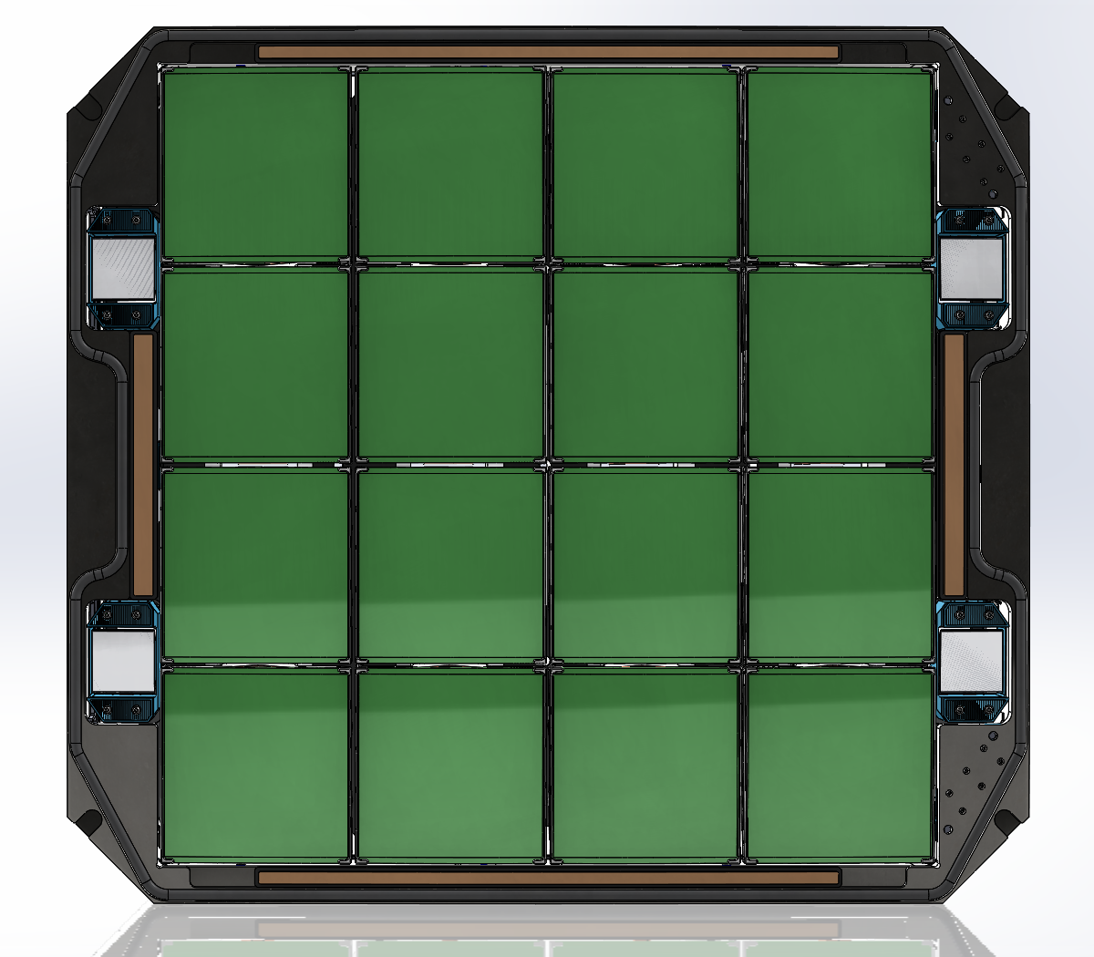
48,000 deg²/night to spectroscopic depth
FoV = 46.7 deg² @1arcsec/pixel
  4x4 mosaic of 6Kx6K CCDs,
Expose 25 sec, repoint in 10 s.
  → faster telescope and dome drives
  → new telescope control system.
Readout during re-pointing
    4 ch/CCD at 1 Mpix/sec/ch
    Preamps in dewar; fully differential signal path; digital CDS.
Downlink during next exposure.

Slide 3
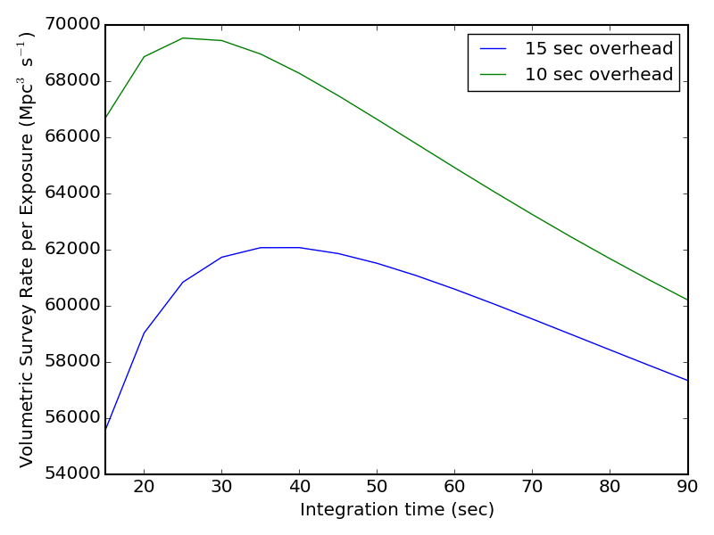
Survey volume vs. exposure time
Goal
Requirement

Slide 4
Optical design
Optical layout
Classic Schmidt design assumes curved photographic plates and no window.
Plano convex field flattener used for smaller focal planes gets too thick for good broadband image quality.
31 mm window with slight concavity on interior reduces curvature of focal plane to ~ 7m.
CCDs are placed on chords with thin plano convex field flatteners on each CCD.
A 3rd element is added to the corrector to only slightly increase its power.

Slide 5
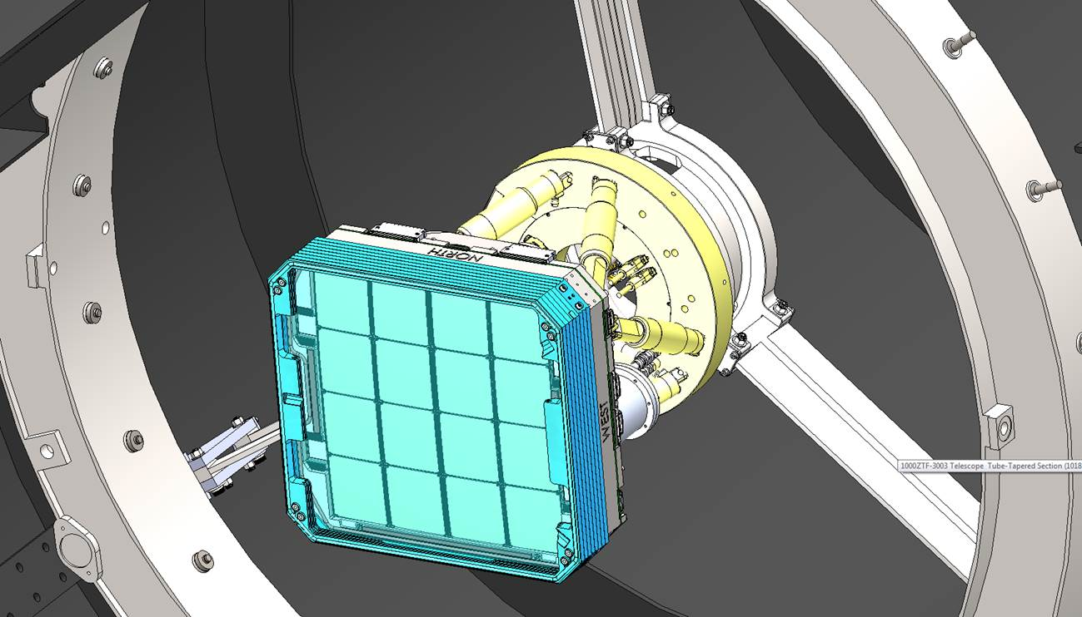
Very compact camera
Sensor area (mm²) is 1.09 times DES and 44% of LSST.
Camera area is 8.2 times smaller than LSST camera…
Total obstruction, including spiders, is only 23% of 1.2m beam.

Slide 6
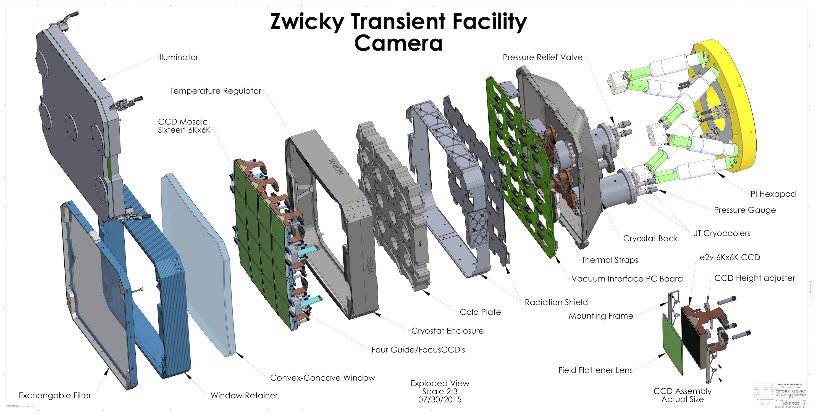
Exploded view of camera

Slide 7
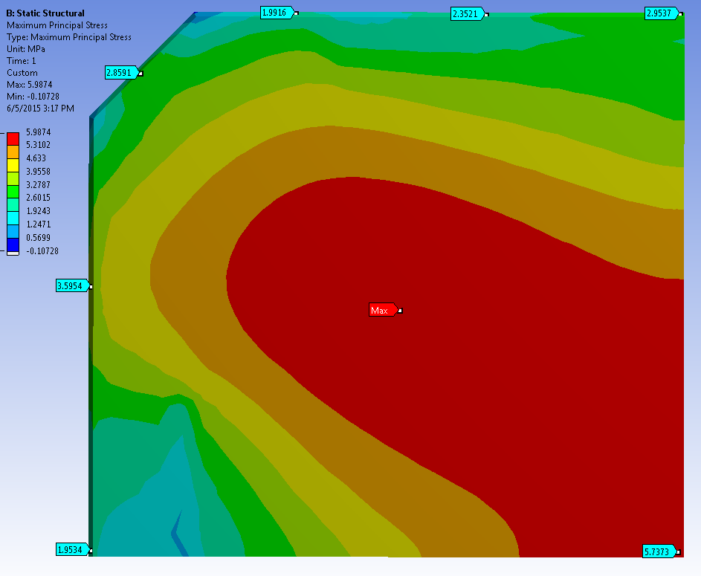
Window (32 mm center thickness)
Optics don’t like thick window.
Convex interior surface rests on compliant gaskets with width and compliance tuned for optimal stress distribution and maximum factor of safety.
Edges beveled and polished as precaution.
First window (28mm) rejected due to defect; 2nd window made thicker for greater FoS as shown.
Stress on inner surface (MPa)
Quarter of window
Factor of safety = 6 relative to 36 MPa which would give 1% probability of failure after 20 years, assuming 75 µm initial crack size (conservative).

Slide 8
Indium Tin Oxide window heater
Conductive gaskets at top and bottom
Make contact with ITO layer in AR coating stack to allow window heating.
Otherwise temperature at center radiatively cooled ~30C below ambient.
Very thin ITO layer keeps transmission loss low (~1%) but requires 160 V drive.
Like Low-E architectural glass but thinner for much lower transmission loss → high resistivity -> higher drive voltage
Same material is used as window demister in luxury cars, and as backside contact for LBNL fully depleted CCDs.

Slide 9
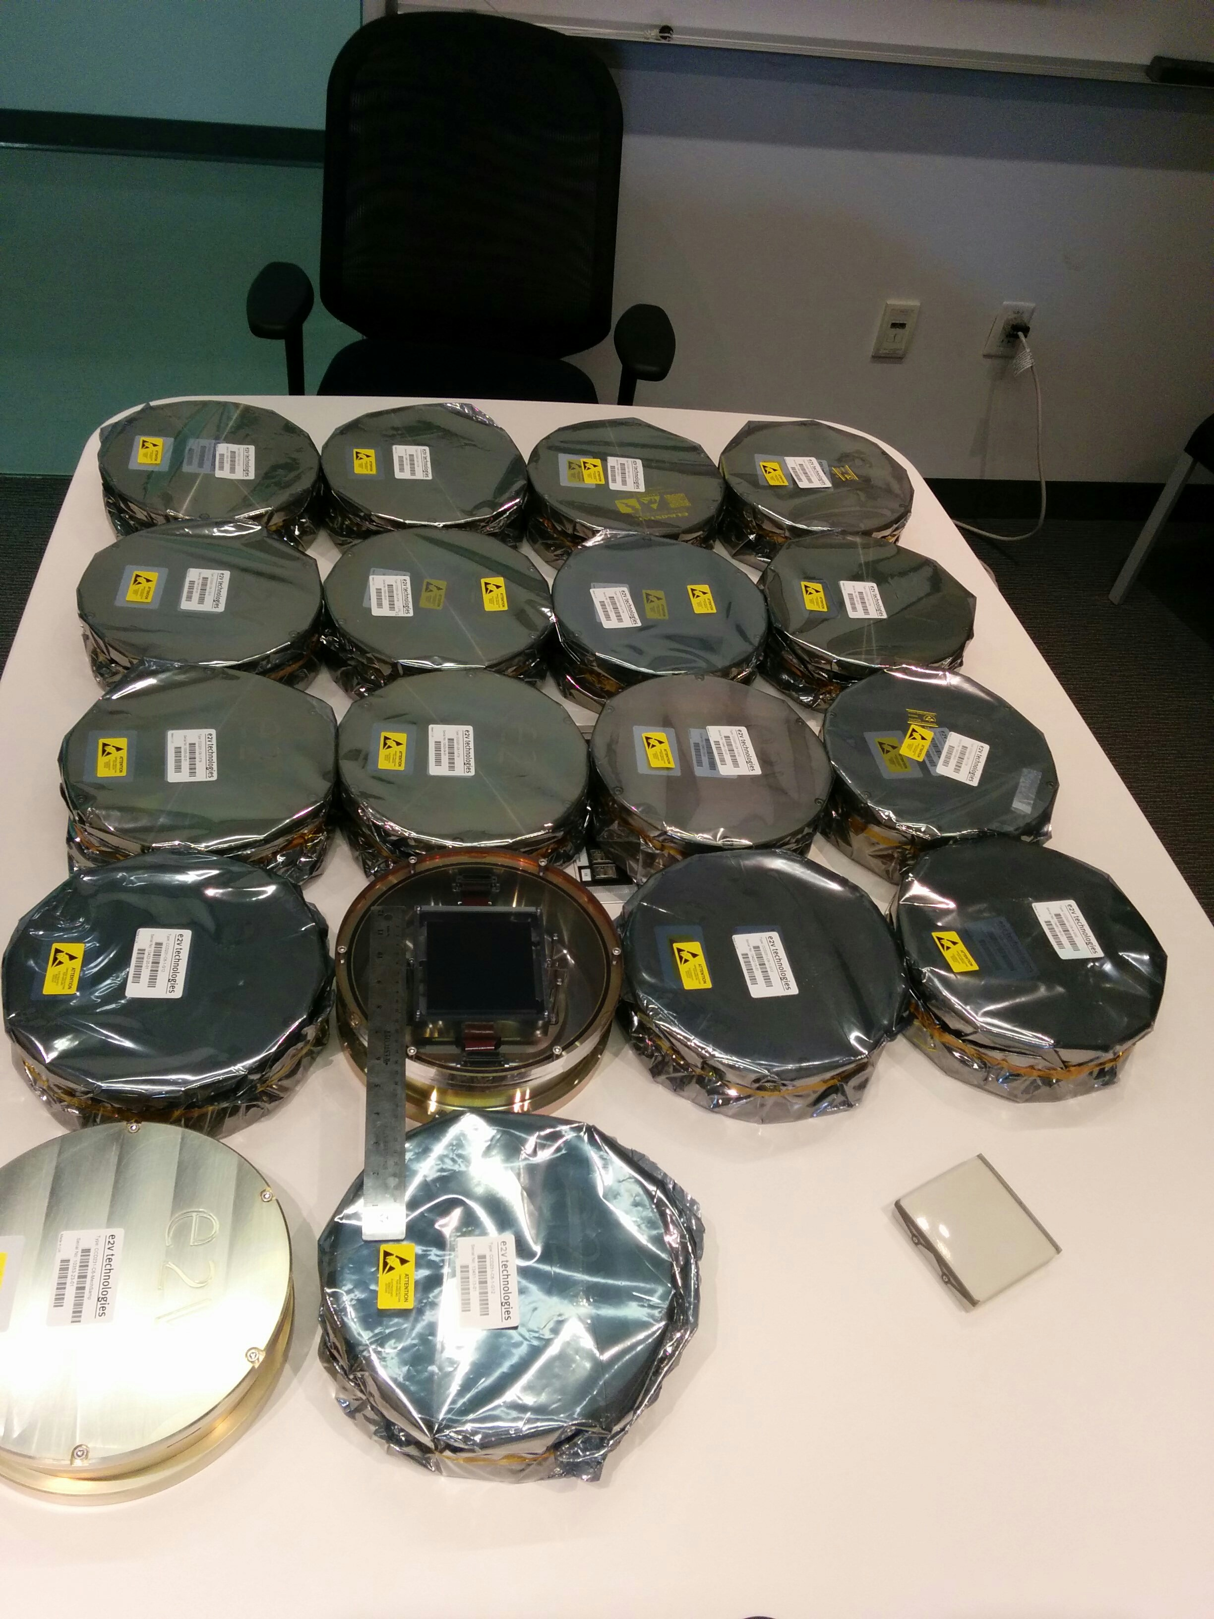
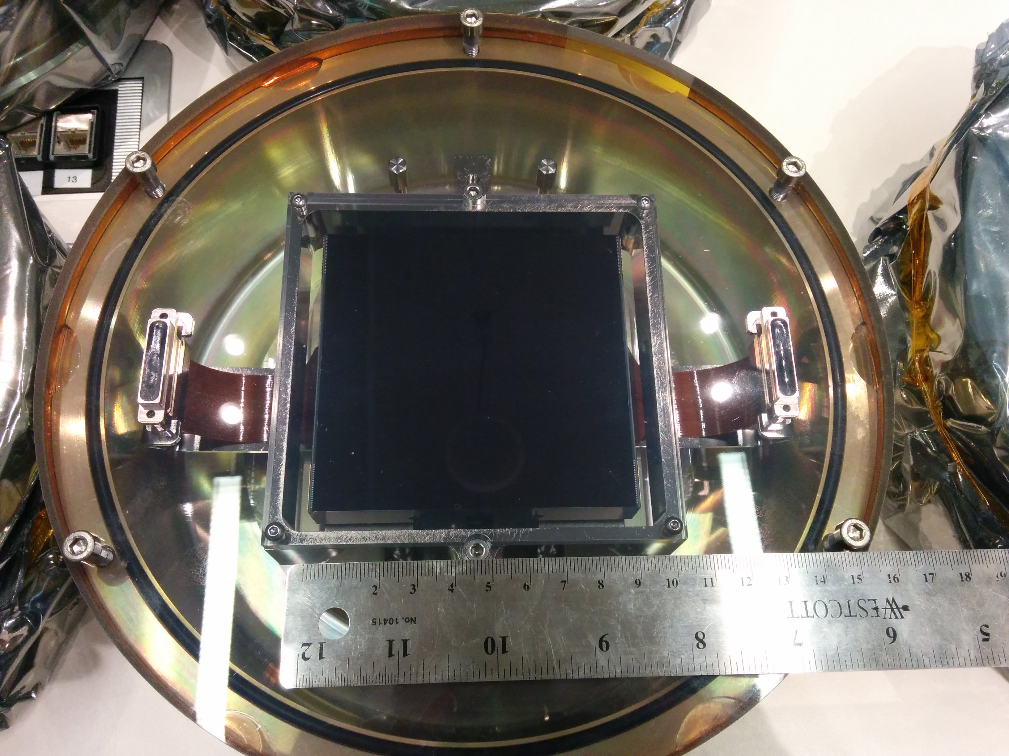
CCDs delivered ahead of schedule
One for P200 prime
Mechanical sample

Slide 10
CCD height control
CCDs must be located to 10 µm rms on facets of ~ 7m radius sphere.
To simplify, original design with wire EDM flexures was replaced by tight-hole-and-slot with controlled preload to allow slippage under thermal contraction.
Thick precision ground shims customized to each CCD to control height.
Initial dead reckoning is based on profilometry.
Final adjustment based on through focus scans on telescope.
Special attention to safe and easy installation.

Slide 11
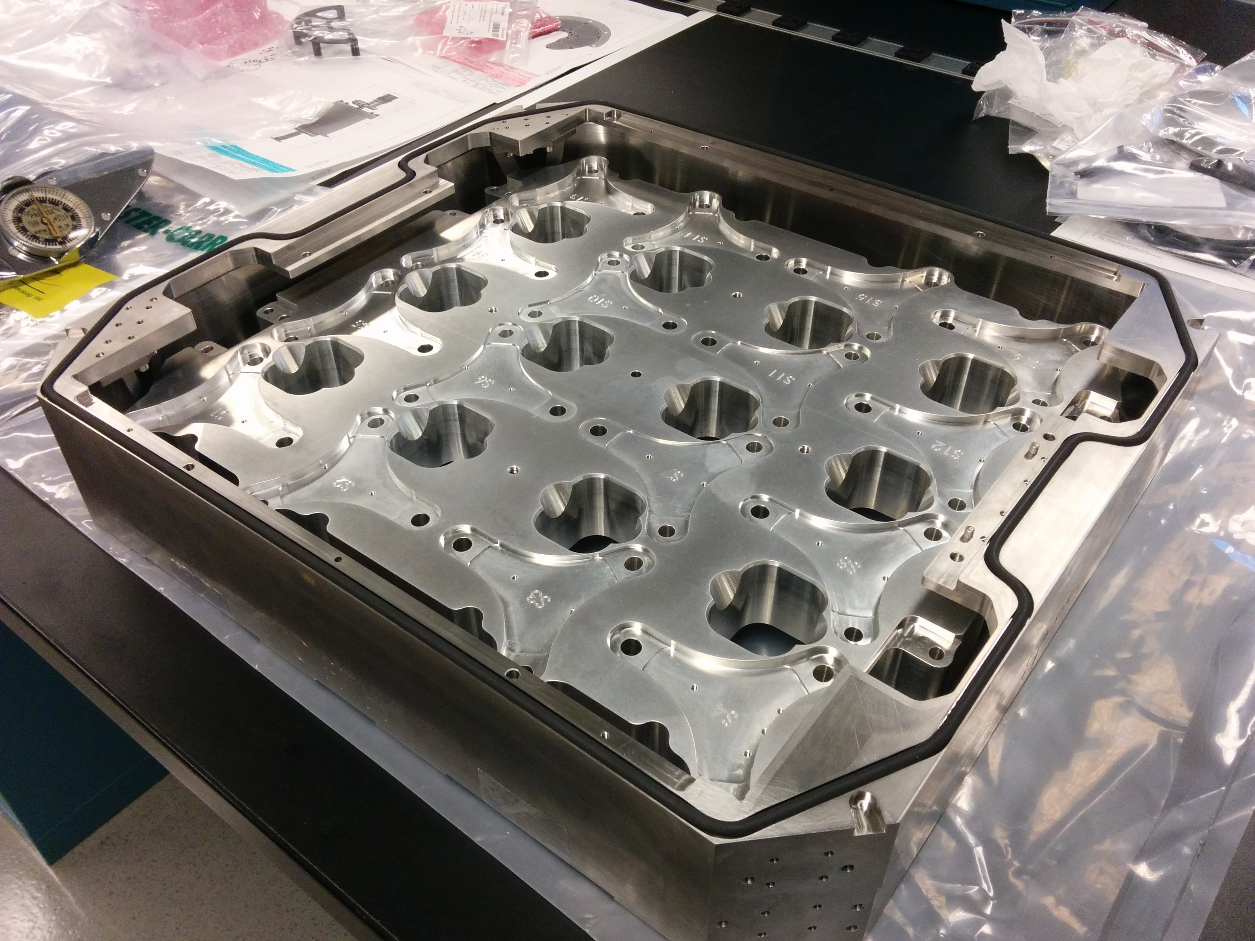
Cold plate in dewar walls (front)
On optical profilometer, with ceramic tooling balls to allow location of hole centers.
Note CCD landings are on chords of spherical surface.

Slide 12
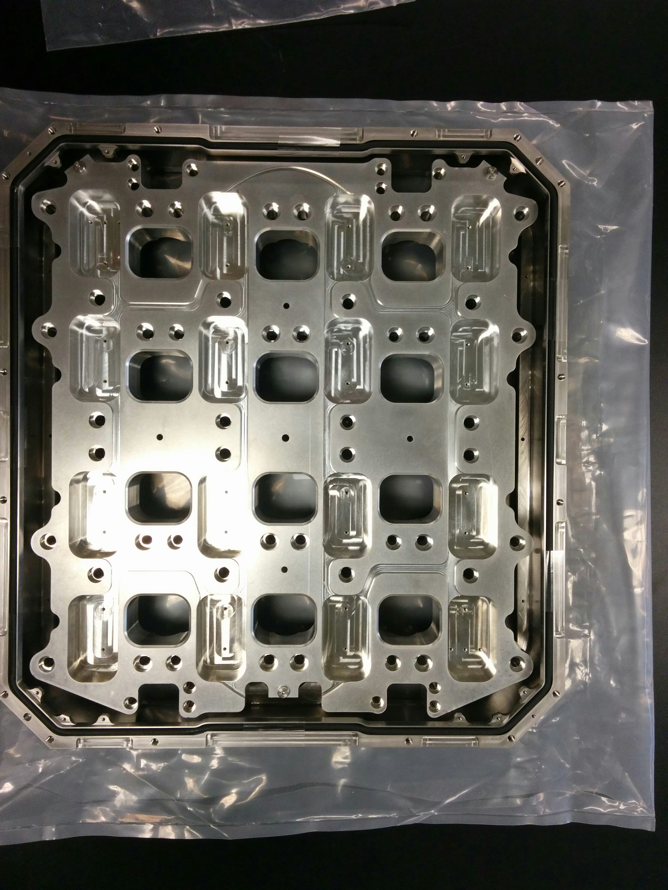
Cold plate in dewar walls (rear)

Slide 13
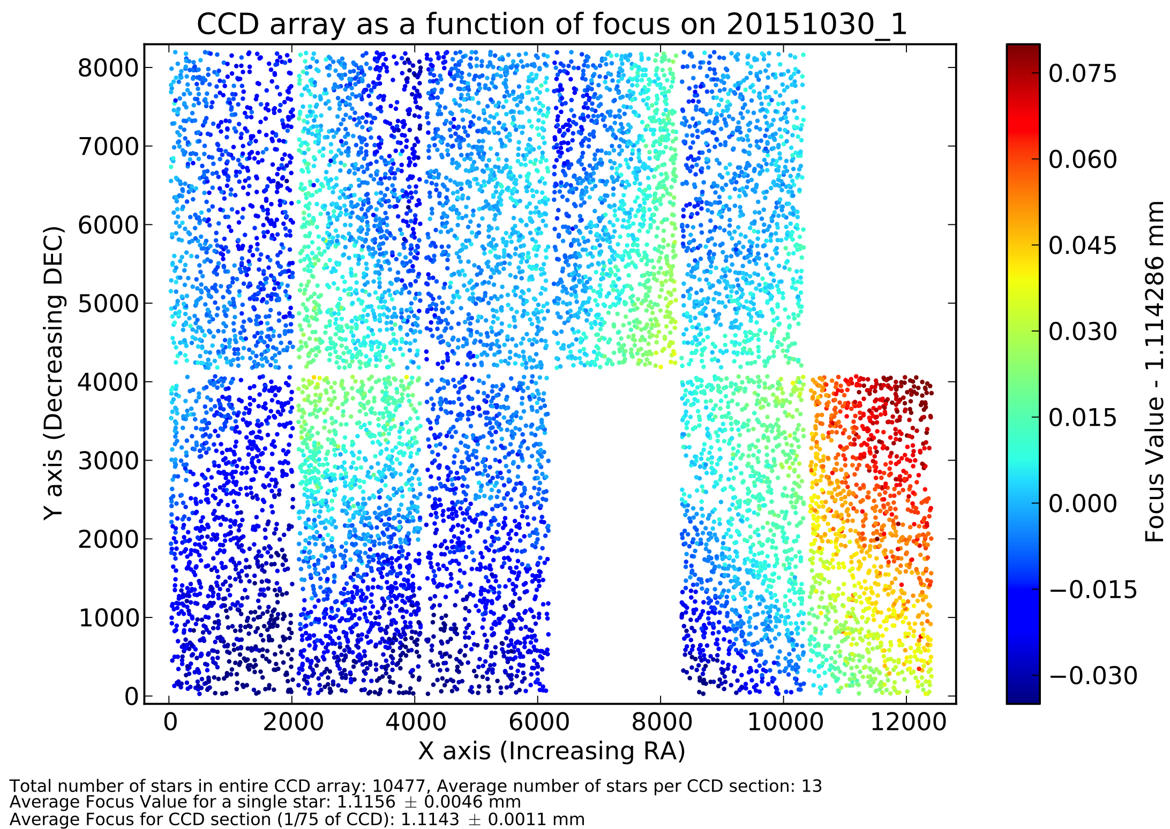
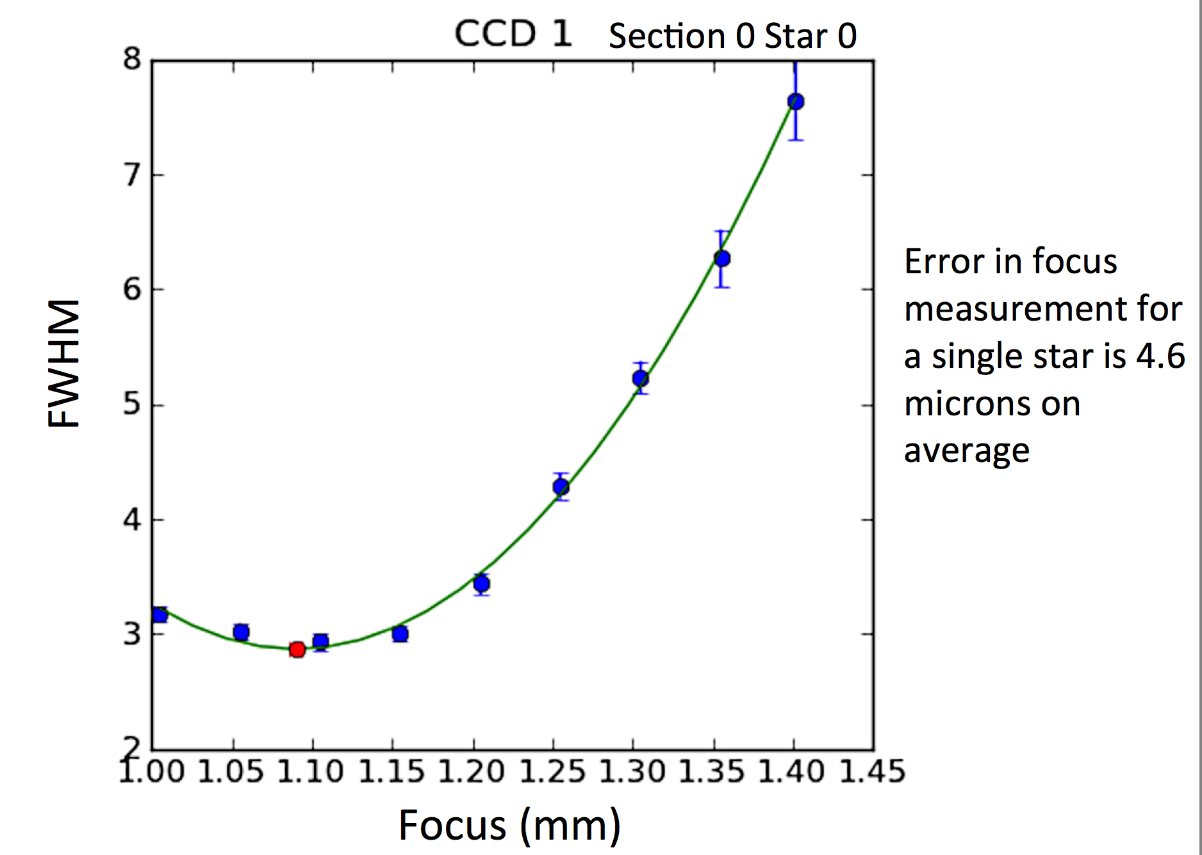
Final height adjustment to be based on through focus scans
Height measurement accuracy demonstrated on PTF by Gina Duggan:
For single star, focus error ~4.6µm
With averaging,
local height error < 1µm

Slide 14
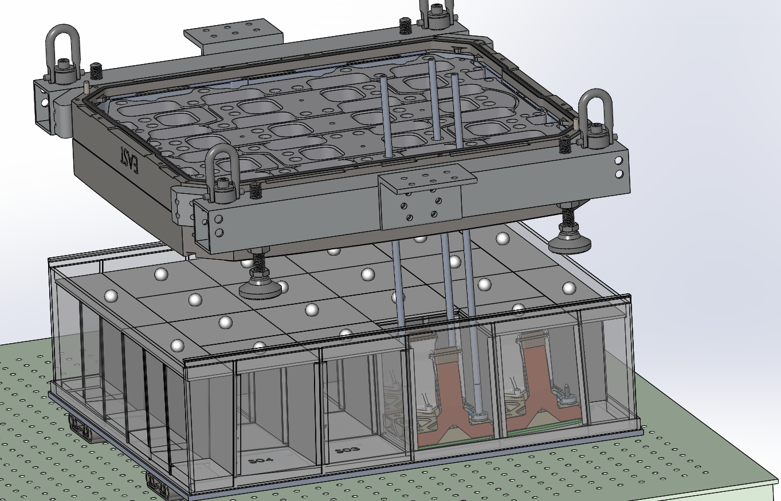
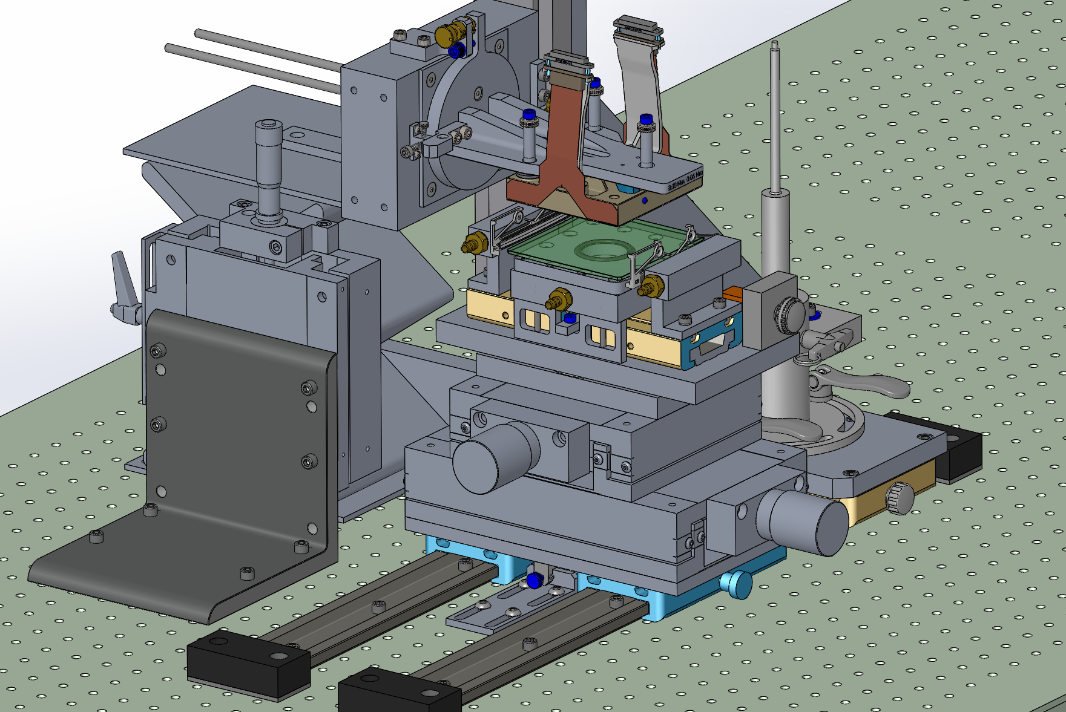
CCD handling fixtures
ZTF CCDs be removed and reinstalled to change shims, after through focus imaging on telescope, so great care has been taken to make process easy and safe.
Story board developed; parts design and procured.
Assembly and testing in progress.

Slide 15
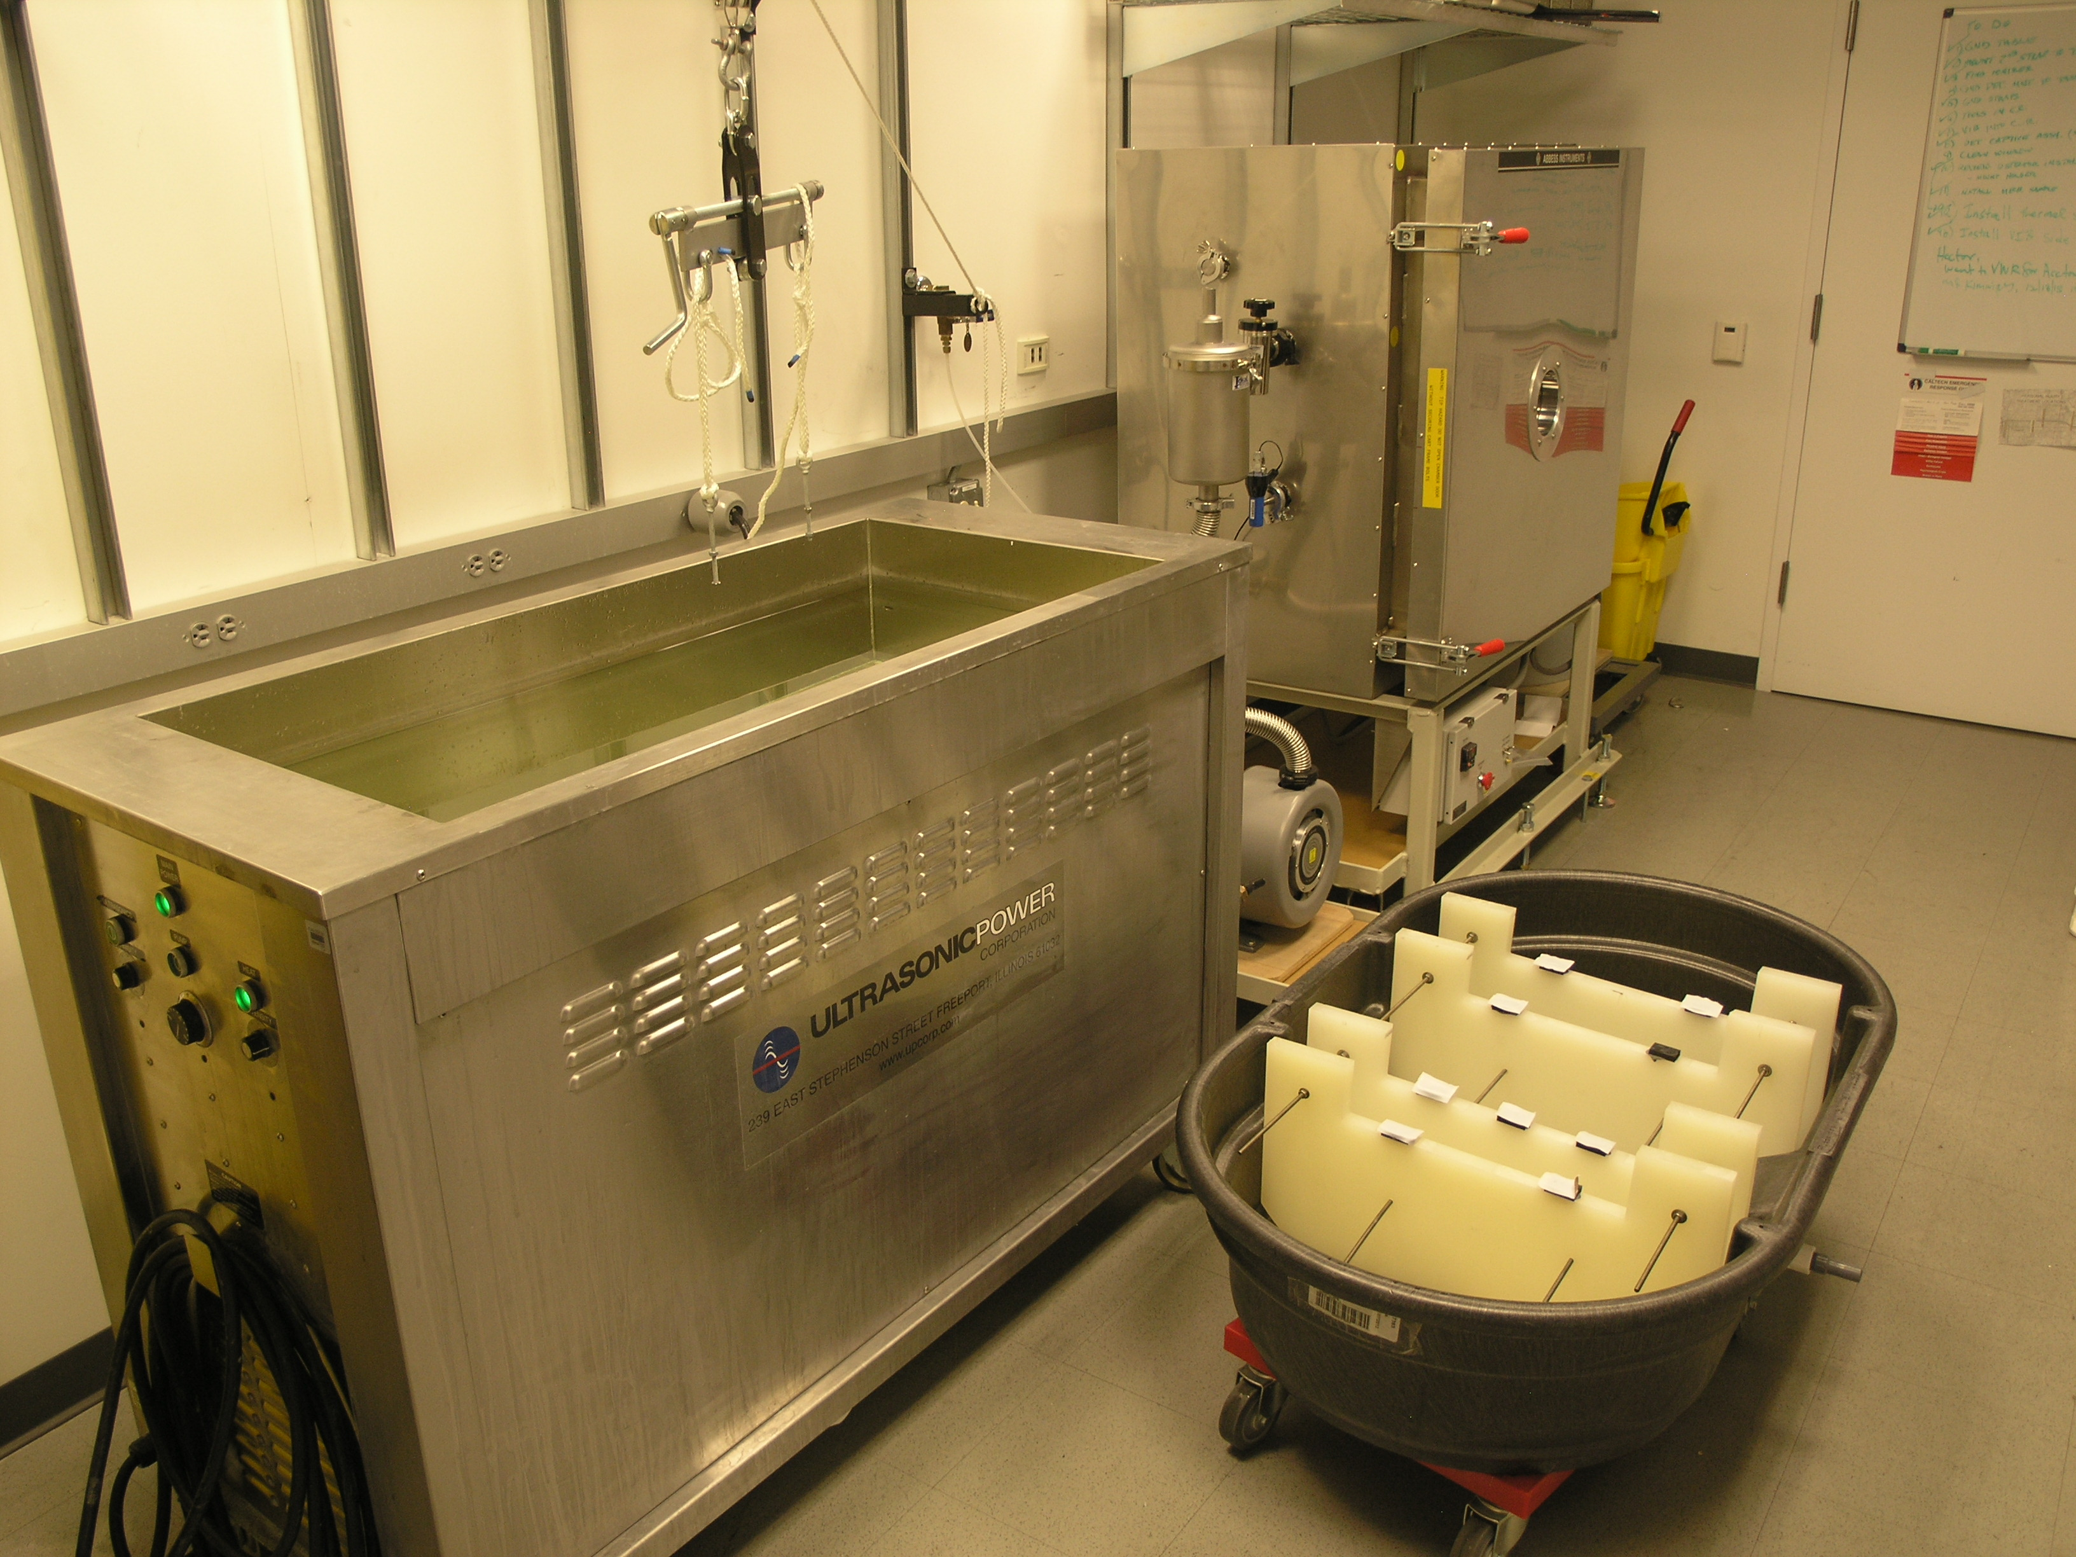
Enlarged vacuum prep facilities
Large vacuum oven
Commensurate lifting equipment
Cold trap
Large oil free vacuum pump
Large ultrasonic cleaner
Rinse tub

Slide 16
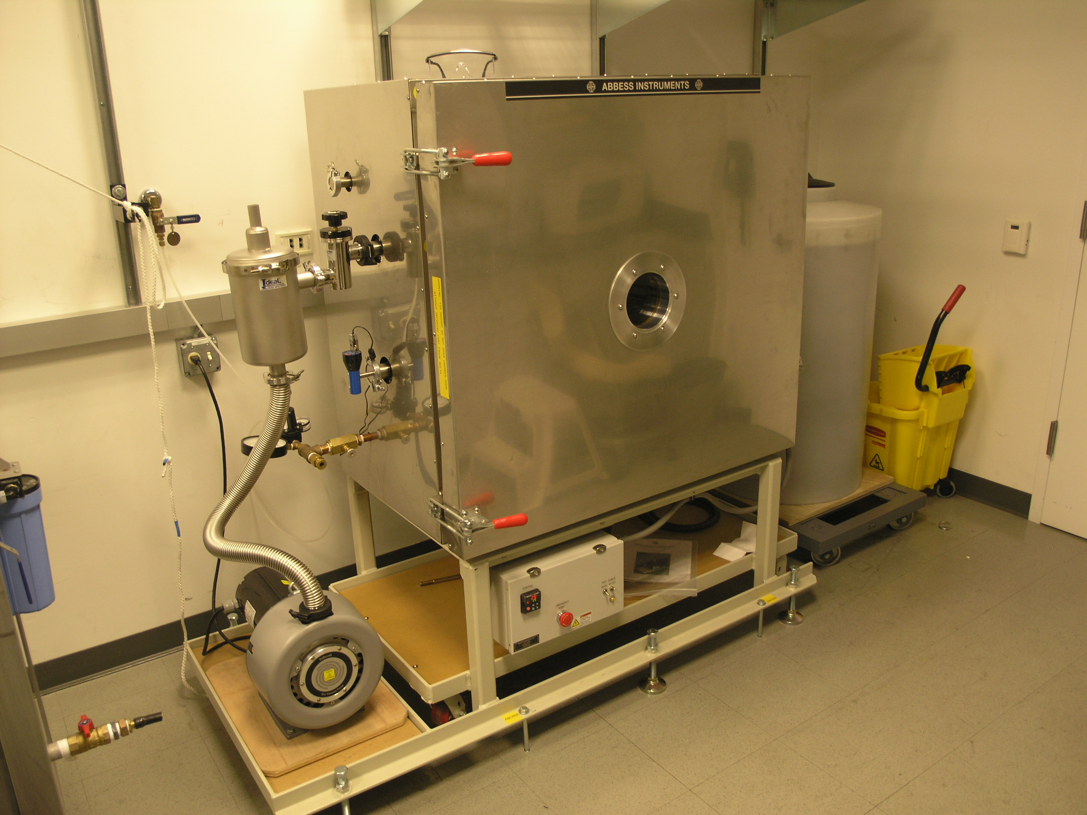
Large vacuum oven
Multiple storage tanks support exchange of water with detergents for ultrasonic-cleaning either metals, optics or large printed circuits

Slide 17
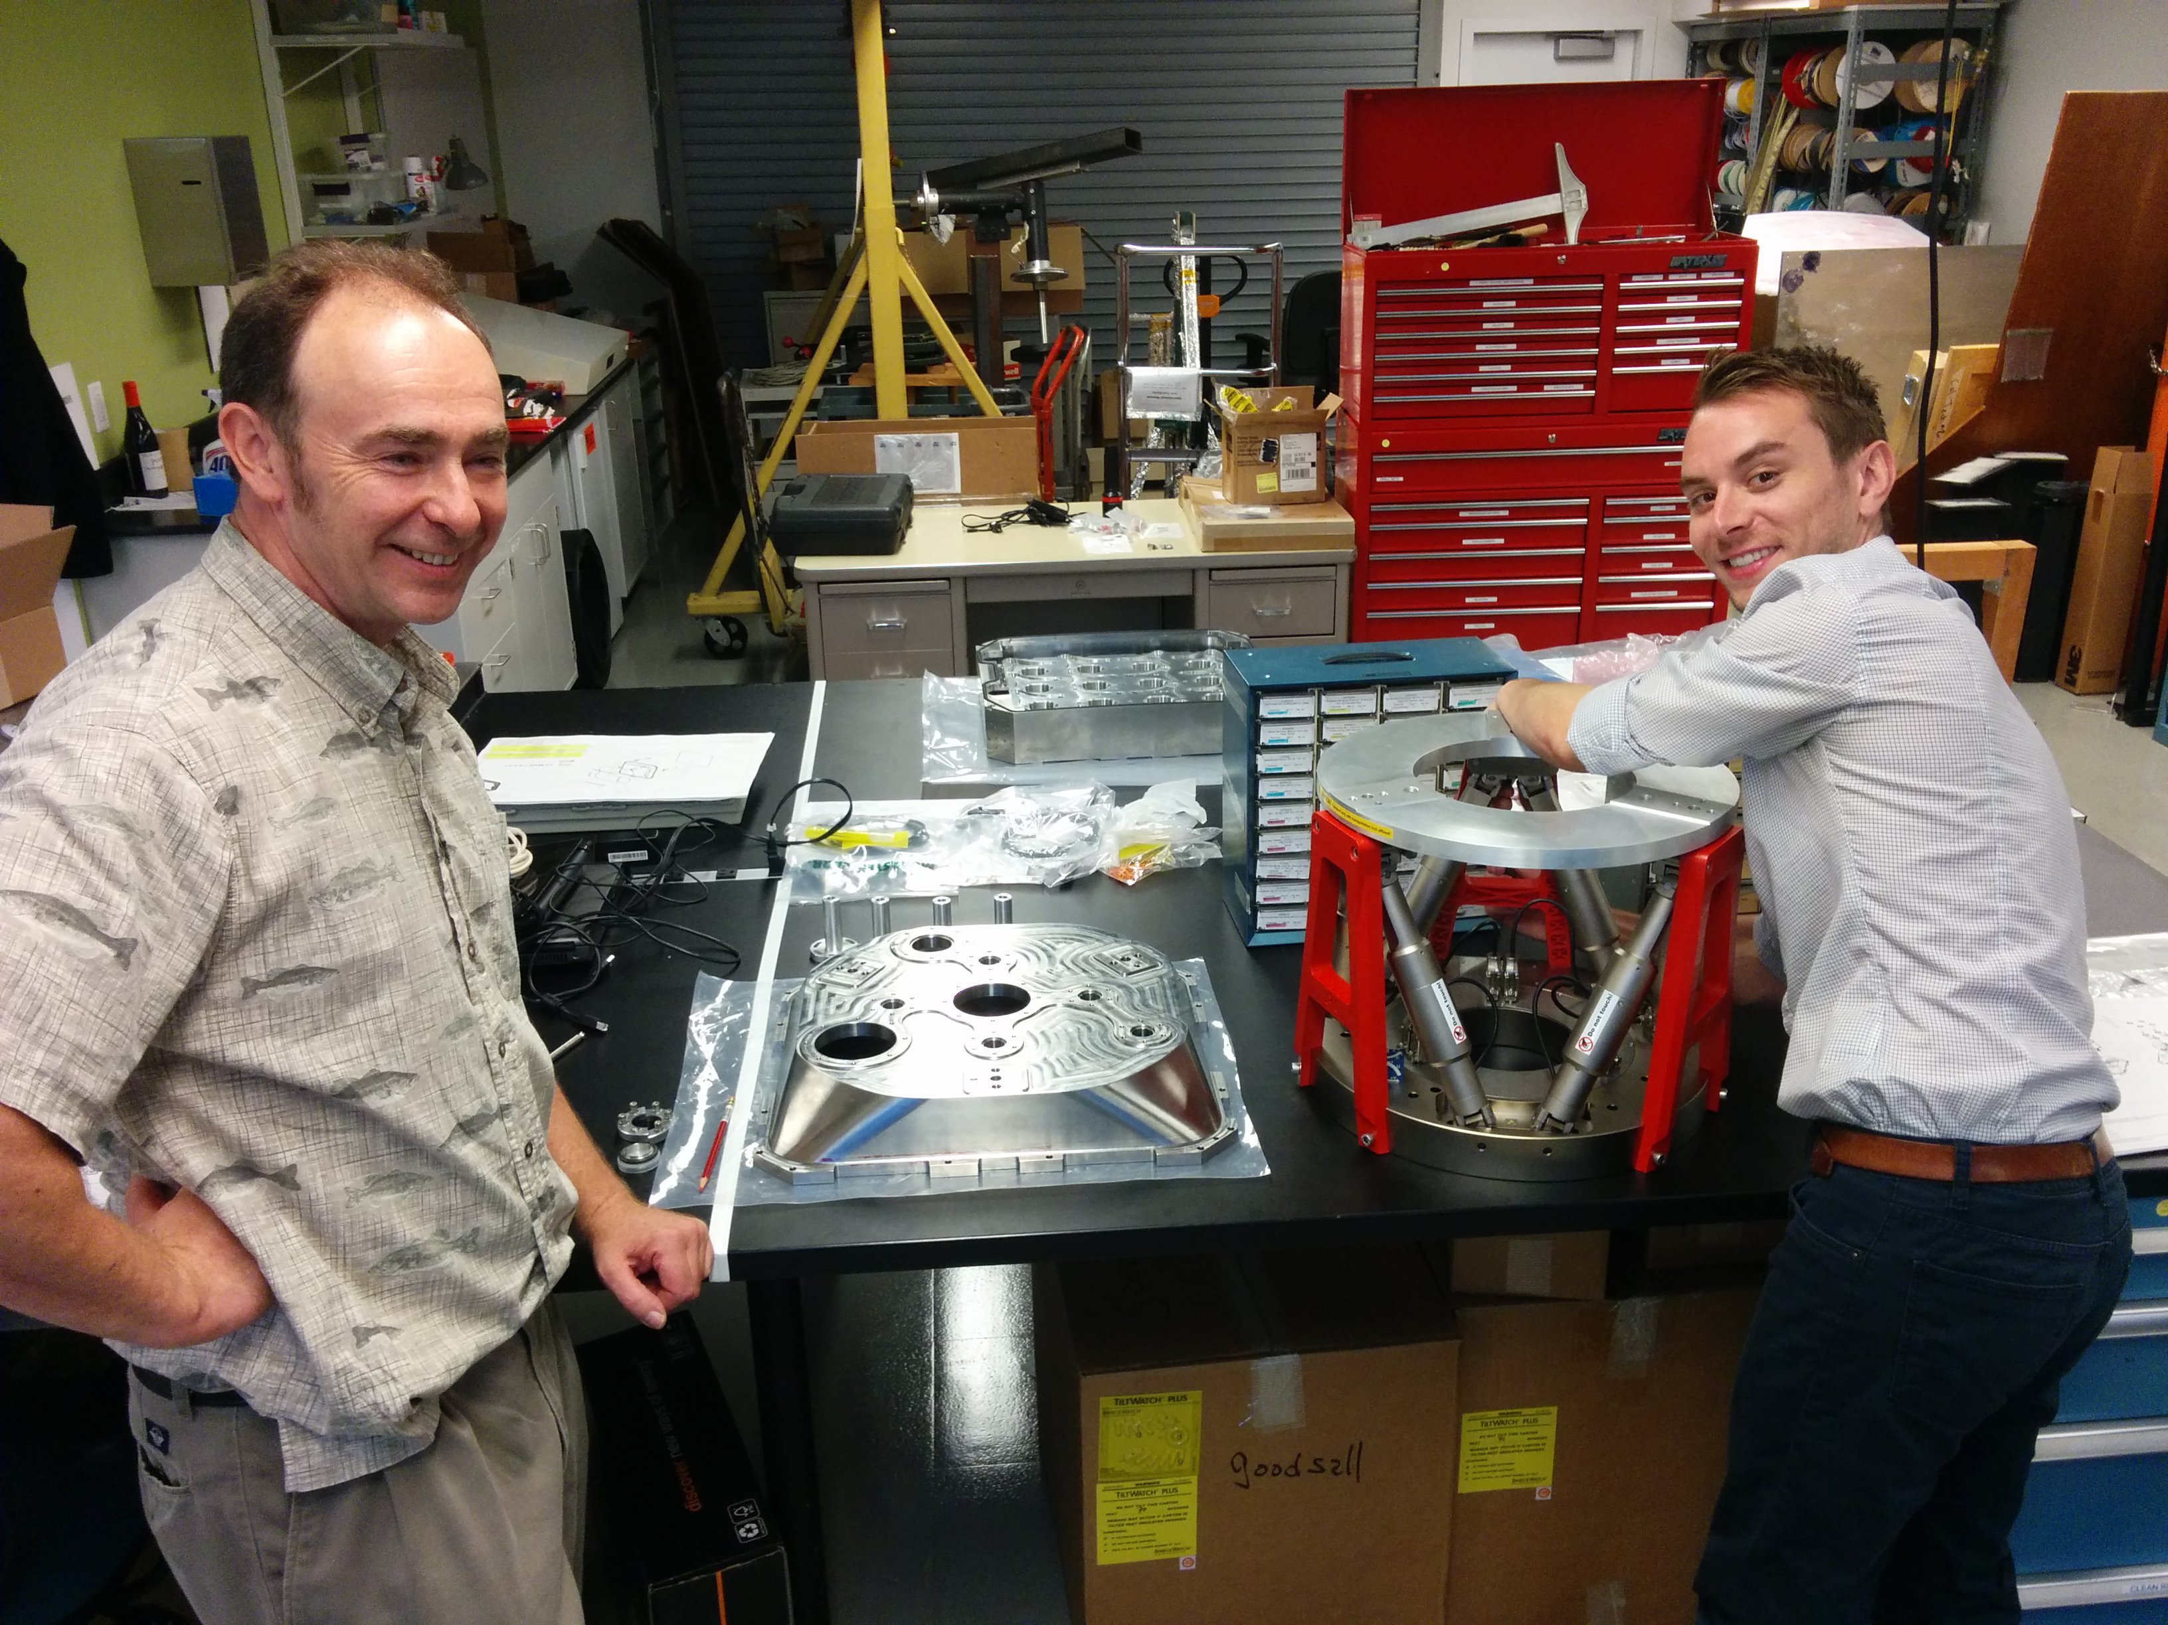
Rear cover

Slide 18
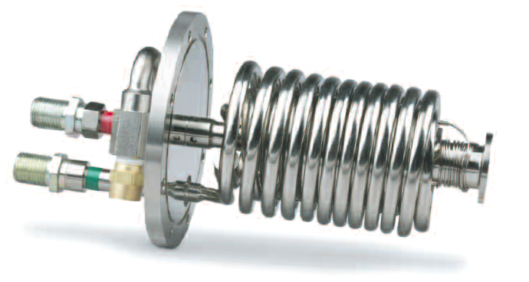
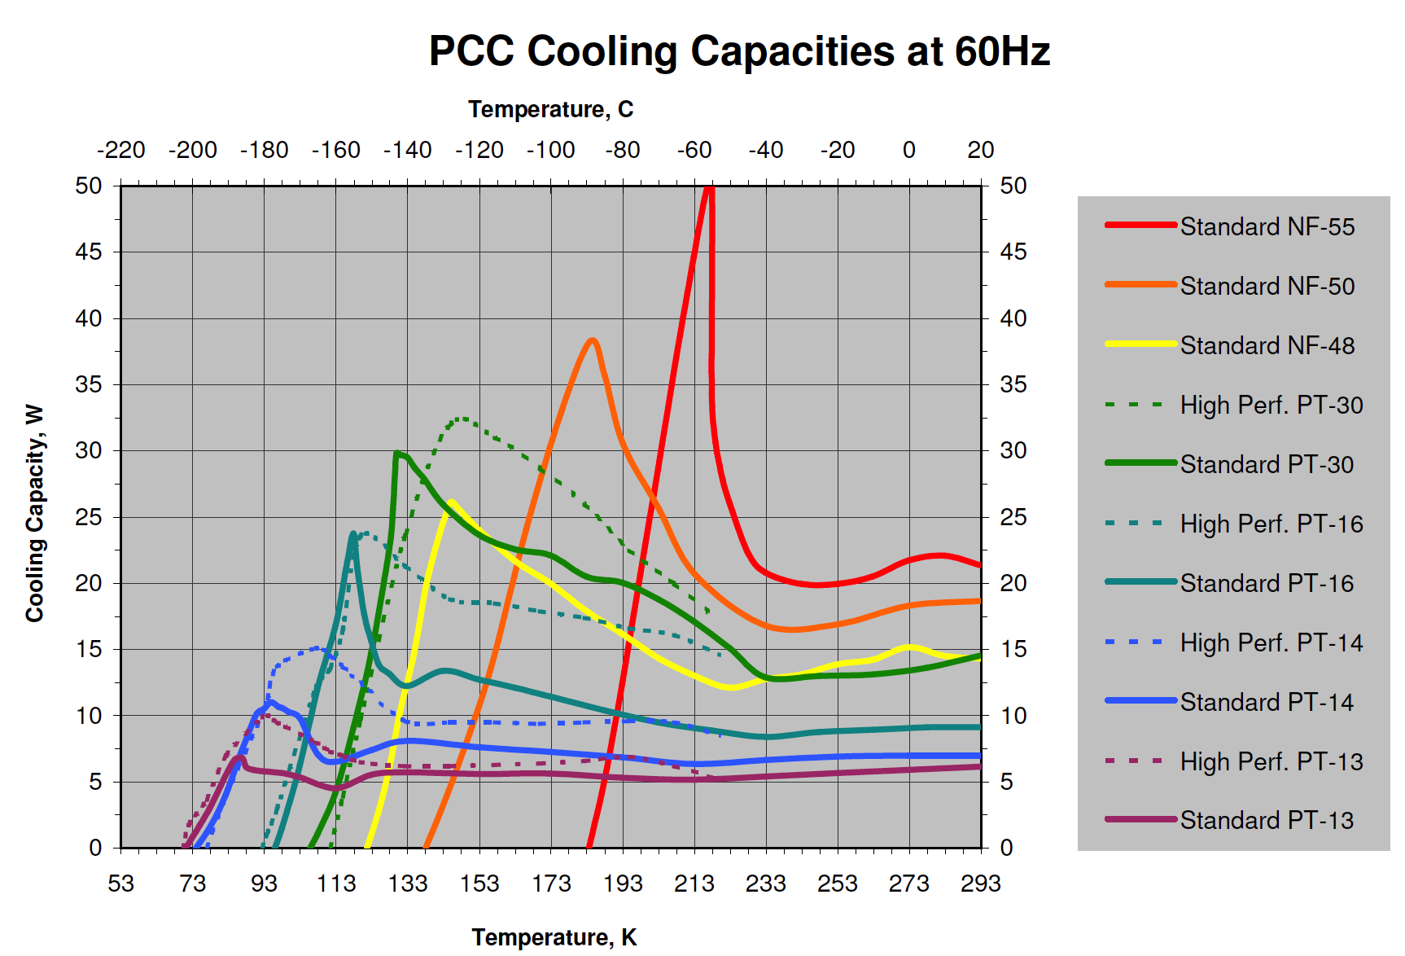
Inexpensive Cooling system
Field flattener lenses work like floating radiation shield to halve radiation from window.
Cold heads fully hidden between hexapod legs.
PT16 refrigerant gets charcoal getters cold enough to sustain vacuum for years.
48W available from two high performance heads with PT16 refrigerant

Slide 19
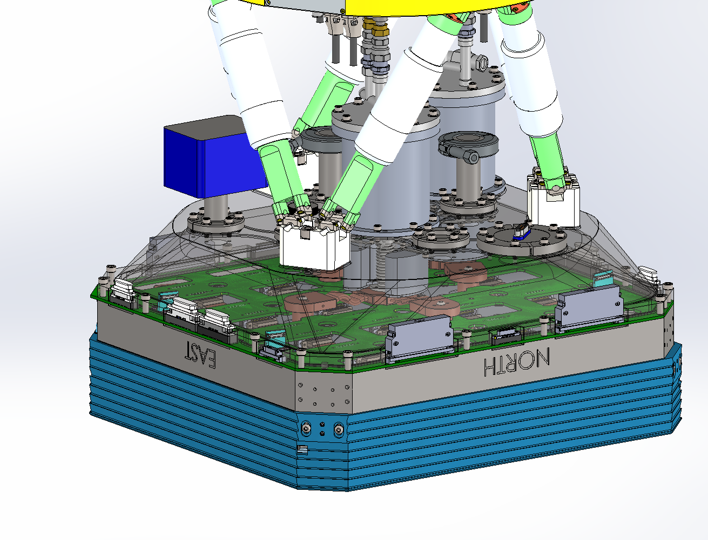
Rear view of assembly
Joule Thompson Coolers nested within hexapod
Connectors and cables at periphery are hidden behind instrument

Slide 20
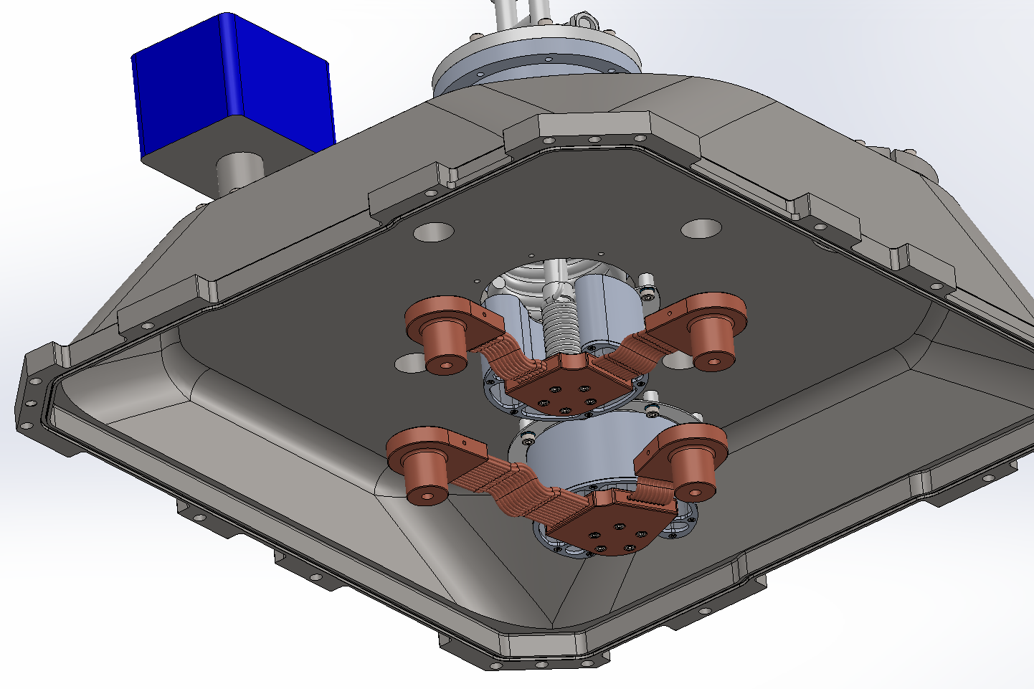
Thermal path
Charcoal getter containers
mounted behind cold head
Flexible thermal links
(behind Vacuum Interface Board)

Slide 21
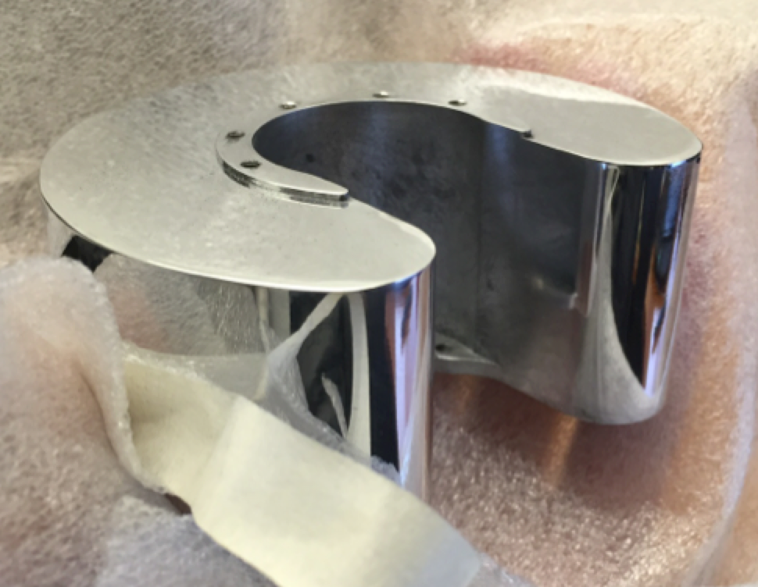
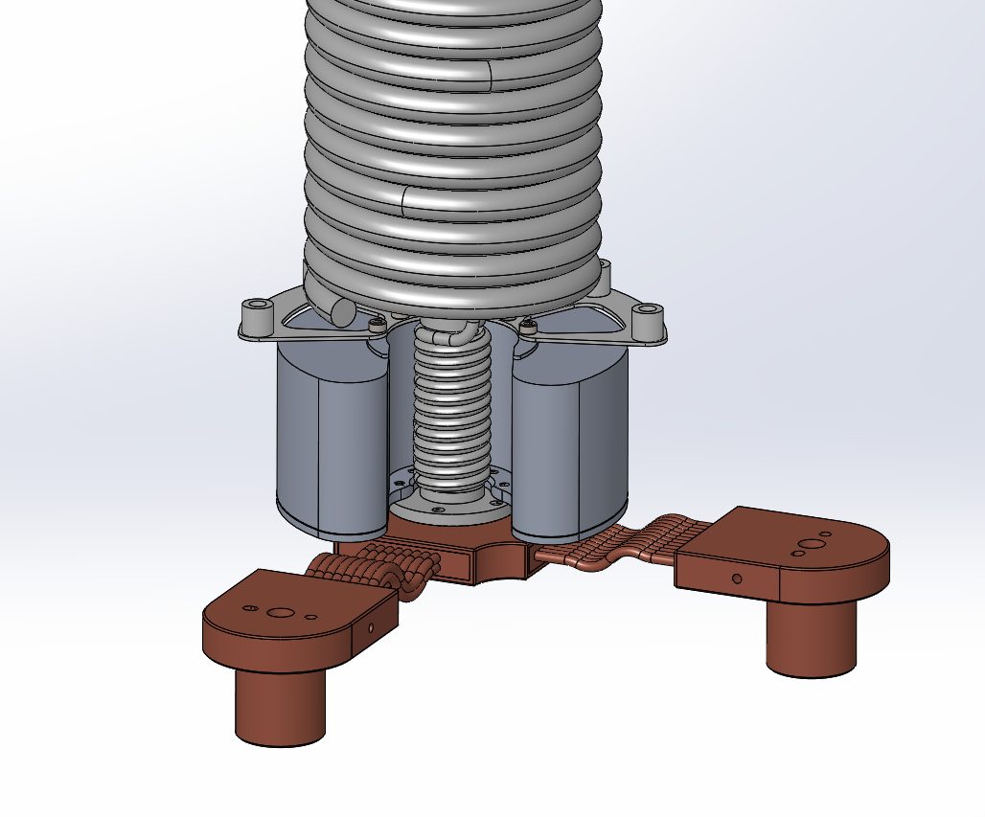
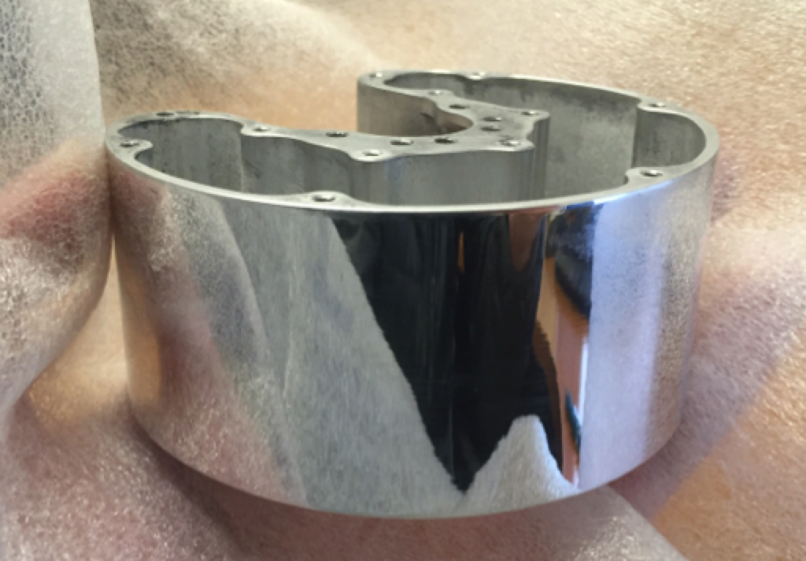
Joule Thompson cooler
Counterflow heat exchanger (polycold Compact Cooler)
expansion capillary
Lateral brace, insulating
Charcoal getter on back of cold head
Cold head
Copper thermal straps on front of cold head
Termination penetrating VIB to connect to CCD cold plate in 4 places.

Slide 22
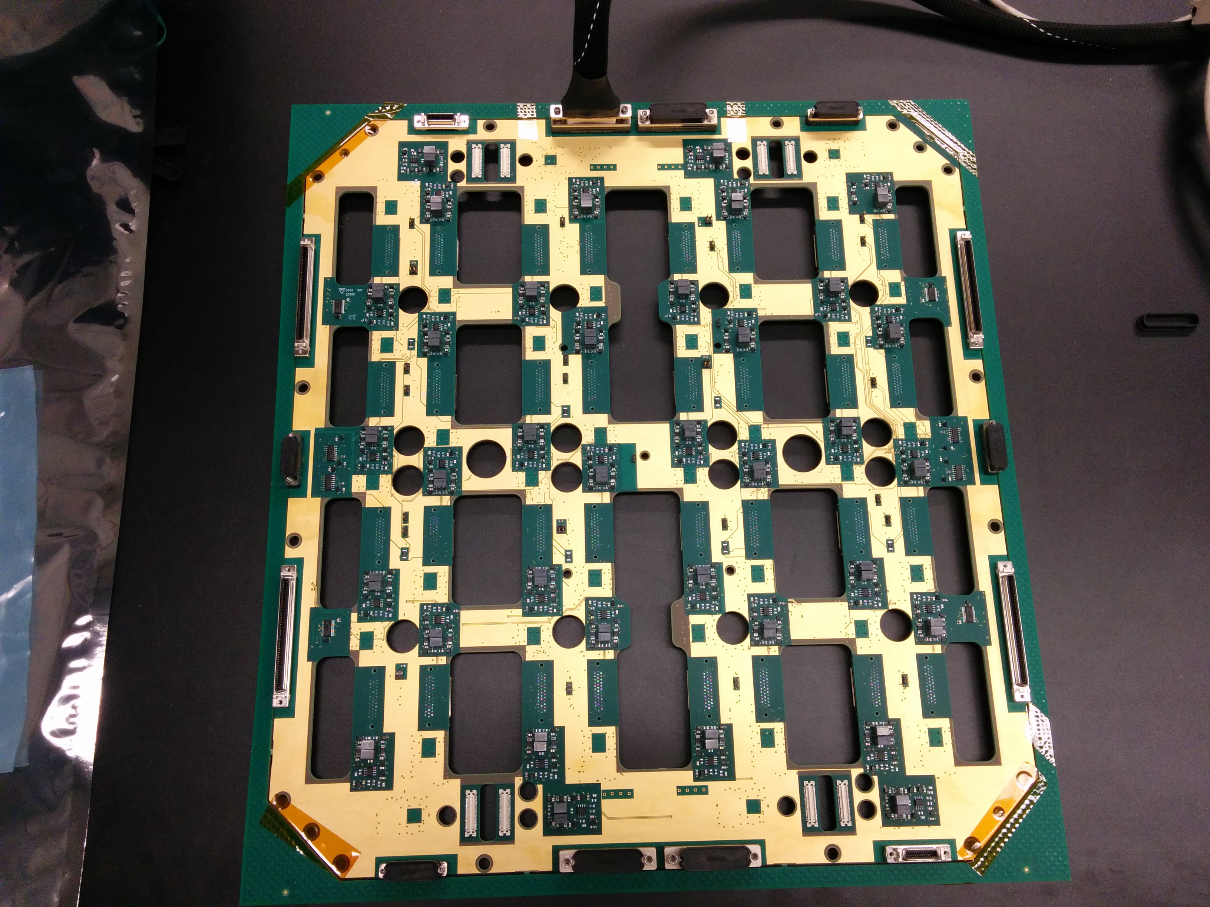
Vacuum Interface Board
This very large PCB is key to ZTF compactness.
Allows any CCD to be removed/installed independently
Pre-amplifiers transmit differentially for low crosstalk at high speed.
Carries all signals through vacuum seals to COTS cables … no hand wiring.

Slide 23
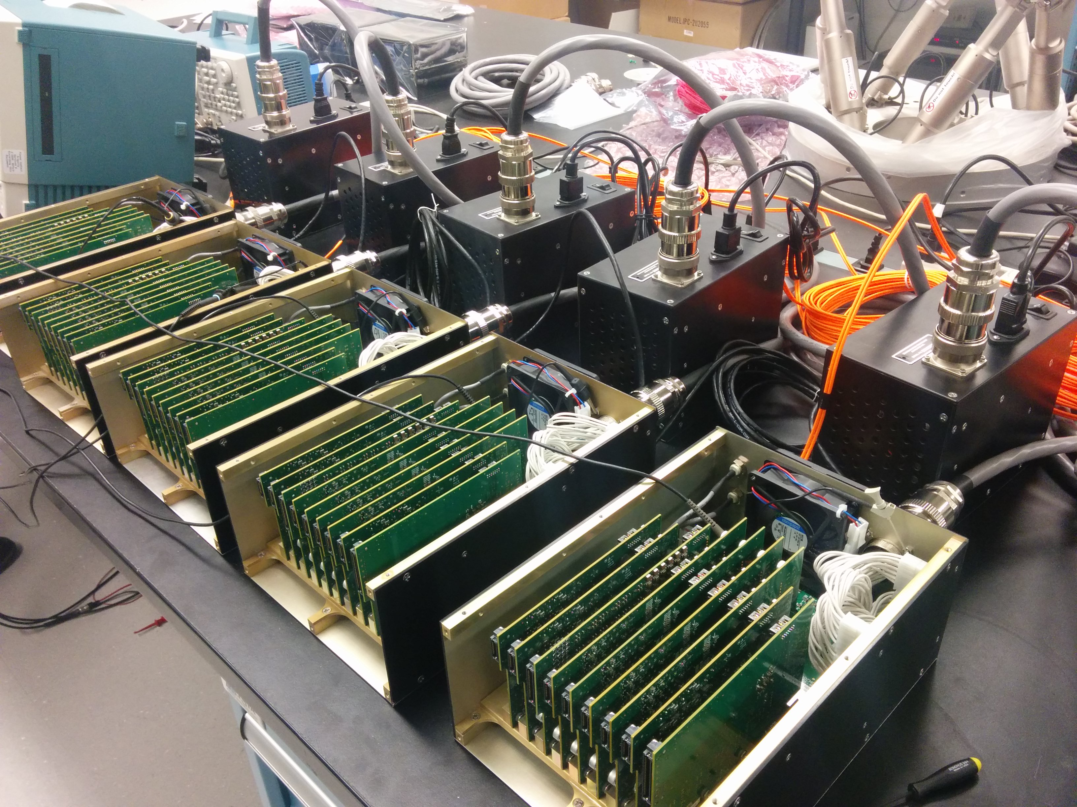
CCD Controllers (in hand, under test)
Semiconductor Technology Associates, “Archon”.
5 controllers are fully independent.
80 ch at 1 Mpix/s each
Common master clock: synchronized, low timing jitter.
Data compression in real time prior to first disk write.
Measuring excellent performance and reliability (no crashes).

Slide 24
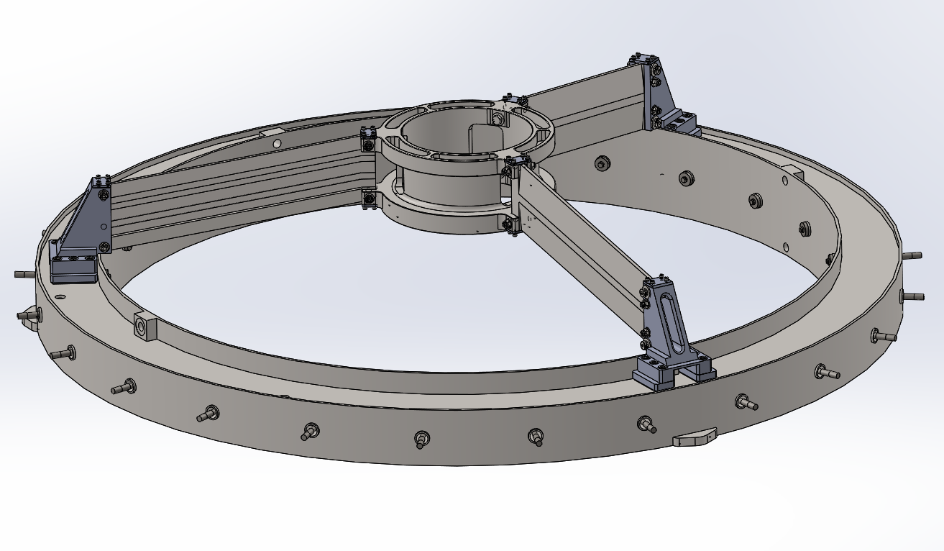
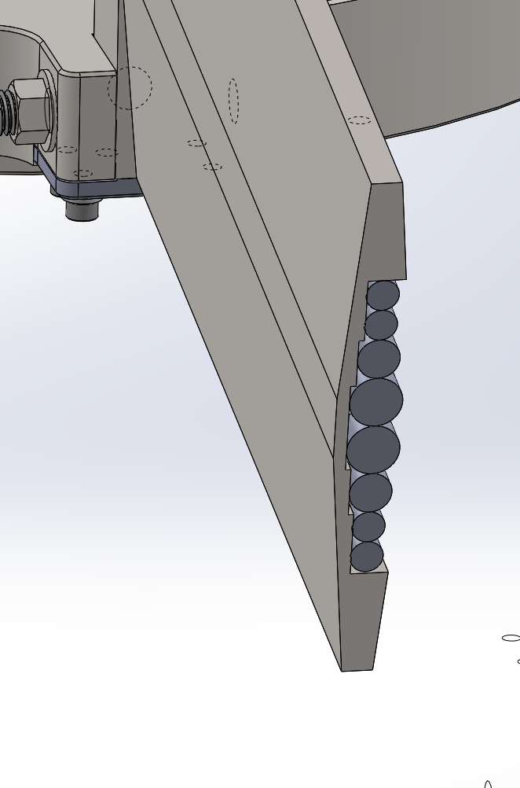
New spiders & hub
Raked backwards to accommodate hexapod
  FEA says still stiff enough
Three spider vanes instead of four; tapered section
  Lower off axis beam obstruction
  Less more compact diffraction pattern
Cables and refrigerant lines hidden within profile
Section

Slide 25
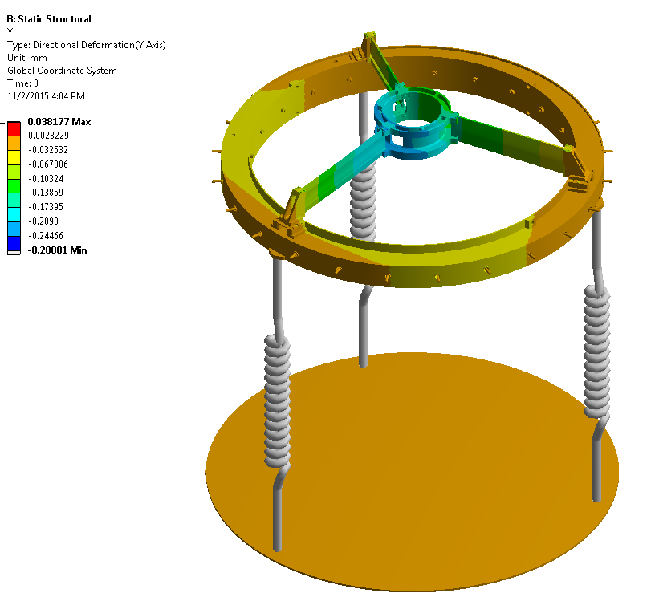
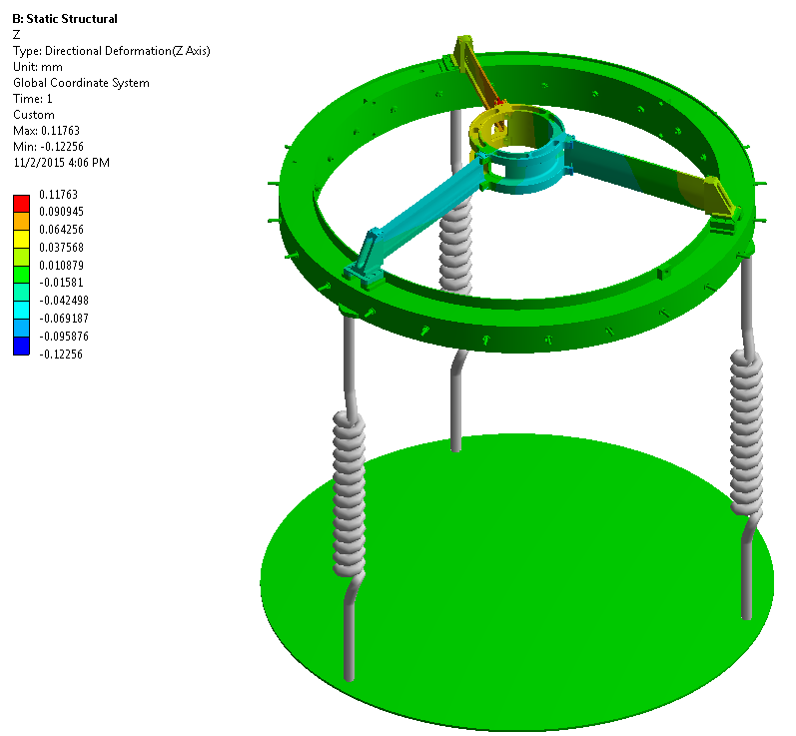
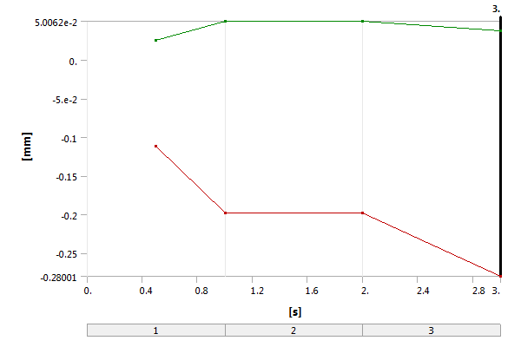
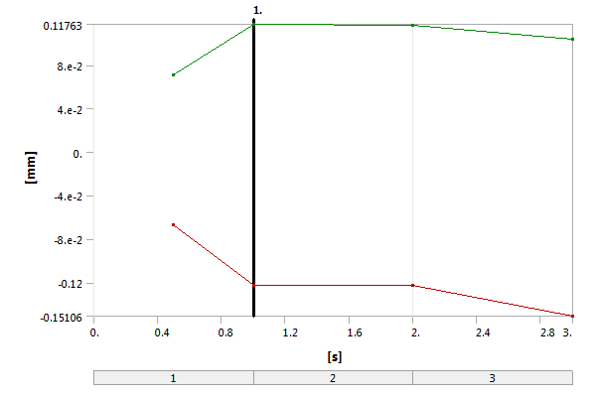
FEA 60° from Zenith → deflections ok
Axial Deformation
Radial Deformation
0s to 1s Bolts Pre-tensioned. 198μm deflection.
2s to 3s Gravity Applied. 80μm deflection
0s to 1s Bolts Pre-tensioned. 122μm deflection.
2s to 3s Gravity Applied. 28μm deflection

Slide 26
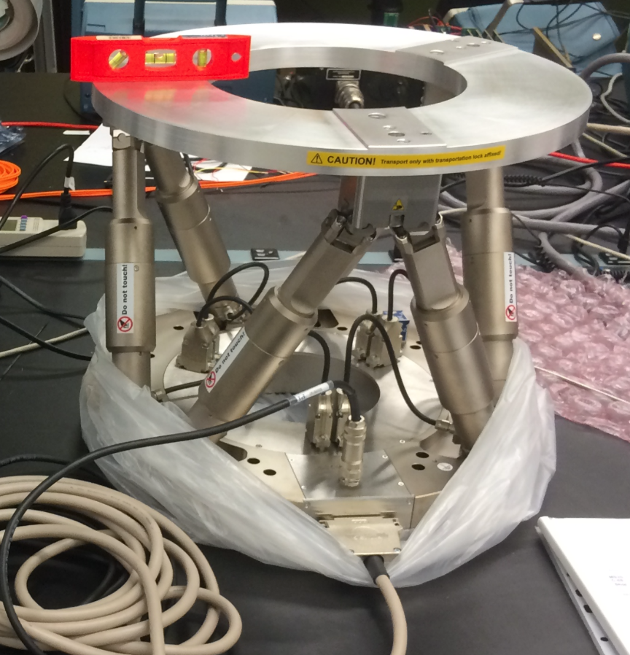
Hexapod (in lab)
Focus, tilt and collimation adjusted during every readout (0.5 mm/s)
Based on predictions from model.
Model updated every exposure using three extra focal CCDs and one in focus, that could be used as guider though probably not required.
Hexapod fully hidden behind instrument; powered down when not moving. … does not back drive.

Slide 27
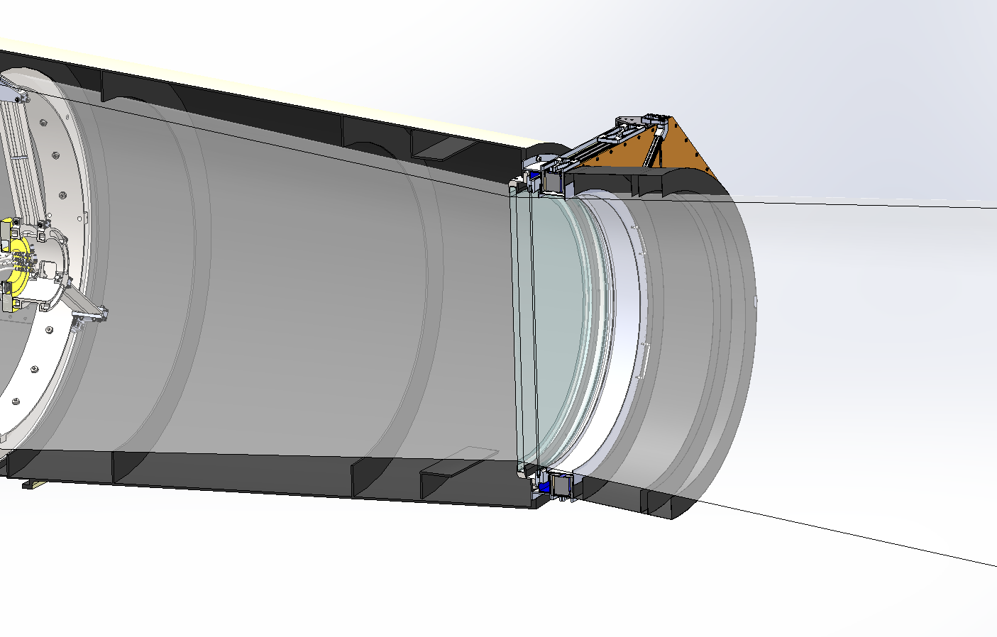
Trim plate
Refigured original corrector will serve as 3rd element to supplement doublet
Extensive baffling planned

Slide 28
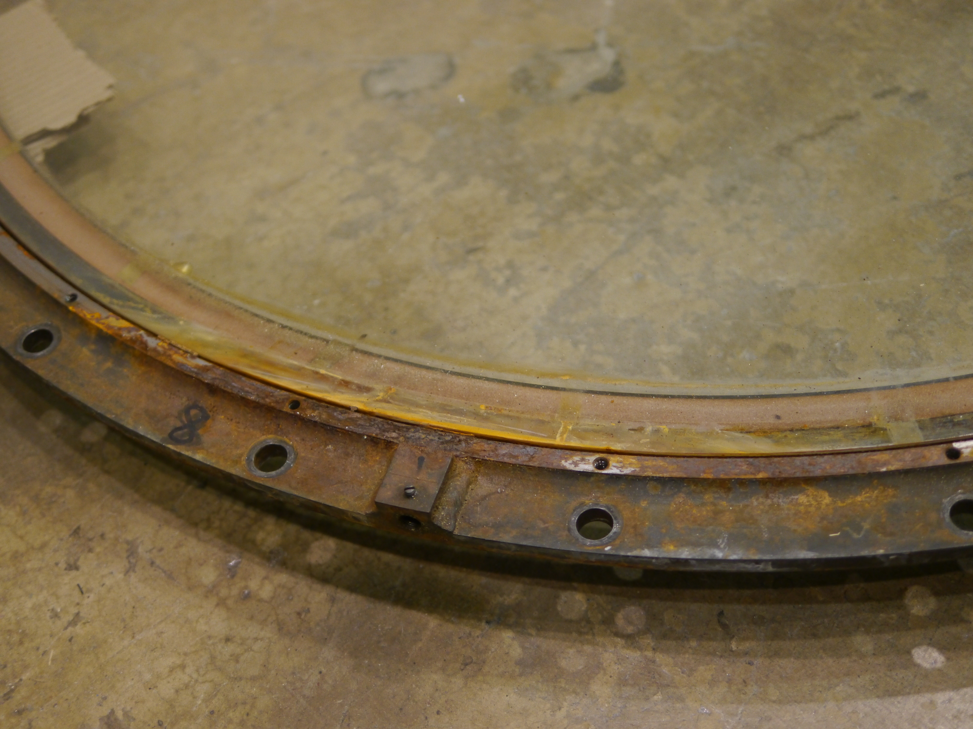
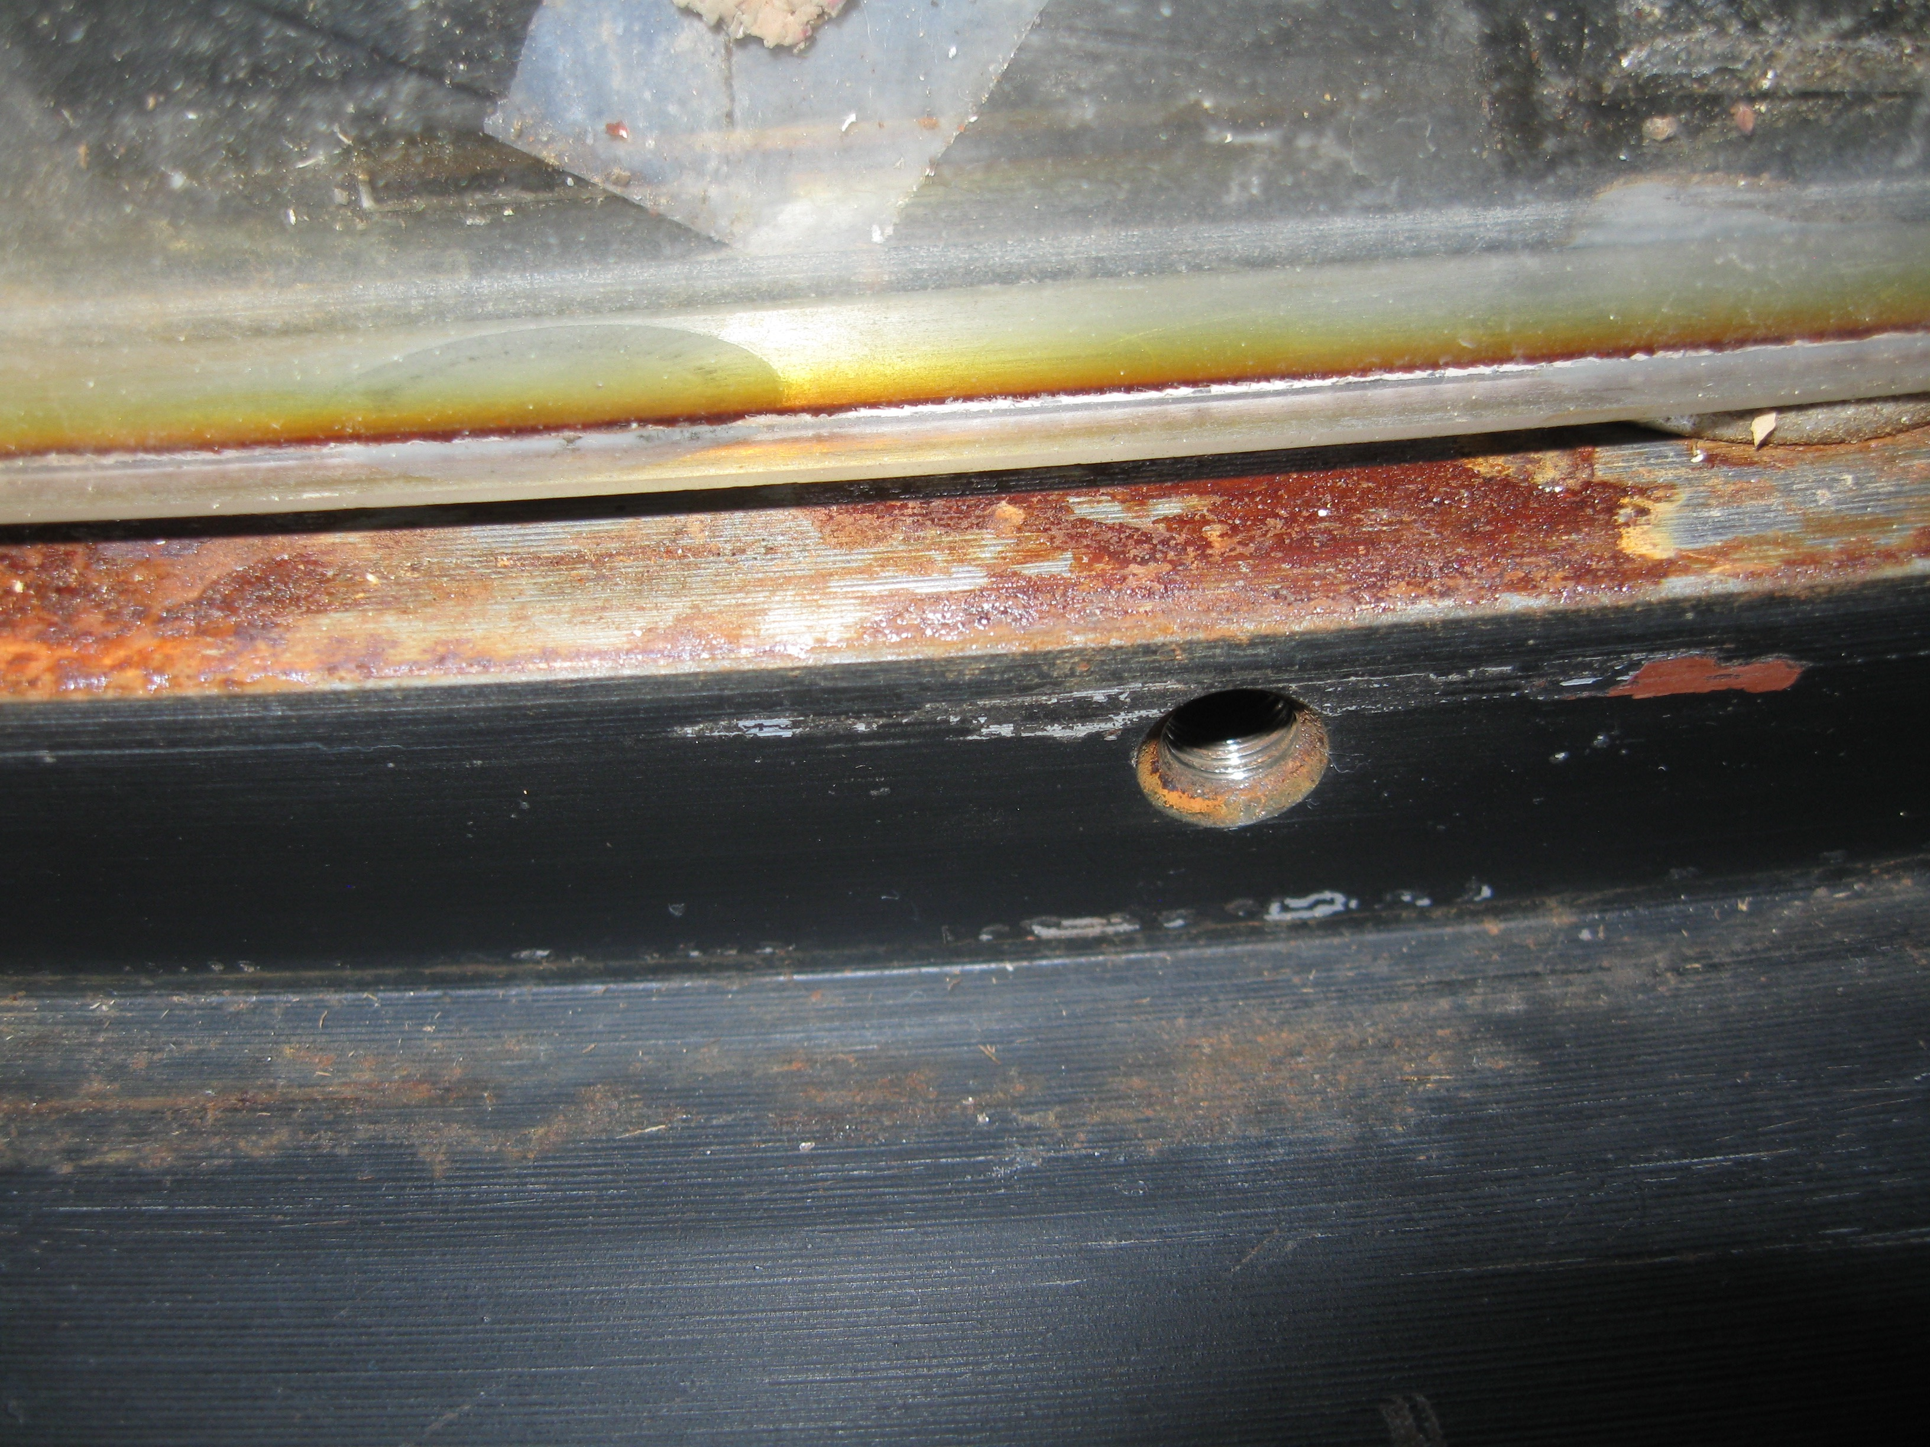
Evidence of condensation on corrector
Severe corrosion due to condensation trickling to low side when telescope stowed (pointing south)
Southern edge of single corrector
1950 to ~ mid 1960’s
Southern edge of “new” doublet cell
mid 1990’s to present.

Slide 29
Radiative cooling of trim plate
For T_{tel} = 5 C = 278 K and is 5% humidity, equivalent temperature of the atmosphere, T_{atm} = -11C = 262 K ^{[1],[2]}
  Placing the trim plate in front of the doublet moves the doublet closer to that of the telescope tube temperature. This reduces tube seeing due to inverse convection, but does not eliminate it. However the trim plate temperature is lower than the doublet alone, increasing the risk of condensation.
How cold? Solving the Stephan-Boltzman equations for four plane-parallel surfaces, one estimates the doublet corrector temperature to be
3T_{corr}⁴ = 2T_{tel}⁴ + T_{atm}⁴
T_{corr} = 273 K = 5K below ambient … tube seeing is still a concern.
and the trim plate temperature is
3T_{trim}⁴ = 2T_{atm}⁴ + T_{tel}⁴
T_{trim} = 267.7 K = 10.3K below ambient … condensation risk.
References
[1] W.C. Swinbank, "Long‐wave radiation from clear skies," Quarterly Journal of the Royal Meteorological Society 89.381 (1963): 339-348.
[2] Mark A. Goforth, George W. Gilchrist, and Joseph D. Sirianni, "Cloud effects on thermal downwelling sky radiance," AeroSense 2002, International Society for Optics and Photonics (2002).

Slide 30
Trim plate heater planned
Add resistive ITO layer to AR coating stack.
Uniform electrical heating to replace the ~120W radiated to sky.
  240 V required but hidden in space between trim plate and doublet.
Servo control to keeps corrector at ambient:
  Eliminates tube seeing due to inverse convection.
  Eliminates condensation risk.

Slide 31
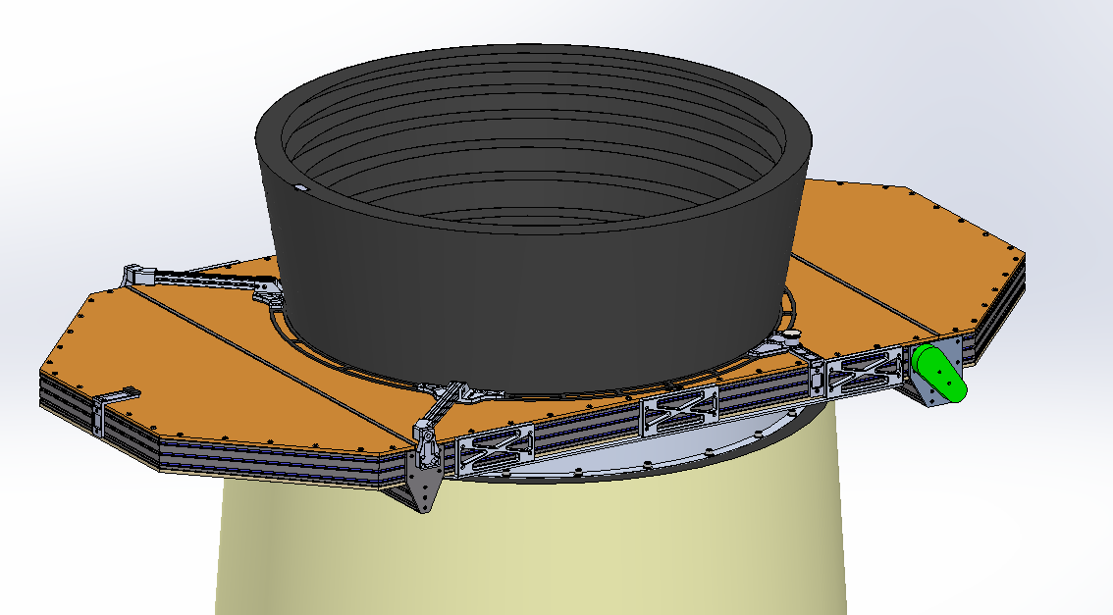
Bonn Shutter is in fabrication
To avoid beam obstruction, pupil plane shutter (in front of telescope) → 1.3m aperture
0.5 s to open or close
Operation to 35 mph wind load.
Dual blades move in opposite directions, driven by common belt so self balancing.
Servo motor with velocity profile to minimize image motion.

Slide 32
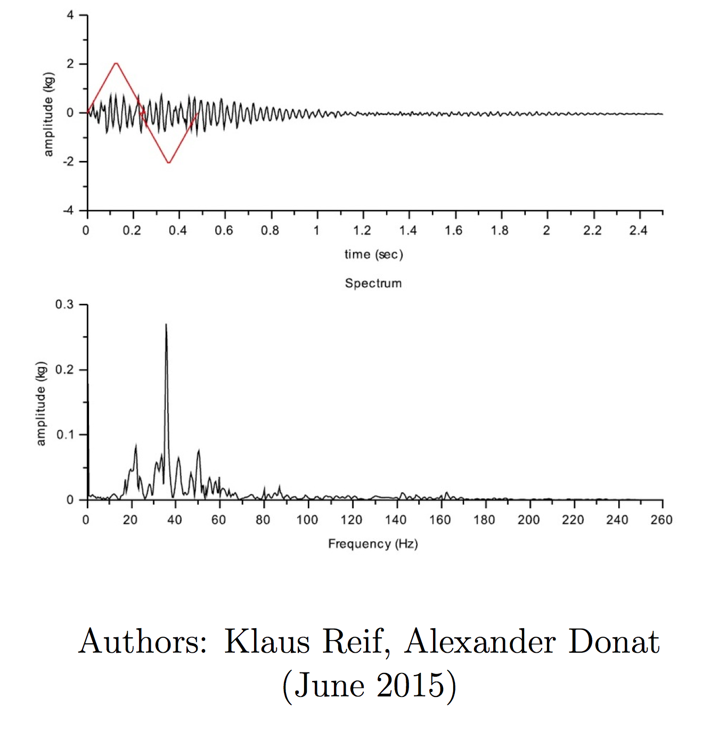
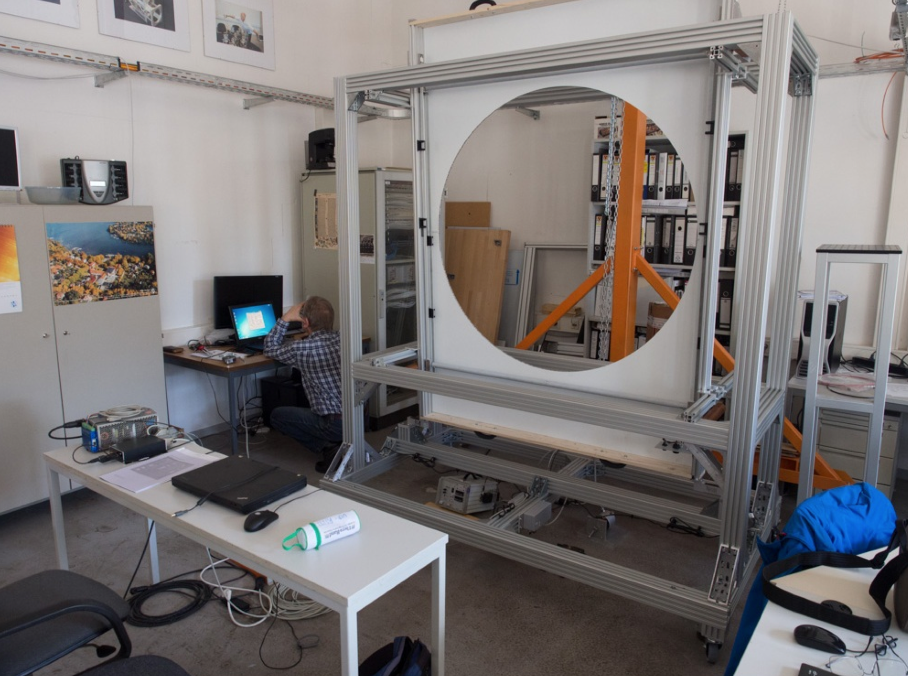
Shutter prototype is under test by BonnShutter and DESY (in Berlin)
Acceleration profile
Reaction force (negligible),
Acoustic noise (acceptable)
Operation to -5 C (pass)
Light leaks (in progress)
Reaction force into frame
Vibration is modest and well above ~ 4Hz telescope resonances

Slide 33
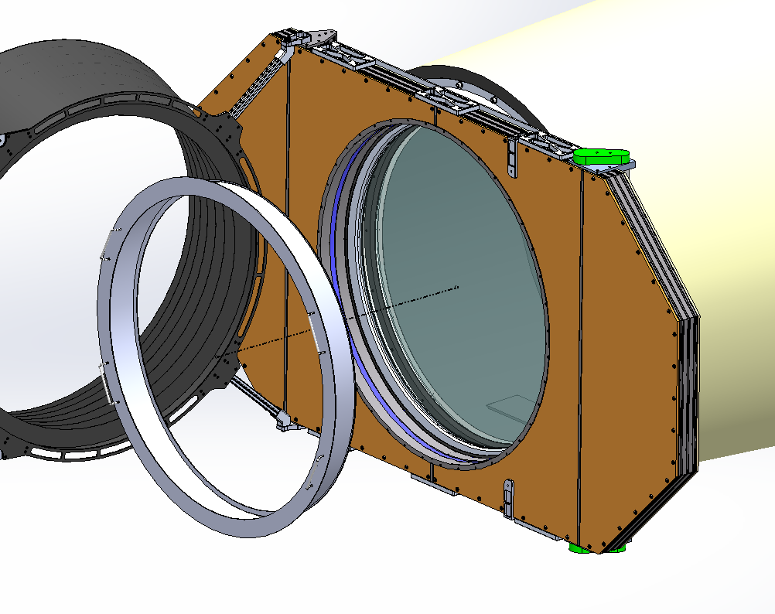
For washing trim plate
baffle hinges to one side.
Lightweight splash guard is installed to protect shutter

Slide 34
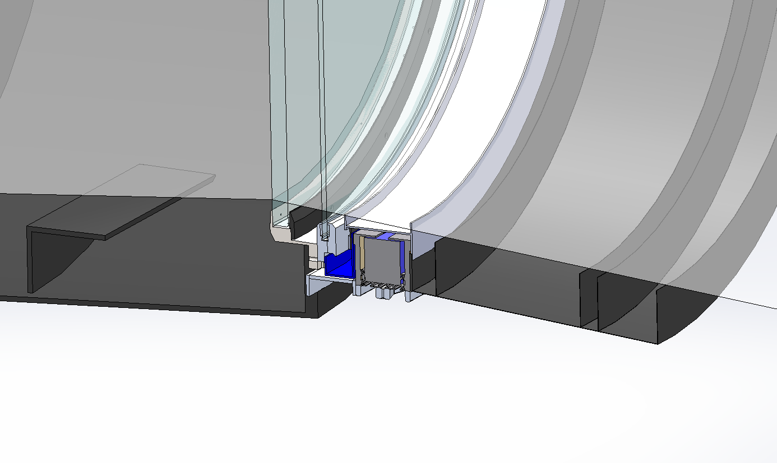
Gutter to collect trim plate wash water
Temporary cover over shutter blade slot
Seals and gutter support frequent washing.

Slide 35
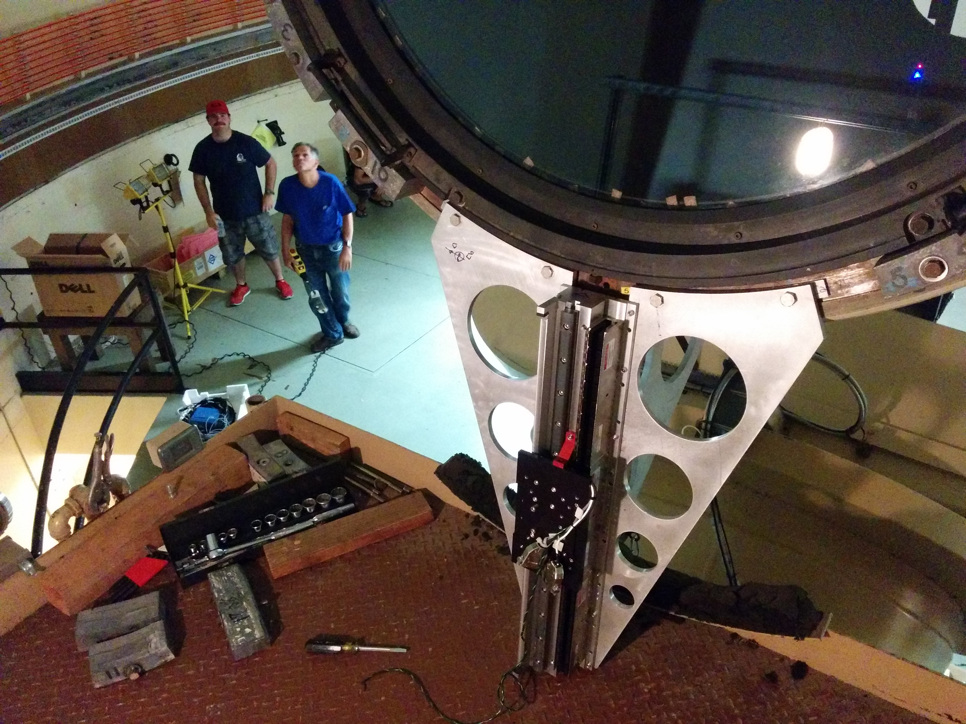
Telescope resonances studied
Programmable input produced by reaction force from Aerotech linear motor
(direct drive with high resolution encloder)
Charge shifting on PTF CCDs (8 lines every ~ 15ms) turns each star into series of spots to allow centroid motions on both axes to be measured at 67 Hz for ~7 s.

Slide 36
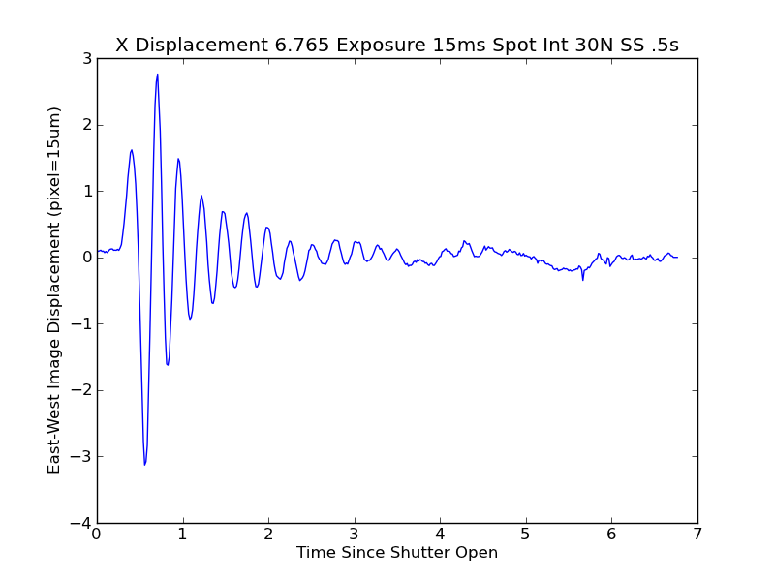
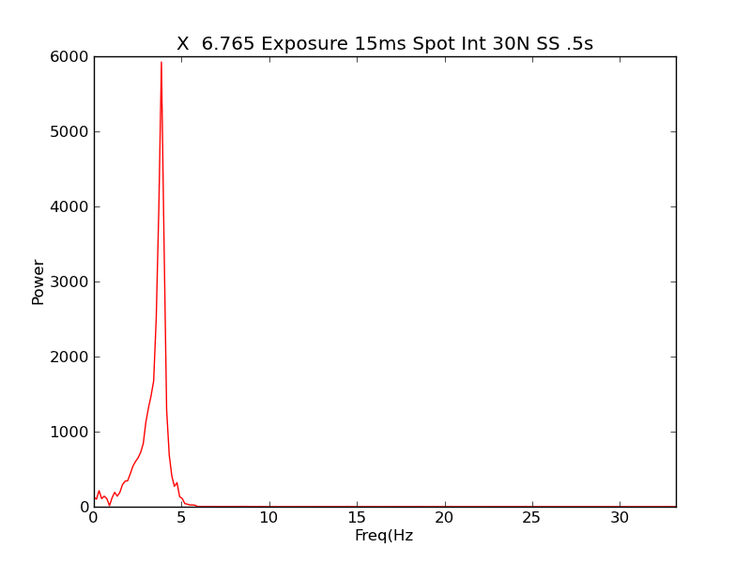
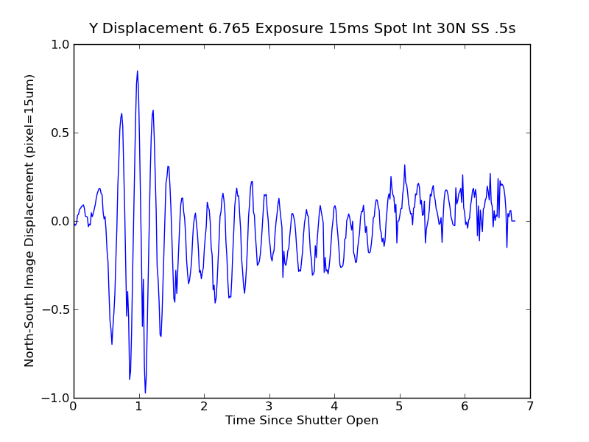
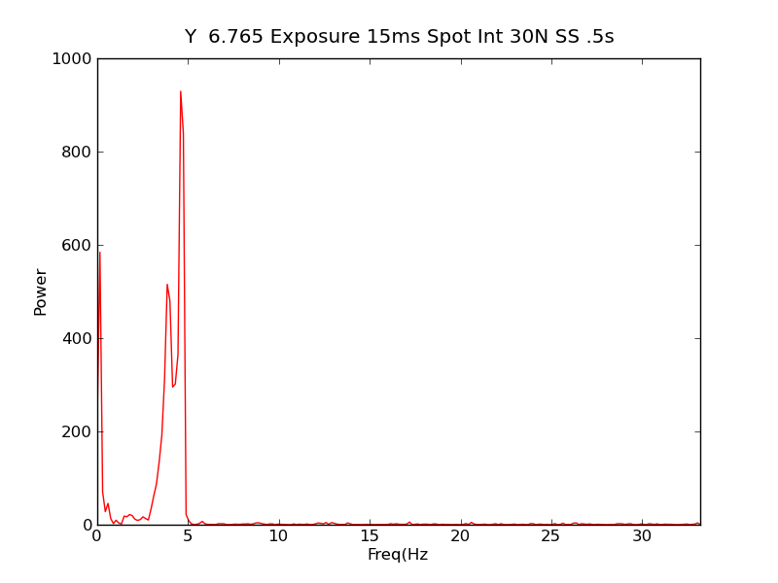
Telescope resonances (30 N excitation in HA)
Image motion
in HA
Frequency response
in HA
Image motion
in Dec
Frequency response
in Dec

Slide 37
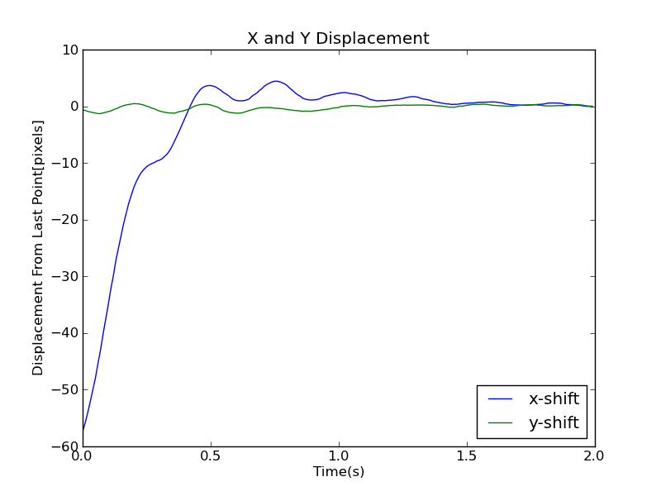
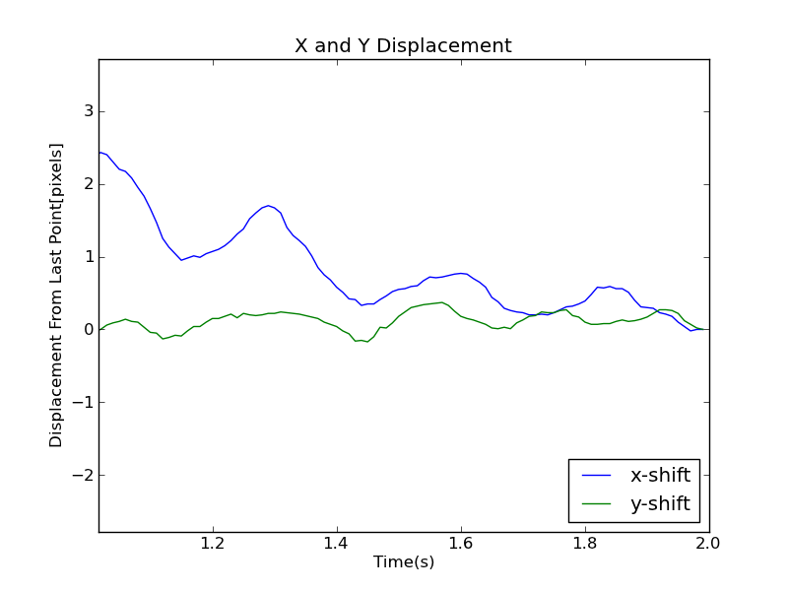
Resonances evident after slews
Shutter opened with charge shifting before end of slew.

Slide 38
Telescope and dome upgrades
Dome
RA drive
Dec drive
Windscreen (new, wireless link)
Flat field screen with LED illumination
Electrical distribution and lightning protection.
Air dryer and filtering (higher volume, lower pressure)
Thermal management in/below dome.
Safer handling of flammable refrigerants
  move compressor to thermally regulated shed outside dome
Modern Variable Frequency drives provide flatter torque-speed curve (>0.5 deg/s²)
and higher top speed ((>3 deg/s⁾

Slide 39
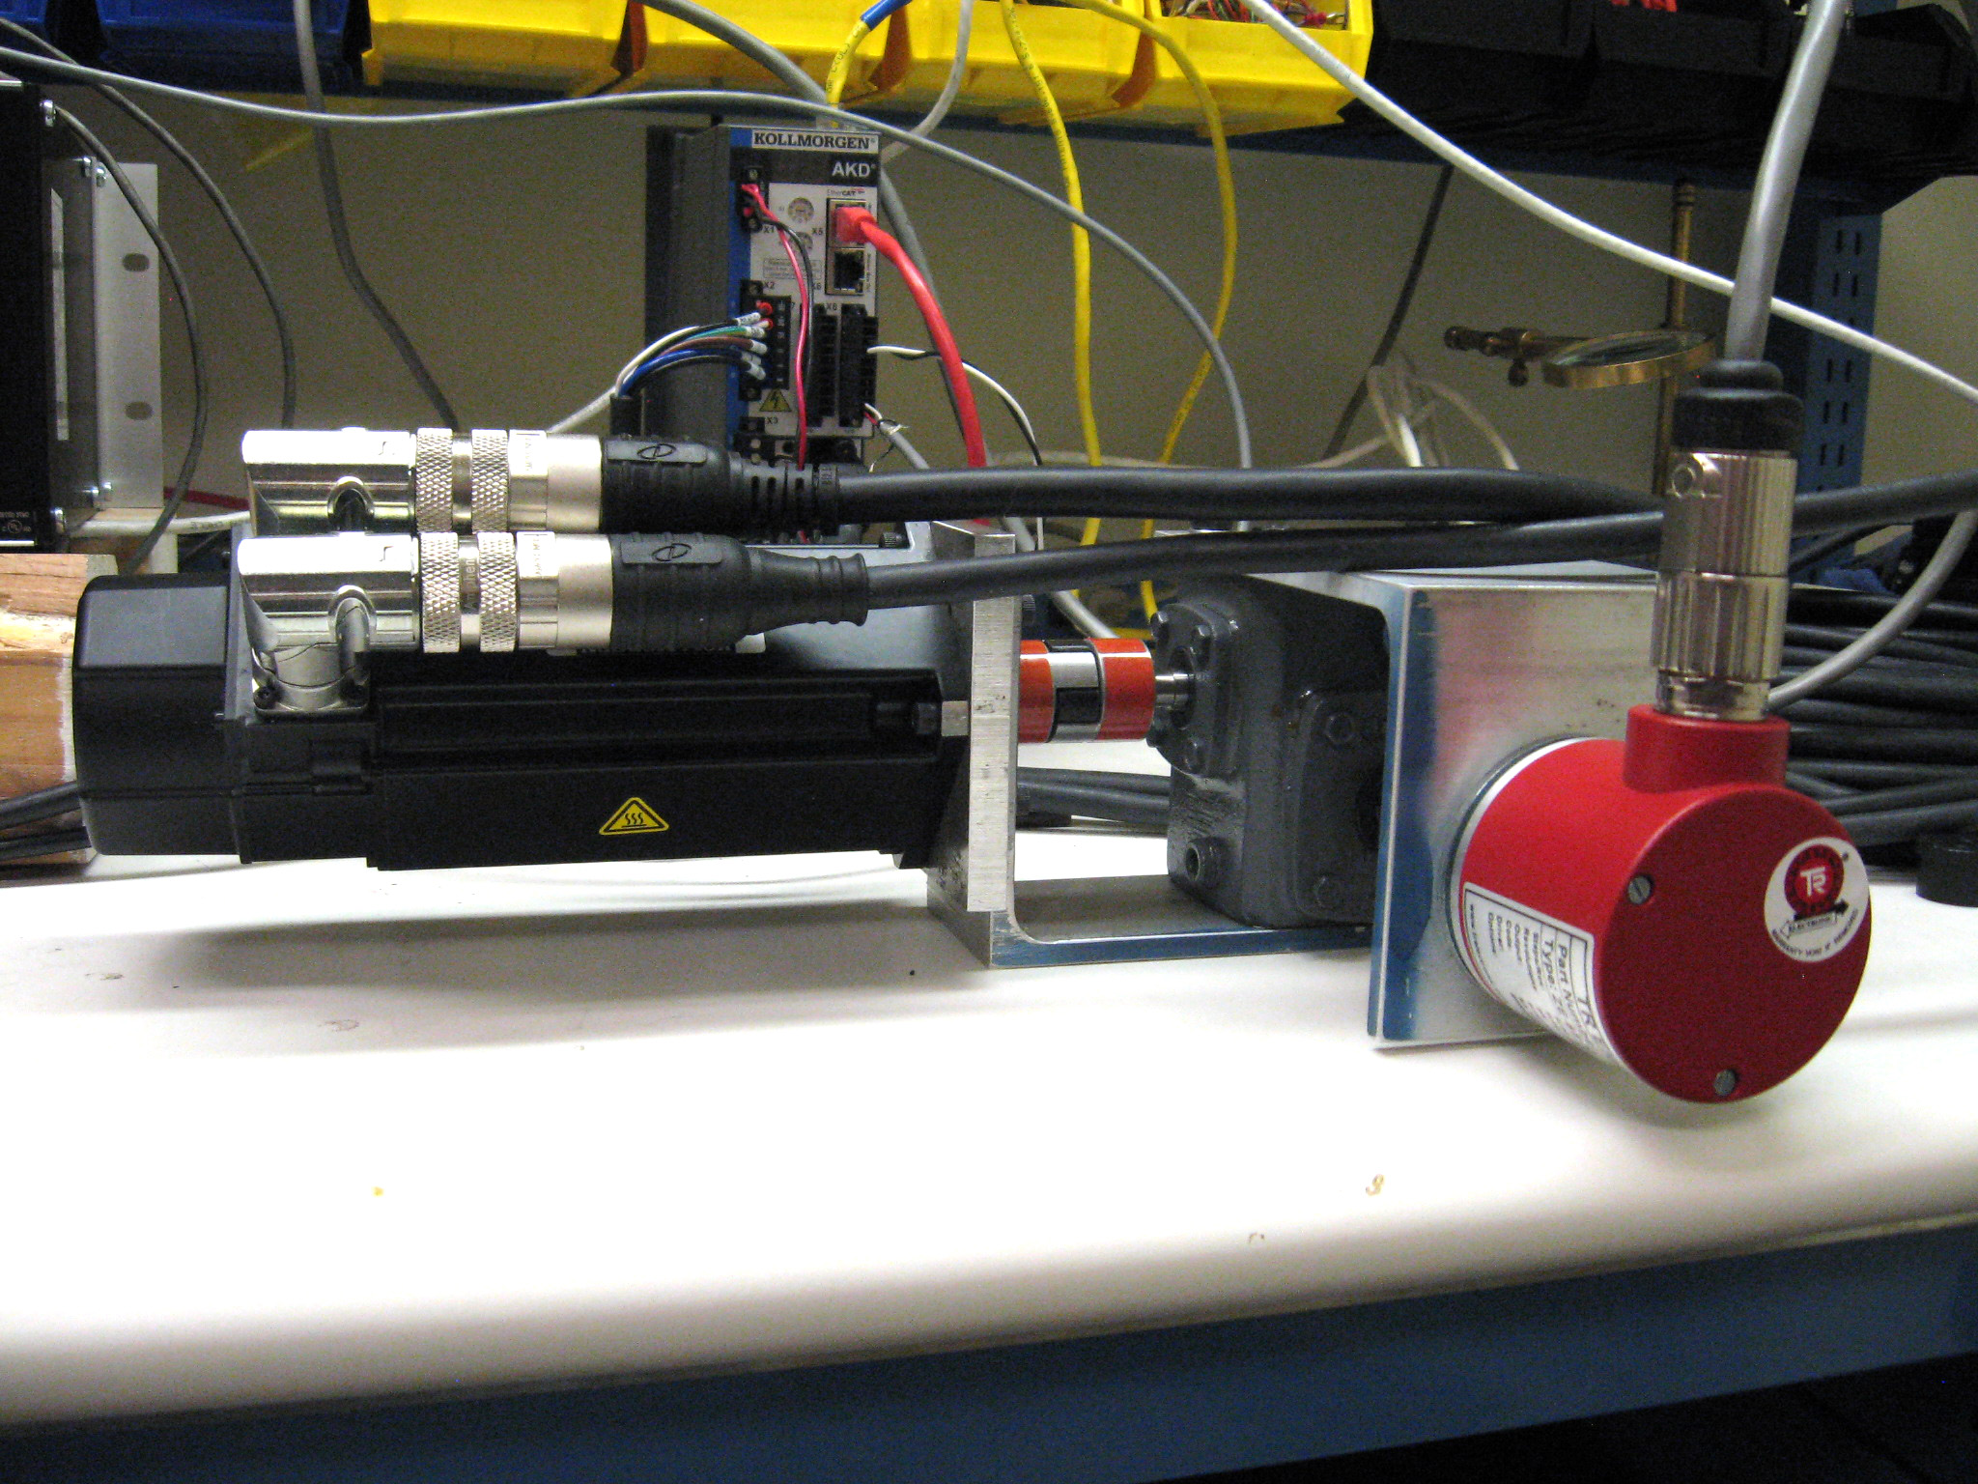
HA drive bench test
New HA and Dec drives to be installed in Feb

Slide 40
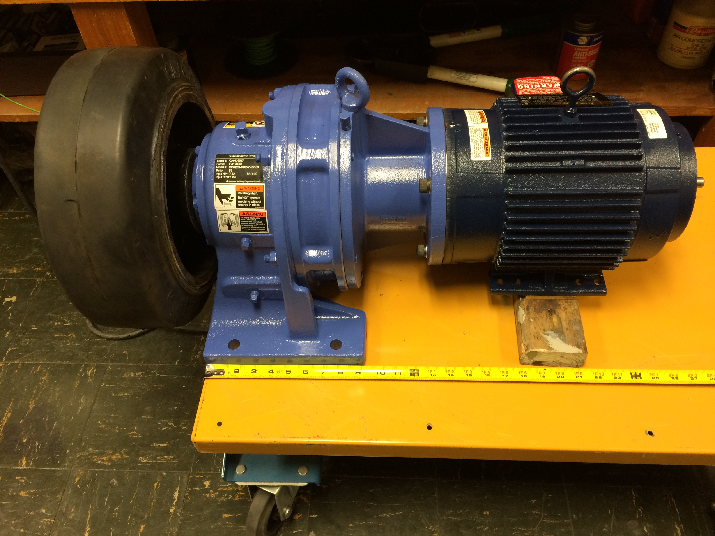
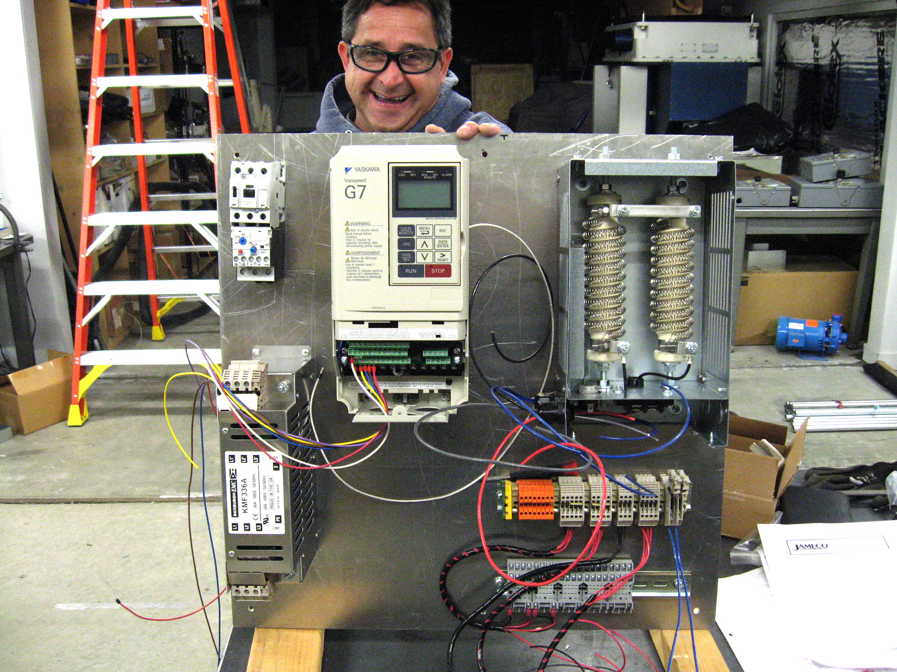
Dome upgrade components
New dome drive motor to be installed in Feb:
More powerful
Servo controlled to give flat torque vs. speed
New gearbox and tyre
New variable frequency controller
→ Increased acceleration and top speed
Only runs as fast as required
Dynamic braking
Optimal settling (no overshoot)

Slide 41


Other infrastructure
New oil pump for Dec drive worm gear
Refurbished windscreen; new drive; wireless control

