Slide 1
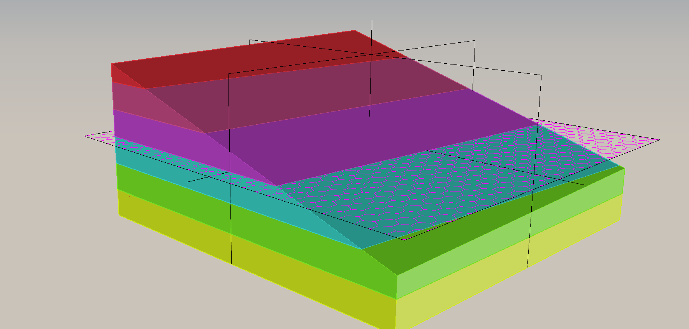
WaSP Target Geometrics
Target device height: 8746 µm
Tolerance: 40 µm
Colored slabs represent finished photon entry surface of the device.
Tip/tilt of finished surface is shown as a slice through the colored slabs where each slab is 10 µm thick.
Purple chicken-wire plane is the target 8746 µm.
View is from the lower right of the device with photons impinging from above

Slide 2
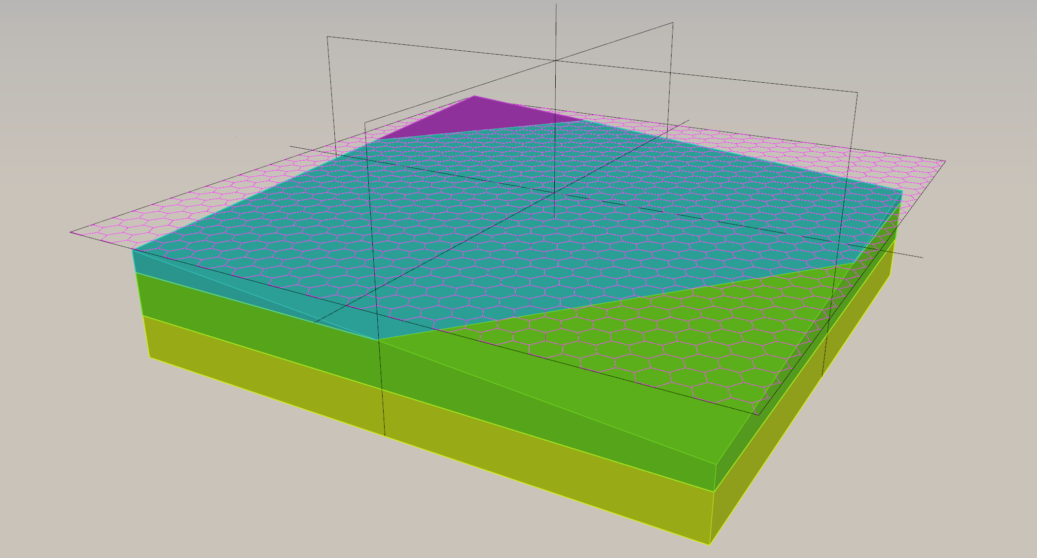
1st WaSP
Average height: 8740 µm
Min/Max: 8750/8732
Angular departure from normal: 0.009 arcsec

Slide 3
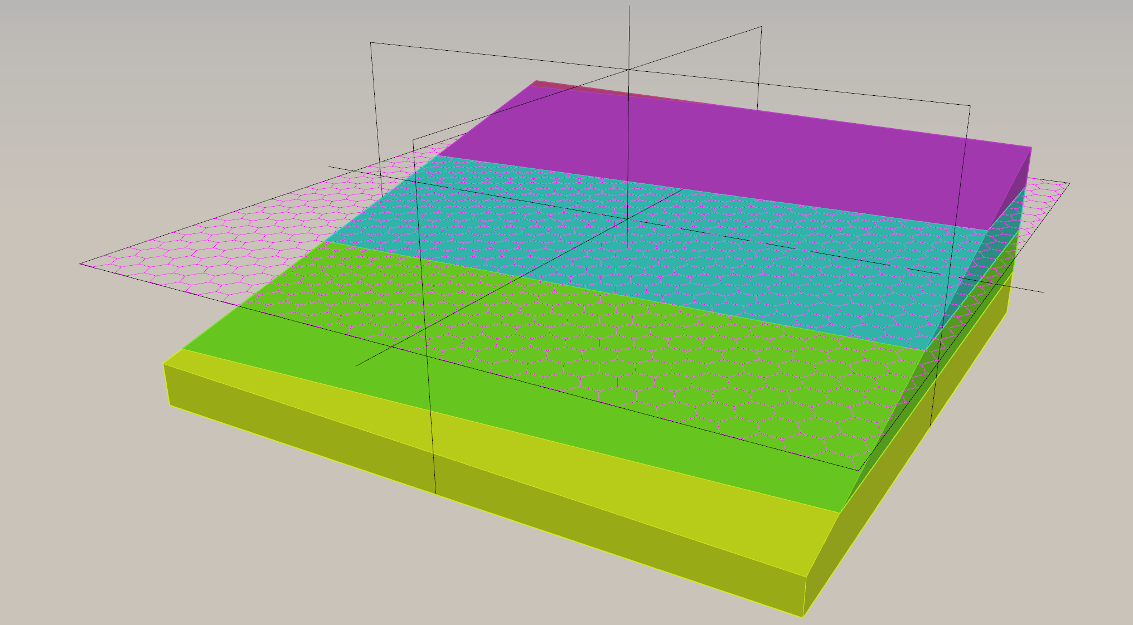
2nd WaSP
Average height: 8740 µm
Min/Max: 8758/8723
Angular departure from normal: 0.023 arcsec

Slide 4
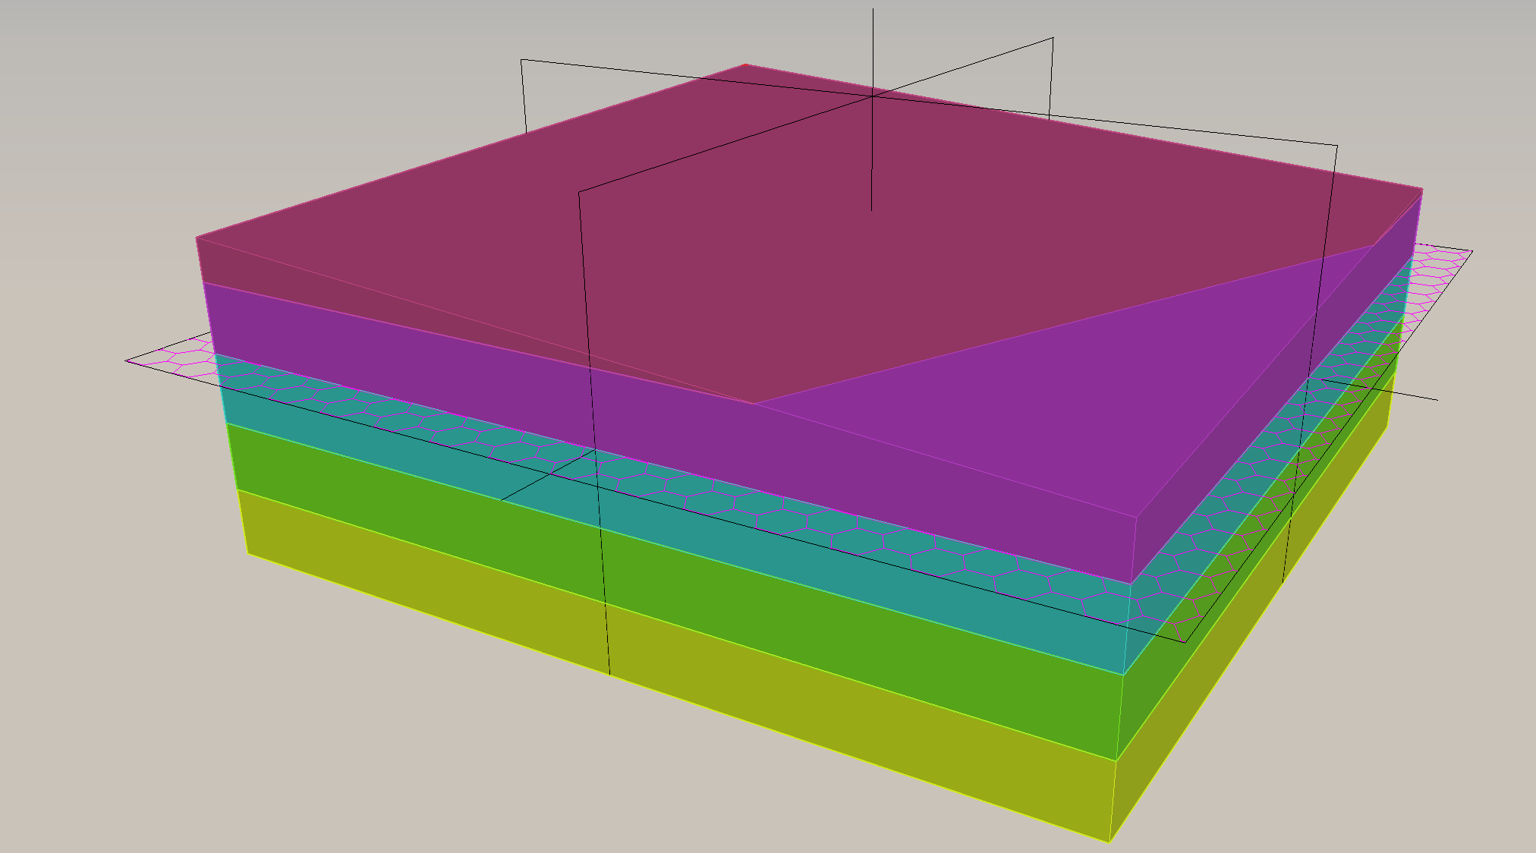
3rd WaSP
Average height: 8759 µm
Min/Max: 8766/8753
Angular departure from normal: 0.008 arcsec

Slide 5
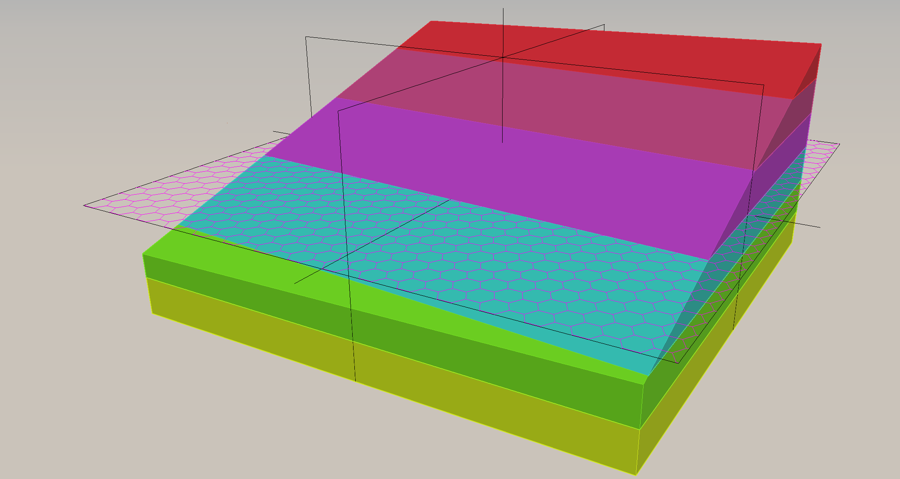
4th WaSP
Average height: 8753 µm
Min/Max: 8775/8732
Angular departure from normal: 0.029 arcsec

