Slide 1
ZTF: PI Hexapod H-850K043 – Instrument Coordinate Systems
Michael Feeney

Slide 2
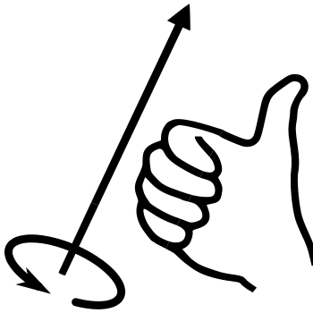
PI Hexapod H-850K043 Coordinate System
The PI Hexapod H-850K043 has a default Cartesian coordinate system located at the upper strut joint plane opposite of the base plate that contains the electronics. The coordinate system is located in the center of the hexapod at this plane.
The axes of the default coordinate system are defined rotationally by the data connector on the electronics base plate of the hexapod. More specifically, the positive X axis points away from the data connector.
The H-850K043 may be programmed to have a user-defined pivot point relative to the default coordinate system. See document “C887T0007 Hexapod Coordinate System” for coordinate system programming. With simple commands, rotational and translational transformations can be applied to generate a custom coordinate system as desired by the user.
The H-850K043 has 6 degrees of freedom with maximum ranges shown below:
Translation X: ±10mm
Translation Y: ±10mm
Translation Z: ±10mm
Rotation θ_{x}: ±5°
Rotation θ_{Y}: ±5°
Rotation θ_{Z}: ±10°
Positive rotation follows the right hand rule.

Slide 3
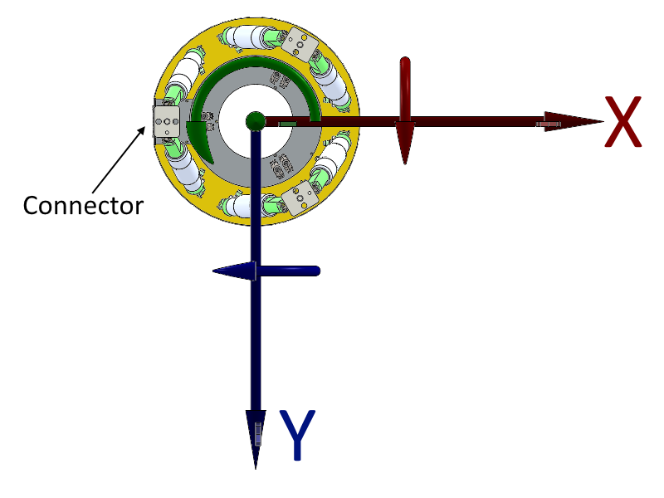
PI Hexapod H-850K043 Coordinate System

Slide 4
PI Hexapod H-850K043 Coordinate System: Relative to ZTF
The H-850K043 is mounted onto ZTF with the data connector facing towards the North-East corner of the cryostat. This orientation was chosen to minimize beam obscuration from the data cable.
Using the default coordinate system from PI, the X and Y axes are not aligned with the cardinal directions of ZTF. Additionally, the pivot point is not located at the focal plane.
In order to align the hexapod axes with the cardinal directions, a positive 30degree rotation about the Z-axis is required (following the right-hand rule). This rotational transformation would align the positive X-Axis towards the West and positive Y-Axis towards the South.
In order to position the coordinate system on the focal plane, a positive Z offset of 210.62mm is required.

Slide 5
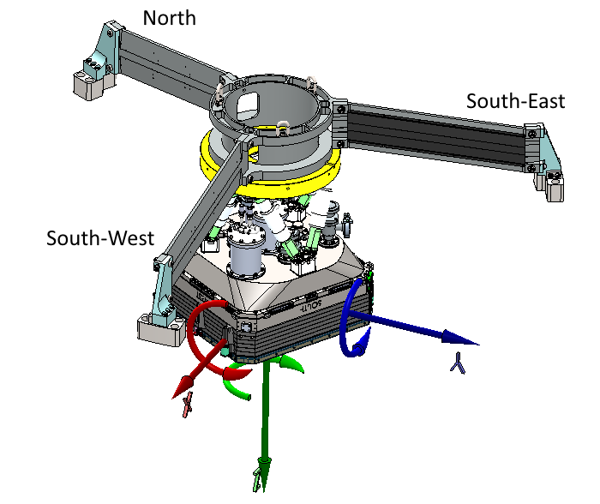
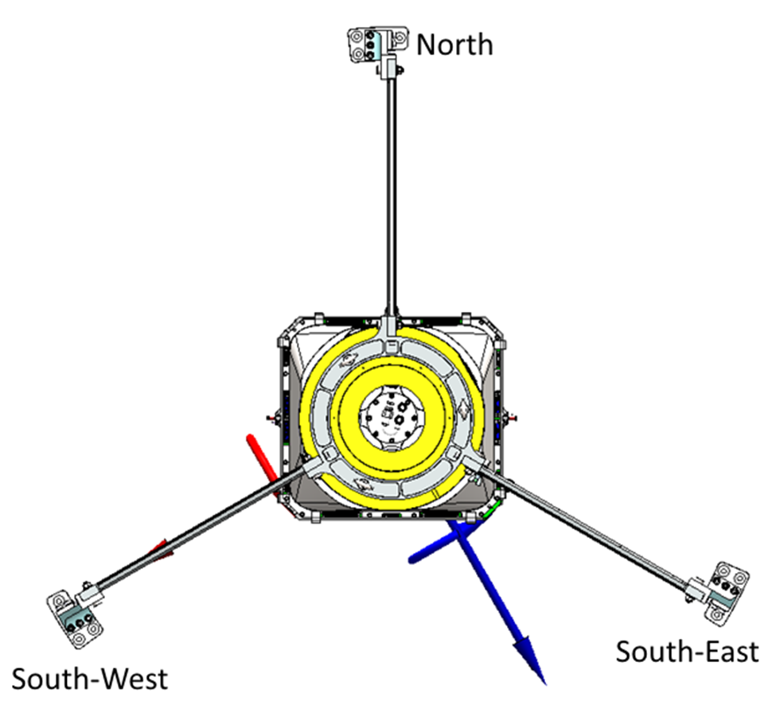
PI Hexapod H-850K043 Coordinate System: Relative to ZTF

Slide 6
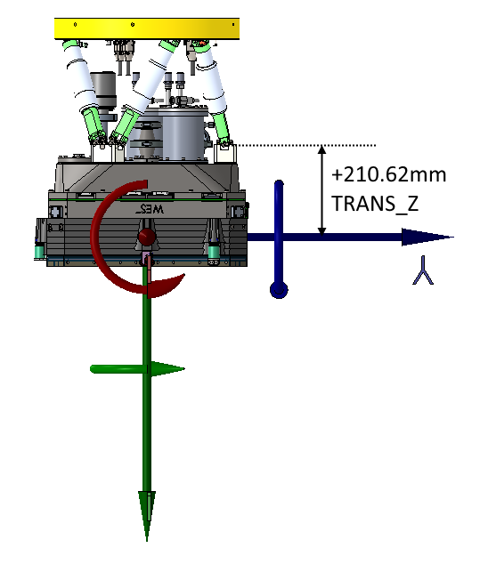
PI Hexapod H-850K043 Coordinate System: Transformation Requirement

Slide 7
PI Hexapod H-850K043 Coordinate System: Relative to P48
With P48 Pointed Towards Zenith:
Axis | Cardinal Direction
+X, -X | West, East
+Y, -Y | South, North
+Z, -Z | Towards Primary, Towards Sky
+θ_{x},-θ_{x} | Pitch North, Pitch South (Dec Axis)
+θ_{Y}, -θ_{Y} | Roll West, Roll East
+θ_{Z}, -θ_{Z} | Yaw Clockwise, Yaw Counterclockwise

