Slide 1
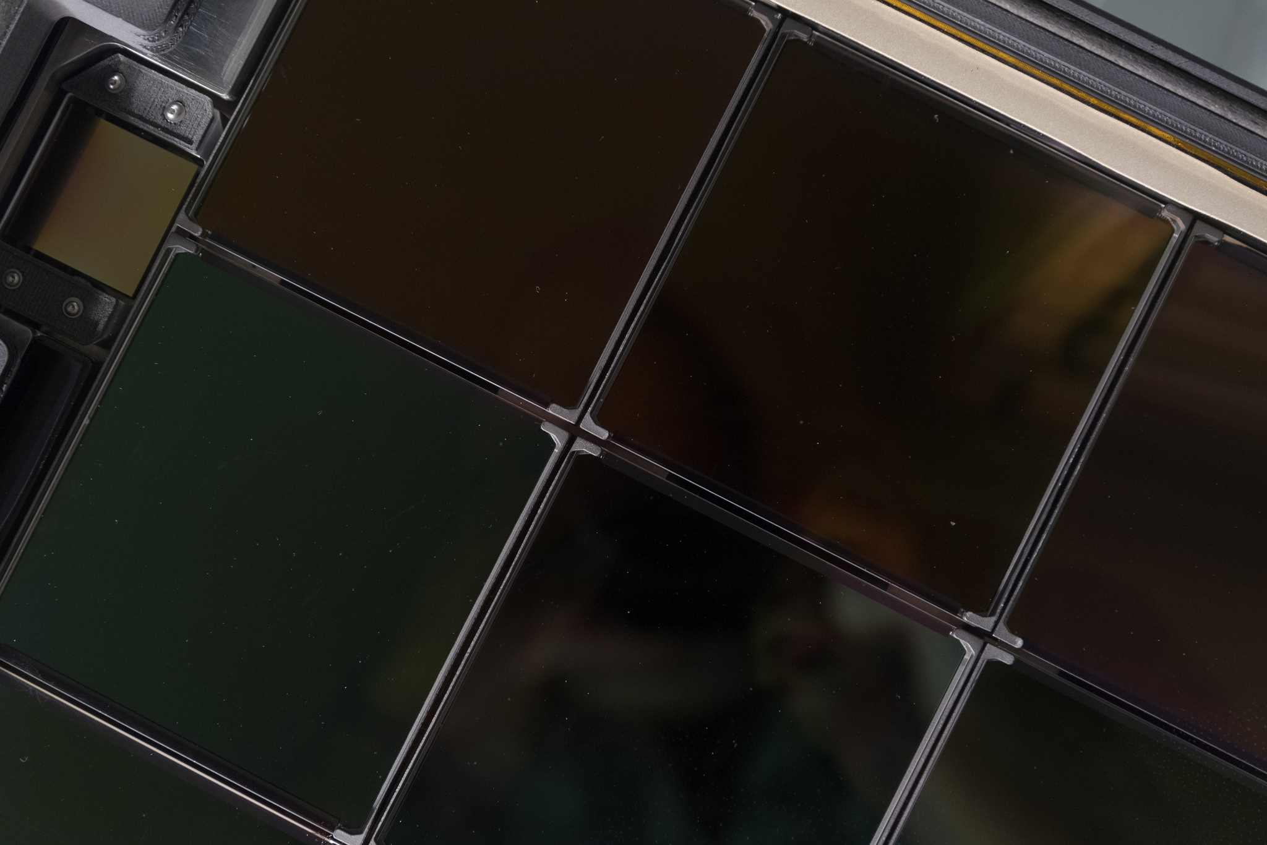
ZTF Technical Status
Nov 30, 2016
Roger Smith

Slide 2
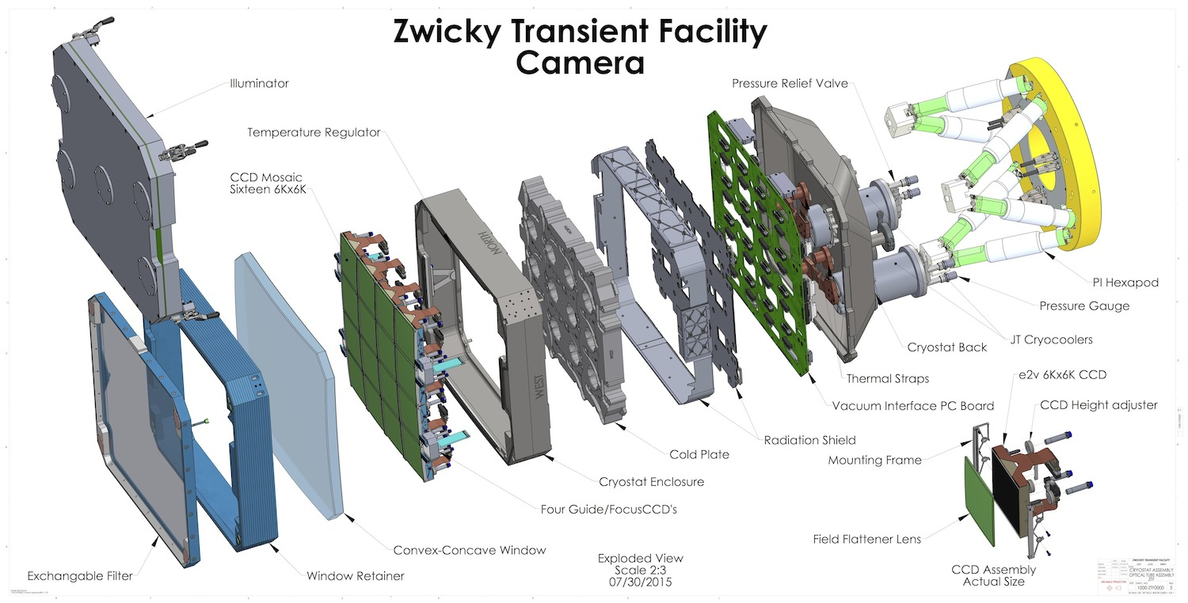
Exploded view of cryostat

Slide 3
Milestones
CRYOSTAT:
Assembly fixtures: story boards developed; fixtures successful
Dewar assembled: low outgassing, no leaks
Window installed: survives pressure.
Window heater: heating works; throughput and reflectivity good.
All CCDs installed with field flatteners: no fit or ESD problems
Cooling system in test: power curves optimized; adequate margin, but flexible links need tuning.
CCD controllers: exhaustive tests automated; tests completed.
CCD Waveform Definitions: done; better tools developed for this.
CCD testing: In progress … all CCD outputs working. Reading out.

Slide 4
Milestones
TELESCOPE
Dome drive: new speed controlled motor & gearbox
Telescope drives: new motors and electronics in use with PTF.
Bonn/DESY shutter: installed and working on PTF
Trim plate: cell design, with seals and drain for washing
Forward Baffle: new; less scattered light
Spiders, hub: designed (fabrication about to start).
Filter exchanger: designed; in fabrication

Slide 5
Milestones
OBSERVATORY
HVAC & electrical: upgraded
Air conditioned equipment room: added to exterior
Dry air system: higher volume system installed
Wind screen: refurbished (but still not automated)
Downlink: data rate improved to meet requirements.

Slide 6
In progress or pending
CCD testing and optimization
CCD readout software
System software
On-telescope Electronics rack
Water cooling under test
Assembly in progress
Spider and hub fabrication
Flat field illuminator
Trim plate polishing and coating
Dome Control Software: upgrade algorithm.
Lightning: protection
New Telescope Control Software
Wind screen: automation

Slide 7
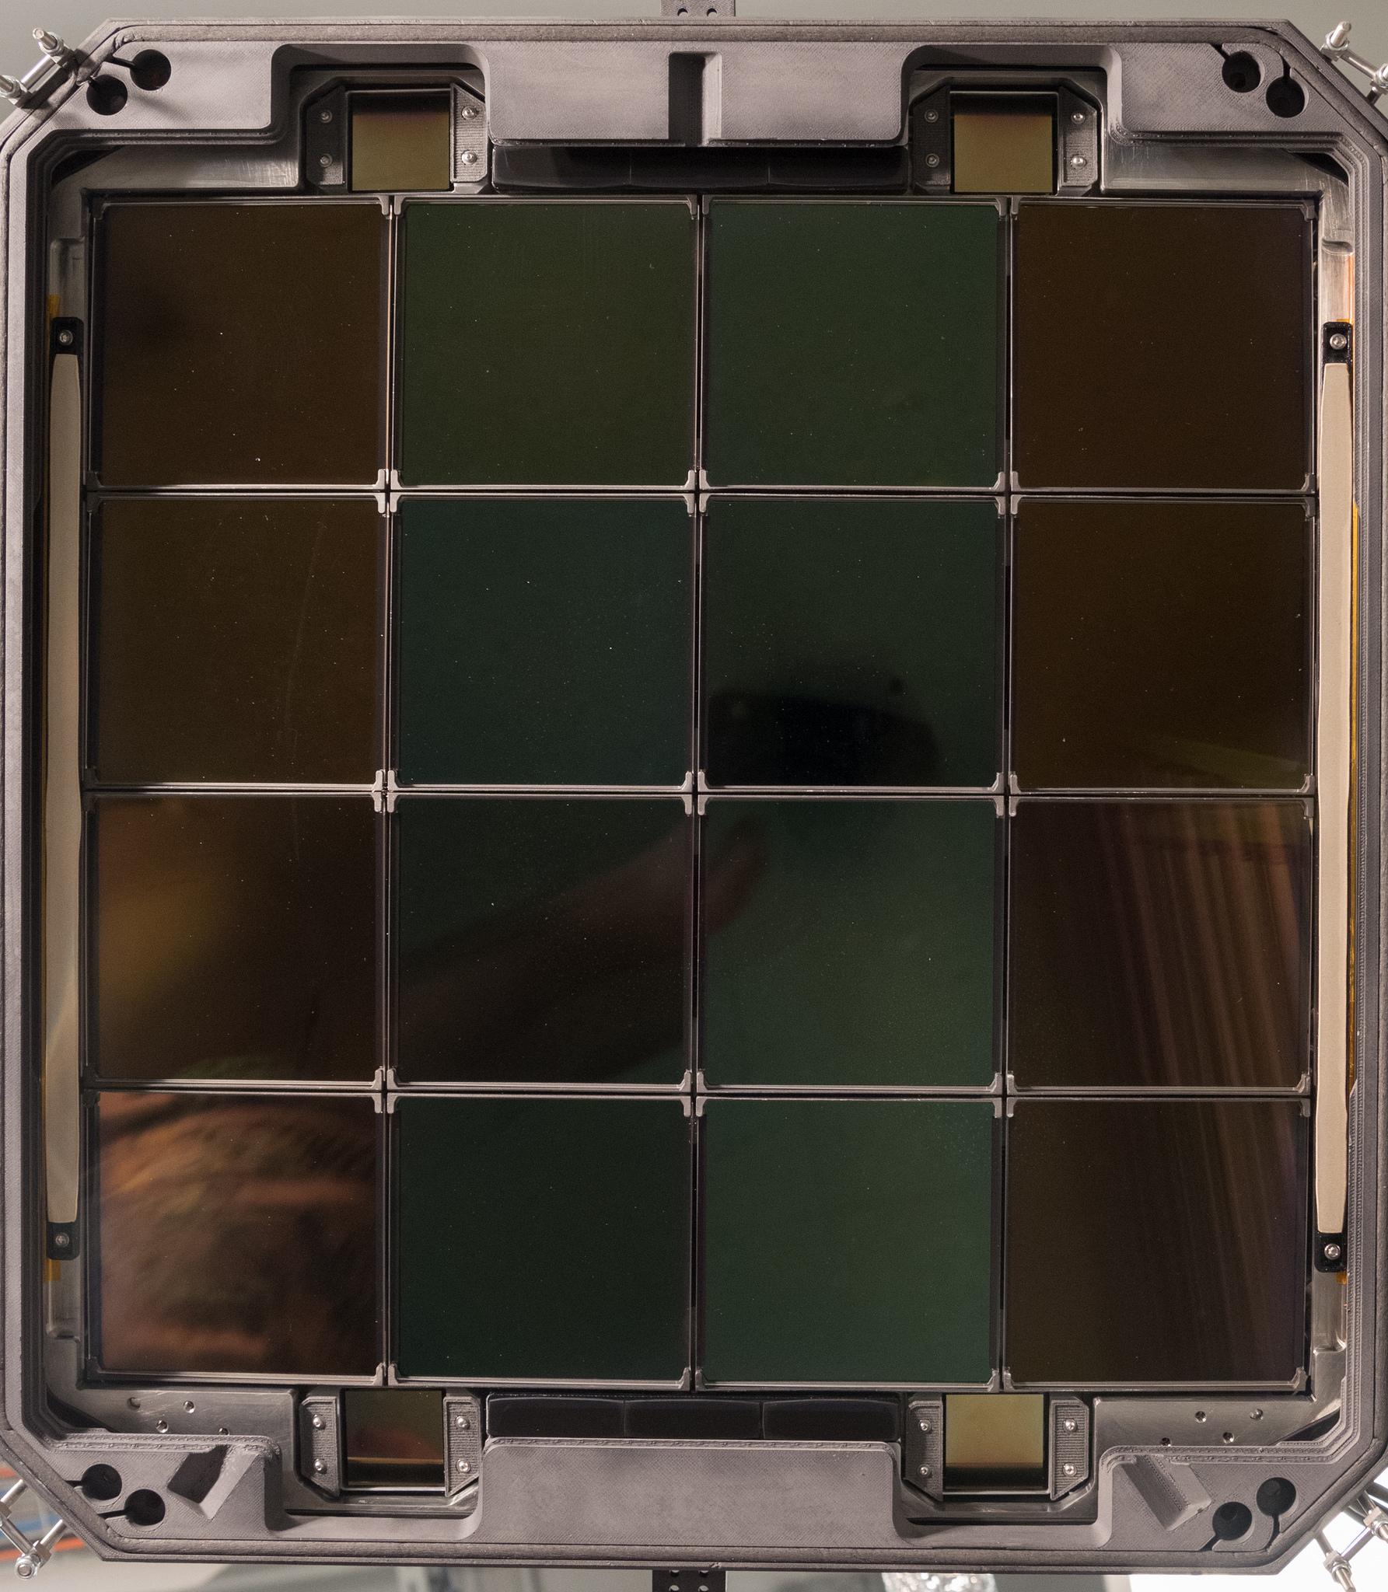
Focal plane cold and operating
2 layer AR coating
Single layer AR coating
Delta doped, multi-layer AR coating, fully depleted thick CCDs

Slide 8
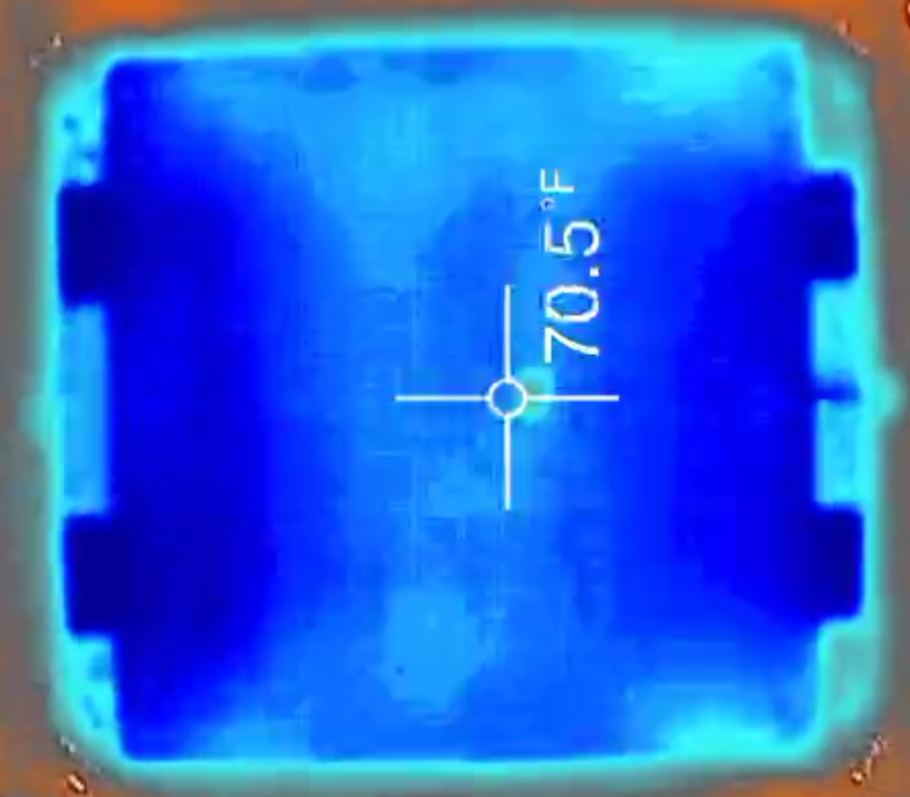
ITO window heater
CCDs cold, ~20W heat
CCDs warm
+ 68.5
Only 1 C gradient,
Power as expected

Slide 9
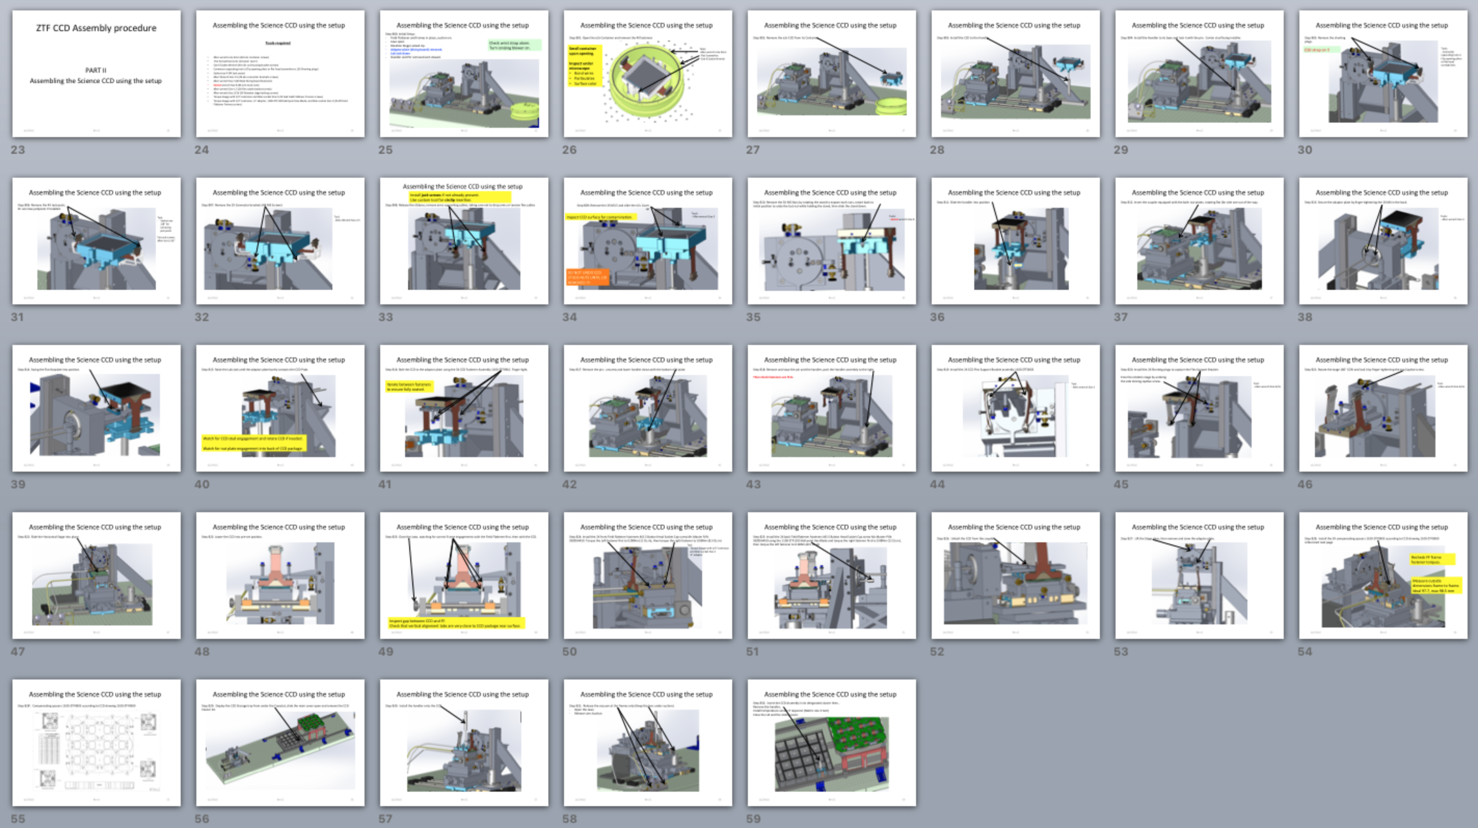
Assembly story boards

Slide 10
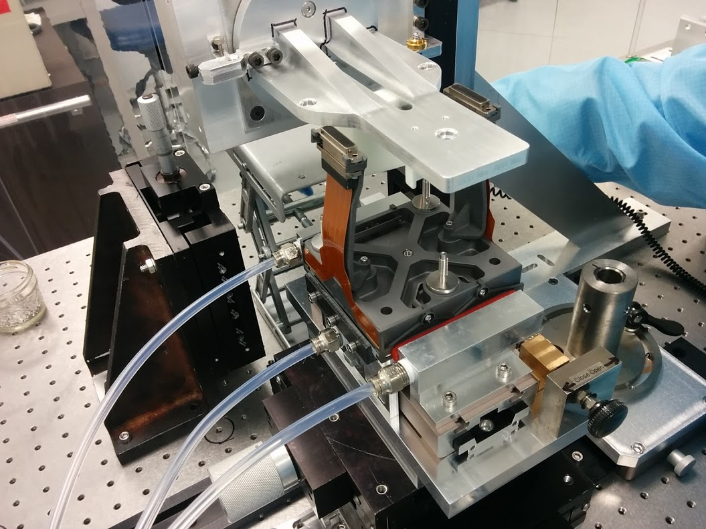
Field flattener installation on CCD

Slide 11
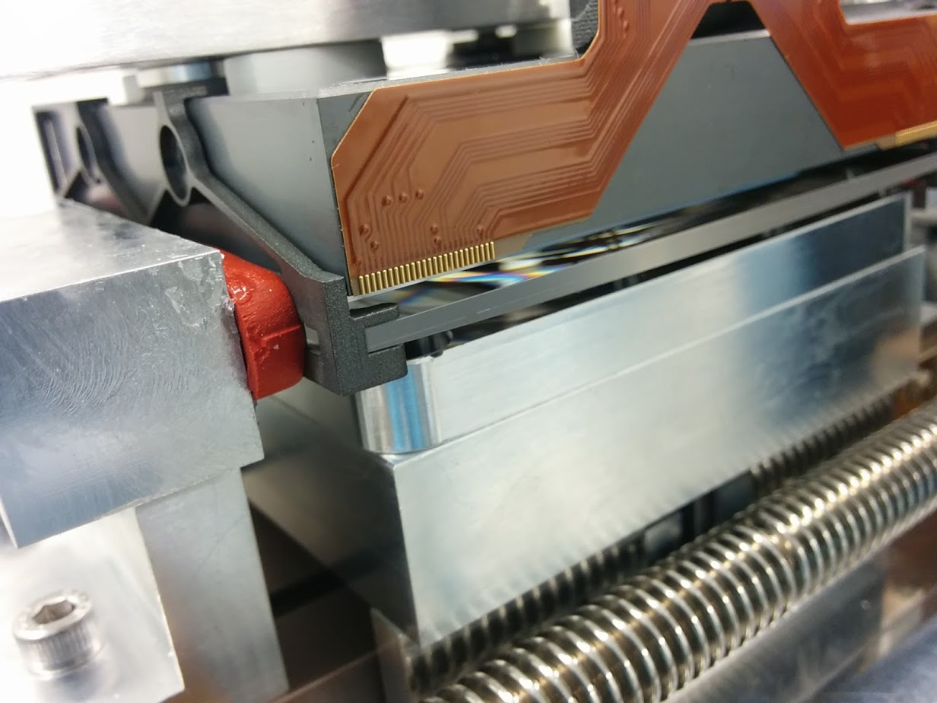

Slide 12
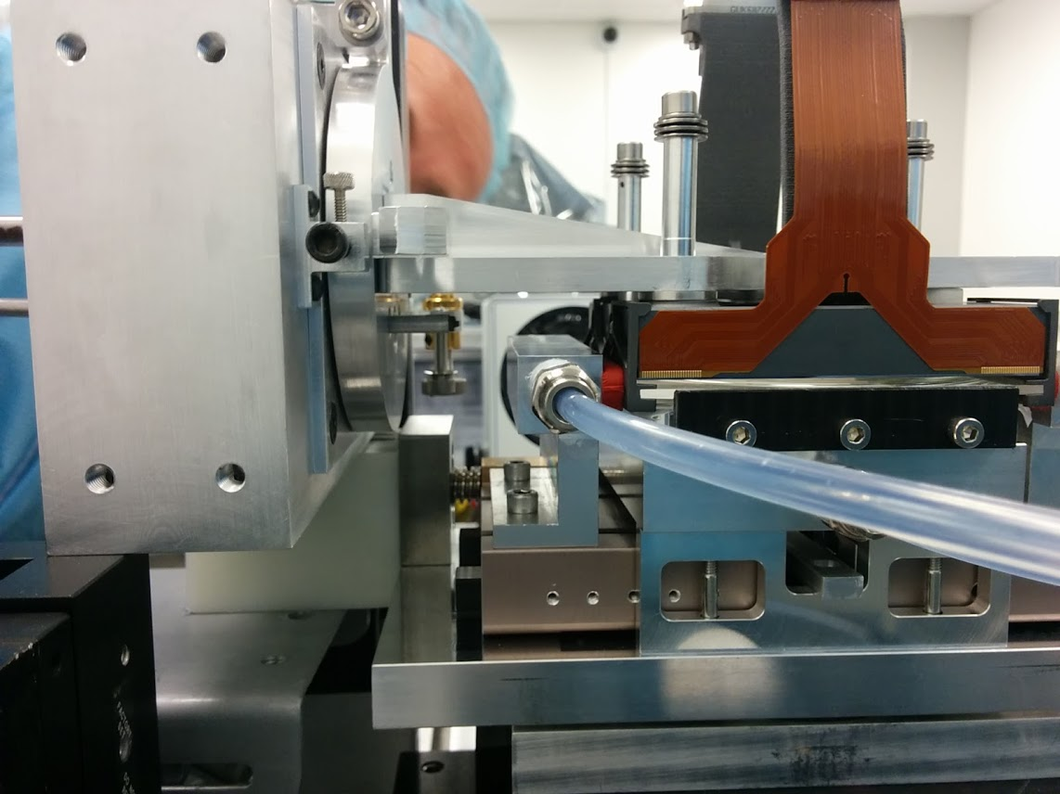

Slide 13
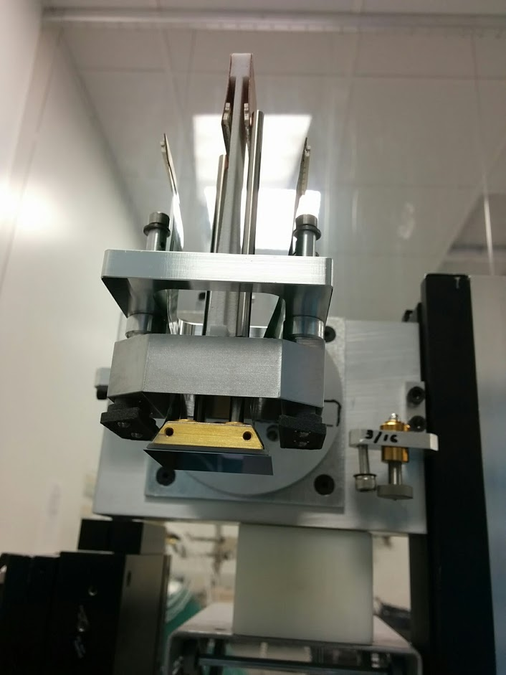
Guider part way into its housing

Slide 14
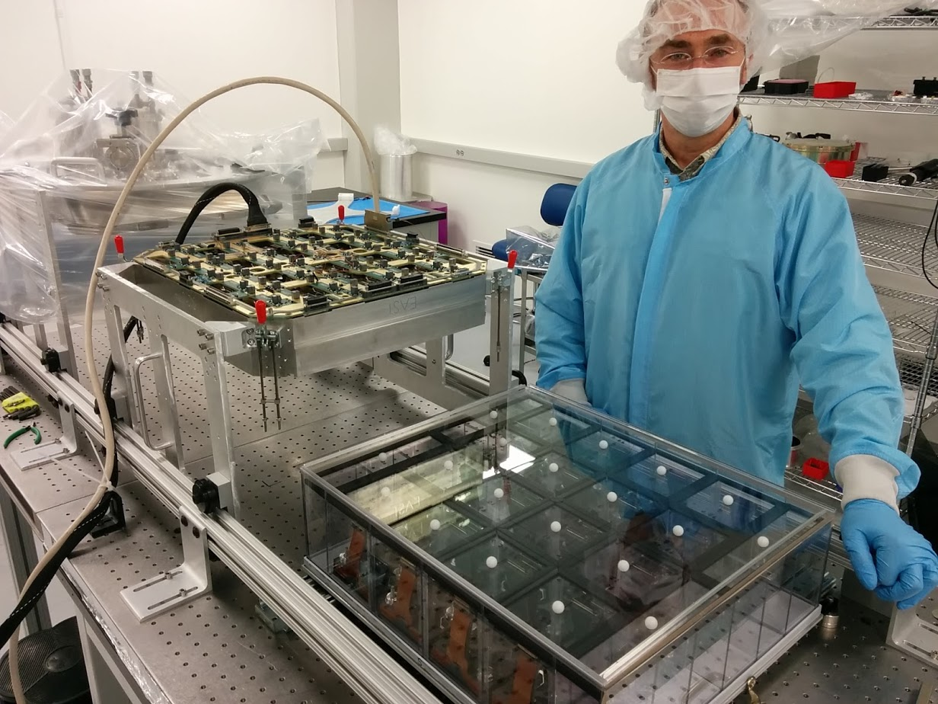

Slide 15
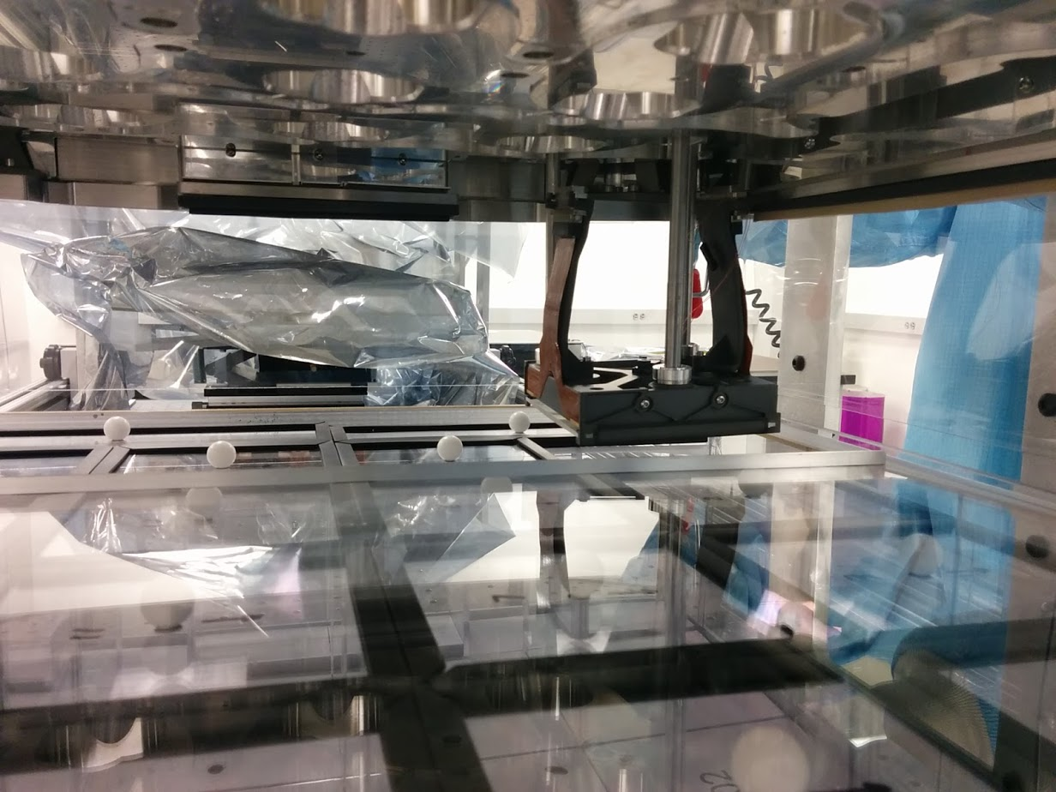

Slide 16
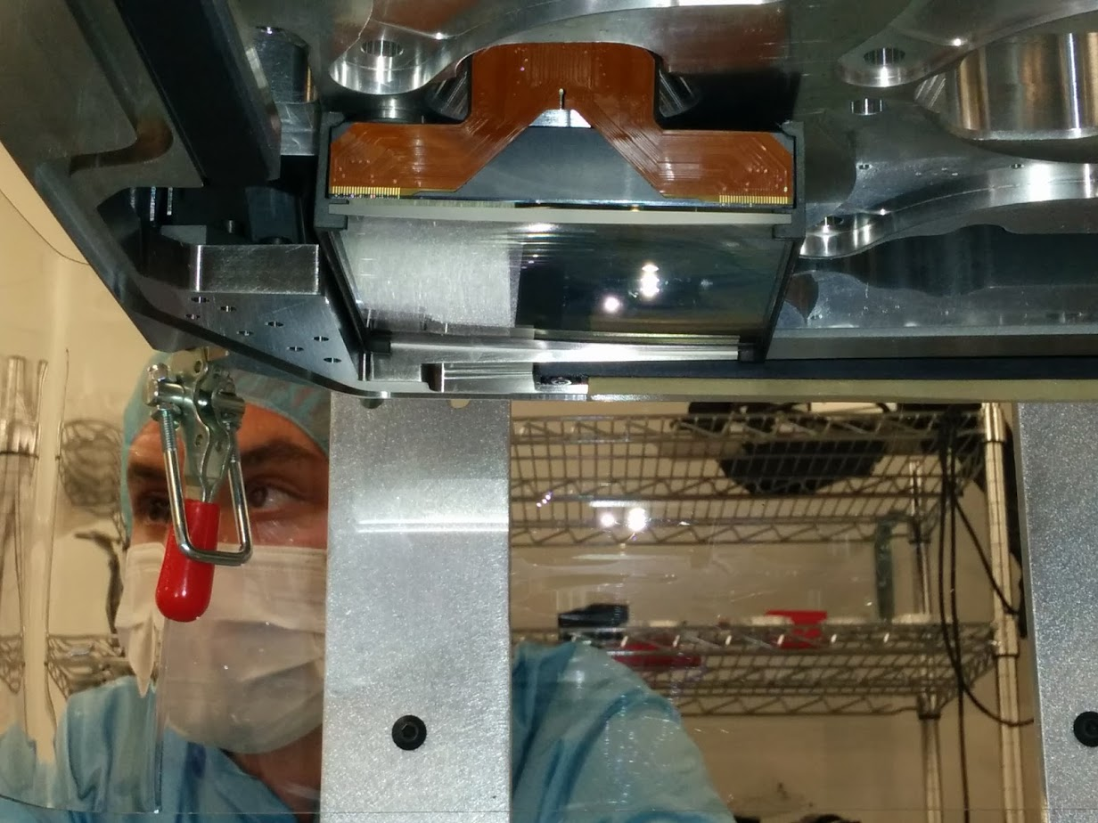

Slide 17
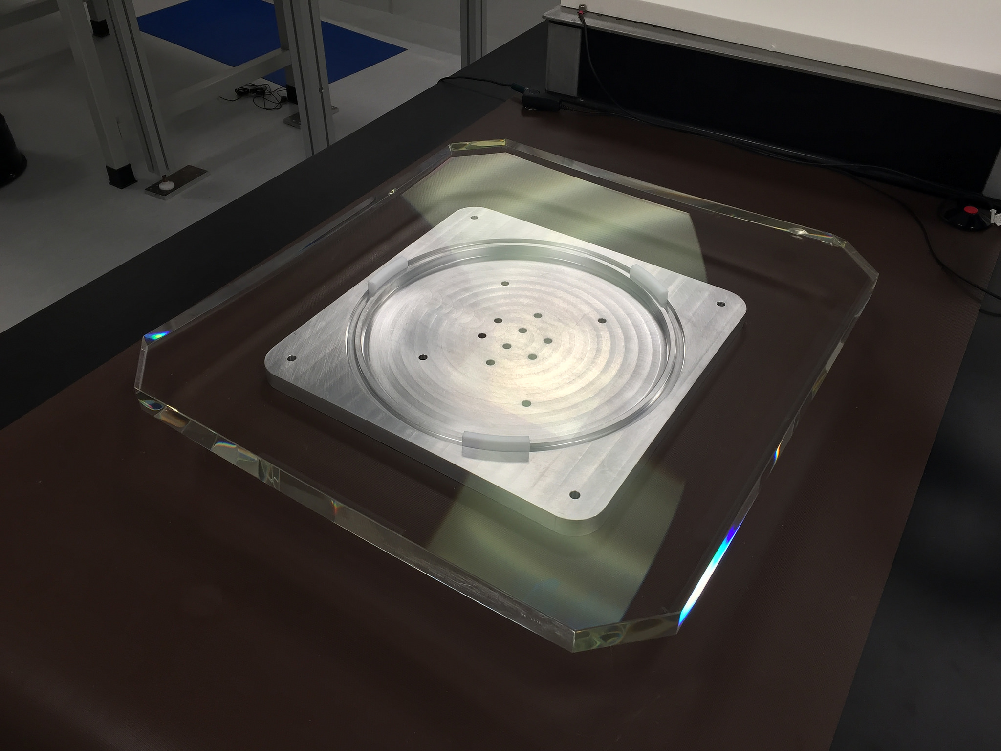

Slide 18
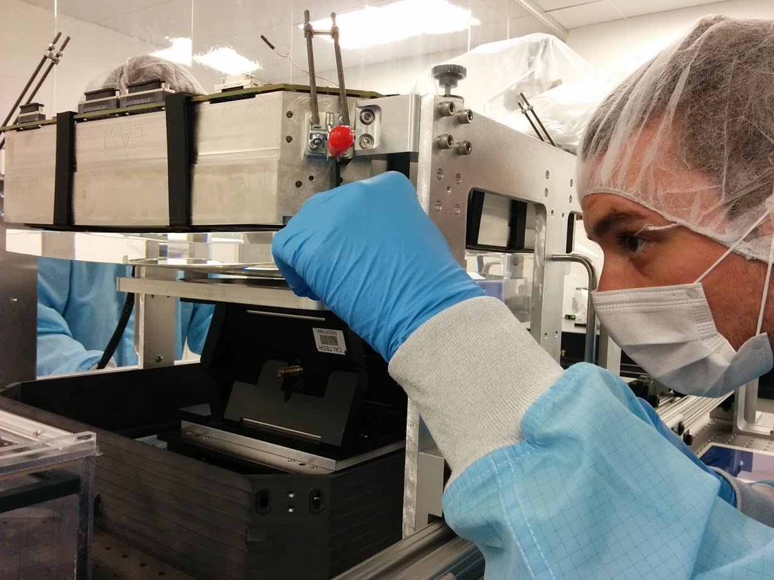

Slide 19
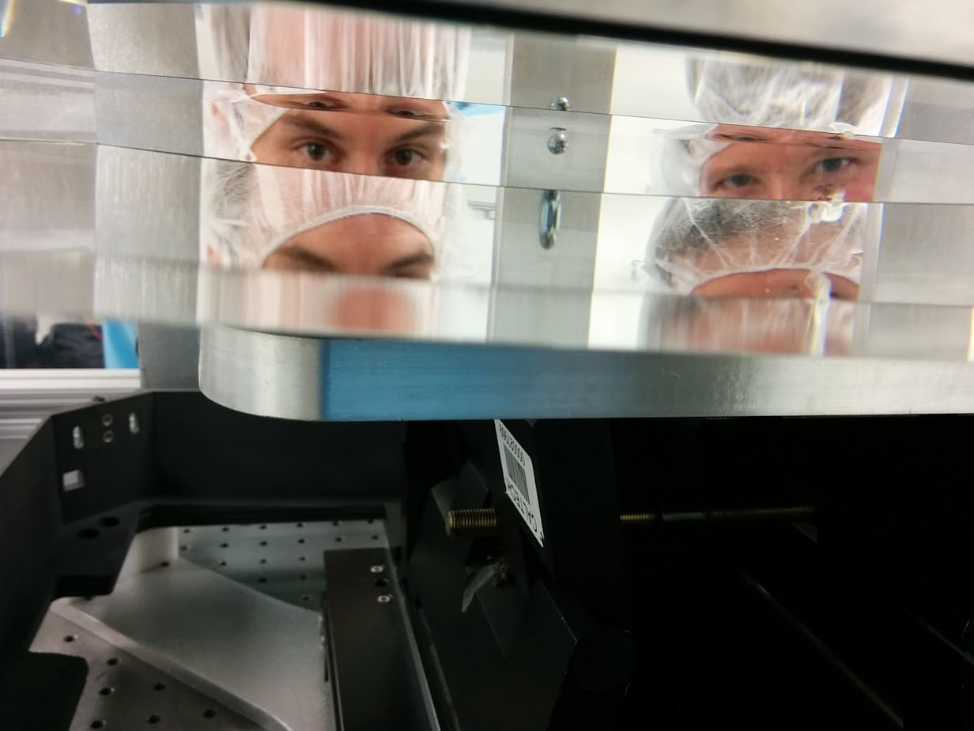

Slide 20
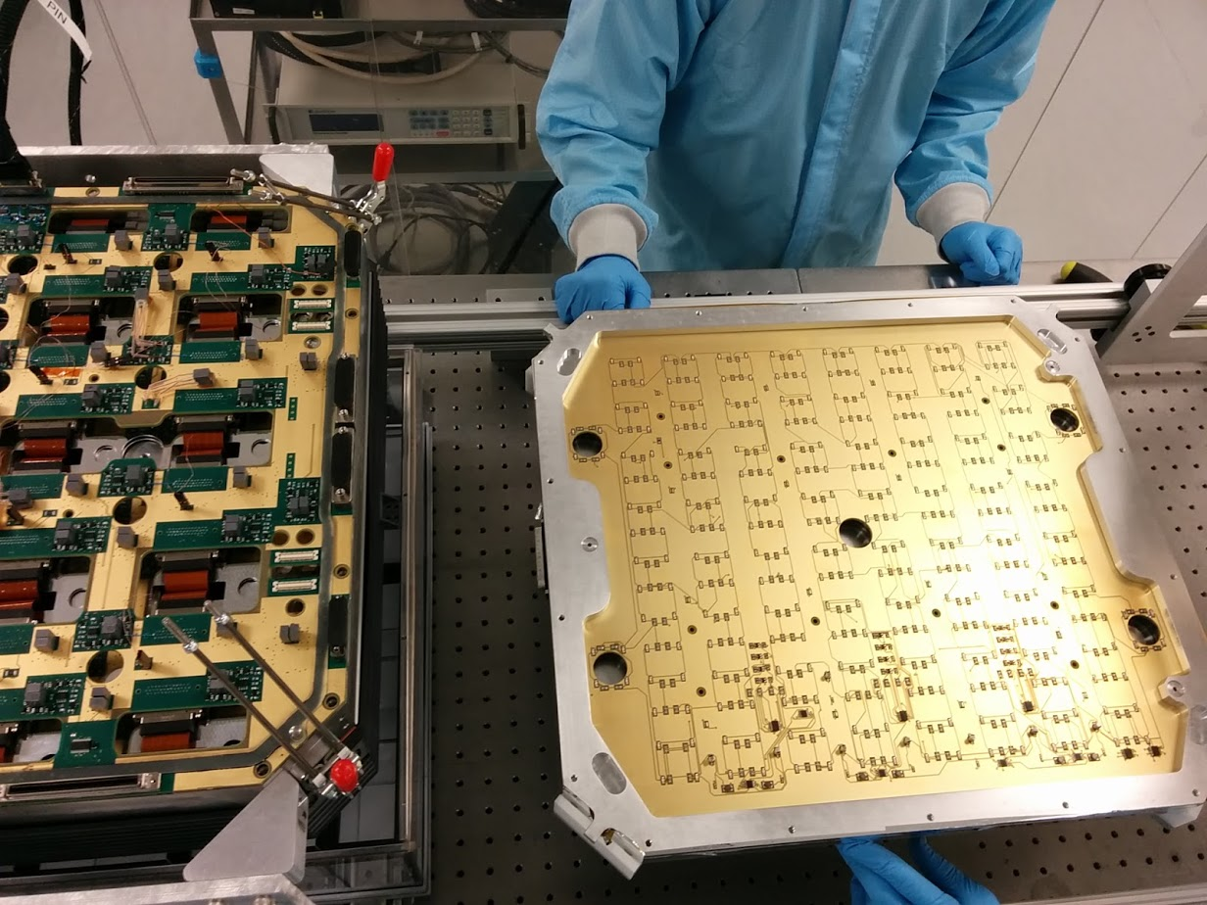

Slide 21
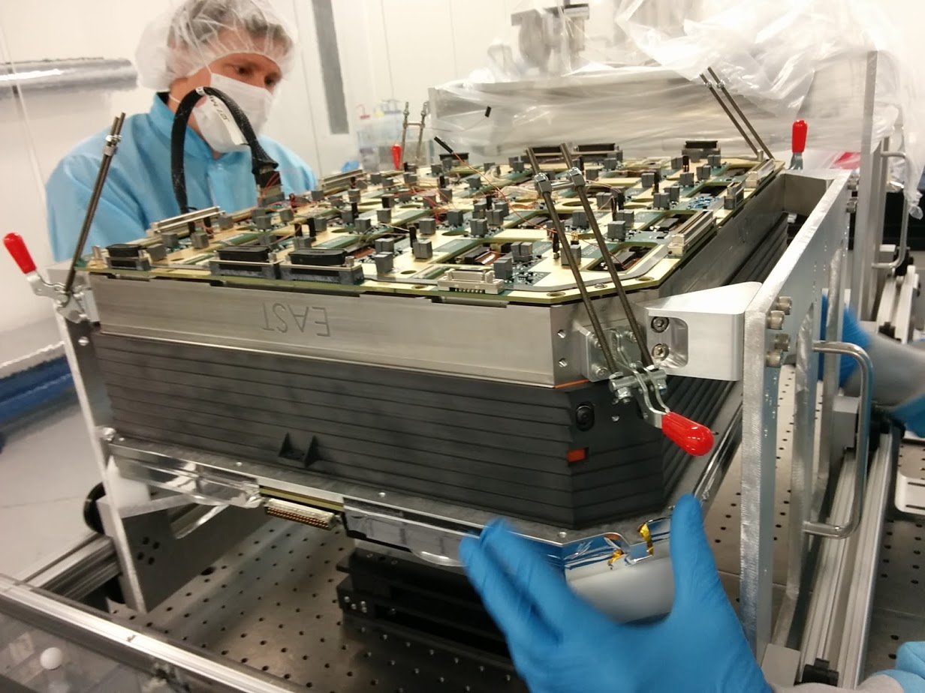

Slide 22
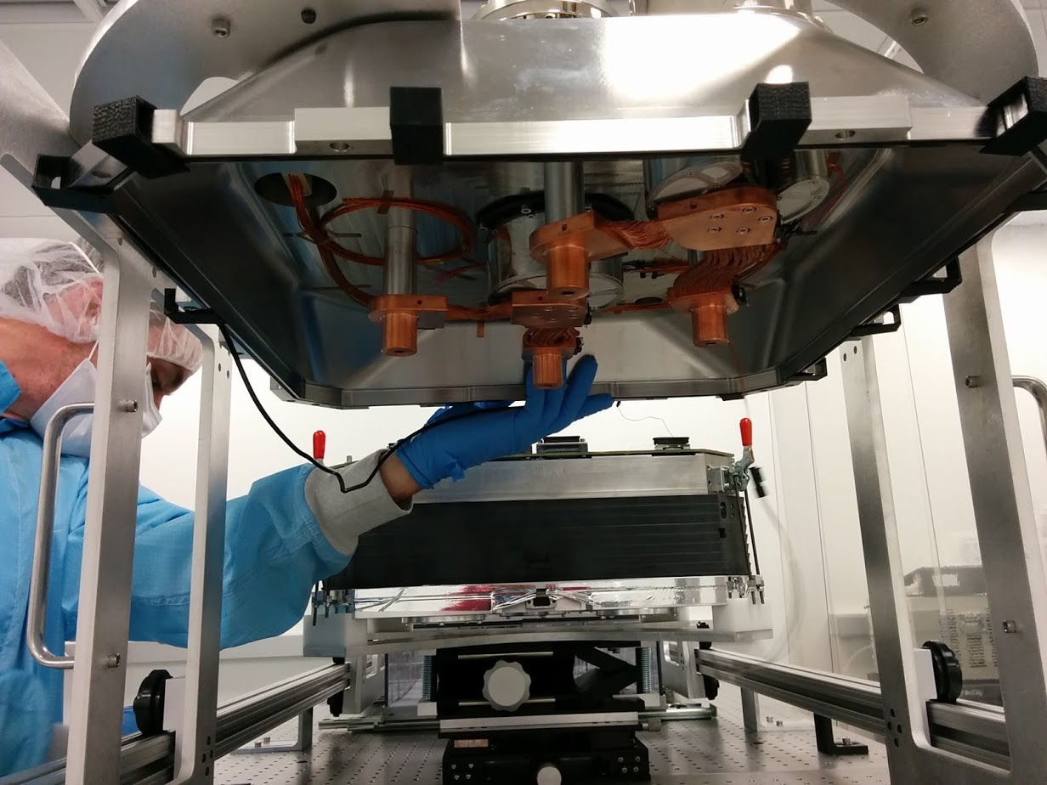

Slide 23
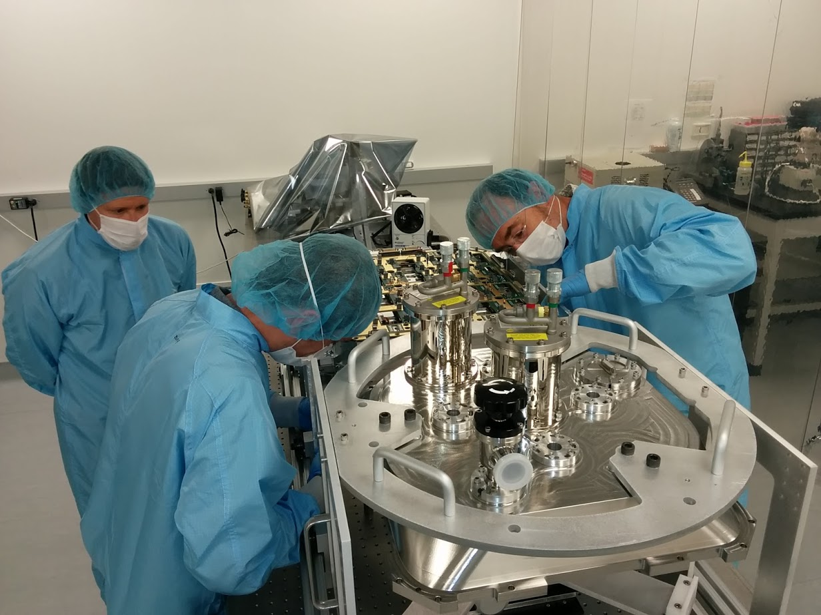

Slide 24
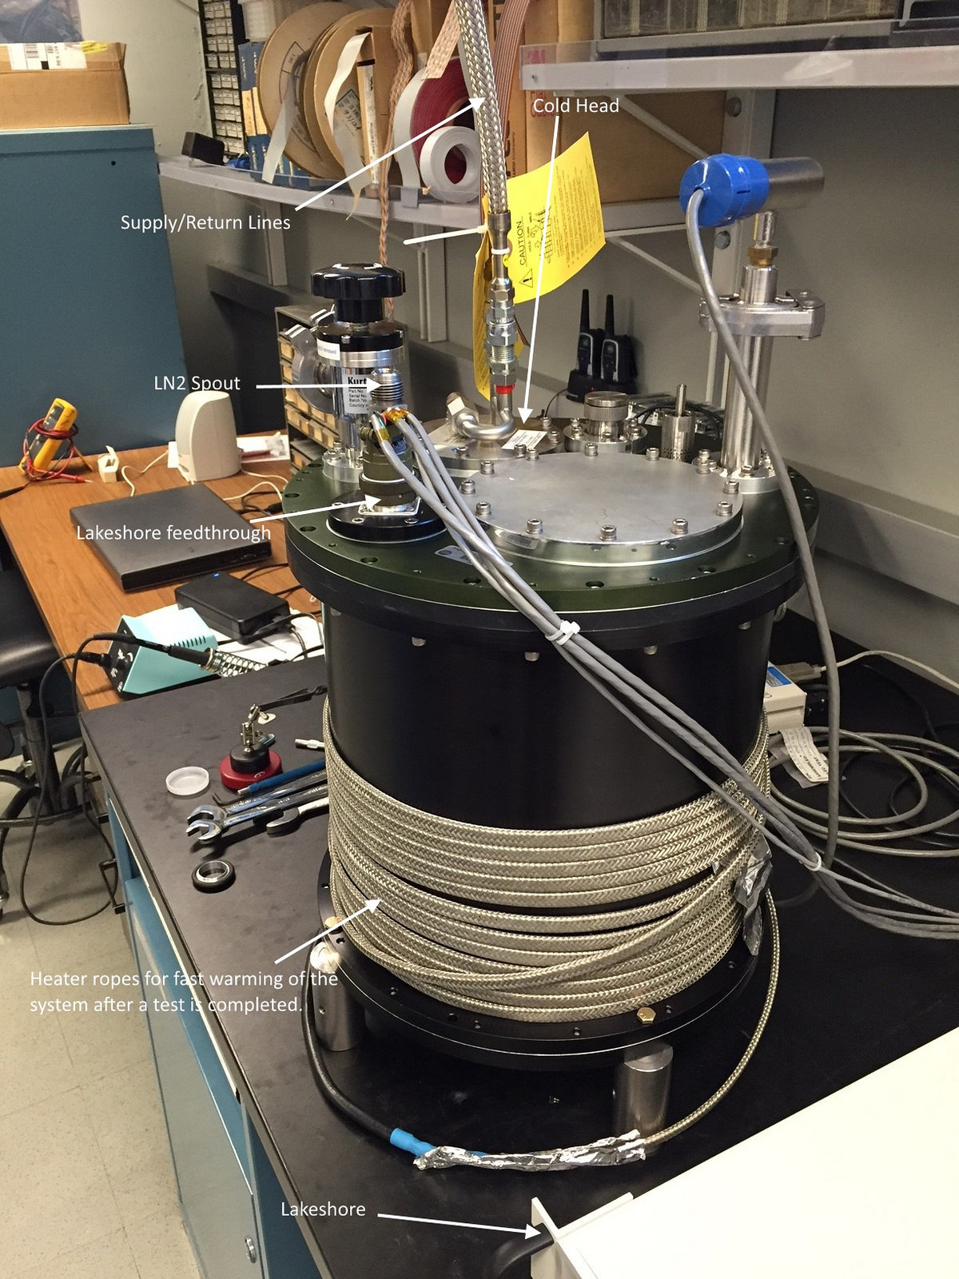
JT Cooler test system

Slide 25
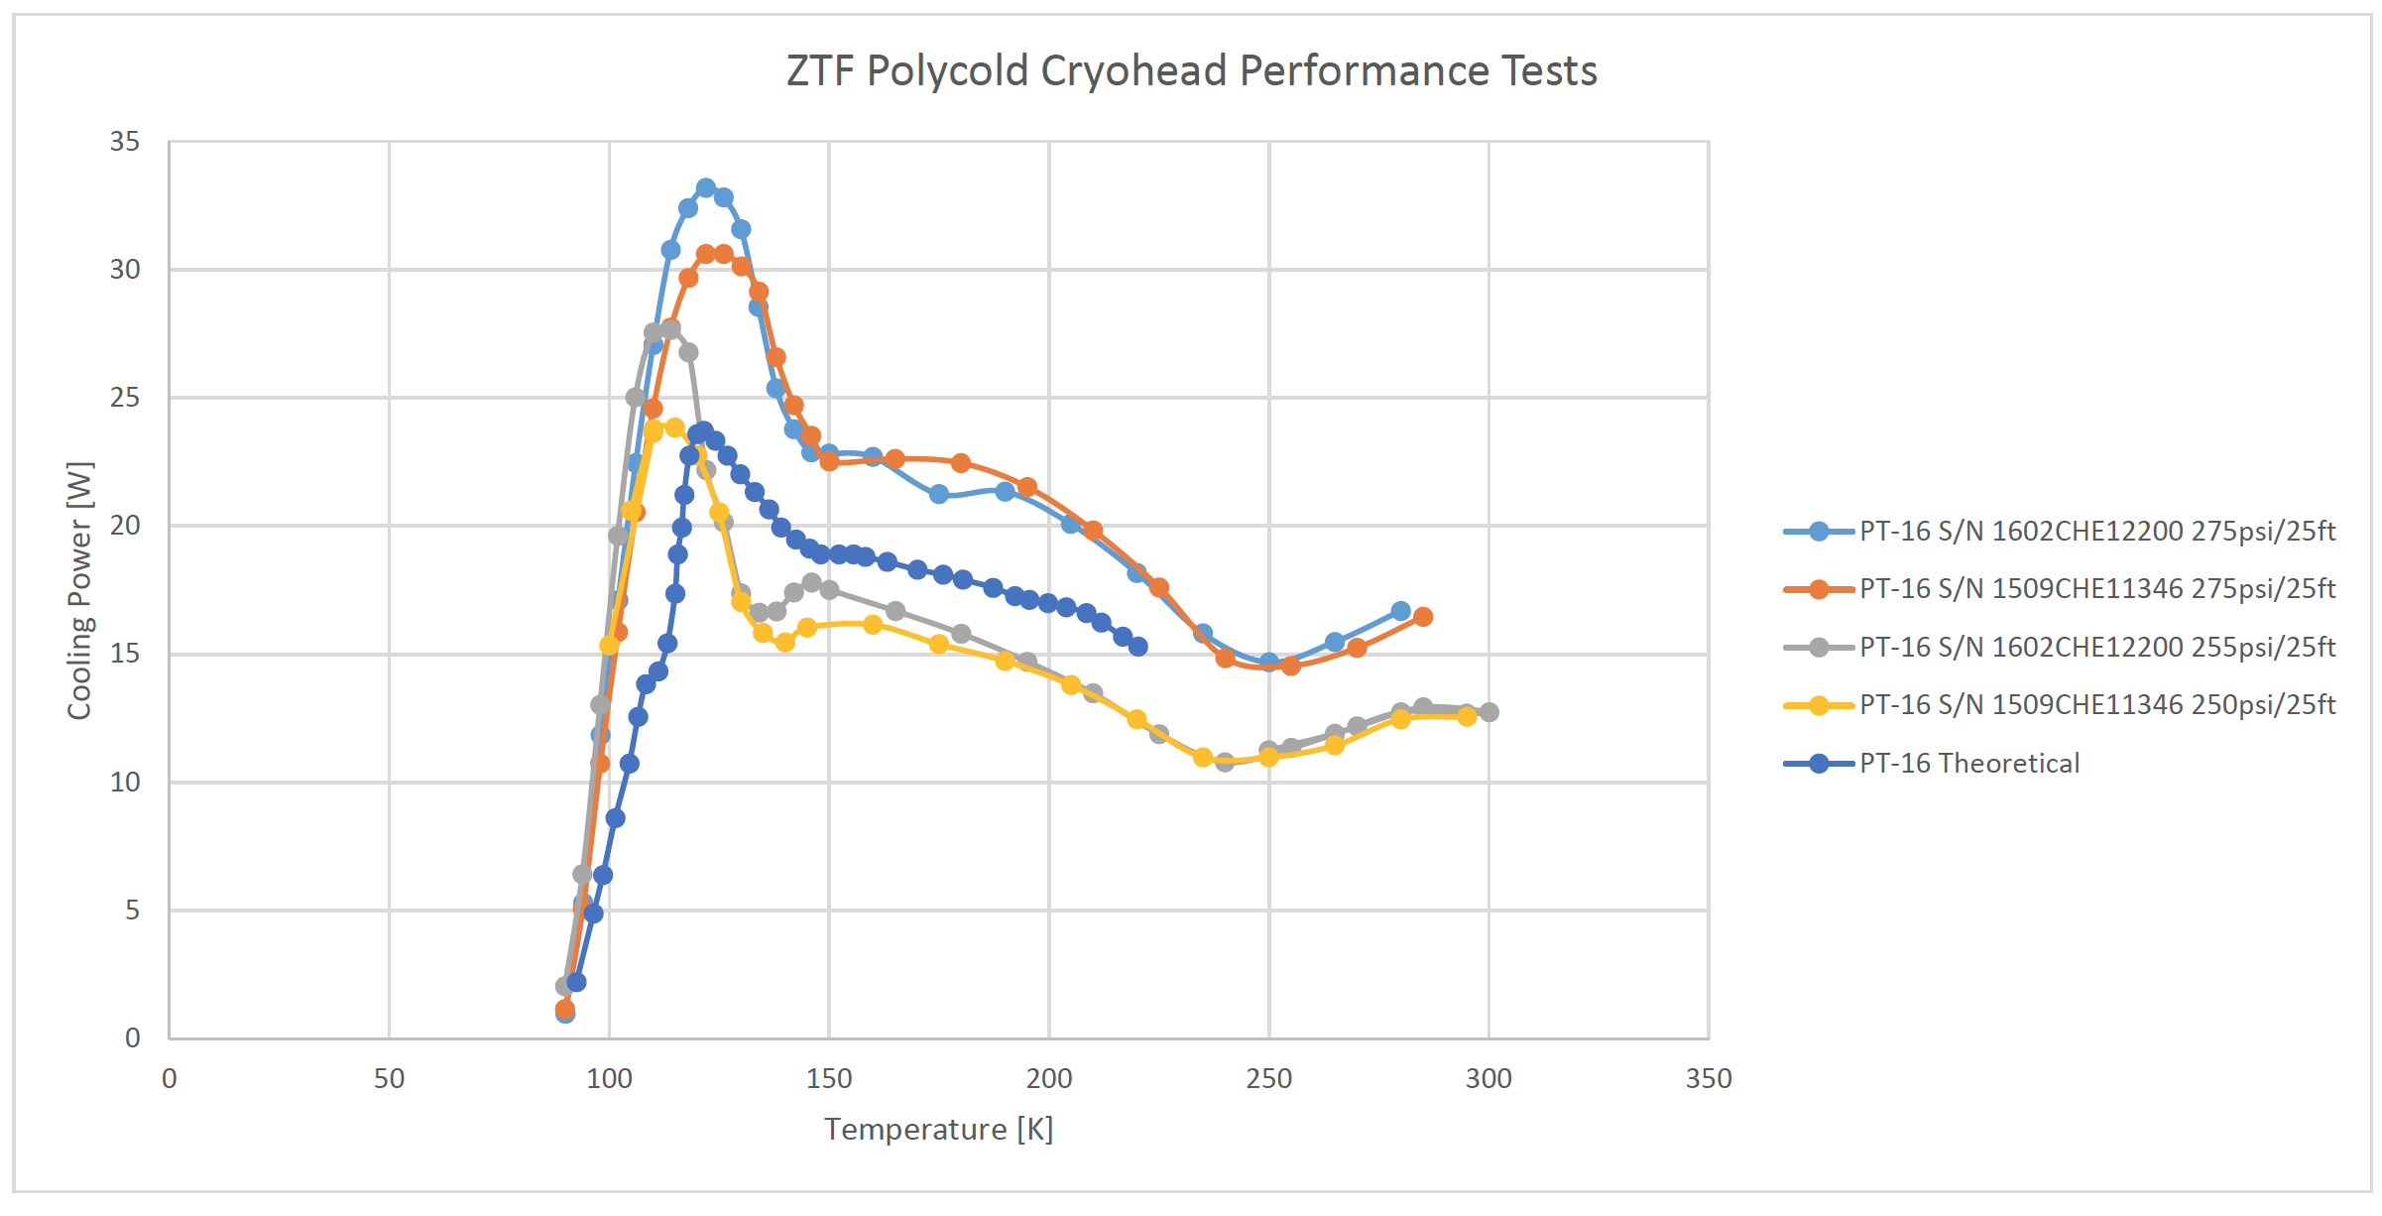
Cooling power measured at Caltech

Slide 26
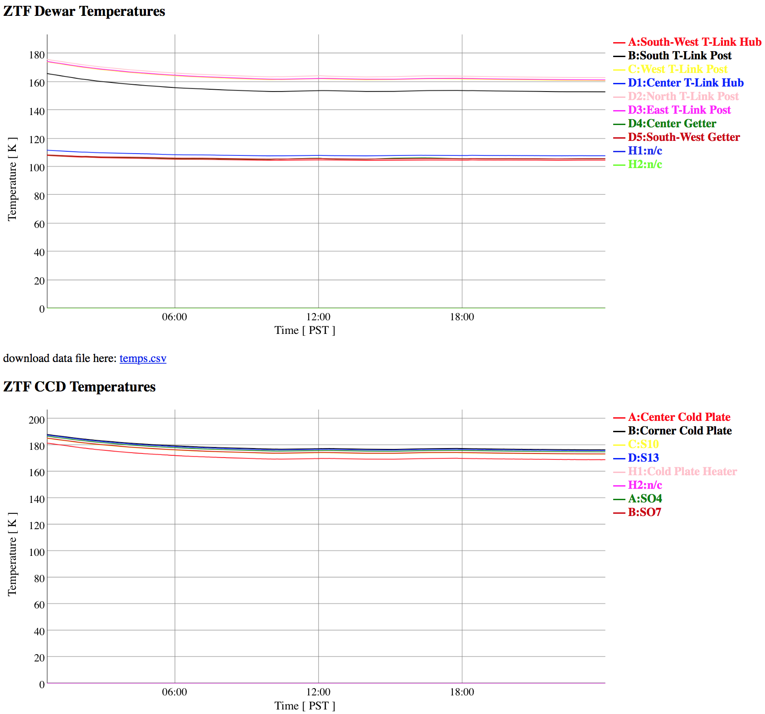
Cooling system works
Need new thermal links to bring CCD temperatures down to 155 K with no heater

Slide 27
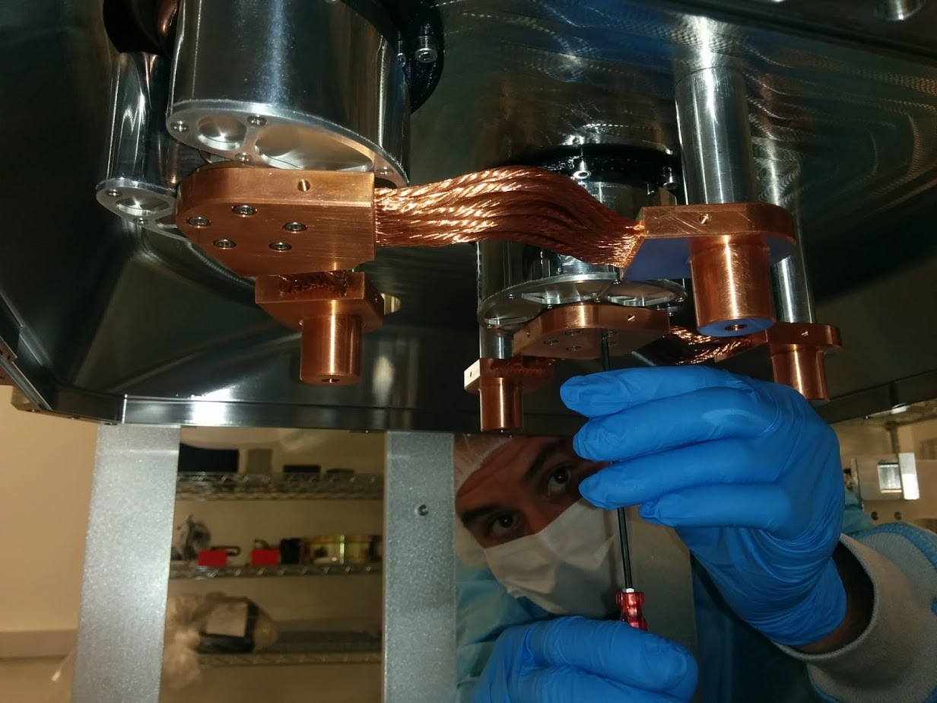
Thermal links and getters
These need to be replaced with more conductive links ☹

Slide 28
CCDs outputs all alive
All CCDs are reading out.
Overscan and prescan in parallel and serial directions is present.
Cosmic rays are present.
Still much work to be done.

Slide 29
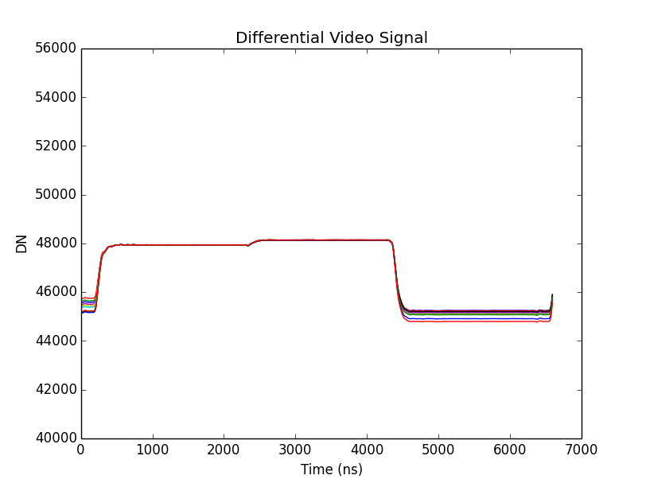
Video Signal (slowed for clarity)
Positive
Video Output
Inverted
Reference
Differential
Video Output
Reduced feedthrough
Faster settling
Noise immunity

Slide 30
Automated Testing Data
With 72 total video channels, test automation is essential. E.g…
← Feedthrough pulse height vs RG_low level for 64 channels:
← Data acquired and analyzed automatically in ~15 minutes.

Slide 31
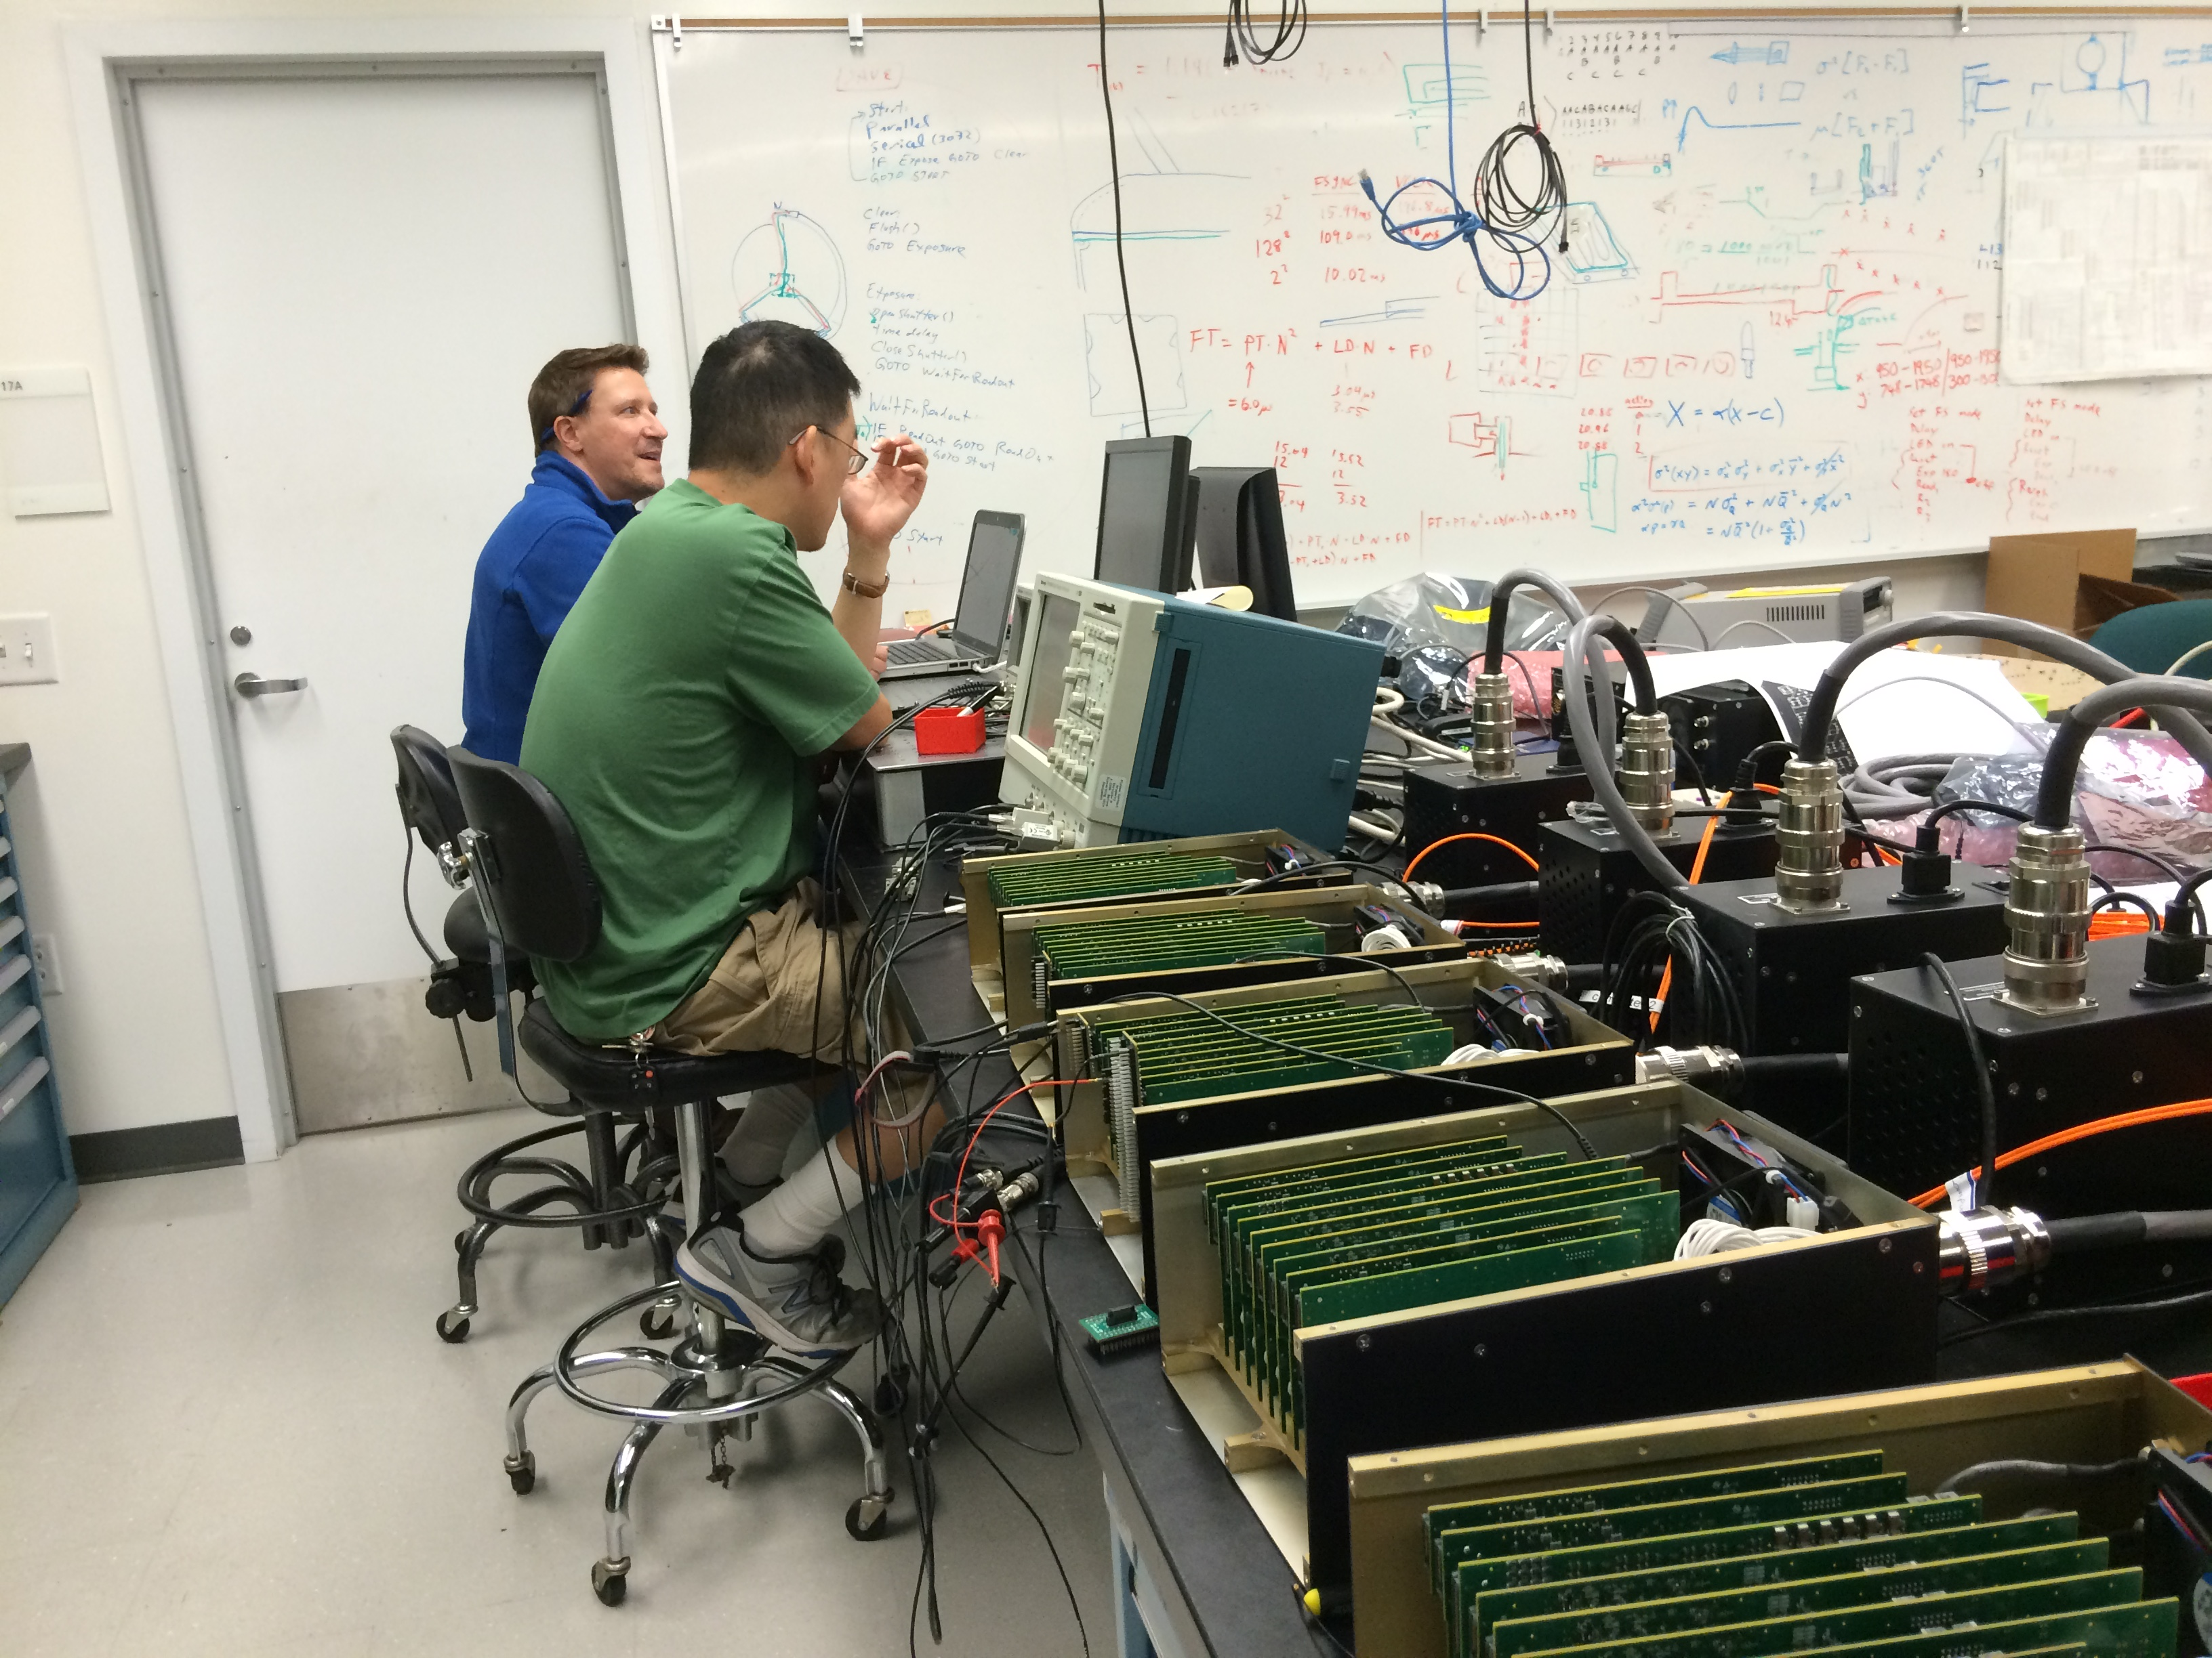
Dec 2015
Stephen Kaye, EE
Peter Mao, Physicist
STA Archon CCD controllers
One per quadrant, one for guide/focus

Slide 32
Automated Test Example
Controller-only crosstalk test
← Response on each channel versus the other 15. (one of 5 controllers)
Large data set taken and analyzed without interaction.

Slide 33
Waveform Definition Language (WDL)
Developed “compiler” for language that waveforms and sequences to be defined by timing rules.
Timing and voltages can be parameterized.
Parameter can then be manipulated by scripts which automate tests.
Can support many permutations of variable clock levels, shifting direction, and waveform timing.
Can implement dependencies of one bias voltage on another etc.

Slide 34
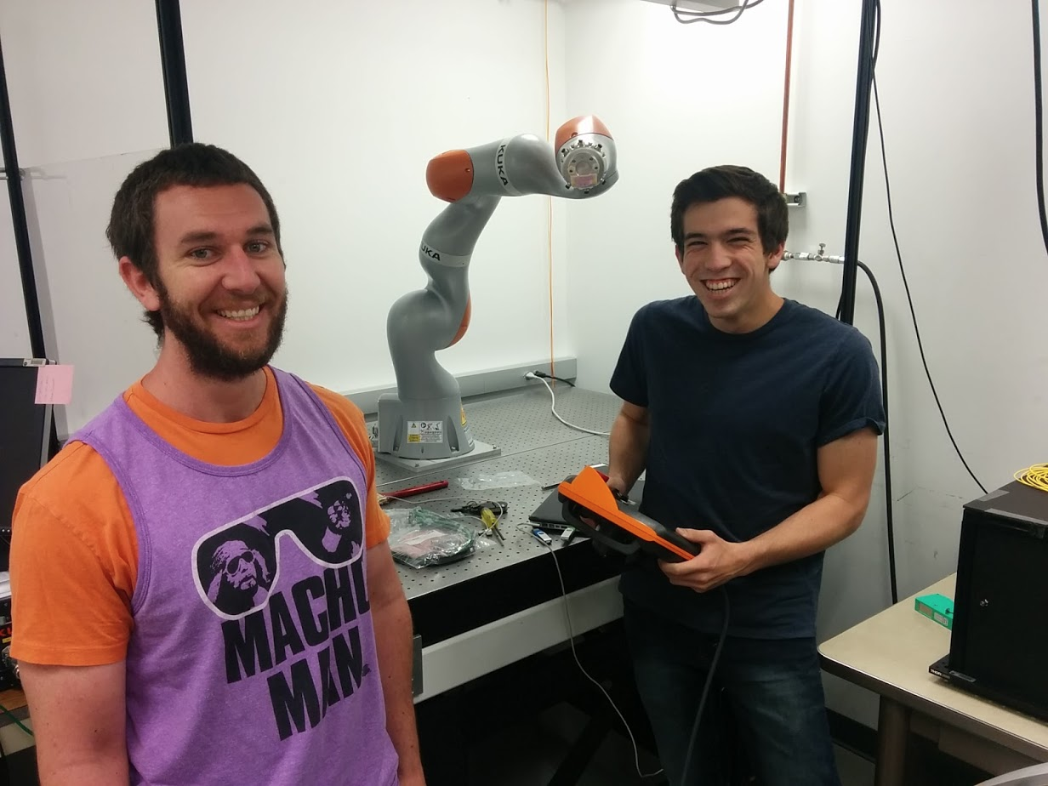
Robot for filter exchanger
Michael Porter, ME:
Filter Exchanger design
Kuka Robot
Jake Zimmer,
Intern: magnetic latch sensing

Slide 35
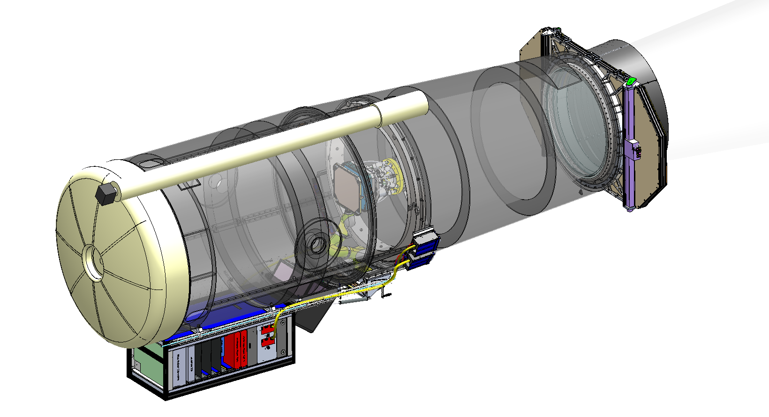
Full P48 solid model

Slide 36
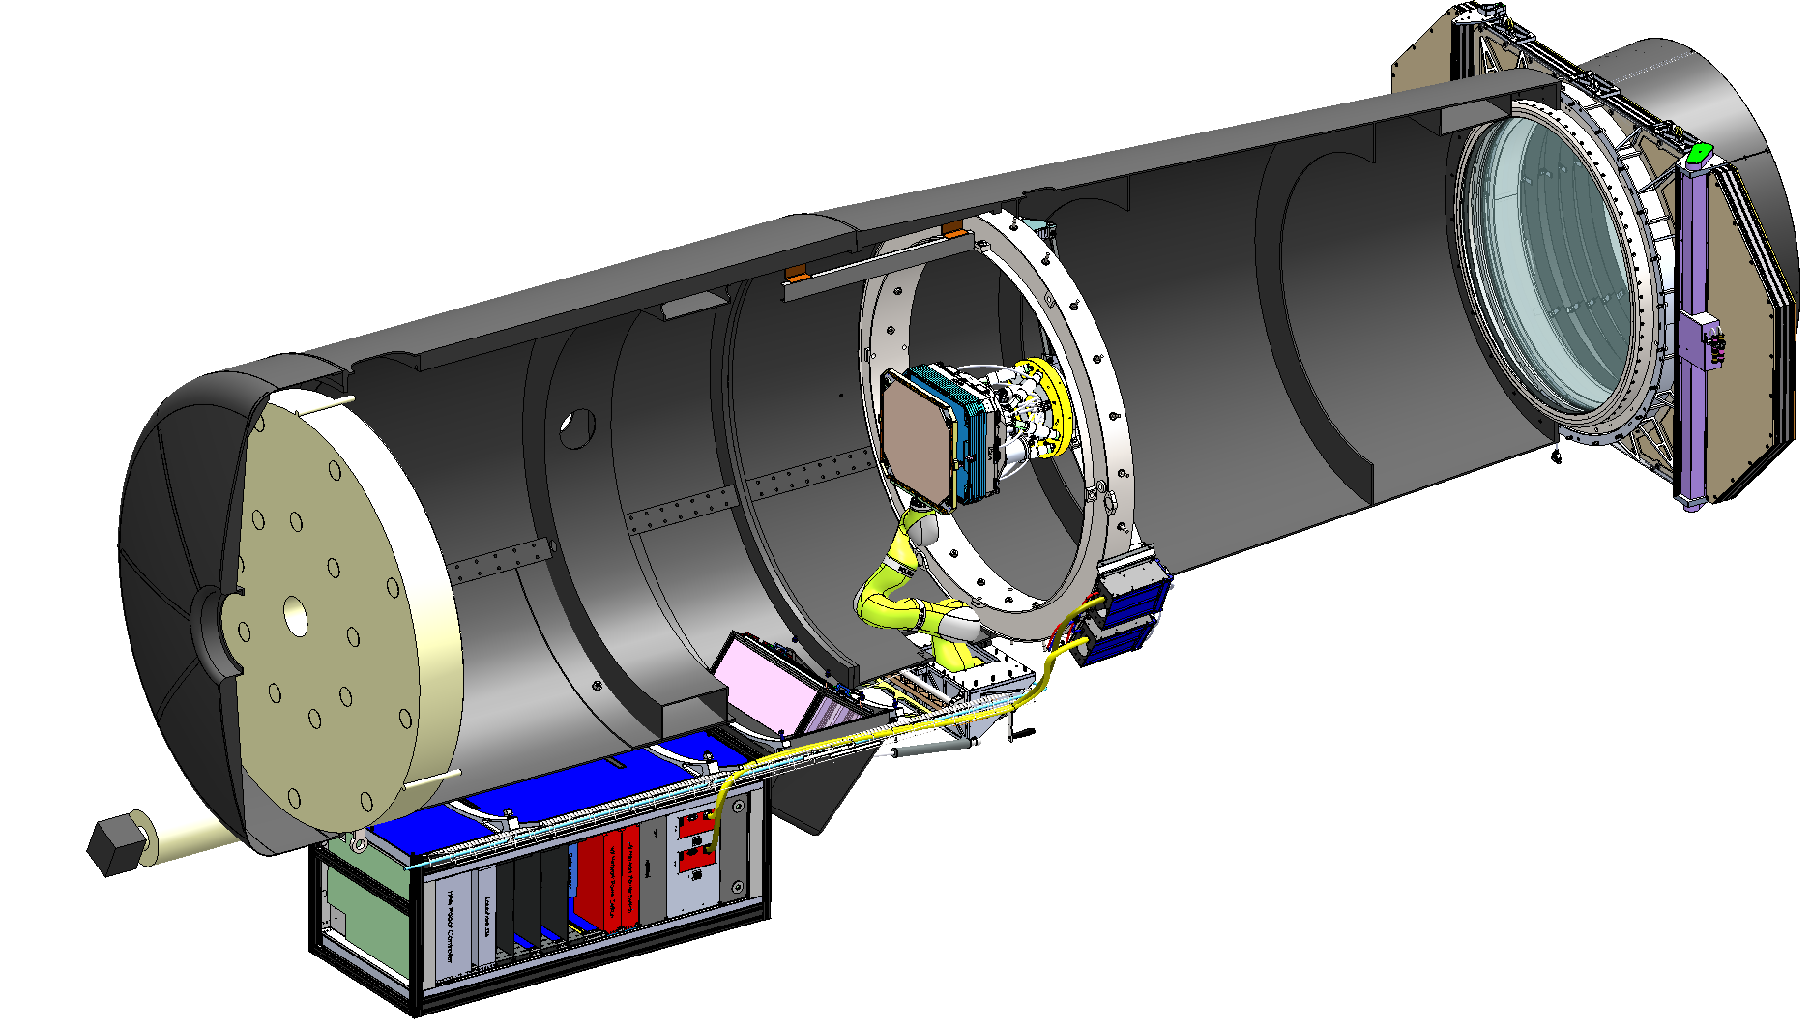
Cutaway (spiders suppressed)
New forward baffle
Bonn Shutter
CCD controllers outside end of spiders
Filter filter exchange robot
Filter storage closet docks through manhole

Slide 37
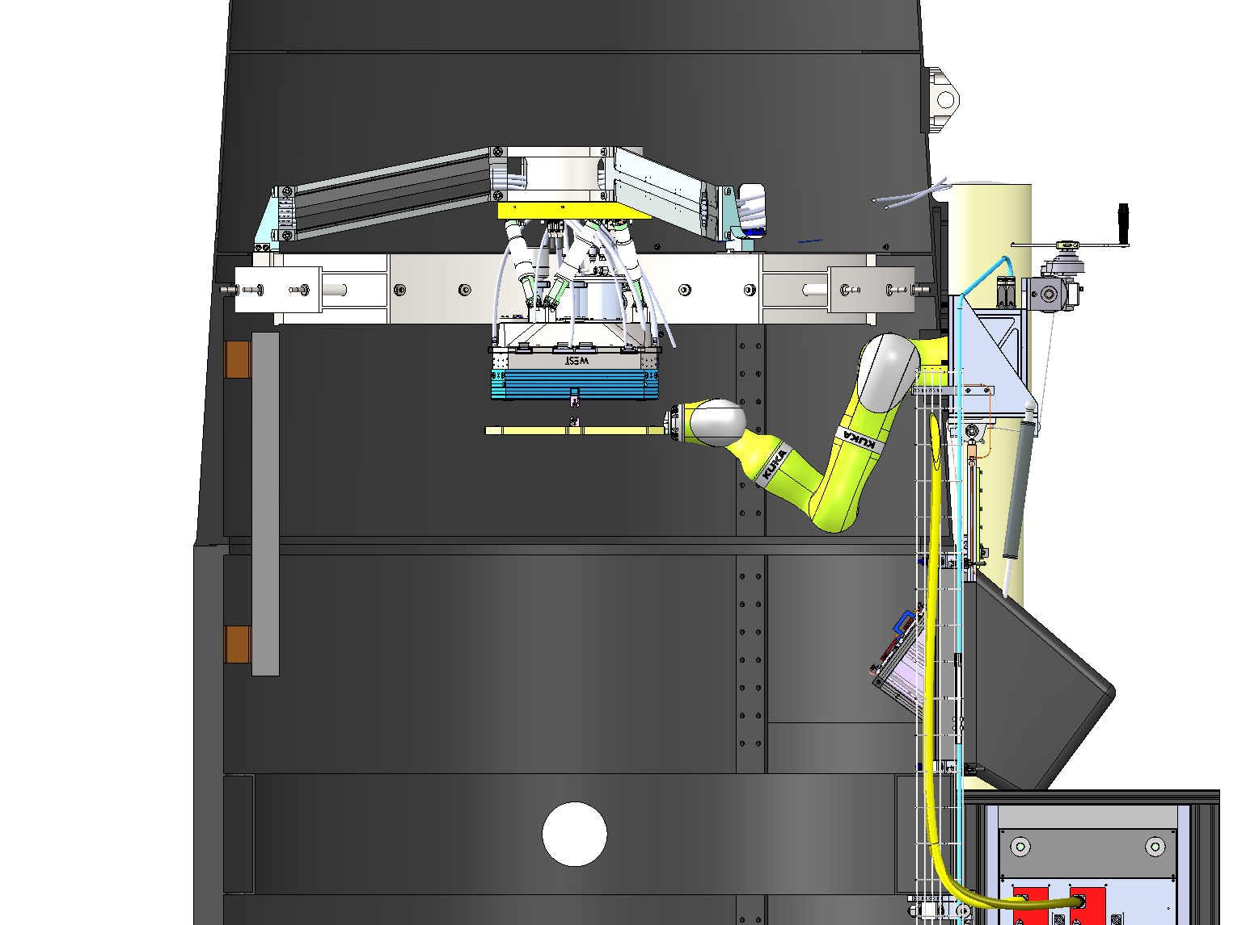
Filter deployment
Redundant latching mechanisms, fully captive at all times

Slide 38
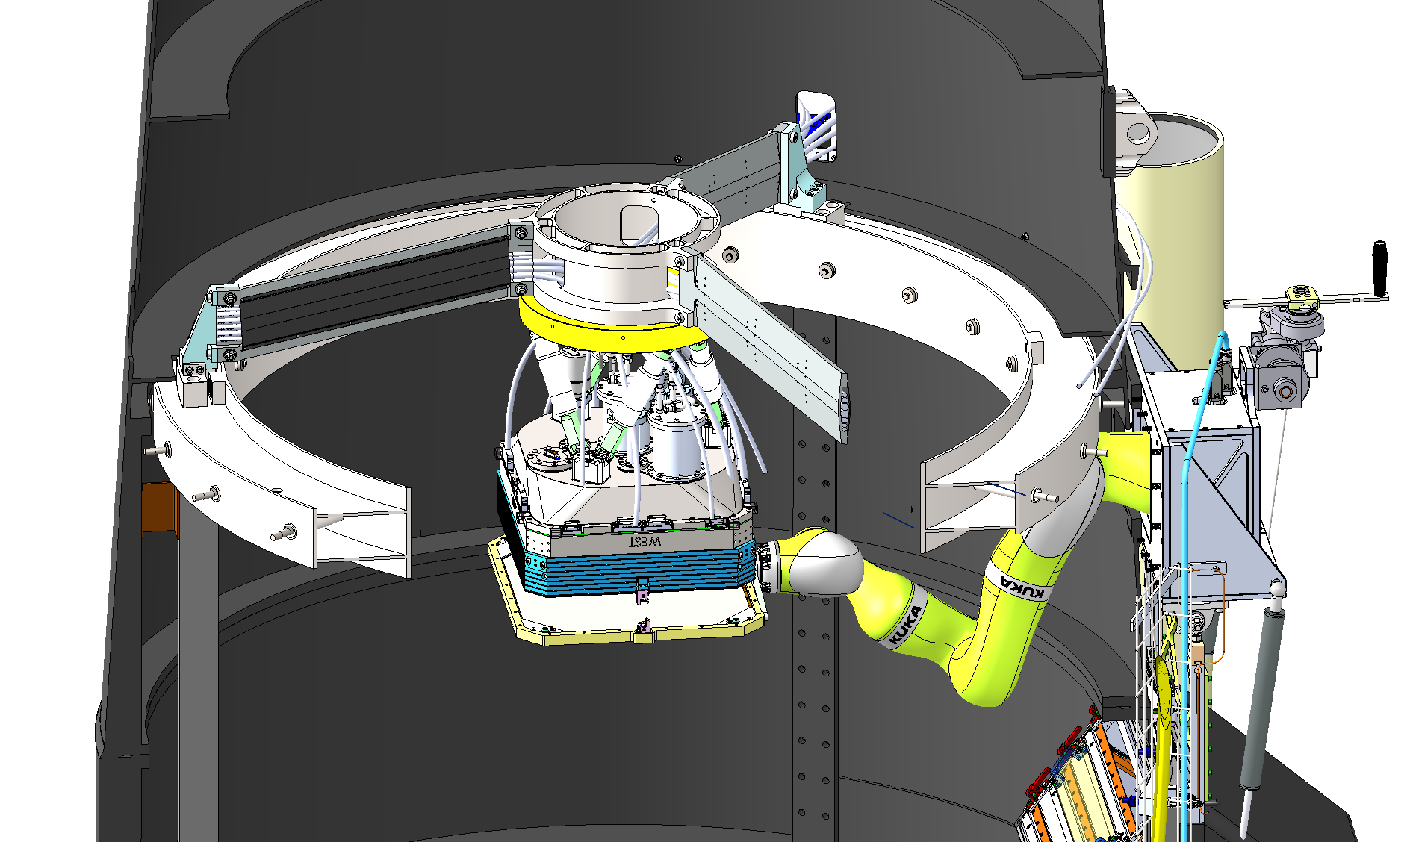
Only 23% beam obstruction by instrument + spiders
Cables and refrigerant lines hidden inside spiders.
Robot retracts and parks under ring girder so no additional beam obstruction

Slide 39
Forward baffle

Slide 40
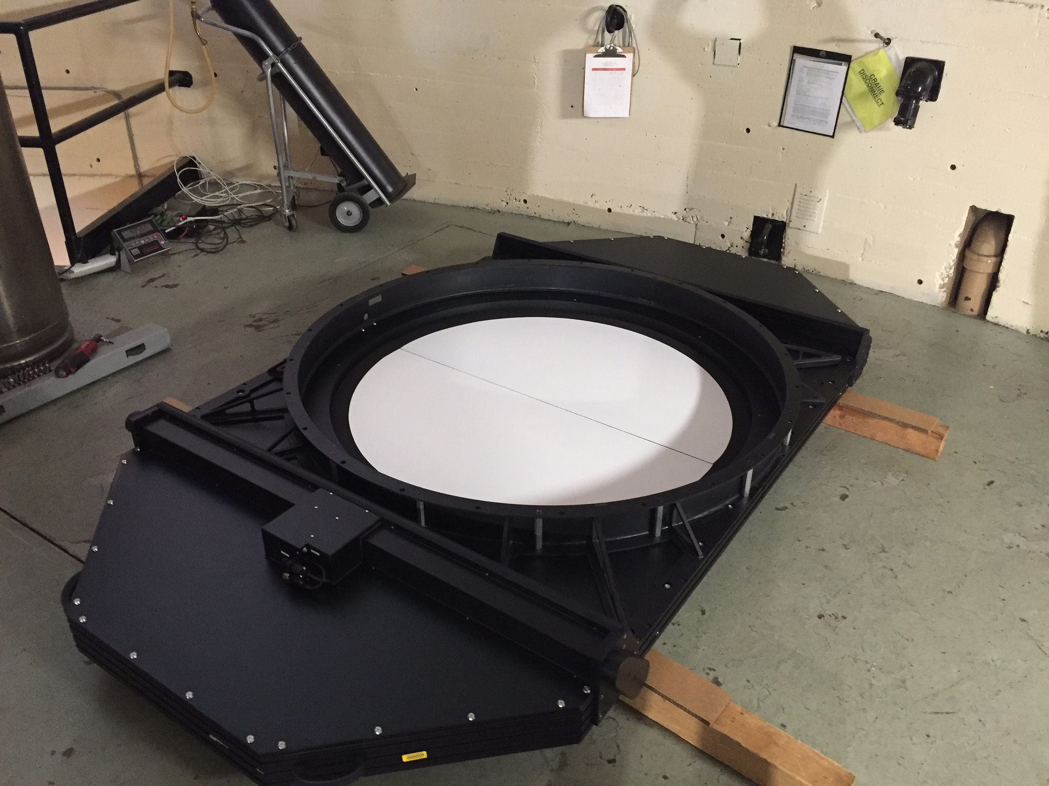
Bonn Shutter on dome floor

Slide 41
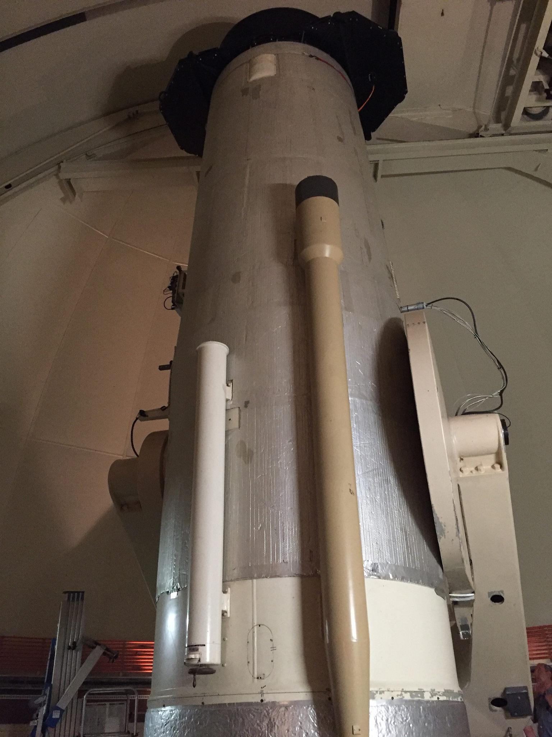
Modest increase in area presented to wind

Slide 42
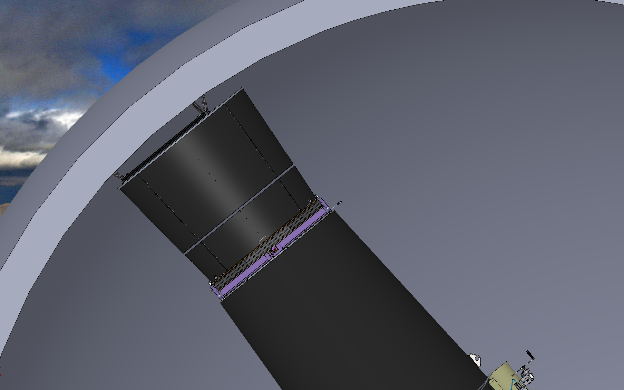
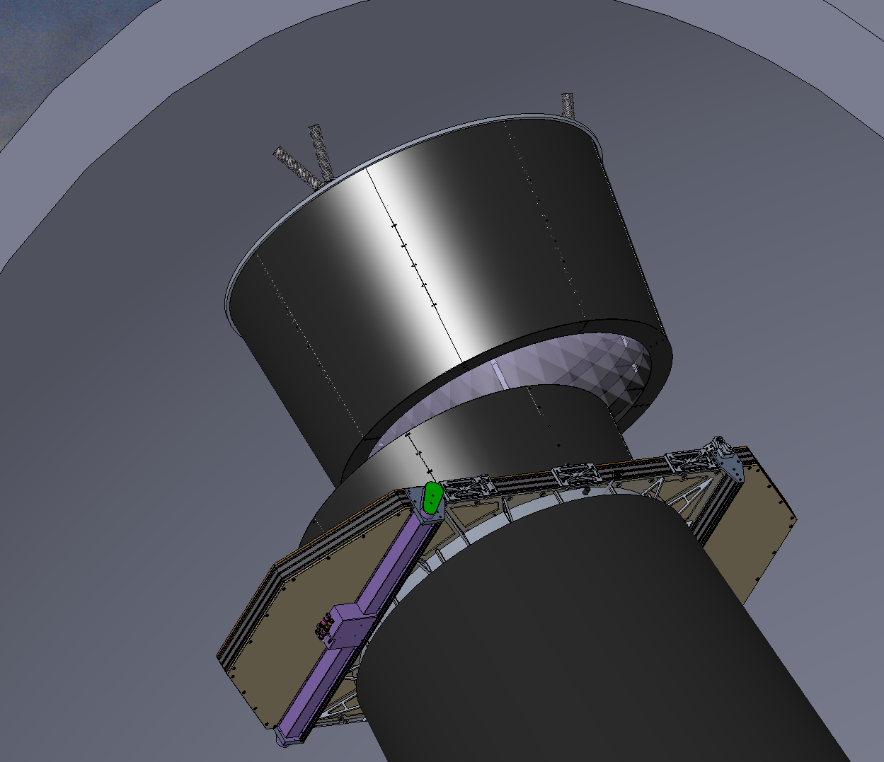
Flat field illuminator
In position
Almost light tight when aligned: ~2” gap with soft gaskets
Moving into position
Ring of LEDs in various colors mounted to illuminator baffle, not telescope.
Fine encoder over short distance around dome docking location allows telescope to move to actual dome position, so dome positioning not critical.

Slide 43
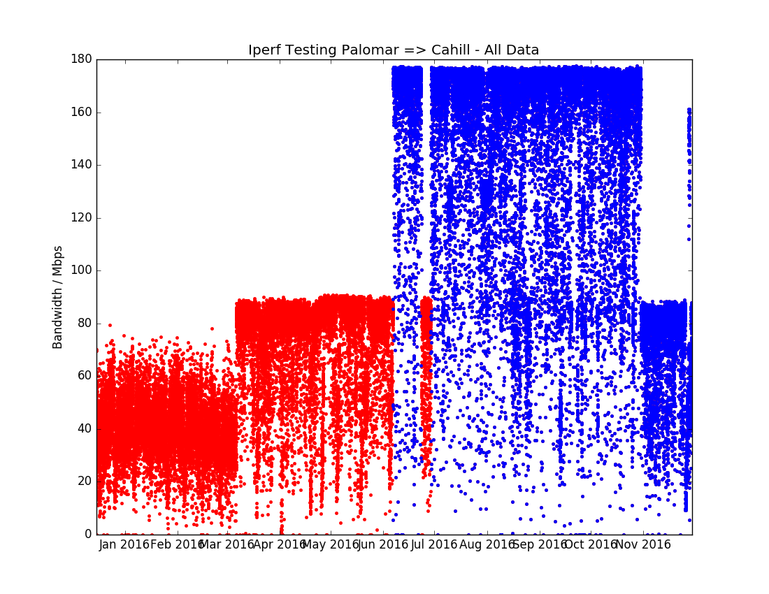
Data link rate monitoring

Slide 44
Good weather

Slide 45
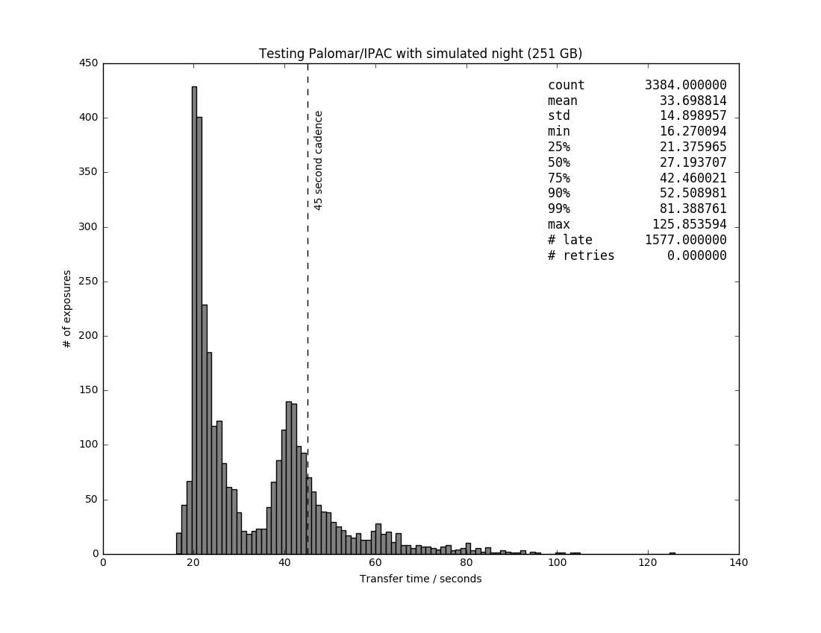
High humidity

Slide 46
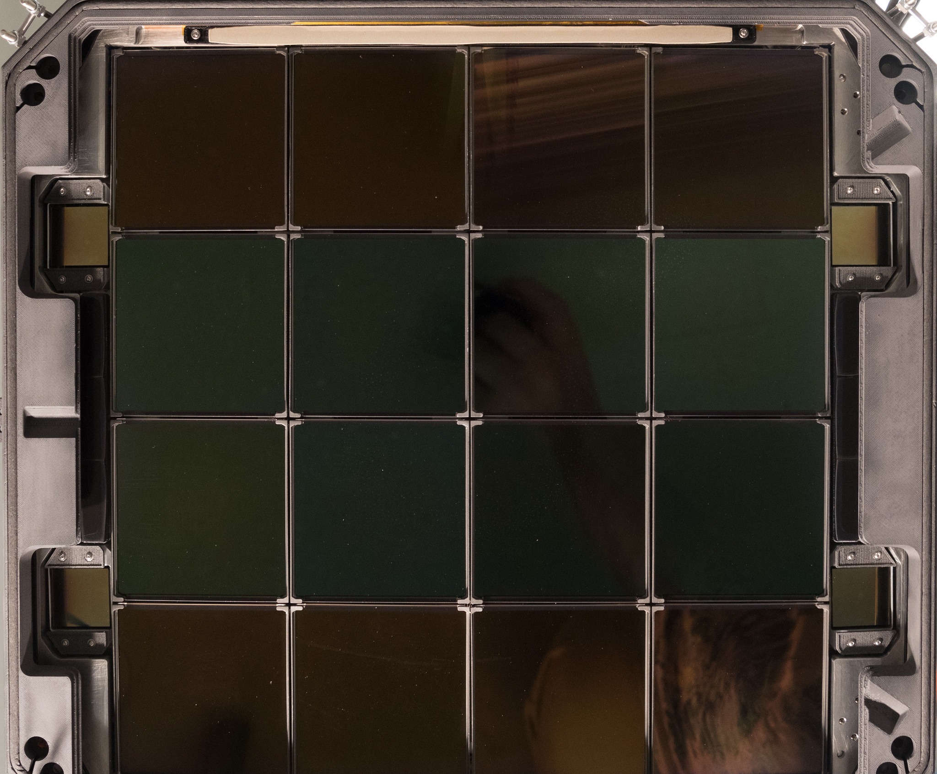
ZTF focal plane last night

