Slide 1
ZTF Filter Mechanism Design Concept Proposal
M. Porter
2016-01-22

Slide 2
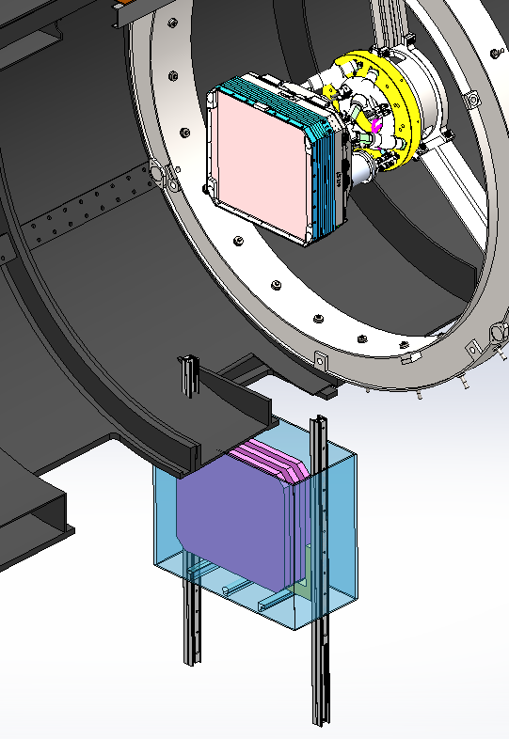
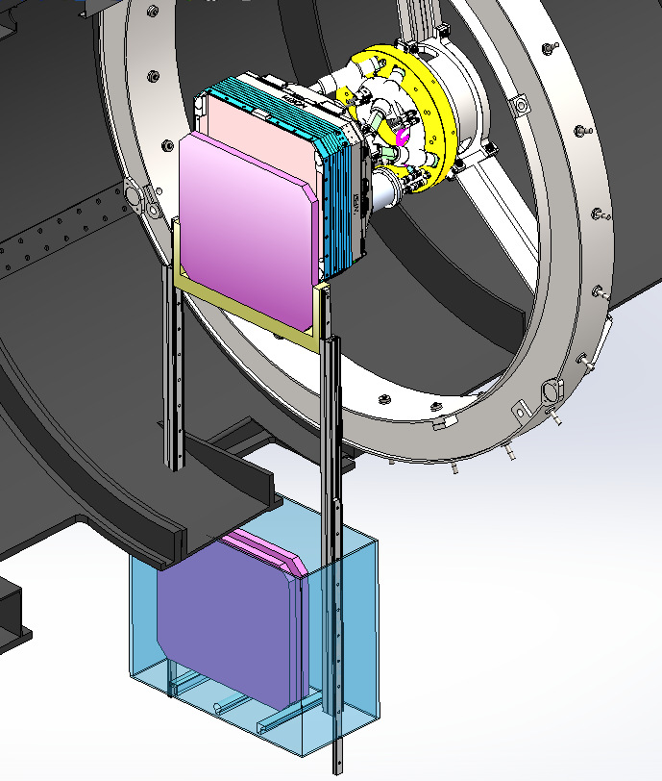
Rail System Architecture
Storage position
Loading position
Carriage
Rails
Jukebox
Courtesy of J. Zolkower

Slide 3
Rail System Operation
Filter deploy sequence
Jukebox motor actuate to position selected filter
Jukebox carriage to Rail carriage hand-off (TBD actuation)
Rail motor actuate to extend rails
After full extension, +Z stage actuation to dock filter to window
Filter hand-off (to instrument) and latch sequence
-Z stage actuate
Rail motor actuate to retract rails

Slide 4
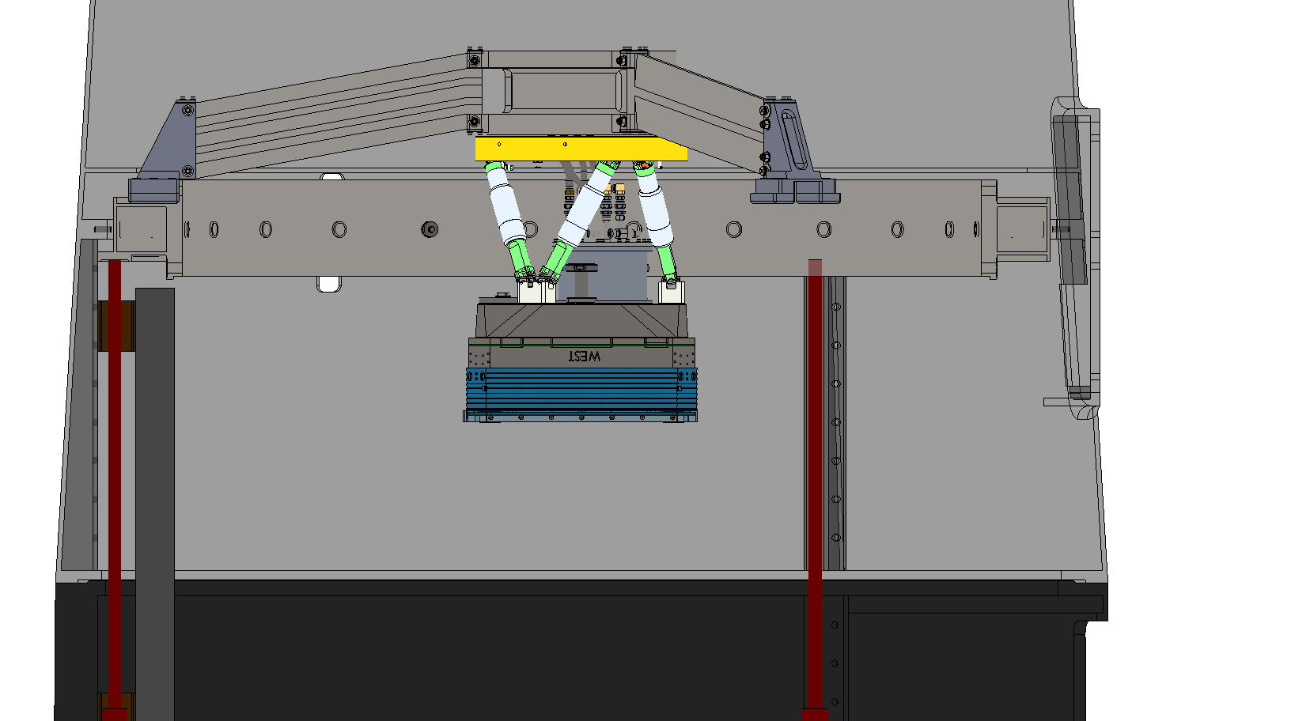
Filter
Carriage
Rail
Carriage
Jukebox

Slide 12
Rail System Operation (Con’t)
Filter retrieve sequence
Jukebox motor actuate to position unoccupied filter carriage
Rail motor actuate to extend rails
After full extension, +Z stage actuation to dock filter to window
Filter hand-off (to rail-side carriage) and latch sequence
-Z stage actuate
Rail motor actuate to retract rails
Rail carriage to Jukebox carriage hand-off (TBD actuation)

Slide 13
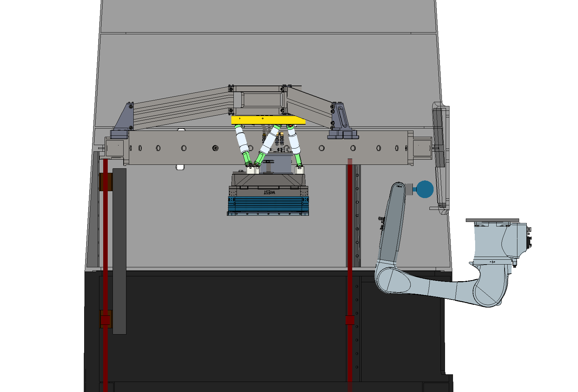
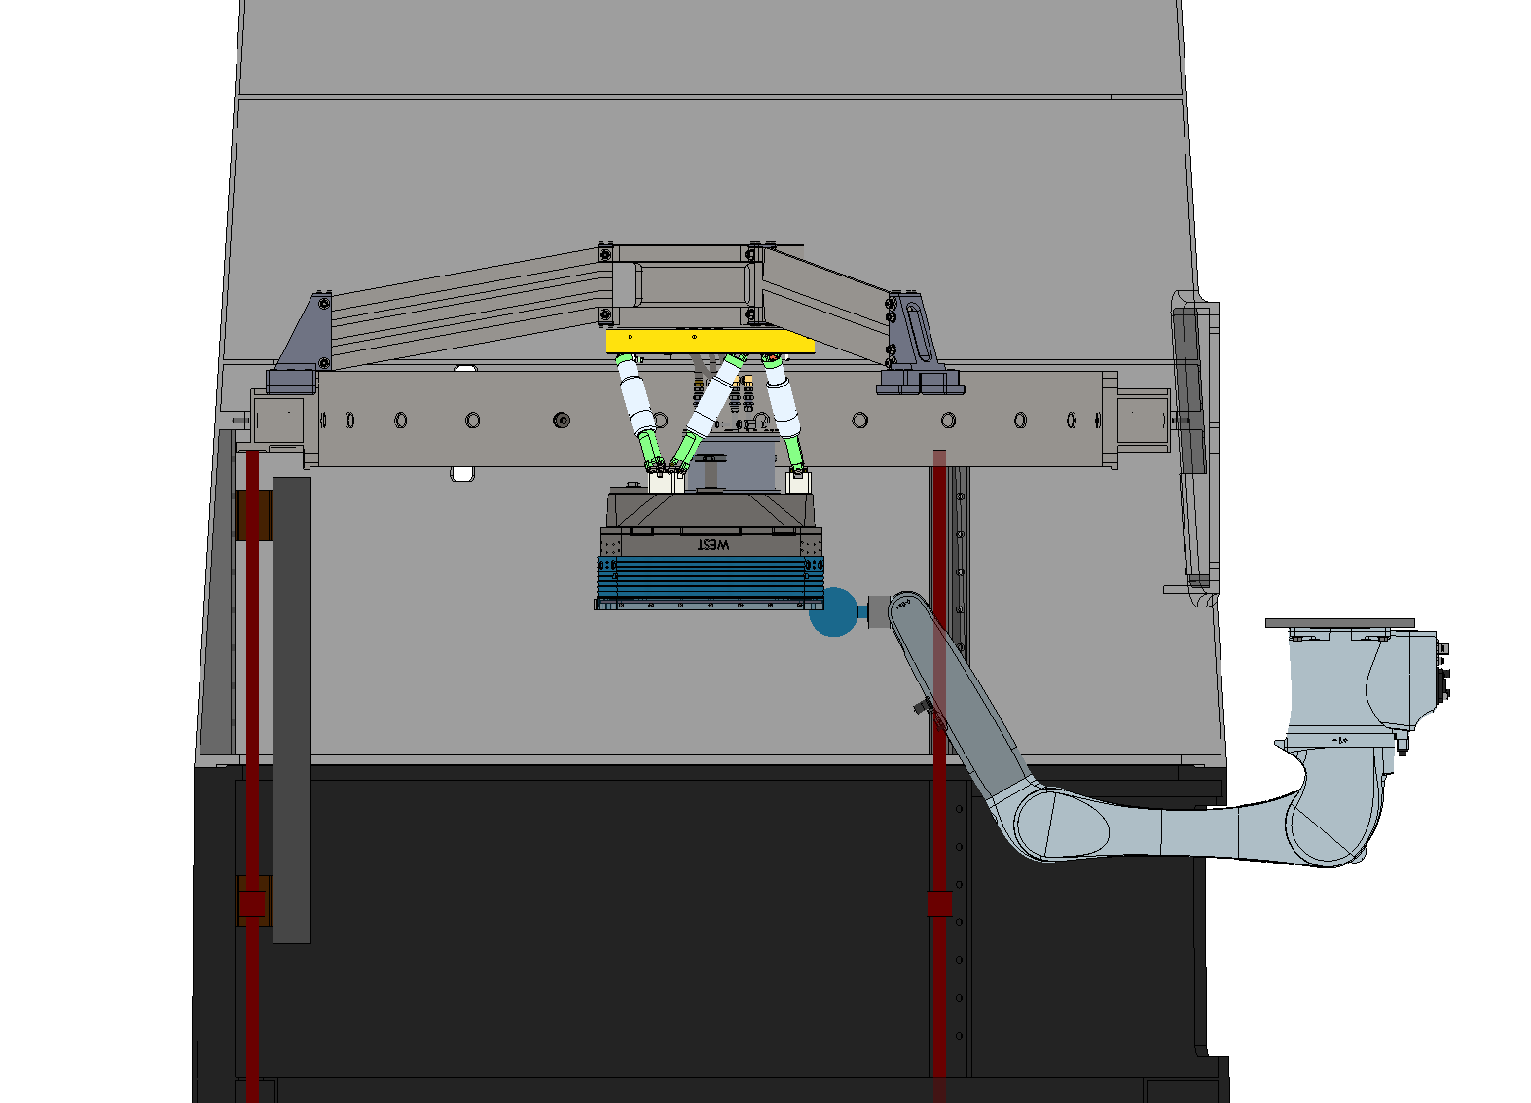
Robotic System Architecture
Storage position
Loading position
End effector
Filter storage
Filter cartridges
Filter cartridges
Kuka KR10 R1100

Slide 14
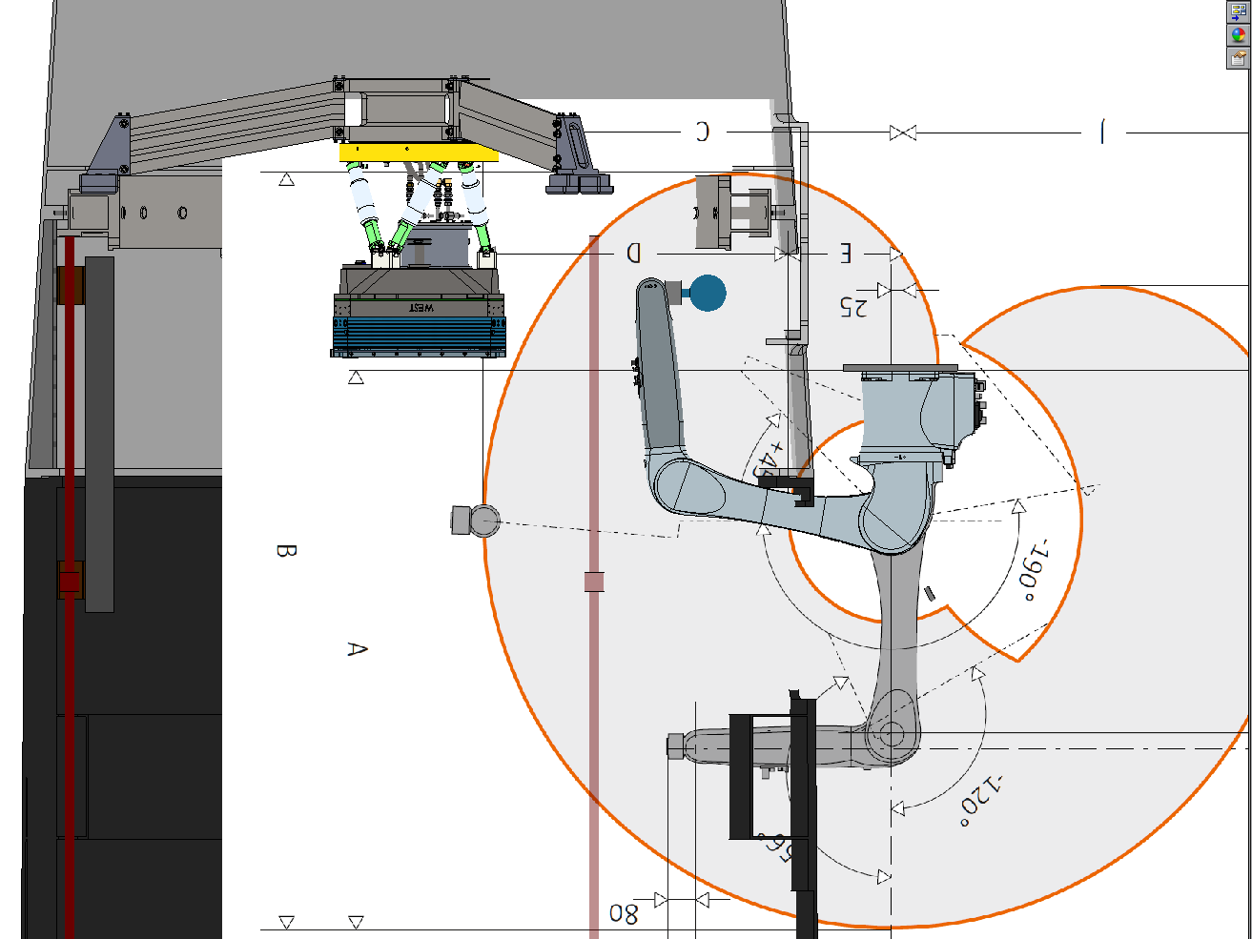
Kuka KR10 R1100
Cost: $40k, Weight: 54kg

Slide 15
Robotic System Operation
Filter deploy sequence
Robot arm maneuver to selected filter
Filter storage to end effector hand-off (TBD actuation)
Robot arm extracts filter and position under instrument window
Filter hand-off (to instrument) and latch sequence
“Handshake” confirmation before end effector release
Robot move to stowed position

Slide 16
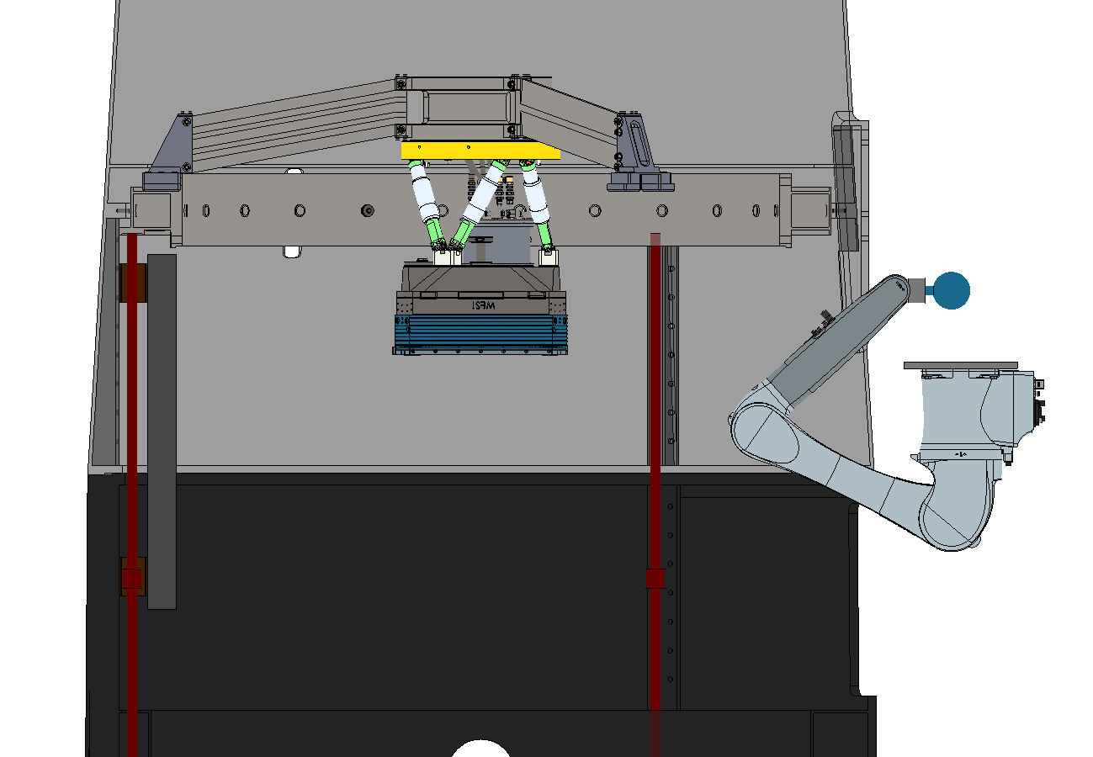

Slide 17
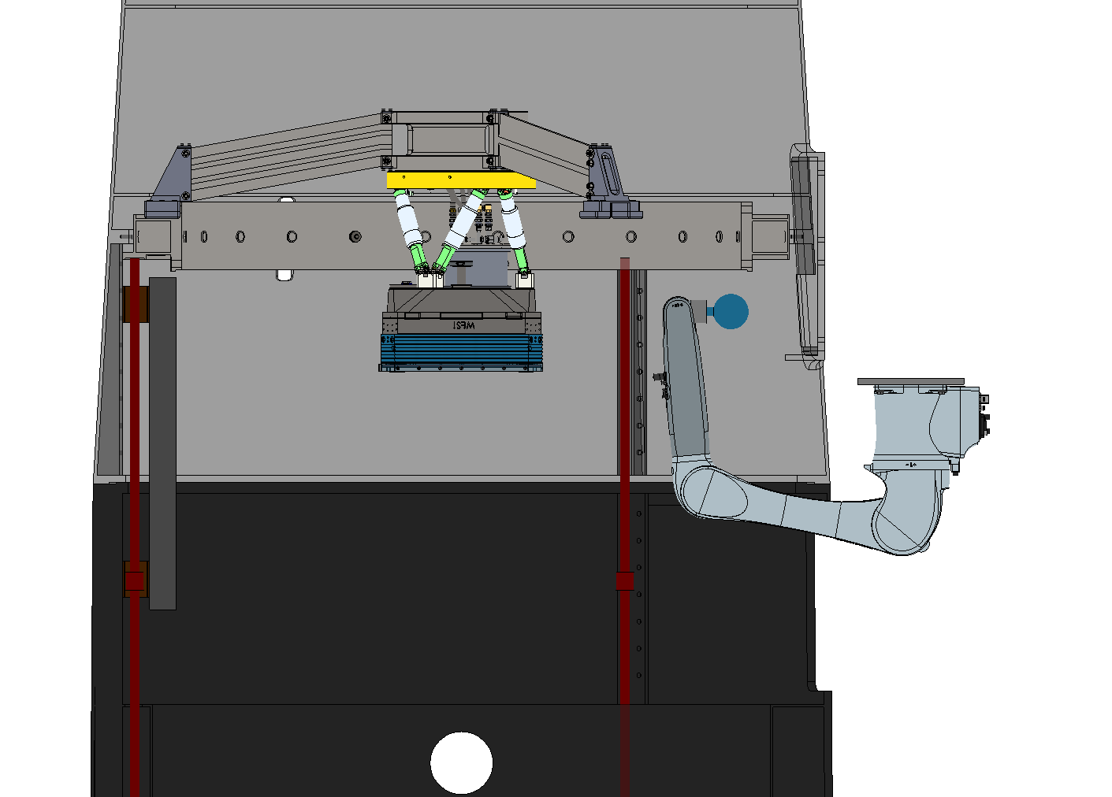

Slide 18
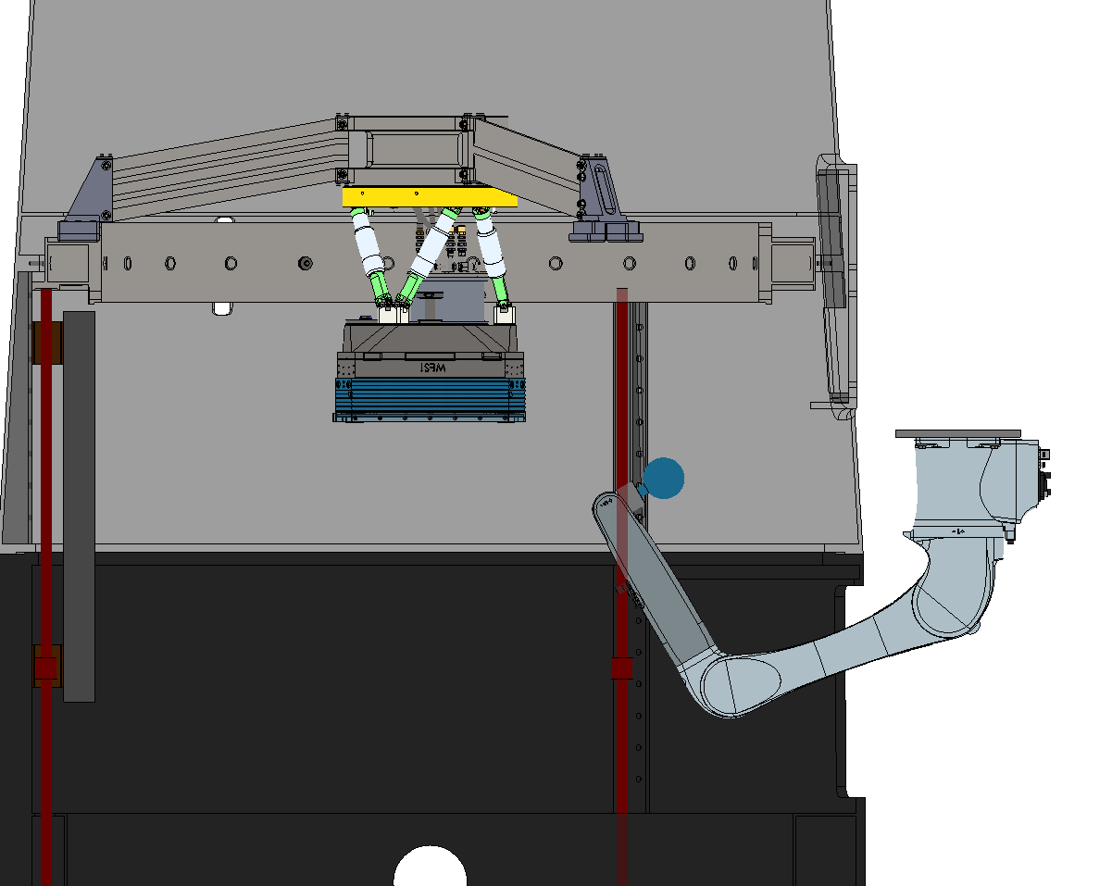

Slide 19
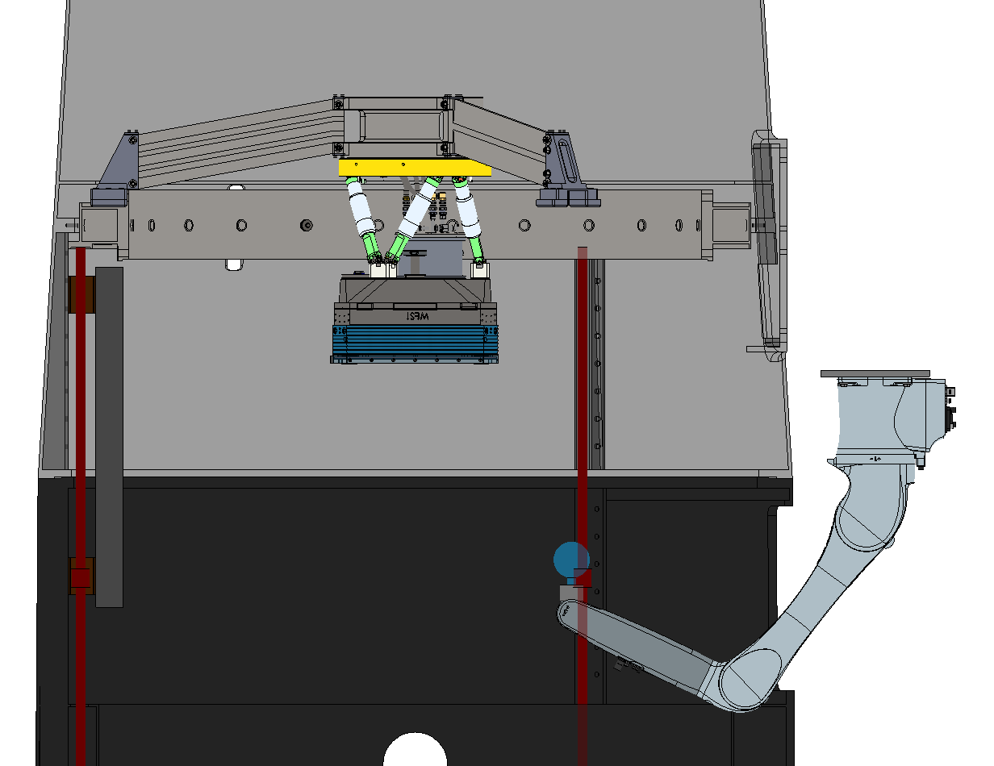

Slide 20
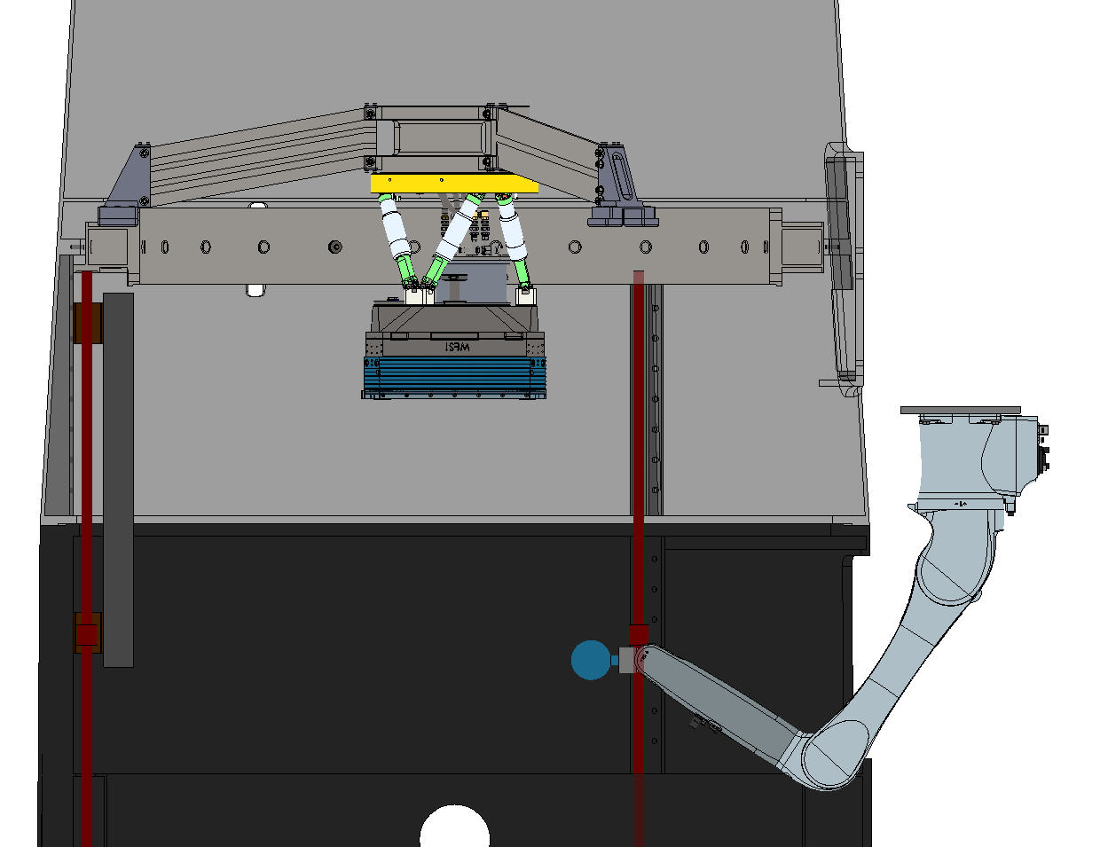

Slide 21
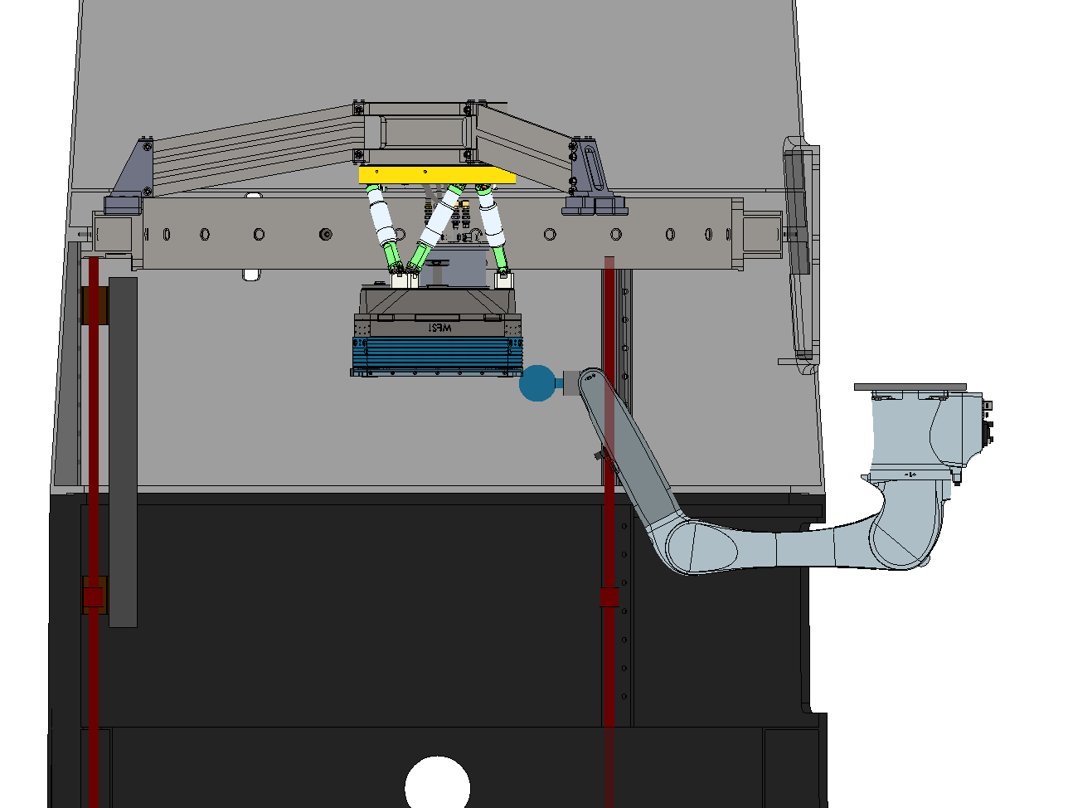

Slide 22
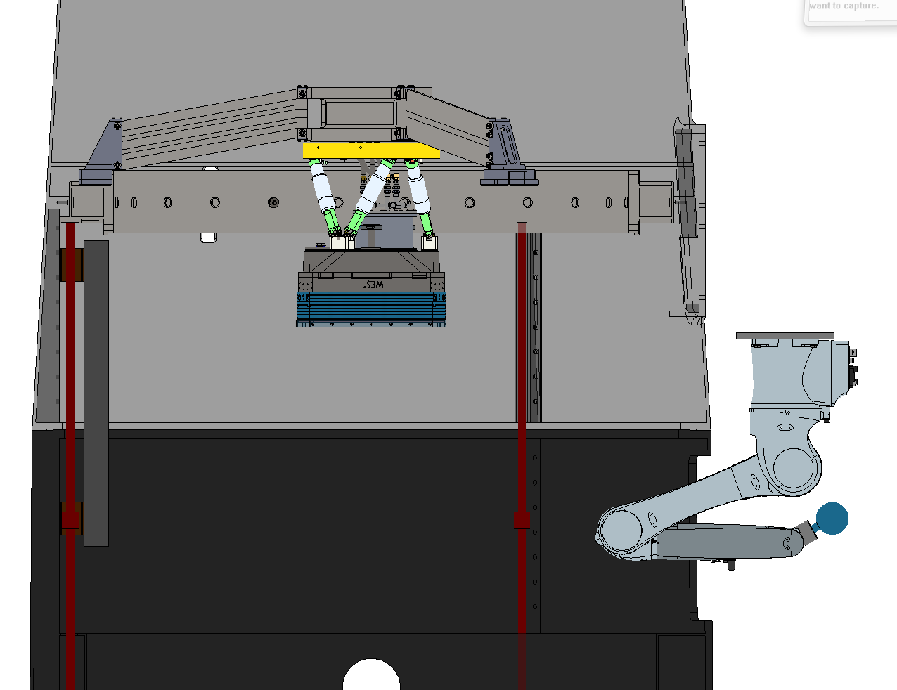

Slide 23
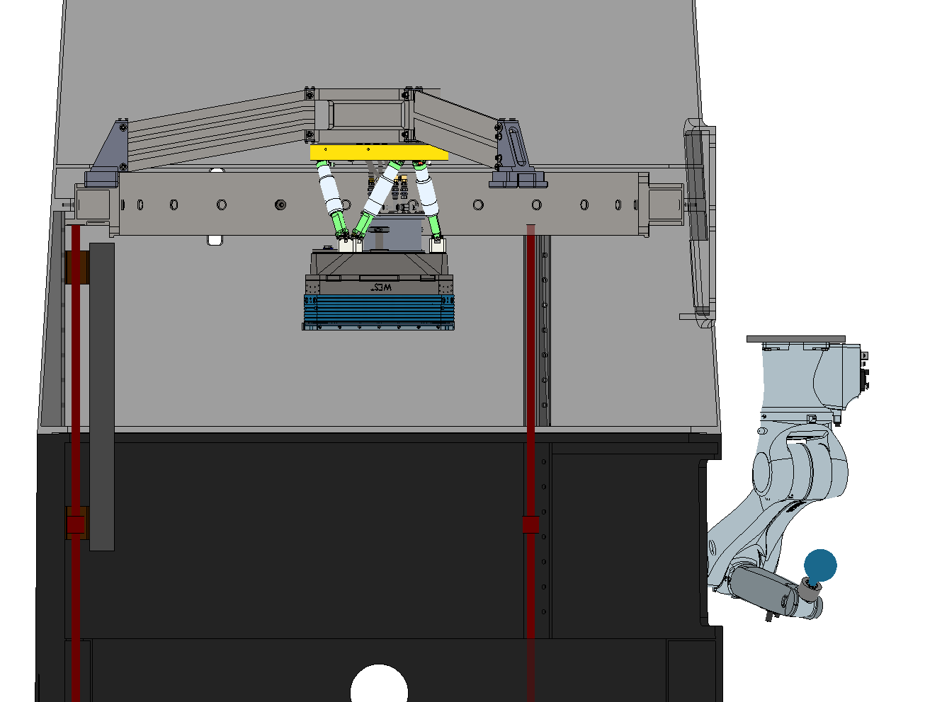

Slide 24
Robotic System Operation (Cont’d)
Filter retrieve sequence
Robot arm position under filter window
End effector engage and latch onto filter
Filter hand-off (to robot) and interlock sequence
Robot arm extract filter and maneuver to selected filter slot
Robot to filter storage (TBD actuation)
“Handshake” confirmation before end effector release
Robot move to stowed position

Slide 25
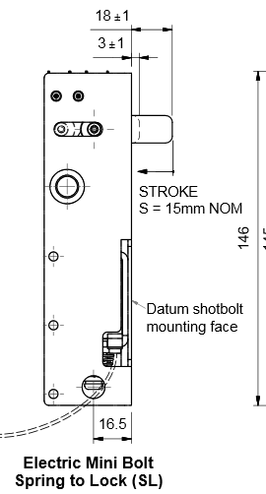
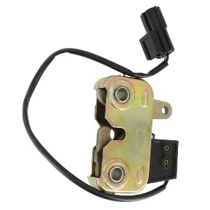
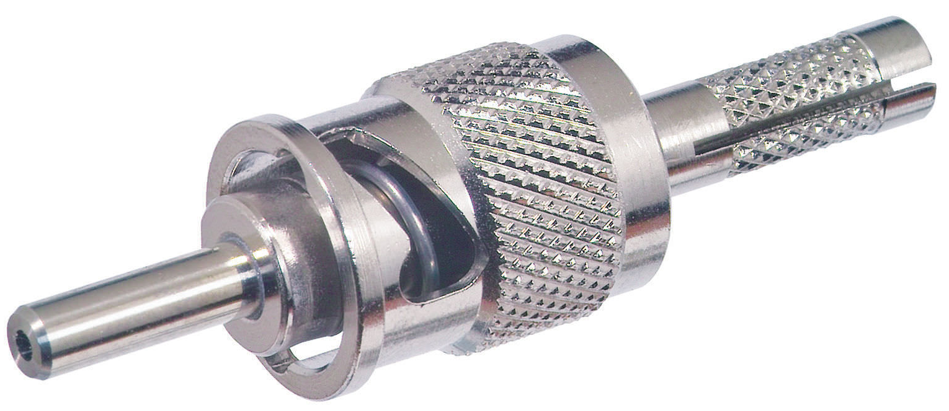
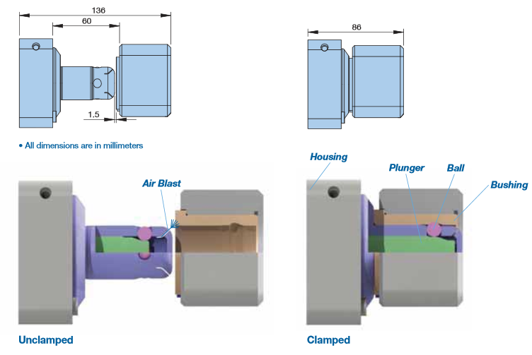
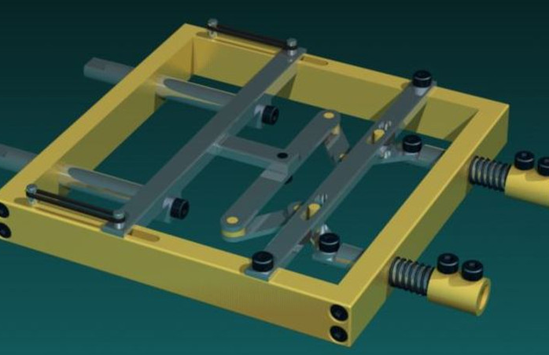
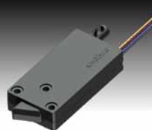
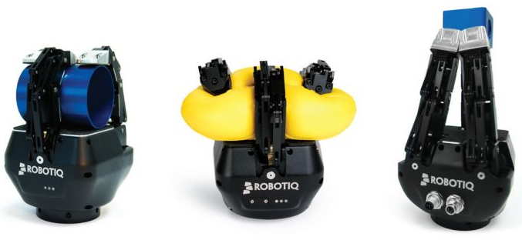
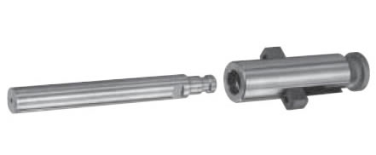
Hand-off & latching approaches
Active | Passive
Solenoid driven pin | Potential trap
Rotary latch | Interlocking pawls
Zero point chuck | Internal latch lock pin
Pulley gang latch | Mechalogic
Keeper
Multi-dof robot gripper

Slide 26
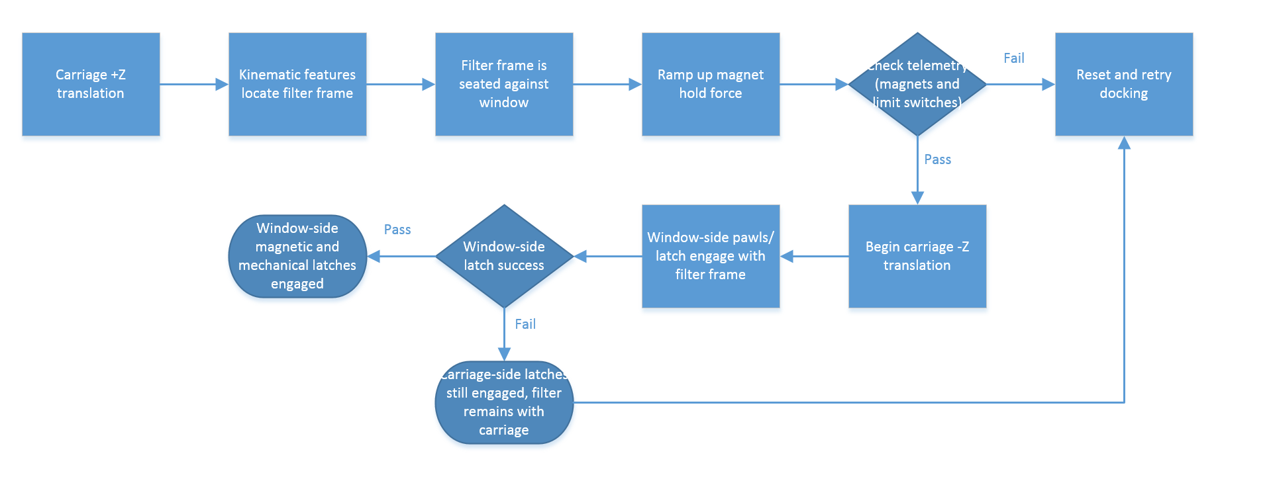
Example hand-off & latch sequence

Slide 27
Requirement compliance
REQ | Title | Summary | Goal | Req’t | Rail CBE | Robot CBE
0105 | Operating Modes | Exchangable, full-field spectral defining filter in front of instrument FOV | Y | Y | Y | Y
0110 | Commissioning and Service Modes | Commissioning, alignment, maintenance, and non-science modes should be supported | Y | Y | Y | Y
0115 | Number of Filters | Shall allow 3 usable filters per night without human intervention | 3 | 3 | 3 | 3
0120 | Filter Safety (Environmental) | All filters and optics shall be protected from harm | Y | Y | Y | Y
0125 | Filter Safety (During Service) | Filters shall be protected during human activities in telescope | Y | Y | Y | Y
0130 | Earthquake Safety | Positive margin on ultimate during equivalent quasi-static acceleration | TBD | TBD | TBD | TBD
0135 | Maximum Operating Accelerations | Filters shall not be damaged by exchanger operation | 4g | TBC | TBC | TBC
0140 | Beam Obstruction | Optical transmission loss due to shadowing from exchanger shall not exceed 1% on-axis | 0.50% | 1% | 0.5 | 0.5
0145 | Axial Positional Precision | Axial separation repeatability shall be less than +/- 0.25mm (per filter) and less than 1mm between different filters | TBC | +/-0.25mm | TBD | TBD
0150 | Lateral Positional Precision | Lateral registration repeatability shall be less than +/- 0.25mm (per filter) and less than 1mm between different filters | TBC | +/-0.25mm | TBD | TBD
0155 | Filter Tilt | Deployed filter angle w.r.t. cryostat window normal shall be less than TBD degrees | TBD | TBD deg | TBD | TBD
0160 | Exchange Time | Filter to filter exchange shall be less than 90 seconds | 60s | 90s | 60 | 40
0165 | Exchanger Reliability | Expected lifetime shall be greater than 33,000 cycles | 40000 | 33000 | TBC | TBC
0175 | Exchanger Impact on Tube Seeing | Surface temperature of exchanger mechanism shall not exceed +/- 3C of telescope tube | +/- 3C | +/- 3C | TBC | TBC

Slide 28
Rail system risk matrix
Likelihood | 5 |  | 005
 | 4
 | 3 |  |  | 003
 | 2 |  | 002 | 004 |  | 001
 | 1
 |  | 1 | 2 | 3 | 4 | 5
 |  | Consequence
ID | Approach/Type | Risk Title
001 | M/I | Dropped filter
002 | M/I | Incomplete actuation
003 | M/I | Incomplete latching
004 | M/I | Impact event
005 | M/R | Late delivery of exchanger
Approach/Type
M: Mitigate
W: Watch
A: Accept
R: Research
I: Implementation
Likelihood
1: Very unlikely
2: Unlikely
3: Likely
4: Very likely
5: Certain
Consequence
1: Minor
2: Moderate
3: Large
4: Severe
5: Catastrophic

Slide 29
Robot system risk matrix
Likelihood | 5
 | 4
 | 3 |  | 005 | 003, 004
 | 2 |  | 002 |  |  | 001
 | 1
 |  | 1 | 2 | 3 | 4 | 5
 |  | Consequence
ID | Approach/Type | Risk Title
001 | M/I | Dropped filter
002 | M/I | Incomplete actuation
003 | M/I | Incomplete latching
004 | M/I | Impact event
005 | M/R | End effector design
Approach/Type
M: Mitigate
W: Watch
A: Accept
R: Research
I: Implementation
Likelihood
1: Very unlikely
2: Unlikely
3: Likely
4: Very likely
5: Certain
Consequence
1: Minor
2: Moderate
3: Large
4: Severe
5: Catastrophic

Slide 30
Technical motivation and recommendation
Subsystem by subsystem comparison – simplicity advantage of robot
COTS system vs. multiple custom systems
Reliability
Less testing required
Built-in safety features of robot (collision detection, torque sensing, etc) and mature consumer software
Robust robot system allows misalignment handling
Ability to leverage JPL experience/expertise

Slide 31
Backup slides

Slide 32
Potential risks of rail system
Description | Impact(s) | Mitigation
Pulley cable breakage | Back-driven motion | Non-backdrivable actuators
Misalignment when docking w/ instrument | Unable to exchange, instrument misalignment, excessive loads | Alignment MGSE, testing
Cable wear and cyclic relaxation | Incomplete actuation | Bi-annual service, testing
No encoder or telemetry | Incomplete actuation, impact event | Redundant limit switches
Unexpected out of plane loading | Incomplete actuation, impact, misalignment | Testing
Lubricated joint seizing | Incomplete actuation | Bi-annual service, testing
Power loss | Loss of telemetry | Recovery procedure
Jamming at jukebox exchange | Unable to exchange | Bi-annual service, testing
Incomplete latch at exchange | Unable to exchange | Interlocking latches
Insufficient FTE’s | Cost/schedule overrun | Contract out subsystem(s)

Slide 33
Potential risks of robot system
Description | Impact(s) | Mitigation
Misalignment when docking w/ instrument | Unable to exchange, instrument misalignment, excessive loads | Torque sensors, built-in current limits, built-in collision detection
Loss of encoder or telemetry | Incomplete actuation, impact event | Redundant limit switches, built-in current limits, built-in collision detection
Unexpected out of plane loading | Incomplete actuation, impact, misalignment | Non-backdrivable actuators, 400% payload mass margin
Lubricated joint seizing | Incomplete actuation | Bi-annual service, testing
Power loss | Loss of telemetry | Recovery procedure, non-backdrivable actuators
Jamming at jukebox exchange | Unable to exchange | Bi-annual service, testing
Incomplete latch at exchange | Unable to exchange | Interlocking latches

Slide 34
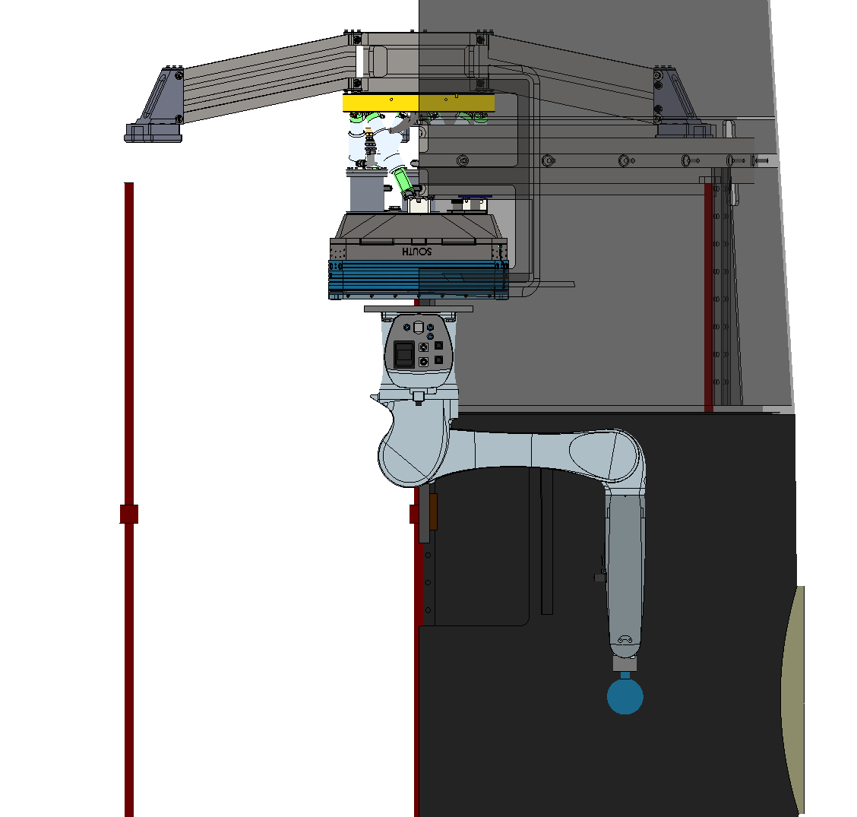
20”
24”

Slide 35
Puzzle https://www.youtube.com/watch?v=LI5cgaF9XVI
Collision detection https://www.youtube.com/watch?v=PX7mT_nTGLg
Human + robotiq https://www.youtube.com/watch?v=tCss_TjSs7Y
Safe handling https://www.youtube.com/watch?v=ymAgKyMF82s
Flex tube assembly https://www.youtube.com/watch?v=3xZWCGP1no8
Pick & place https://www.youtube.com/watch?v=Pt4KzYNRrIk
Machine vision https://www.youtube.com/watch?v=_U4sGRB2peU
Delicate handling https://www.youtube.com/watch?v=EgzL7V9GU-Q
Demo https://www.youtube.com/watch?v=oeYbLFrsTiI
Dynamic human safety https://www.youtube.com/watch?v=sUp3EL-8xgE
Vision + force sensing https://www.youtube.com/watch?v=TPQ0ISwOgb8
Human safety https://www.youtube.com/watch?v=rOIl3EnJhl0
Glass panel cleanroom https://www.youtube.com/watch?v=4SBr4tClbf4
http://blog.robotiq.com/bid/37452/How-To-Handle-Fragile-Parts-With-Robots

Slide 36
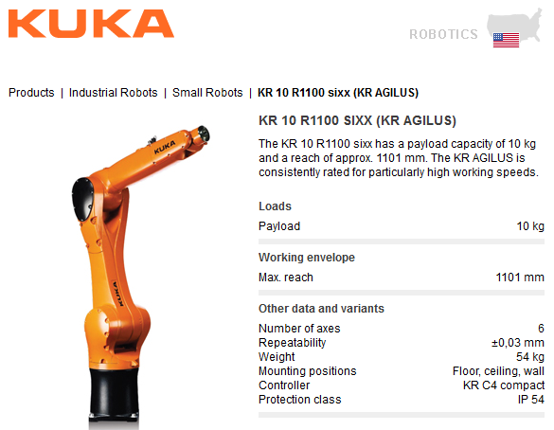
KR10 R1100 spec

Slide 37
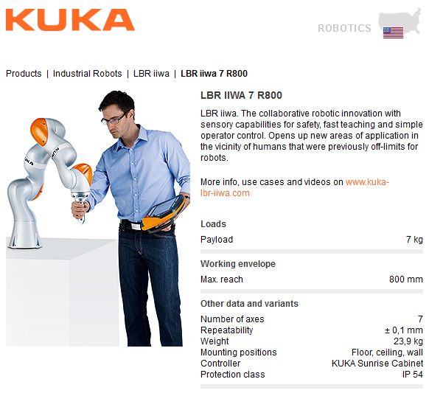
LBR R800 spec

