Slide 1
ZTF Filter Exchange Mechanism Trade Study Summary
M. Porter
2016-01-22

Slide 2
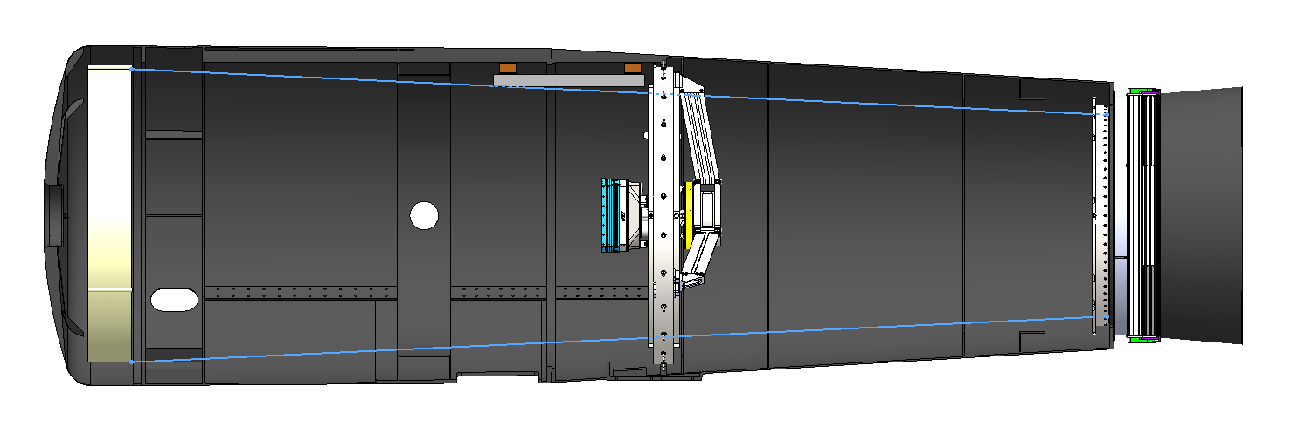
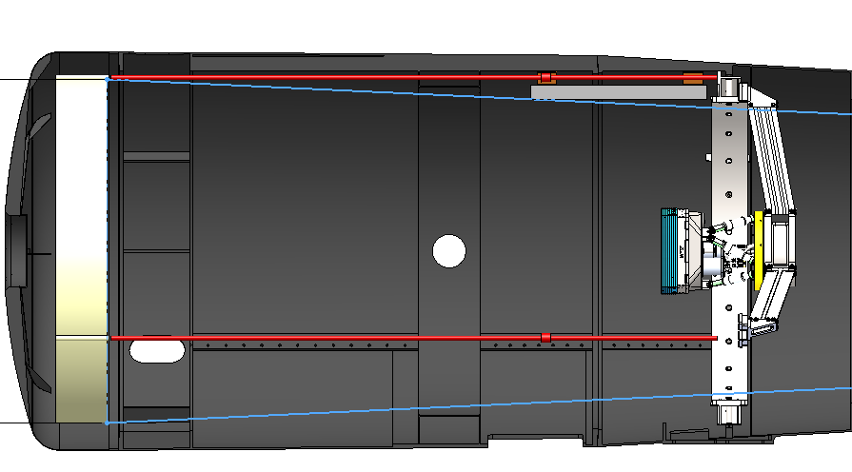
System Context
Invar metering rods
Beam profile

Slide 3
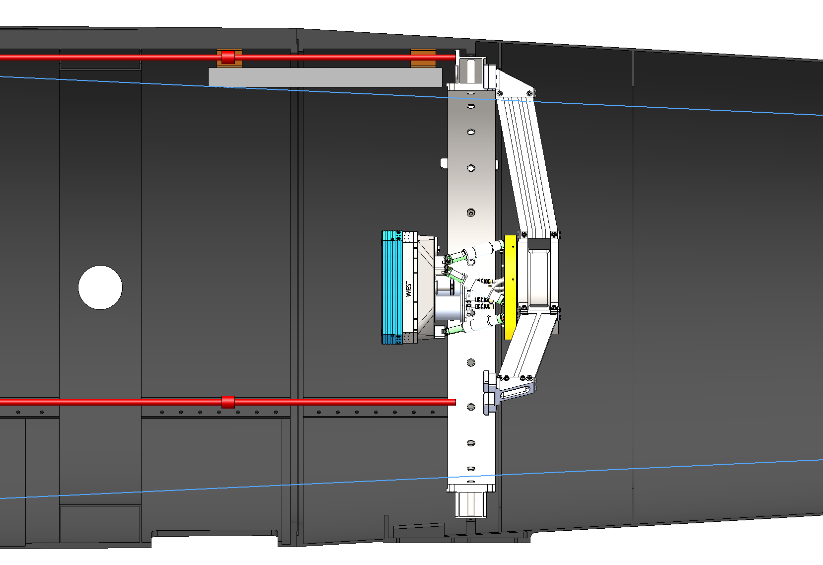
System Context Ctd.
Instrument
Filter
Spider

Slide 4
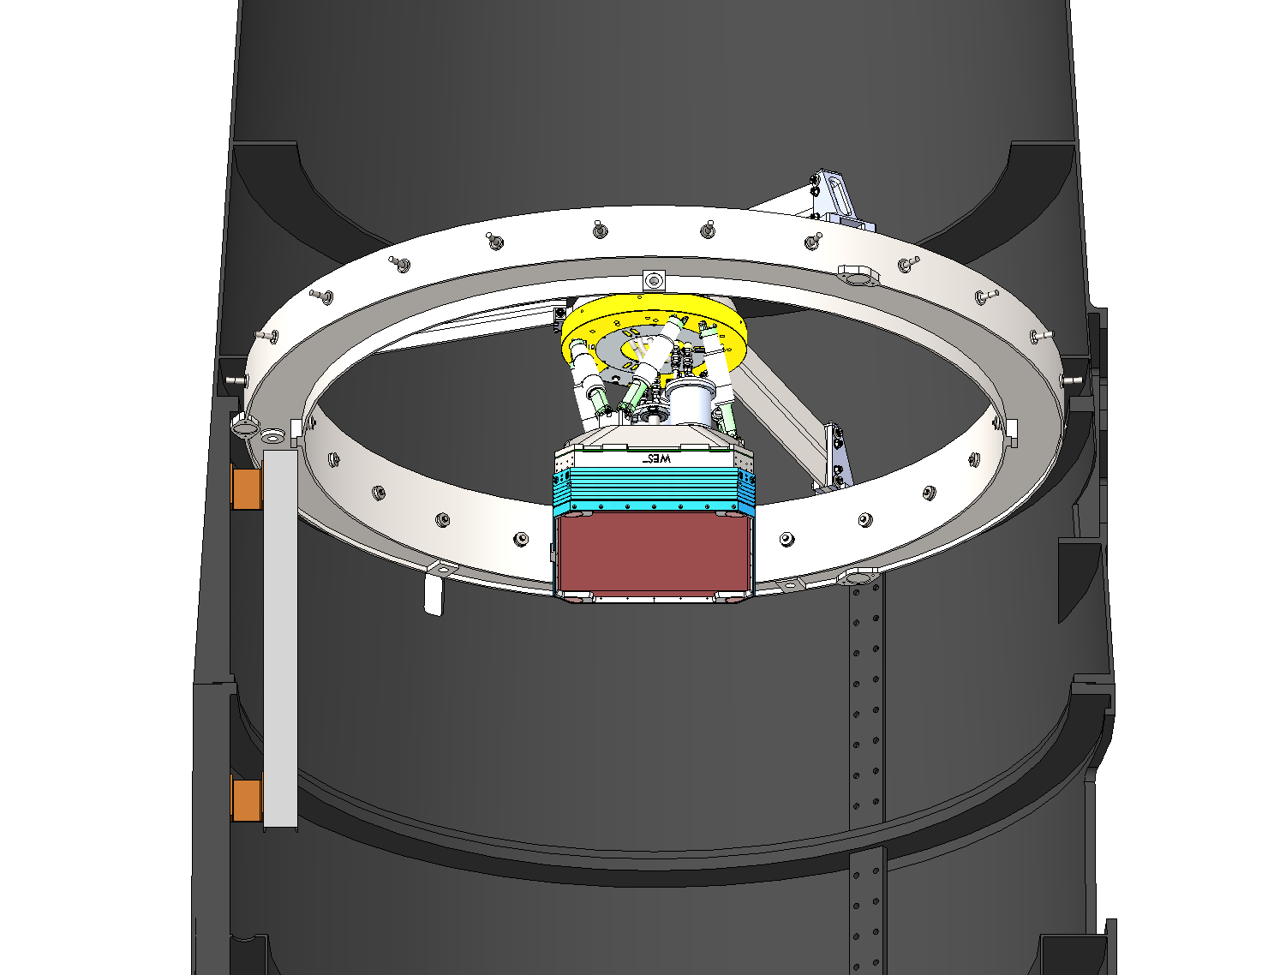
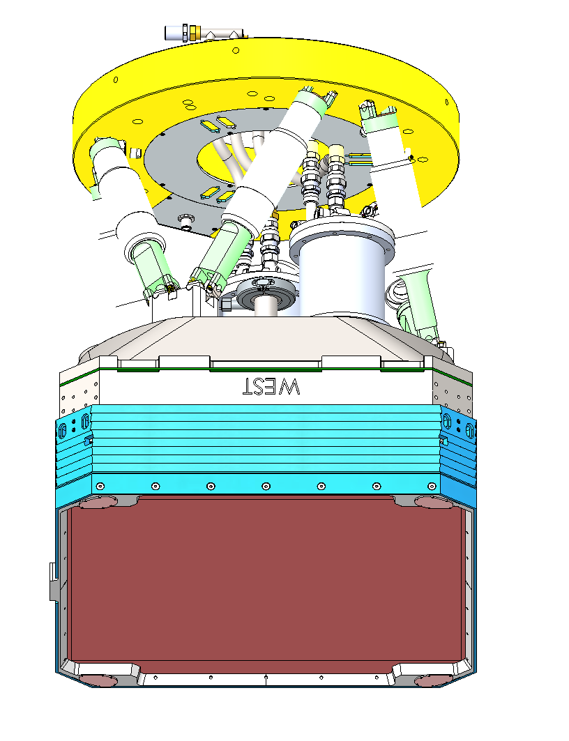
System Context Ctd.
Ring Girder
Hexapod

Slide 5
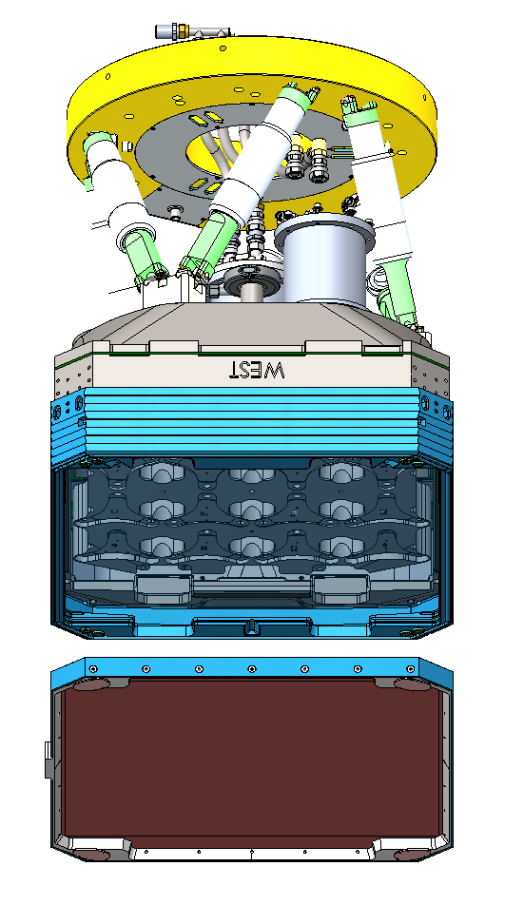
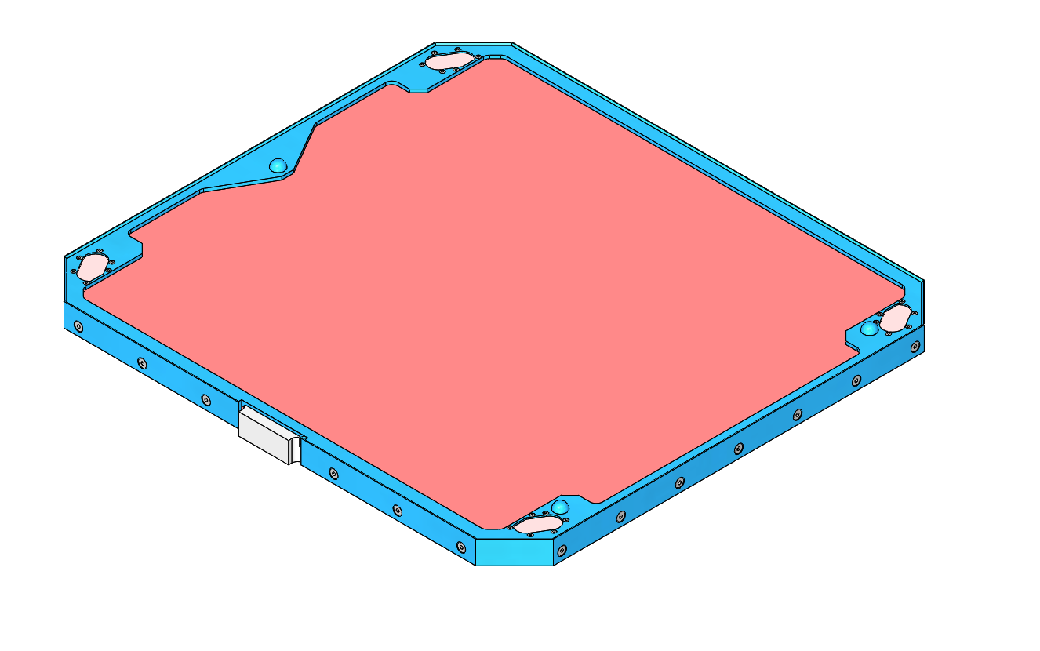
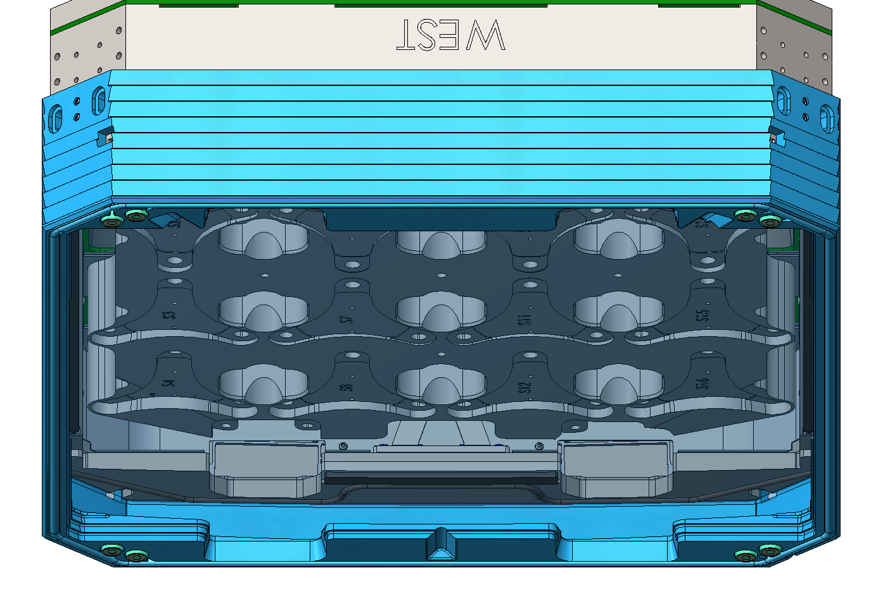
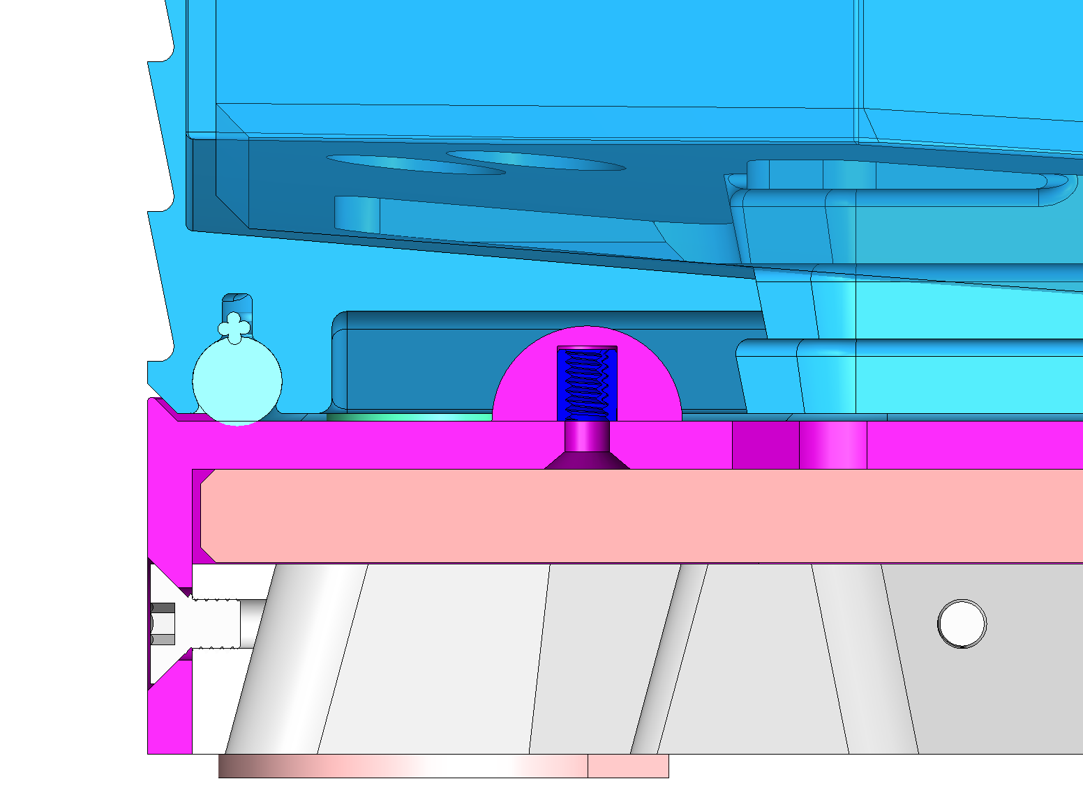
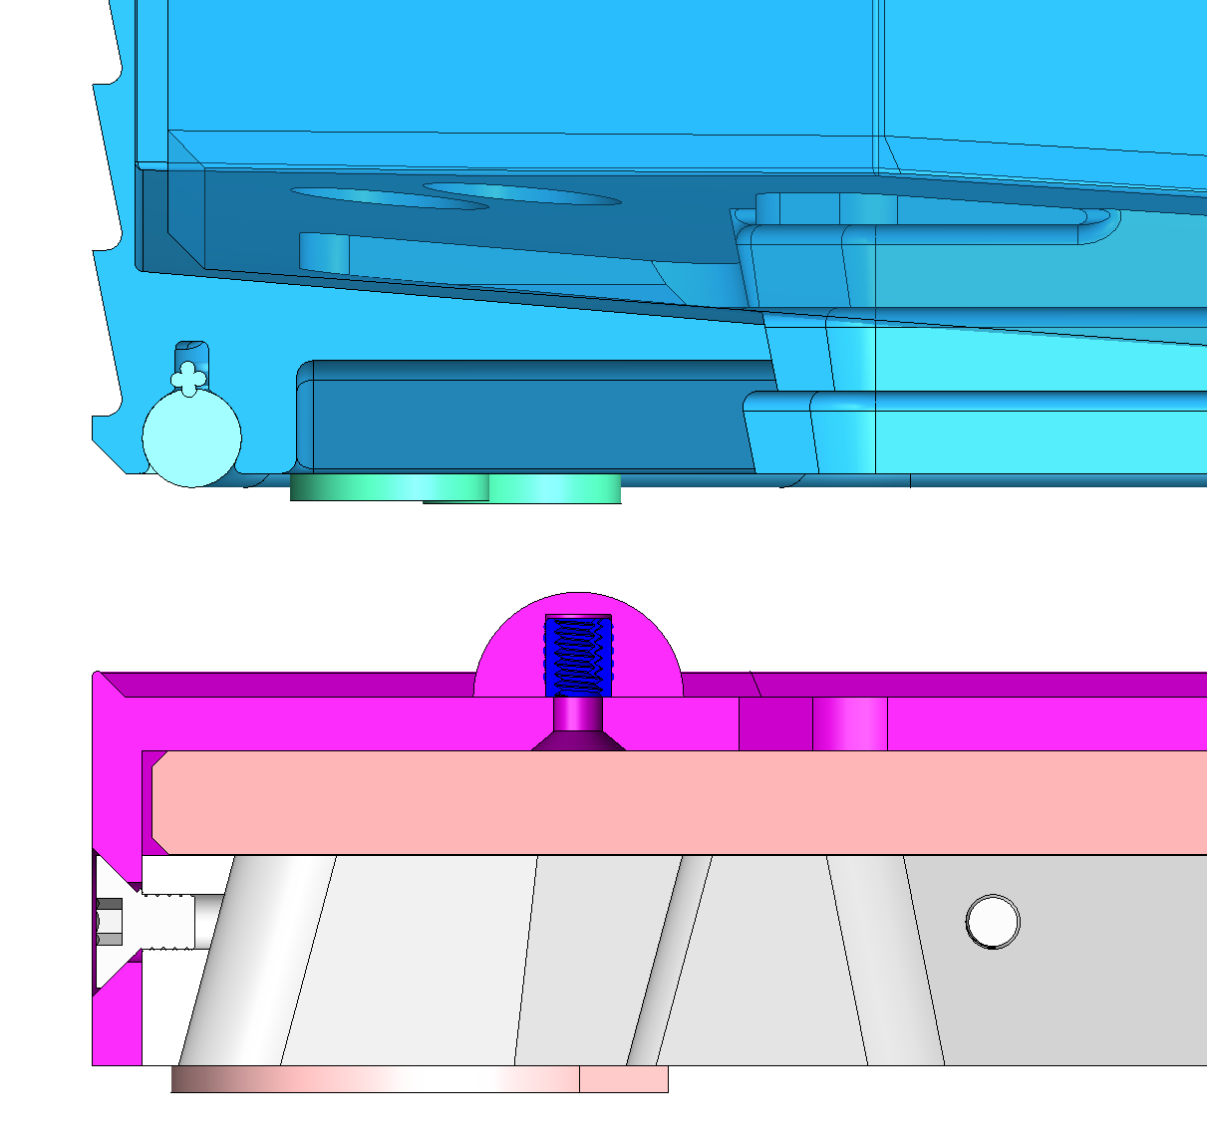
System Context Ctd.
Filter assembly
Instrument window I/F

Slide 6
Designs Evaluated
Description | Pros | Cons
Swinging boom | Minimal obscuration (as-deployed) | Reliability, stowed obscuration and stray light, servicing, gravity-assisted actuation
Rail and pulley system | Reliability, heritage | Obscuration, complex exchange b/w filters
Tank tread | Heritage | Complexity, dynamics, servicing, stray light
Yoke | Simplicity | Obscuration, interference
Telescoping boom | Reliability | Obscuration, complex exchange b/w filters
Linkage mechanism | Reliability | Obscuration, complex exchange b/w filters
Pulley carts | Minimal obscuration | Complexity
Robotic arm | Reliability, minimal obscuration | Filter hand-off required
Telescoping rail system | Reliability, minimal obscuration | Filter hand-off required

Slide 7
Designs Evaluated
Description | Pros | Cons
Swinging boom | Minimal obscuration (as-deployed) | Reliability, stowed obscuration and stray light, servicing, gravity-assisted actuation
Rail and pulley system | Reliability, heritage | Obscuration, complex exchange b/w filters
Tank tread | Heritage | Complexity, dynamics, servicing, stray light
Yoke | Simplicity | Obscuration, interference
Telescoping boom | Reliability | Obscuration, complex exchange b/w filters
Linkage mechanism | Reliability | Obscuration, complex exchange b/w filters
Pulley carts | Minimal obscuration | Complexity
Robotic arm | Reliability, minimal obscuration | Filter hand-off required
Telescoping rail system | Reliability, minimal obscuration | Filter hand-off required
Approaches ruled out as a result of previous reviews

Slide 8
Overview of concepts for context
Swinging boom
Rail system
Robot arm
Rail and robot systems will be presented in more detail shortly

Slide 9
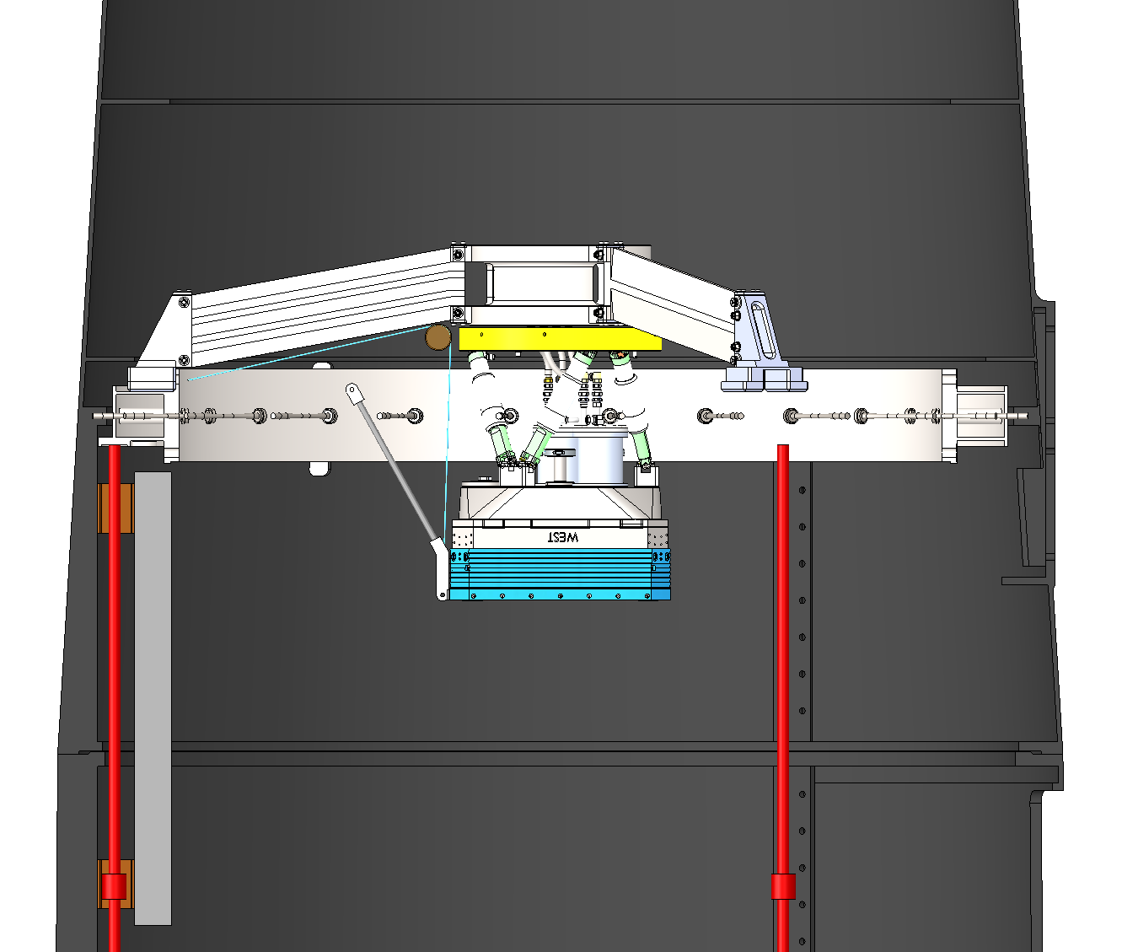

Slide 10
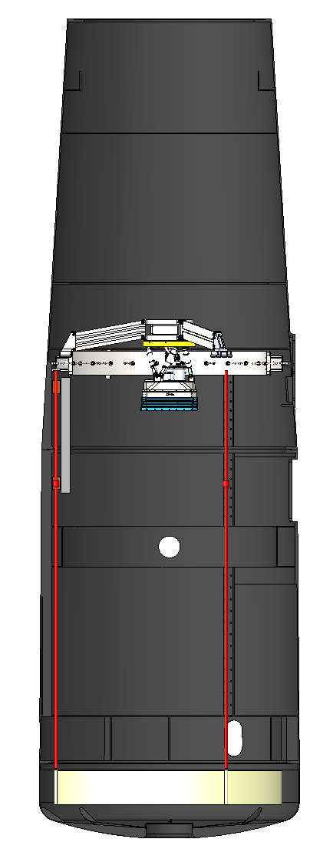
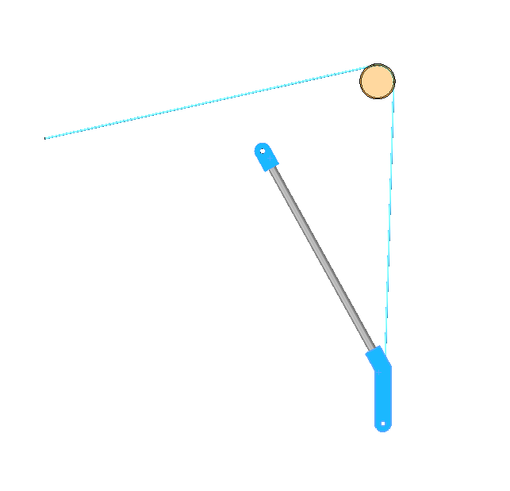
Gravity vector

Slide 11
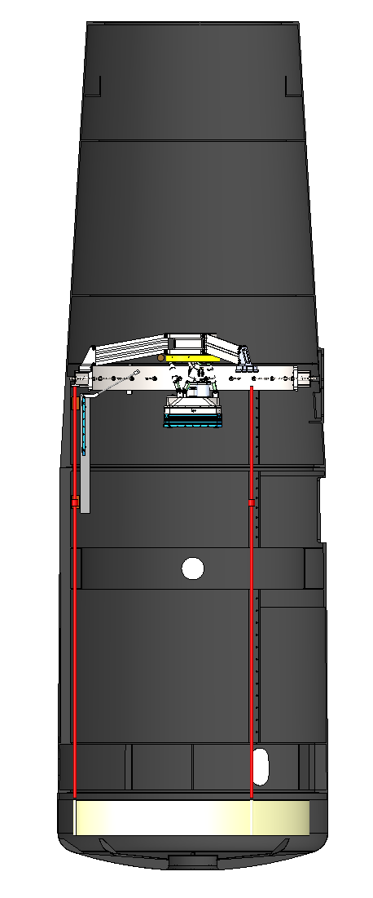
50deg

Slide 12
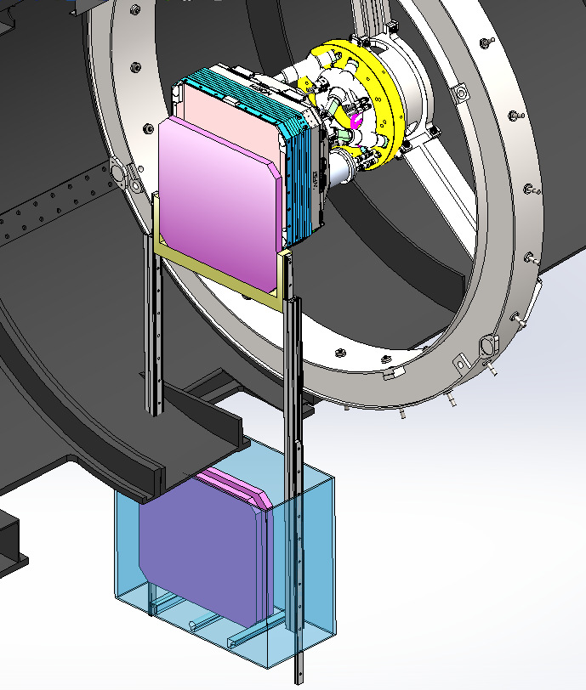
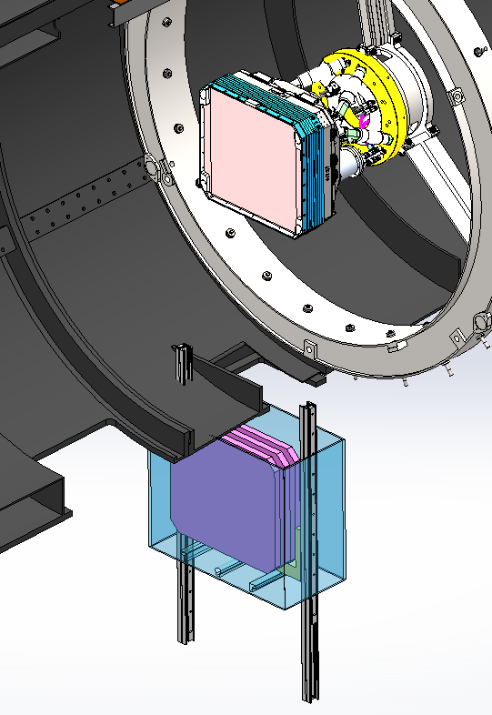
Loading position
Storage position
ZTF Filter Exchanger
Linear actuator
with Jukebox
Courtesy of J. Zolkower

Slide 13
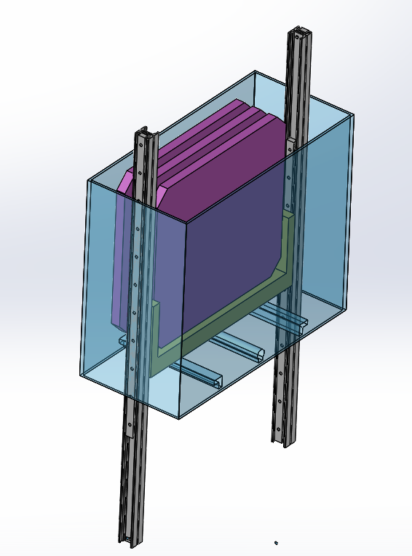
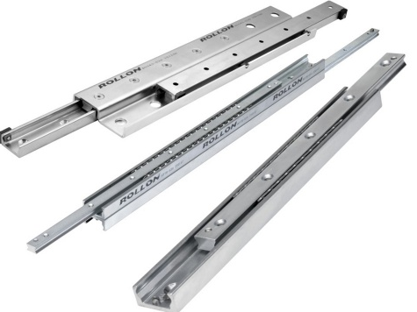
Filter Exchanger Mechanism
Storage position
Telescoping rails
(Various off-the-shelf options)
Motorized drive moves rails/carrier between storage position and camera load position
Jukebox mech
Filter shuttle mech
3 positions
Carrier
Selectively locked to Filter frame
Courtesy of J. Zolkower

Slide 14
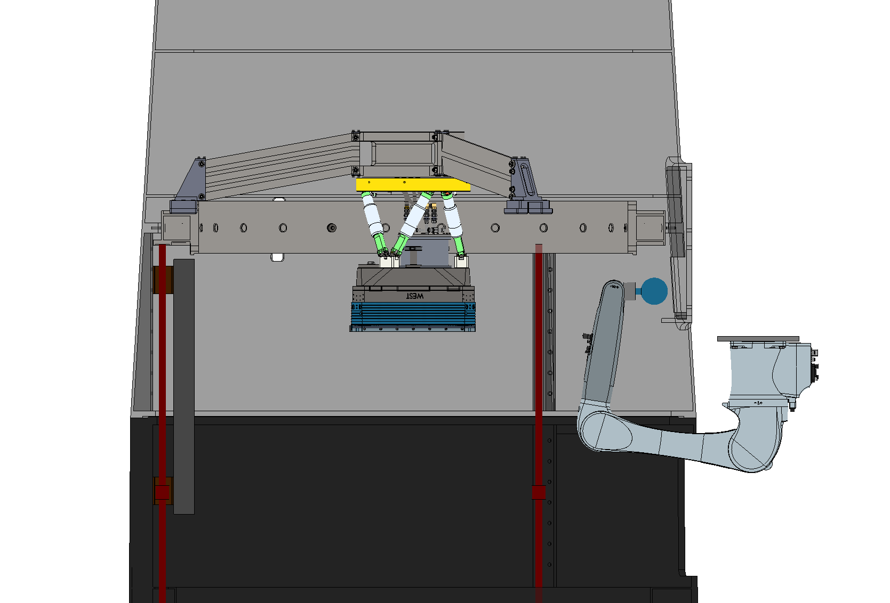
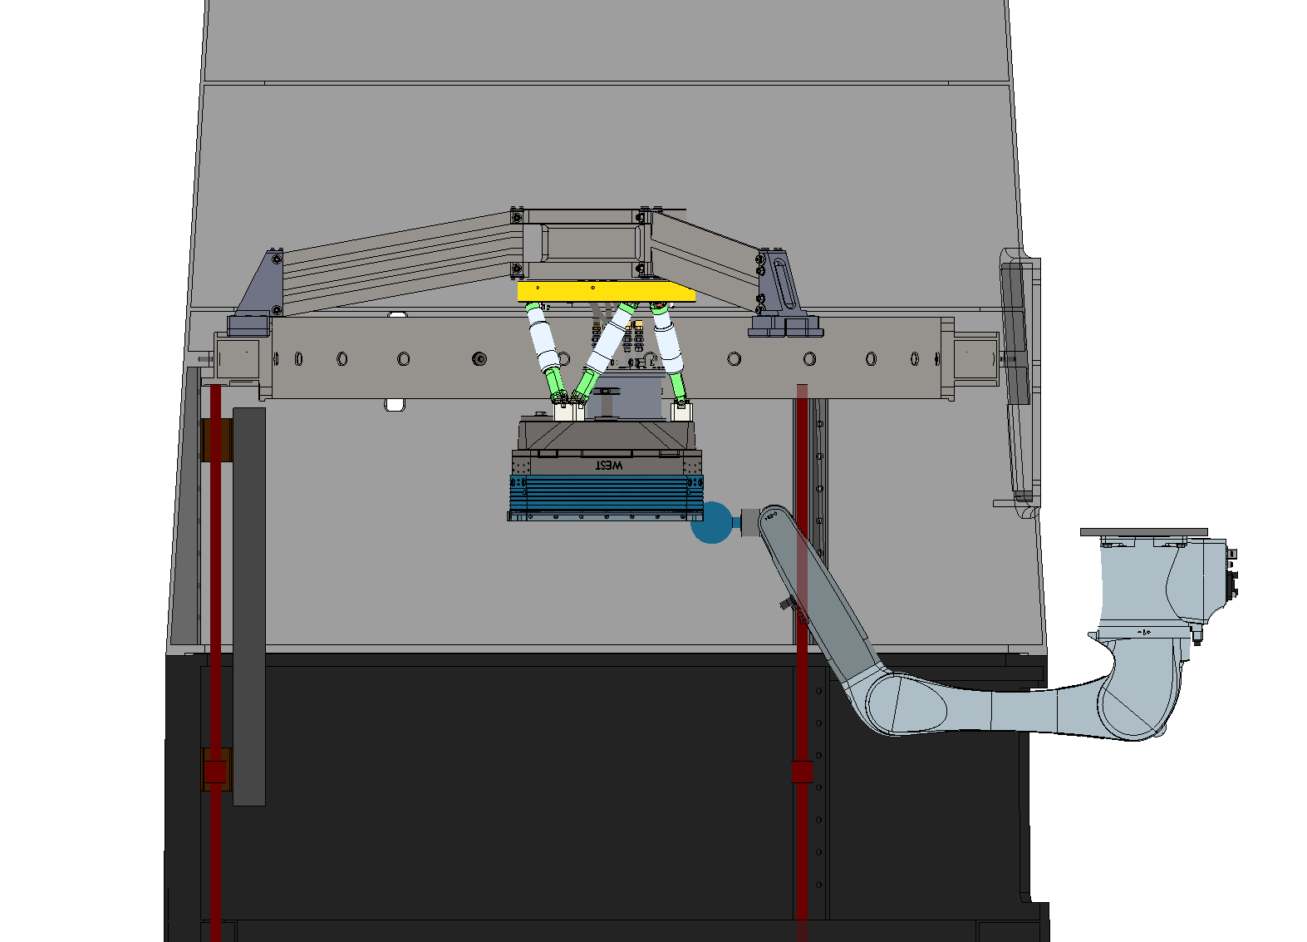

Slide 16
Summary
Requirement | <= 0.5 | < 60s |  |  |  |  |  | < 0.5mm | High | Desired | Desired | >= 3
Mechanism Concept | % on-axis obscuration (est) | Deploy/stow cycle time (est) | Heritage | Instrument I/F complexity | Operational complexity | Exchange complexity | Stow complexity | Positional repeatability | Reliability | Access | H-a/H-c frequent filter exchange compatibility | Filter capacity | Mass (telescope balance)
Gravity-assisted boom | 0.25 | 45-60s | N | Misalignment compsensation | Coordinated telescope slew | Stow/deploy | Capture mechanisms | TBD |  | Moderate | Poor | 3 | Low
Rail-guided carriage | 0.5 | < 30s | Y | Deployable rail | Deployable rail | Filter jukebox | Filter jukebox | < 0.5mm |  | Moderate | Good | > 5 | Medium
Robotic arm | 0.5 | < 30s | Y | Latching mechanism | Minimal | End effector | End effector | < 0.25mm |  | Easy | Good | > 5 | High

Slide 17
Summary
Marginal requirement compliance or added complexity
Desirable or advantageous
Requirement | <= 0.5 | < 60s |  |  |  |  |  | < 0.5mm | High | Desired | Desired | >= 3
Mechanism Concept | % on-axis obscuration (est) | Deploy/stow cycle time (est) | Heritage | Instrument I/F complexity | Operational complexity | Exchange complexity | Stow complexity | Positional repeatability | Reliability | Access | H-a/H-c frequent filter exchange compatibility | Filter capacity | Mass (telescope balance)
Gravity-assisted boom | 0.25 | 45-60s | N | Misalignment compsensation | Coordinated telescope slew | Stow/deploy | Capture mechanisms | TBD |  | Moderate | Poor | 3 | Low
Rail-guided carriage | 0.5 | < 30s | Y | Deployable rail | Deployable rail | Filter jukebox | Filter jukebox | < 0.5mm |  | Moderate | Good | > 5 | Medium
Robotic arm | 0.5 | < 30s | Y | Latching mechanism | Minimal | End effector | End effector | < 0.25mm |  | Easy | Good | > 5 | High

Slide 18
Rail system
Robot arm
Increased #DOFs
COTS system
Complex end-effector
Existing s/w
Fewer mechanized DOFs
Complex “jukebox”
Custom subsystems
Filter hand-off latching
Filters and mech. stored outside of telescope

Slide 19
Backup Slides

Slide 20
Filter Mechanical Requirements
REQ | Feature | Requirement | Goal
0040 | External Dimensions | 491.5 x 448.0 mm | N/A
 | Note: Four corners are 44.19 mm x 45.00 deg faces, so that the part is an (irregular) octagon.
0045 | Material | Fused Silica | N/A
 | Fused silica is selected for its high optical transmission, high strength, and low fabrication cost.
0050 | Center Thickness | 6.5 mm +0.0 – 0.5 mm | N/A
0055 | Index Uniformity | < 10 ppm | N/A
0060 | Wedge | < 0.1 mm ETD | N/A
0065 | Flatness | < 2 millimeters | N/A
0070 | Clear Aperture (Coating) | Coating must be applied within 5mm of all edges | N/A
0075 | Clear Aperture (Specifications) | All optical specifications to be met within a 415 mm x 423 mm clear aperture | N/A
0080 | Edge Defects | No cracks, all chips to be stoned, no chips > 2 mm | N/A
0085 | Surface Finish | Scratch-dig: 80-50 or better | N/A
0090 | Bevel | All edges at 45 deg with 1-2 mm face | N/A
0095 | Edge Treatment | Ground | N/A
Rationale: Unlike the vacuum window, the filters are not under stress, so a commercial ground edge finish should suffice.

Slide 22
Filter Exchanger Functional Requirements
REQ | Feature | Required | Expected
0105 | Operating Modes | ZTF shall conduct science survey operations with an exchangeable, full-field spectral defining filter in place. | N/A
 | Rationale: Optical image quality in ZTF will be degraded by TBC arcsec FWHM in the absence of the glass substrate of a filter in place.
0110 | Commissioning Modes | Commissioning, alignment, and other non-science modes utilizing no spectral filter (e.g. all filters stowed) should be supported. | N/A
 | Rationale: An example operation may be imaging without any filter in order to help diagnose the source and magnitude of optical ghosts or light scattering sources.
0115 | Number of Filters | The filter exchanger shall allow at least 3 filters to be usable during a single night of observing, without human intervention | 3
 | Note: Up to as many as 6 or even 8 ZTF filters may eventually be procured for various targeted survey projects. The filter exchanger must allow for human-driven exchange of the available 3 filters during daytime setup operations, which may occur in adverse weather conditions.
0120 | Filter Safety (Environmental) | All filters and telescope optics (Corrector plates and M1), whether deployed, stowed, and in off-telescope storage, shall be protected from harm (defined as an event or events leading to their not meeting the requirements herein), in the case of sudden power loss, strong winds, precipitation within the dome, or other summit hazards (see also Earthquake Safety.) | TBD
 | Note: Lightning strike resilience should be per NFPA 780 [RD1].
REQ | Feature | Required | Expected
0125 | Filter Safety (During Service) | The filters shall be protected during human activities within the telescope tube. | TBC
0130 | Earthquake Safety | All filters (deployed, stowed, and in off-telescope storage) shall be protected from harm (defined as an event or events leading to their not meeting the requirements herein), in the case of 10-year return period earthquake (see reference documents RD1 and RD2). | TBD
 | Discussion: The filter exchanger shall be designed such that earthquakes of this size cause no damage and the P48 can continue to operate with less than one-week interruption to operations, after appropriate inspection can be arranged. The levels of a 10-year period return earthquake have a ~10% probability of being exceeded in a one year period.
0135 | Maximum Operating Accelerations | 4 g acceleration or deceleration of the filter during deployment or stowage | TBC
 | Note: Any elastomer between the filter glass and window frame should not become fully compressed by 4g deceleration during deployment.

Slide 23
Filter Exchanger Performance Requirements
REQ | Feature | Required | Expected
0140 | Beam Obstruction | Optical transmission loss due to shadowing from a deployed filter shall not exceed 1% on-axis and 2% at a point 5 degrees off-axis (goal of 0.5% and 1% respectively.) | TBD
 | Note: This requirement has the potential to significantly drive the architectural choices of the filter exchanger. Design engineers should coordinate closely with the Project Scientist, Systems Engineer, and Palomar Chief Scientist to assess the feasibility of the requirements and goals listed here.
0145 | Axial Positional Precision | The separation between window vertex and filter vertex shall be repeatable to < 0.5 mm, for any single filter, even after a human filter exchange. | TBD
 | Note: The axial repeatability between different filters can be as much as 1 mm (TBC).
0150 | Lateral Positional Precision | The lateral positional repeatability between window vertex and filter vertex shall be repeatable to < 0.5 mm (TBC), for any single filter, even after a human filter exchange. | TBD
 | Note: This requirement is driven by the science objective of having moderately repeatable and stable flat fields (TBC).
0155 | Filter Tilt | The absolute tilt of a deployed filter, relative to the normal of the optical axis of the cryostat window, shall be < TBD degrees. The repeatability of this tilt shall be < TBD degrees. | TBD
 | Note: Need tolerances from Zemax [Dekany].
REQ | Feature | Required | Expected
0160 | Exchange time | The filter exchanger subsystem will complete a change from any filter to any other filter in < 120 seconds (goal < 60 seconds). | TBD
 | Note: This requirement is to be interpreted that the elapsed wall clock time from the end (close shutter) of one exposure with one filter, to the start (open shutter) of a subsequent exposure using a different filter, shall be less than the exchange time. Discussion: We expect filter exchanges to be relatively rare during the main ZTF survey execution. However, experience with PTF suggests our partnership may in the future be interested in H-alpha/H-continuum differential imaging, for which more frequent exchanges may be necessary. The requirement here is biased toward supporting more frequent exchanges and could be relaxed should the science team definitively exclude future on/off differential imaging programs.
0165 | Exchange frequency and lifetime | The filter exchanger should be able to change filters after any 30 second camera exposure during the course of a single night (up to 10 hrs) for 5 (TBC) consecutive nights. To maintain this level of usage, maintenance of the filter mechanism that precludes observing for 2 nights per annum is allowed. | TBD
 | Discussion: We do not expect this kind of frequent exchange mode to be employed except for targeted campaign observations (e.g. a phase bright lunation of the moon.) Note: With 60 sec exchange time followed by 30 second exposure, or 90 seconds per exchange, ZTF would within a long 10 hr night perform 400 exchanges (240 with 120 second exchange time.) Assuming this is done for 60 nights over 3 years, and that during all other operating nights (180 more per year) there are 4 exchanges, the total number of filter exchanges in 3 years = 60 * 400 + 180 * 4 = 24,720.
0170 | Filter ghost intensity (per pixel as fraction of total intensity of source star) | Less than sky for all sources up to 100x saturated in 25s exposure. | Expected to not be a driving factor (TBC).
 | Note: The direct filter ghost at 60 mm spreads light over 8x10⁶ pixel if flat. This is further attenuated by CCD and filter reflectivities.

Slide 24
Images

Slide 25

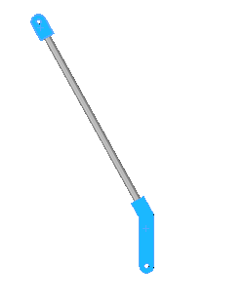
50deg

Slide 26
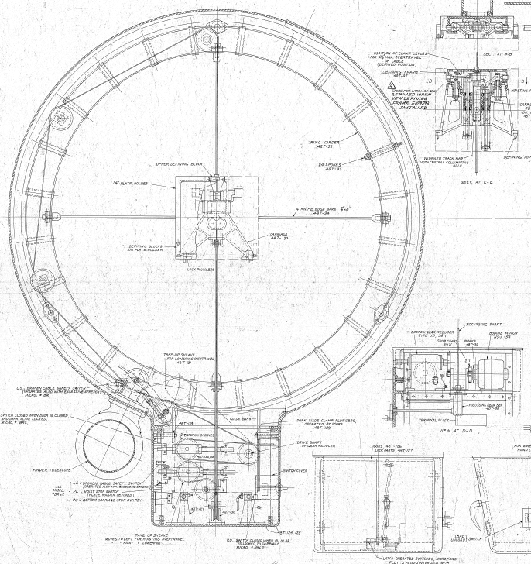
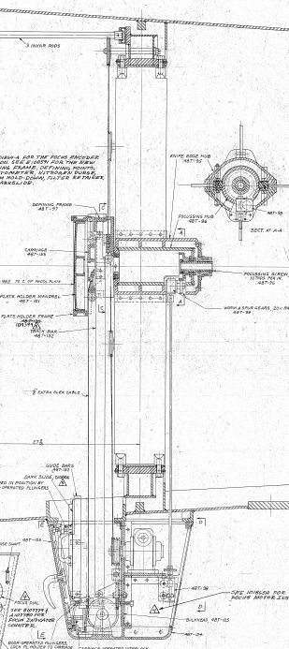
48” Telescope: original plate loading mechanism
Cable drives carriage
Carriage travel
Cable drives carriage
This could be CD changer or jukebox mech for multiple filters.
Existing hole in tube. Currently covered by elect cab

Slide 27
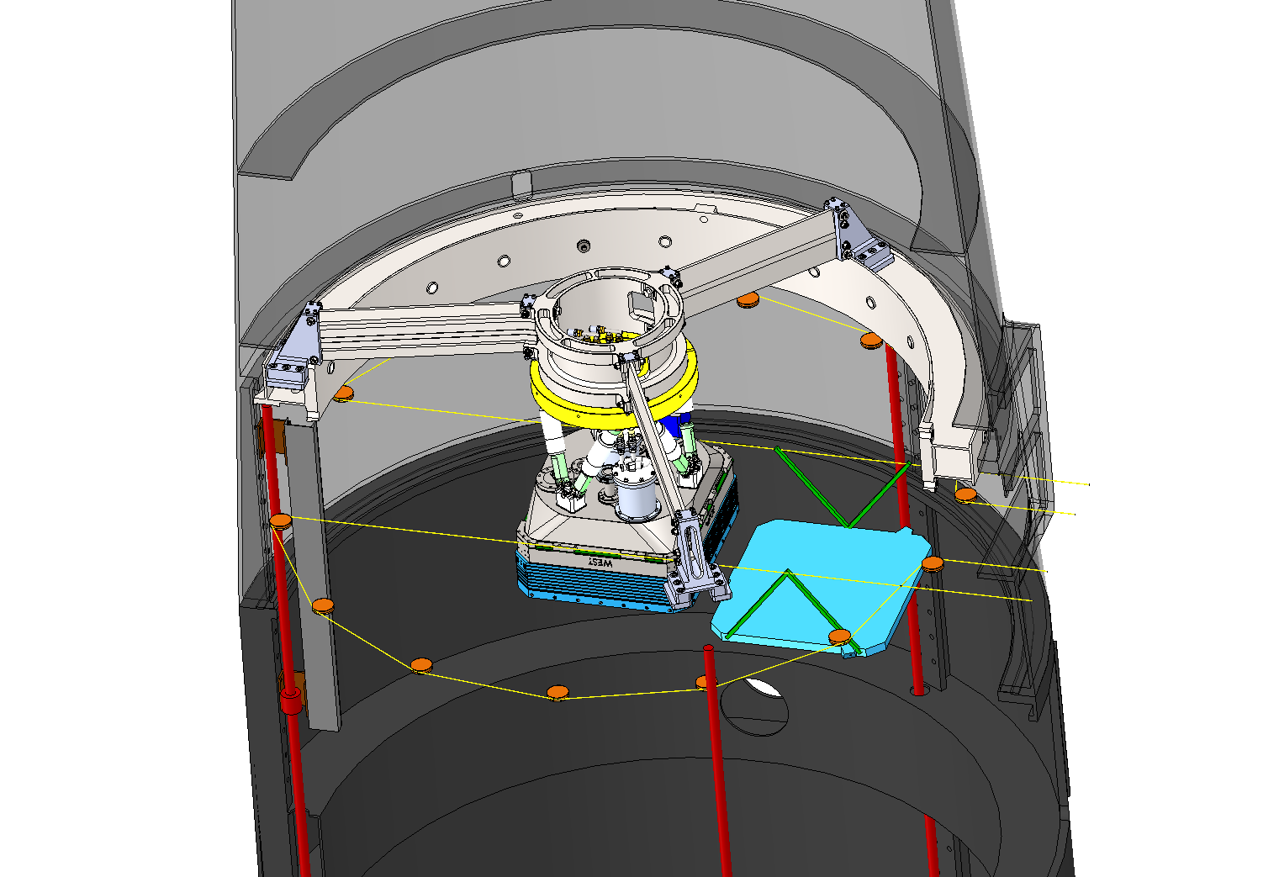

Slide 28
