Slide 1
ZTF Team Meeting
2015-04-15

Slide 2
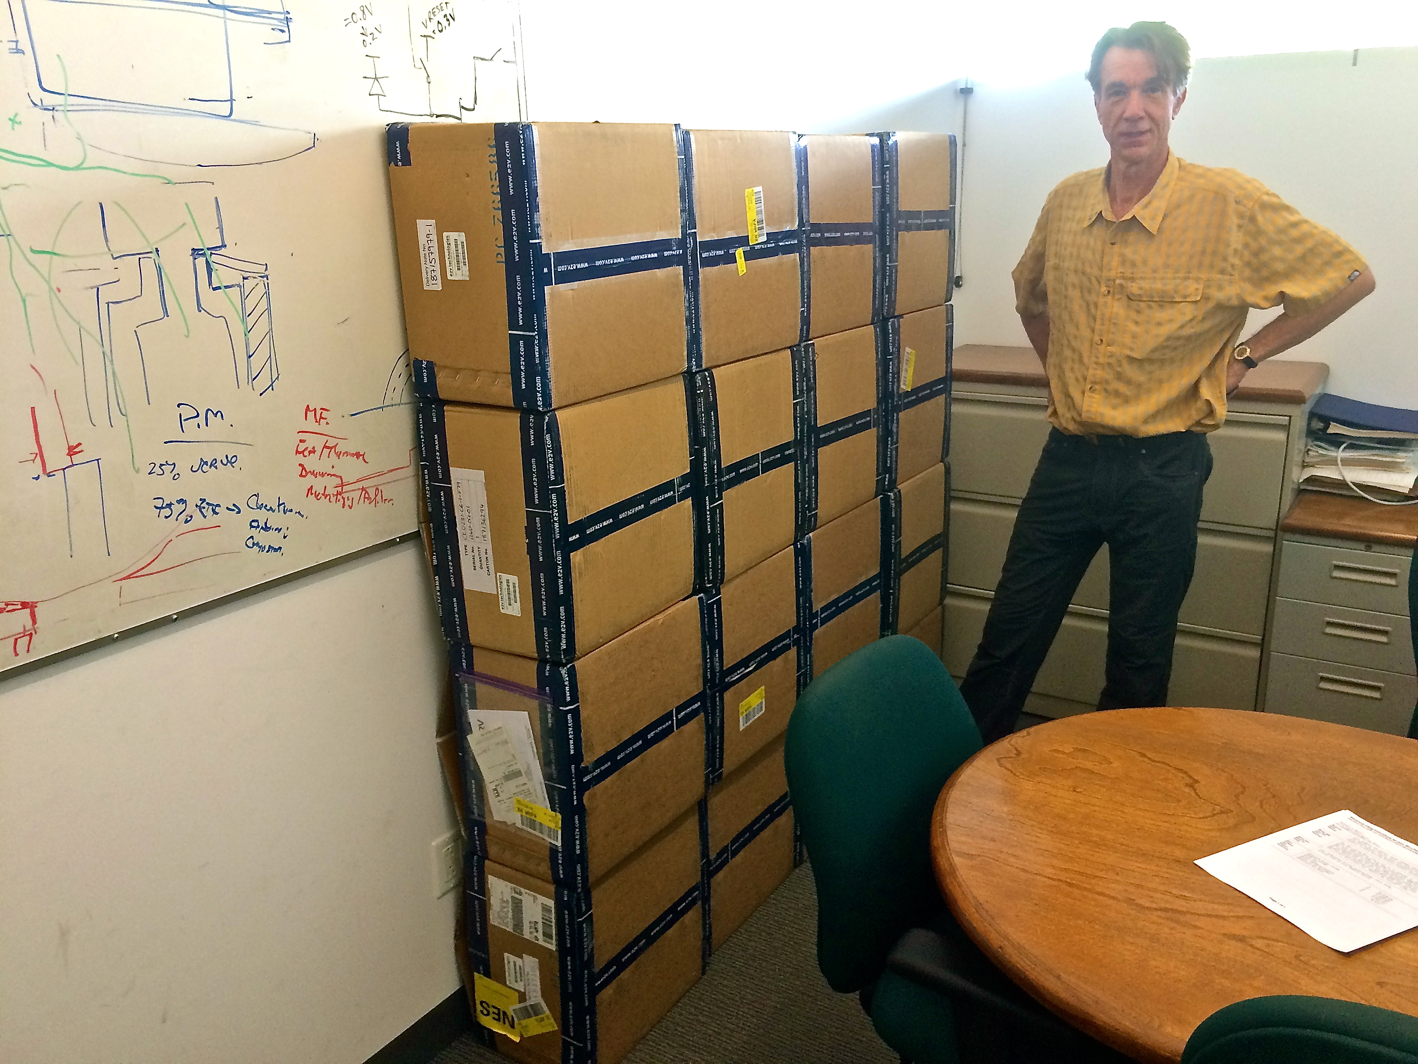
All 16 CCDs have been received
Cosmetics are good: typically 1 bad column/CCD
Height profile is excellent: P-V = 17 µm +- 4 µm
Noise very consistent → 11+-0.3 e- at 1 MHz for differential transmission.
QE well above contractual requirement.

Slide 4
ZTF optics (reported by Dan Reiley)
Window
No update
Verified that coating vendor can deposit ITO
ITO transmission and resistivity numbers obtained from coating vendor.
Filter
Dan will visit Renyard on Thursday.
Expect to recommend them, pending proof of capability of this specific design.
Will place a PO soon.
Should we wait for re-verification of specs from science team?
Field elements – no action
Trim plate – no action
Dewar cover
Electroluminescent film ordered & due soon
Need to test at low temperature experienced when radiatively cooling inot cold window when backed by low emissivity cover

Slide 5
Window SUPPORT
Alex Delacroix

Slide 6
Window support problem
Shawn showed that firm window support produces about 10% less stress at center than compliant support.
However the G10 gasket on compresses about 1 µm when manufacturing tolerances in gasket and seat could be 200 µm.
The resulting deflections are comparable to the overall window deformation so unacceptable loss of safety factor will result.
So change back to compliant gasket, but modulate the width to generate the force profile that would have resulted from the rigid support.
Concept has been demonstrated using flat window but has not yet been fully optimized for real window.

Slide 7
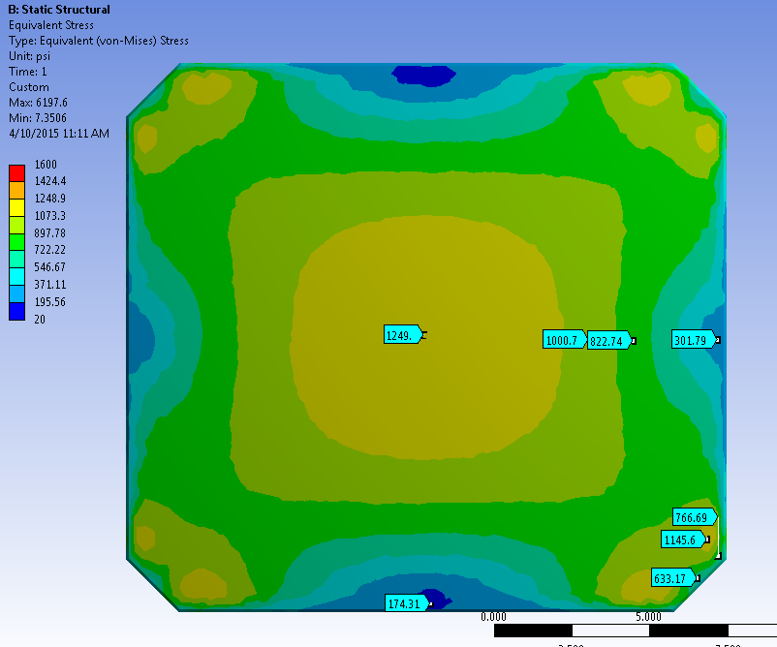
RIGID SUPPORT (no manufacturing errors) Steel o-ring (Young’s Modulus = 2.9E7psi)

Slide 8
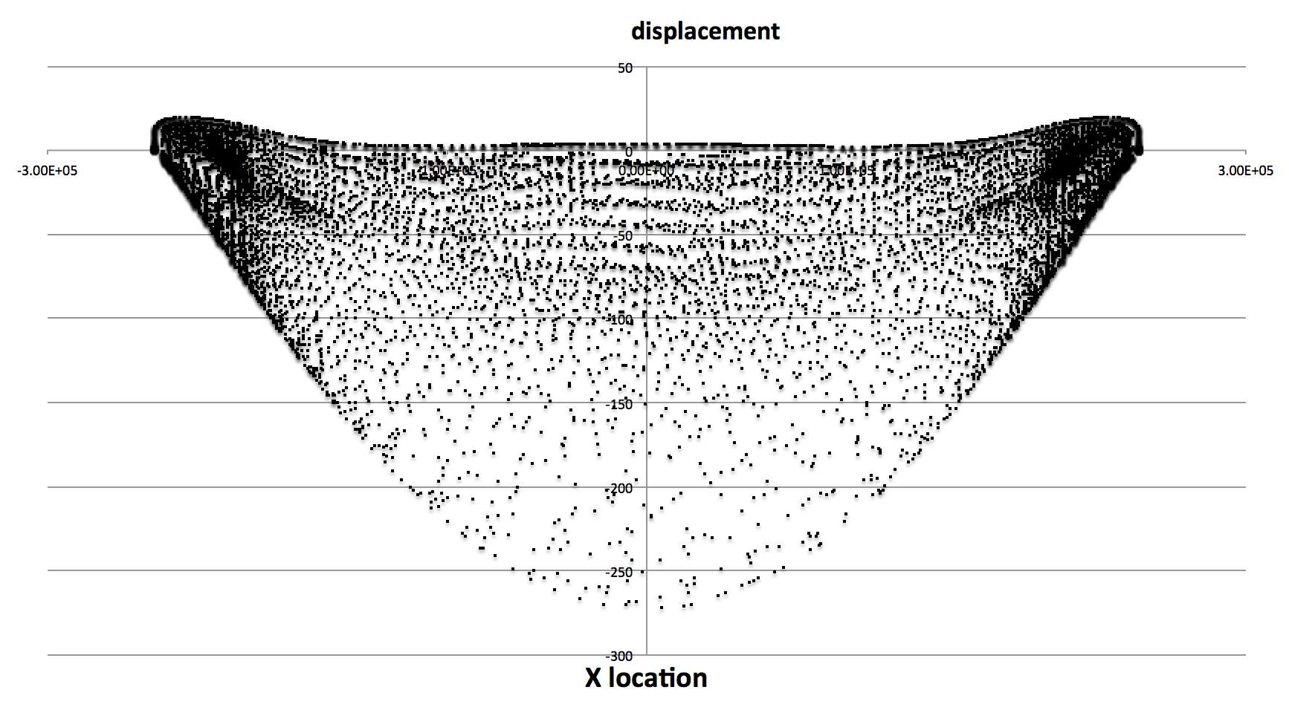
Displacement plots

Slide 9
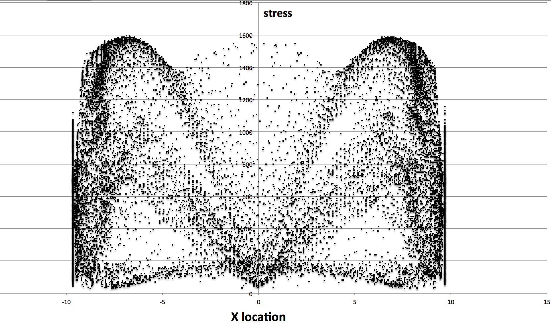
Stress plots

Slide 10
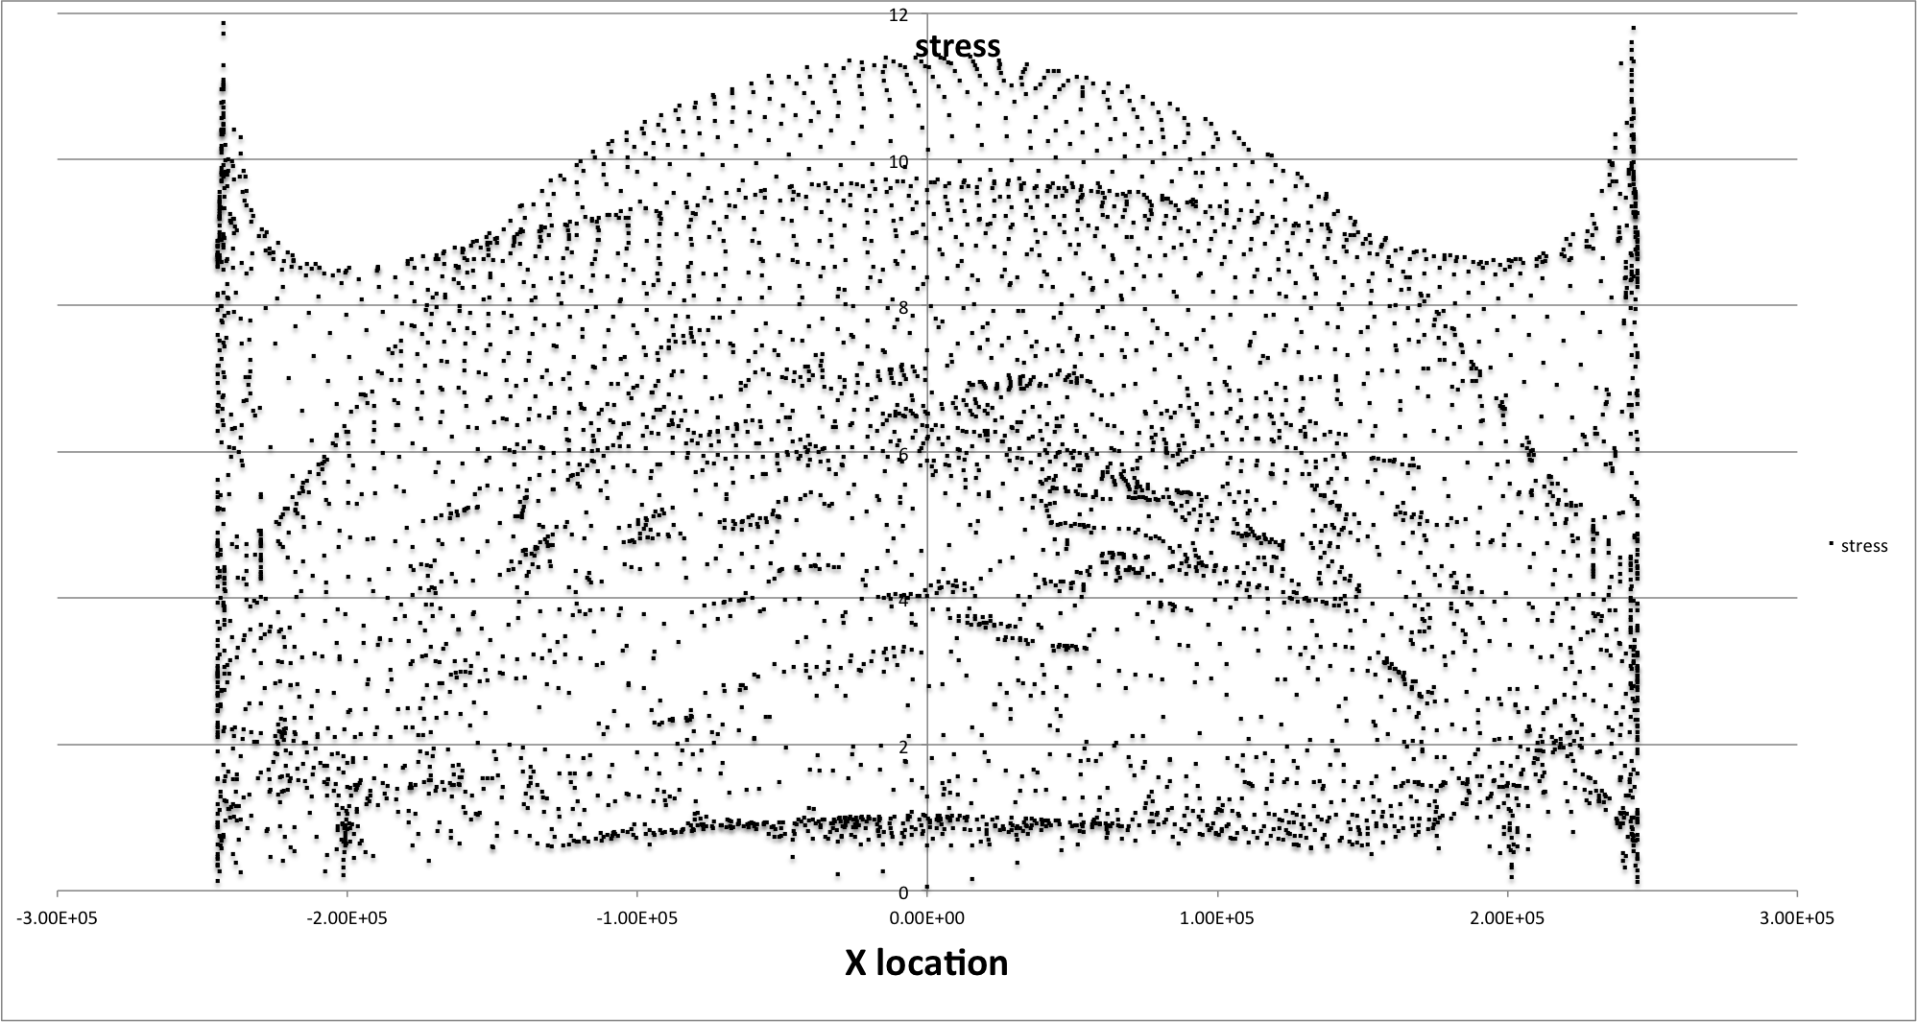
Stress, compliant suppotrt with supplemetal gasket, 2014-04-14
Not yet optimized

Slide 11
SIMPLE FLAT WINDOW, COMPLIANT SUPPORT O-ring young’s modulus 1000 psi Z Deformations

Slide 12
O-ring young’s modulus 1000 psi Stress

Slide 13
O-ring young’s modulus 1000 psi 4 Gasket, O-ring material, 200L X 5.33H X8W mm Stress

Slide 14
O-ring young’s modulus 1000 psi 4 Gasket, o-ring material, 100L X 5.33H X8W mm

Slide 15
O-ring young’s modulus 1000 psi Real Curved window and Enclosure

Slide 16
O-ring young’s modulus 1000 psi Real Curved window and Enclosure Stress

Slide 17
O-ring young’s modulus 1000 psi 4 Gasket, 1500 psi modulus , 200L X 5.33H X4W mm Real Curved window and Enclosure Stress

Slide 18
WINDOW HEATER
Michael Pheeny, Roger Smith, Dan Reiley

Slide 19
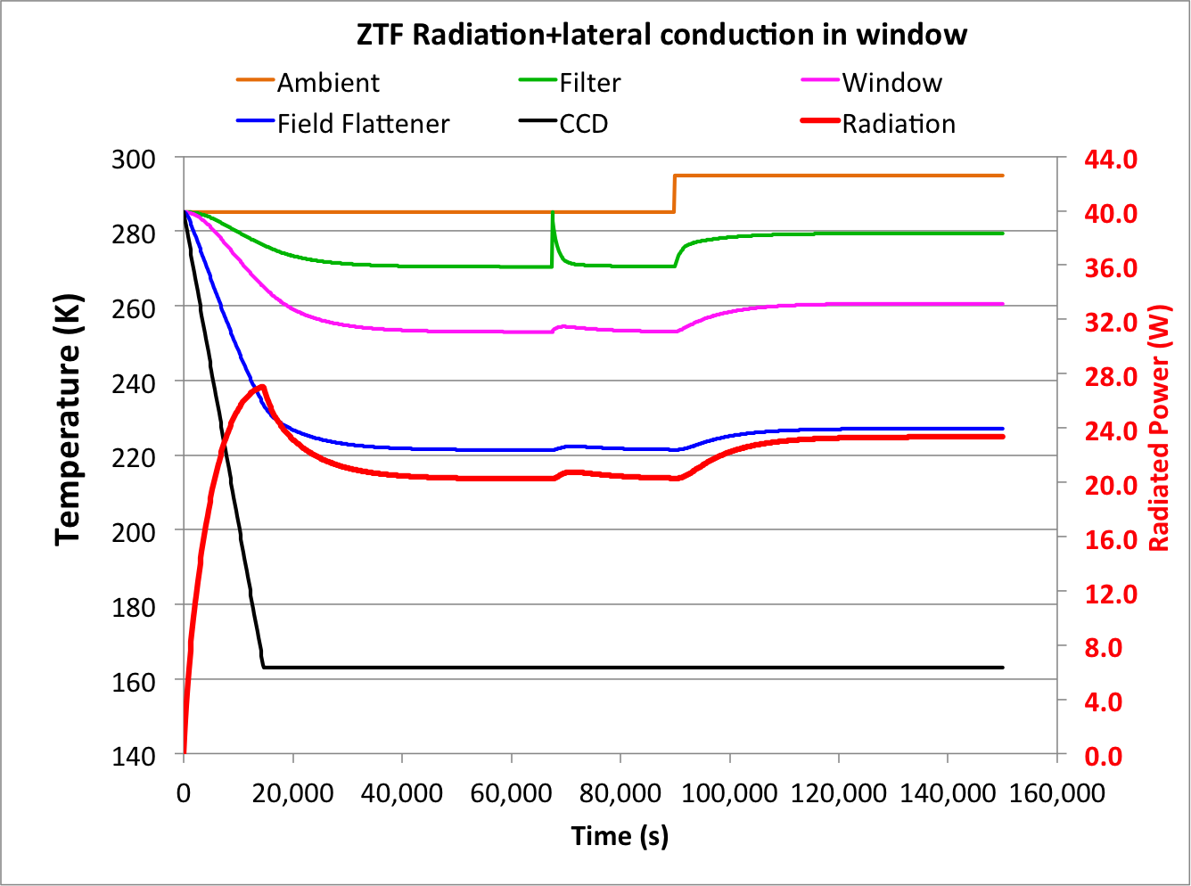
Filter cools 15K below ambient if no window heater
15K

Slide 20
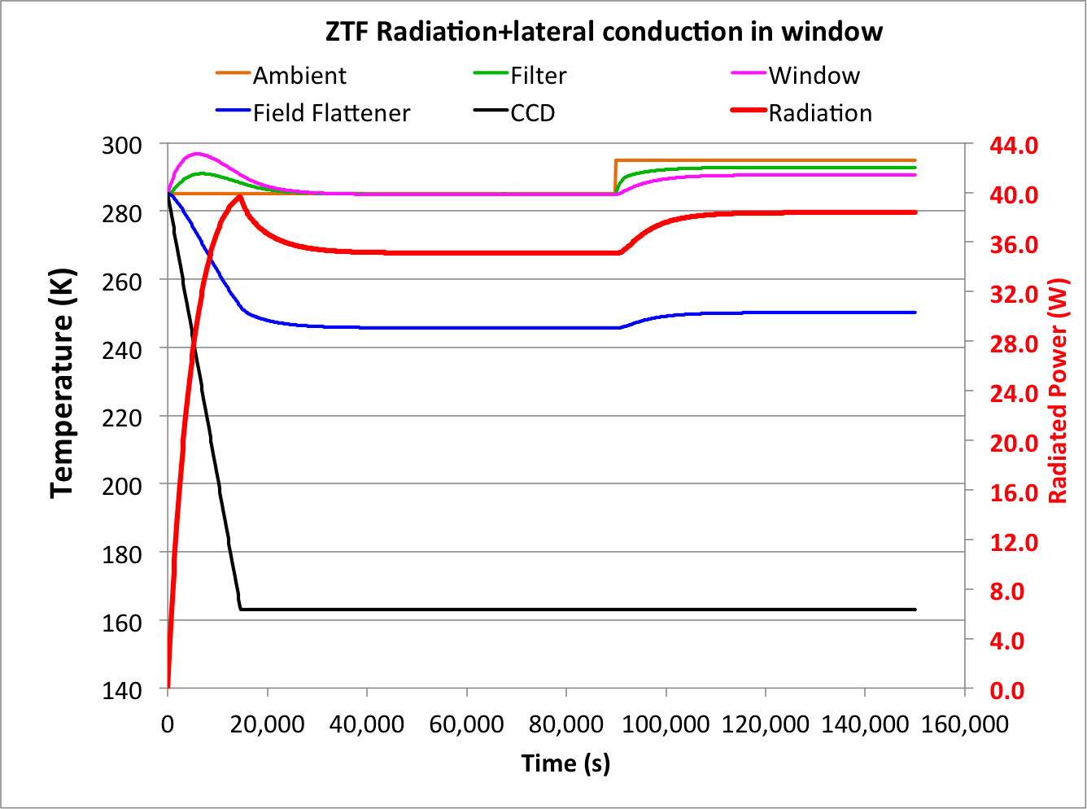
35W window heater required at Ta=285K

Slide 21
Image quality test on P48 with hotplate
Impact on image quality of cold filter is expected to be unacceptable for >3 degree cooling of filter. (Rich Dekany)
To test this a temperature-controlled black painted Aluminum plate with insulated back affixed to PTF. Hole allows imaging while plate temperature increased above ambient. (Assembled by Patrick Murphy.)
Last week, extrafocal movies and in focus images were obtained versus temperature by Richard Walters and Michael Feeney, near zenith and ~45 degree zenith distance.
….Analysis is in progress.

Slide 22
Extra focal movie
See ZTF_extrafocal with hotplate.mov

Slide 23
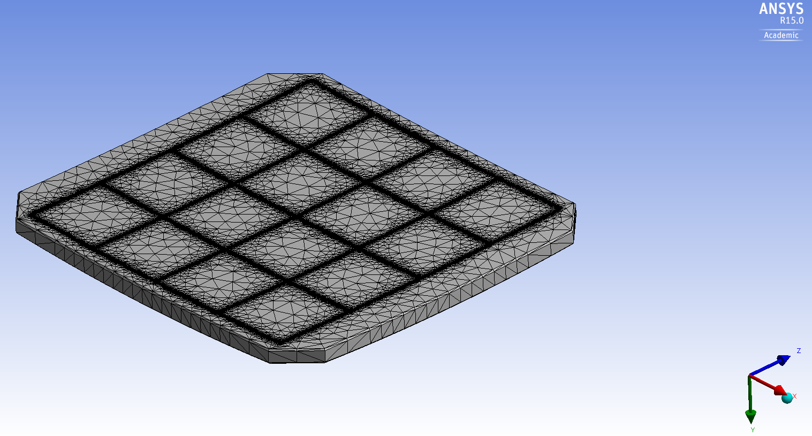
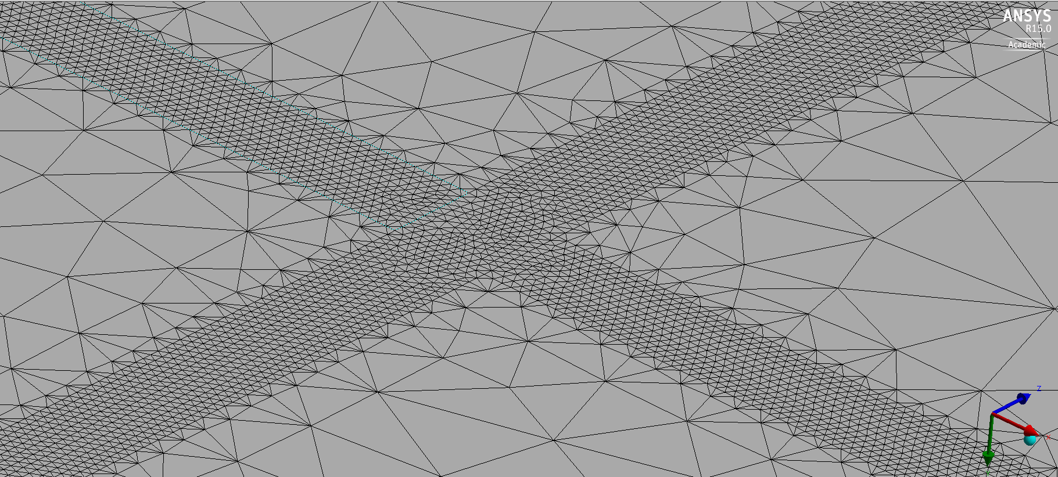
Cryo Window: Thermal Analysis Mesh
Conductive ink/paint is viable; 1mm traces run between beam footprints on window interior → no throughput loss.
Study the temperature distribution and resulting stress caused by thermal expansion gradient…

Slide 24
Cryo Window: Thermal Analysis Temperature
18K peak-to-peak temperature modulation

Slide 25
Cryo Window: Thermal Analysis Stress
35W in heater wires reduces safety factor by 5%

Slide 26
Indium Tin Oxide coating is viable
Transparent conductive film, 40 nm thick →
<1% throughput loss.
160 V DC supply needed to dissipate 35W; can be on internal surface so no risk to personnel.
Uniform heat → low stress in glass.
Applied as part of AR coating on interior: easy to organize and low risk fabrication.

Slide 27
Getter Container
Michael Pheeny

Slide 28
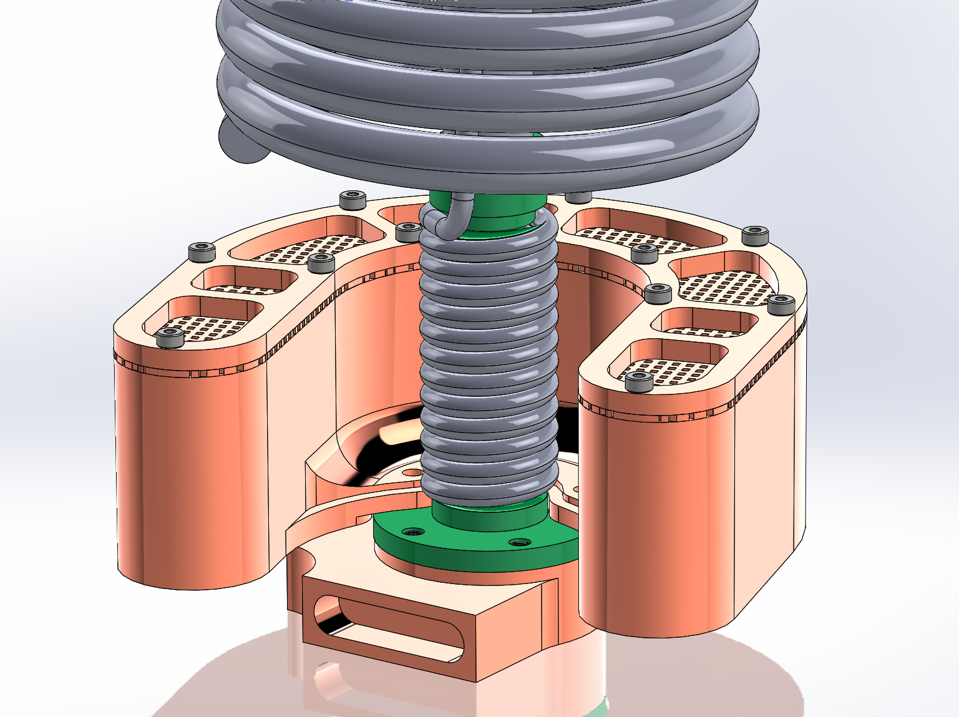
Polycold PCC Cold Path
Getter attached to back of cold head so not in series with path to thermal link → lower getter temperature → higher pumping efficiency.

Slide 29
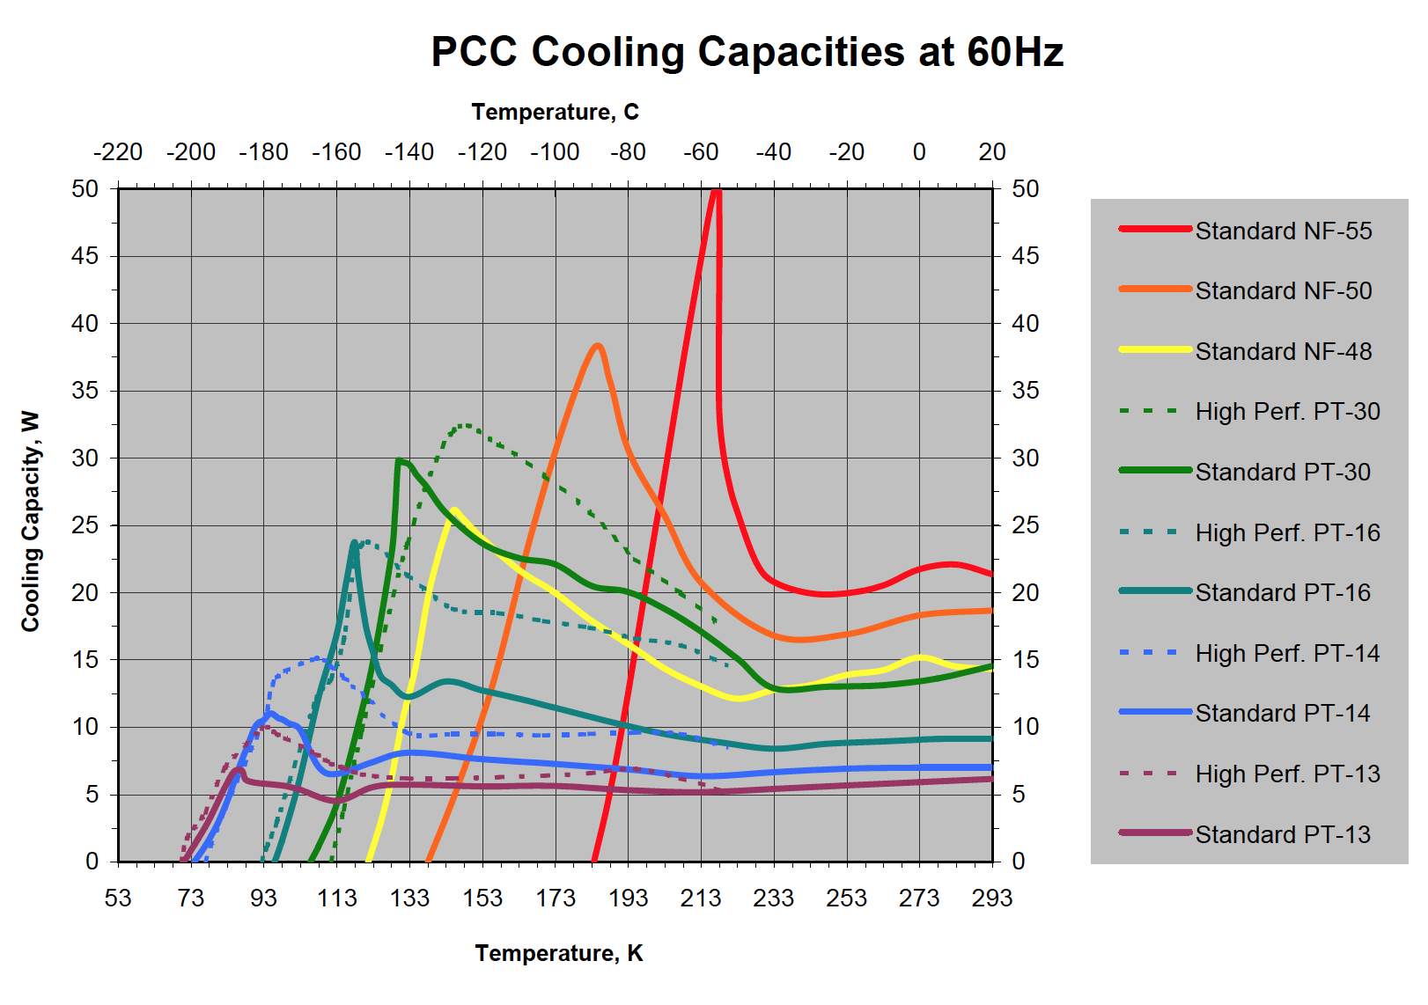
Refrigerant Chosen
At 230K where load curve comes closest to cooling curve, high performance heads with PT-16 refrigerant provides similar cooling power to PT-30
Final temperature is 10K colder so getter will pump much more efficiently.
Can shut down the window heater and install low emissivity window cover to get past the kink

Slide 30
Refrigerant Routing
Paul is working on routing of refrigerant lines.
Looking into having one compressor and manifold to split the flow to the two cooling heads. (Several reports on CCD world say this works.)

Slide 31
Cable Routing to spiders
Paul Gardner

Slide 32
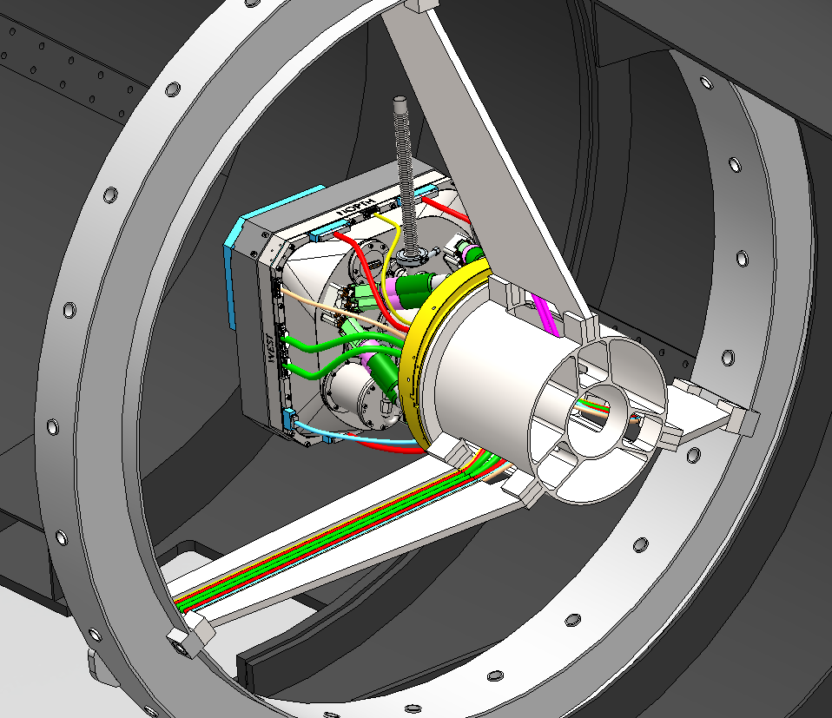
Vacuum hose not present when observing

Slide 33
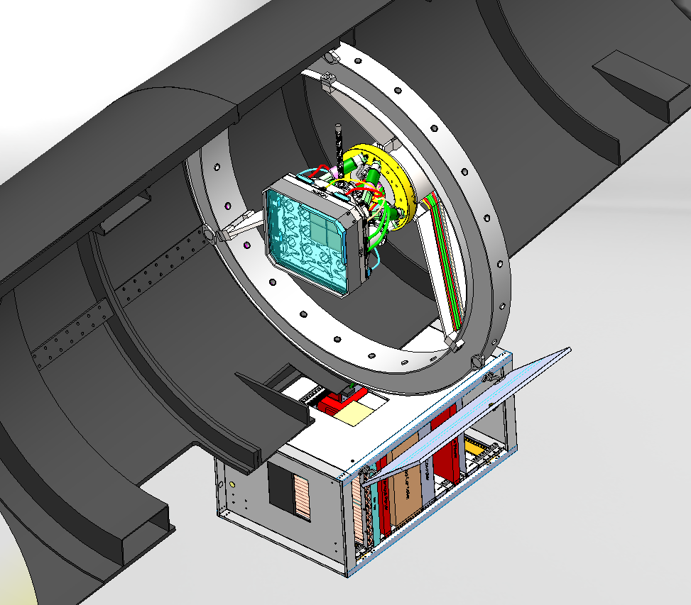

Slide 34
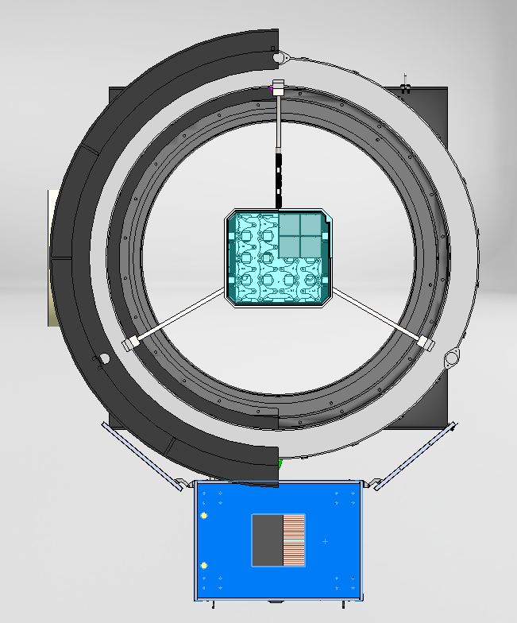
Cables do not obstruct beam

Slide 35
Guider mount
Justin Belicki

Slide 36
Cutaway showing guider/focus CCD assembly. Nytek mask and isolating G9 standoffs are shown.

Slide 37
Guider/focus installation

Slide 38
Guider/focus installation through VIB. Shorting plugs and assembly for support of flex cables shown.

Slide 39
Thermal Shield Assembly

Slide 40
Archon sync tests
David Hale, Steve Kaye

Slide 41
Custom Backplanes
Received custom chassis modules Apr.9
Each chassis using fiber to connect to host computer
Synchronization tests have begun

Slide 42
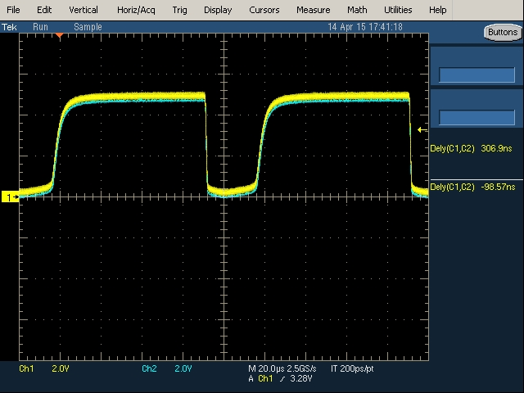
Custom Backplanes
Trigger out signal used for first synchronization test
Waveforms stable relative to each other when master clock is connected to slave
Reset timing brings edges into alignment
Next test with clock driver signals from timing script

Slide 43
LVDS Card Testing
Need to test each LVDS pair
Loopback test for amplifier voltage in ADC module
Was waiting on update of GUI
Can use own host from rack computers
Will not interfere with synchronization tests

Slide 44
Amplifier Test Board
RFQ for board at vendor
Turn around time can be as short as 2 days
Components on order
Impedance calculation may need adjustment for correct geometry – edge coupled microstrip

Slide 45
VIB Layout
VIB sent for layout, but incorrect terms were on PO
Resolved on Monday 4/13, but caused delay in layout
Will check in with vendor weekly (at least) for progress
Mods still(?) required to VIB cut outs for:
Larger thermal links
Guider cables with shorting connectors.

Slide 46
Science Transition Board
Schematic received from STA on 4/9 for double check
Schematic defines position of cards
Allows work to begin on final configuration file
Worked with Michael on mechanical features of transition card and front plate
Need to share information with STA

Slide 47
ARCHON TRANSITION CARD mounting and box cover
Michael Pheeny

Slide 49
Archon Box: Rear Cover Design

Slide 50
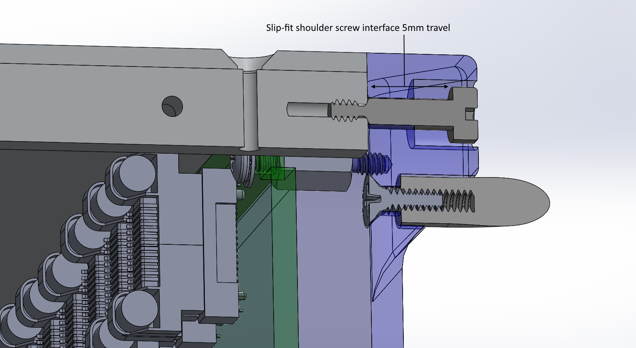
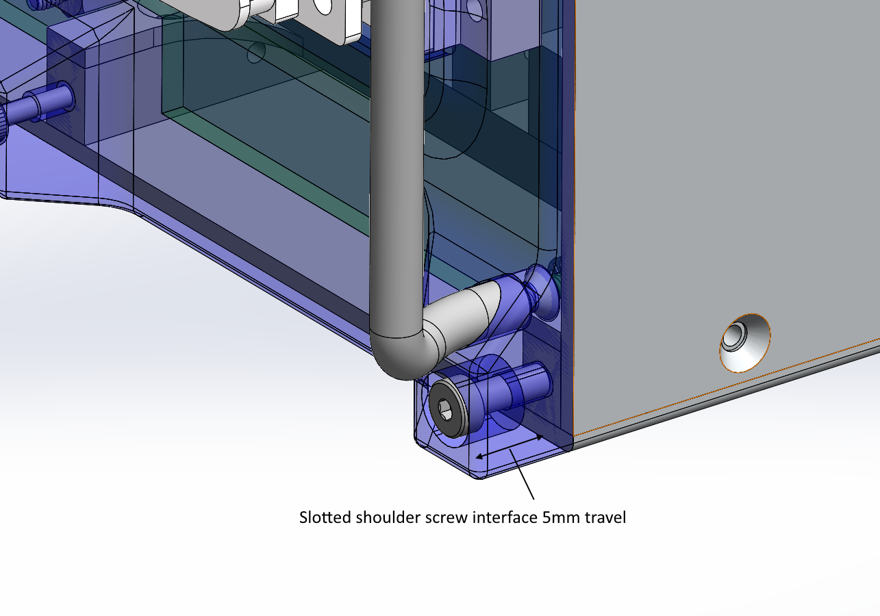
Archon Box: Rear Cover Design

Slide 51
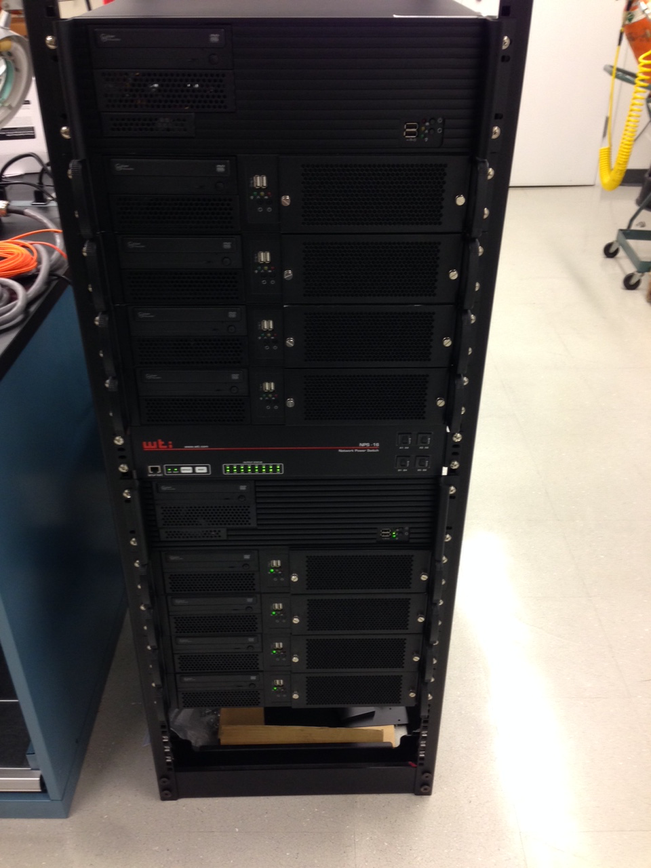
Software Status
Reed has finished building and configuring the final ZTF computer systems (primary and spare
Installed in rack in Cahill 17
New computers are being used for all CCD controller testing
Work continues on robotic control software
Building interfaces to hardware
Creating control daemons for robotic interactions

Slide 52
Software
Dave:
Working on running multiple Arcons and testing Sync.
John writes:
Back from NIRES as of 14 April.
Working on the CR3000 data logger. Controller is back from the manufacturer, this time with the correct power supply. Established communications to the controller via telnet and manufacturer’s software. Still studying the documentation to learn how best to do the data logging.
Working on temperature-control software.
Ramping up on the hexapod software.

Slide 53
Notes
No new mechanical fab contracts issued this week, though vendor confirmed June 5 deliver for cold plate.
Expect release of enclosure, shields and supporting parts this week.
See next slide for actions.

Slide 54
Actions
Eric:
Get final signoff on filter specs from science team.
Dan:
Visit Reynard; place filter PO
Combine data for surface heights of CCDs to evaluate what tweak to field flattener is desirable, if any.
Advance window cover design; test electroluminescent material.
Alex:
Final optimization window support.
Implement consequent mods to enclosure
Get final quotes for enclosure and/or issue PO.
Michael:
Finalize Archon transition board mount, and order part for first article.
Add radiative transfer to window temperature/stress model.
Finalize getter design
Work on thermal link and cold head brace.
Negotiate enlarged VIB holes with Steve.

Slide 55
Actions
Justin:
Negotiate enlarged VIB holes for guider cable with Steve
Finalize enclosure; shield, masks and shield support drawings. Place orders.
Finalize guider adapter design
Paul:
Define and order cryocooler hoses (fittings) and manifold. Routing of hoses.
Cable routing and cable restraints. Cable lengths.
Steve:
Monitor VIB contract; pass on changes.
Finalize and procure preamp test board.
Finalize specs for science transition card
Test sync and timing jitter.
Patrick:
O-ring spring rate test for various window O-ring candidates
Clean room setup ?

Slide 56
Actions
Dave:
Multi-host coordination and controller sync tests
Data transfer reliability test to be repeated in the new multi-host configuration with sync.
Reed:
????
John:
test data logger and integrate into ZTF software environment.

