Slide 1
POMO Meeting
ZTF REQUIREMENTS
Roger Smith
2014-09-22

Slide 2
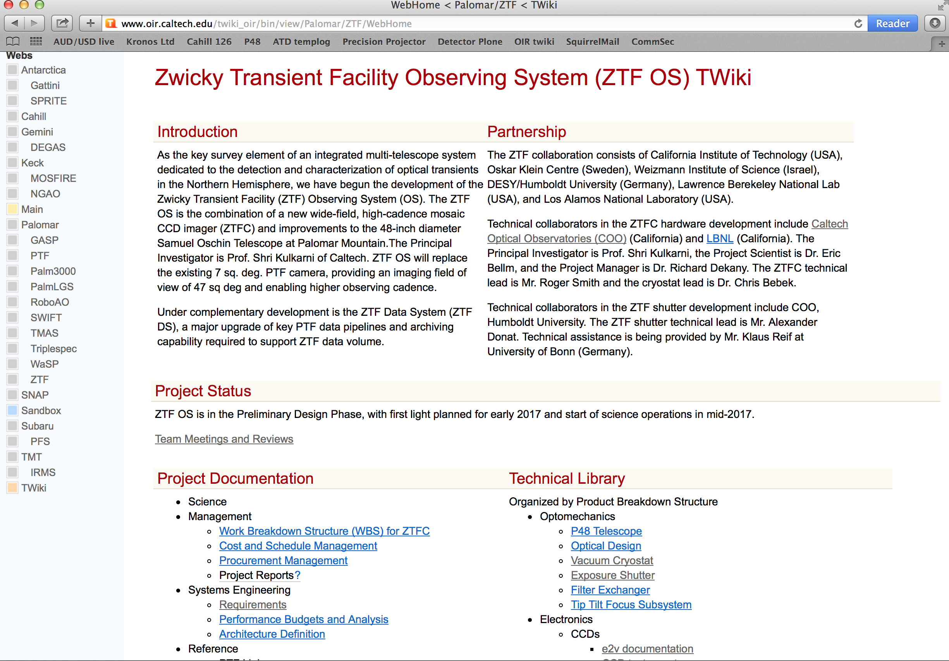

Slide 3
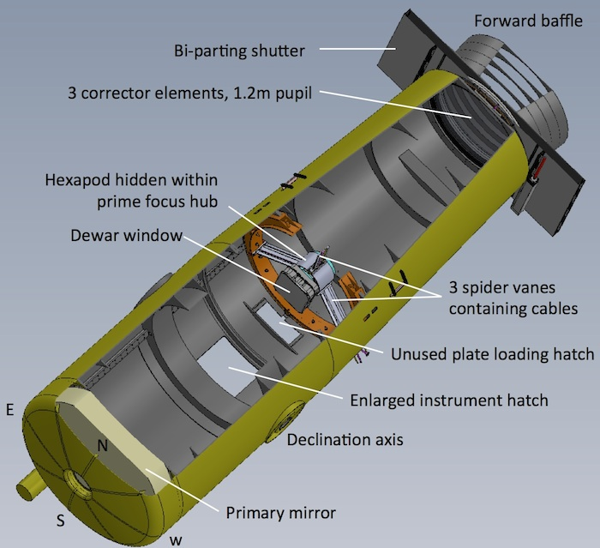

Slide 4
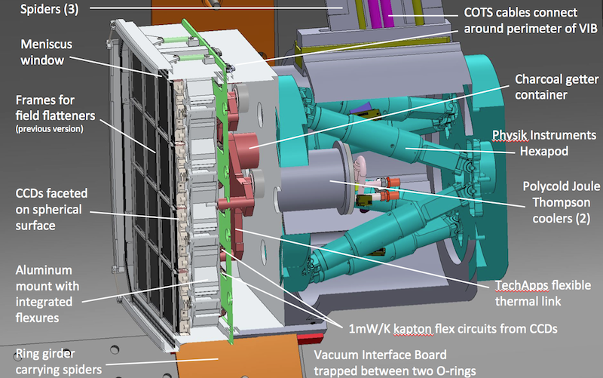

Slide 5
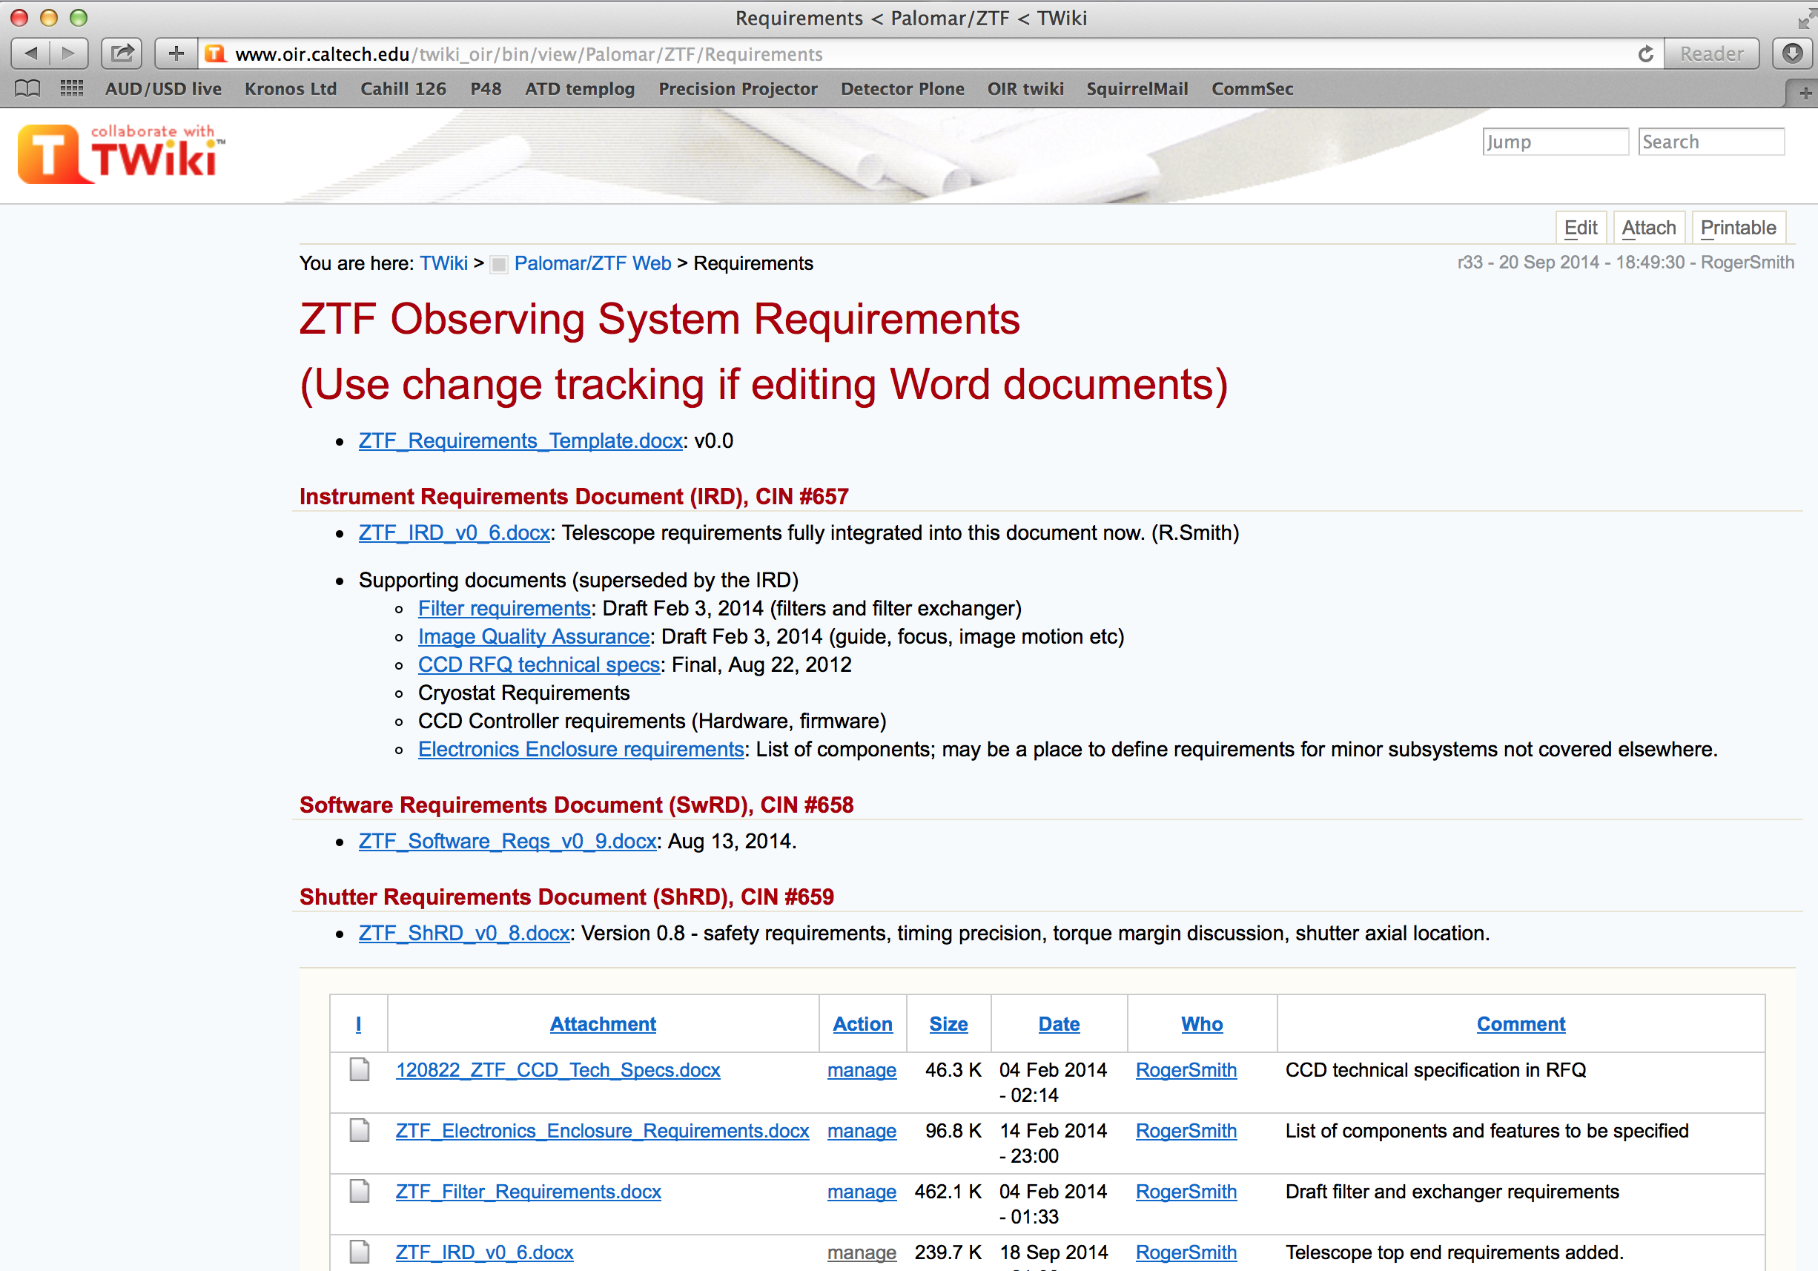
NB: If you can’t find a requirement or find an error/inconsistency please notify Roger.

Slide 6
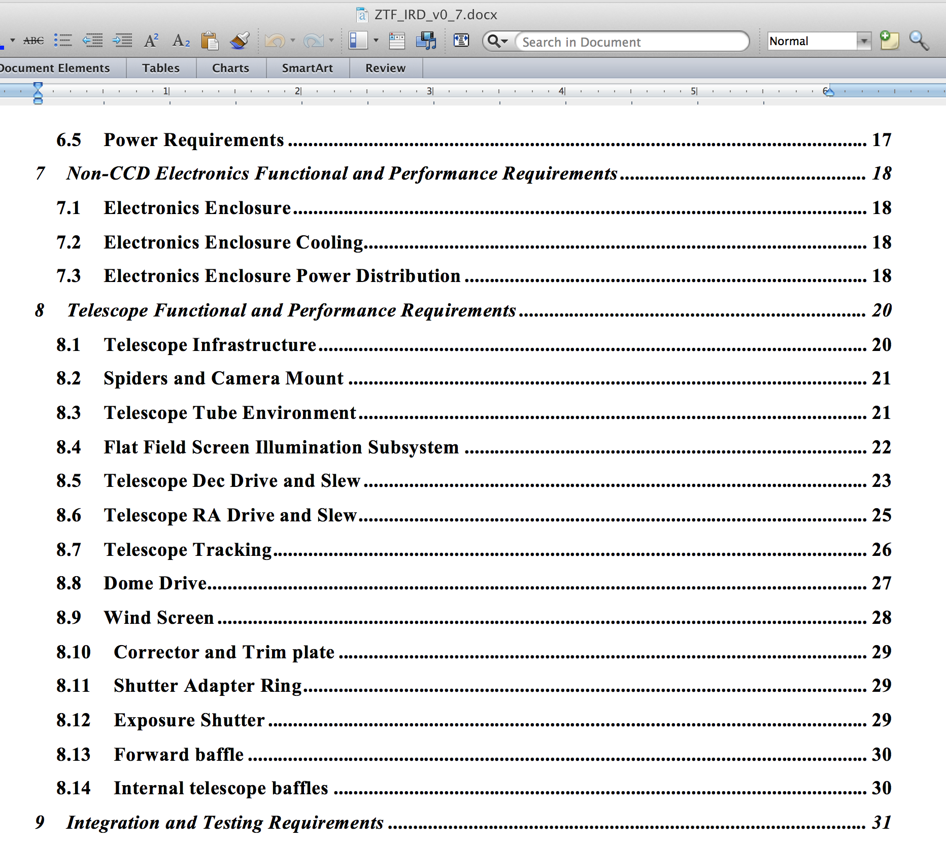

Slide 7
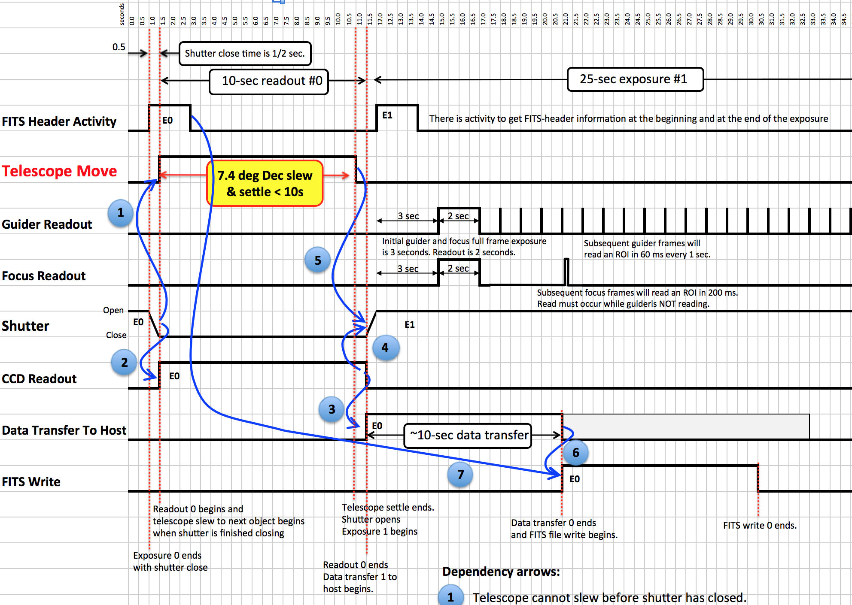
http://www.oir.caltech.edu/twiki_oir/bin/view/Palomar/ZTF/PerformanceBudgets

Slide 8
Warning:
requirements may change
…see next slide
Specs in development

Slide 9
Measurement of telescope resonances as part of shutter specification development may inform how new TCS acceleration profiles should be shaped to minimize excitation of resonances.
Linear scale
Shutter as example
Sudden acceleration to constant velocity
→ high frequency comb
Log scale
Soft start and end
Soft start reduces high frequencies ~ 10x

Slide 10
Full list of upgrades
Weather; telemetry; logging ?
Lighting and surge protection?
Seeing: AC, ventillation ?
Windshield
Dome
Telescope drives; TCS
New spiders, hub, and hexpod
Baffles; inside and out.
Corrector trim plate installation and cleaning
Shutter installation and safety
Refrigerant lines to dual compressors
Guide and focus
Filter mechanisms (option)
Flat field illuminators (pulsed)
Enlarge access hatch
Cryostat lift and handling fixtures.
Tube air: dew point, dust, pressure, temperature
Electronics enclosure; cable paths; cooling
CCD controller locations & cooling.
Computers, spares
Data transport: HPWREN

Slide 11
Telescope Tube Mods
New 3-vane spiders; maybe new ring girder
  How installed.
New instrument mount with hexapod.
New holes in tube for cables, refrigerant.
Lines to 2 compressors instead of 1. Temperature control?
CCD controllers at ends of spiders.
New electronics rack on telescope.
3 filter mechanisms for very large filters which park against interior walls.

Slide 12
Instrument and filter Installation
Enlarge access hatch
Winch on rail against tube for lifting instrument though hatch.
Lift fixture accommodates some rotation about CoG.
Guide pins to mate with hexapod.
Window cover both protects and allows CCD operation without dry air.

Slide 13
Air inside telescope
New more aggressive air dryer
Dew point, humidity, temperature logging
Temperature control of instrument wall.
Desiccant in Window Cover
Controlled air flow into tube but minimal overpressure since this represents grave danger to corrector.
Control gaps; fill with filter material to limit ingress of dust and back-diffusion of water vapor.
Interior to be treated as “clean room” (clothing, temporary HEPA filtered air.

Slide 14
Pupil Plane Shutter
Size of table tennis table. Supplied by BonnShutter.
Bi-parting. Balanced. Work in progress to test effect on image motion of slight mass imbalance or timing offset.
Designed for survival in 35 mph wind.
  Close at 25 MPH? → half the force on shutter.
Lift points (eye bolts) to be supplied above CoG to allow installation
Discuss adapter ring and bolt access.

Slide 15
Baffling
New forward baffle between top end and dome; removable for cleaning corrector.
New internal baffling of telescope walls, especially upper half.
NB: must remove PTF baffles.
Repaint interior of tube.

Slide 16
Telescope Balance
Paul is studying this.
Changes to be accommodated:
  Forward baffle
  Shutter + adapter ring
  Corrector trim plate
  New spider and hexapod
  Heavier instrument
  New filter mechanisms.
  New electronics enclosure.

Slide 17
Telescope Drive Upgrade
Lower gear ratio required on Declination
Nominally no change on RA Axis.
What mechanical maintenance??
Electrical upgrades??
  Computer and OS?
  Motor/encoder electronics?
Software upgrade to Palomar Universal TCS.

Slide 18
Dome
New motor: speed controlled servo.
Same encoders.
Smarter algorithm takes into account next pointing.
  Arrives just in time.
  Accelerates slightly before end of exposure.
  Independent of telescope.
Reinstate windscreen

Slide 19
Seeing improvements ?
Possible, though no well defined plans yet:
Day
  insulation improvements?
  Air condictioning
Night
  Air extractor.

Slide 20
Power
Lighting protection.
  What is state of lightning rods, grounds?
Power conditioning (Surge protection)
UPS ? … probably not needed.

Slide 21
Weather, Telemetry, Logging
wind ?
rain ?
Temperatures
Humidity
Pressure in cryostat.
Air flow from air dryer
Other data logging: e.g. Event timing log to diagnose observing duty cycle is already in place.

Slide 22
Flat field illuminator
Stabilized LEDs for diagnostics
Upgrade to be controlled by shutter timing pulse (with true shutter disabled).

Slide 23
Computing and Downlink
Fully parallel all the way to disks.
4 host computers + 1 spare; any can serve as master.
POMO responsible for data transport; camera systems and IPAC data center are passive generators/consumers of images and non-participants in transport.
IPAC+COO are handling compression.
Shopbell is investigating HPWREN throughput, which in theory is adequate but not yet high enough fraction of theoretical.

