Slide 1
ZTF Observing System
Roger Smith, Systems Engineer
NSF visit to Caltech
2014-07-24

Slide 2
Outline
Camera comparisons
Technical challenges
Subsystem walk through
Key strategic choices
Enabling technologies

Slide 3
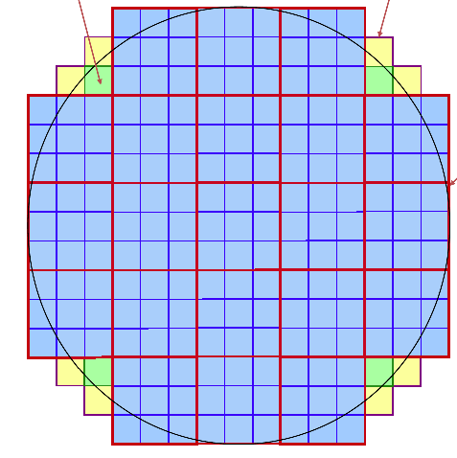
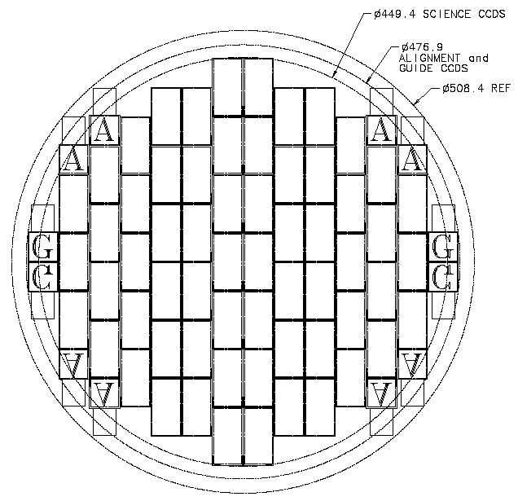
LSST
DECam
ZTF

Slide 4
Prime focus cameras*
 | DECam | ZTF | LSST
Telescope, Location | 4m Chile | 1.2m Palomar | 8.4m Chile
Field of View | 2.9 | 47 | 9.8 | degree²
Survey Speed | 130 ? | 3800 | ~900 | deg²/hour
Collecting area | 9.9 | 0.87 | 35 | m²
Image Scale | 0.27 | 1.0 | 0.2 | arcsec/pixel
Science Pixels | 520 | 606 | 3170 | Mpixel
Camera + filter size | 1.6 x 2 | 0.48 x 0.44 | 1.65 | m
Focal Plane Diameter | 480 | 560 | 634 | mm
Overhead per pointing | 20 | 10 | 3+5 | sec
Readout Channels | 124 | 64 | 3024
Pixel/channel | 4 | 9 | 1 | Mpixel
Pixel rate per ch. | 200 | 1000 | 500 | kHz
*PanSTARRS, Skymapper and JPAS are at cass. focus

Slide 5
Technical Challenges for ZTF
Cost: maximize survey volume per unit time per dollar,
For objects bright enough for spectroscopic follow up.
Compactness: minimize beam obstruction
→ large focal plane at prime focus on relatively small telescope
Shutter blades and filters stow outside telescope
Minimize dead time:
15s readout time (10s goal)
Faster telescope repointing
Faster dome move
Fast shutter
Near real time data transfer and analysis

Slide 6
Strategic decisions
Coarse image scale:
Big pixels on sky → more sky photons → higher read noise → faster readout → lower channel count = less electronics & lower CCD optimization costs
Fewer pixels → less silicon to buy, less data to store transport and process.
Matches Image quality of telescope and site
DIQ more sensitive to lateral charge diffusion
Conventional CCDs, maximum size
Lowest cost per unit area
Fewer parts
Good fill factor without extreme tolerances

Slide 7
Key technology choices
Cover these points during walk-through….
Cold field flatteners
Halves the radiative load → small cheap cooling system
Vacuum interface board
Eliminate dewar wiring and hermetic connectors
COTS cables to electronics outside telescope tube.
Differential signal transmission
Robust, high speed signal transmission to electronics outside telescope → low crosstalk and fast settling; COTS electronics
Pupil plane shutter
No beam obstruction
Force balanced (bi-parting)
Made and tested off-site

Slide 8
ZTF Walk through

Slide 9
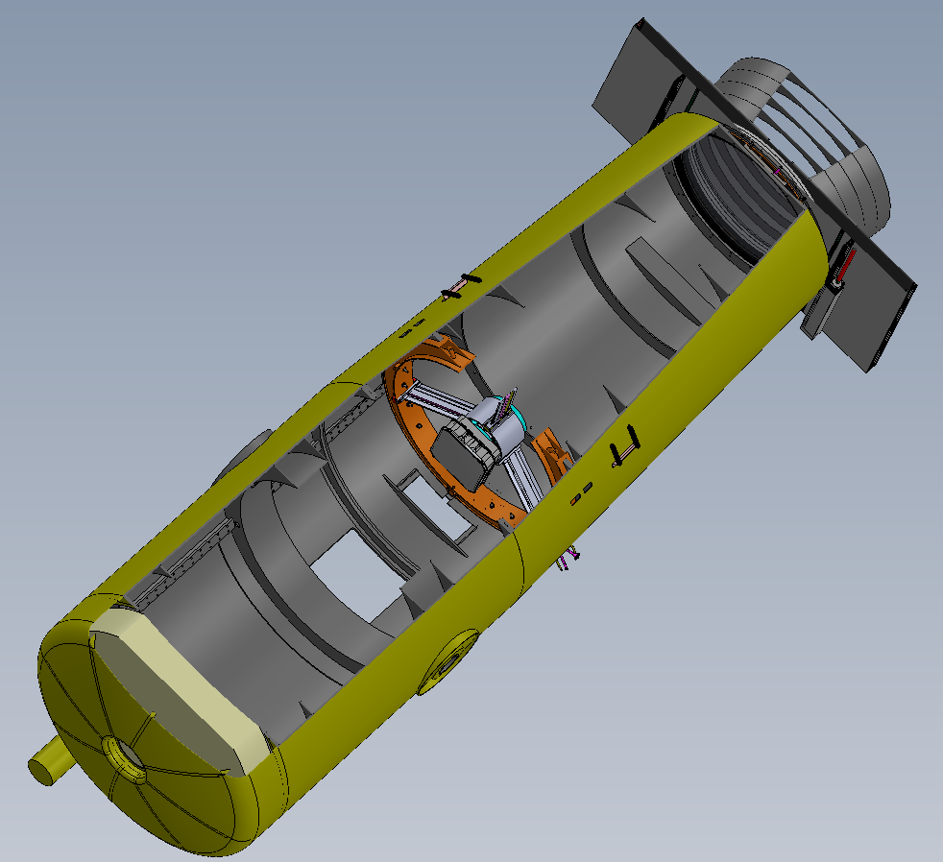
Forward baffle
Bi-parting shutter
3 corrector elements, 1.2m pupil
Hexapod hidden within prime focus hub
Dewar window
3 spider vanes containing cables
Unused plate loading hatch
E
Enlarged instrument hatch
N
Declination axis
S
Primary mirror
w

Slide 10
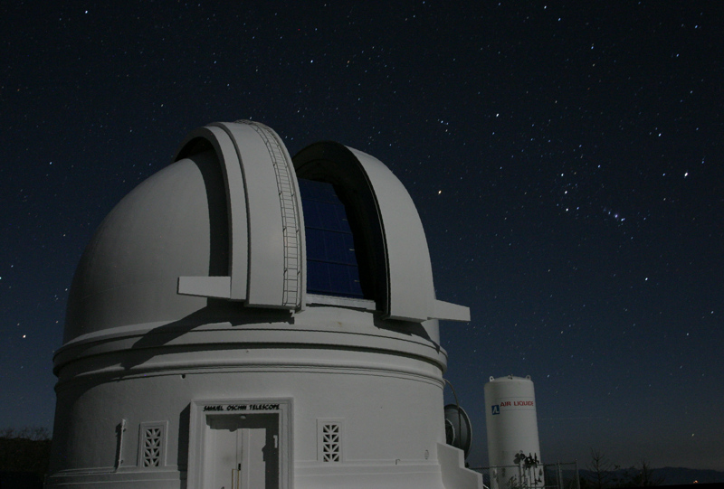
Dome
New speed-controlled drive.
Velocity profiling
arrive just in time
Trajectory based on next exposure, as well as present
cruise through
accelerate before shutter closes
Reinstate windshield

Slide 11
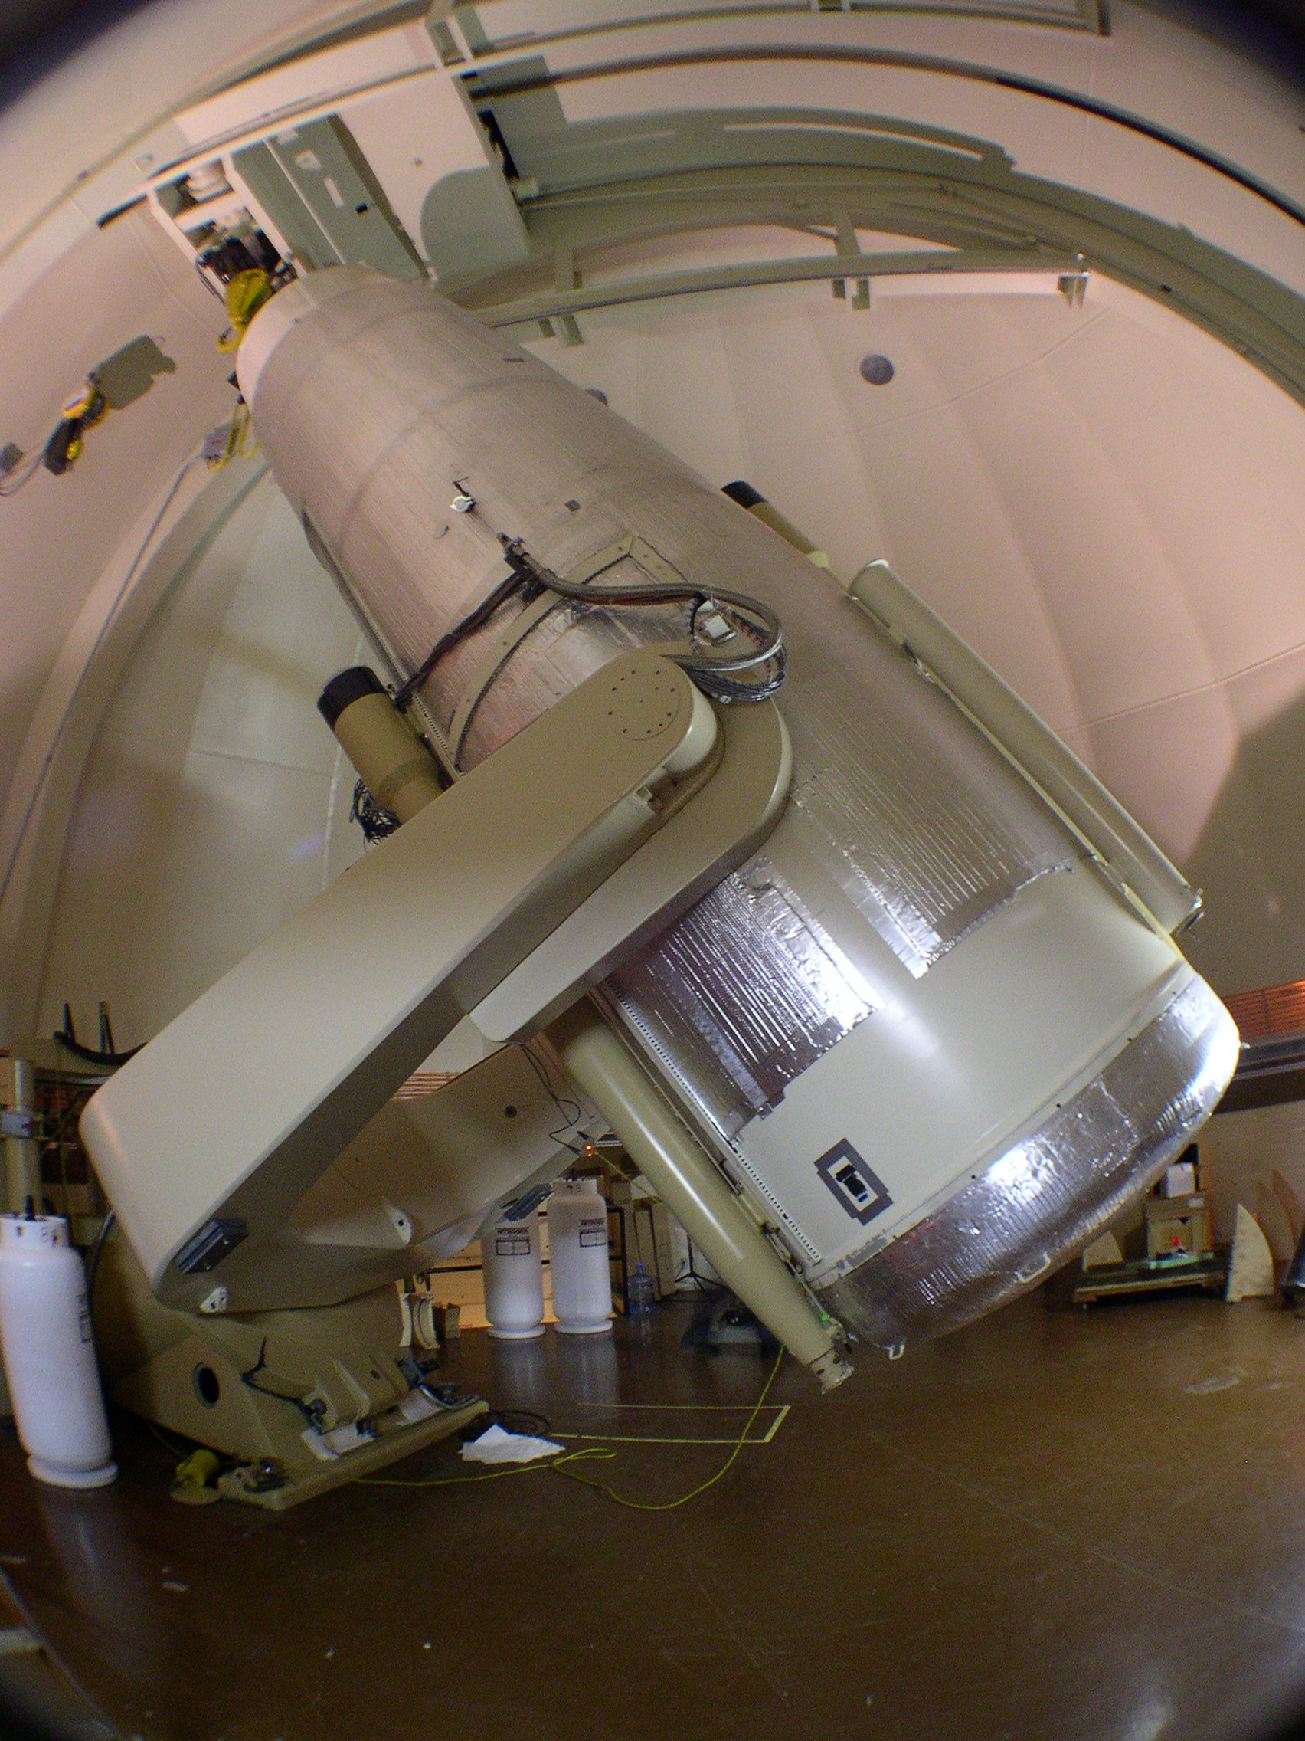
Telescope
New baffles in front of shutter and inside tube
Lower gear ratio on declination axis; retune → faster slews
…Use existing high resolution direct shaft encoder
Enlarge access door and instrument handling fixtures.
Seal, clean and repaint interior
Flush tube with dry (and filtered) to prevent condensation on window (and dust on optics)

Slide 12
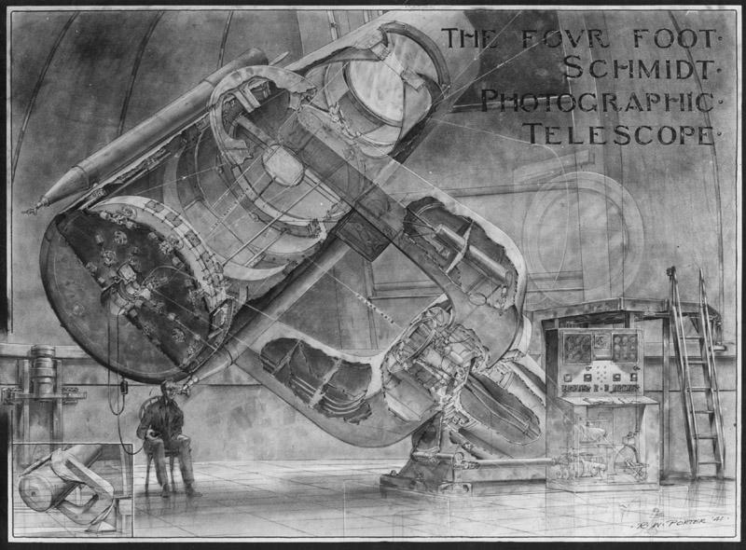
Shutter:
Pupil plane → bi parting → balanced
Impact on pointing testable in advance
Shutter air extractor to clean blades.
Original shutter behind corrector to be replaced with flat blades in front.
Wind screen to be re-instated

Slide 13
Bonn Shutter team has extensive experience

Slide 14
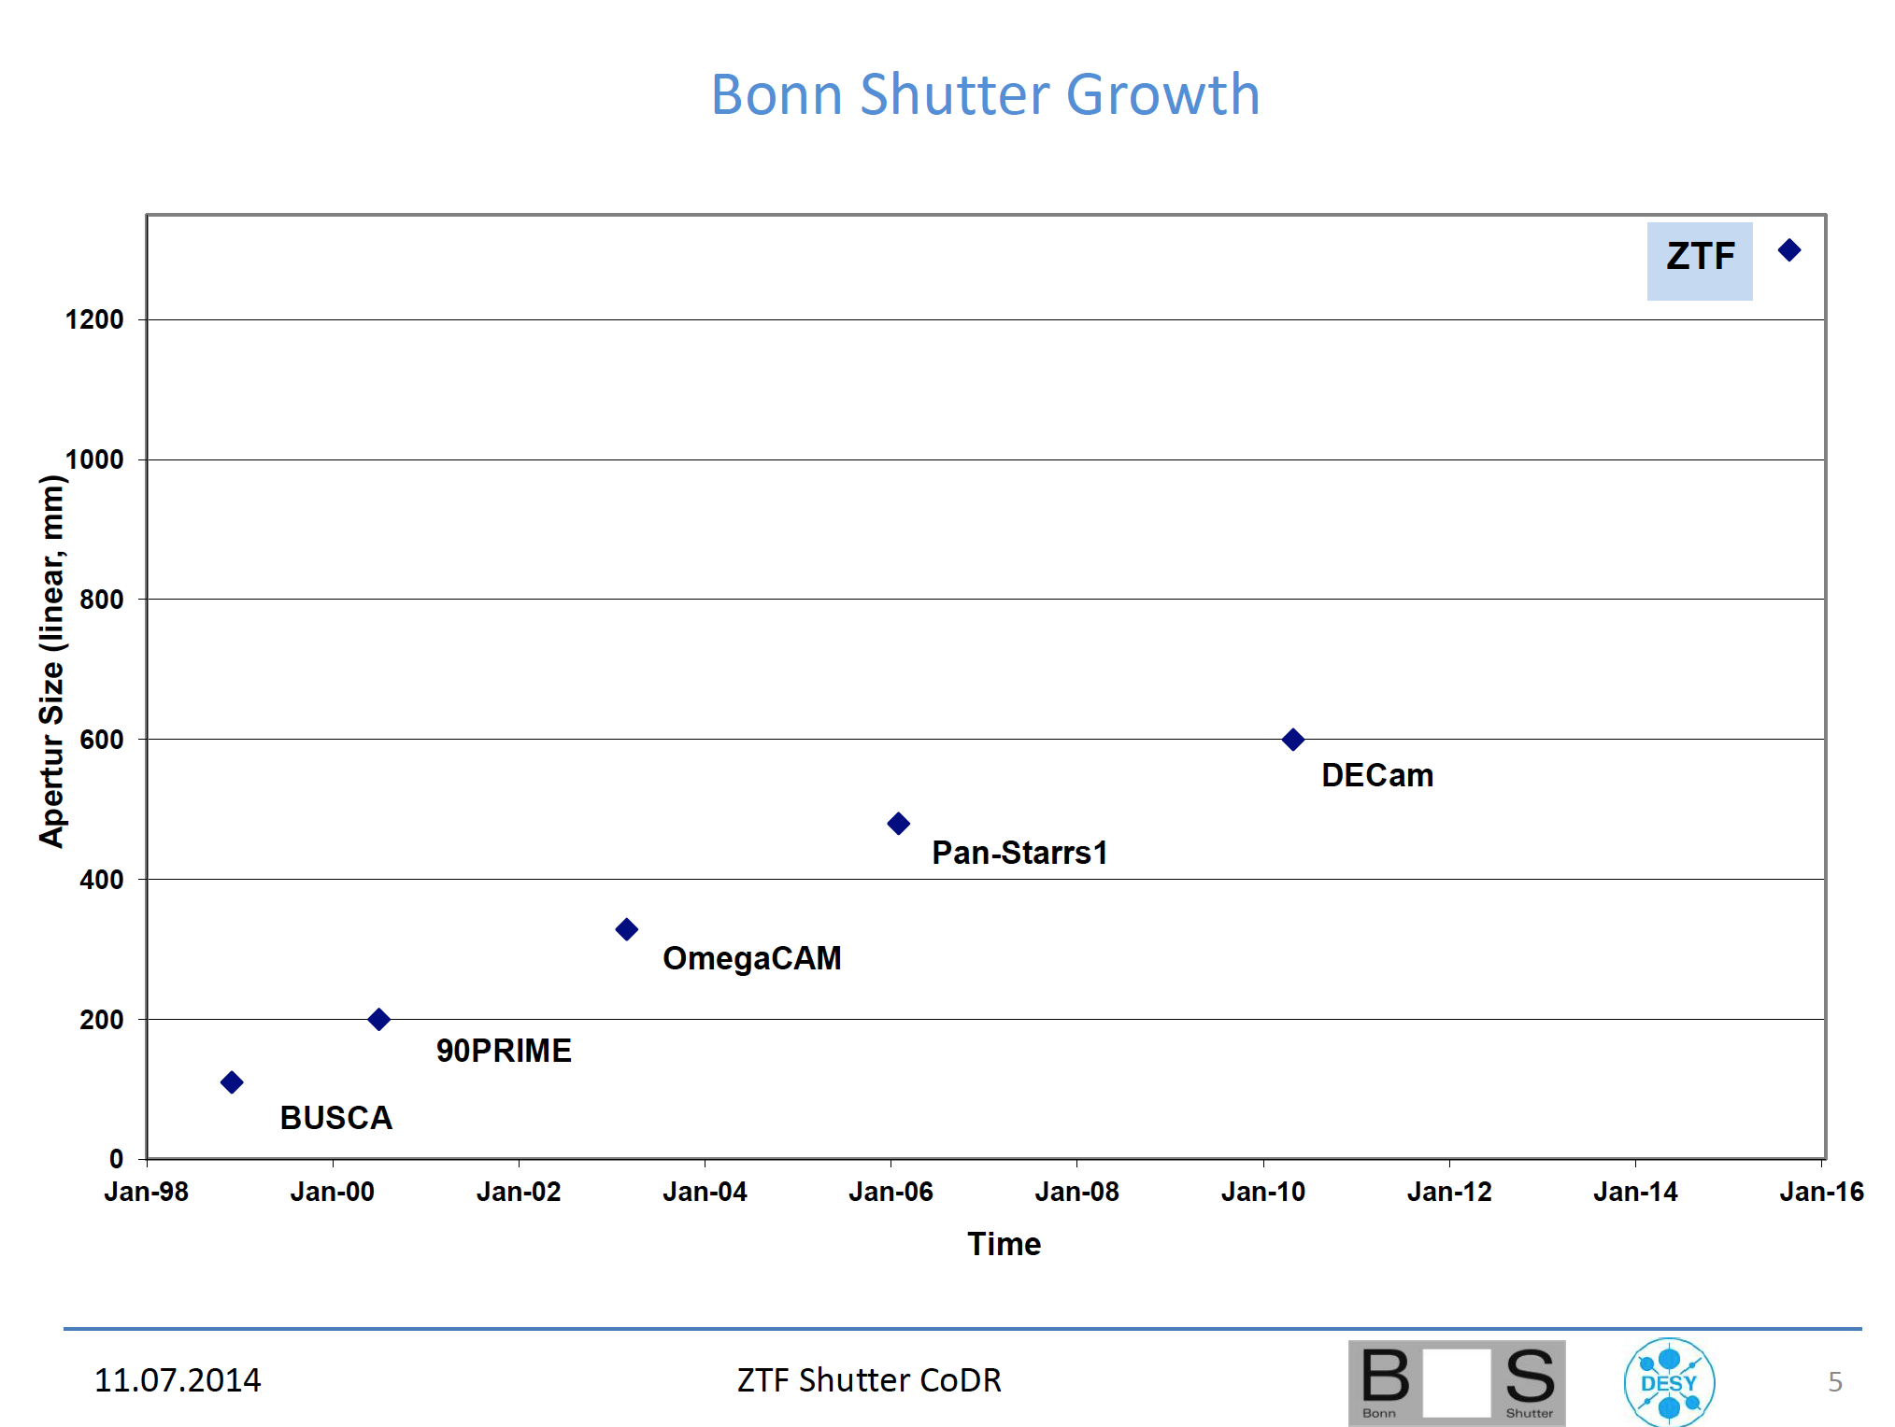
Bonn Shutter team has extensive experience
Single motor, pupil shutter, bi-parting
2g acceleration, 3kg/blade, balanced.
Dual motor, focal plane shutters

Slide 15
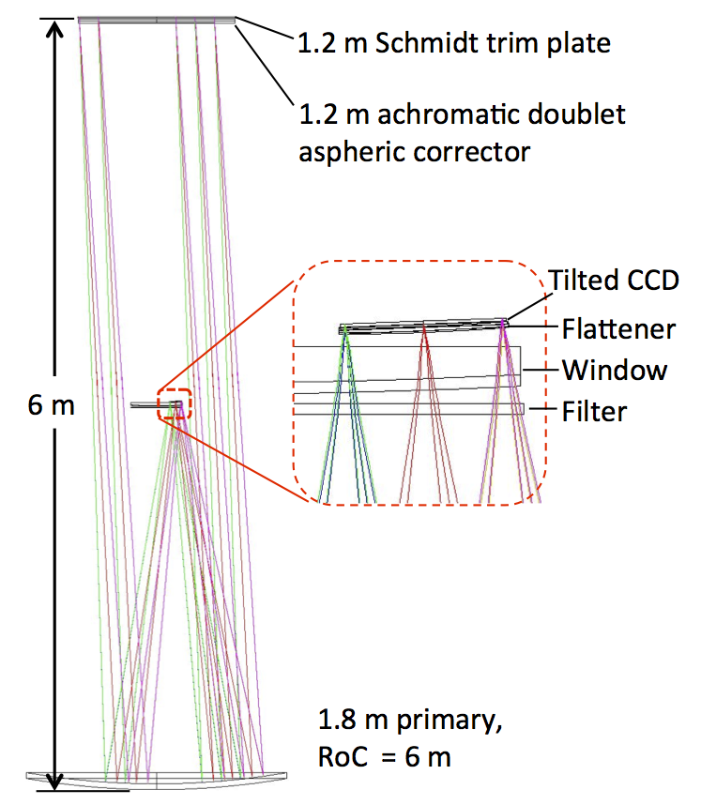
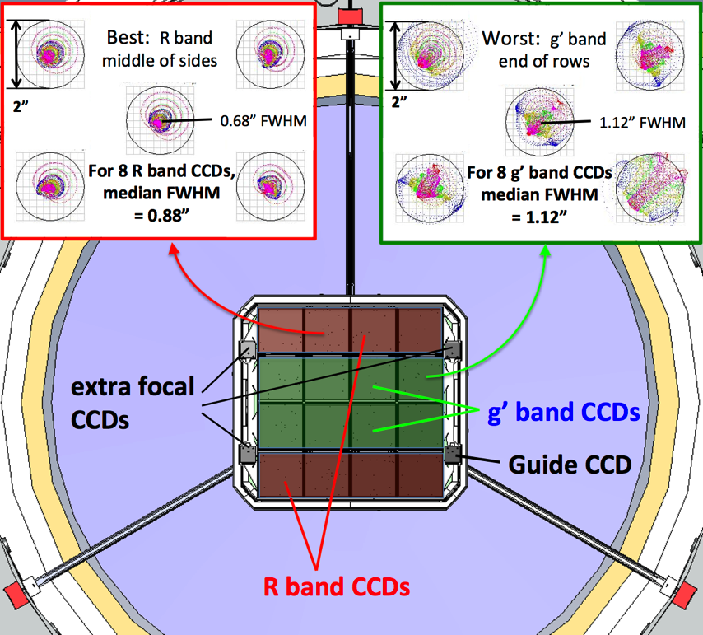
Optics
Powered window supports 2.3 ton force of atmosphere with FoS=6.
3rd corrector element ← fixes aberrations caused by thick dewar window.
CCDs faceted on spherical focal surface.
Plano-convex field flatteners
Compensate for residual field curvature
Substrate for fixed G and R filters
act as radiation shield, halving thermal load.
Upgrade to exchangeable (flat) filter can be supported.

Slide 16
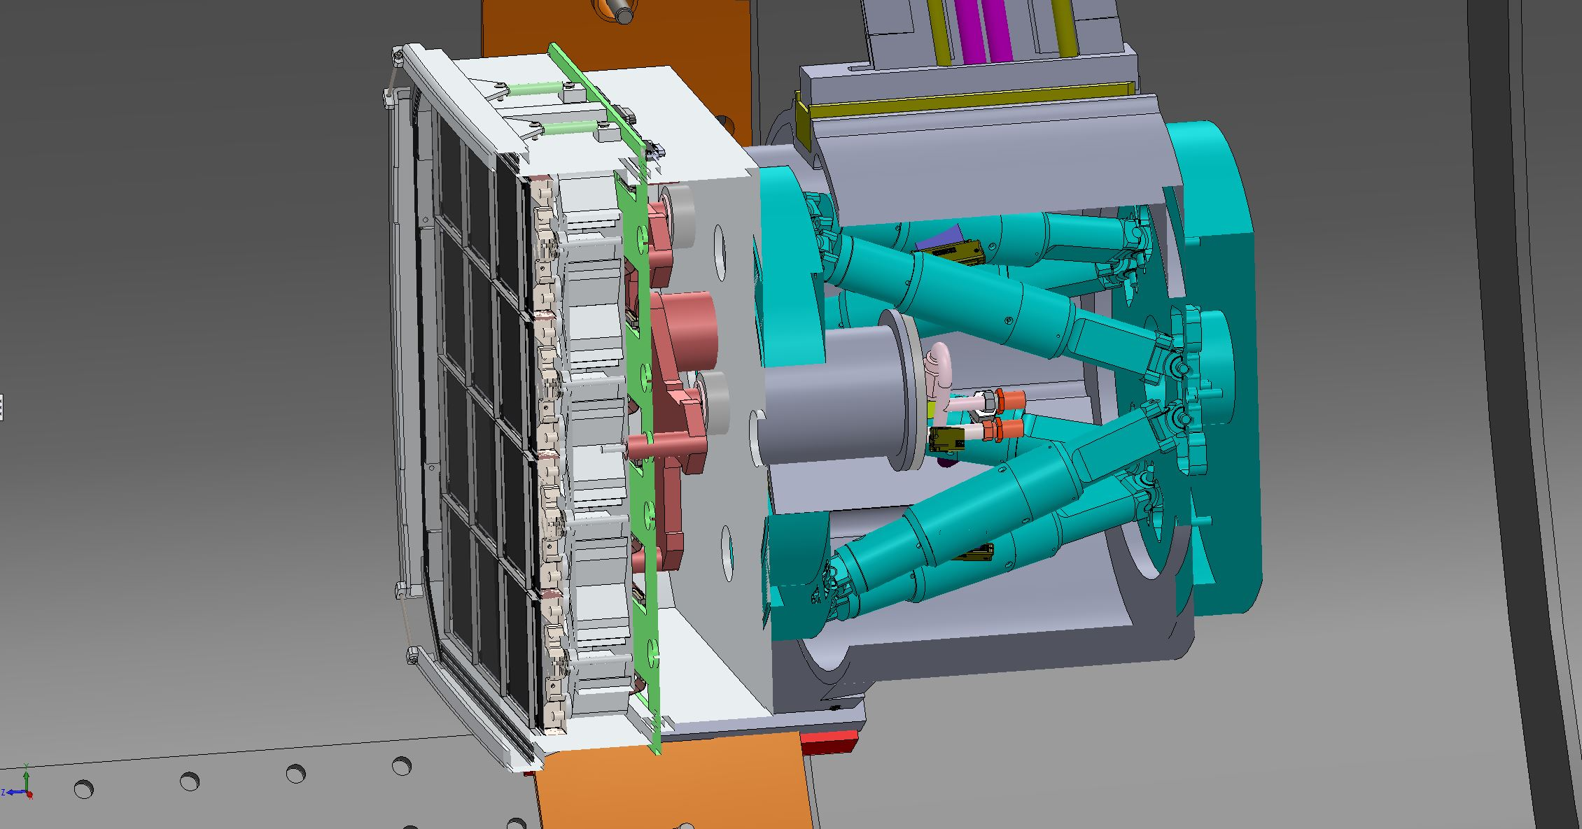
ZTF Dewar
Designed by LBNL, guided by Caltech
Spiders (3)
COTS cables connect around perimeter of VIB
Meniscus window
Charcoal getter container
Frames for field flatteners (previous version)
Physik Instruments
Hexapod
CCDs faceted on spherical surface
Polycold Joule Thompson coolers (2)
Aluminum mount with integrated flexures
TechApps flexible thermal link
1mW/K kapton flex circuits from CCDs
Ring girder carrying spiders
Vacuum Interface Board
trapped between two O-rings

Slide 17
How ZTF can be so much simpler than LSST:
50 times fewer readout channels, due to…
Half as much silicon
1.5 times pixel size
Twice pixel rate
Faster shutter
1 readout per pointing not 2
5x longer readout time to match slew (unlike LSST)

Slide 18
LSST electronics are in vacuum!
ZTF electronics outside telescope:
no custom ASICs,
looser power budget
smaller cooling system
much easier assembly

Slide 19
ZTF Dewar
Designed by LBNL, guided by Caltech
Spiders (3)
COTS cables connect around perimeter of VIB
Meniscus window
Charcoal getter container
Frames for field flatteners (previous version)
Physik Instruments
Hexapod
CCDs faceted on spherical surface
Polycold Joule Thompson coolers (2)
Aluminum mount with integrated flexures
TechApps flexible thermal link
1mW/K kapton flex circuits from CCDs
Ring girder carrying spiders
Vacuum Interface Board
trapped between two O-rings

Slide 20
Hexapod and Spiders
New spiders reduce beam obstruction
support new hexapod
conceal cables
3 instead of 4 …. shorter diffraction spikes.
Generic hexapod from Physik Instruments provides ample resolution.
Long travel useful for optical diagnostics.
All 6 degrees-of-freedom used:
Focus, tip, tilt
XY for optical alignment.
Field rotation due to atmospheric dispersion and polar axis misalignment.

Slide 21
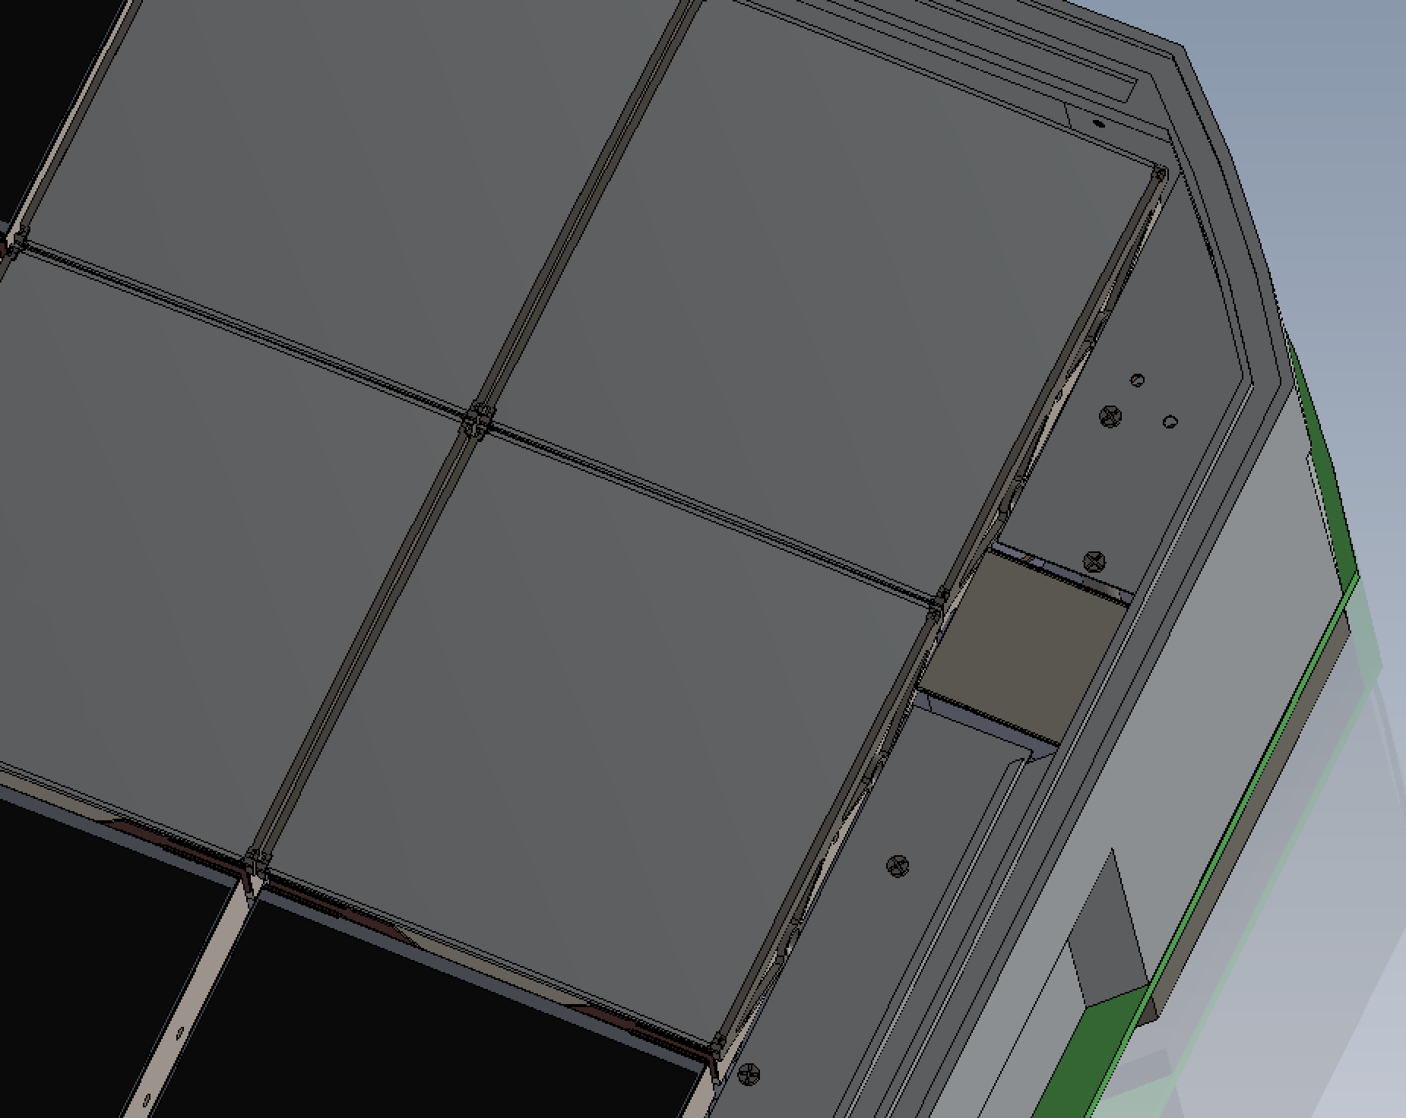
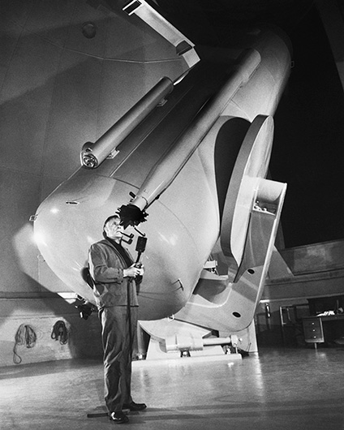
Delivered Image Quality
Guide telescopes no longer used
3 extra focal imaging CCDs at edge of focal plane for…
focus, tilt sensing
mirror figure and optical alignment diagnostics
2Kx2K auto-guider in 4th corner of focal plane used for long exposures or diagnostics.
Full DIQ budget has been developed.
Edwin Hubble
1889-1953

Slide 22
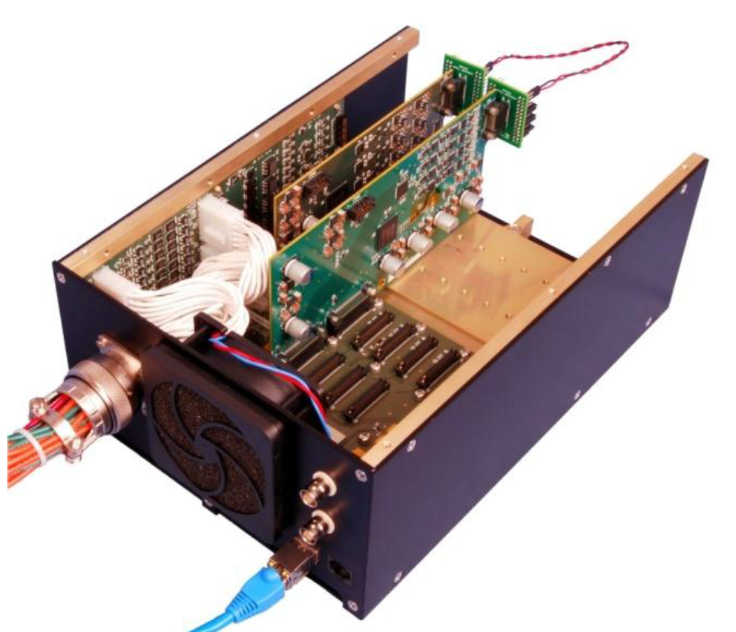
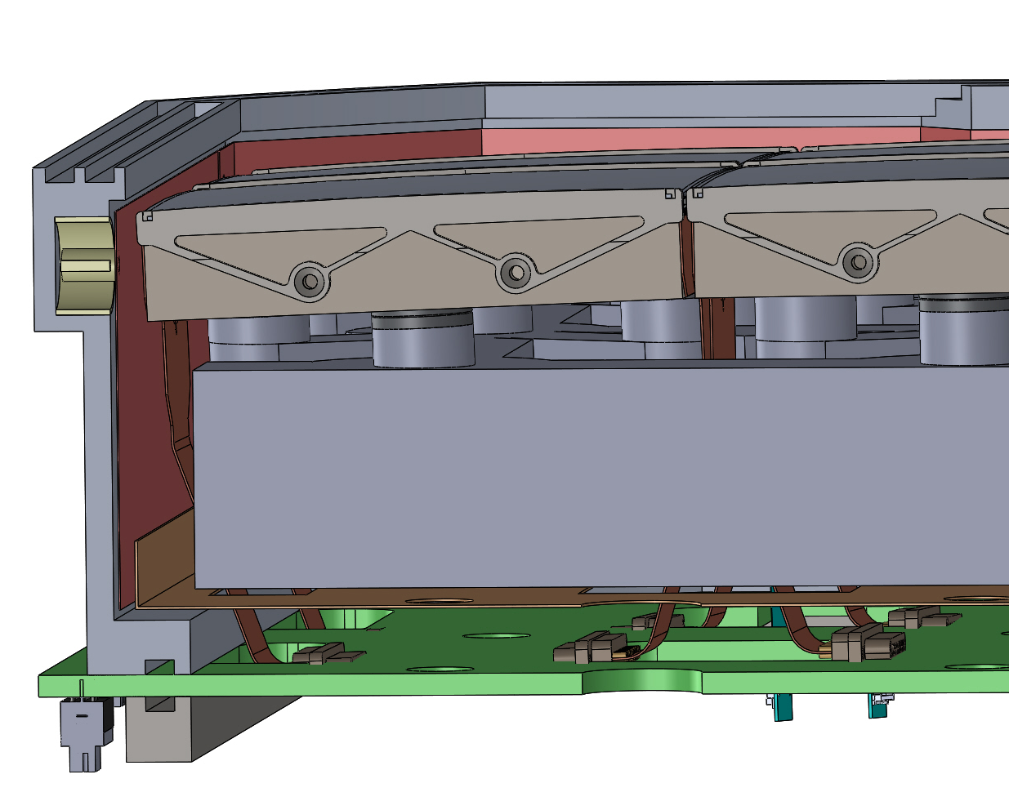
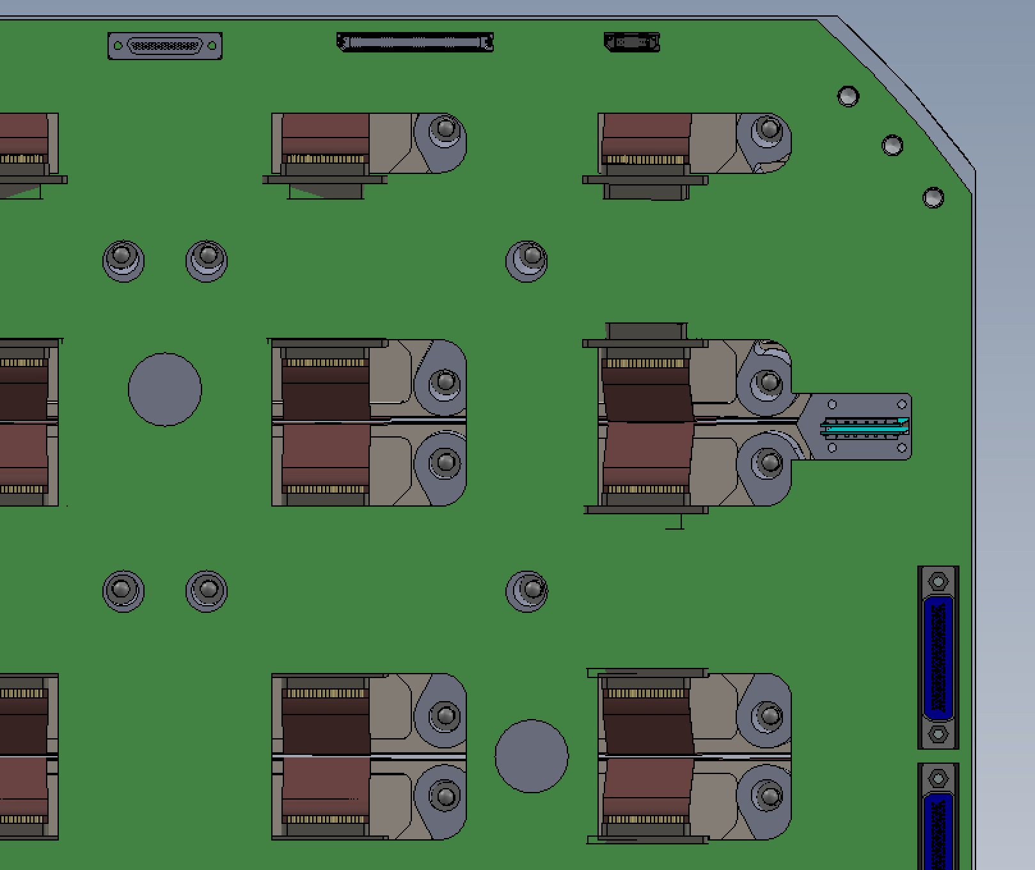
Electronics
Commercial CCD controller outside telescope.
STA’s “Archon” is optimized for high pixel rate.
Drives 4 CCDs with ganged clocks.
16 true differential CCD outputs; preamps in dewar drive differential transmission line.
Vacuum interface board eliminates dewar wiring and hermetic connectors.
Rear cover flange

Slide 23
Archon 1 of 5
P48 Control Room
CCD
Clock boards(3)
Motherboard
Server
1 of 5
Clock boards(3)
8 Clocks (3)
private Gbit Ethernet
0.9 TB/night, compressed.
CCD
30 Biases
<512 Mb/s
RAID Disk
CCD
4ch ADC
4ch ADCs (4)
4ch ADCs (4)
CCD
4 ADCs (4)
Server
2 of 5
private Gbit Ethernet
Archon 1 of 5
RAID Disk
Daily average ~100 Mb/s
CCD
Clock boards(3)
Motherboard
Clock boards(3)
8 Clocks (3)
CCD
30 Biases
Communications
CCD
Server
3 of 5
4ch ADC
4ch ADCs (4)
4ch ADCs (4)
CCD
4 ADCs (4)
RAID Disk
Clk & Sync
HPWREN
155Mb/s
Shared
Gbit Ethernet

Slide 24
Data transport
Tolerant of loss of CCD controller or link outage.
Responsibilities and mechanisms same as PTF:
Observing System (COO)
each controller has separate data link to a server with local disk
tile-compressed FITS file per CCD; header not compressed.
monitor disk usage, but no responsibility to notify.
Palomar (POMO)
maintain physical link (HPWREN)
trawl for new FITS files (on 5 servers)
copy images to IPAC
delete from servers only when successful
IPAC:
provides repository to receive data
detects new data and initiates processing.

Slide 25
Observing System Summary
ZTF is optimized for cost effectiveness.
Leverage existing facilities and expertise.
High sensitivity (QE, beam obstruction, DIQ)
Low overheads (shutter, readout, repointing)
Simple
→ Relatively easy to commission and maintain.
→ Reliable

