Slide 1
Voltage Levels on Preamp
Stephen Kaye

Slide 2
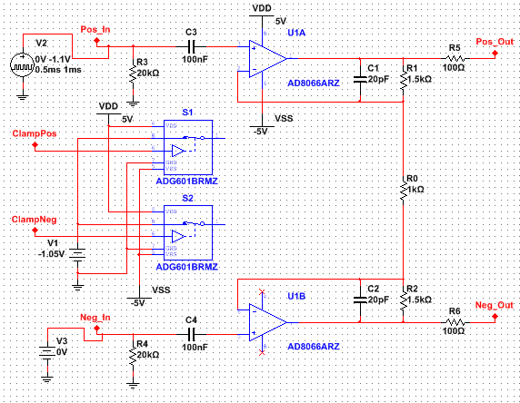
Differential Amplifier Circuit

Slide 3
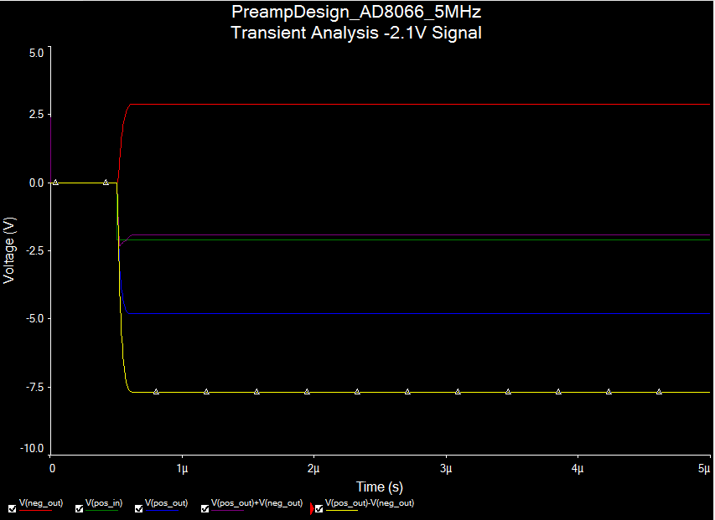
Full Well Signal

Slide 4
Full Well
Differential output voltage: -7.69 V
Common Mode voltage: -1.93 V
Positive output: -4.8 V
Negative Output: 2.88 V

Slide 5
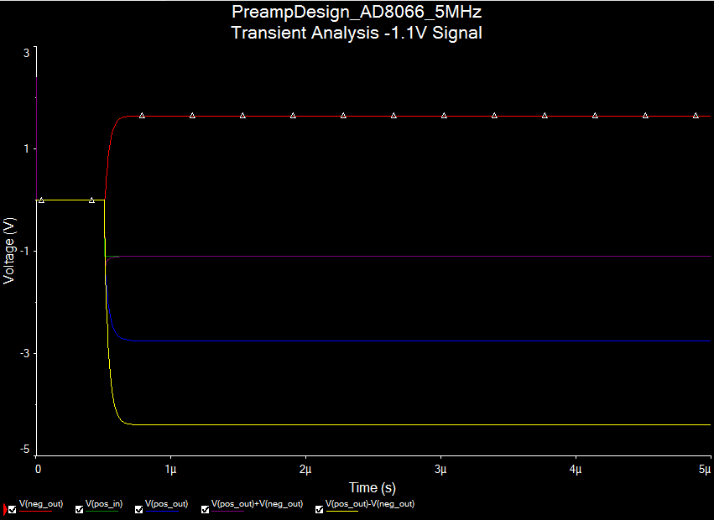
Half of Full Well

Slide 6
Half Full Well
Differential output voltage: -4.39 V
Common Mode voltage: -1.1 V
Positive output: -2.75 V
Negative Output: 1.65 V

