Slide 1
Clock Driver
PSpice Simulations
Bhushan Joshi
Kalpesh Chillal
Pravin Chordia
IUCAA

Slide 2
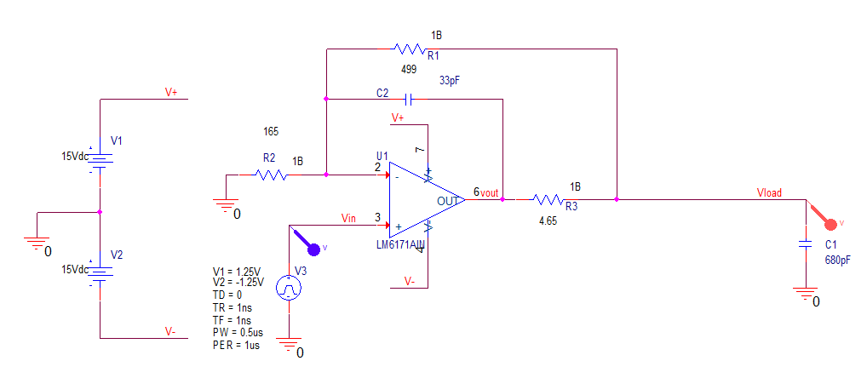
In-the-loop Compensated Clock Driver
Without Transmission line

Slide 3
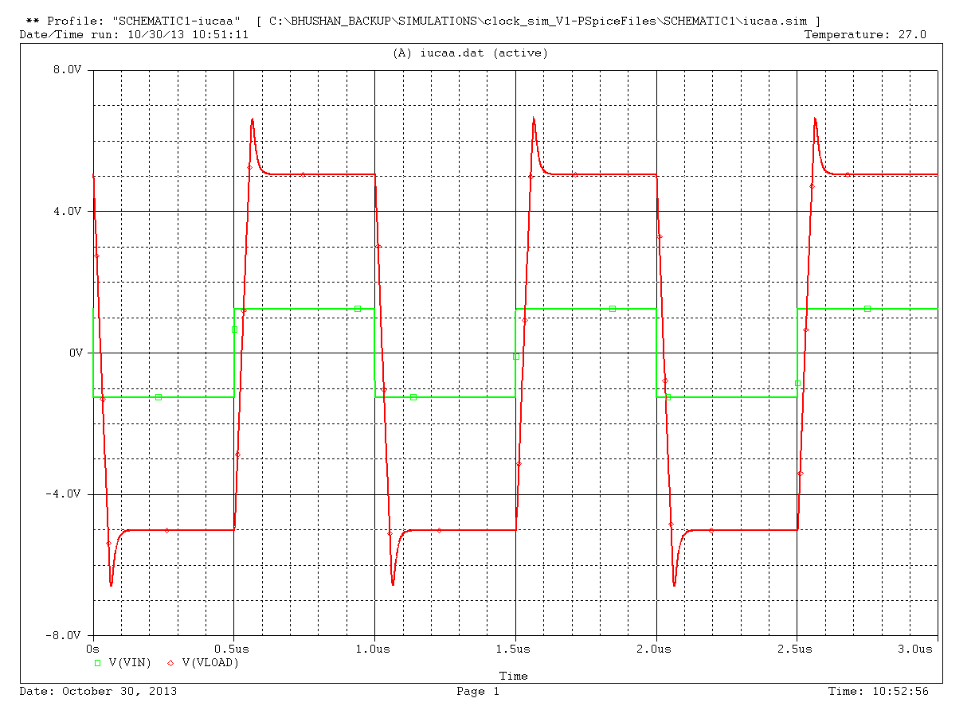
In-the-loop Compensated Clock Driver
Without Transmission line
Transient Analysis

Slide 4
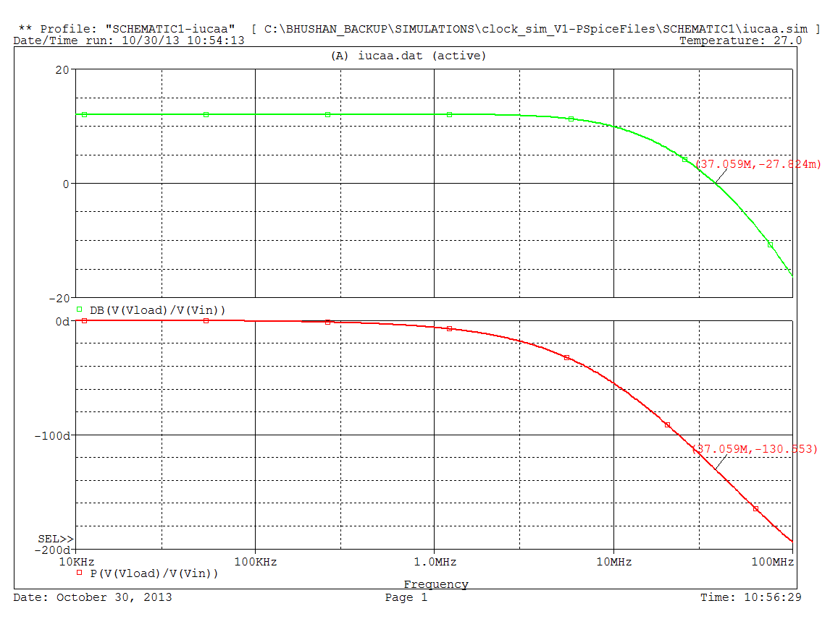
In-the-loop Compensated Clock Driver
Without Transmission line
AC Analysis

Slide 5
In-the-loop Compensated Clock Driver
With Transmission line
PSpice Simulations

Slide 6
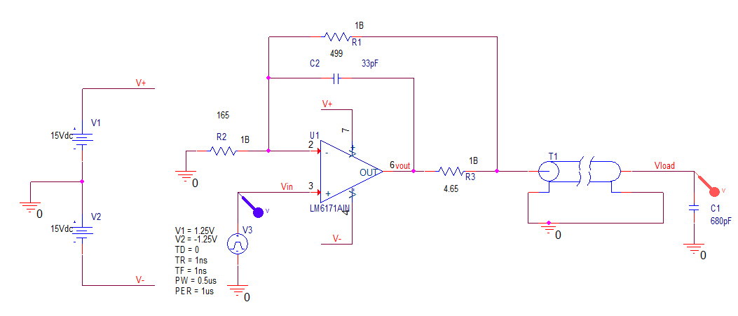
In-the-loop Compensated Clock Driver
With Transmission line

Slide 7
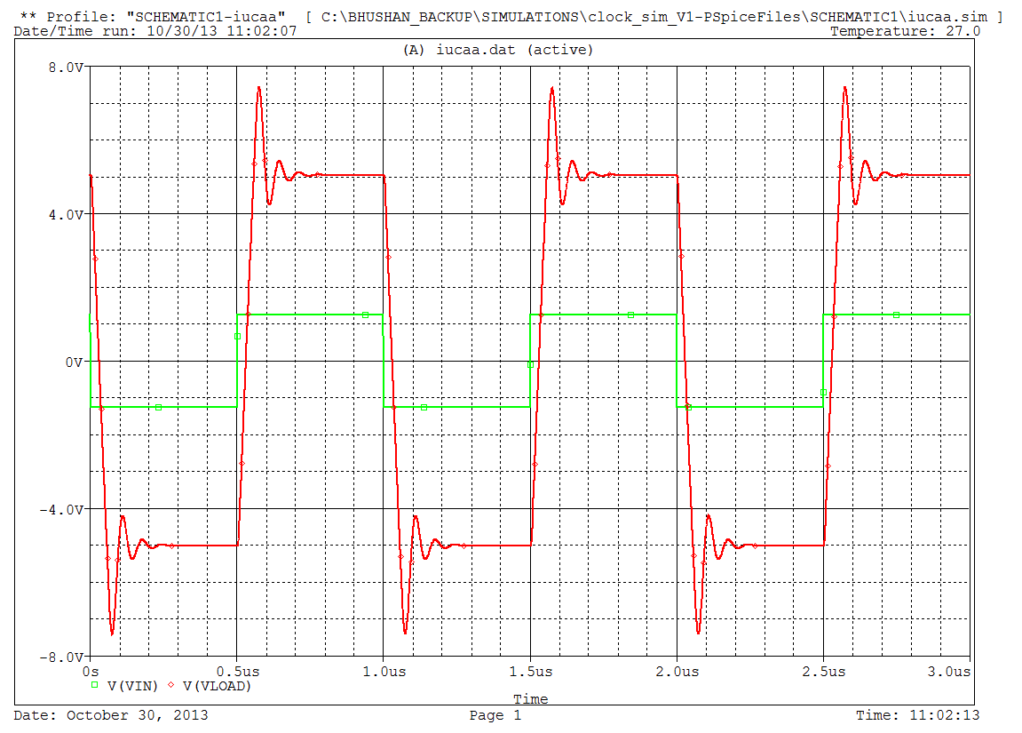
In-the-loop Compensated Clock Driver
With Transmission line
Transient Analysis

Slide 8
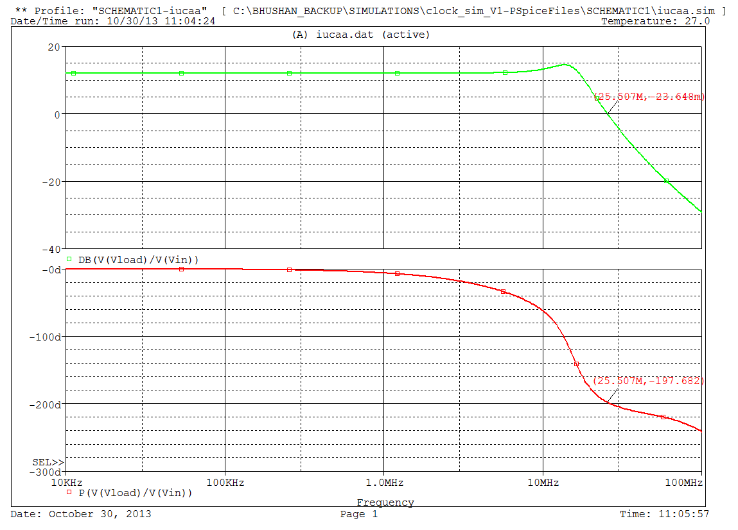
In-the-loop Compensated Clock Driver
With Transmission line
AC Analysis

Slide 9
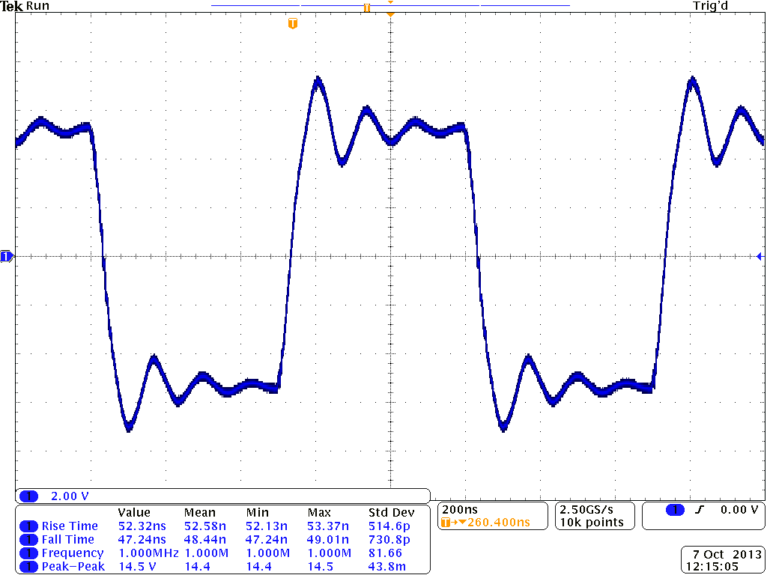
Result of Compensated Clock Driver Implemented on test board
With Transmission line
Transient Analysis (DSO screenshot)

Slide 10
Lead Compensated Clock Driver
With Transmission line
PSpice Simulations
Reference(1): Chapter 7,Voltage-Feedback Op Amp Compensation
Literature Number SLOA079
Excerpted from Op Amps for Everyone
Literature Number: SLOD006A
Author : Texas Instruments
Page: 7-13
Reference(2): For Calculation of value of capacitor C22
http://www.mathworks.in/products/control/examples.html?file=/products/demos/shipping/control/opampdemo.html

Slide 11
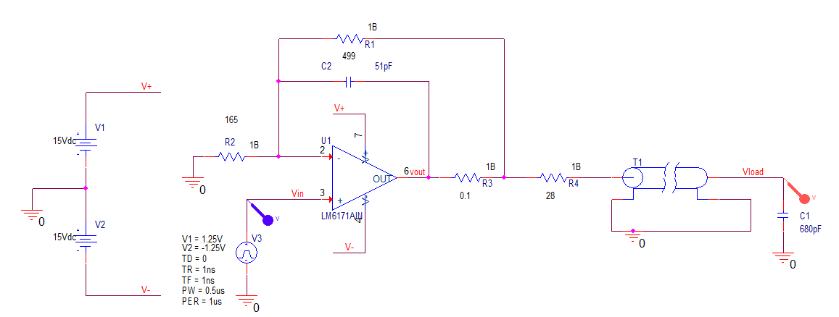
Lead Compensated Clock Driver
With Transmission line
Since Simulator can not take 0Ω and to keep same schematic 0.1Ω resistor is used

Slide 12
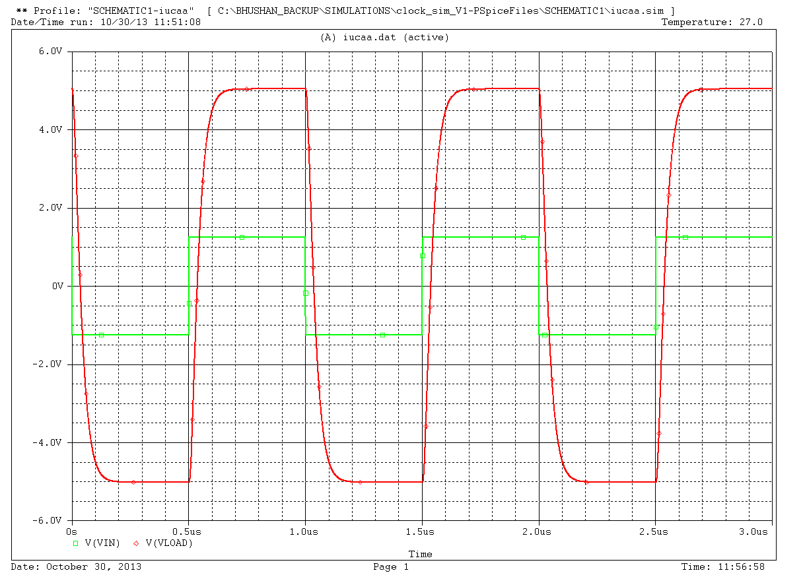
Lead Compensated Clock Driver
With Transmission line
Transient Analysis

Slide 13
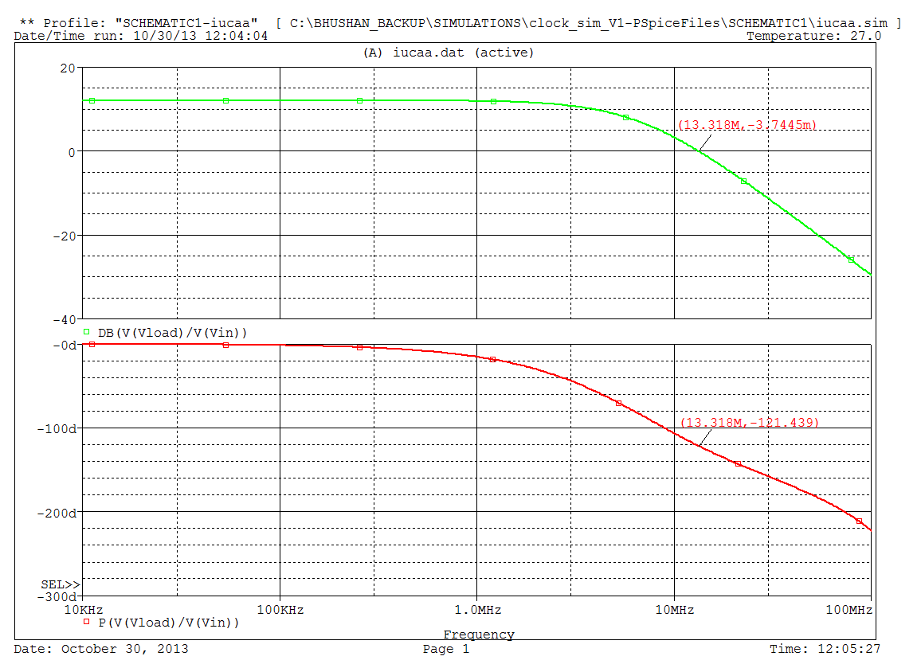
Lead Compensated Clock Driver
With Transmission line
AC Analysis

Slide 14
Lead Compensated Clock Driver
With Transmission line
Implementation on test board

Slide 15
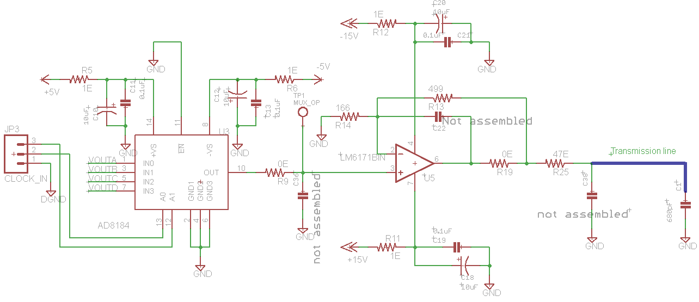
Clock Driver without any Compensation
Load Cap

Slide 16
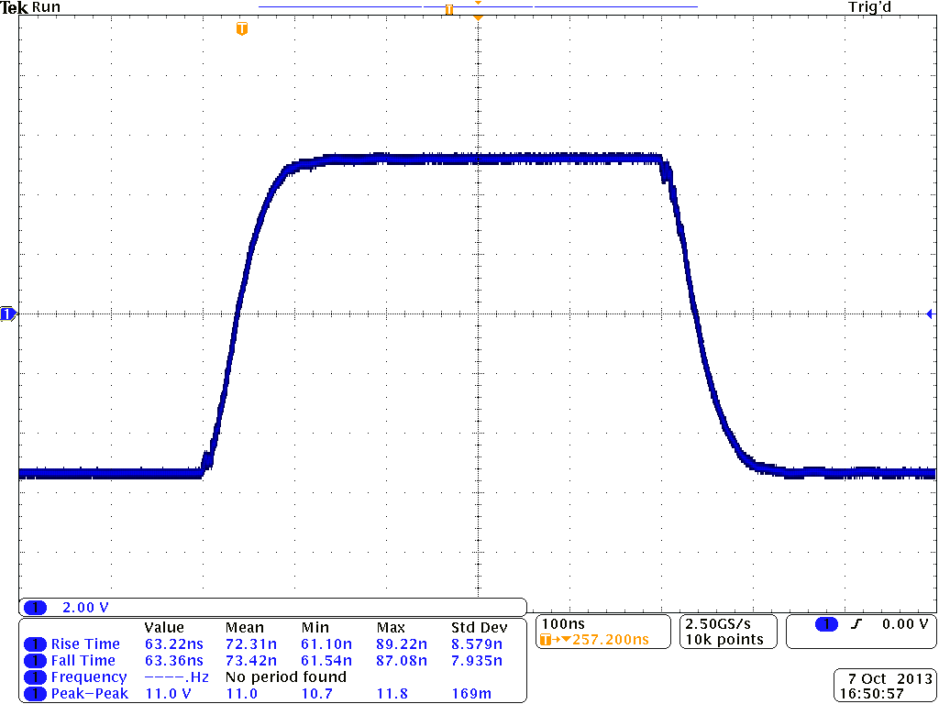
Result of Clock Driver without any Compensation

Slide 17
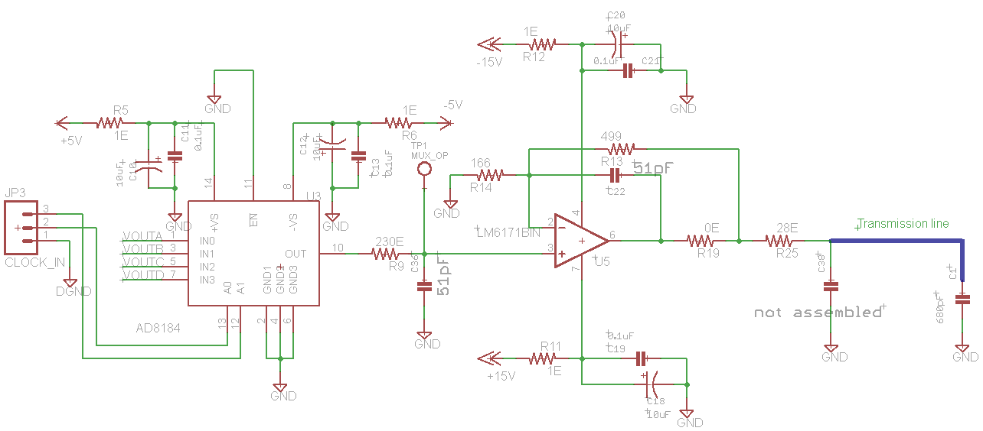
Clock Driver with Lead Compensation
Changed values
Load Cap

Slide 18
Result of Clock Driver with Lead Compensation

Slide 19
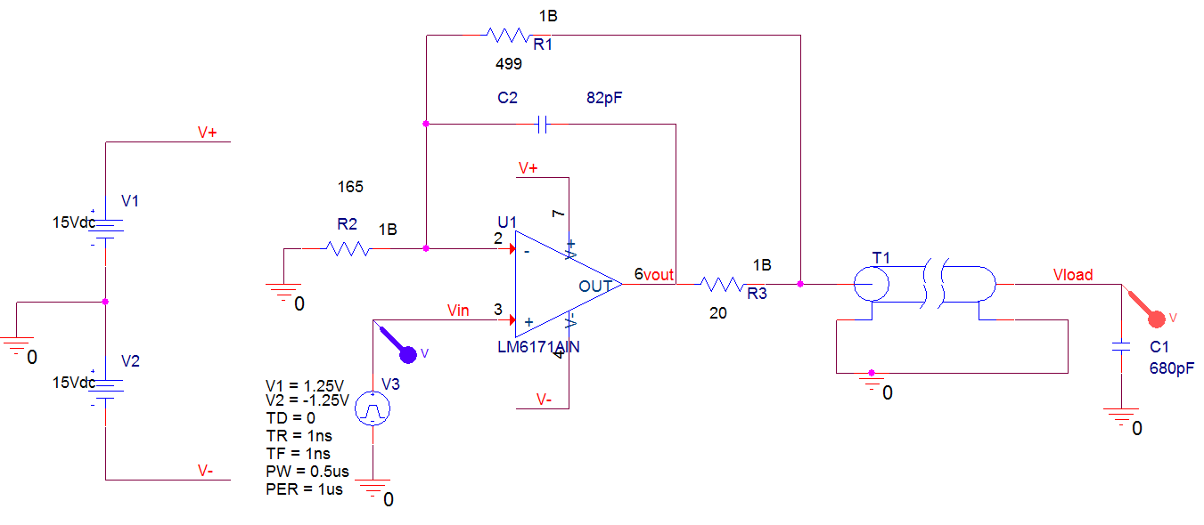
Clock Driver with In-the-loop Compensation (Optimized R3,C2 values are selected for 680pF capacitor and transmission line as Load)

Slide 20
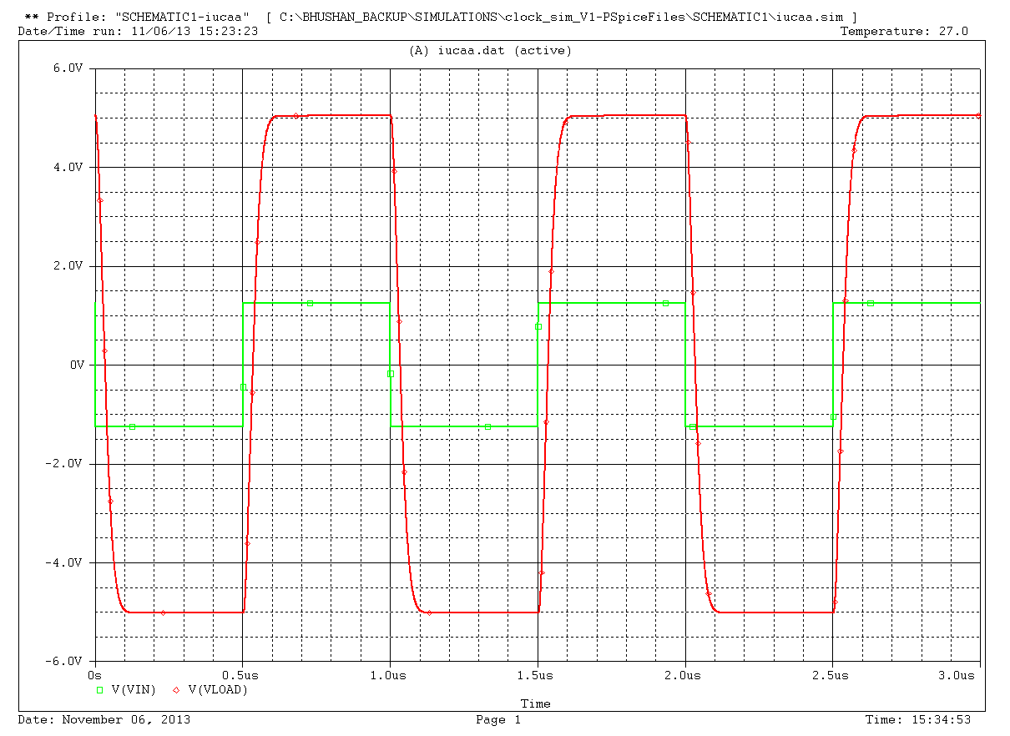

Slide 21
