Slide 1
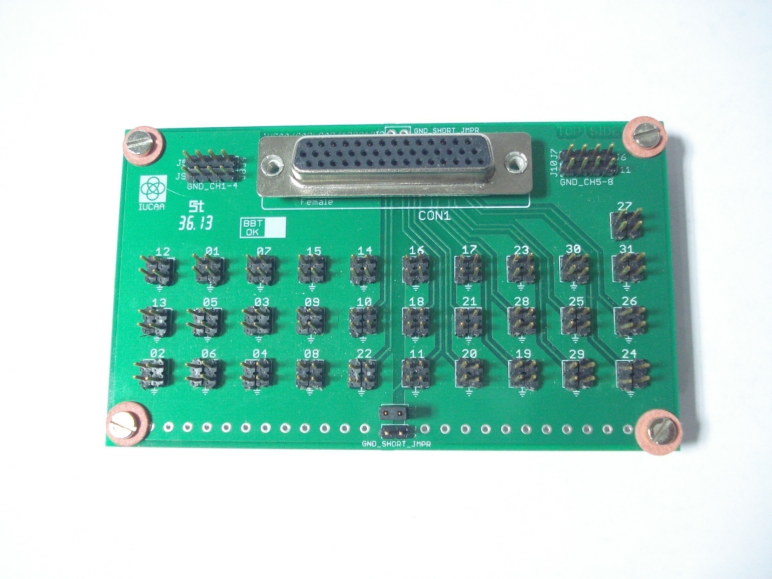
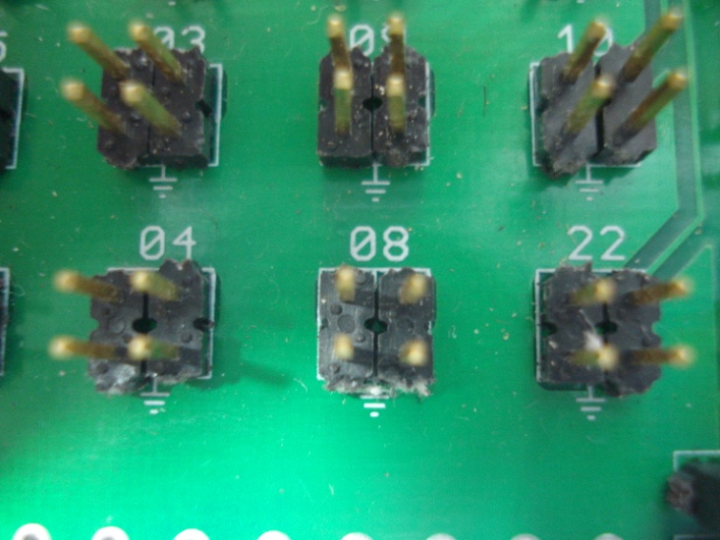
IFPAC Capacitive Load Board Top View
Pins for Capacitive Load
Pins to Probe Oscilloscope

Slide 2
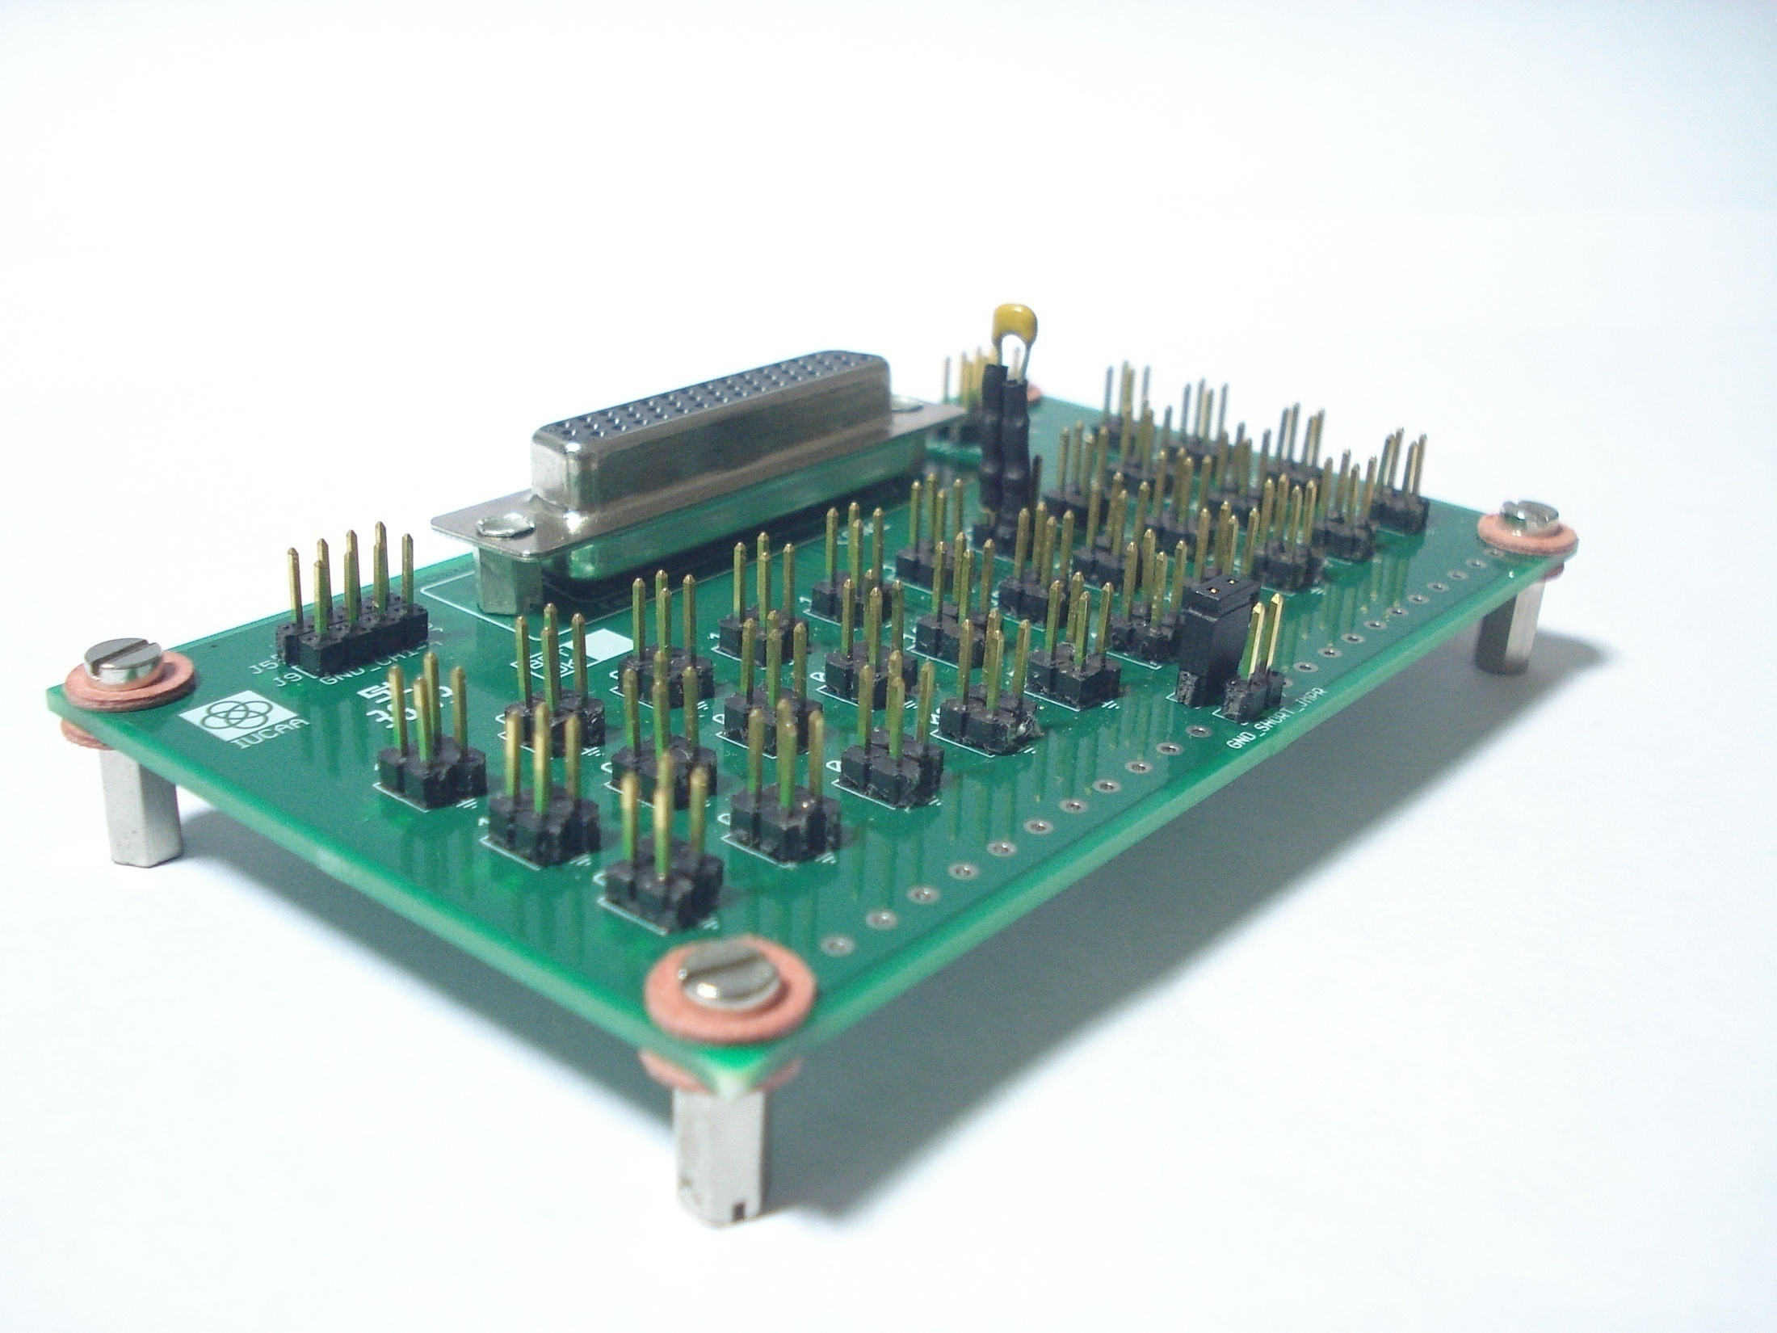
IFPAC Capacitive Load Board
One Capacitive Load added

Slide 3
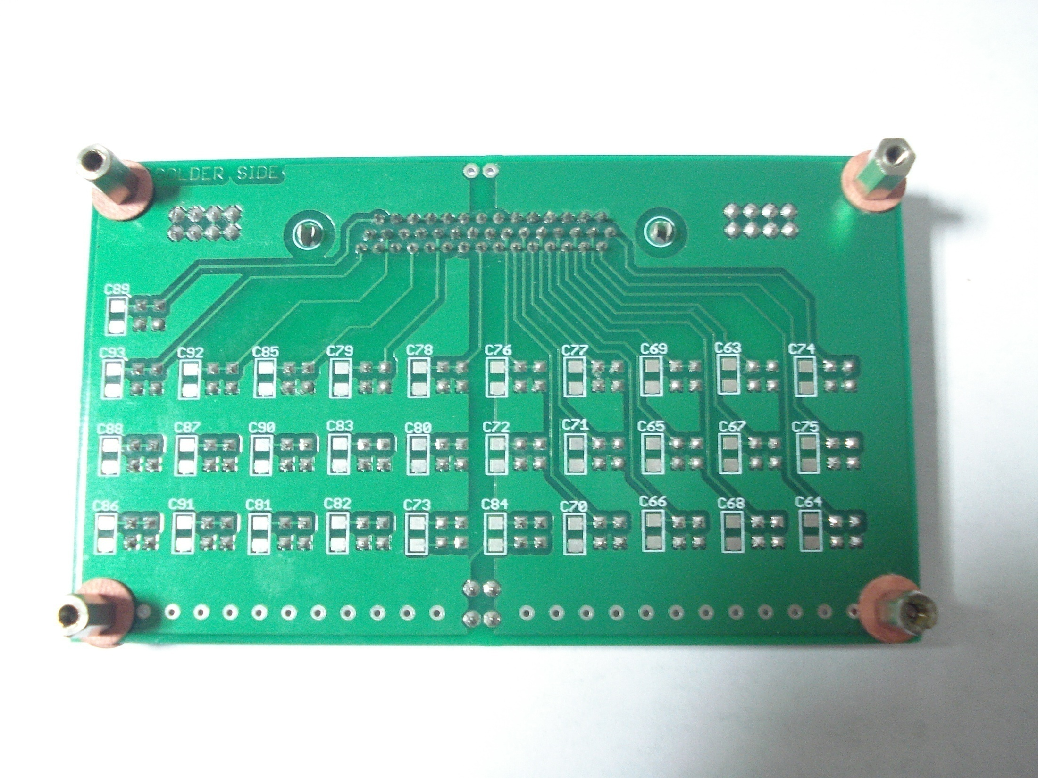
IFPAC Capacitive Load Board Bottom View With SMD Dummy Capacitive Load Provision
Through Hole Capacitors and SMD Capacitors are in parallel. SMD cap can be mounted from this side and through hole from top side

