Slide 1
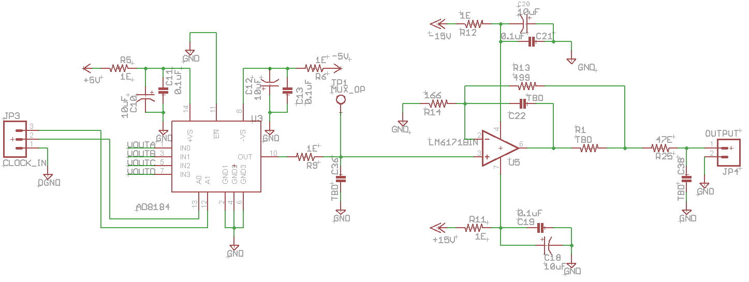
Clock Driver without change

Slide 2
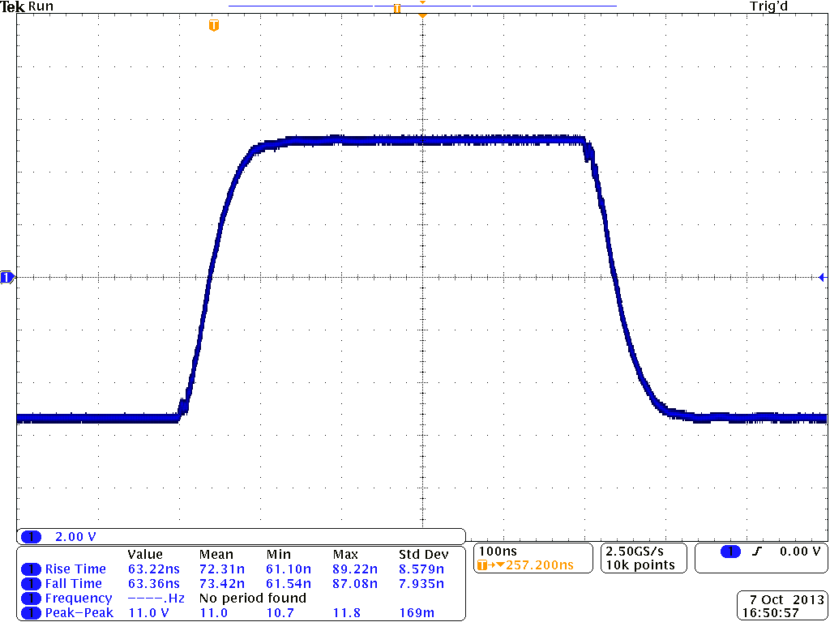
Result of Clock Driver without change

Slide 3
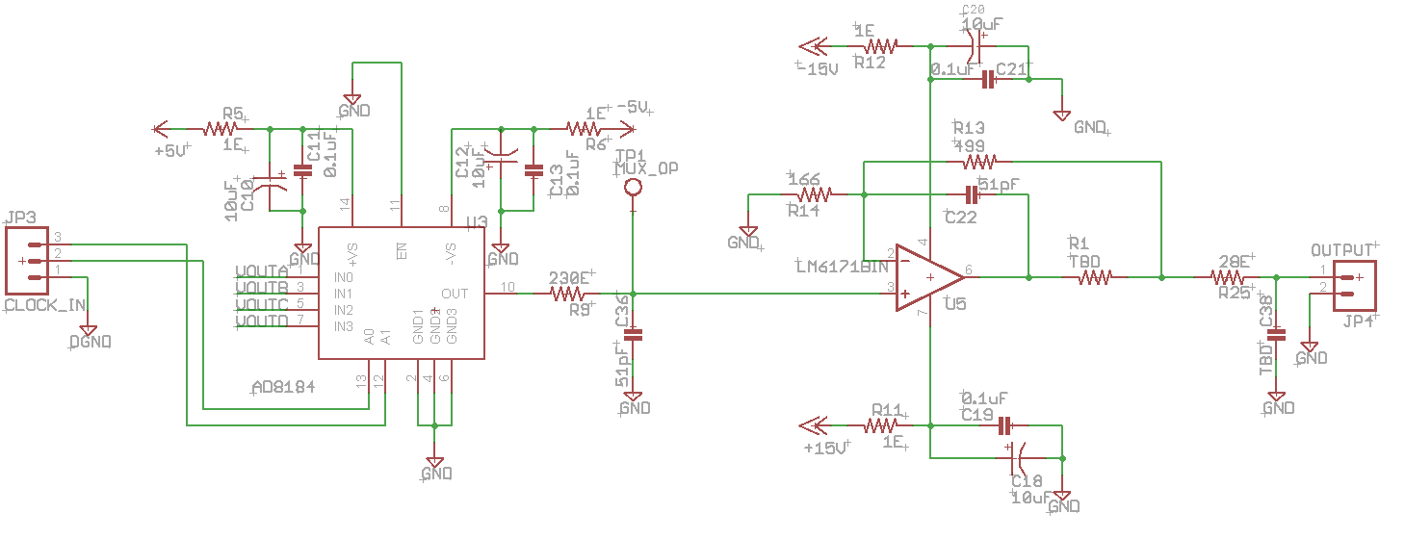
Changed values

Slide 4
Result of Clock Driver with change

