Slide 1
Clock Driver Simulations
Stephen Kaye

Slide 2
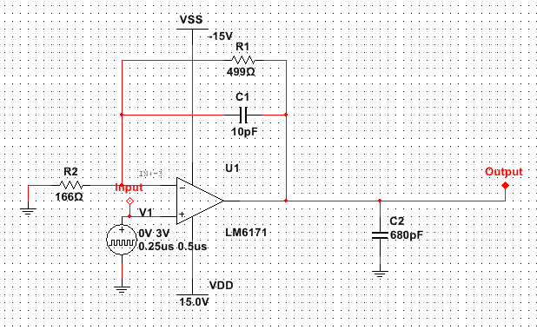
Clock Driver As Designed

Slide 3
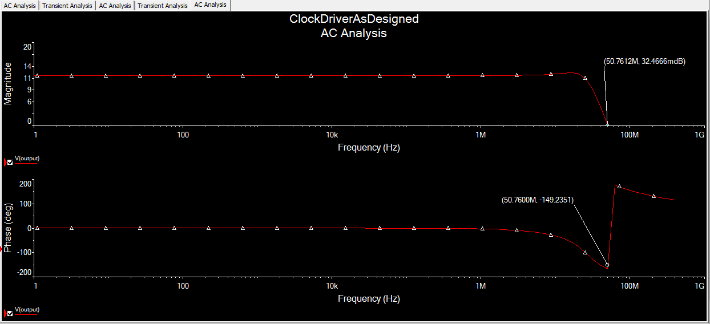
Clock Driver As Designed
AC Analysis

Slide 4
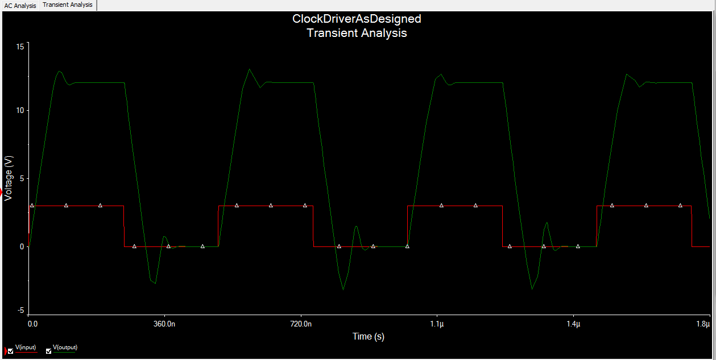
Clock Driver As Designed
Transient Analysis

Slide 5
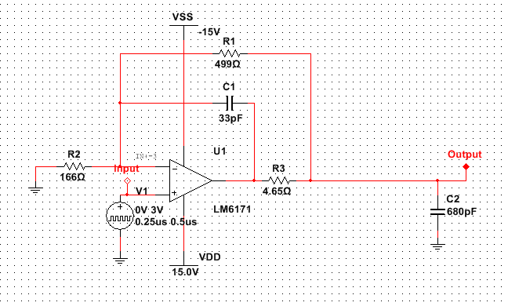
Compensated Clock Driver

Slide 6
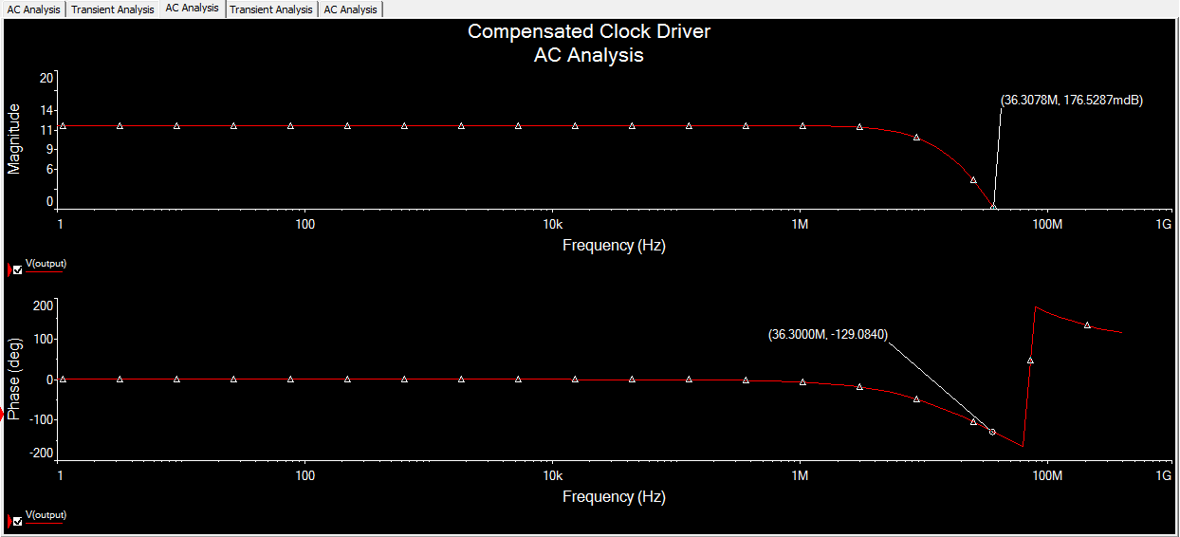
Clock Driver With Compensation
AC Analysis

Slide 7
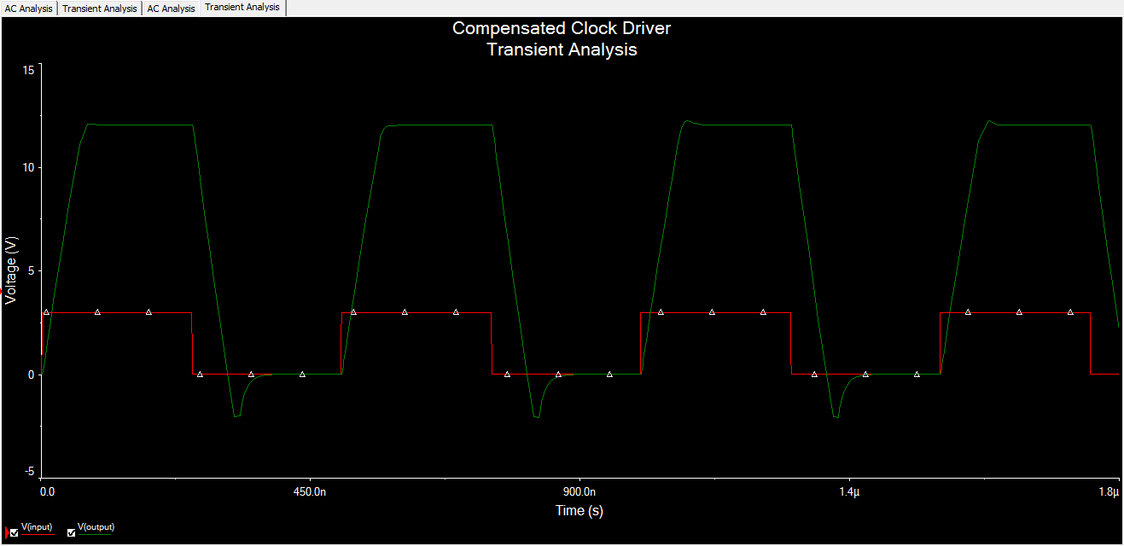
Clock Driver With Compensation
Transient Analysis

