Slide 1
Circuit Simulation
Stephen Kaye

Slide 2
MultiSim
Recommended by Analog Devices
Has many Analog Devices parts in library
Schematic capture of circuit
AC analysis and noise analysis

Slide 3
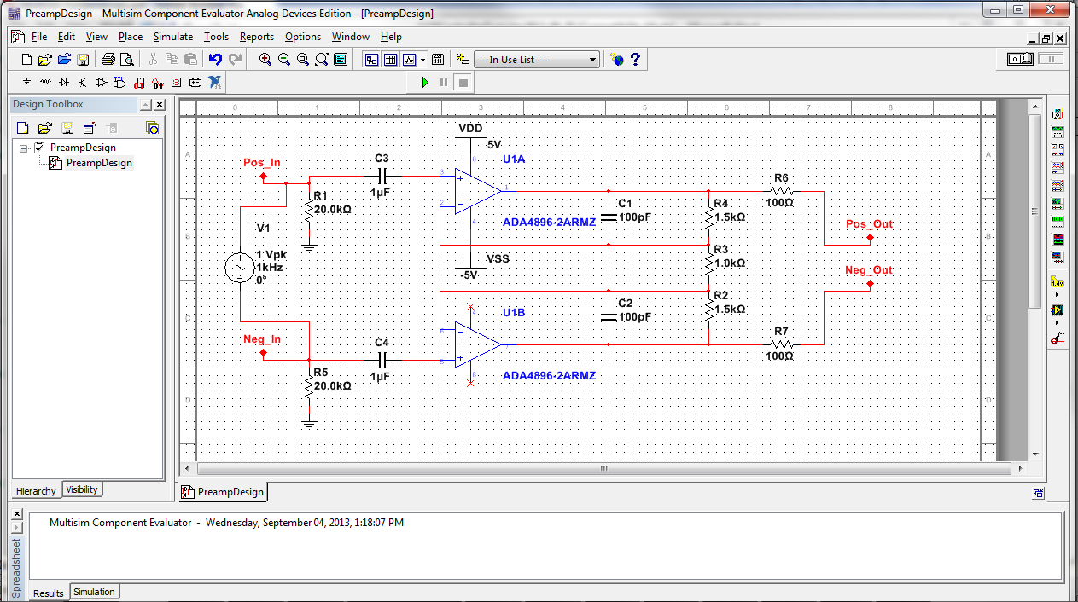
Schematic Capture

Slide 4
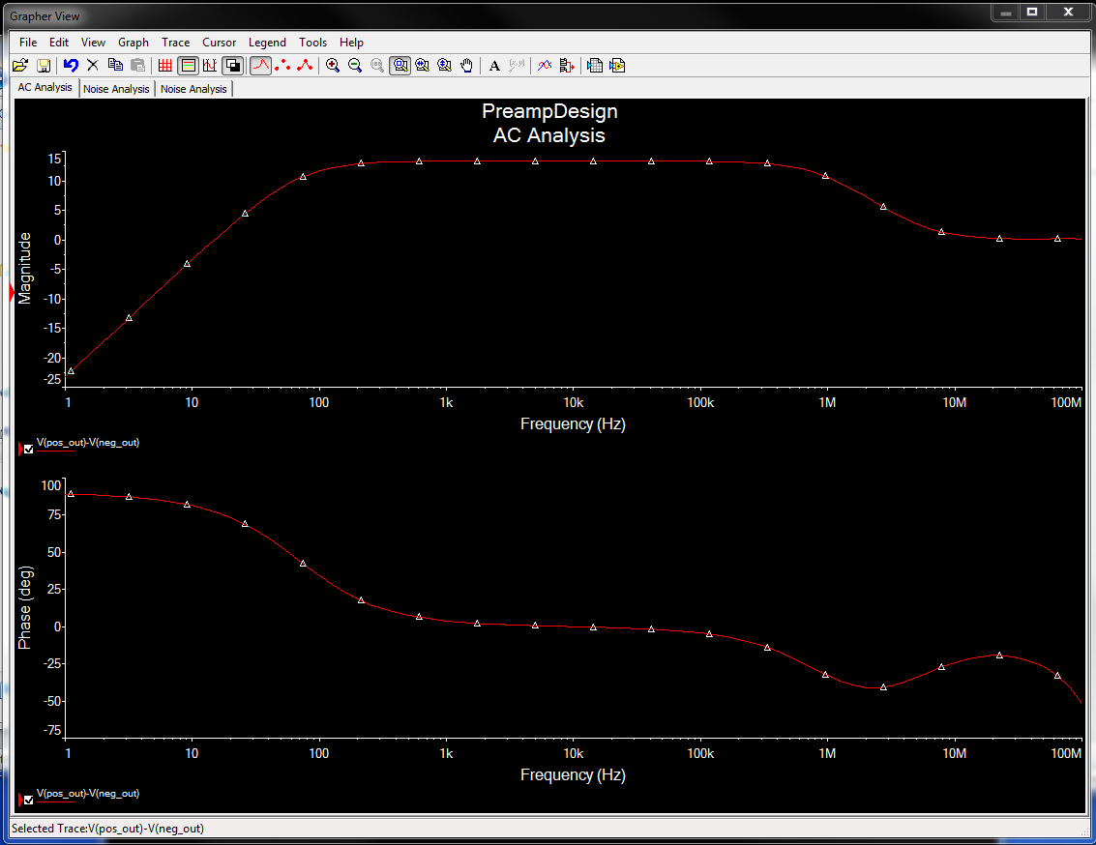
AC Analysis

Slide 5
