Slide 1
Single Board Controller Comments
Roger Smith
Caltech
2013-05-13

Slide 2
Single Board Controller
Motivated by the need for high ADC clock rates
Clocks exceeding 140 MHz (or more)
FPGA adjacent to ADC is necessary
Eliminates backplane complexity
High speed signals no longer travel along backplane
Advantage of a single low impedance analog ground plane
Board performance not affected when placed on extenders
Final package has A/C power in and USB out

Slide 3
Single Board Challenges/Questions
Will everything fit on a single board?
Would like to use standard size (eg. 6U VME board)
Custom size board not out of the question
Custom sizes require a custom enclosure
Power requirements
Associated power board with single board controller
Do power requirements allow for a compact power supply board?
Other questions/challenges?

Slide 4
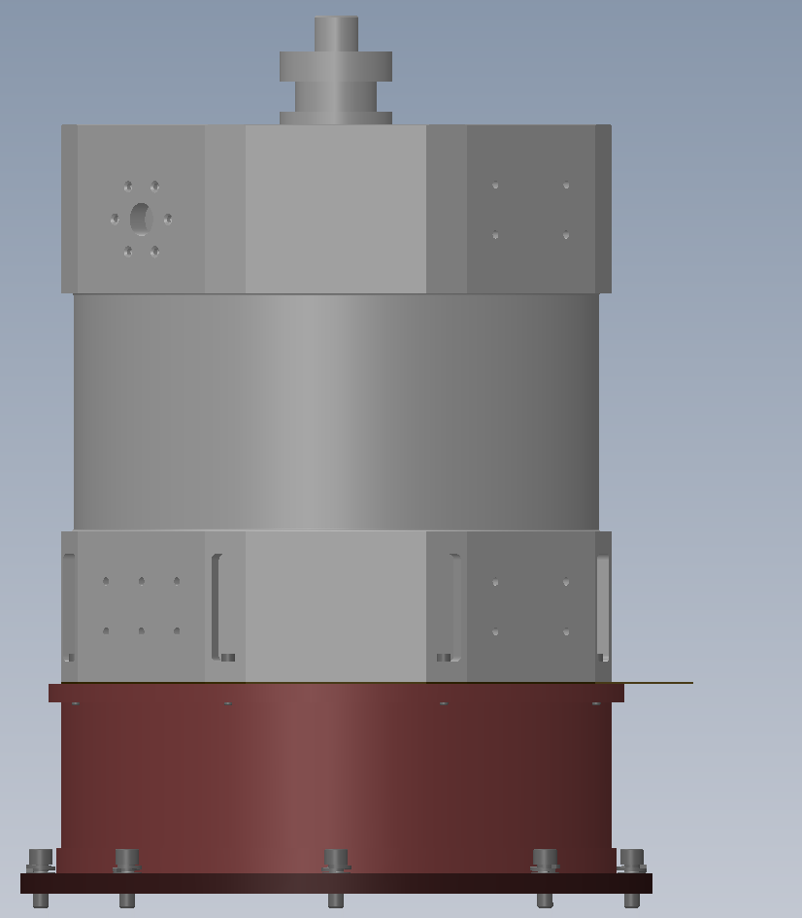
Electronics box
USB over fiber
AC power
Front panels with ejectors
We are contemplating a single board CCD controller to operate both science and guide CCDs, plugging this directly into a slightly extended vacuum interface board.
Plug-in power supply between board and dewar within same enclosure.
Remove side panel to gain access to test points on controller board.
Board dimensions are TBD.
Box mounts to flat faces of dewar. Its ok to have to remove boards to access bolts.
Cooling by conduction to dewar.
CCD controller PCB
283 mm
Power modules

Slide 5
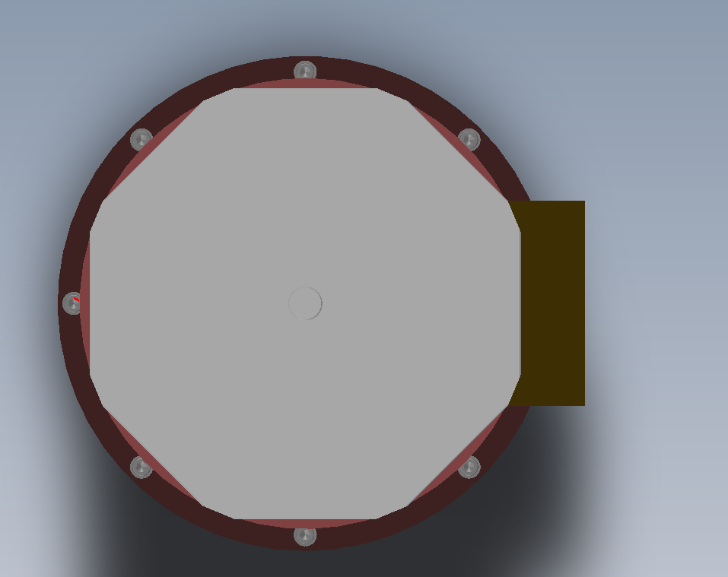
Electronics box mount
PCB dimensions are yet TBD….
Options to consider:
Eurocard 6U = 230mm wide * 160mm deep like VME.
Extended 3U = 100mm wide * 230mm deep like Leach controller.
This provides less lateral overhang.
Is this enough board area?
Do Vicor power modules fit in this space?
Plug in Power
Controller
278 mm

