Slide 1
Questions on IFPAC_SCHEMATIC

Slide 2
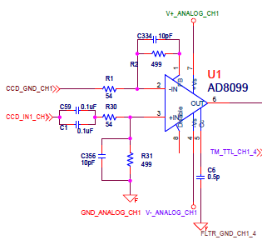
Signal Chain Preamplifier
Gain for preamp is ~9.2x so the
signal will probably hit the amplifier rails with
a full well signal: eg for CCD231-C6:
Full well = 350,000e- * 7µV/e-
= 2.45V at input
= 9.2*2.45V at output
= 22.5V at output
Where is resistor
For compensation
Network?
Does compensation keep the
amplifier from oscillating?
Compensation Capacitor should go to –Vs, not GND

Slide 3
Signal Chain Preamplifier
Has large signal gain (~9.2x) and the output voltage range is ~+/- 3.7V. The amplifier will hit the rail at ~57,500 e- which is less than full well.
Has the compensation capacitor been connected to the negative supply voltage?
Datasheet recommends a resistor in the compensation network. Has this been added?
Does compensation capacitor prevent oscillation?

Slide 4
Questions about preamp concept
Typical output impedance of source follower on CCD with 20kohm load resistor is about 5Kohm. Input impedance of video preamp is 54+499 ohm on the non-inverting side where the CCD signal is injected, so the signal will be attenuated by the potential divider formed by the CCD output impedance and the preamp input impedance. Ie by a factor of 10.
To reduce the input attenuation to 10% (say) we need the output impedance of the CCD to be 61 ohm or less. For a JFET buffer transistor it is typically a few hundred ohms so that wont work either. This implies that there be a preamp ahead of the preamp.
In fact, we do intend to put a differential output preamp in the dewar in this instance. The preamp stage becomes redundant and in fact needs to be removed since it has too much gain.
There is another problem: the noise. The voltage noise is 0.95 nV/RtHz but to this we must add the current noise which is 2.6pA/rtHz times the source impedance (5K+54) in parallel with the input impedance of the preamp (499) so this results in 2.6E-12/(1/5054+1/499) = 1.1 nV/rtHz. Adding in quadrature with voltage noise gives total input noise = 1.51nV/rtHz. Multiply this by the noise gain 1+9.2 to get 15.4 nV/rtHz which is not good considering that the net signal gain is 0.92.
CONCLUSION: this preamp is unsatisfactory.

Slide 5
Alternative preamp, differential
Common mode gain = 1
Differential gain = (Ra+Rb+Ra)/Rb
Need op amps with 2-3nV/rtHz voltage noise and <100 fA current noise.
+
-
Ra
Rb
Ra
-
+

Slide 6
Single sided preamp?
Lower noise is possible with single sided preamp since there is no noise from the reference side.
However whether this matters depends on the CCD. Once the CCD has high enough sensitivity and thus high enough output voltage noise then the preamp noise is less critical. This needs further analysis.
For ZTF’s in-dewar preamp, we have the same considerations.

Slide 7
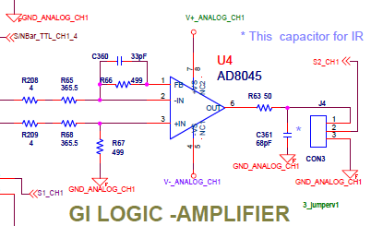
Analog Second Stage
Need 33pF in parallel to
Make truly differential

Slide 8
Analog Second Stage
Has a 33pF capacitor been added in parallel to R67?
While the 8045 is described as unity gain stable it has an underdamped response (ringing) at the low gain being used.
PSRR is very good at 100kHz to 1MHz where we most care.

Slide 9
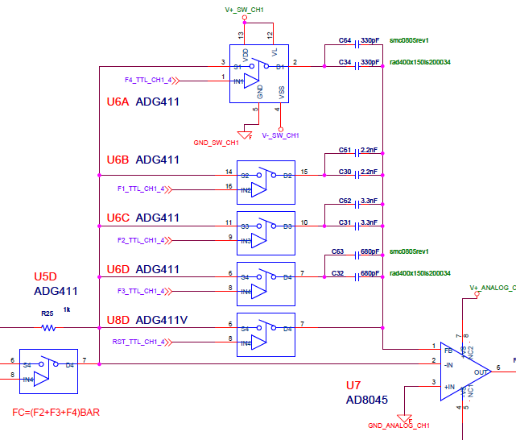
Integration Amplifier
Is there a logic to the capacitor values?
Why are there two in parallel?
Open loop is possible in this configuration

Slide 10
Integration Amplifier
Is there a logical scheme to the values of capacitors chosen?
Why are there two capacitors in parallel in each feedback path?
Putting the amplifier into open loop is possible with this configuration. How is this prevented?

Slide 11
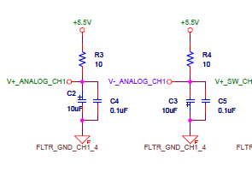
Amplifier Bypass Capacitors
These are the only bypass capacitors for
All of the op-amps. There should be at least a high frequency bypass capacitor very close to the op-amp and the trace inductance must be minimized (short and wide).

Slide 12
Amplifier Bypass Capacitors
Have bypass capacitors been added for each amplifier on board?
Oscillation problems can occur without these capacitors. What have the tests of the board shown?

Slide 13
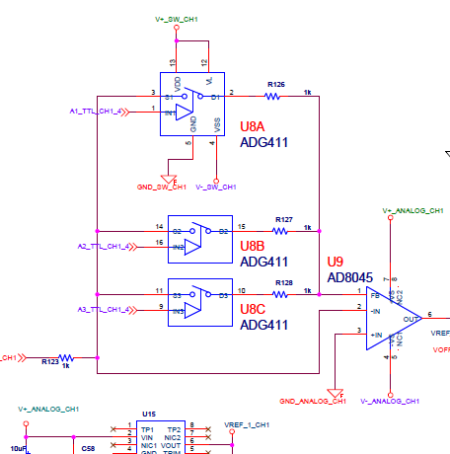
Buffer Amplifier
Amplifier has -1 or fractional gain(!?)

Slide 14
Buffer Amplifier
Multiple resistors in feedback path create a small feedback resistor. This makes the amplifier attenuate the signal. Is this what was intended? Why?
This stage does not seem to be needed and if not it should be eliminated.
Note that the switch resistances can introduce subtle signal non linearities, as well as leakage currents which can result in small DC drifts.

Slide 15
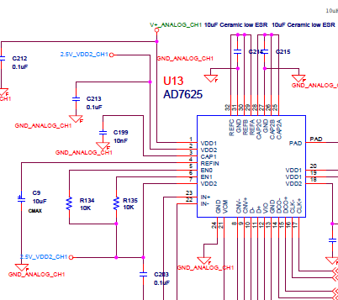
ADC Questions
Supply voltage same as amplifiers
Need high speed ceramic cap too on RefIn pin. Make sure caps are very close to ADC and that traces have lowest possible inductance. This is critical to DNL.

Slide 16
ADC Questions
The ADC uses the amplifier supply voltage. Does this voltage need to be regulated or does using this voltage deliver acceptable results?
Does the datasheet call for an additional high speed ceramic capacitor on the RefIn pin?
Where are the band limiting components that are needed for anti-aliasing ? !

Slide 17
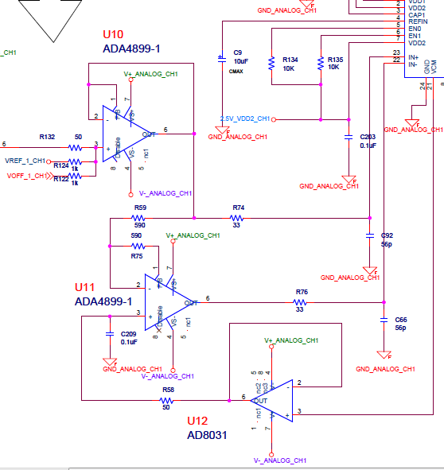
ADC Input Question
Please describe the
signal input scheme for
the ADC.
How much offset is there? Is it fixed.

Slide 18
ADC Input Question
Could you please describe/explain the ADC signal input scheme
Designating the input voltage to U10 from U9 as V_{in}, the input equation we calculate is 2V_{in} + 2.048 + V_{offset}/2
  Discounting the offset voltage, to match the ADC input range V_{in} is expected to be in the range of -3.072V to 1.024V.
  The addition of V_{ref} to U10 creates the asymmetric voltage range, is this what was intended?
You start with a differential input convert to single sided for the dual slop integrator then convert back to differential into the ADC. If you made the dual slope integrator differential, maybe you could simplify (fewer stages) and get much better crosstalk and supply rejection. This is how most image sensor ASICs are designed internally.

Slide 19
Feedback caps !!
Every op amp should have the provision for feedback capacitance to be added to improve stability and kill off unneeded bandwidth so that noise is improved.
5-10pF feedback is typically needed since input and wiring capacitance is typically a few pF.

Slide 20
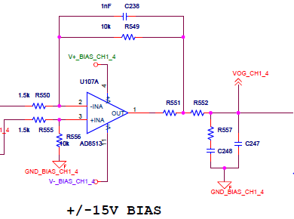
Bias Amplifier
Values missing … choice affects stability.

Slide 21
Bias Amplifier
What are the values of resistors R551 and R552?
Placing R551 within feedback loop increases output impedance and can cause unstable behavior. Why is R551 placed where it is?

Slide 22
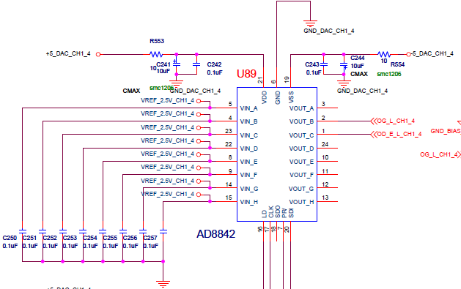
Number of Bias Lines
All inputs are used, but only two outputs are used

Slide 23
Number of Bias Lines
All inputs have voltages, but only two outputs are used. Are there more bias lines available on this card?
Have more bias lines been implemented on the already built card?

Slide 24
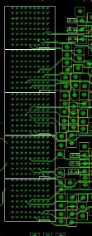
Backplane Connector
Backplane connector
Is high density and will
be hard to probe.
The large number of rows (9) forces one to use more layers to route the connector.
This topology is probably unnecessary.

Slide 25
Backplane Connector
The connector is very high density and we are concerned that probing the signals will be difficult.
Is it possible to use a lower density connector?
What percentage of pins in the connector are used?

Slide 26
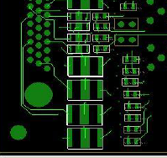
Backplane Traces
Traces are frequently very thin and close together.
This example is on the backplane.
Thin traces are:
More inductive
More resistive
Prone to failure due to manufacturing defects.
Small gaps cause:
capacitive loading,
Crosstalk
likelihood of accidental bridges occuring due to manufacturing defects

Slide 27
Backplane Traces
Backplane traces are small and close together.
What are the trace widths?
What is the spacing between traces?
Has there been any crosstalk problems?
Has there been any manufacturability problems?

Slide 28
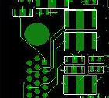
Improper Trace Clearance
There is
not enough clearance
between trace and
mounting hole.
Risk of bridging during manufacture.
Risk of hole being drilled oversize or in wrong place also trace will be cut.
NOT ROBUST.

Slide 29
Improper Trace Clearance
There seems to be no clearance between mounting hole and signal trace
What is the spacing between mounting holes and traces?
Has there been manufacturability problems with the current spacing?

Slide 30
ADC Test Request
Noise test:
  Acquire data on all channels with normal readout timing, except dual slope integrator simply sits idle during normal integrations. Noise measured is from integrator, ADC buffer, output offset, and ADC. Should be 1 ADU or less
ADC Histogram test:
  Apply 10Hz triangle wave to input and use single sample integration (not dual slope). Any ADC value is equally likely. Histogram of data should be flat. Acquire enough data so that each ADC code occurs 1000 times on average. Make histograms for each ADC output and histogram of histograms (DNL error distribution).

