Slide 1
Questions on IFPAC_SCHEMATIC

Slide 2
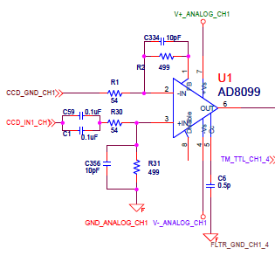
Signal Chain Preamplifier
Gain for preamp is ~9.2x and the
signal will hit the amplifier rails with
a full well signal
Where is resistor
For compensation
Network?
Does compensation keep the
amplifier from oscillating?
Compensation Capacitor should go to –Vs, not GND

Slide 3
Signal Chain Preamplifier
Has large signal gain (~9.2x) and the output voltage range is ~+/- 3.7V. The amplifier will hit the rail at ~57,500 e- which is less than full well.
Has the compensation capacitor been connected to the negative supply voltage?
Datasheet recommends a resistor in the compensation network. Has this been added?
Does compensation capacitor prevent oscillation?

Slide 4
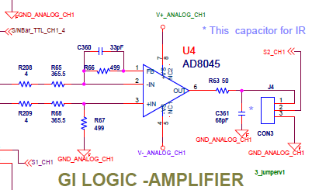
Analog Second Stage
Need 33pF in parallel to
Make truly differential

Slide 5
Analog Second Stage
Has a 33pF capacitor been added in parallel to R67?

Slide 6
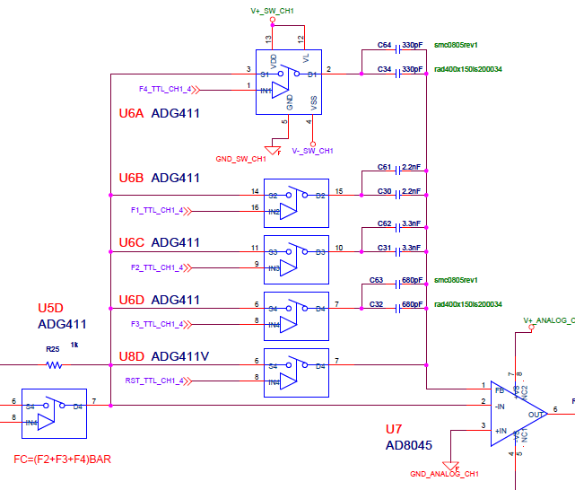
Integration Amplifier
Is there a logic to the capacitor values?
Why are there two in parallel?
Open loop is possible in this configuration

Slide 7
Integration Amplifier
Is there a logical scheme to the values of capacitors chosen?
Why are there two capacitors in parallel in each feedback path?
Putting the amplifier into open loop is possible with this configuration. How is this prevented?

Slide 8
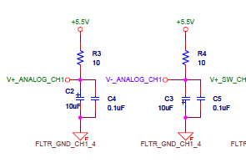
Amplifier Bypass Capacitors
These are the only bypass capacitors for
All of the op-amps. There should be a pair
near each op-amp.

Slide 9
Amplifier Bypass Capacitors
Have bypass capacitors been added for each amplifier on board?
Oscillation problems can occur without these capacitors. What have the tests of the board shown?

Slide 10
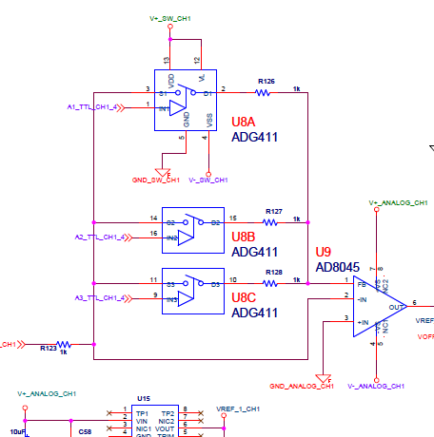
Buffer Amplifier
Amplifier has -1 or fractional gain(!?)

Slide 11
Buffer Amplifier
Multiple resistors in feedback path create a small feedback resistor. This makes the amplifier attenuate the signal. Is this what was intended? Why?

Slide 12
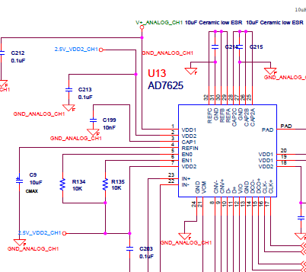
ADC Questions
Supply voltage same as amplifiers
Need high speed ceramic cap too
On RefIn pin

Slide 13
ADC Questions
The ADC uses the amplifier supply voltage. Does this voltage need to be regulated or does using this voltage deliver acceptable results?
Does the datasheet call for an additional high speed ceramic capacitor on the RefIn pin?

Slide 14
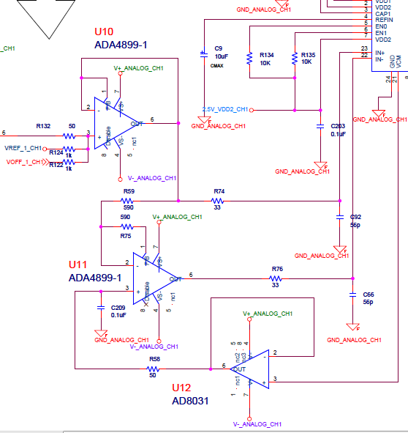
ADC Input Question
Please describe the
signal input scheme for
the ADC

Slide 15
ADC Input Question
Could you please describe/explain the ADC signal input scheme
What is the equation for the input signal?
Do all of the offsets keep the signal within the voltage range of the ADC?

Slide 16
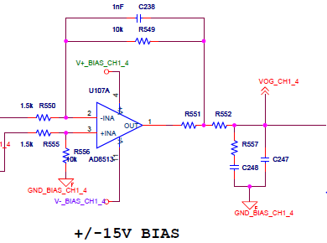
Bias Amplifier
Values missing
Unstable topology

Slide 17
Bias Amplifier
What are the values of resistors R551 and R552?
Placing R551 within feedback loop increases output impedance and can cause unstable behavior. Why is R551 placed where it is?

Slide 18
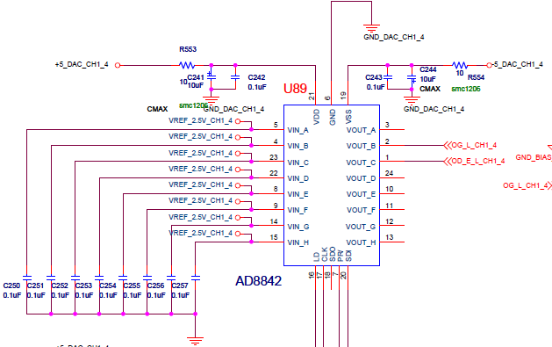
Number of Bias Lines
All inputs are used, but only two outputs are used

Slide 19
Number of Bias Lines
All inputs have voltages, but only two outputs are used. Are there more bias lines available on this card?
Have more bias lines been implemented on the already built card?

Slide 20
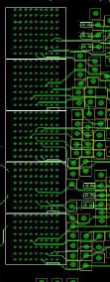
Backplane Connector
Backplane connector
Is high density and will
be hard to probe.

Slide 21
Backplane Connector
The connector is very high density and we are concerned that probing the signals will be difficult.
Is it possible to use a lower density connector?
What percentage of pins in the connector are used?

Slide 22
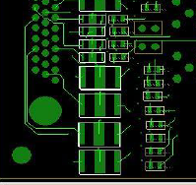
Backplane Traces
Backplane traces are small and close together.

Slide 23
Backplane Traces
Backplane traces are small and close together.
What are the trace widths?
What is the spacing between traces?
Has there been any crosstalk problems?
Has there been any manufacturability problems?

Slide 24
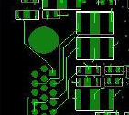
Improper Trace Clearance
Concerned that there is
not enough clearance
between trace and
mounting hole

Slide 25
Improper Trace Clearance
There seems to be no clearance between mounting hole and signal trace
What is the spacing between mounting holes and traces?
Has there been manufacturability problems with the current spacing?

