Slide 1
WASP
Science & Guide CCD
Assembly Fixture
Step By Step Procedure

Slide 2
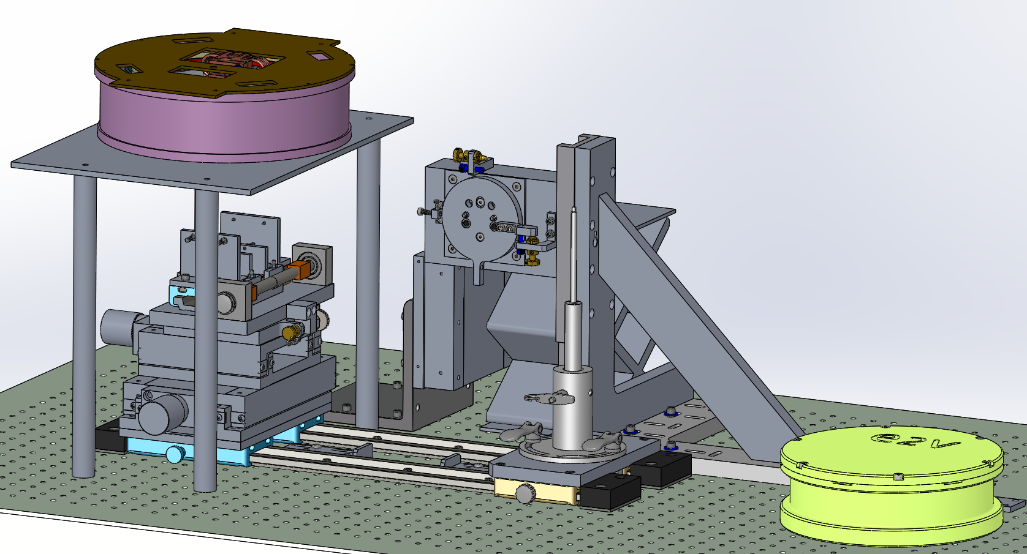
WASP CCD Assembly Fixture
WASP Dewar
Rotation Stage
CCD Handler
Horizontal Stage
Optical Bench

Slide 3
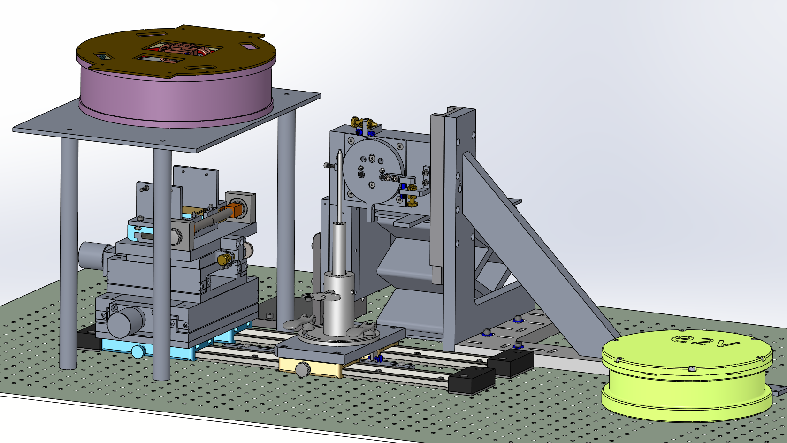
WASP CCD Assembly Fixture
Step 1: Slide the CCD Handler into position

Slide 4
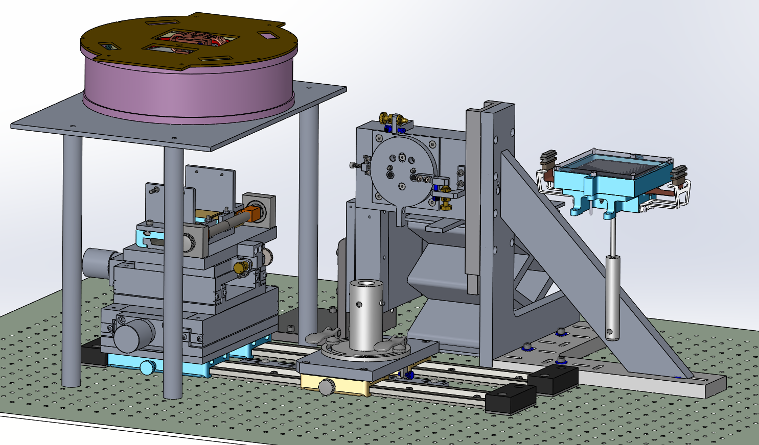
WASP CCD Assembly Fixture
Step 2: Bolt the CCD package to the Handler

Slide 5
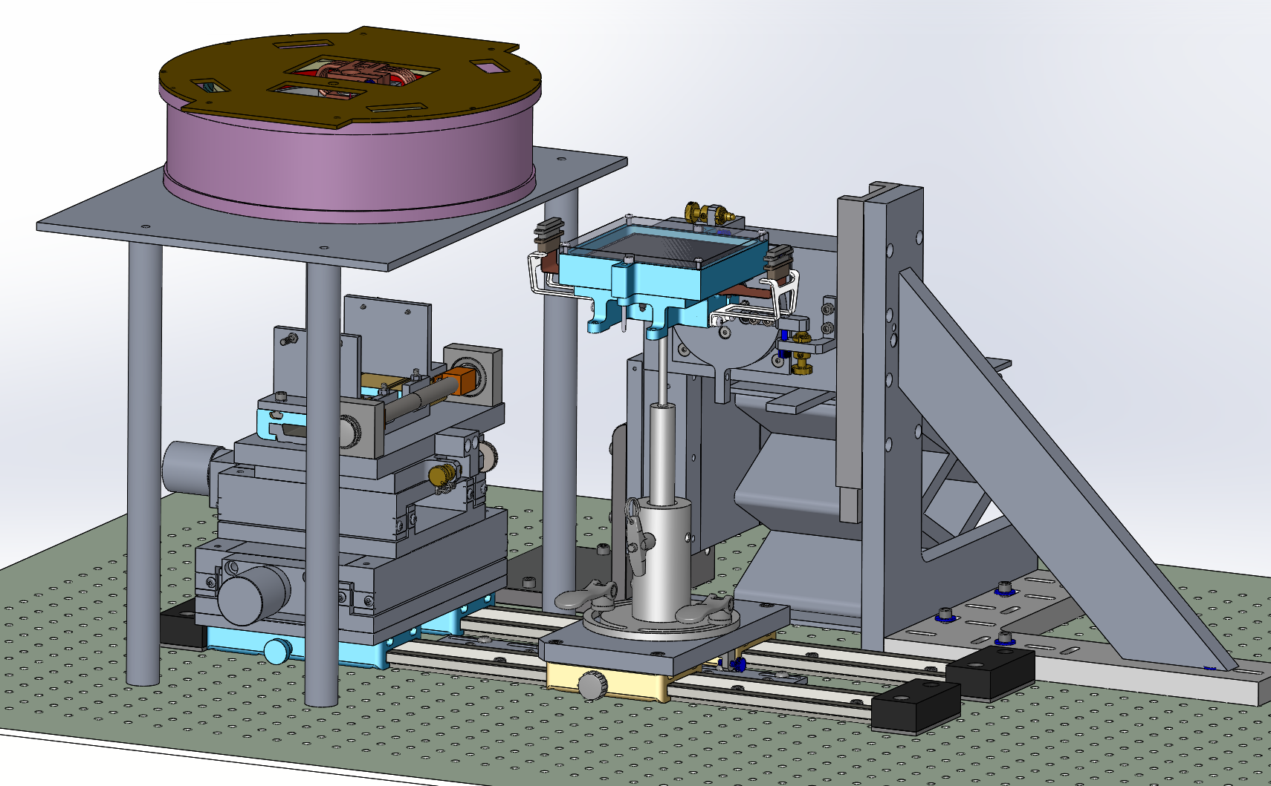
WASP CCD Assembly Fixture
Step 3: Install the CCD Handler to the Base.

Slide 6
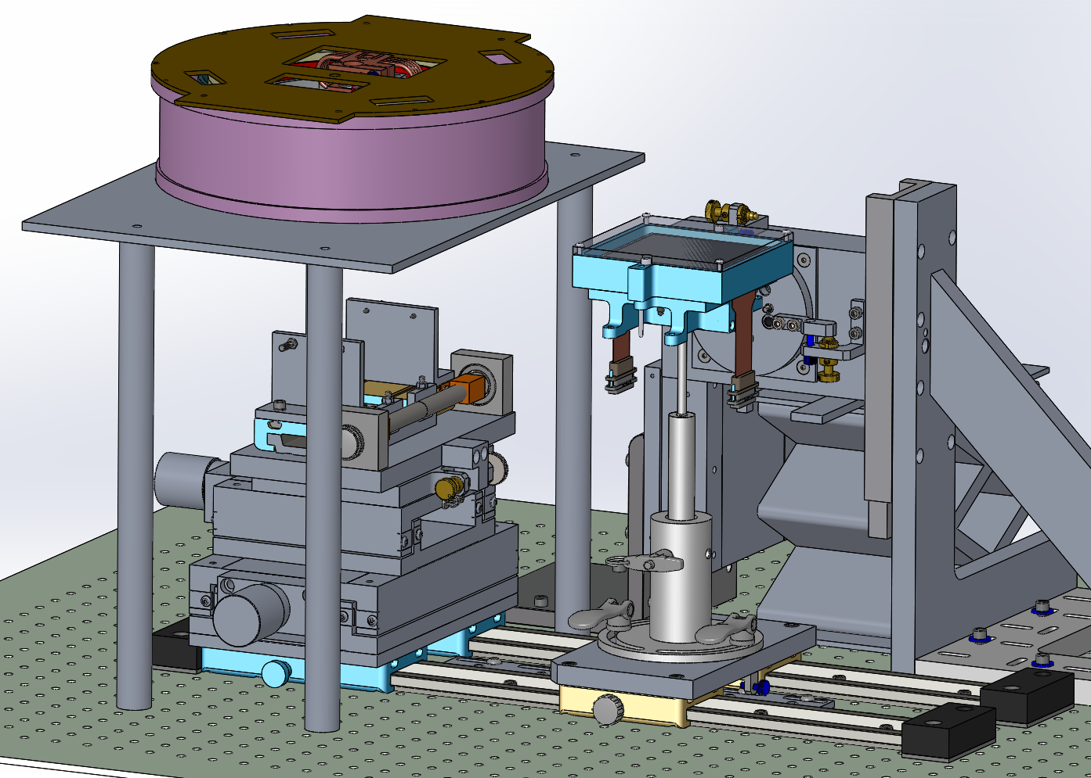
WASP CCD Assembly Fixture
Step 4: Install the connector attachment hardware and Free the Ribbons

Slide 7
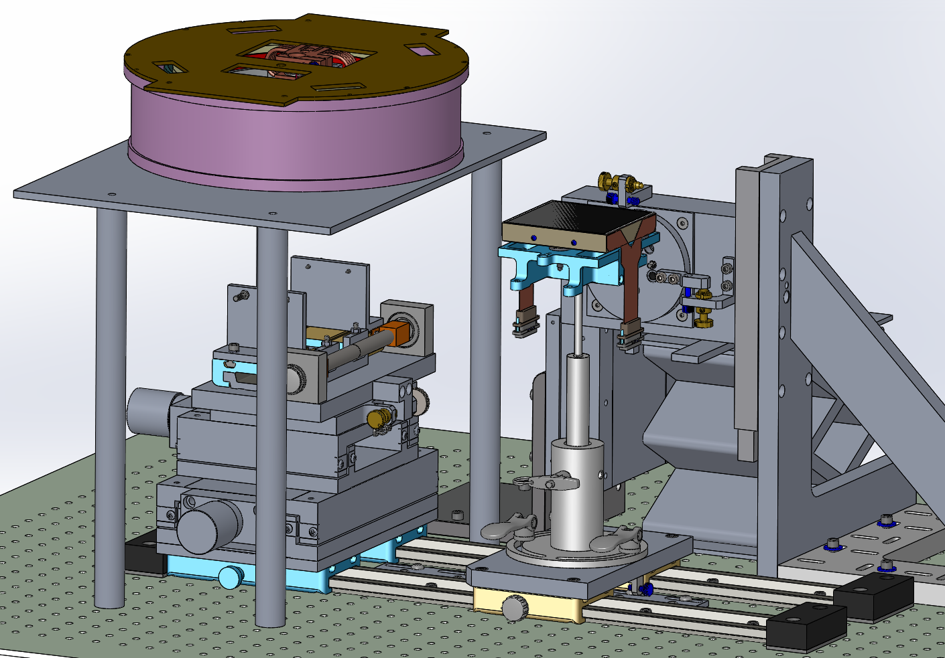
WASP CCD Assembly Fixture
Step 5: Remove the e2v Cover

Slide 8
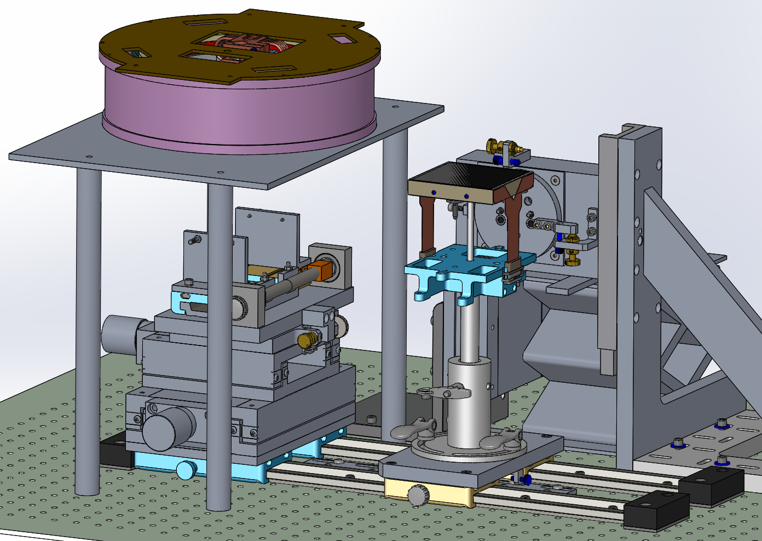
WASP CCD Assembly Fixture
Step 6: Unbolt the e2v Bottom cover.

Slide 9
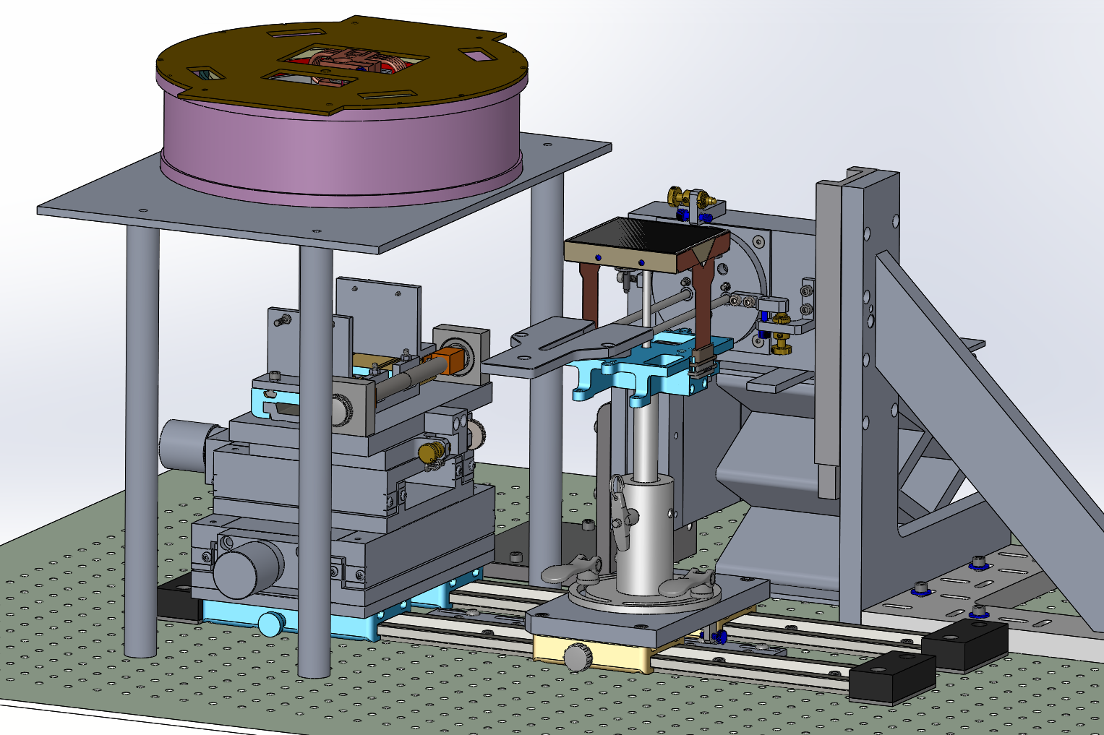
WASP CCD Assembly Fixture
Step 7: Insert the Coupler

Slide 10
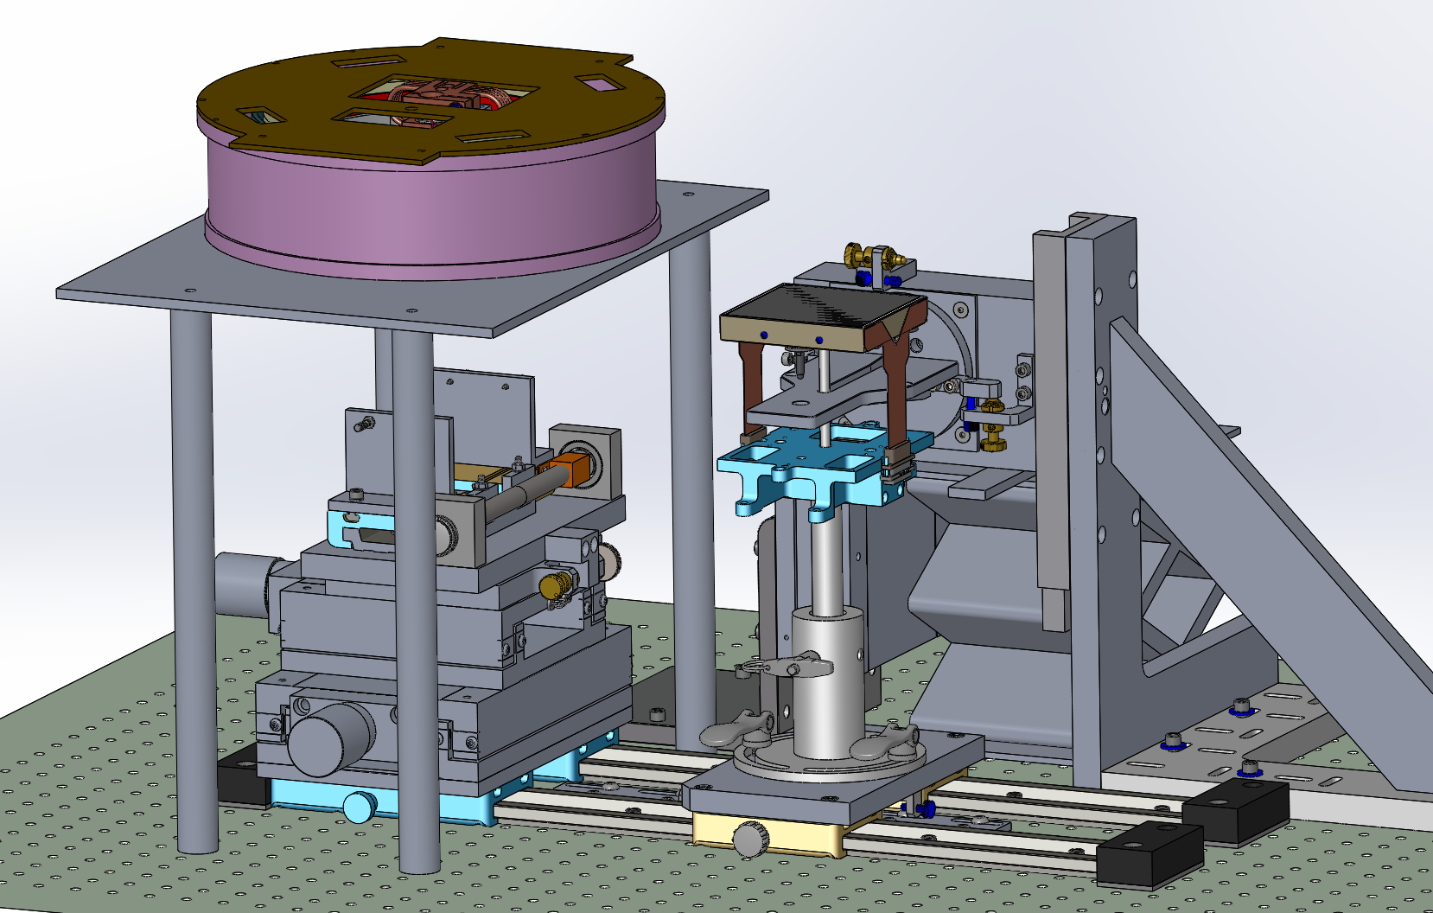
WASP CCD Assembly Fixture
Step 8: Bolt the Coupler to the rotation Stage

Slide 11
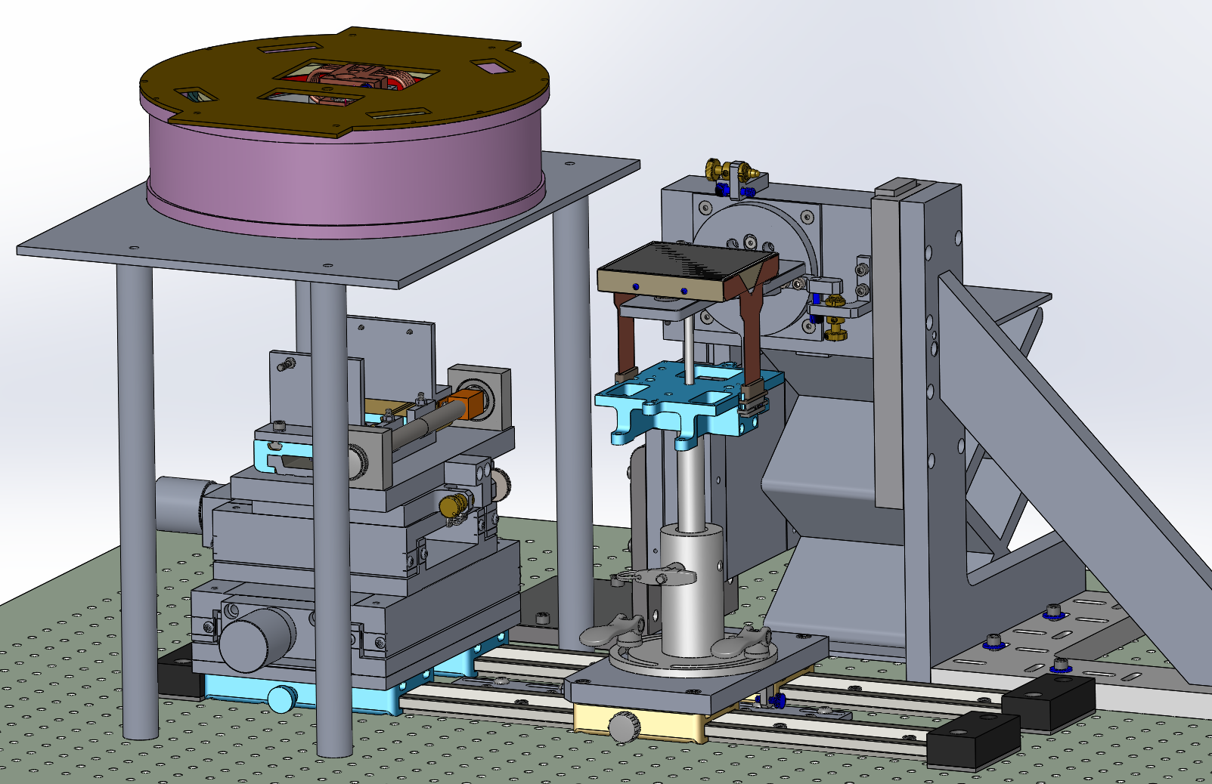
ZTF CCD Assembly Fixture
Step 9: Lift the coupler to the CCD Base

Slide 12
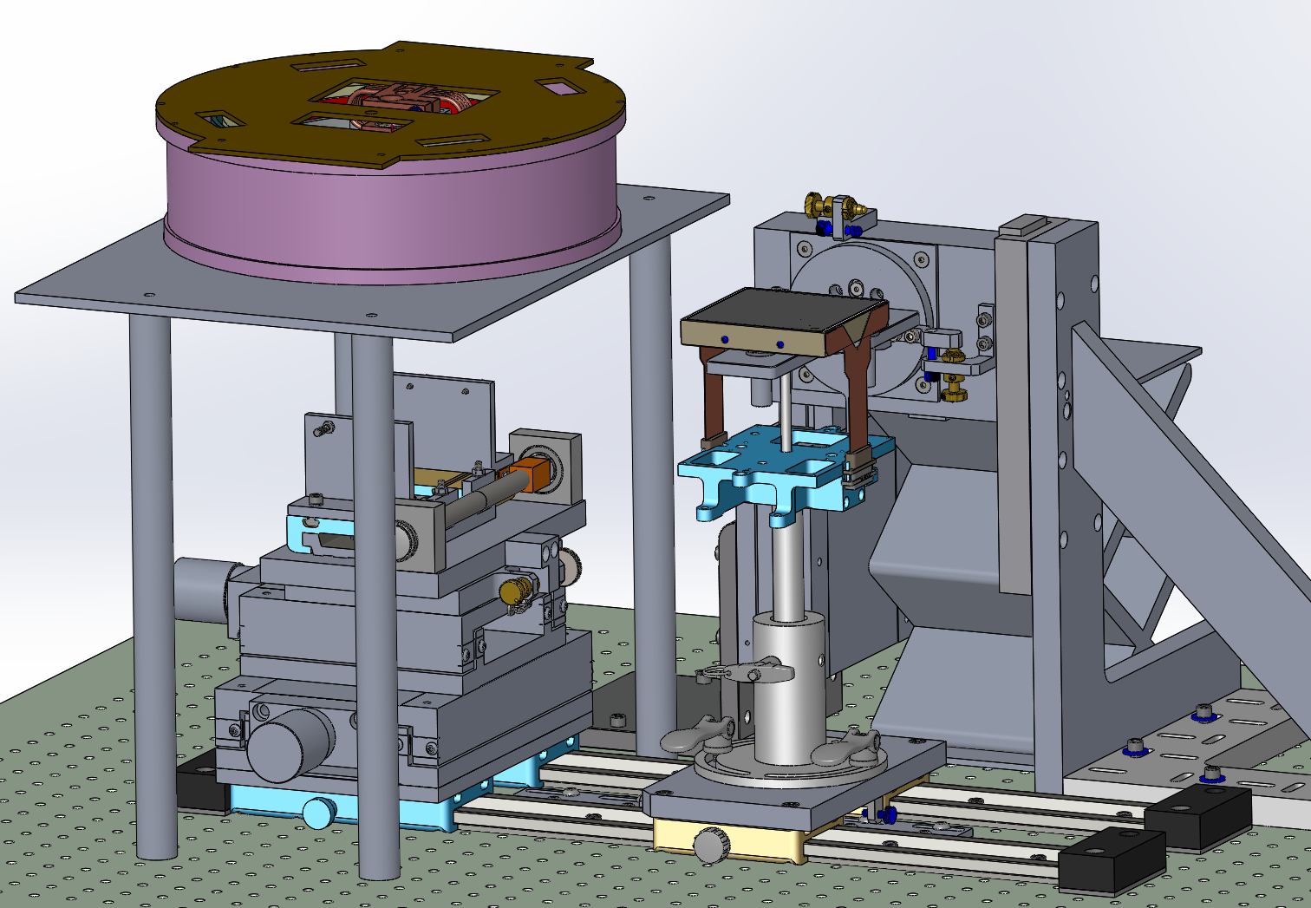
WASP CCD Assembly Fixture
Step 10: Secure the CCD to the Coupler using the Barrel Nuts

Slide 13
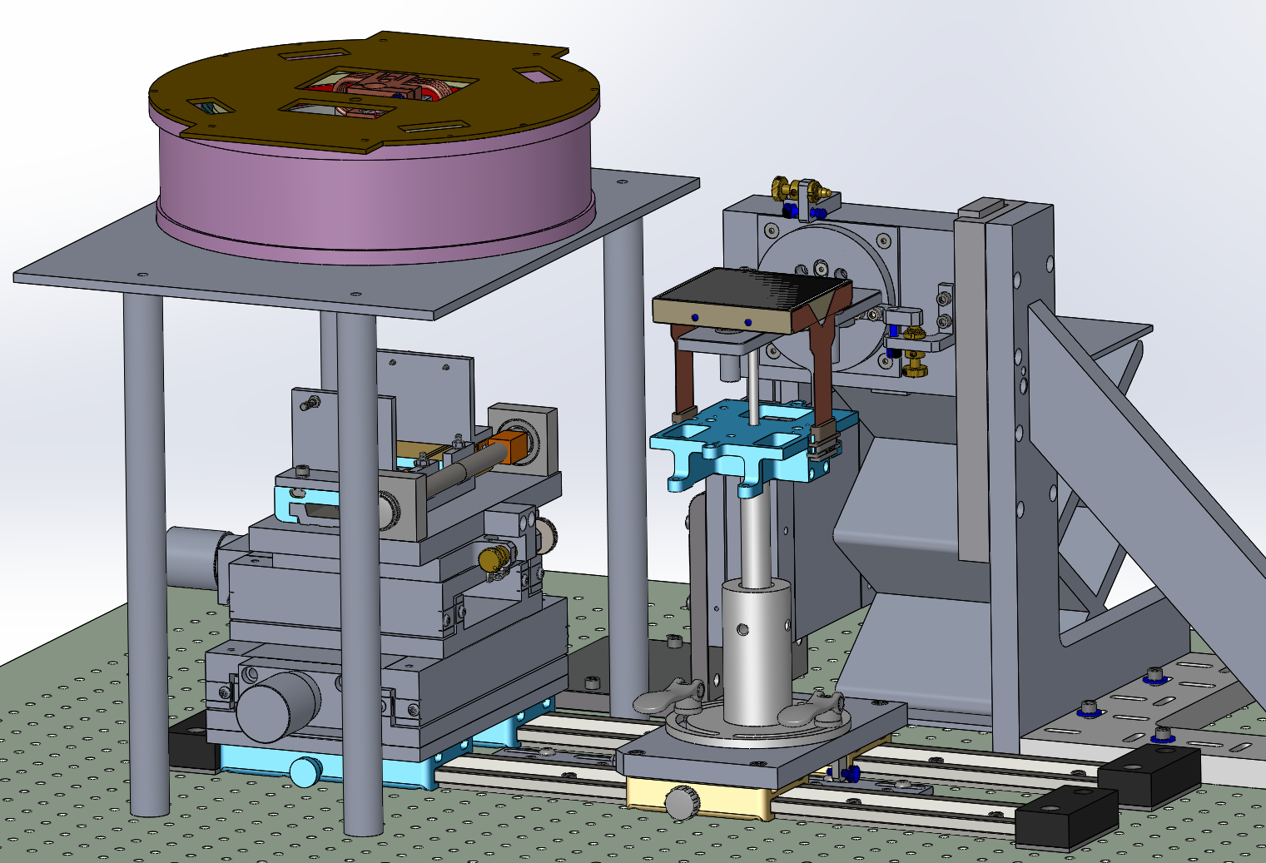
WASP CCD Assembly Fixture
Step 11: Remove the Handler Pin

Slide 14
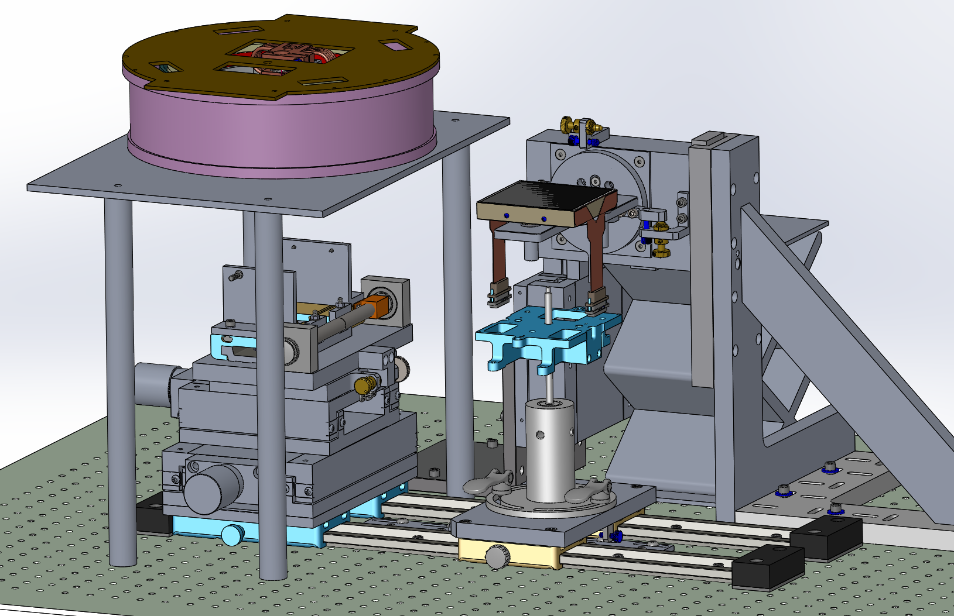
WASP CCD Assembly Fixture
Step 12: Unscrew the Handler from the CCD

Slide 15
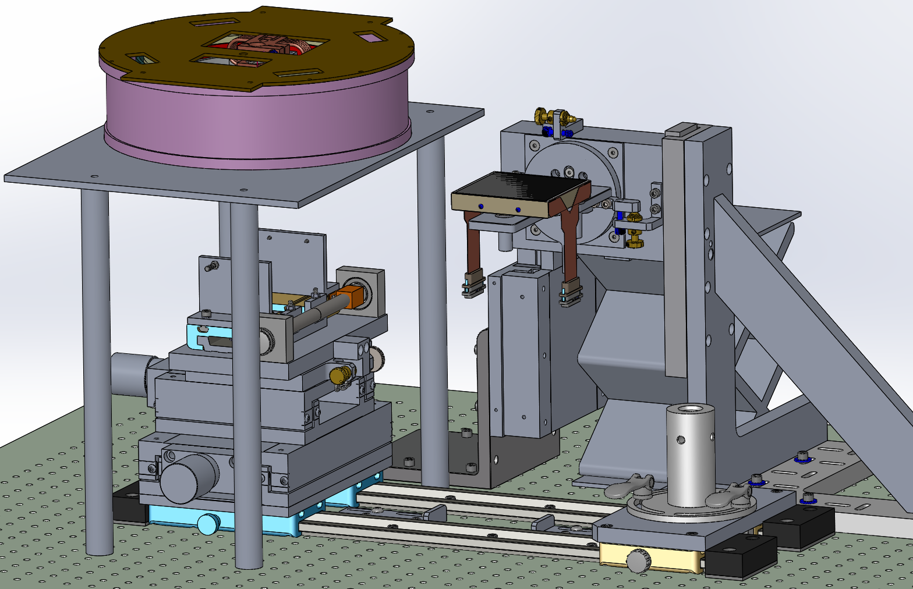
WASP CCD Assembly Fixture
Step 13: Park the Handler Assembly.

Slide 16
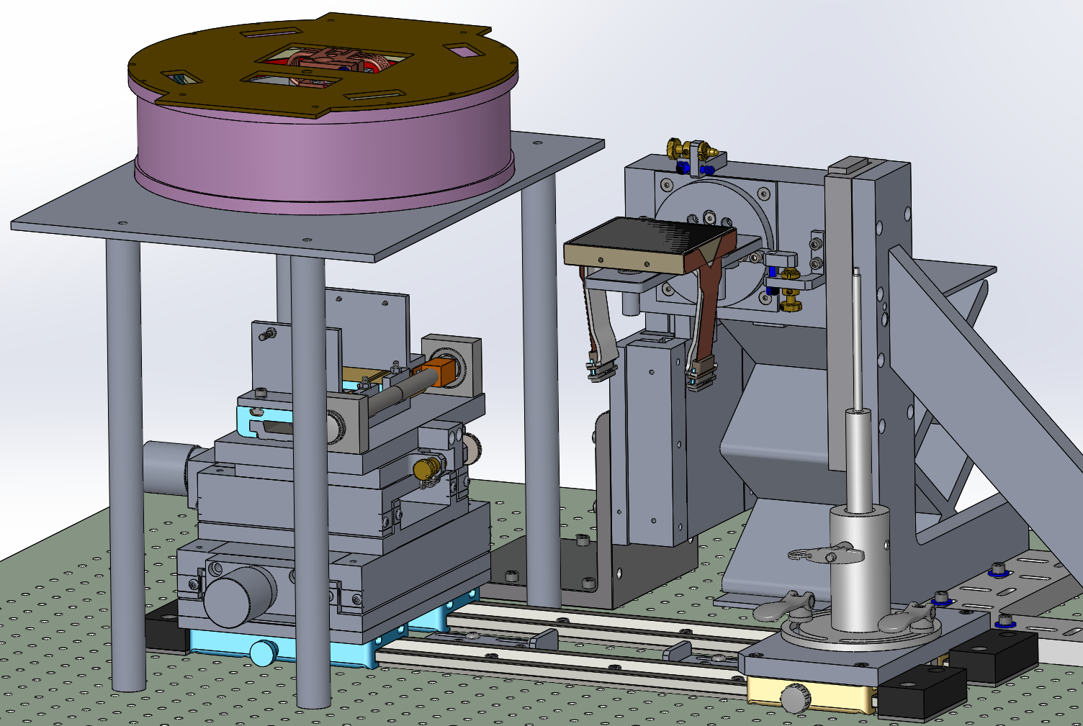
WASP CCD Assembly Fixture
Step 14: Install the Ribbon Holders

Slide 17
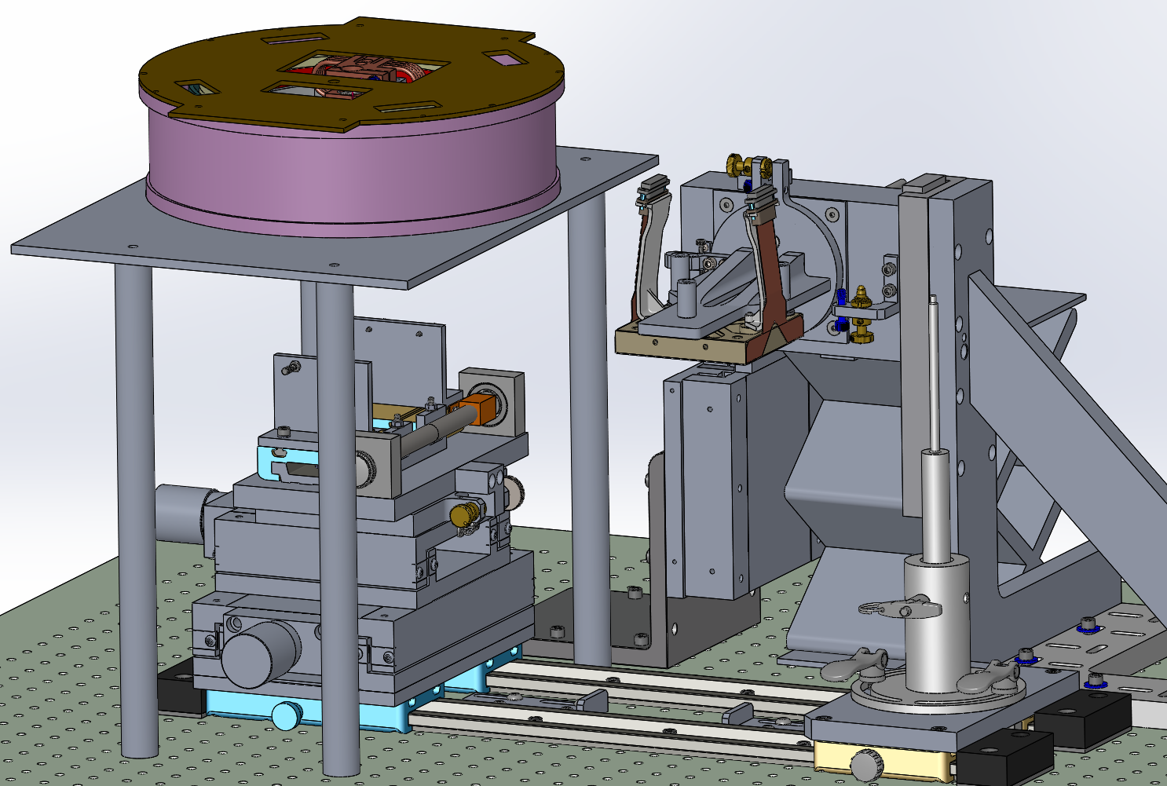
WASP CCD Assembly Fixture
Step 15: Rotate the Stage 180 deg and lock it.

Slide 18
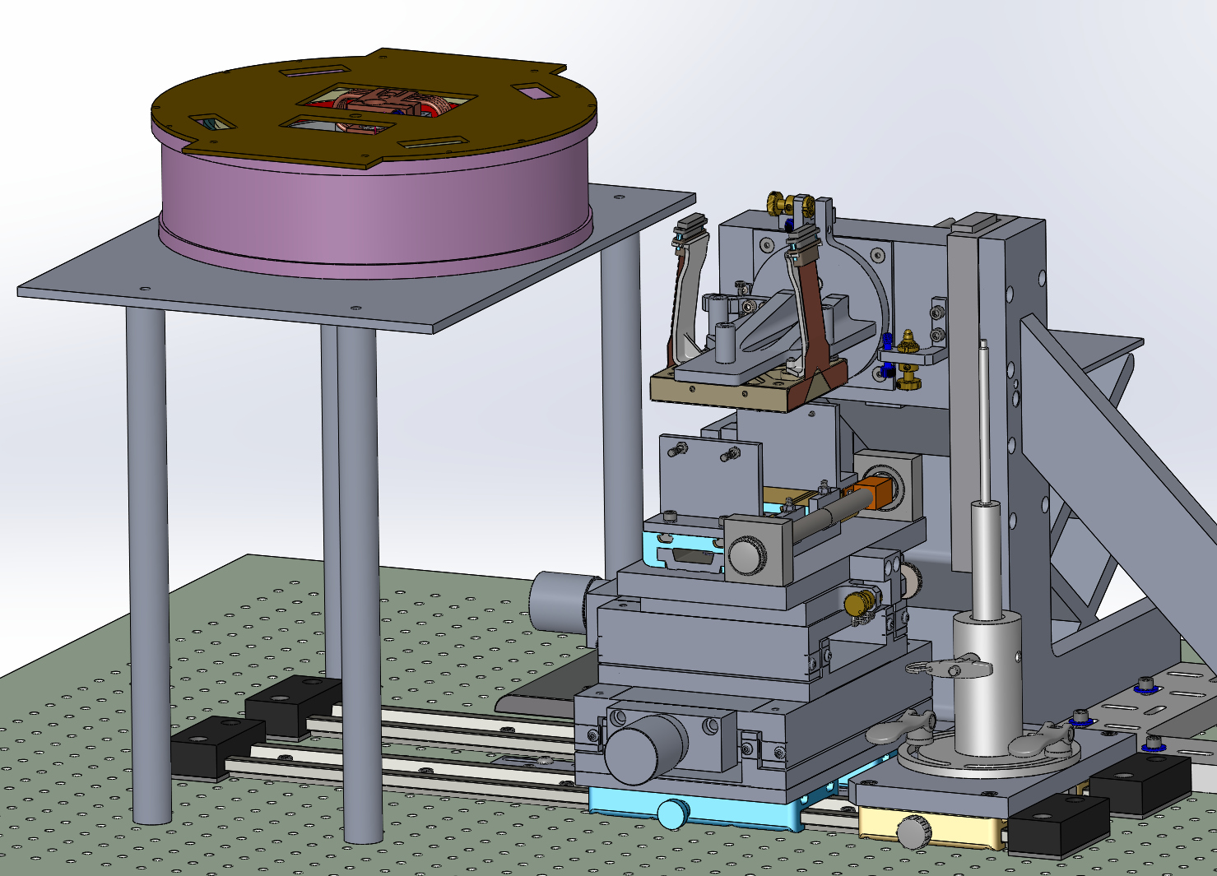
WASP CCD Assembly Fixture
Step 16: Slide the horizontal Stage into place.

Slide 19
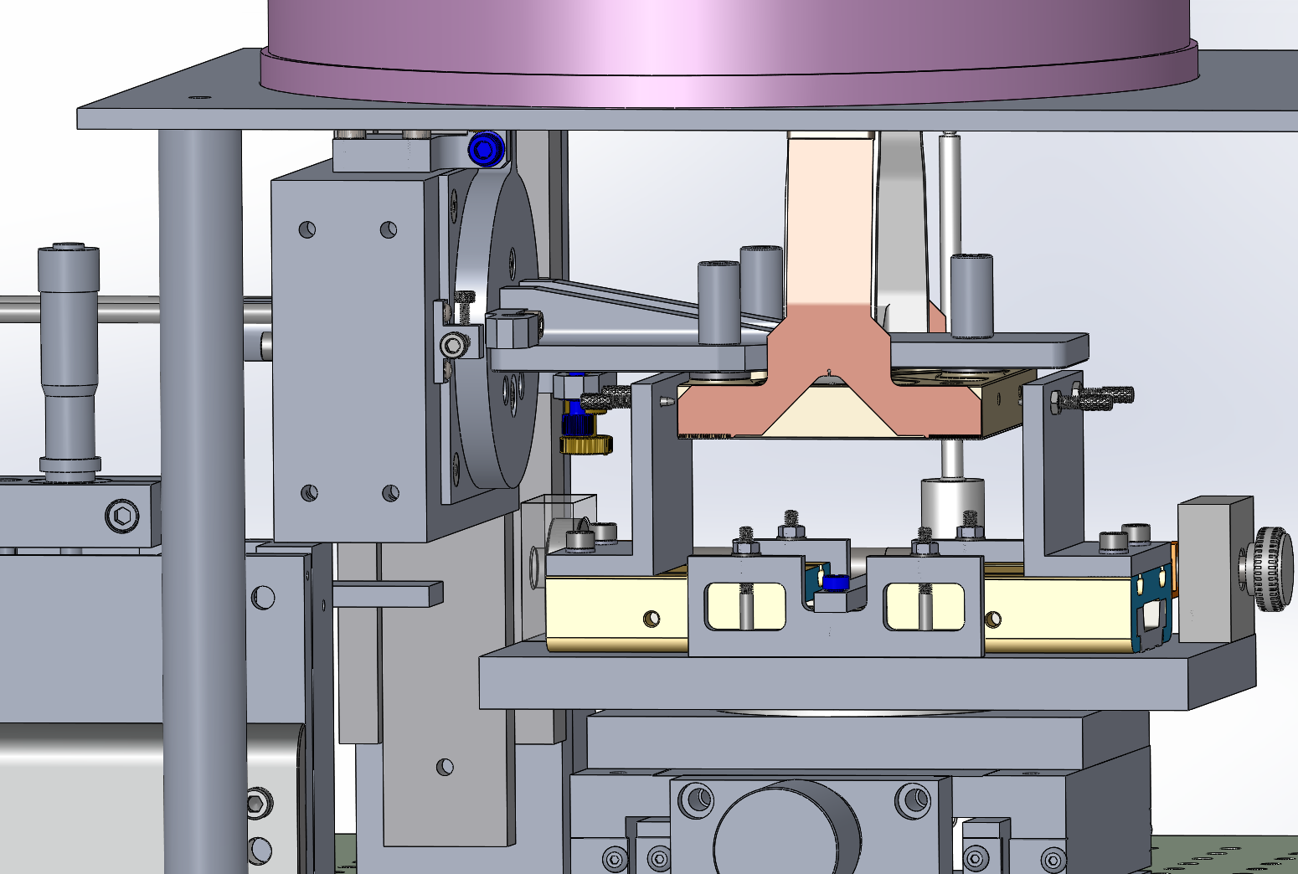
WASP CCD Assembly Fixture
Step 17: Lower the CCD into vertical position between jaws.:

Slide 20
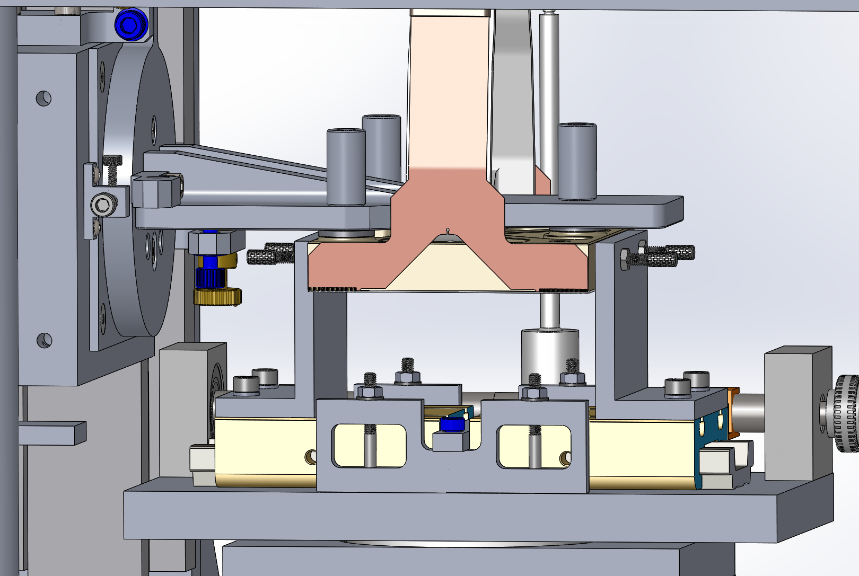
WASP CCD Assembly Fixture
Step 18: Close the jaws

Slide 21
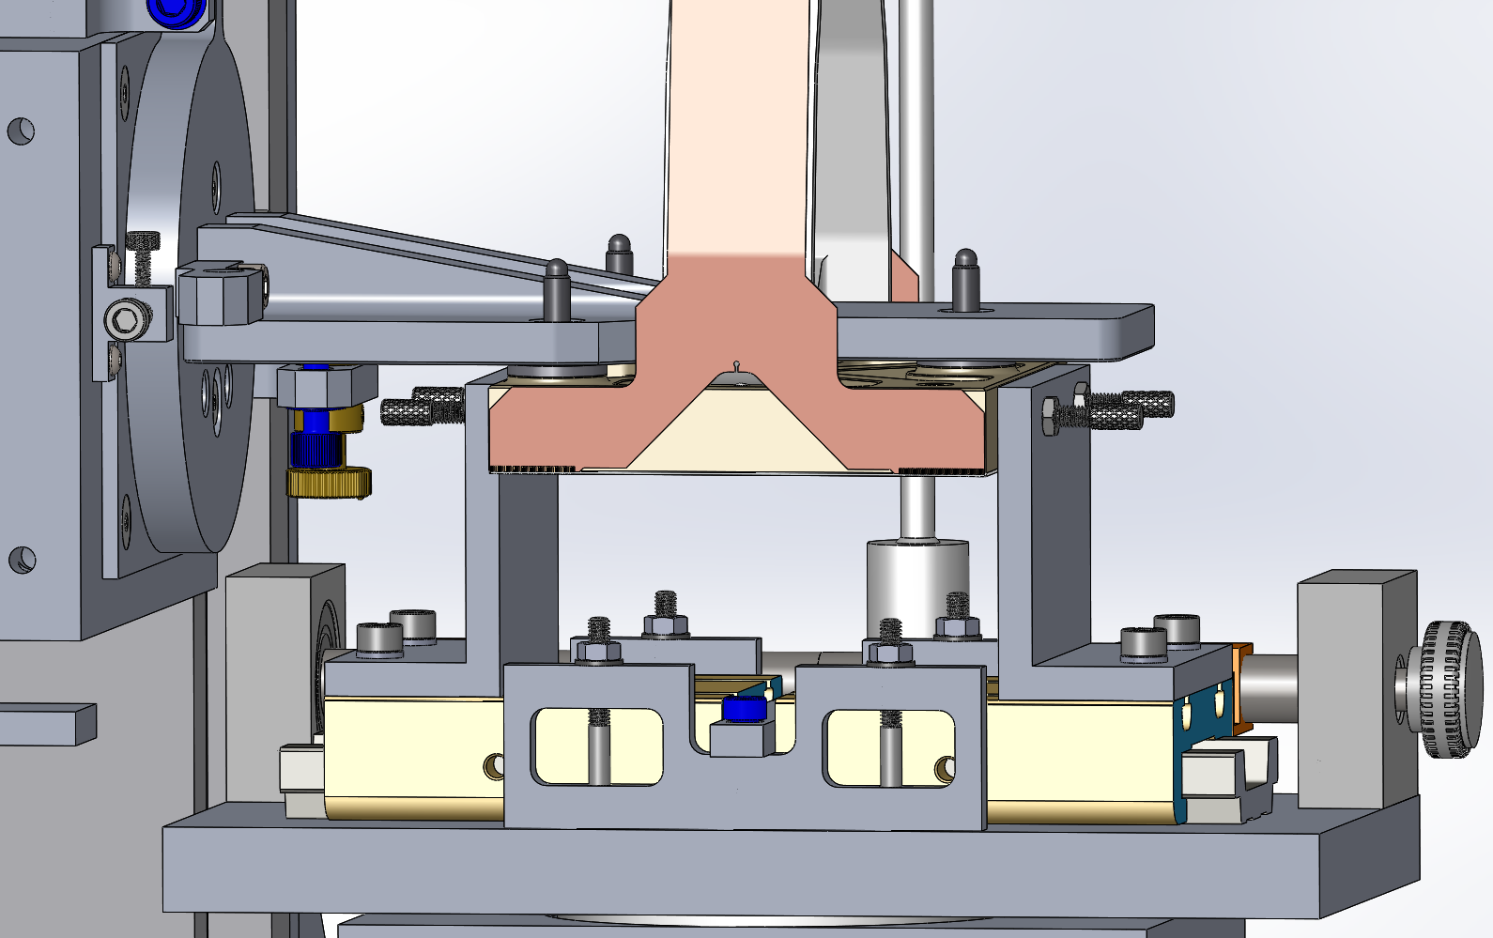
WASP CCD Assembly Fixture
Step 19: Unbolt the CCD

Slide 22
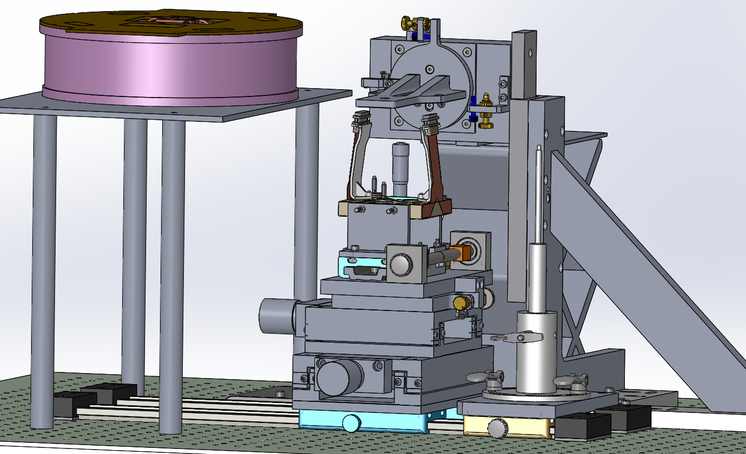
WASP CCD Assembly Fixture
Step 20: Raise the Rotation Stage Clear.

Slide 23
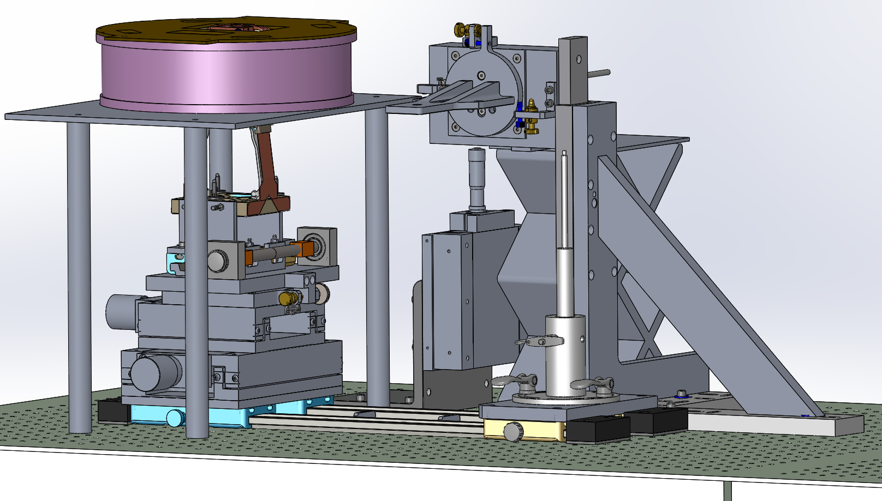
WASP CCD Assembly Fixture
Step 21: Slide the CCD under the Dewar.

Slide 24
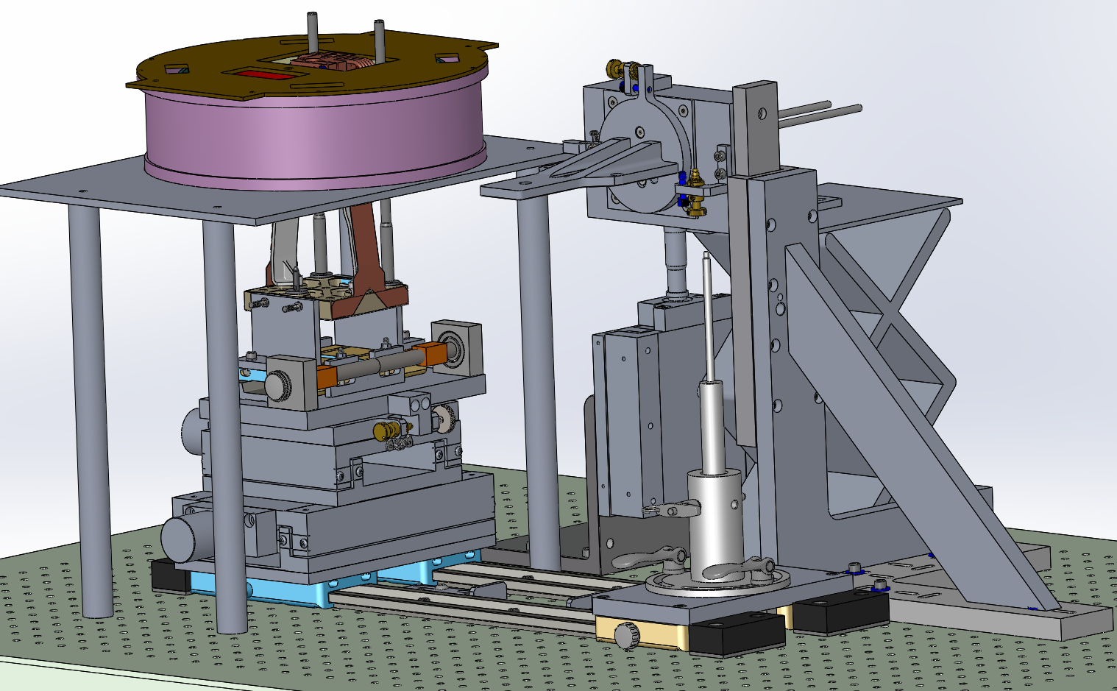
WASP CCD Assembly Fixture
Step 22: Lower the Guide rods to the CCD thru the Dewar

Slide 25
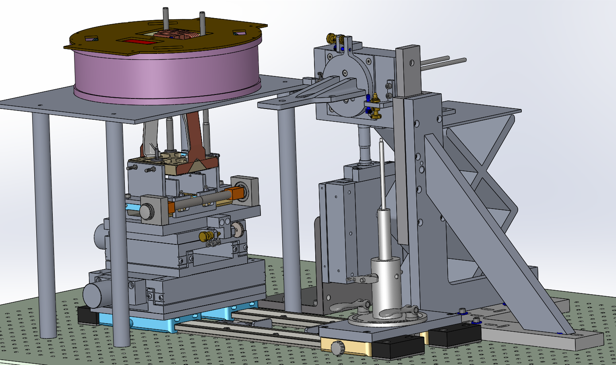
WASP CCD Assembly Fixture
Step 23: Open the Jaws

Slide 26
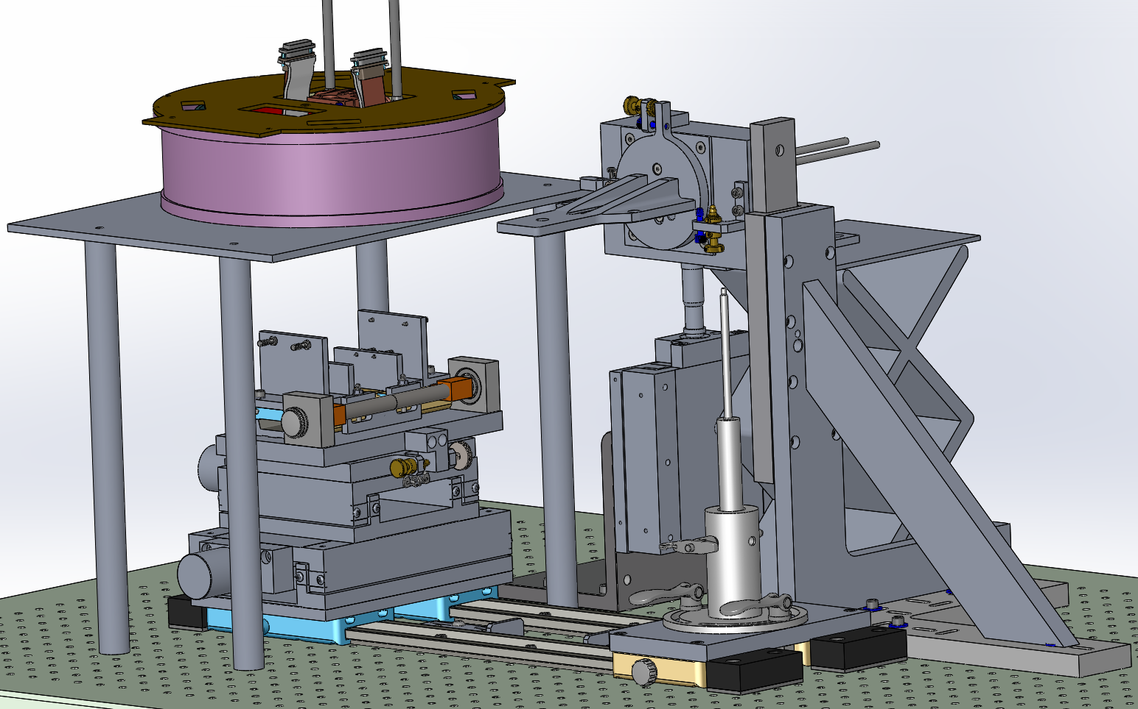
WASP CCD Assembly Fixture
Step 24: Pull the CCD Up

Slide 27
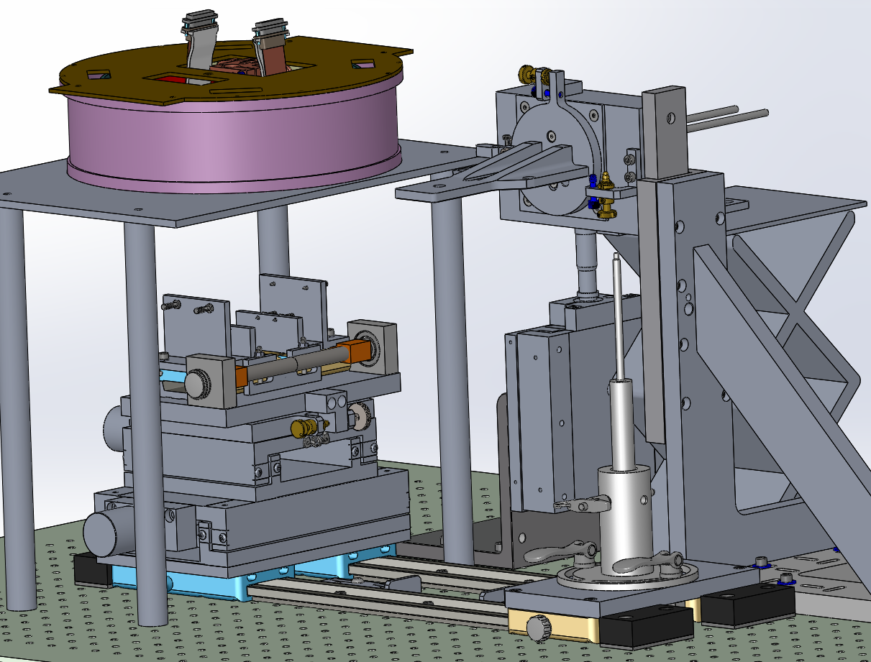
WASP CCD Assembly Fixture
Step 25: Replace Guide Rods with Fasteners

Slide 28
WASP CCD Assembly Fixture
Step 26: Replace Guide Rods with Fasteners

Slide 29
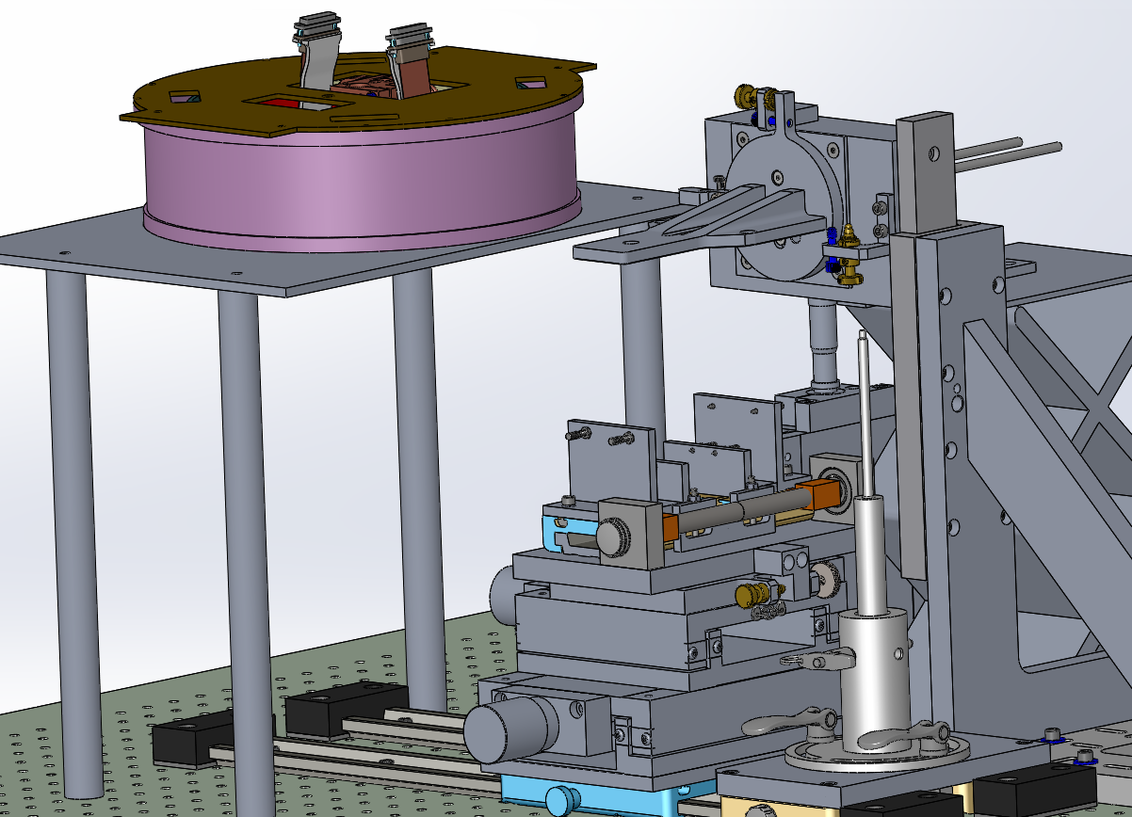
WASP CCD Assembly Fixture
Step 27: Slide the Horizontal Stage into place and open the jaws.

Slide 30
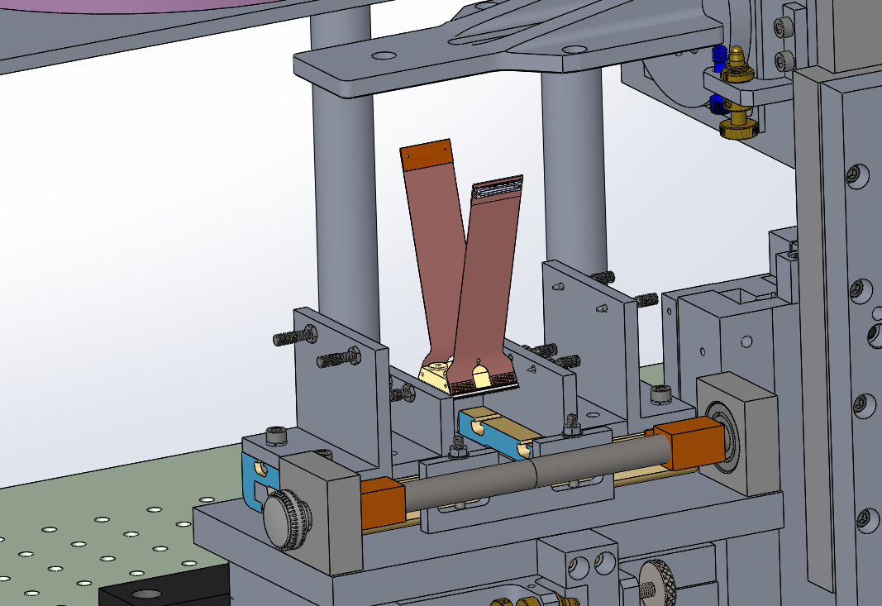
WASP CCD Assembly Fixture
Step 28: Place the Guide CCD between the Jaws

Slide 31
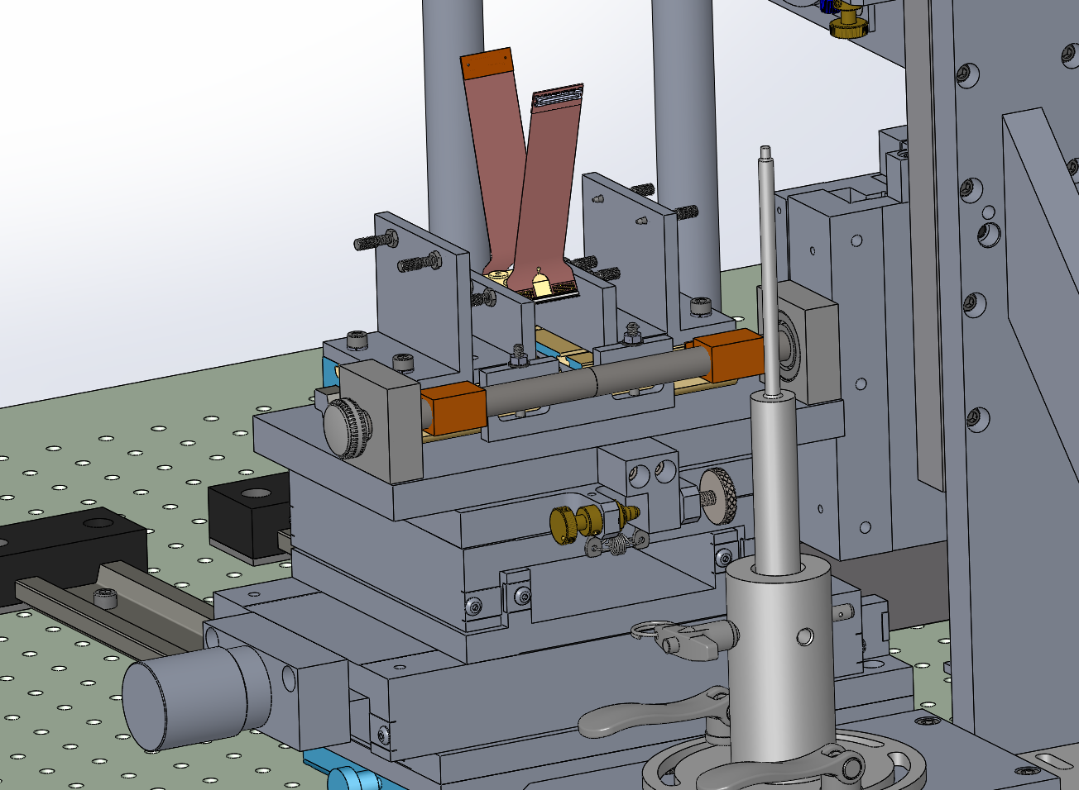
WASP CCD Assembly Fixture
Step 29: Close the Jaws

Slide 32
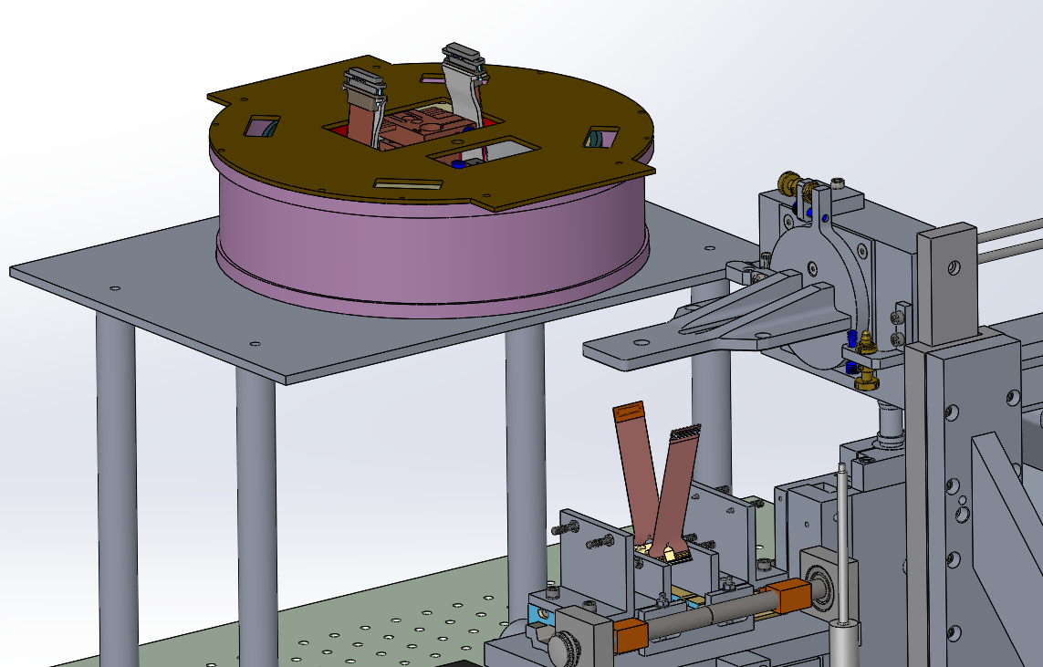
WASP CCD Assembly Fixture
Step 30: Rotate the Dewar 90 deg CCW

Slide 33
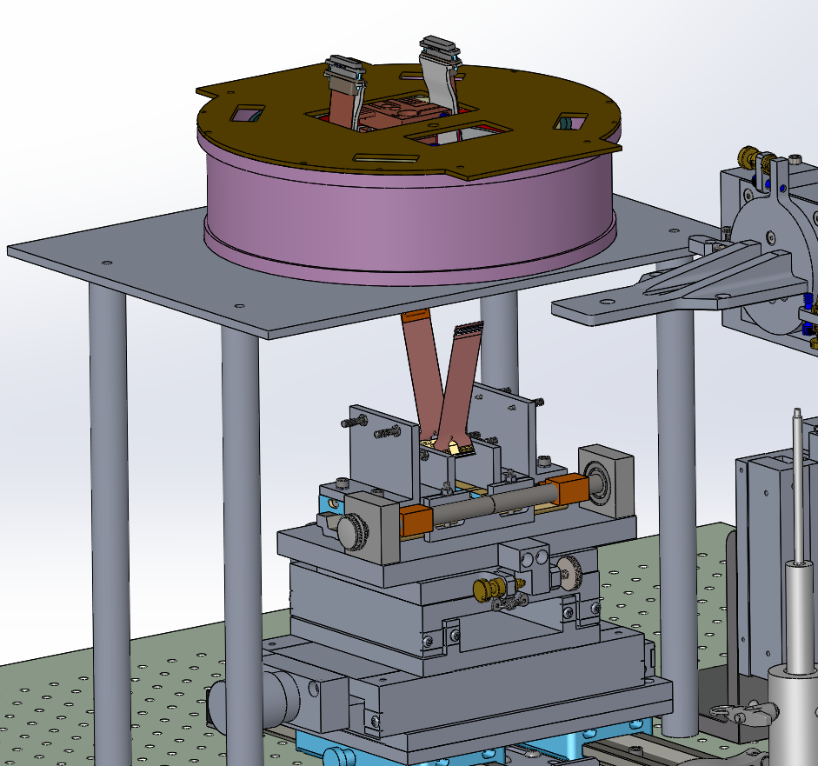
WASP CCD Assembly Fixture
Step 31: Slide the Horizontal Stage into position under the Dewar

Slide 34
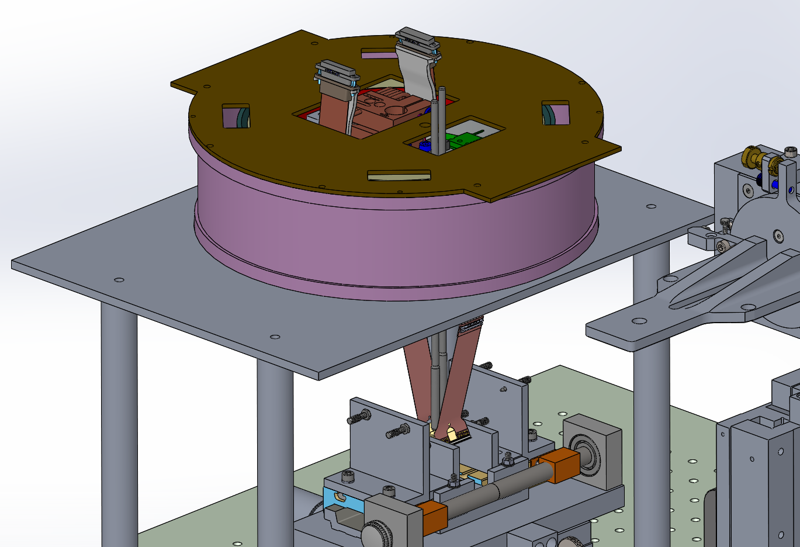
WASP CCD Assembly Fixture
Step 32: Lower the Guide rods to the CCD thru the Dewar.

Slide 35
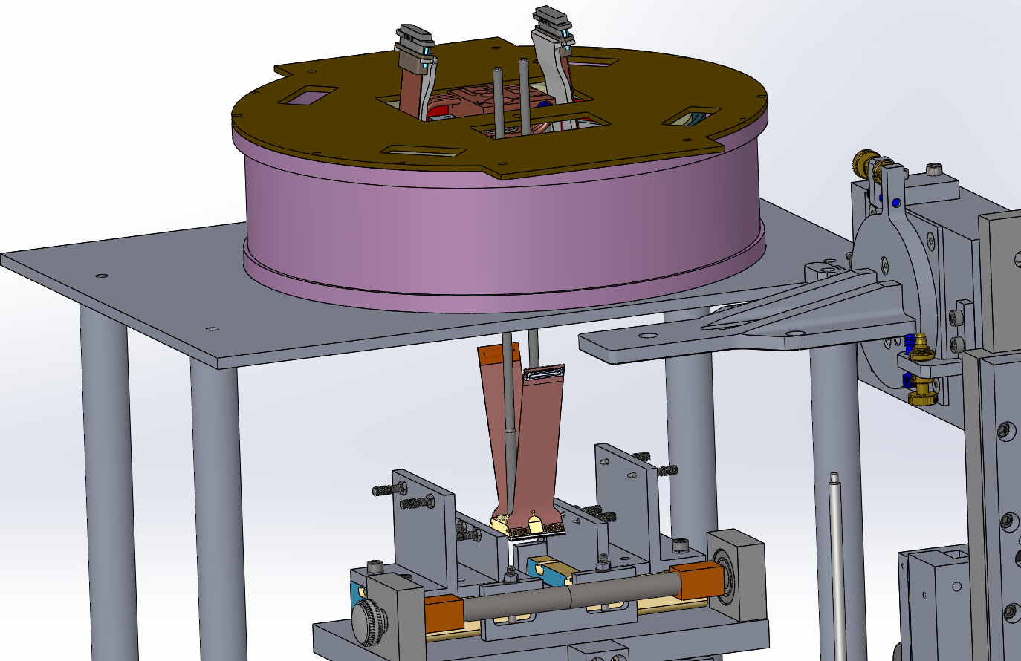
WASP CCD Assembly Fixture
Step 33: Open the Jaws.

Slide 36
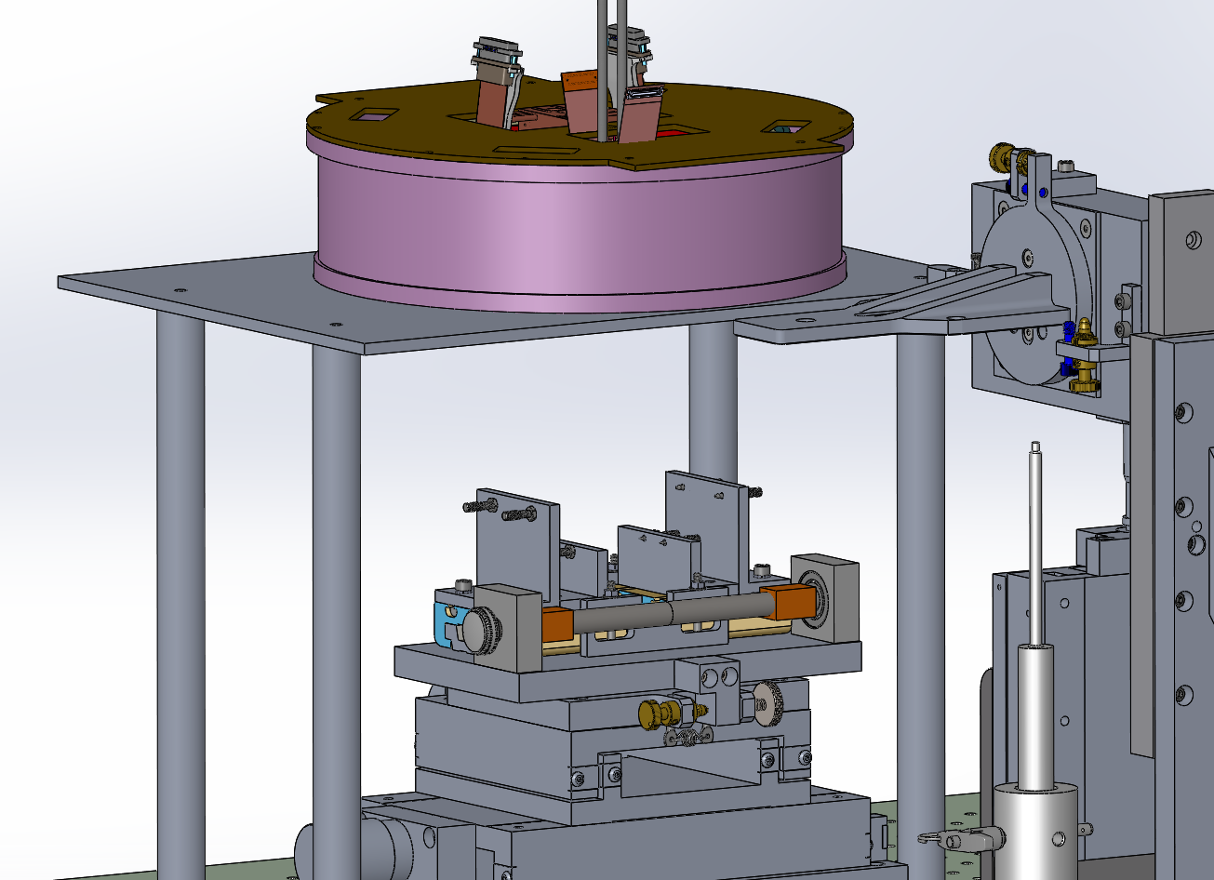
WASP CCD Assembly Fixture
Step 34: Pull the CCD up and fasten it.

Slide 37
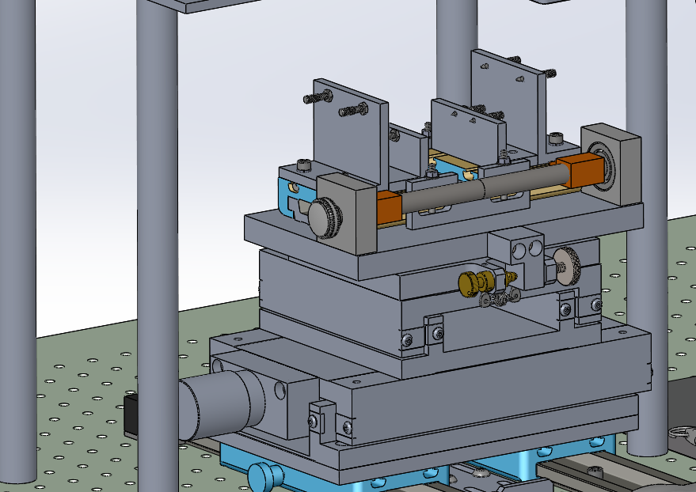
WASP CCD Assembly Fixture
Step 35: Set the Horiz Stage for the AFT CCD and repeat from step 27

