Slide 1
WASP
Science CCD Assembly Fixture
No Guiders
Step By Step Procedure

Slide 2
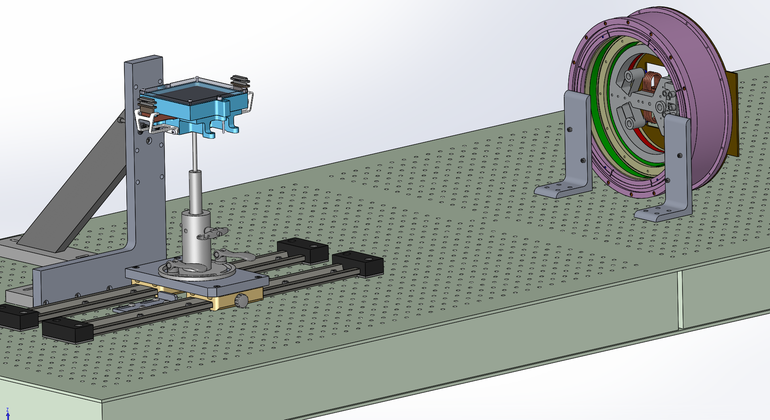
WASP CCD Assembly Fixture
Vertical Bracket
WASP Dewar
CCD Handler
Optical Bench

Slide 3
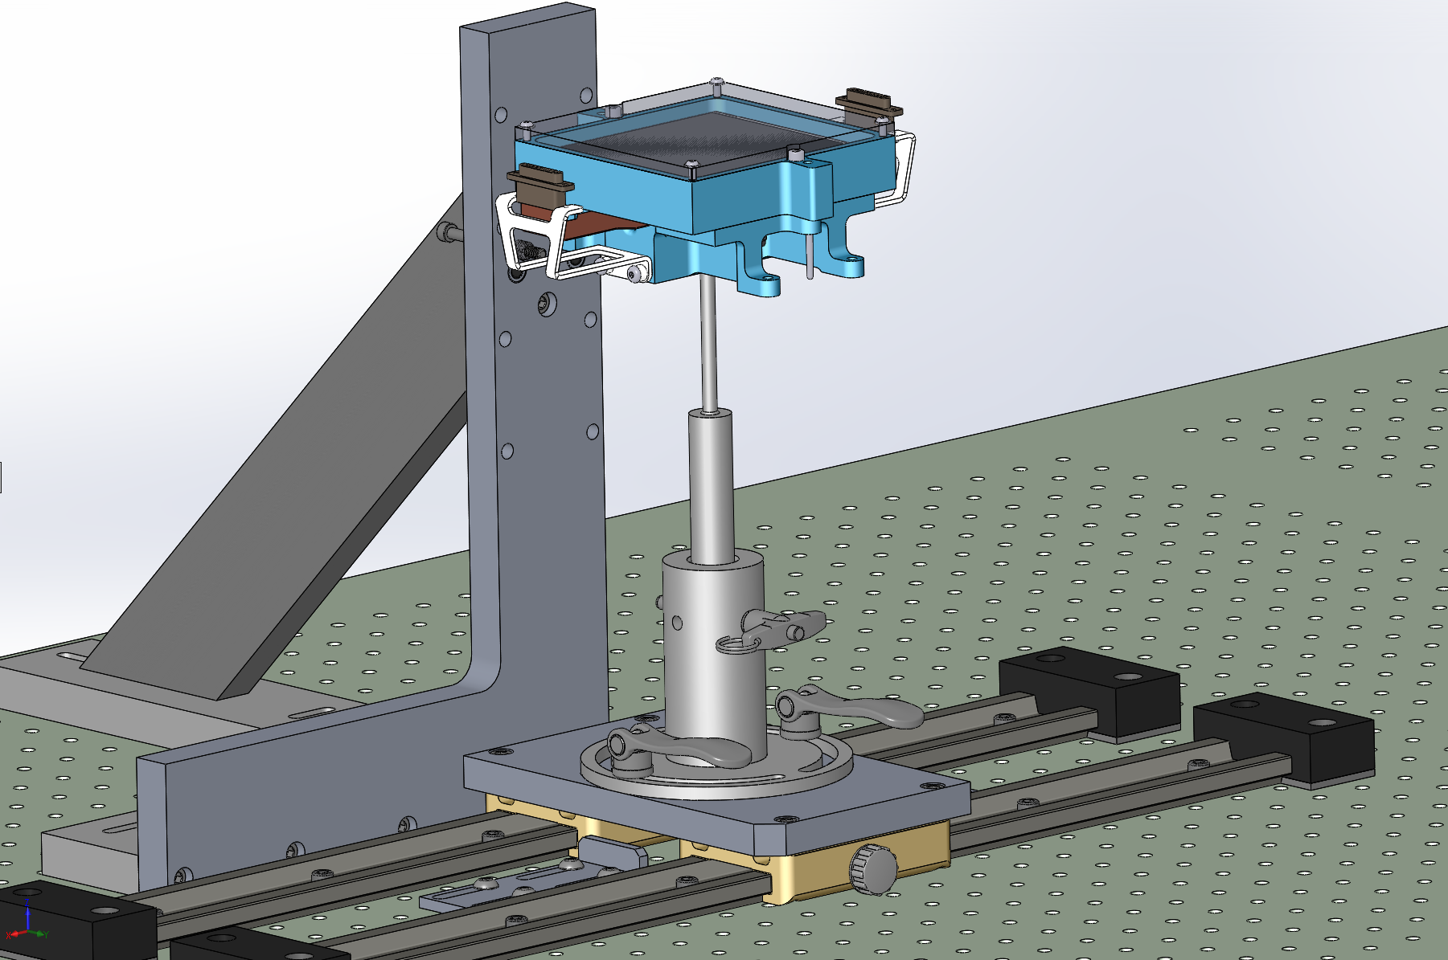
WASP CCD Assembly Fixture
Step 1: Install the CCD on the Handler

Slide 4
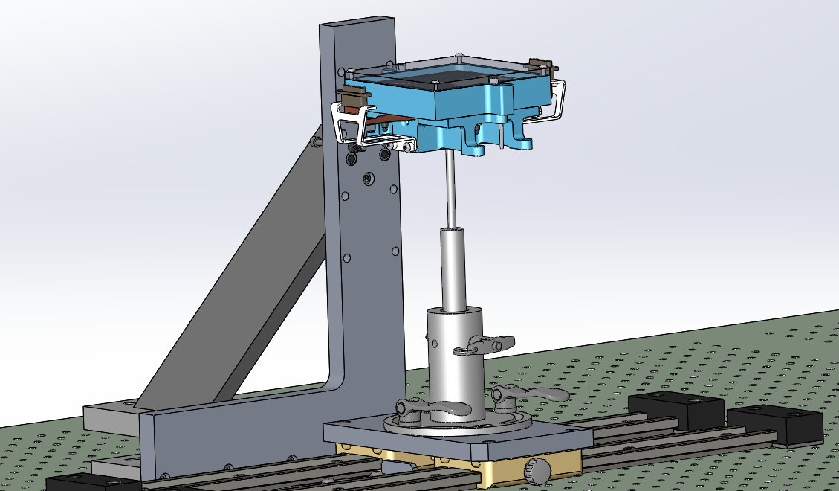
WASP CCD Assembly Fixture
Step 2: Remove the Plug covers(?); detach shorting plugs from props; re-install the shorting plugs

Slide 5
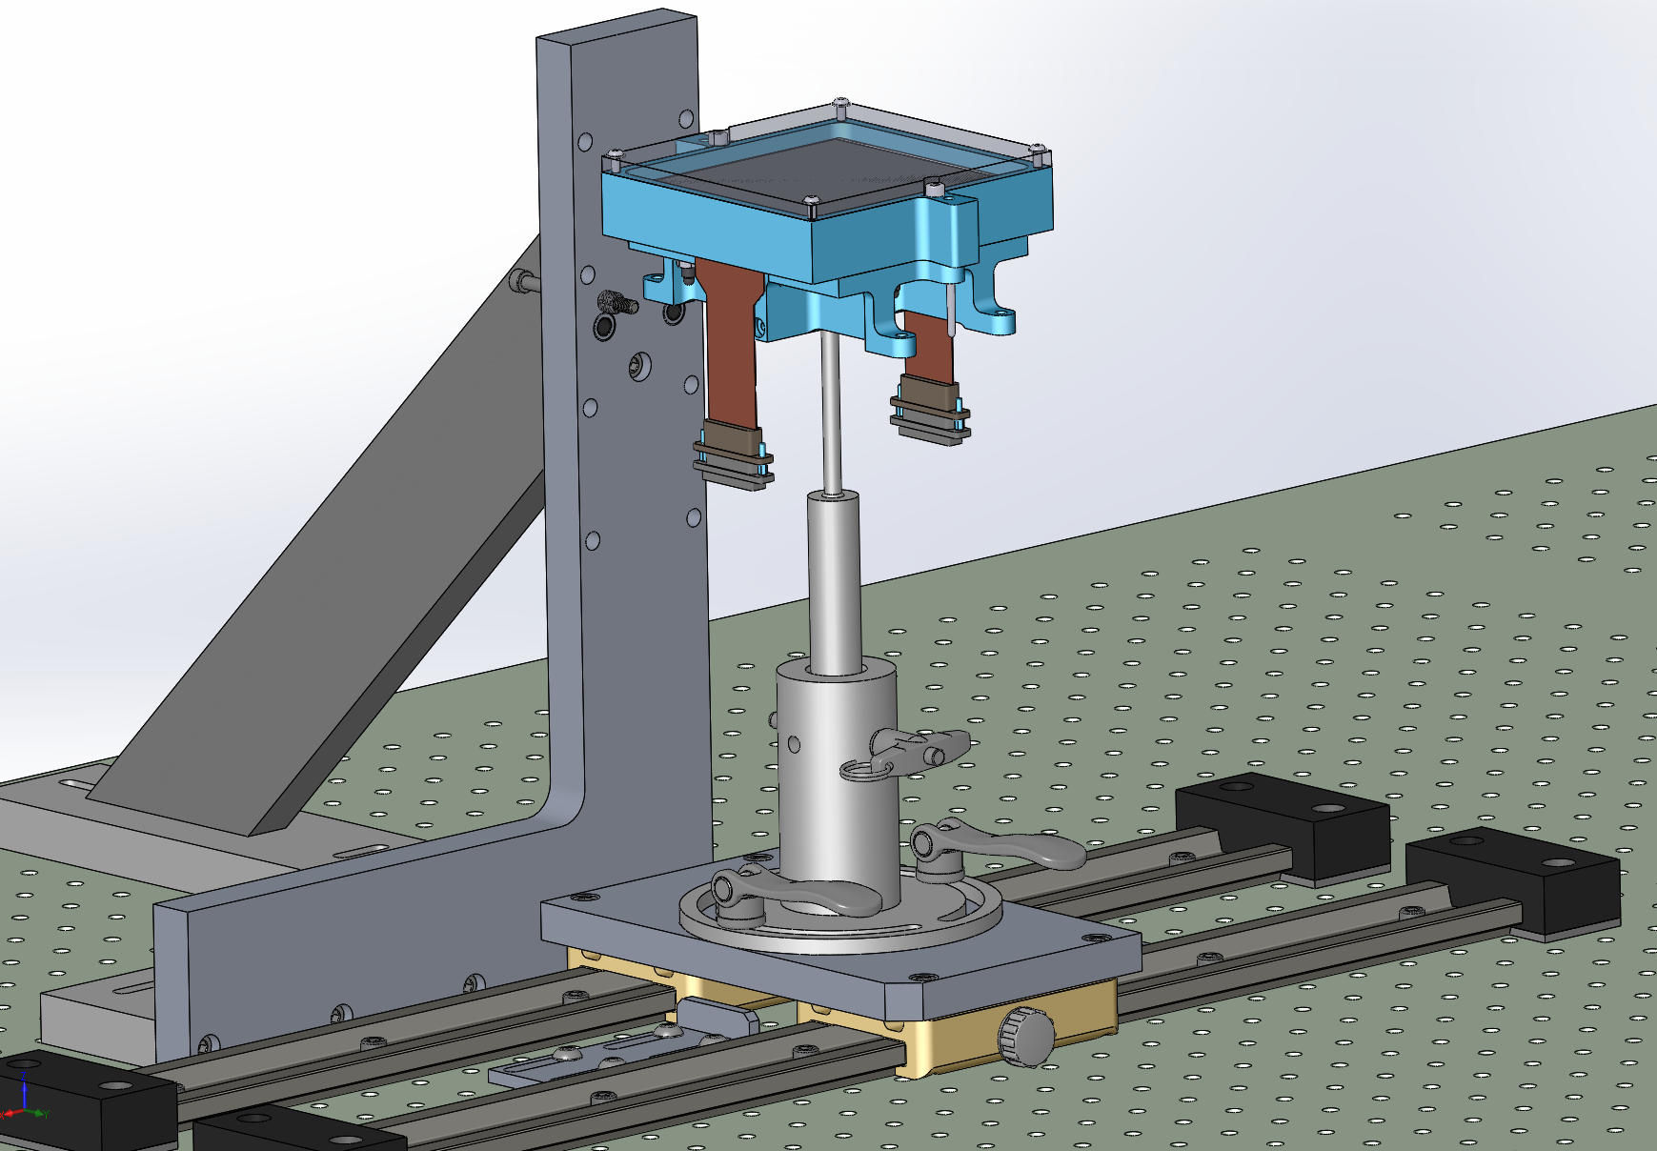
WASP CCD Assembly Fixture
Step 3: Free the Ribbons
by removing props

Slide 6
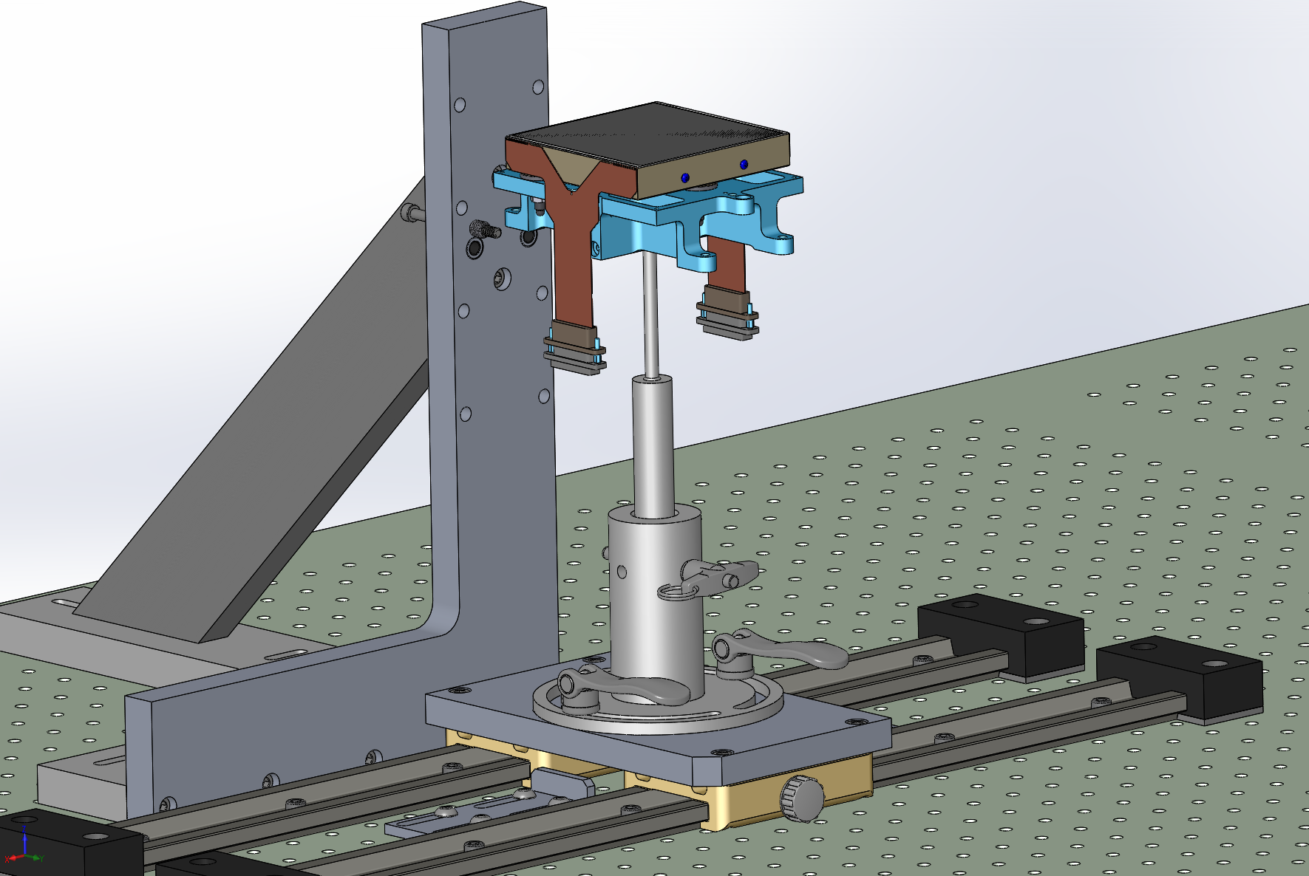
WASP CCD Assembly Fixture
Step 4: Remove the e2v Cover

Slide 7
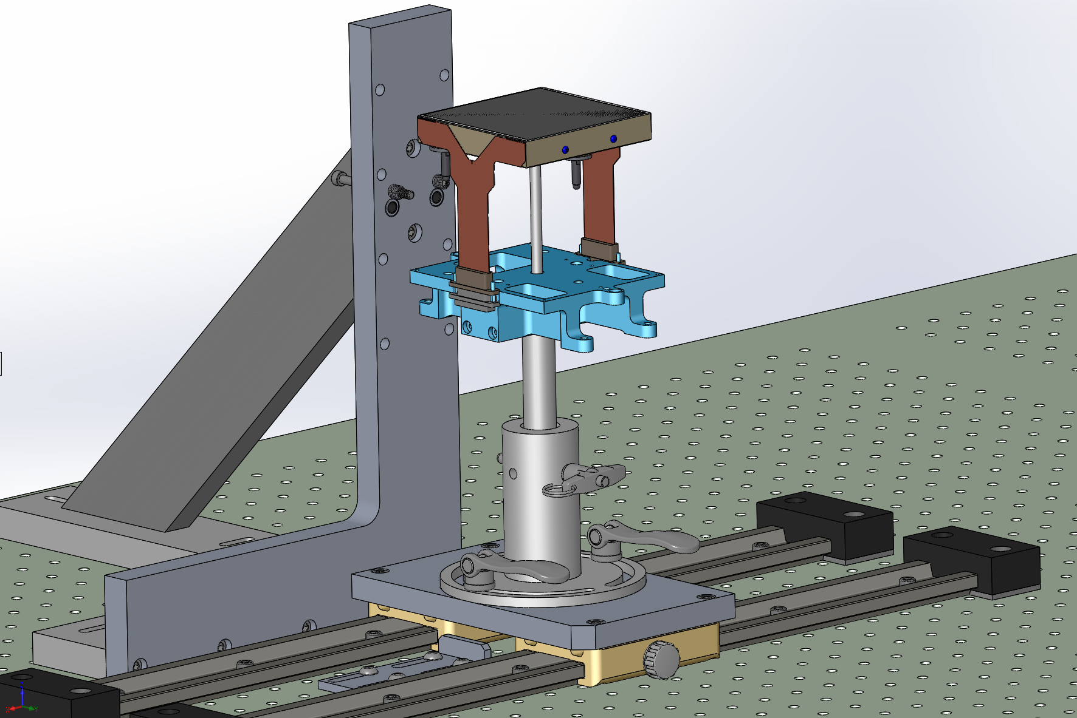
WASP CCD Assembly Fixture
Step 5: Unbolt the e2v Bottom cover.

Slide 8
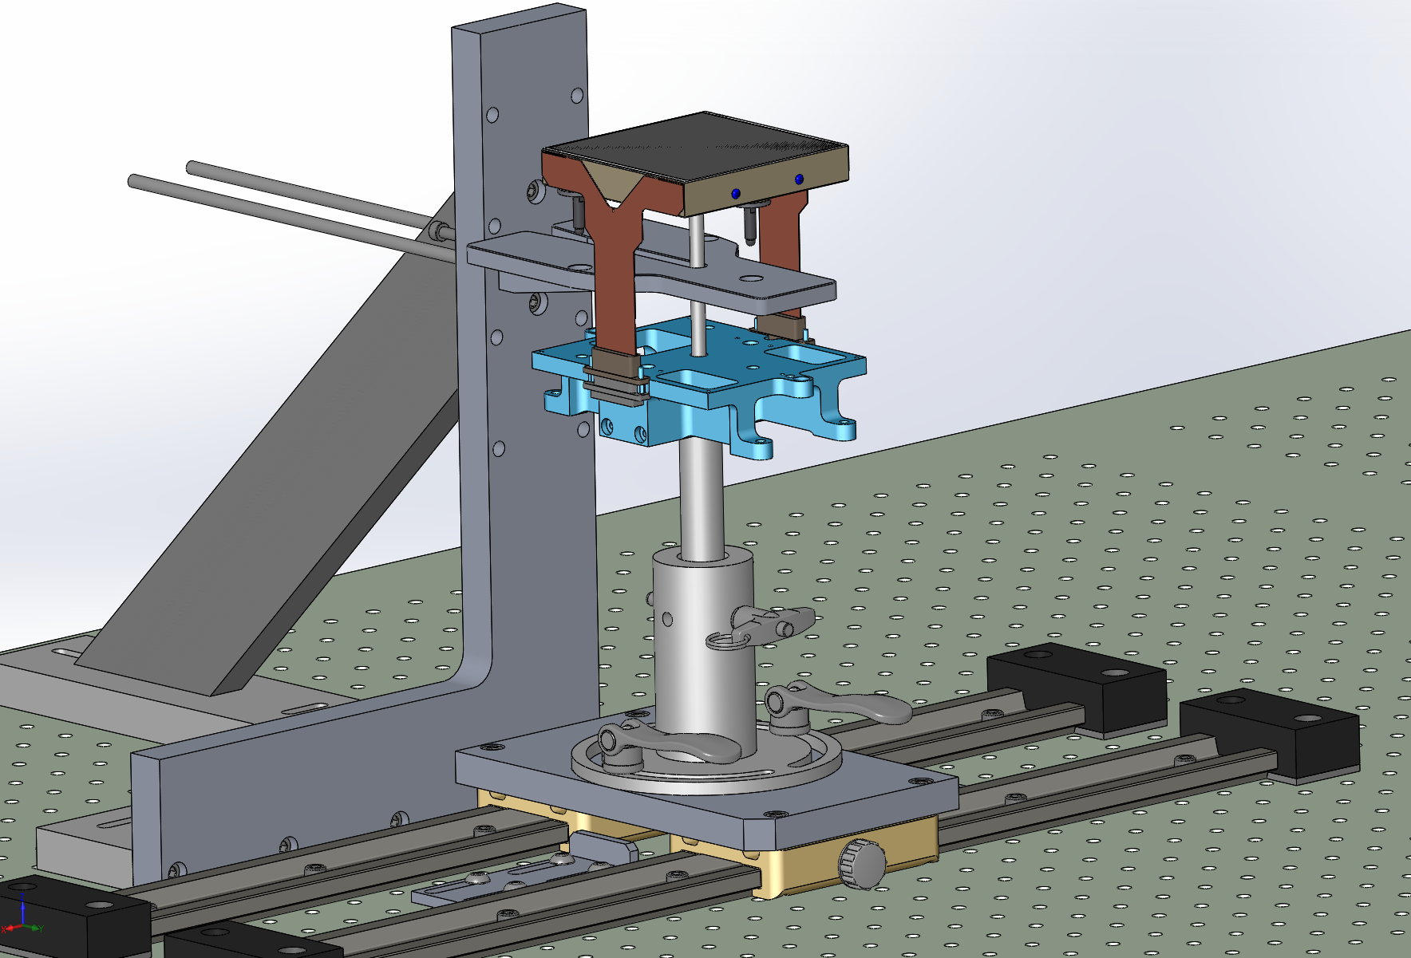
WASP CCD Assembly Fixture
Step 6: Insert the Coupler et Fasten it with the short screw

Slide 9
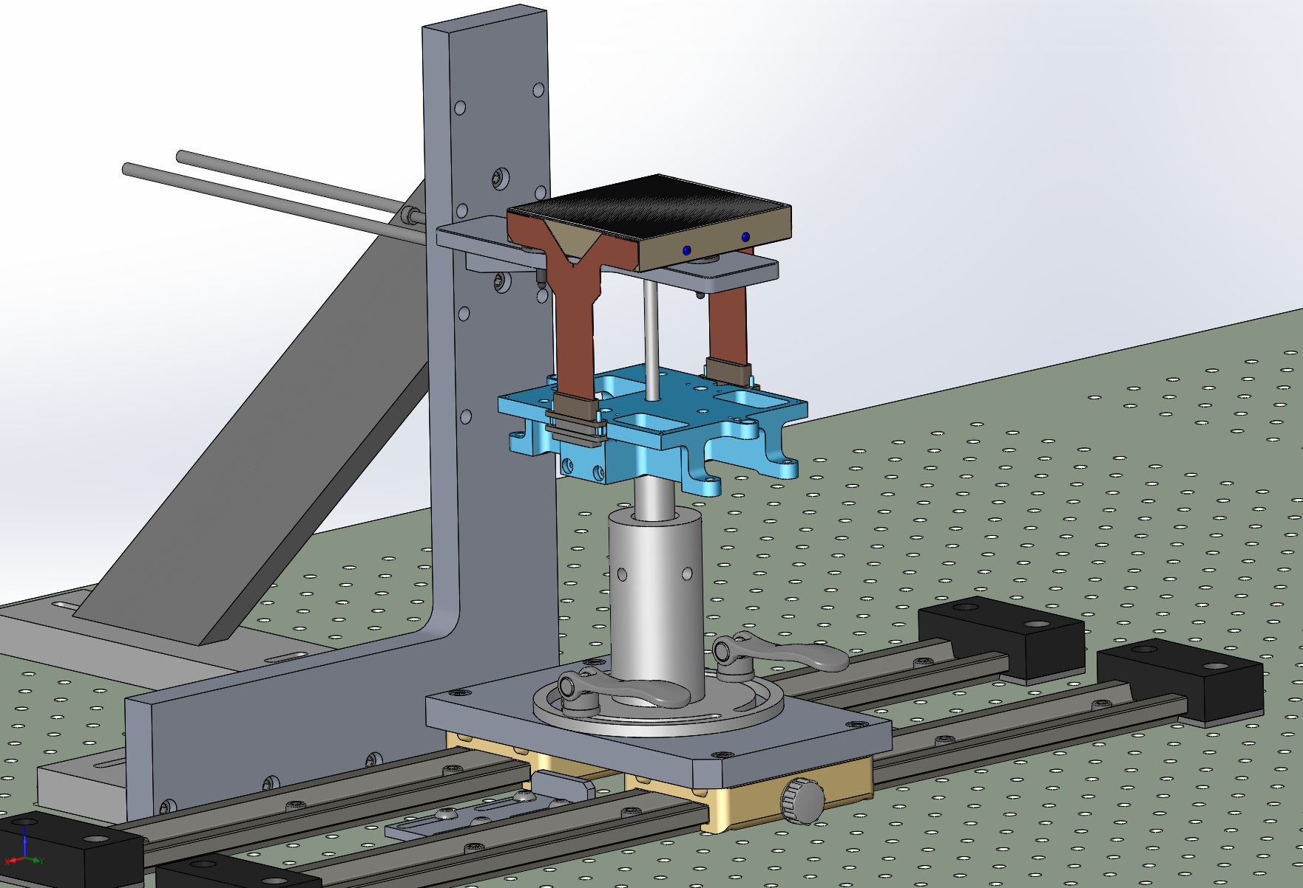
WASP CCD Assembly Fixture
Step 7: Remove the Handler Pin

Slide 10

ZTF CCD Assembly Fixture
Step 8: Insert the 3 Temporary Barrel Nuts

Slide 11
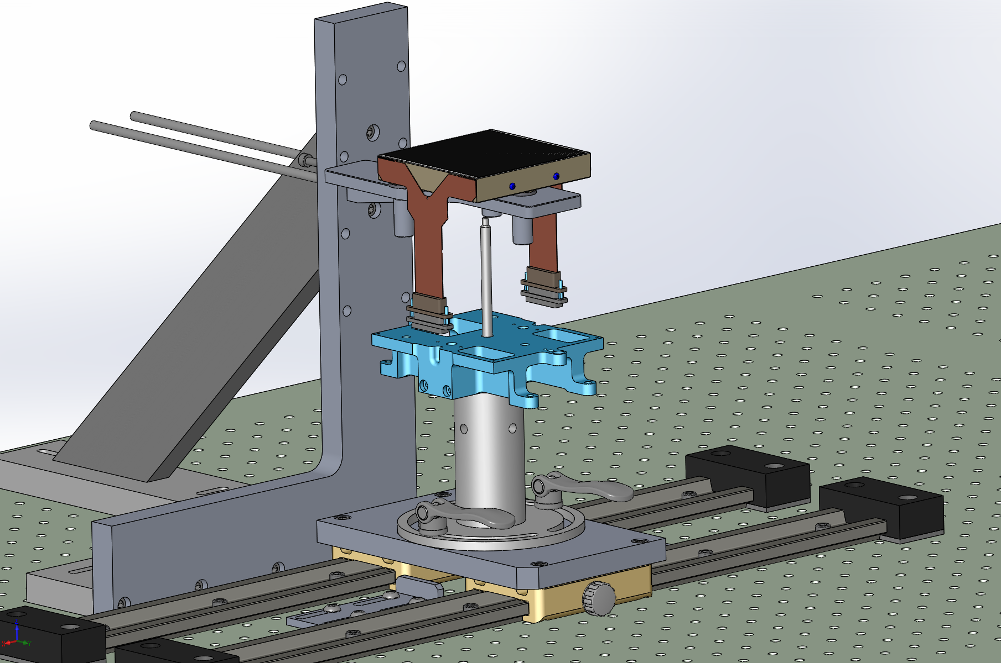
WASP CCD Assembly Fixture
Step 9: Free the CCD from the Handler

Slide 12
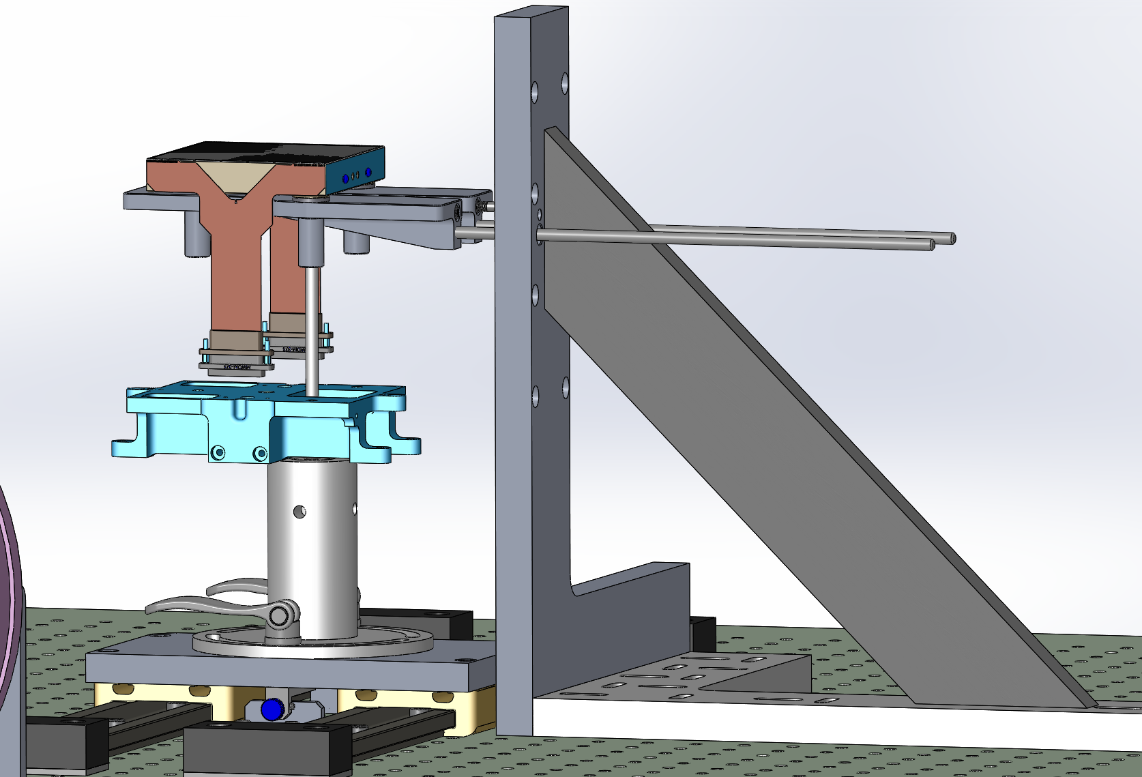
WASP CCD Assembly Fixture
Step 10: Remove the Short Screw and slide the Coupler all the way to the Long bolt out.

Slide 13
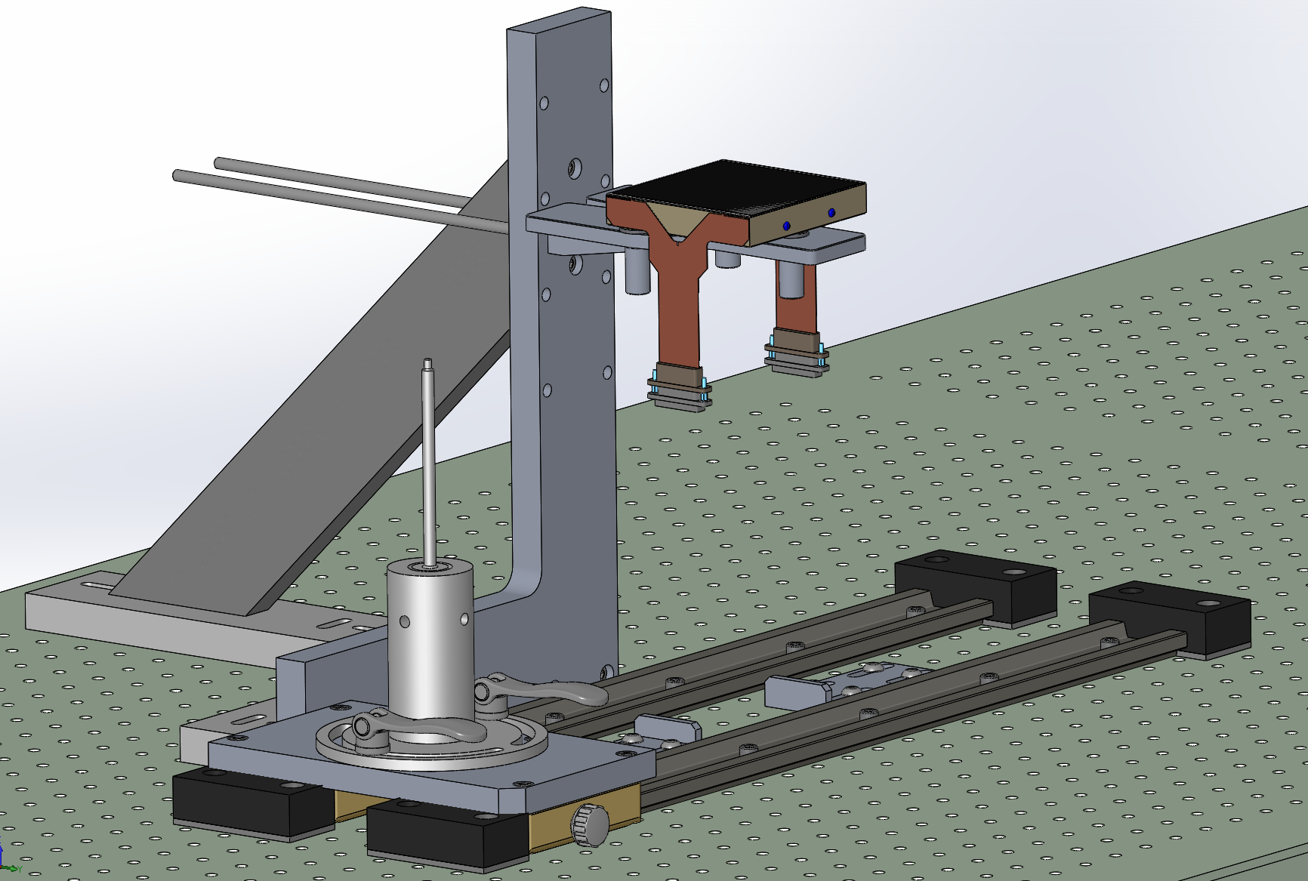
WASP CCD Assembly Fixture
Step 11: Move the Handler to its parking location

Slide 14
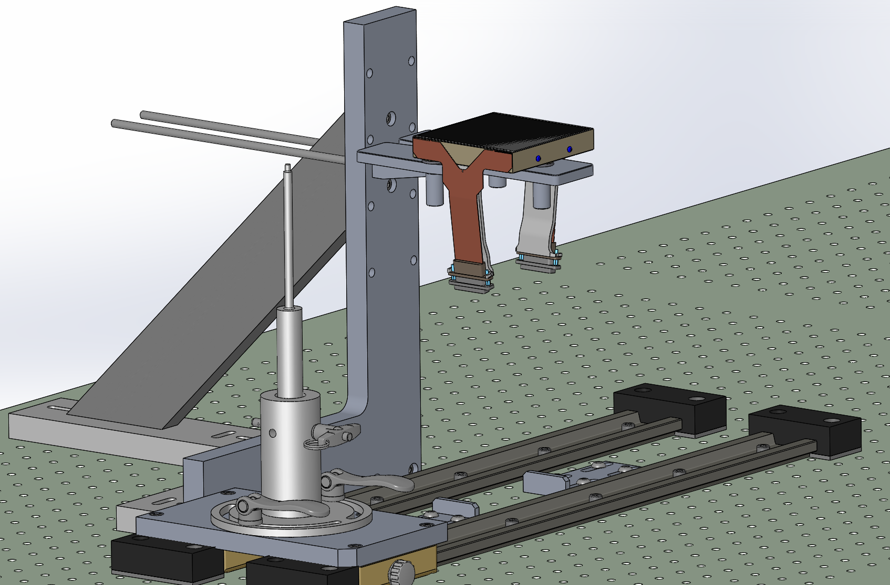
WASP CCD Assembly Fixture
Step 12: Install the CCD ribbon holders

Slide 15
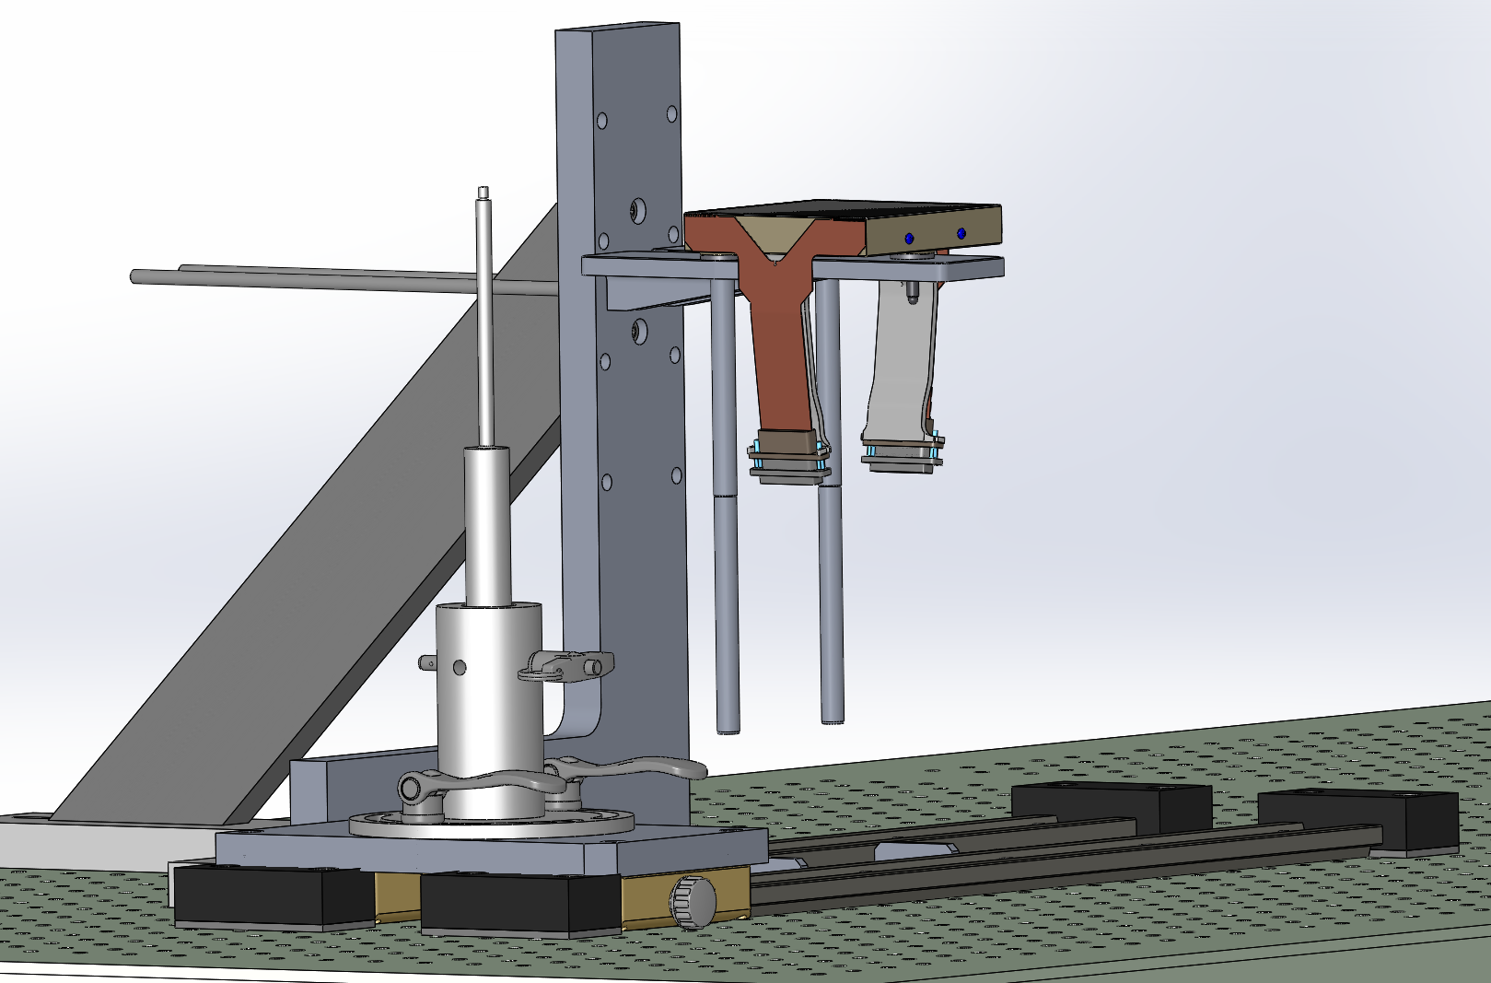
WASP CCD Assembly Fixture
Step 13: the 2 aft Guide rods

Slide 16
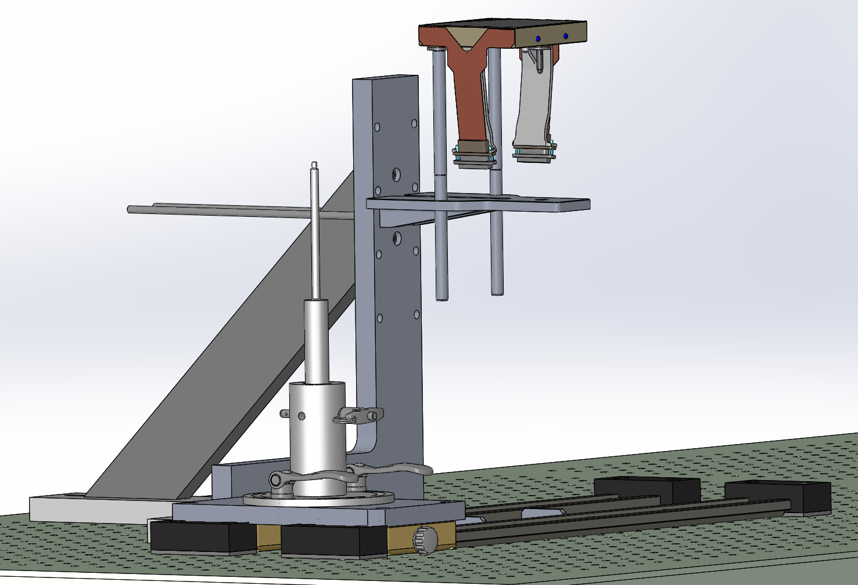
WASP CCD Assembly Fixture
Step 14: Slide the CCD Out

Slide 17
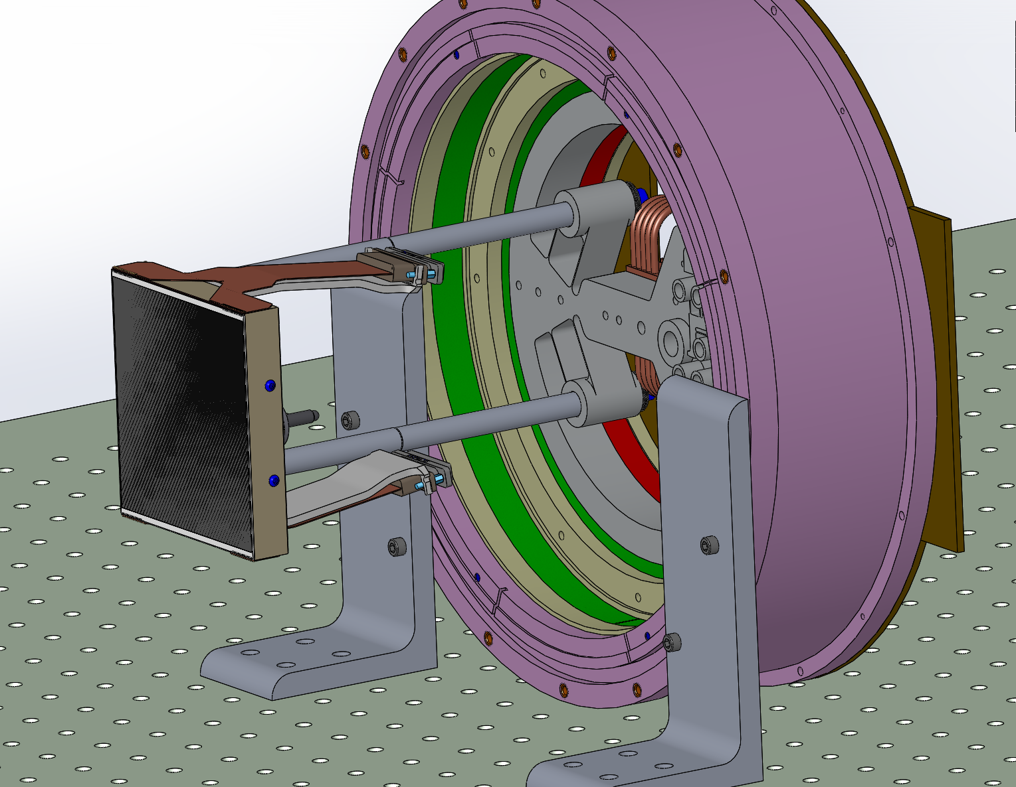
WASP CCD Assembly Fixture
Step 15: Install the CCD guide rods thru the Dewar

Slide 18
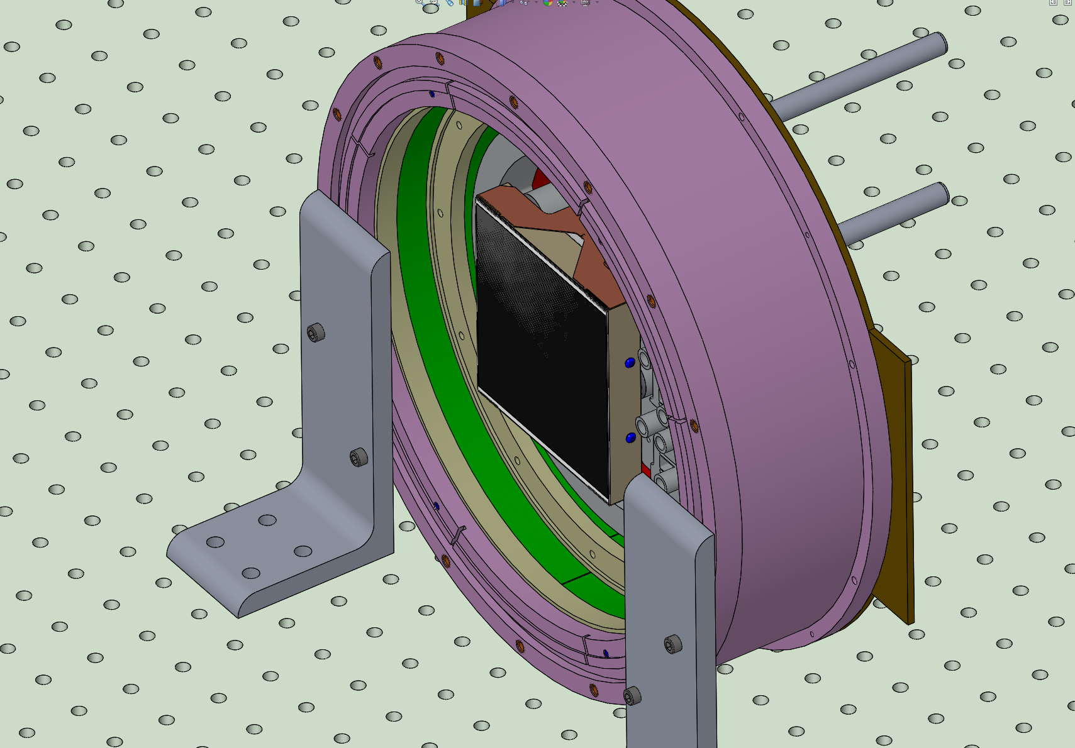
WASP CCD Assembly Fixture
Step 16: Slide the CCD into position:

Slide 19
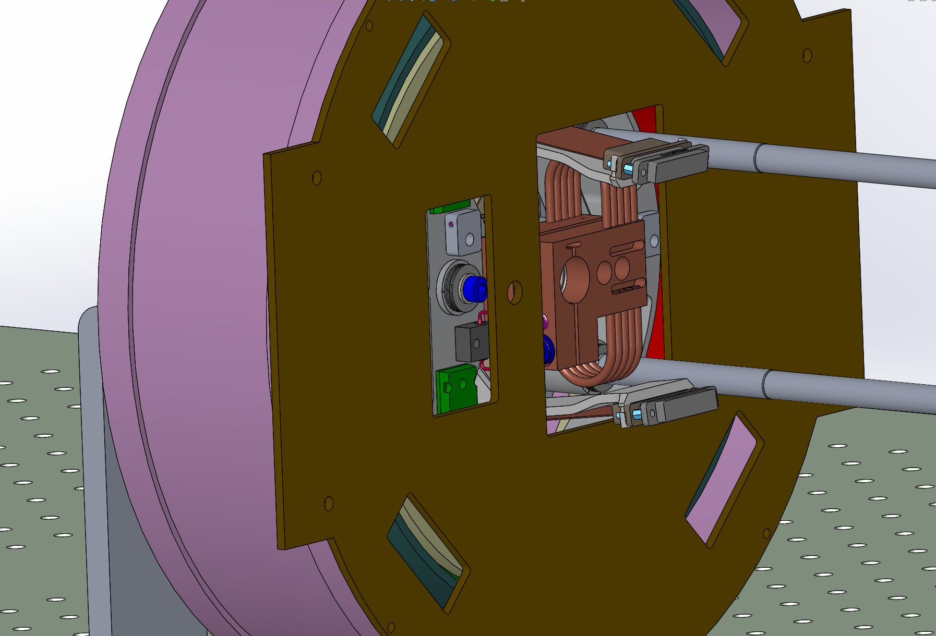
WASP CCD Assembly Fixture
Step 17: Tighten the Captive fastener

Slide 20
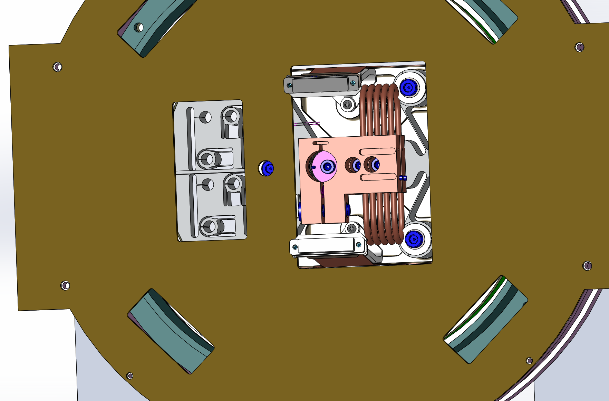
WASP CCD Assembly Fixture
Step 18: Install the remaining 2 fasteners

